Slide 1
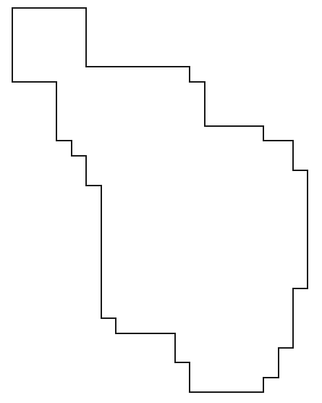
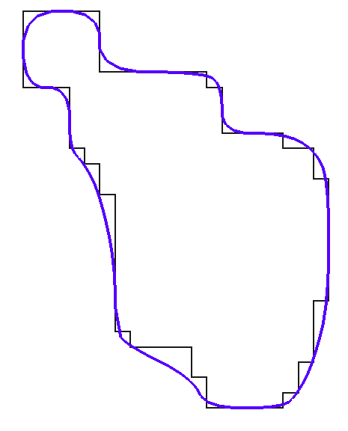

L > SCL
SCL
L > SL
SL

Slide 2
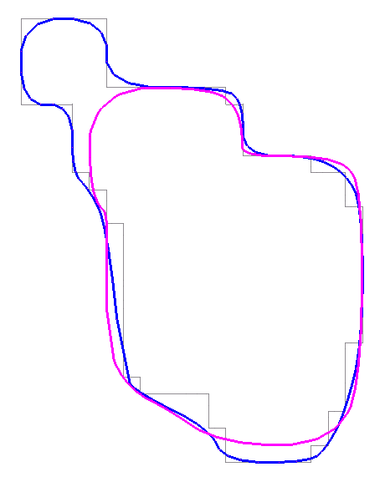
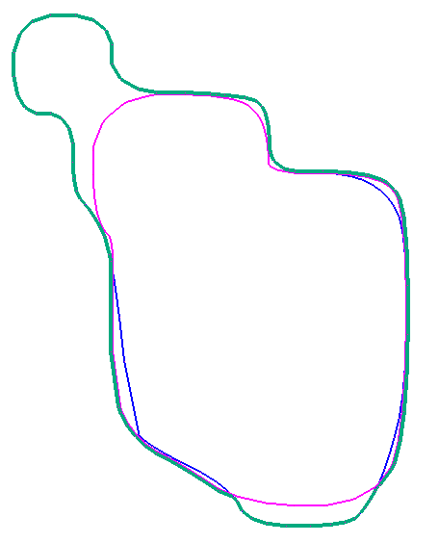
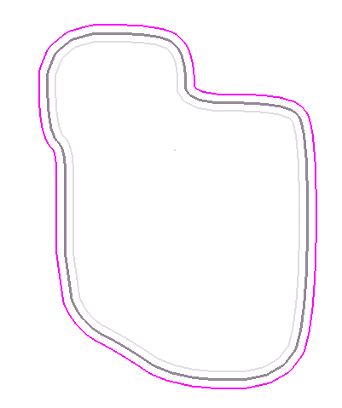
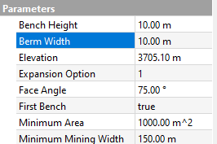
Purple – PB Crest offset equal to berm width parameter
Blue – optimization shell intersection interpretation (see previous graphics)
Purple – PB Crest offset equal to berm width parameter
Blue – optimization shell intersection
Green – final toe
Grey – Previous bench (PB)
Dark grey – PB Crest
Purple – PB Crest offset equal to berm width parameter

Slide 3
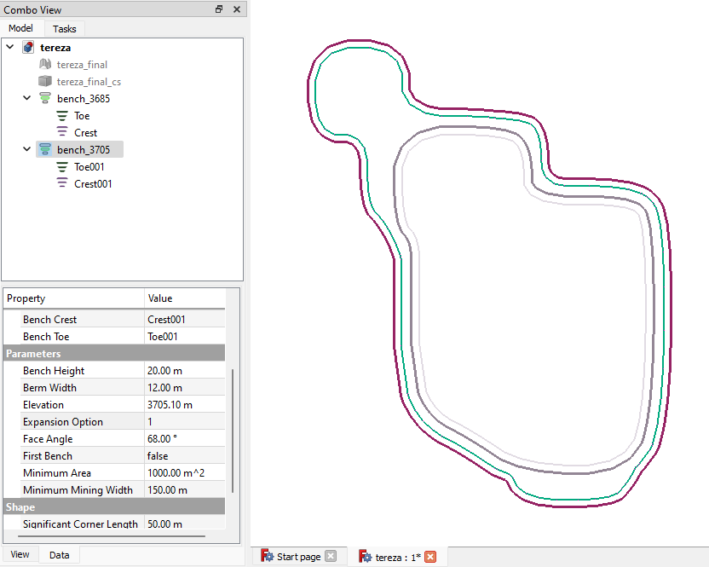
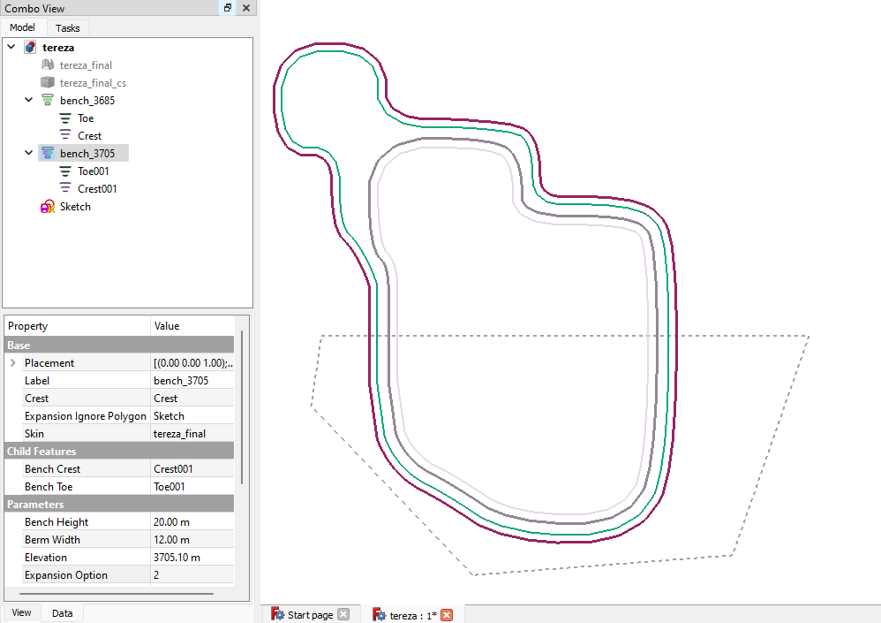

Slide 4
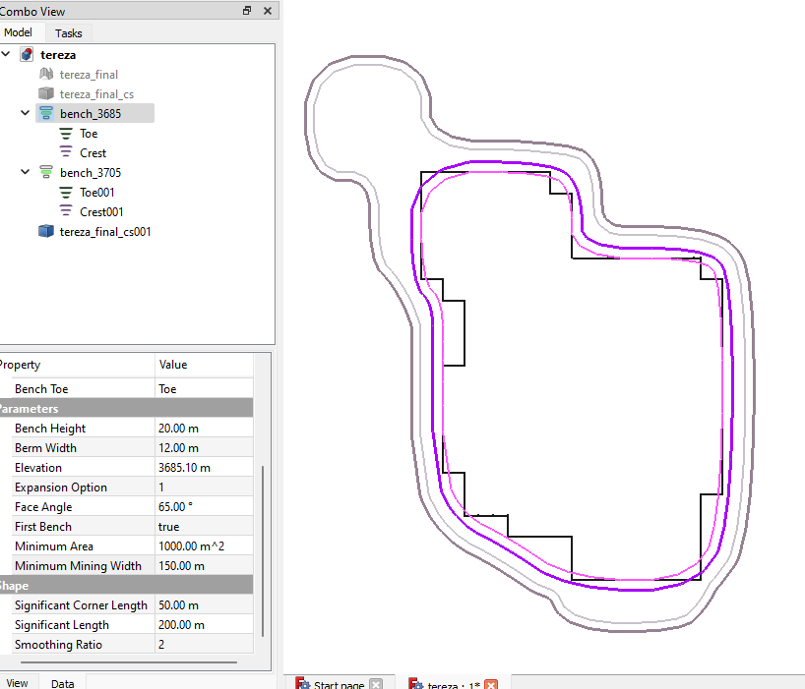
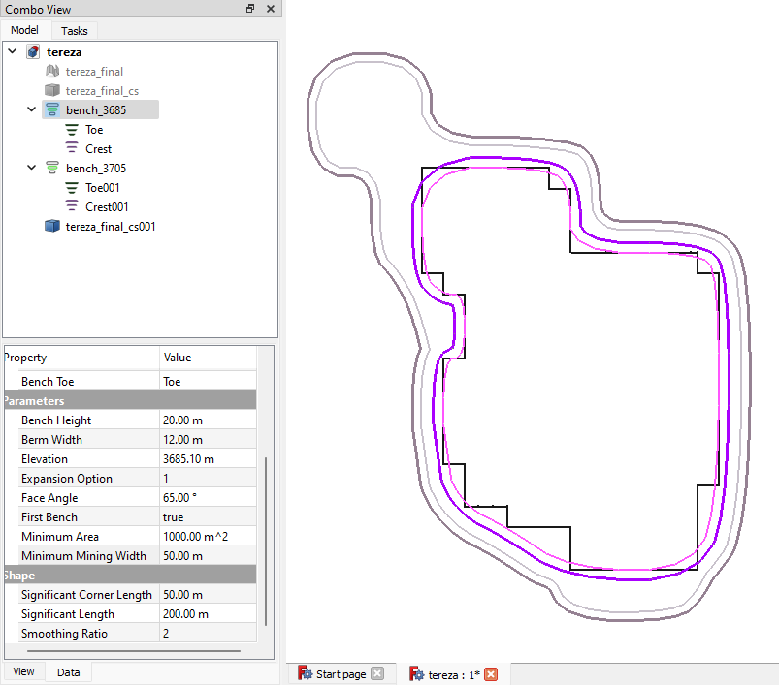
L < MMW
L >= MMW
MMW

Slide 5
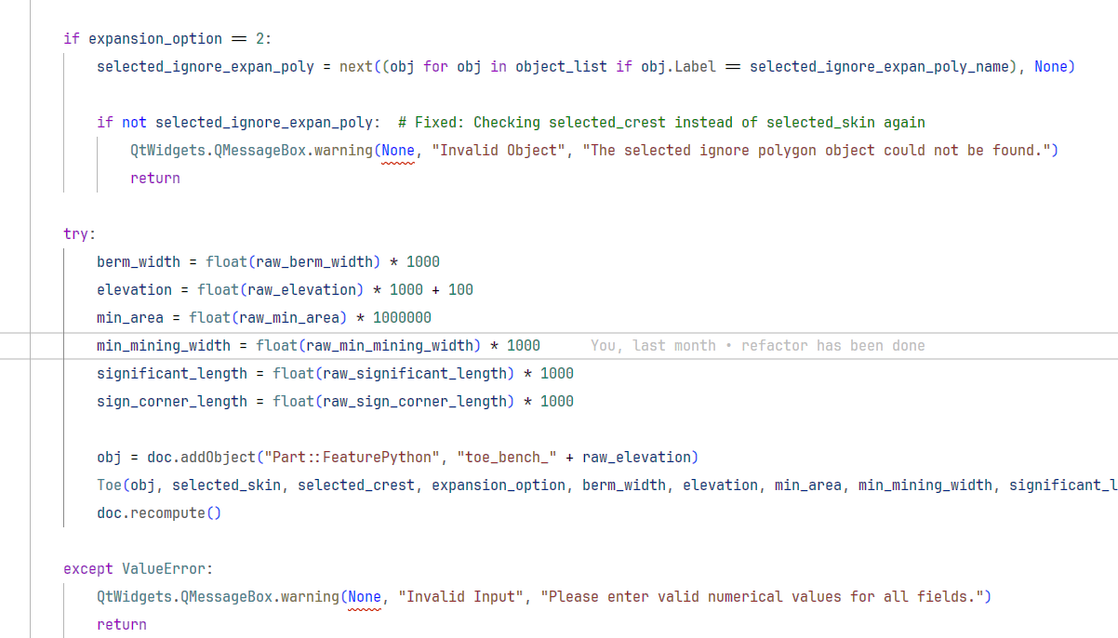

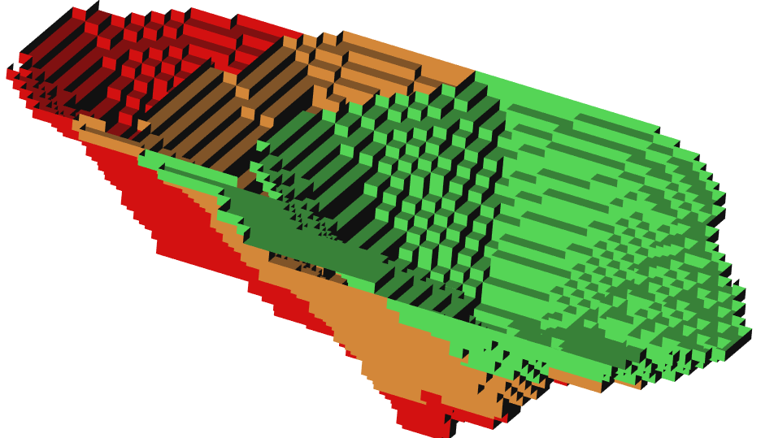
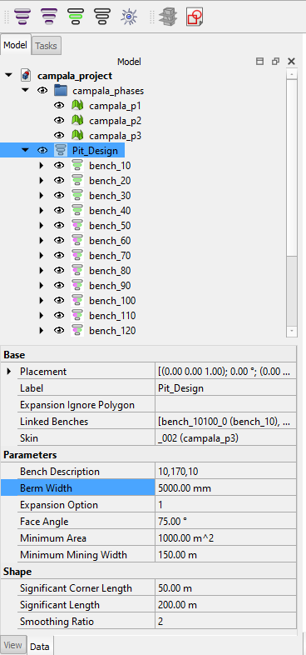
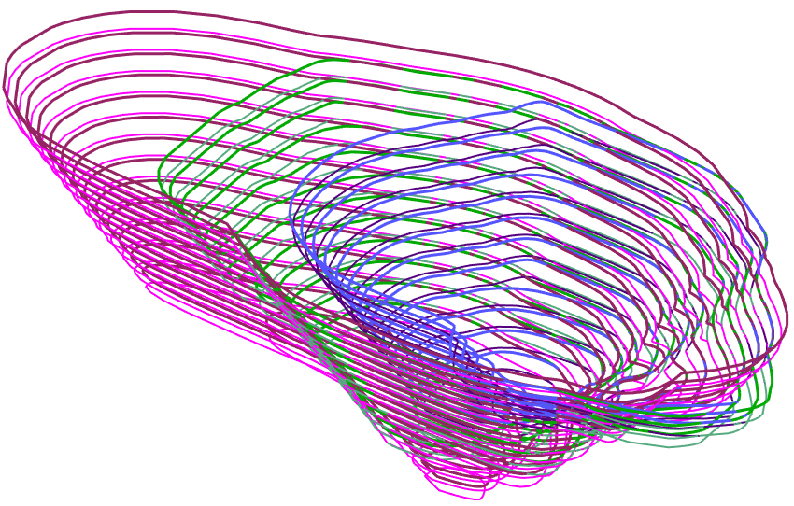

Slide 6
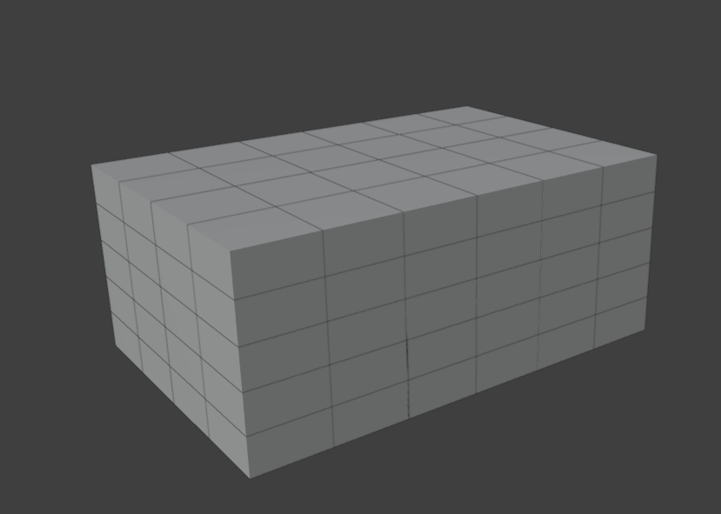
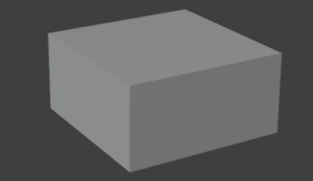
tensor_y
size_z
size_x
tensor_u
size_y
tensor_w
axis_w (z)
axis_v (y)
axis_u (x)
origin

Slide 7
[20. 20. 20. 20.]
[20. 20. 20. 20. 20. 20.]
[10. 10. 10. 10. 10.]
axis_w (z)
axis_v (y)
axis_u (x)
origin

Slide 8
5 4 5
6 4 5
3 4 5
4 4 5
2 4 5
6 1 5
1 4 5
5 1 5
4 1 5
2 1 5
3 1 5
1 4 4
1 1 5
1 3 4
6 1 3
5 1 3
1 2 4
4 1 3
6 1 2
1 1 4
3 1 3
5 1 2
2 1 3
4 1 2
6 1 1
1 4 1
1 1 3
3 1 2
5 1 1
1 3 1
2 1 2
4 1 1
3 1 1
1 2 1
1 1 2
2 1 1
1 1 1
1 1 1

Slide 9
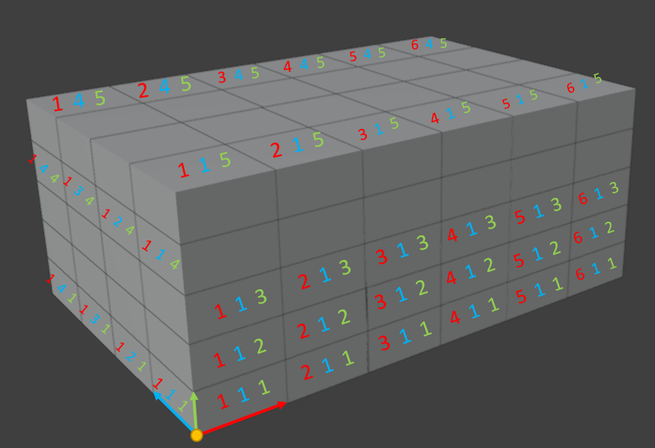
1-1-1
2-1-1
3-1-1
4-1-1
5-1-1
6-1-1
1-2-1
2-2-1
3-2-1
Arr[0]
Arr[1]
Arr[2]
Arr[3]
Arr[4]
Arr[5]
Arr[6]
Arr[7]
Arr[8]
…

Slide 10

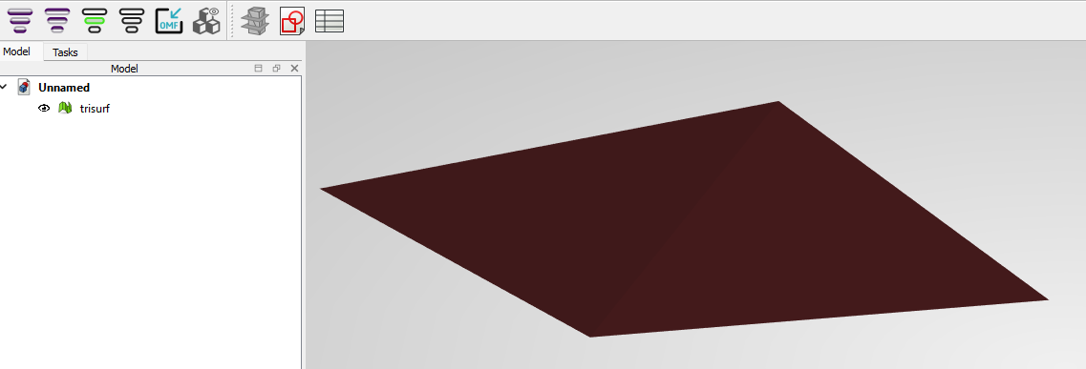
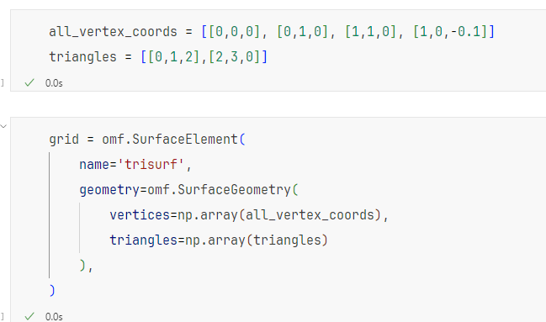
1, 1, 0
0, 1, 0
1, 0, -0.1
0, 0, 0

Slide 11
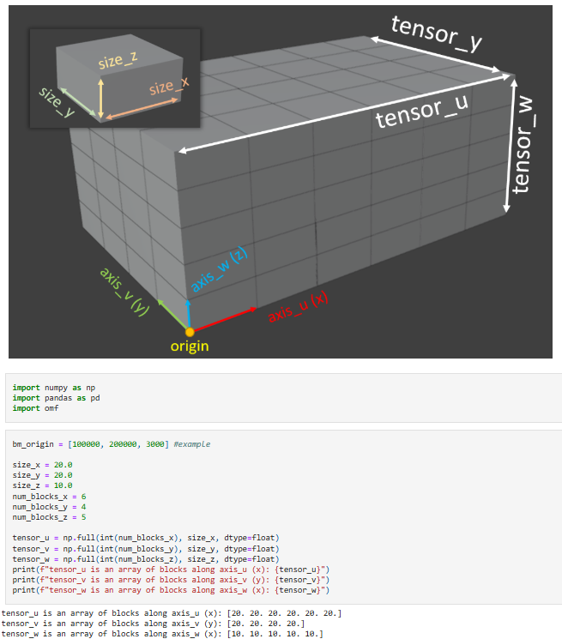



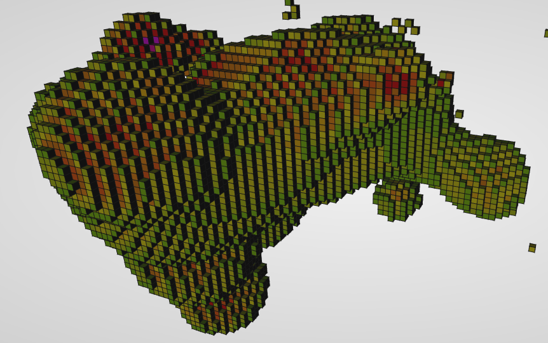

Slide 12
Vertices = [[x1, y1, z1], [x2, y2, z2], [x3, y3, z3], [x4, y4, z4]]
Segments = [[0,1], [1,2], [2,3], [3,0]]
v2
1
2
v3
0
v1
3
v4

Slide 13
