Slide 1
PROBLEM
E-w
Ecosystem friendly
E-waste and management
E-waste is electronic products that are unwanted, not working, and nearing or at the end of their “useful life.” Computers, televisions, VCRs, stereos, copiers, and fax machines are everyday electronic products.
E-w
Ecosystem friendly
Tel: +254111779367
denisminister196@gmail.com

Slide 2
Solution
To come in with an team/company that can manage, or do maintenance of electronics basically for computers and laptops at lower price.
Run campaign to enable people know positive causes of e-waste

Slide 3
Solution
Come up with a company/members that can offer servicing tender for schools, institutions and the new education system (CBC) this services will like;
Computer hardware maintenance
Software maintenance
General laboratory network maintenance
Printer maintenance
A/cs and other electronic maintenance
Creating web platform that will enable clients to communicate directly with servicing team or customer care in charge.

Slide 4
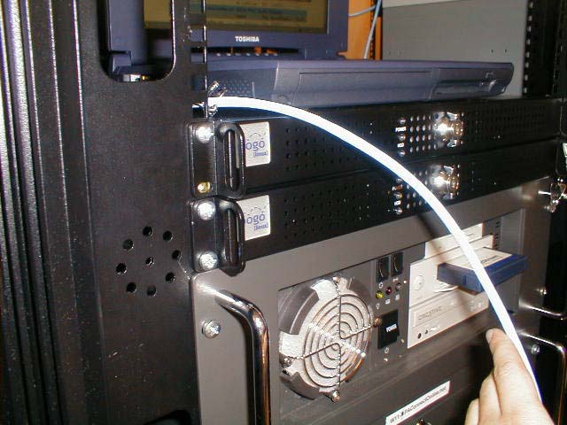
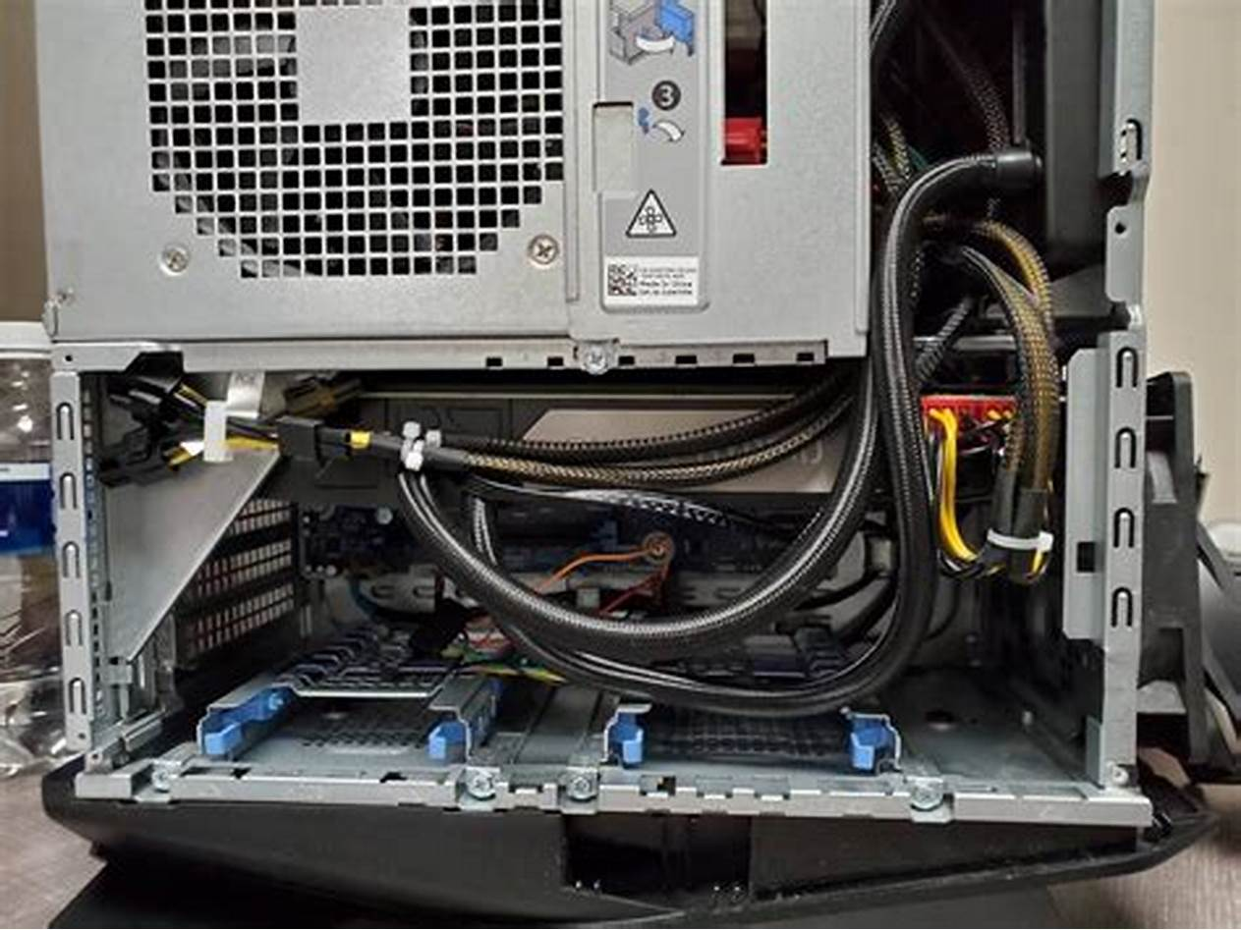
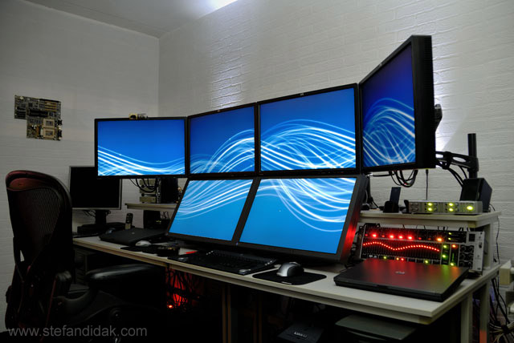
Products
,

Slide 5
Target Market
The target market for this platform will be learning instructions that is;
Universities institutions
Collages
Secondary schools
Primary schools
Governments organizations
And private organizations/offices.

Slide 6
Market size
Audience
My audience basically will match everyone and all platforms named above and with a condition that you. will be able to own electronic named above..
Market target
To be the most e- waste management and servicing company in Kenya and in east Africa.

Slide 7
Competitors
Self employed technicians
These are technicians that are self employed, they are sparsely populated and unable to reach most institutions simply because they are not registered/ not meeting the requirements to operate in wide range.

Slide 8
Competitive advantage
SKILLED TECHNITIANS THAT UNDERSTAND BOTH SOFTWARE AND HARDWARE DESIGN
Will accept all mode of payment after doing services or selling goods ; cheque, cash e-money e.t.c.
Availability.
Trustworthy
Best customer relations.

Slide 9
Traction

Slide 10
January
This is the time the team of the organization will be campaigning for their services thus their will be no much profit, this month will much focus on voluntary jobs.
OBJECTIVES
To alert organization that there is new upcoming e-waste management organization.
To enable clients know that the new upcoming organization is ready to offer quality services
To enable the clients drop their previous tender team because of the new exiting e-waste management company that are offering free service/ services at lower price.
Running social media adverts allover and Campaigns

Slide 11
February - March - April
In the mid Feb the company will be focusing on signing of new tenders
Delivering services to their potential customers
Competing with co-business rivals.
Showing their competence and legibility of the services that they are offering across all platforms

Slide 12
Business Model
THE BUSINESS WILL BASICALLY CONSIST OF;
FIELD TECHNICIANS (MOBILE TECHNICIANS)
CAMPAGNE TEAM
MARKET RESEARCH TEAM
STATIONERY TECHNICIANS

Slide 13
Each and every sector will be capable of doing there work respectively;
Field technicians (mobile technicians) – dealing with immediate repair.
Champagne team
Will be capable of running champagnes, creating awareness , - ( the disadvantage of poor e-waste management and the importance of e-waste management )
Market research team
This team will mainly focus on market research both locally and nationally.
Stationery technicians
This team will be capable of doing maintenance of machinery's that require serious attention and thorough repair .

Slide 14
Profit Margins
Servicing
Selling Of Products (Laptops, Computers, A/cs )
Public Campaign (Harmful Of E Waste)

Slide 15
Market Approach
Online
This online approach will be done through running social media adverts to notify customers that their are new team who are out to manage, control, & to repair e-waste materials.
Offline
- This will have the same agenda but the difference will come in while conducting physical meetings and meeting with the clients face to face in order to interact and to express their products and services.

Slide 16
Ask
Financial support (operational expenses at the start)
This will consist company registration.
Searching of all legal operational documents
Campaigning finance.

Slide 17




The Team
Denis Omondi
Hardware And Network Specialist
Pursued In Information Communication Technology At The Kisumu National Polytechnic
Currently Under Taking Web Development
Scarlen Abongo
Hardware Engineer
Completed Computer Hardware Maintenance Course At The Kisumu National Polytechnic, Kenya
Bonface Oluoch
Software Engineer
4th Year At Kirinyaga University Pursuing Computer Science.
Laureen Atieno
Team Ambassador
Done Information Communication Technology At The Kisumu National Polytechnic, Kenya

