Slide 1
Street Traffic Simulation
Charles Erwin

Slide 2

Topics to Cover
What is involved in Traffic Simulation?
Value/Usefulness of Traffic Models
Examples of Current Traffic Models
References

Slide 3
Traffic Simulation
Traffic Simulators are a type of Traffic study. There are three types of traffic flow studies, differing in scope:
  microscopic scale: at a first level, every vehicle is considered as an individual, so an equation is written for everyone, usually an ODE.
  macroscopic scale: in analogy with fluid dynamics models, it is something more useful to write a system of (PDE) balance laws for some gross quantities of interest, e.g the density of vehicles or their mean velocity.
  mesoscopic (kinetic) scale: a third, intermediate, possibility, is to define a function f(t,x,V) which expresses the probability of having a vehicle at time t in position x which runs with velocity V. This function, following methods of statistical mechanics, can be computed solving an integro-differential equation, like the Boltzmann Equation.

Slide 4

Traffic Simulation (cont)
Even though Traffic Flow has been studied as early as the 1950s, there still isn’t one general theory applied in real flow conditions.
Traffic is very difficult to simulate because not only are the elements mechanical, the reactions and behaviours of human drivers must also be accurately predicted.

Slide 5
Usefulness of Traffic Models
Modeling traffic is useful to engineers and city planners.
Simulate control measures available:
  Speed Limits
  Vehicle specific limitations (trucks)
  Lane changing restrictions
  Flow control at ramps
Simulate Infrastructure before it is bought.
Introduce new parameters such as cruise control and see the effects.

Slide 6
Specific Example: IDM
The Intelligent Driver Model (IDM) is a "car-following model", i.e., the traffic state at a given time is characterized by the positions, velocities, and the lane index of all vehicles. The decision of any driver to accelerate or to brake depends only on his own velocity, and on the "front vehicle" immediately ahead of him.

Slide 7


IDM (cont)
Lane-changing decisions, however, depend on all neighboring vehicles. Specifically, the acceleration dv/dt of a given driver depends on his velocity v, on the distance s to the front vehicle, and on the velocity difference Delta v (positive when approaching).
v0 | Desired velocity on free road.
T | Desired safety headway following other vehicles.
a | Acceleration in every day traffic.
b | Comfortable braking deceleration.
s0 | Minimum bumper-to-bumper distance to front of vehicle.
Δ | Acceleration exponent.
where

Slide 8
IDM (cont)
Parameter | Car | Truck
v0 | 120 km/H | 80 km/H
T | 1.5 s | 1.7 s
s0 | 2.0 | 2.0
a | 0.3m/s^2 | 0.3m/s^2
b | 3.0 m/s^2 | 2.0 m/s^2
In general, every "driver-vehicle unit" can have its individual parameter set.
  Trucks are characterized by low values of v0, a, and b.
  Careful drivers drive at a high safety time headway T.
  Aggressive ("pushy") drivers are characterized by a low T in connection with high values of v0, a, and b.
  Here are some Values in General:

Slide 9
IDM (cont)
IDM is only a “Longitudinal Traffic model”, in that it only takes into account traffic in a world where there is only ever one lane. This of course is not very useful by itself.
To fully utilize IDM, another traffic model is necessary to allow for multiple lanes. The example utilised here used “MOBIL.”

Slide 10
MOBIL: Lane Change Model
MOBIL = Minimizing Overall Braking decelerations Induced by Lane changes
Lane changes takes place, if
  the potential new target lane is more attractive, i.e., the "incentive criterion" is satisfied,
  and the change can be performed safely, i.e., the "safety criterion" is satisfied.
Introduce new parameter p: Politeness factor.

Slide 11
MOBIL (cont)
While other lane-change models typically assume purely egoistic behaviour, i.e., p=0, MOBIL can model different behaviours by varying this factor:
  p > 1 => a very altruistic behaviour.
  p є [0, 0.5] => a realistic behaviour: Advantages of other drivers have a lower priority, but are not neglected: Notice that this feature means that yielding to "pushy" is included into MOBIL.
  p=0 => a purely selfish behaviour. Notice that also selfish drivers do not ignore the safety criterion!
  p<0 => a malicious personality who takes pleasure in thwarting other drivers even at the cost of own disadvantages. This may have some interesting game-theoretic consequences. Of course, even those mischief makers do obey the safety criterion.

Slide 12
Microsimulation of Road Traffic
Online Applet
http://vwisb7.vkw.tu-dresden.de/~treiber/MicroApplet/index.html

Slide 13
Traffic Model: Dresden 3d Model
Instance: Driver notices that traffic suddenly stops for no apparent reason.
  After some time, vehicles begin to move again.
  Modeled in a traffic microsimulation by Dirk Hellbing of Dresden University of Technology.
  Presented with the idea of allowing a driver to see what the cause of the traffic jam really is instead of just stopping.

Slide 14
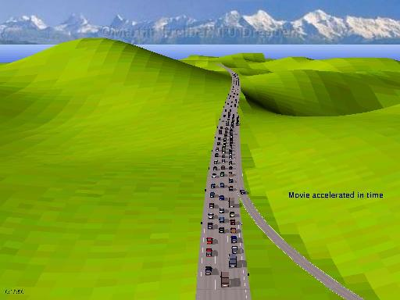
Dresden 3d Model (cont)
Example of the “Phantom Traffic Jam”

Slide 15
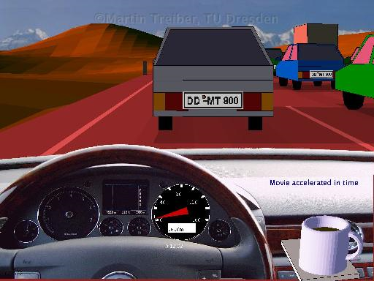
Dresden 3d Model (cont)
Traffic with Environmental Conditions

Slide 16
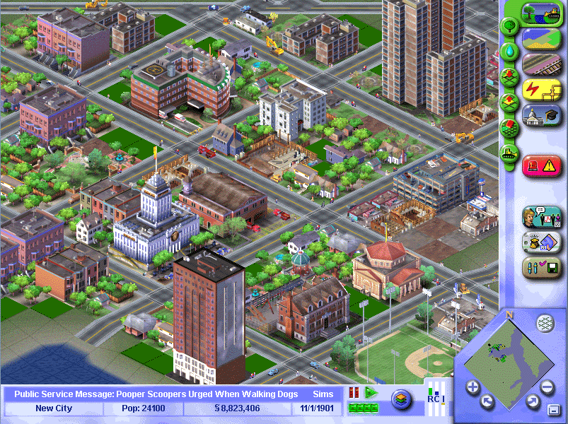
A Famous Traffic Model: SimCity
SimCity’s Traffic Generation Model
  Traffic has been a major part of SimCity since the very first version of the game.
  Generating reasonable routes for a City’s inhabitants is handled via trip generation, where a Sim attempts to find a way from one destination to another via the road network.
  The programmers wanted to capture intent in transportation simulation.

Slide 17
SimCity (cont)
SimCity’s Traffic Generation Model
  The solution to how a Sim finds a route between two destinations is solved using A* search.
  Instead of using distance as a heuristic, which would prevent things like mass transit or walking from being likely options, SimCity’s search routine uses time as the parameter to minimize.
  Travel time is calculated by a number of factors. Each form of transportation can move over each different kind of tile at a different speed. Pedestrians can travel over all types of roads at a fixed rate, but cars and busses can go faster on main roads than on residential streets. In addition, they can go really fast on highways, which are forbidden to pedestrians by the laws of the city.

Slide 18
SimCity (cont)
SimCity’s Traffic Generation Model
  Most forms of transportation are affected by how much traffic has previously traveled over a tile. Each type of road has a different capacity for traffic, and once a tile reaches capacity traffic slows down. A very congested tile can be extremely slow, causing Sims to investigate other paths first.
However, there are major flaws in the SimCity model.
  The suggested solution to most congestion in SimCity is to add more routes for Sims to choose from. An alternative solution I independently discovered was adding multiple toll booths along congested paths. The engine allows for as many booths as can fit and therefore you can maximize transportation profit as well as minimize congestion along routes, a very unlikely solution in real life.

Slide 19
References
Basics of Traffic Flow http://en.wikipedia.org/wiki/Traffic_flow
Traffic Simulation applet designed and written by Martin Treiber.
"TU Dresden 3d traffic simulator" at www.mtreiber.de
SimCity 4’s Traffic Model http://simcity.ea.com/about/inside_scoop/traffic.php

