Slide 1
Cutting And Packing Algorithms Research Framework
http://caparf.googlecode.com
28 December 2009, Ufa SATU
Denis Nazarov

Slide 2

Cutting and packing algorithms developement problems
Algorithms details are often omitted in articles
It's hard to get/generate test instances proposed by other authors
Different system configurations for testing
Small number of review articles with algorithms comparisions

Slide 3
Cutting and Packing Algorithms Research Framework
CAPARF consists of:
  Problems definition (for each type of problems)
  Algorithms for solving particular type of problems or even a number of types (including lower/upper bounds, exact methods)
  Test instances (raw data and generators)
CAPARF provides:
  Convenient «testing scenario» model
  Various reports generators (for example, results for article in TeX or presentation)
  Easy way to develop your own algorithms using existing methods and compare them with well-known reference algorithms by other authors

Slide 4
CAPARF benefits
CAPARF contains a lot of algorithms and test instances for cutting and packing problems
CAPARF is an OpenSource project hosted at http://code.google.com under GPLv3 licence.
CAPARF is a cross-platform framework since it is implemented in Java
CAPARF forces unification: all algorithms for the same type of problem have the same interface

Slide 5
Problem definition in CAPARF
Each problem definitin consists of the following «fundamental types»:
    Input — input data for the problem,
    Output — output data for the problem
    OutputVerdict — result of output data verification
OutputVerifier is defined for triple of <Input,Output,OutputVerdict>, which is responsible for output data verification

Slide 6
Example 1: simple algorithm
package com.googlecode.caparf.examples;
import java.util.ArrayList;
import java.util.List;
import com.googlecode.caparf.framework.base.Algorithm;
import com.googlecode.caparf.framework.spp2d.Input;
import com.googlecode.caparf.framework.spp2d.Output;
public class OneLineSample extends Algorithm<Input, Output> {
@Override
public Output solve(Input input) {
List<Output.Point2D> placement =
new ArrayList<Output.Point2D>(input.getRectangles().size());
int currentHeight = 0;
for (Input.Rectangle rect : input.getRectangles()) {
// Place current rectangle on the top of the previous rectangle
Output.Point2D lowerLeftPoint = new Output.Point2D();
lowerLeftPoint.x = 0;
lowerLeftPoint.y = currentHeight;
placement.add(lowerLeftPoint);
// Add height of the rectangle to the current height
currentHeight += rect.height;
}
return new Output(placement);
}
}

Slide 7
Example 2: testing scenario
// Create testing scenario instance
Scenario<Input, Output, OutputVerdict> scenario =
new Scenario<Input, Output, OutputVerdict>();
// Add algorithms to scenario
scenario.addAlgorithms(
new SimpleFit(ItemOrder.NEXT_ITEM, PlacementStrategy.DEFAULT),
new SimpleFit(ItemOrder.NEXT_ITEM, PlacementStrategy.SHIFT_RIGHTMOST_ITEM),
new SimpleFit(ItemOrder.FIRST_FIT, PlacementStrategy.DEFAULT),
new SimpleFit(ItemOrder.FIRST_FIT, PlacementStrategy.SHIFT_RIGHTMOST_ITEM));
// Create suite of Berkey and Wang inputs and add it to scenario
InputSuite<Input> berkeyWangSuite = new InputSuite<Input>()
.addAll(BerkeyWangGenerator.getReferenceInstances(Type.CLASS_I))
.addAll(BerkeyWangGenerator.getReferenceInstances(Type.CLASS_II))
.addAll(BerkeyWangGenerator.getReferenceInstances(Type.CLASS_III))
.addAll(BerkeyWangGenerator.getReferenceInstances(Type.CLASS_IV))
.addAll(BerkeyWangGenerator.getReferenceInstances(Type.CLASS_V))
.addAll(BerkeyWangGenerator.getReferenceInstances(Type.CLASS_VI));
scenario.addInputSuite(berkeyWangSuite);
// Set output verifier for scenario
scenario.setVerifier(new OutputVerifier());
// Run scenario
CaparfCore<Input, Output, OutputVerdict> invoker =
new CaparfCore<Input, Output, OutputVerdict>();
invoker.run(scenario);

Slide 8
Contribution
One can contribute to CAPARF developement by:
  Adding implemention of «good» algorithm described in some published article
  Adding new problem type definition
  Adding or suggesting improvements/fixes in CAPARF core
Roles in CAPARF developement:
сontributor — create various changes and send them for code-review
developer — create various changes, do code-reviews, commit changes to the trunk

Slide 9
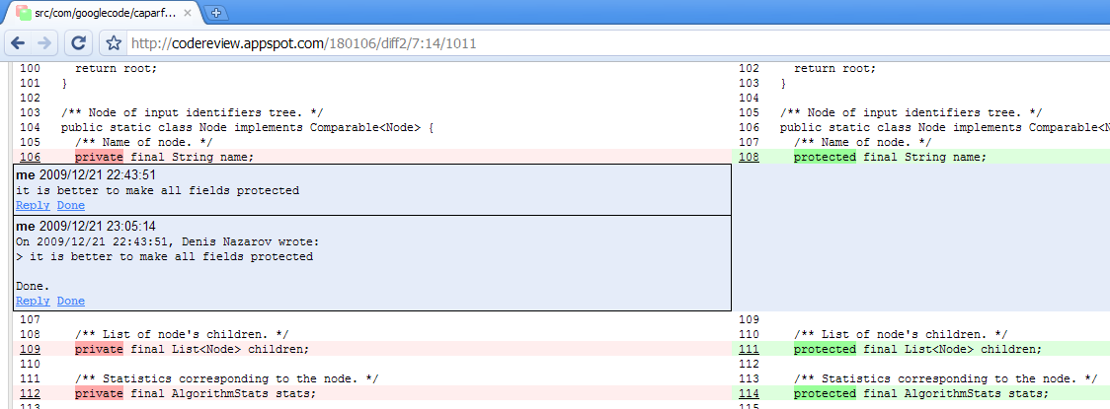
Code-review in CAPARF
All changes in CAPARF are required to pass code-review before commit using Rietveld Code Review Tool (for example, http://codereview.appspot.com/180106/show).

