Slide 1
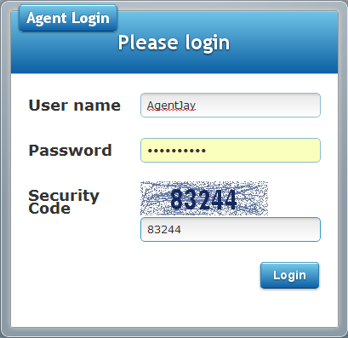
Enter the Security Code as shown

Slide 2
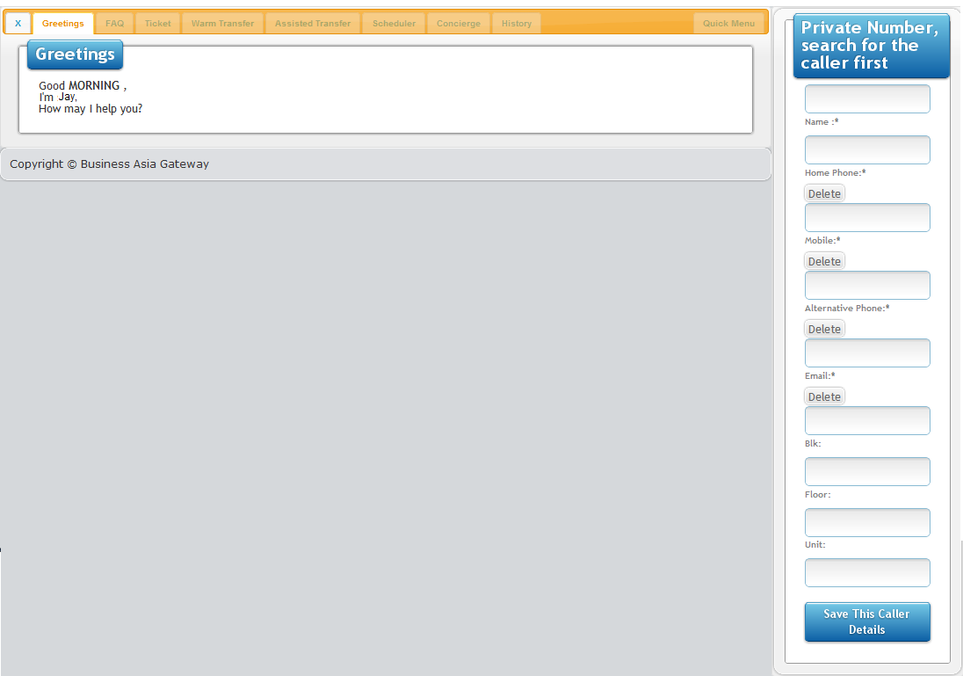
Menu Tabs
Dynamic Menu Content
Caller ID Panel

Slide 3
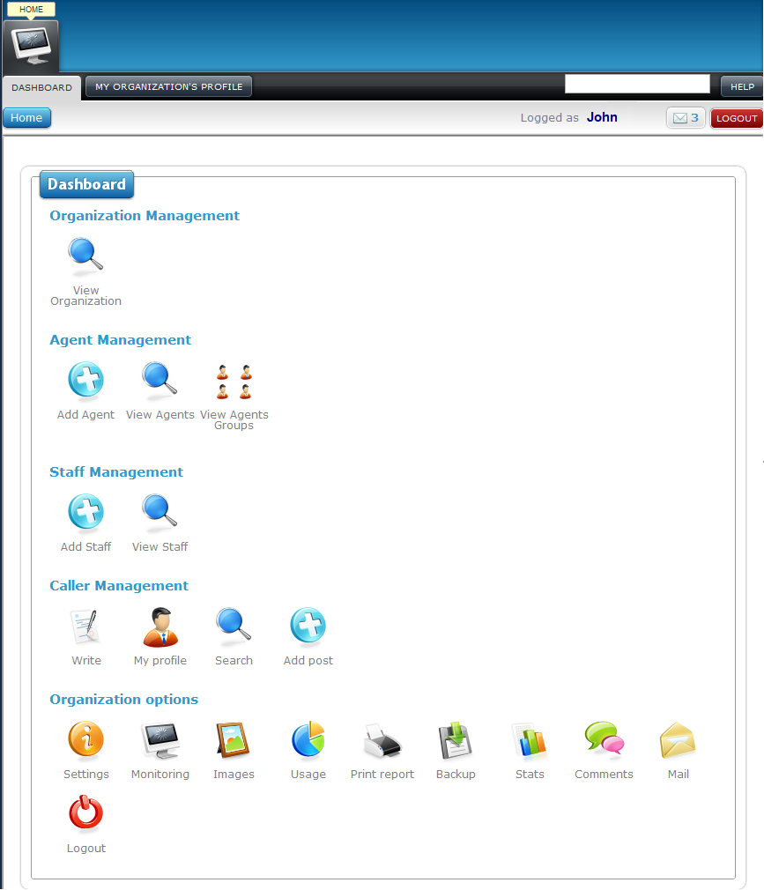
5
2
3
5
5
5
1
4
5
5
5
5
6
5
1
5
1
5
1
5
1
5
1
5
1
5
1
5
1
5
1
5
1
5
1
5
10
10
10
7
10
10
10
10
10
10
10
10
10
8
9
10
11
12
13
14
15
16
17
18
19
20
21
22
23
24
25
26

Slide 4
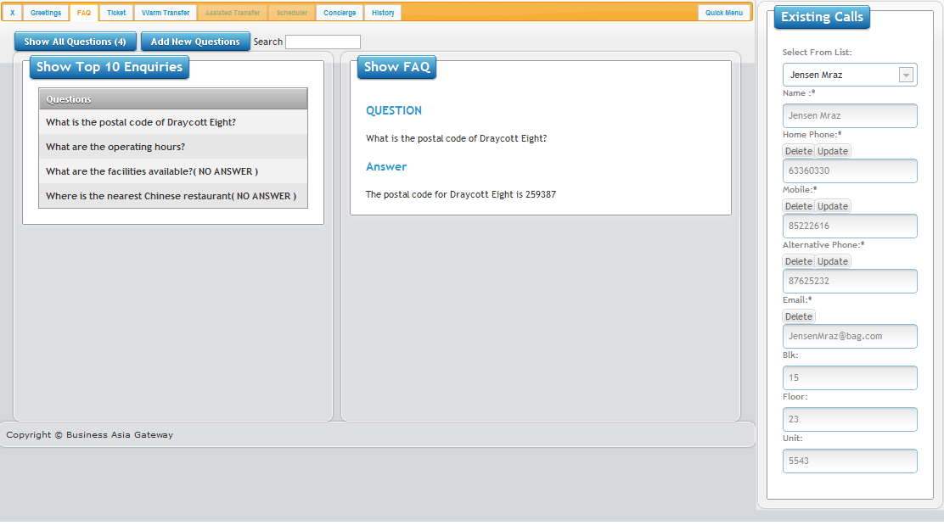

2
1

Slide 5
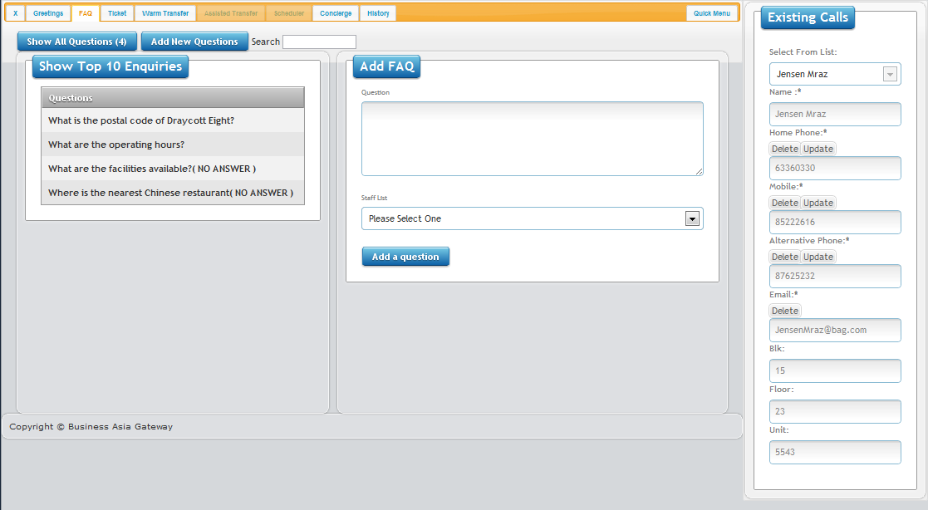
1
2

Slide 6
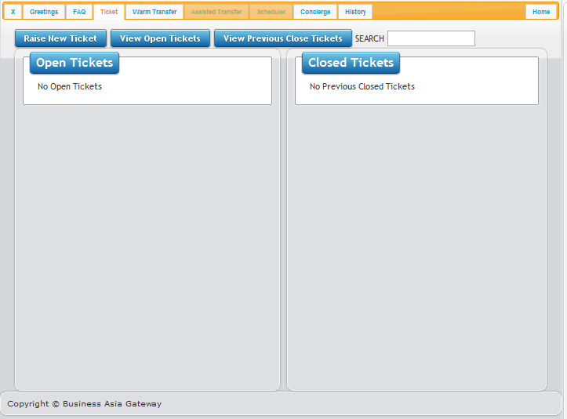
1
2
2

Slide 7
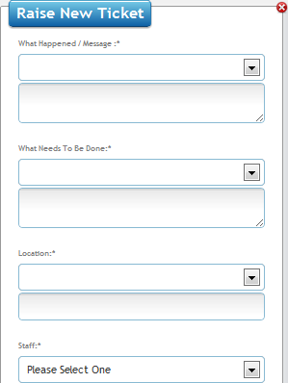
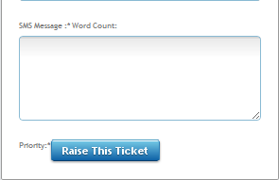
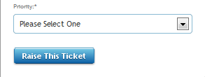
1. Type a short description of the caller problem / issue here
(e.g. My lights in the kitchen have stopped working)
2. Type a short solution here.
(e.g. Get FM electrician to replace faulty lights)
3. Type in location of problem found / address of caller.
(e.g. in the Kitchen, Draycott Ave 99 #16-45)
4. Assign ticket to correct staff member for resolution from drop down menu. (e.g. Jay, John, )
5. Edit the SMS to maintain a 160 chars limit
(e.g. UHP, lights faulty@ Draycott Ave 99 #16-45, Jensen Mraz, John to replace faulty lights)
6. Click this button to assign the urgency (priority) of this issue
7. Click this button to raise the ticket.

Slide 8
