Slide 1
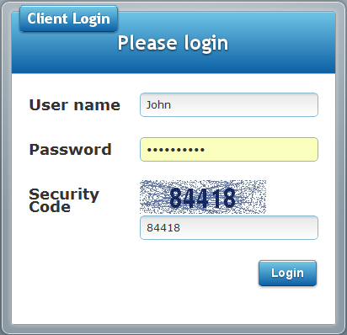
Enter the Security Code as shown

Slide 2
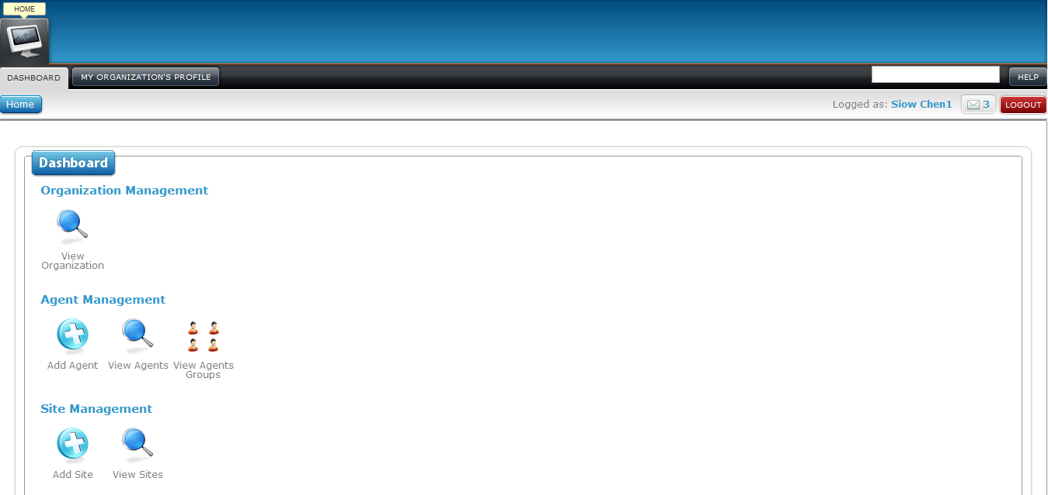

Slide 3
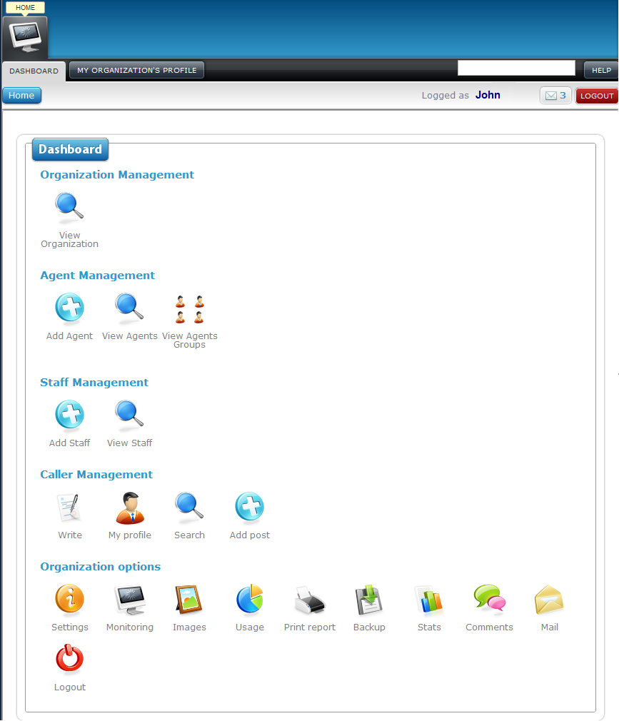
5
2
3
5
5
5
1
4
5
5
5
5
6
5
1
5
1
5
1
5
1
5
1
5
1
5
1
5
1
5
1
5
1
5
1
5
10
10
10
7
10
10
10
10
10
10
10
10
10
8
9
10
11
12
13
14
15
16
17
18
19
20
21
22
23
24
25
26

