Slide 1
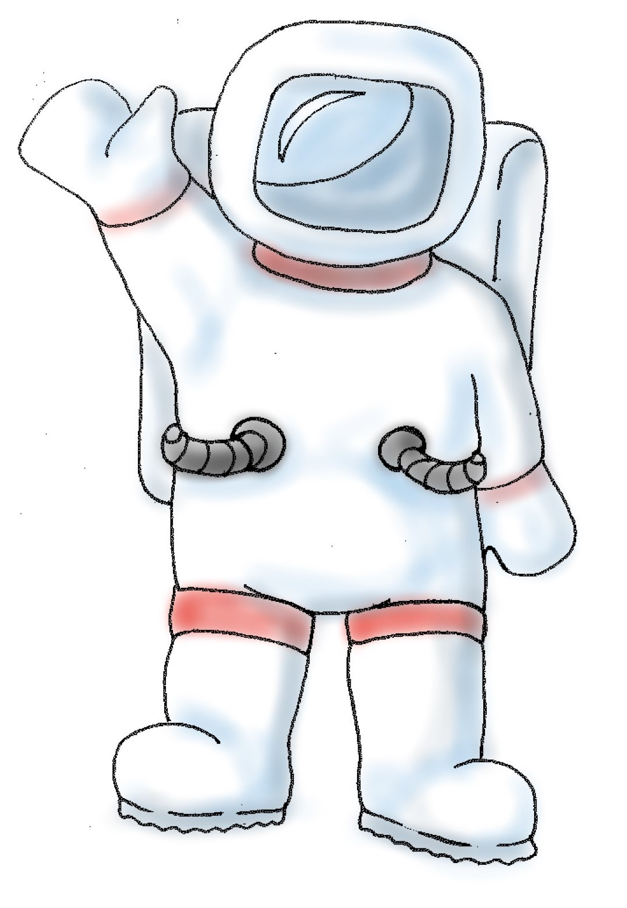
This is Jamie.
S/he is an astronaut.

Slide 2
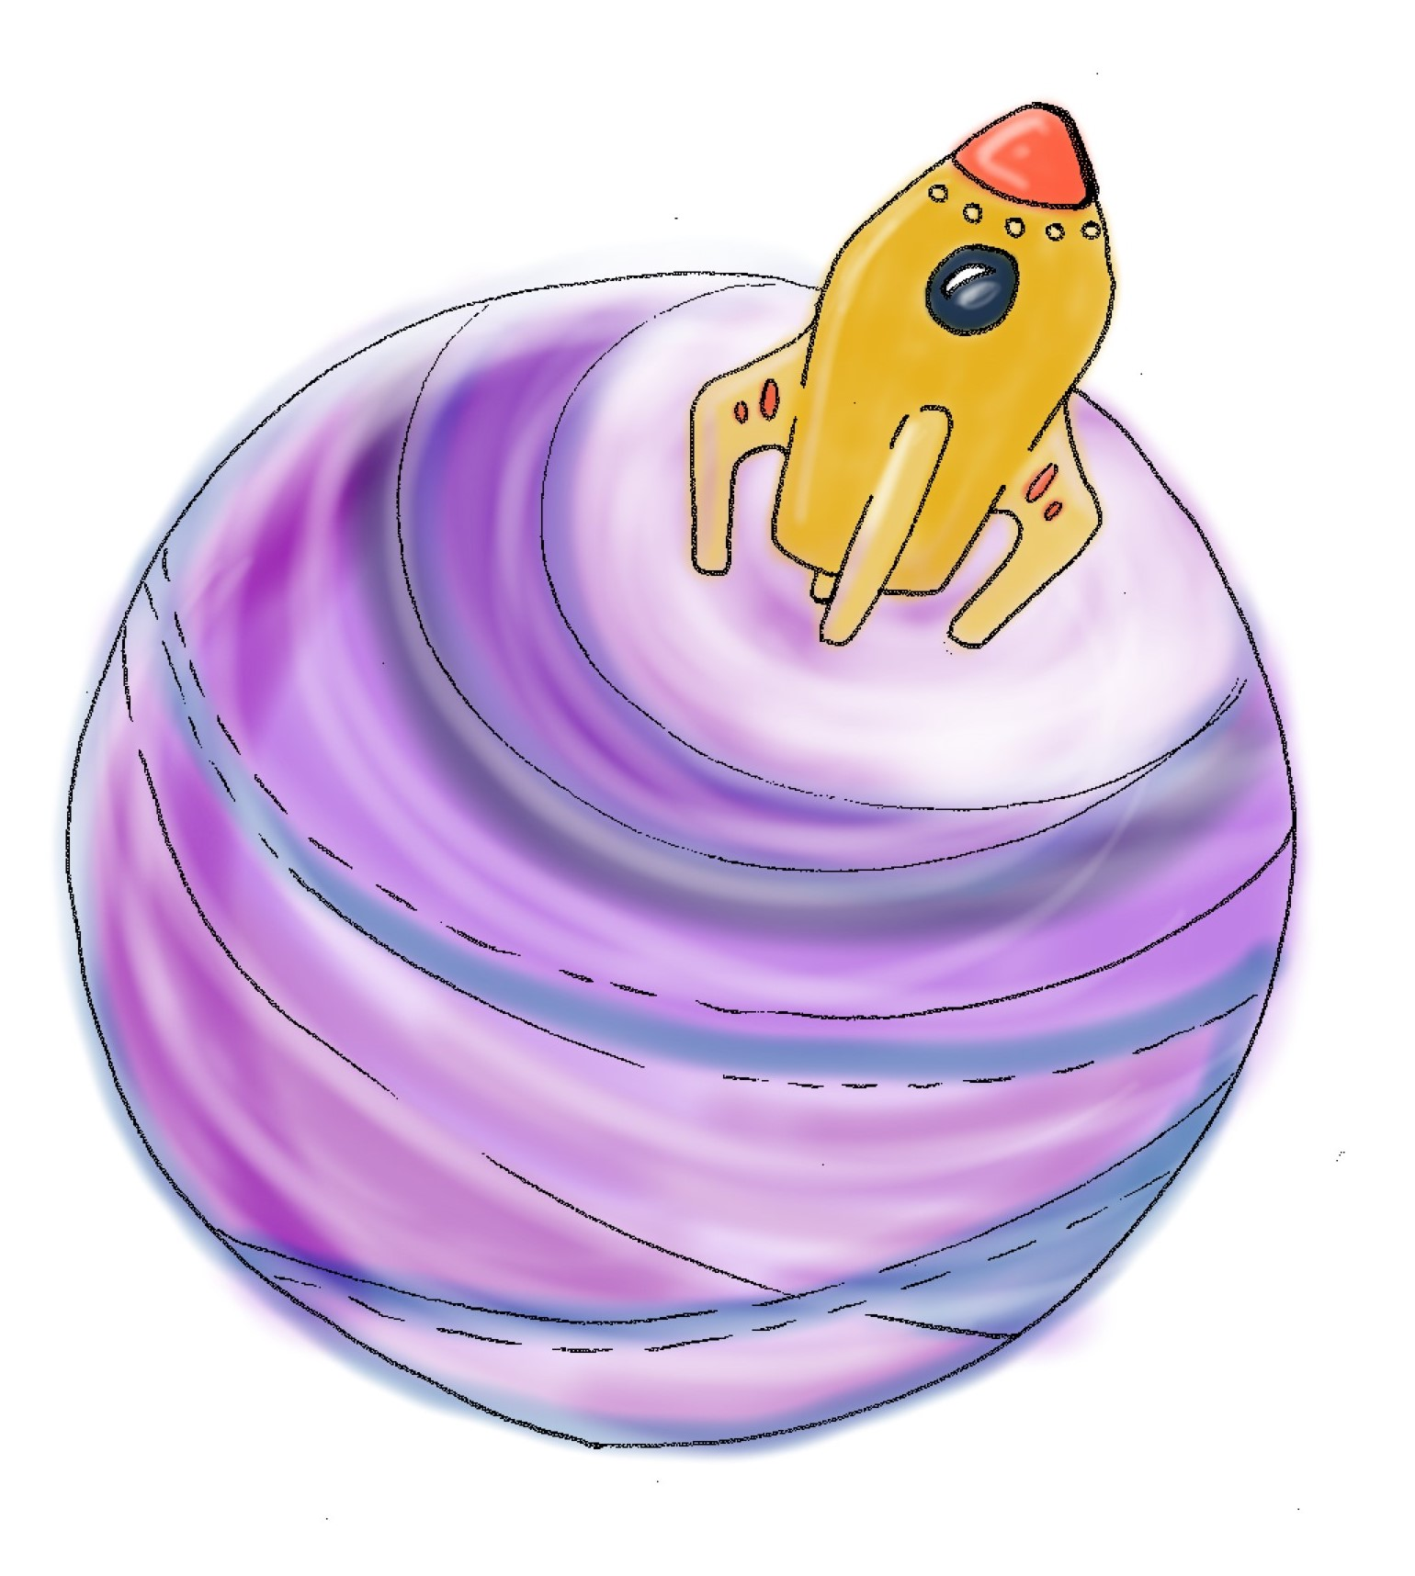
Jamie has landed on a planet far away from his/her home.

Slide 3
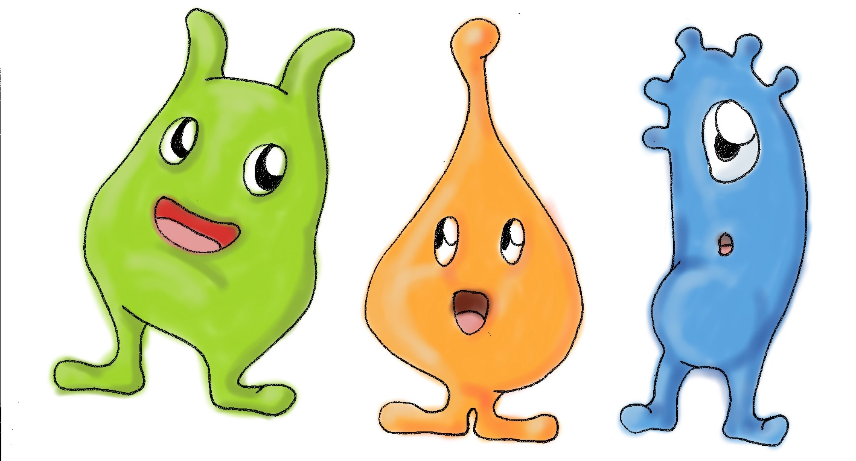
S/he has found some new alien friends there.

Slide 4
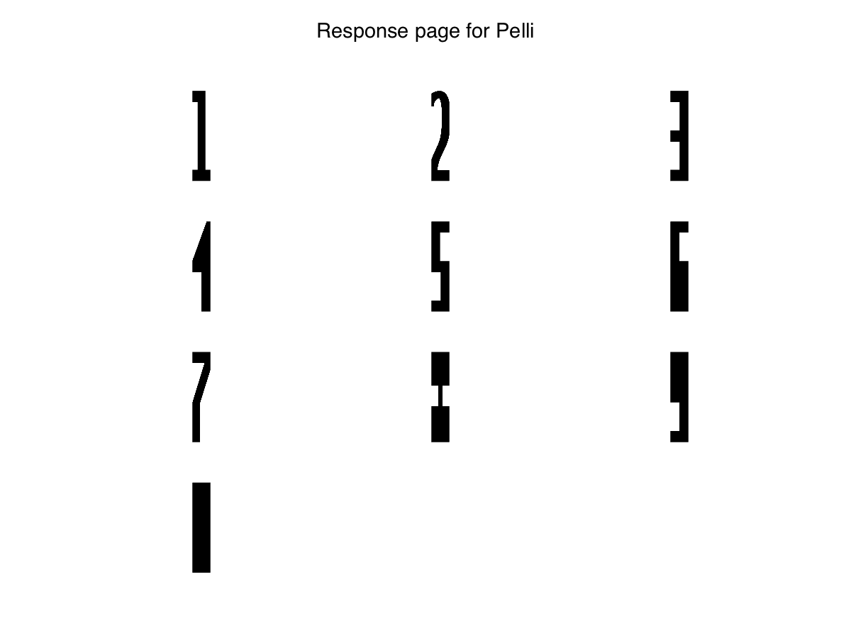
His/her alien friends cannot speak, but they have invented a symbol language to talk to Jamie.
Here are the symbols Jamie and his alien friends use.

Slide 5
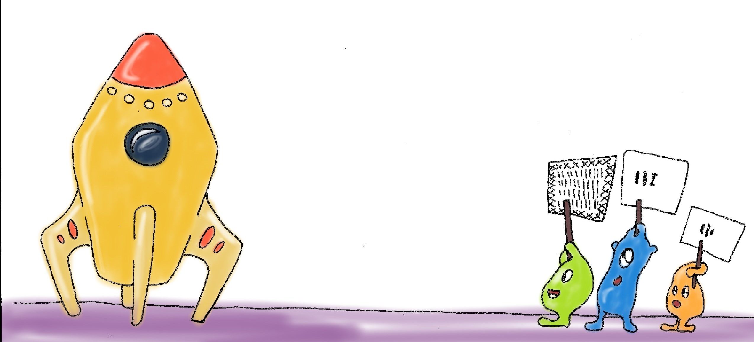
Now it’s time for Jamie to fly home again.
But Jamie’s spacecraft does not have enough fuel anymore to get back home! Jamie is already in his/her spacecraft, and the doors are locked. S/he could fly some miles to pick up fresh fuel, but s/he does not know where to go.
His/her alien friends try to tell her where Jamie can find more fuel, but their signs are far away.

Slide 6
Can you help Jamie to understand what his/her alien friends try to tell him/her?

Slide 7
We will show you the signs the aliens show Jamie on this screen here. You can point on the symbols you can see there on this sheet [give the Response Page] and we will tell Jamie your answers.

Slide 8
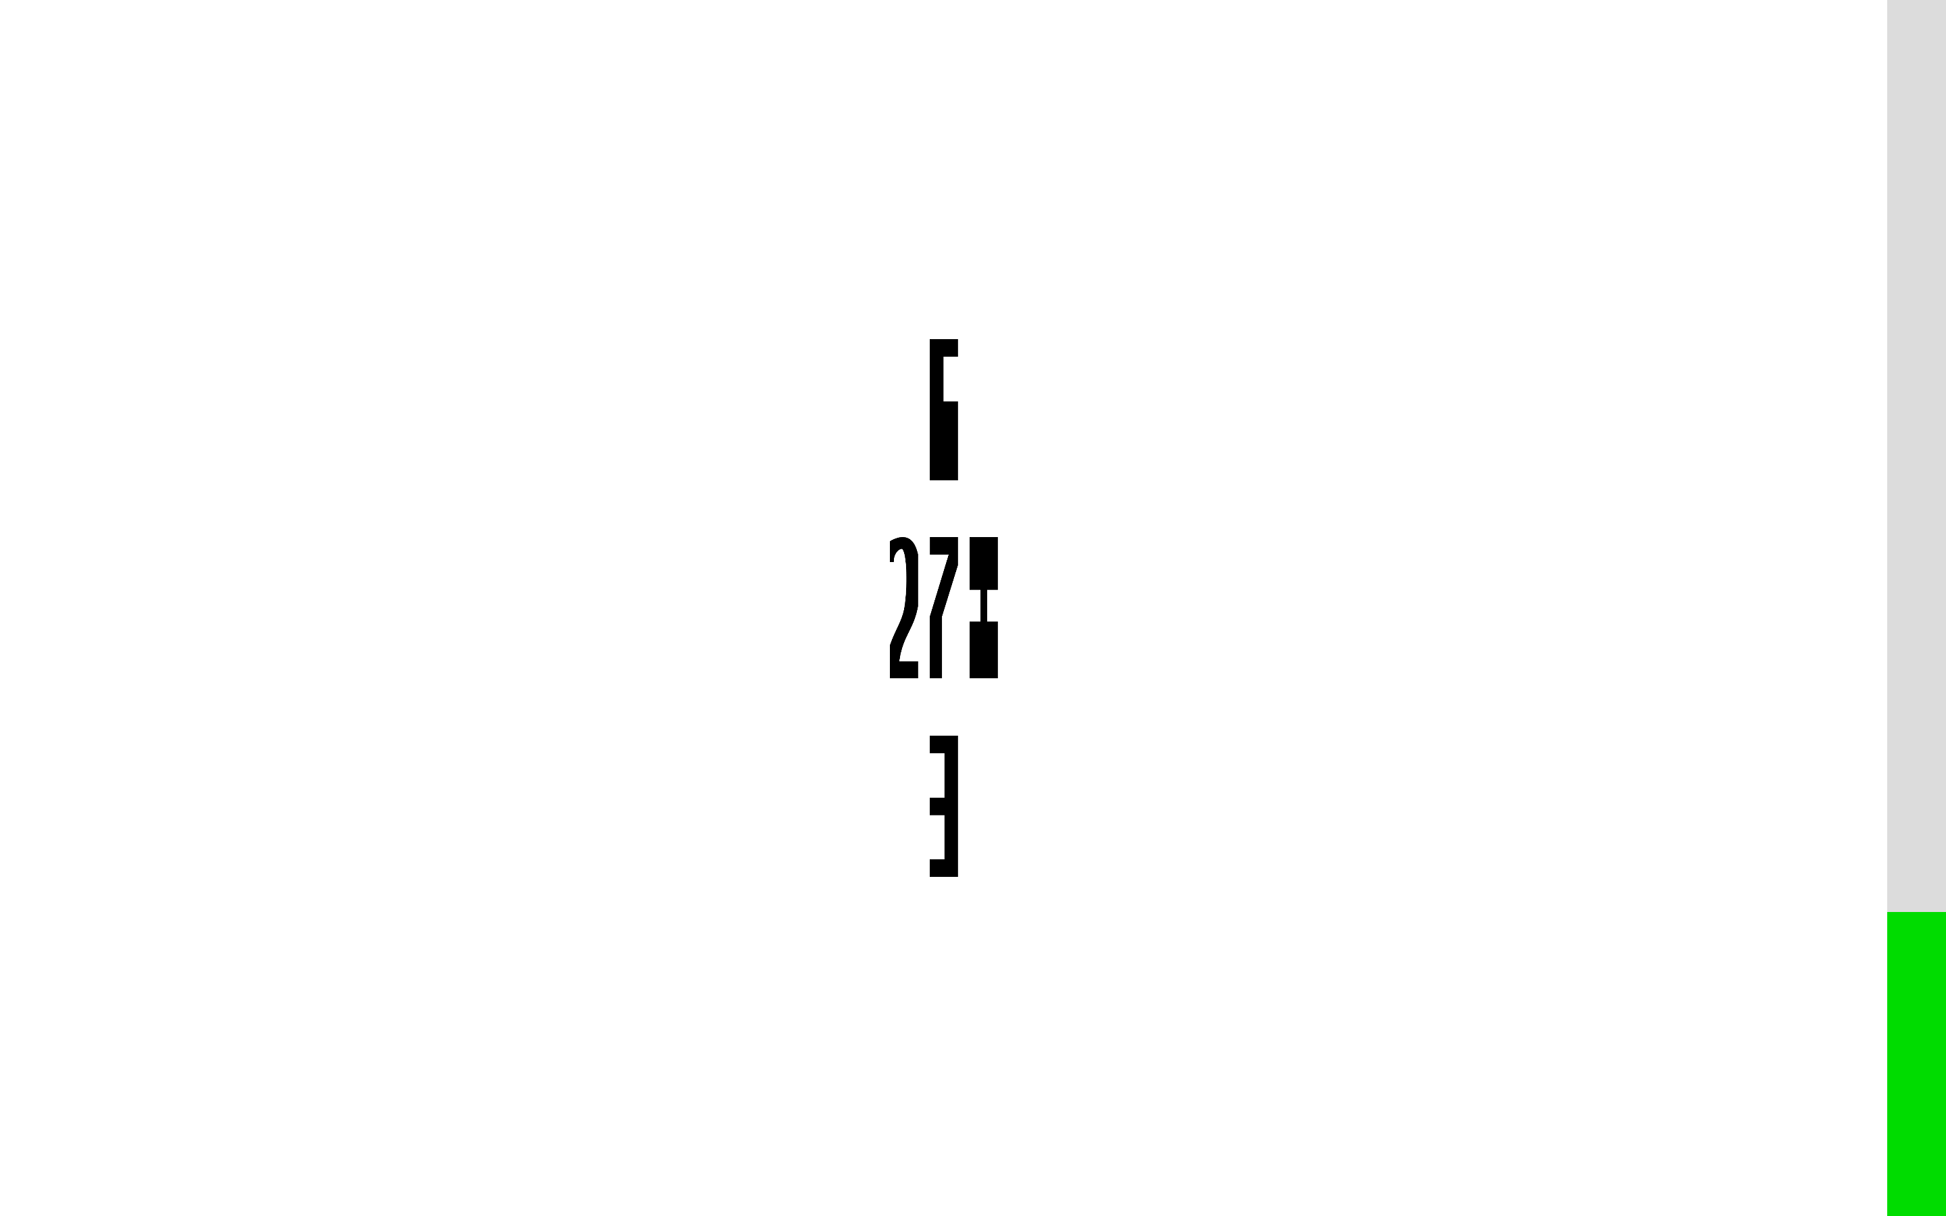
This bar on the screen will show you how much fuel Jamie has already collected. When it’s green all the way, Jamie can get home again.

Slide 9
So, are you ready to help Jamie to read his alien friends’ symbols?

