Slide 1
DAILY STOCK CLOSING PRICE PREDICTION USING NEURAL NETWORK AND MACHINE LEARNING TECHNIQUES
Denis Roystan Richard Dalmeida

Slide 2
CONTENTS
Introduction
Problem Statement
Aim & Objectives
Literature Review
Methodology
Results and Discussions
Conclusion and Future Recommendations

Slide 3
INTRODUCTION
Stock is in today’s world very notable among stock investors and financing institutions. The stock market plays a crucial role in determining the economic strength of any country.
It desires investors to predict the stock price in advance by time series analysis of the stock’s continuous data, thus, proving to occur variations in the value of a stock.
Nevertheless, stock forecasting is a complicated job because of noise in continuous data, nonlinearity, and non-stationary characteristics
Stock prediction helps companies to undertake profit-making decisions for the future growth aspects of their products and services.

Slide 4
INTRODUCTION
In this research, we have used Extreme Gradient Boosting (XGBoost) and Long Short Term Memory (LSTM) for stock prediction.
This research paper will study if volume traded over past years and price have any correlation and it will select the best features from dataset used for stock prediction.
This research will even study the volatility of market pre and post of Demonetization and Covid-19 time period to examine if unforeseen circumstances affect the share market and it’s listed stocks
This paper will also discuss the future scope of extending this research with more features and a large dataset.

Slide 5
PROBLEM STATEMENT
Back in the days when there was no AI/ML in the finance domain, professionals started using fundamental and technical analysis to predict stock movements. It is termed the best tool available those days, but it needs thorough understanding of statistics and accounting.
In the worst case scenario, investors unfailingly depend upon the tips/recommendation given by the brokers at the exchange or by the credit rating agencies. Henceforth, this leads to a biased outcome, and sometimes the large group of investors are left disappointed and hopeless.
This study aims to predict the stock closing price proximately to actual prices. This will help the investors to deliberately choose the stocks and also walk in the path of a successful investment journey.

Slide 6
AIM & Objectives
The principal objective of this research is to forecast the next-day closing price of a stock using LSTM and XGBoost to provide better results in terms of precision and less erroneous results and to prove that deep learning models are better than machine learning models.
Effectiveness of LSTM & XGBoost models in predicting the stock closing price in terms of performance and less erroneous.
Explore how deep learning models are significantly more viable than machine learning models.
Conduct hypothesis testing to determine the effectiveness of past 10-year stock trend in the forecast.
Impact of prediction models on the recommendation for traders to buy/sell stock.
To study the volatility of market pre and post of Demonetization and Covid-19 time period.
Inferences drawn out of volume traded over 3 years, 5 years and 10 years and between Volume Weighted Average Price (VWAP) and Closing Price

Slide 7
Literature Review
MACHINE LEARNING APPROACH
In the past research papers used Linear Regression, Random Forest (RF), Support Vector Regression (SVR), etc. In some papers the researcher have used this models for comparative analysis
DEEP LEARNING APPROACH
In the past research papers. predictive models used algorithms like Artificial Neural Network (ANN), Convolutional Neural Network (CNN), Recurrent Neural Network (RNN), Long Short-Term Memory (LSTM), Multilayer Perceptron (MLP), and Deep Neural Network. Some researchers even used hybrid models of ANN or LSTM for better predictions.
OTHER APPROACHES
In the past research papers, time series models were also introduced such as Auto Regressive (AR) model, Auto Regressive Integrated Moving Average (ARIMA) model and Three Months Moving Average (3MMA) and Exponential Smoothing model

Slide 8
Literature Review
In previous research papers, most of the researchers used Yahoo Finance dataset. Some of the papers used stock tick data or financial data like balance sheets. profit-loss statements, etc.
In some of the papers, researchers used sentiment analysis of financial news and opinions fetched from social media platform like Twitter.
In one of the paper, Feature selection is conducted using Principal Component Analysis (PCA) before passing it to learning model.
Most of the research papers predicted the close price feature of the selected stocks and some even predicted open price.

Slide 9
Methodology

Slide 10
Methodology
DaTASET
The historical dataset is collected for five companies from different sectors – Infosys Ltd, Glenmark Pharmaceuticals Ltd, Indiabulls Housing Finance Ltd, Maruti Suzuki India Ltd, Adani Ports and Special Economic Zone Ltd.
The time interval of the dataset is from 01/01/2011 to 01/03/2021. Important columns/features that will be used for creating stock price predicting model – Close Price, WAP (Volume Weighted Average Price), Spread (Close-Open, High-Low) and created variables like moving averages (20 DMA, 50 DMA, 100 DMA, 200 DMA).
EVALUATION TECHNIQUES
The evaluation of the models is intended to assess the precision of the generalization of a model for future data (not observed/not disclosed).
The following evaluation metrics are used in this research – R-Squared, Mean Absolute Percentage Error (MAPE), Root Mean Squared Error (RMSE) and Mean Bias Error (MBE).

Slide 11
Methodology
Long Short Term Memory (LSTM)
It comprises an input layer, LSTM layer that takes the sequence from the previous layer, followed by a dense layer with 5 neurons and then final dense layer that outputs the predicted value. The output layer is composed of a single LSTM cell that will yield the expected value in terms of the closing price of the stock. The optimizer used here would be Adam for the LSTM network.
Extreme Gradient Boosting (XGBoost)
In this proposed model, the stock data features were provided as input for the training of each weak ensemble model which in turn combines them to produce improved results.
Hyper-parameters are tuned for minimizing forecasting error and in turn optimize the final output. n_estimators, max_depth, learning_rate, gamma and random state are tuned for XGBoost model in this research

Slide 12
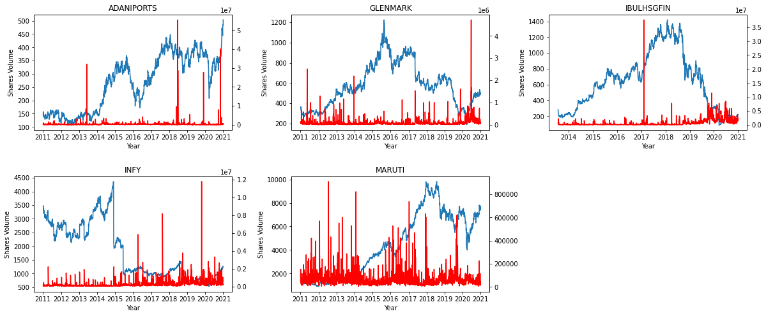
RESULTS AND DISCUSSIONS
Price and Volume Correlation
From the above graph chart we can say that volume is positively correlated to the closing price of the stock. It might be the external factors that affect more the volume traded over a particular time period, but we can say that if the shares traded volume is increased, then there is a high chance of an increase in the stock price.

Slide 13
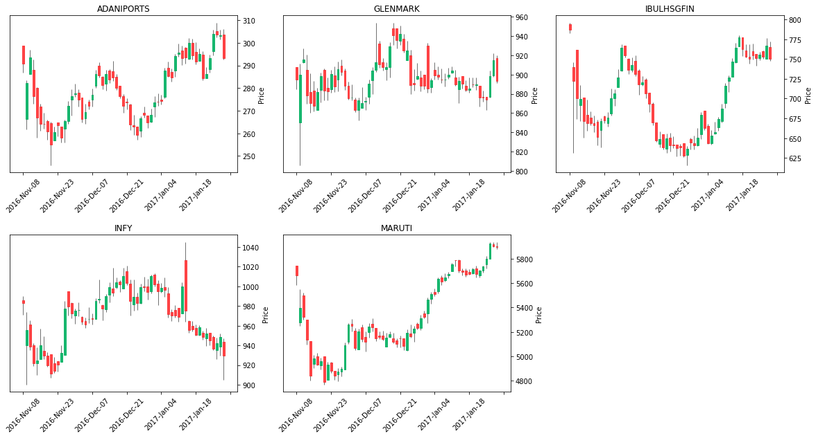
RESULTS AND DISCUSSIONS
It shows that the economic policy of demonetization on 08/11/2016 has affected the stock market prices to a great extent, but the bear market lasted only for a month, and again the prices started shooting up. Thus, we can say that the changes in economic policies do affect the share market
Candle chart for demonetization time period

Slide 14
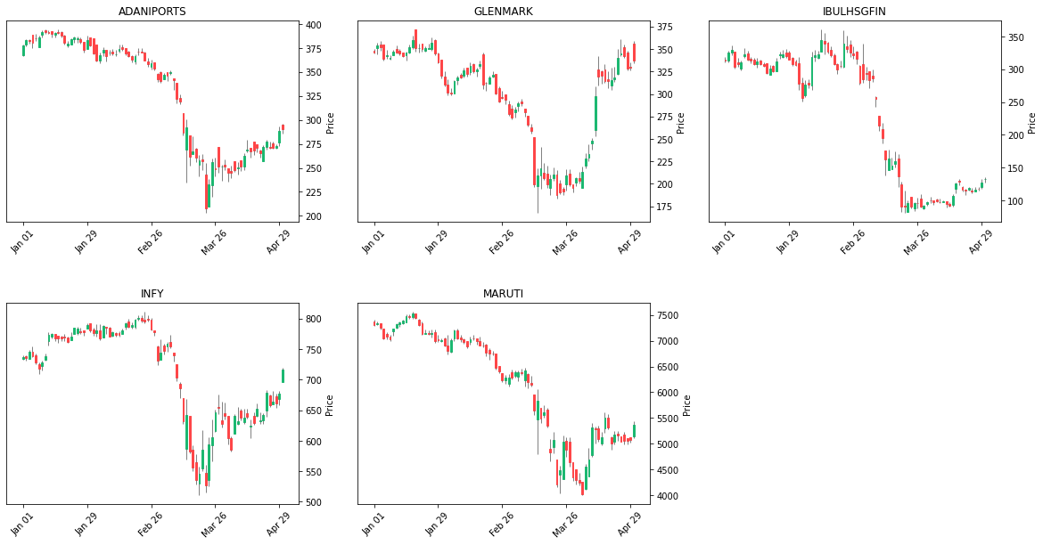
RESULTS AND DISCUSSIONS
Candle chart for covid-19 time period
The above figure shows that during the pandemic start period of 01/02/2020 due to covid-19 has made the stock market fall very sharply. We can clearly see that prices have gone down up to 40% within a month. This clearly indicates that any unforeseen circumstances if occurred would highly influence the share market stock prices.

Slide 15
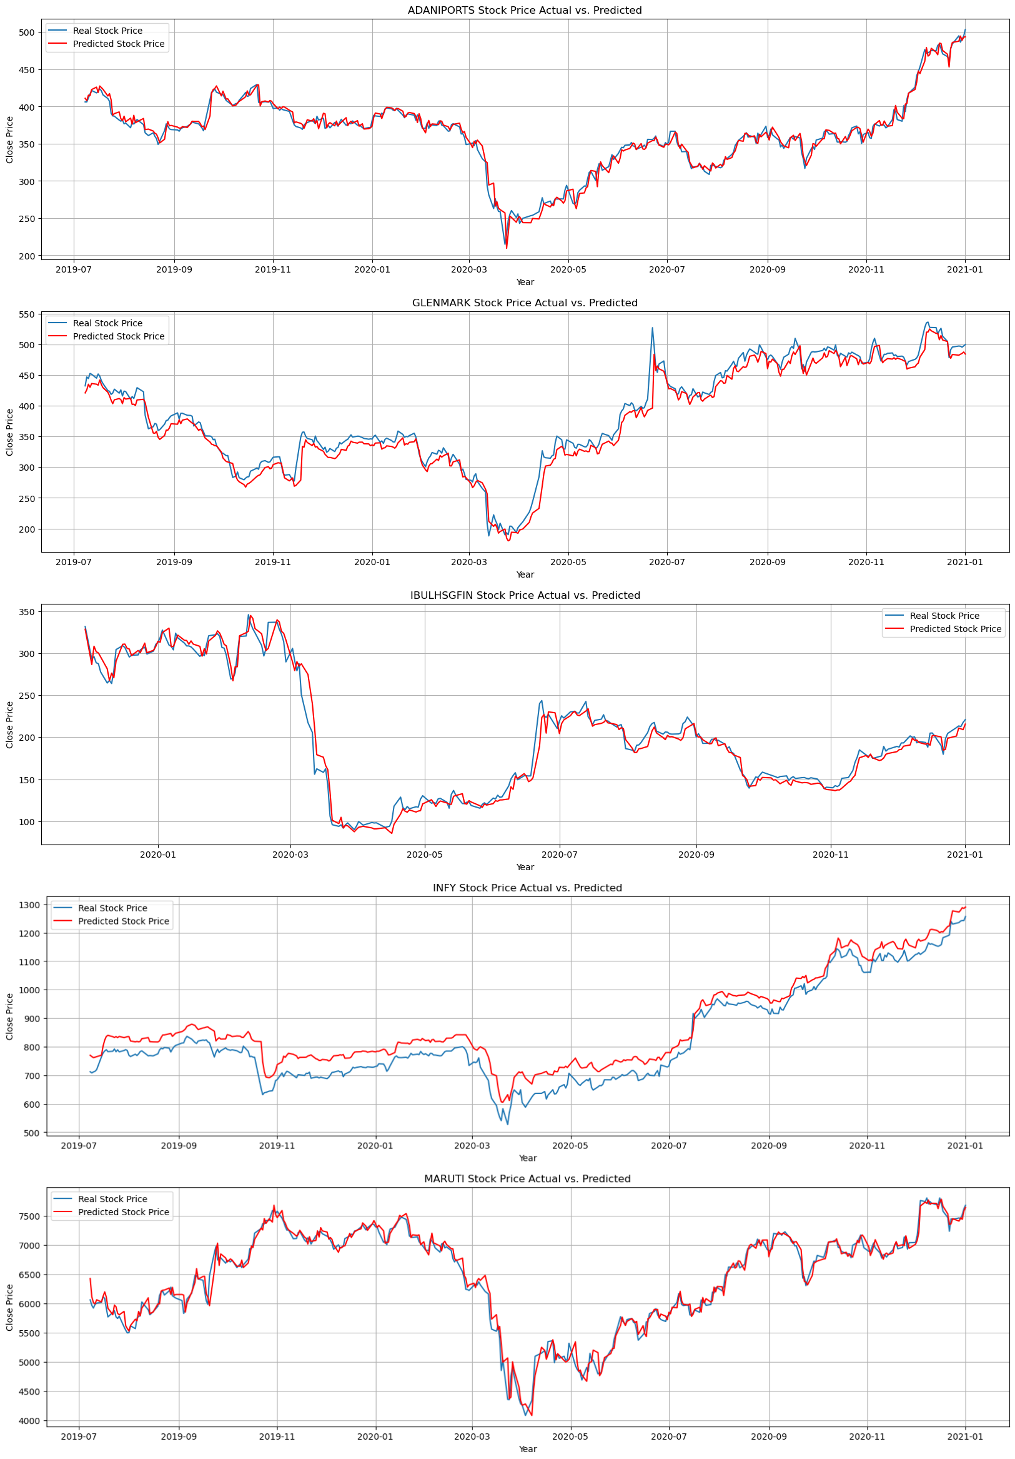
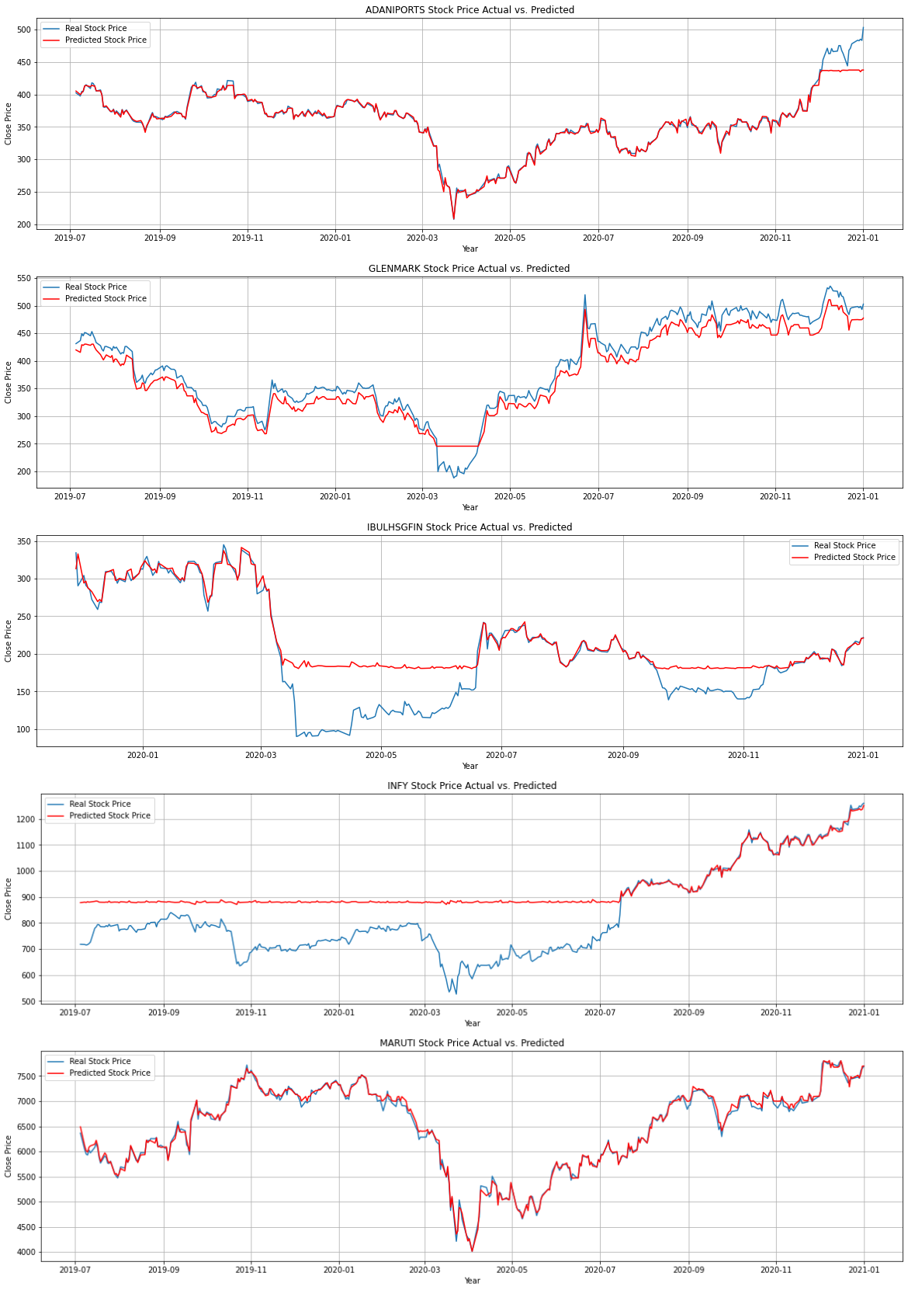
LSTM Model Prediction vs Actual Results
XGBoost Model Prediction vs Actual Results

Slide 16
RESULTS AND DISCUSSIONS
EVALUATION METRICS
Company |  | LSTM |  |  |  |  | XGBoost
 | R2 Score | RMSE | MAPE | MBE |  | R2 Score | RMSE | MAPE | MBE
Adani Ports | 0.98 | 7.31 | 0.02 | -0.54 |  | 0.97 | 8.96 | 0.01 | 2.16
Glenmark | 0.97 | 15.38 | 0.03 | 10.2 |  | 0.93 | 21.19 | 0.05 | 16
Indiabulls Housing Finance | 0.98 | 10.54 | 0.04 | 1.26 |  | 0.76 | 33.72 | 0.16 | -19.2
Infosys | 0.91 | 51.7 | 0.06 | -47.92 |  | 0.37 | 133.51 | 0.15 | -100.87
Maruti | 0.98 | 119.72 | 0.01 | -18.57 |  | 0.99 | 60.06 | 0.01 | -18.28
Comparative analysis of the R-Squared (R2 Score), MAPE, RMSE, and MBE values obtained using LSTM and XGBoost model is shown in Table. it can be observed that LSTM shows better prediction results for stock prices.
The comparative analysis indicates that for Adani Ports, Glenmark, Indiabulls Housing Finance, and Maruti Suzuki companies, LSTM proves to be a better technique, giving better metric values of R-Squared (R2 Score) and MAPE as shown in the Table.

Slide 17
CONCLUSION and FUTURE RECOMMENDATIONS
The conducted study helps to summarize that we can use deep learning and machine learning models for stock prediction. It also states that the past data is highly effective in forecasting the future prices of stock. Using this model, we can even recommend stocks to investors for making their profits in the share market.
The features like Volume Weighted Average Price (VWAP), Spread Close-Open, and Spread High-Low are highly important features for predicting the prices of stock.
In contrast to evaluation metrics based on R2 Score, RMSE, MAPE and MBE estimate evidently stipulate that LSTM provides better prediction of stock closing prices as compared to XGBoost. Results reveal that the finest values derived by LSTM model yield R2 score (0.98), MAPE (0.01), RMSE (0.42) and at last MBE (-0.54).

Slide 18
CONCLUSION and FUTURE RECOMMENDATIONS
For future work, deep learning models could be developed which include financial news, articles along with financial parameters such as profit and loss statements, balance sheets, dividends, company announcements, stock-splits, bonus/rights issue, shares buyback, diverse types of information such as tweets, news, and other text-based data. Similarly, we can also pass technical indicators and fundamental details to achieve better results.
Since statements and opinions of renowned personalities are known to affect stock prices, a possible extension of this stock prediction system would be by combining latest sentiment analysis that can be linked with the LSTM to better train weights and further improve accuracy.
We can further improve the model by deeper network (Deep Neural Networks), more hyperparameters, adding more layers, regularizing overfitting/underfitting of model by Dropout, alternative loss functions, adaptive optimizers, features and time-steps, larger batch size and training for longer.

Slide 19
THANK YOU
Denis Roystan Richard Dalmeida
Liverpool John Moores University
+91-96190-65737
denisroystan01@gmail.com

