Slide 1
Resistive Heating for Cable Solder Flow
September 2020
James Logan

Slide 2
Concept
Do heating for cable solder flow by driving current through cable
Copy as much existing power electronics, connector designs, calculations, etc. as possible from existing body of work
Source power supply from same family as WHAM magnet driver
Copy power supply/cable connectors & related calcs from WHAM magnet driver
Straight-up copy Dan N’s WHAM solder controller rig to drive solder reservoir heating
Keep it simple
If it works without insulation, don’t insulate it
If there are COTS heating elements that work, use them

Slide 3
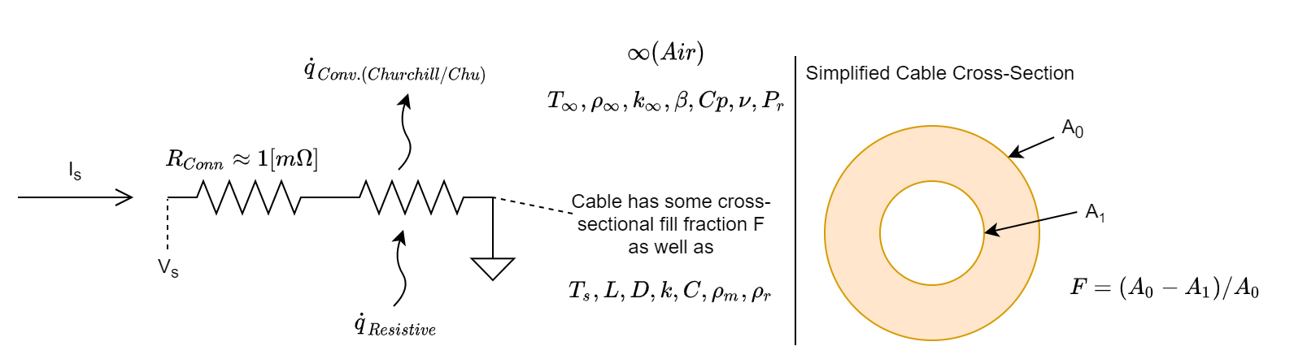
Heating Calculations
The cable is modeled as a horizontal copper cylinder in ambient air
Jacket is modeled as 3mm copper; actual
Natural convection heat losses calculated per Churchill & Chu correlation
Connector resistances estimated as 0.5mOhm per connector
Per WHAM’s PDR materials for cable connectors for the same power supply (slide 97)

Slide 4
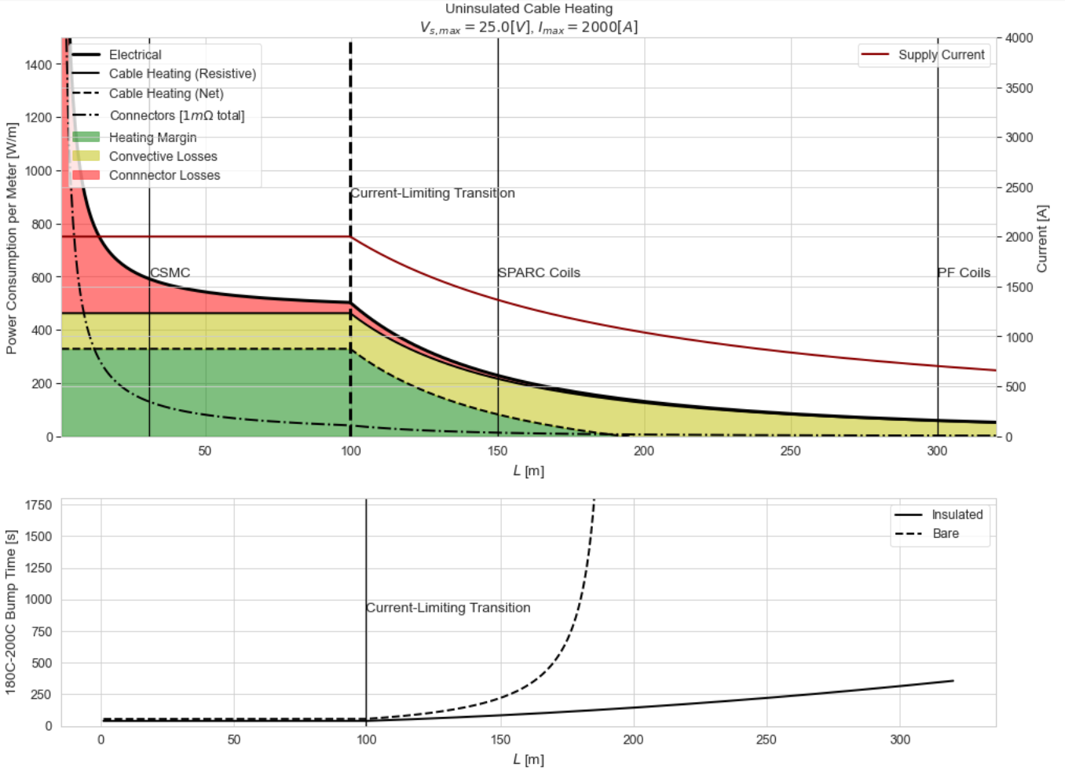
Performance Estimates – 25V, 2kA Supply
Looks good uninsulated out to about 150m cable length
This covers
Short-section dev cables
CSMC
SPARC
Would need insulation to do PF coils
Bump times are typically <10% of solder flow time
Calculations (excel & jupyter): https://www.dropbox.com/sh/kz3p1is6b2mf0i0/AABi30b9gEivslBp9s_yAvEqa?dl=0

Slide 5
Open Items
Connectors need active cooling
~9kW dissipation per connector at max current
Likely have to throw away end-sections of cable due to uneven heating
Might need to do better than 0.5mOhm cables/connectors to decrease losses
Hot-spotting in copper cable
Independent of solder wetting, there will be some length-wise variation in resistivity
1% variation in resistivity -> ~1% difference in power dissipation, but if it’s a short section, that will conduct upstream and downstream
Unclear what “normal” lengthwise resistivity variation will look like
How much wattage can we pull?
Need at least ~25kW
B-fields and hoop stresses for coil geometries
Is it ok to put this much current into those coils? How much support is needed? Can the supports be thermally insulated effectively?
Composites compatibility – do we have to do this before wrapping coils?

Slide 6
BOM (W.A.G.)
Item | $ (tot) | Count | Description
MagnaPower TSDx-xxxx/480 | ~$12,000 | 1 | High-current power supply, likely 25V/2000A
4550T121 | $236 | 4 | 4ft, 312W heater tape (for solder reservoir)
WHAM solder controller | $1,432 | 1 | 4p4t temperature controller (for solder reservoir)
BX-DM1E-10ED13-D | $777 | 1 | PLC w/ ethernet, 6ch RTD module, analog output module, & all terminal blocks
PLC software (DataWorx) | $400 | 1 | Only one PLC needed for small workpieces
RTDs for cable sense | ~$300 | 4 | Guestimate for short cables
High-current cables & connectors | ~$1,000 | 2 | Guestimate
Total | $16,145
Magna-Power Catalog: https://magna-power.com/assets/files/datasheets/datasheet_ts_4.4.0.pdf
WHAM solder controller: https://www.dropbox.com/home/SPARC_Joint/Research_Projects/GDT/Manufacturing/Heating%20Ring

Slide 7
Assumptions
Target temperature is 200C; ambient temperature is 20C
Radial thermal diffusion >> convective rate -> lumped-parameter model is valid
Bi = hD/k = 3e-4 to 7e-4, Biot number agrees
Cable core internal geometry not important to heat transfer at jacket surface
Seems ok. In reality, will get slightly less heat transfer between jacket-core lands
Solder electrical conductivity is negligible
Leaded solder typically <=10% of copper’s electrical conductivity
In bare configuration (with convection), conservative to assume section wetted w/ solder to run colder by about the atmospheric temp delta times the dissipative power ratio
180K * P_wetted / P_dry = 180K * R_wetted / R_dry since the same current flows through both
In reality, convective heat transfer also decreases linearly with surface temp, so temp delta will be less
This gives a worst-case temp delta of about 1-2K if solder takes up ~5-10% of cross-section
Copper resistivity corresponds to 200C temperature (about 2x ambient)

Slide 8
BACKUP

Slide 9
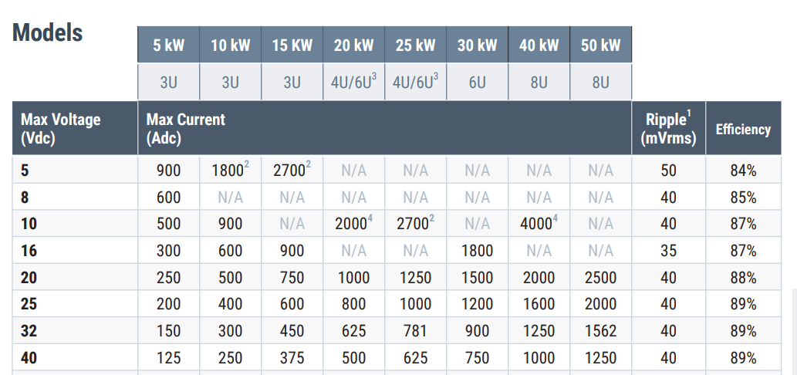
Magna-Power Stock Model Catalog
Magna-Power Catalog: https://magna-power.com/assets/files/datasheets/datasheet_ts_4.4.0.pdf

Slide 10
Solder Flow Velocity 1/3
Stated values are longitudinal velocity – flow velocity relative to channel walls is slightly faster
Evaluated using B-N-T approximation for friction factor
This gives an explicit formulation that extends across turbulent transition
Confirmed gives same result as Haaland for high Re as-implemented
https://ascelibrary.org/doi/10.1061/%28ASCE%29HY.1943-7900.0001540
Assumed channel geometry is 0.3mm x 5.5mm at 20cm pitch (14 deg angle) w/ 10% relative roughness
Helical path length bookkept as increased wetted length; no accounting for minor losses which should be small due to inability to develop counter-rotating vortex in thin passage
Downstream pressure assumed vacuum
Did not account for non-flowing deadspace, which seems likely to increase actual flow times by ~2-3x
Liquid 60-40 solder properties per matweb (2cP viscosity, 8600 kg/m^3)
http://www.matweb.com/search/datasheet_print.aspx?matguid=06a31d97bb734b509043d81cf131b280

Slide 11
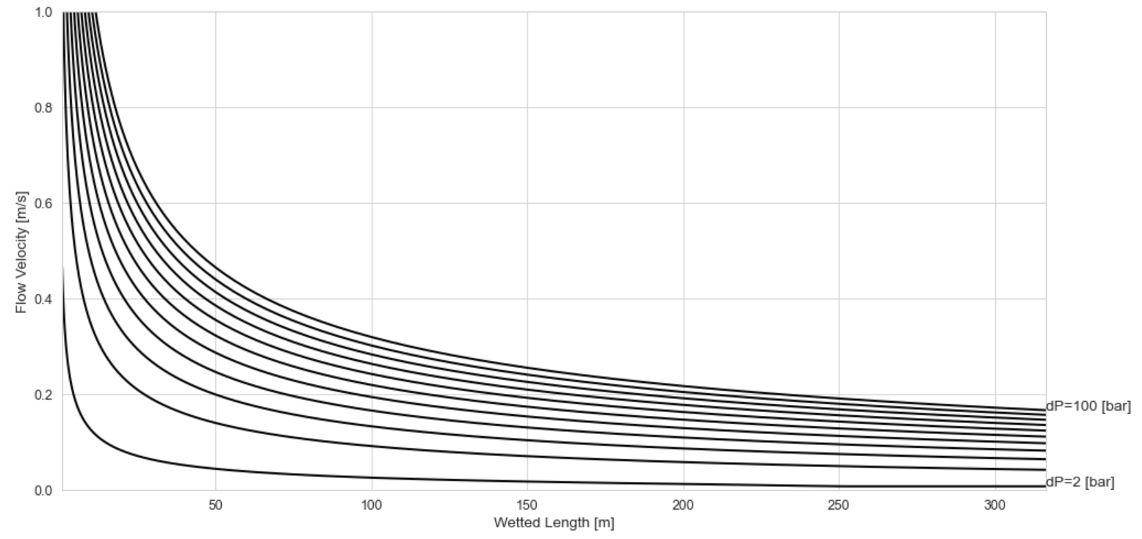
Solder Flow Velocity 2/3

Slide 12
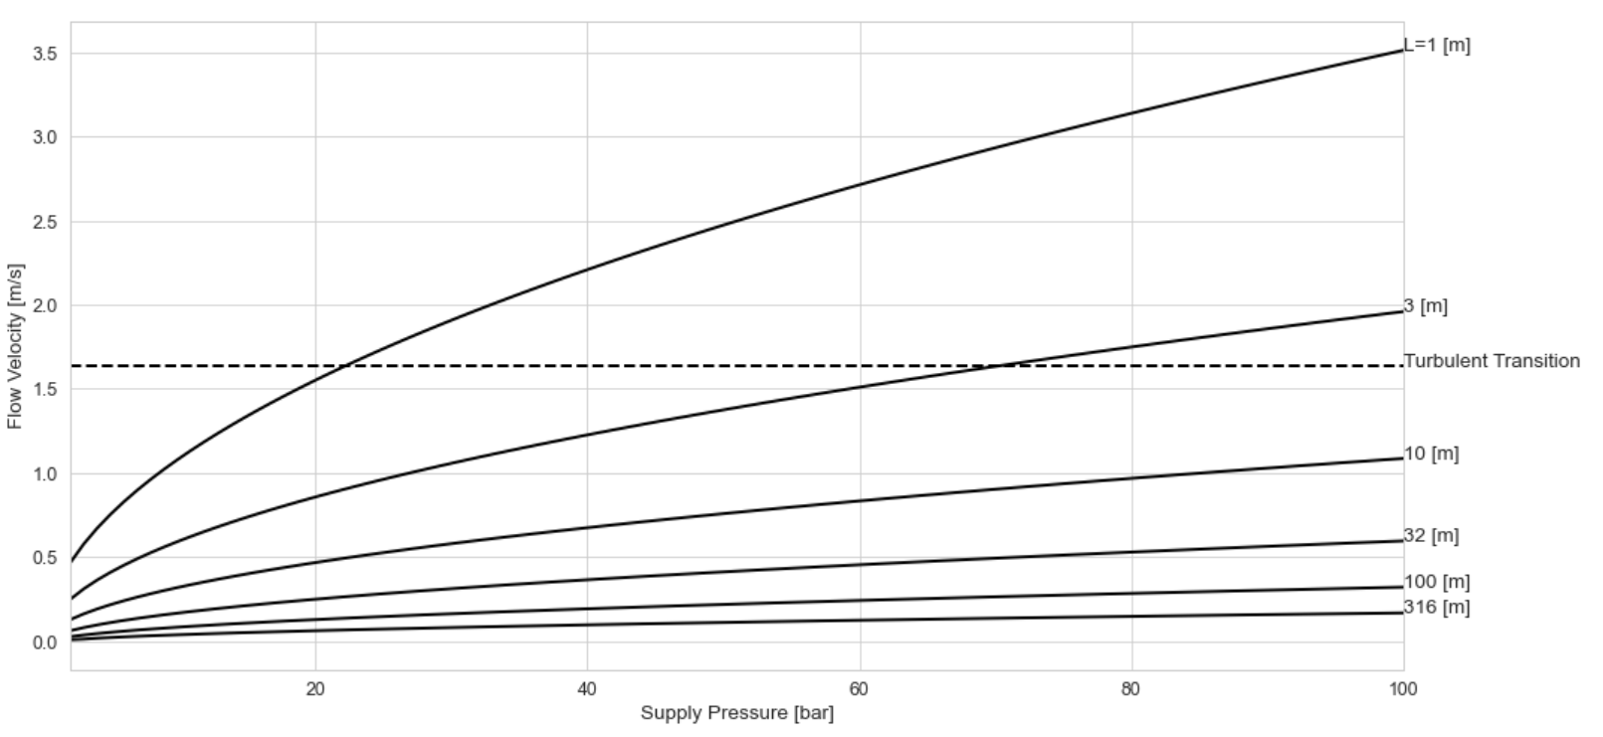
Solder Flow Velocity 3/3

