Slide 1
EECS 448 Project 2
by GitsOutForHarambe

Slide 2
Overview
Additions:
Week view
Multiday event
Timeframes
Recurring events (weekly, biweekly, monthly)
Changed from File I/O to SQL
Fixed dates

Slide 3
Division of Labor
Denis Sehic:
Week View
Front end stuff (add event form)
Jack Stevens:
Event handling
Danny Murga:
SQL stuff
PHP

Slide 4
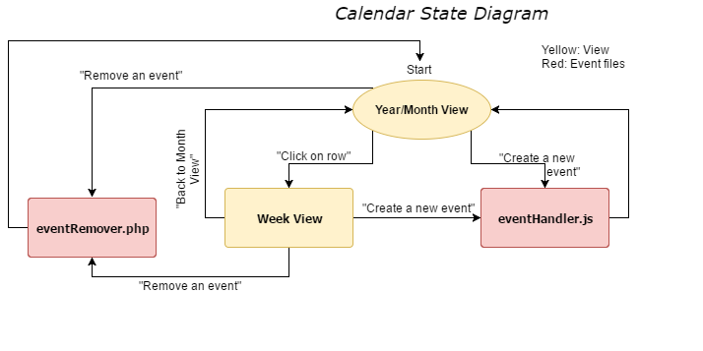

Slide 5
Challenges
Order events by time
Making it so week view doesn’t trigger if you click the buttons
We eventually changed how week view worked
Convert to SQL

Slide 6
Features that didn’t make it
Make it so the ‘Add Event Form’ doesn’t move when you click week view.
All project requirements met.

Slide 7
What could we have done differently?
Provided better documentation
Met more times throughout the week

