Slide 1




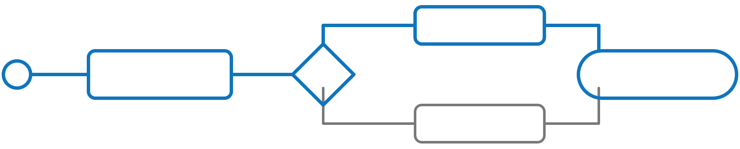
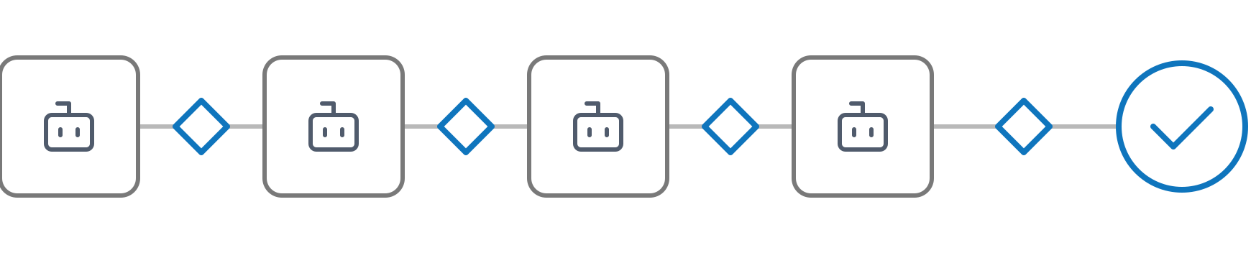

Conversational AI — From Brief to Deployed
// 3 PHASES · 1 SYSTEM · AI-ASSISTED
Methodology and AI-assisted tooling for every phase of a ConvAI project.
01 / SCOPE
BUSINESS
02 / DESIGN
CUSTOMER
03 / BUILD
SYSTEM
IN Client brief
IN Scope & Feasibility Report
IN Conversation Design Package
Which conversations pay off?
What does the customer hear?
What must the system do?
Intent discovery & feasibility
Resolution-based ROI model
7-pillar scoping framework
Verbatim dialogue scripts
Visual conversation flowchart
Variable & entity dictionary
Spec-first multi-agent pipeline
Built on Cognigy.AI
Quality gates at every handoff
OUT
Scope & Feasibility Report
OUT
Conversation Design Package
OUT
Deployed flow + test report + handover docs
Not consulting that improvises — a structured system with AI-assisted delivery at every step.
Notes:
Three phases, one system. The three phases speak three different languages to three different readers. SCOPE is the business view: which conversations pay off, in volume, feasibility and euros, for client management — intent discovery and feasibility, a resolution-based ROI model and the 7-pillar scoping framework, ending in the Scope and Feasibility Report. DESIGN is the customer view: what the customer hears, turn by turn, signed off by client stakeholders on paper — verbatim dialogue scripts, a visual flowchart and a variable and entity dictionary, packaged as the Conversation Design Package. Each phase's output is the next phase's input: the brief goes into Scope, the Scope and Feasibility Report into Design, and the Conversation Design Package into Build. BUILD is the system view: the spec adds what design does not cover (data contracts and sample payloads, error handling per backend call, session state, volume and SLA, generative-AI strategy, the compliance gate), and from that spec a multi-agent pipeline on Cognigy.AI builds, tests and documents the flow, with a quality gate at every handoff, delivering the deployed flow, a test report and handover docs. The point: not improvisation, a structured system with AI-assisted delivery at every step.

