Slide 1
Location Analysis of Gyms in Munich
Finding the best location to open a new gym

Slide 2
Project goal: Locate the best possible location for an upcoming new gym

Slide 3
Data used in the project come from: - Wikipedia - Foursquare

Slide 4
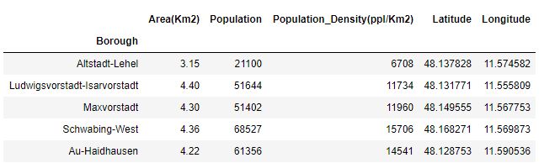
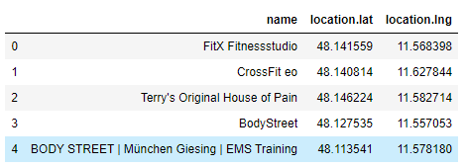
Datasets
Munich Boroughs
Current gyms in the city

Slide 5
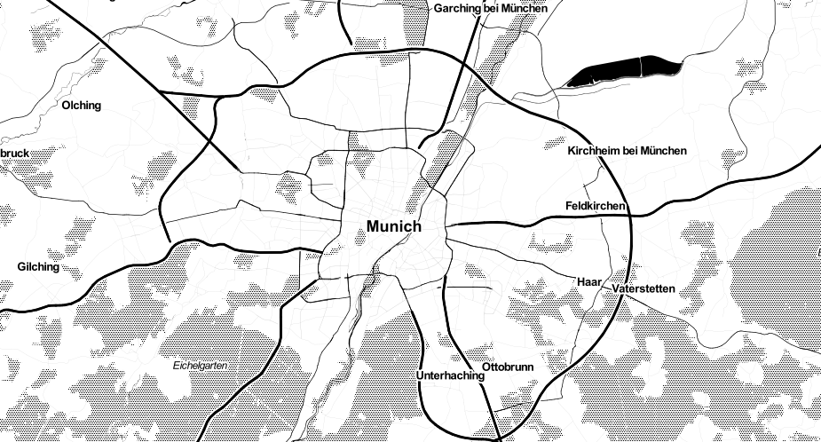
Munich map

Slide 6
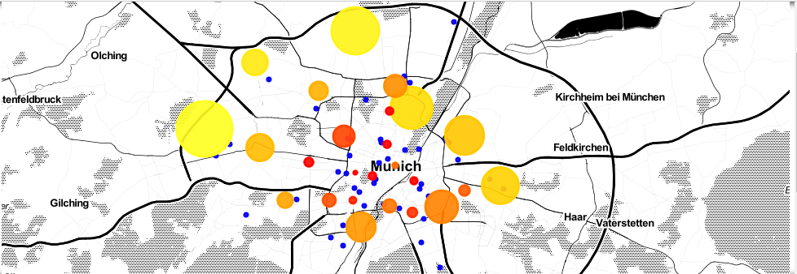
Plotted map

Slide 7
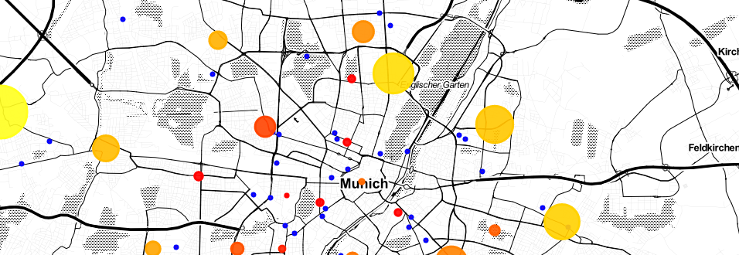
Inspecting the map visually
This area looks empty.

Slide 8
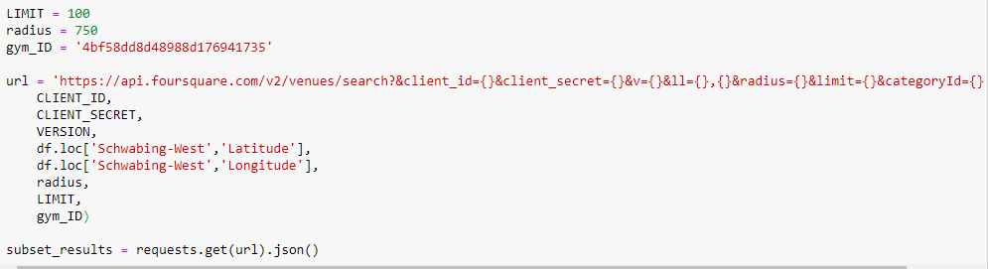
Querying a certain borough for gyms

Slide 9

Empty result set

Slide 10
Conclusion
In the borough "Schwabing-West" there exist an abstract circle with center on the borough coordinates (48.168271 N, 11.569873 E) and radius of 750 meters where are no gyms currently operating.

Slide 11
Thank you!

