Slide 1
Columns in the dataset
Endophyte: the two “treatments” R3E3 and R3E5
Breplicate:biological replicate
Treplicate: technical replicate
Zt_Strain:Zymoseptoria strains
Area_endophyte: the area occupied by the endophyte
Area_inhibition: area without zt growth
Ratio_inhibition: normalized area by the area occupied by the endophyte
Ratio_Scales1: the ratio but in a categorical scale. Breaks every cm.
Ratio_Scales2: the ratio but in a categorical scale breaks every 0.5 cm
Radius_inhibition: Radio halo minus radius endophyte calculated from the perimeter. R3E5 data not really Good.
Percentage_inhibition: percentage of plate occupied by the inhibition área
Melanization: if the Zt strain has melanized (1) or not (0) when in contact with the endophyte (plate compared to a lawn without endophyte)
Remove_astringent: all the data i would remove because the lawns are much les dense
Remove_loose: only those plates where the inhibition area can’t be distinguished well

Slide 2
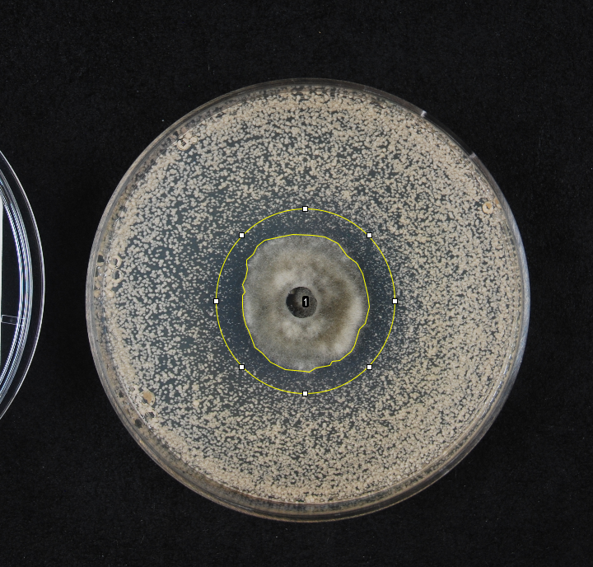
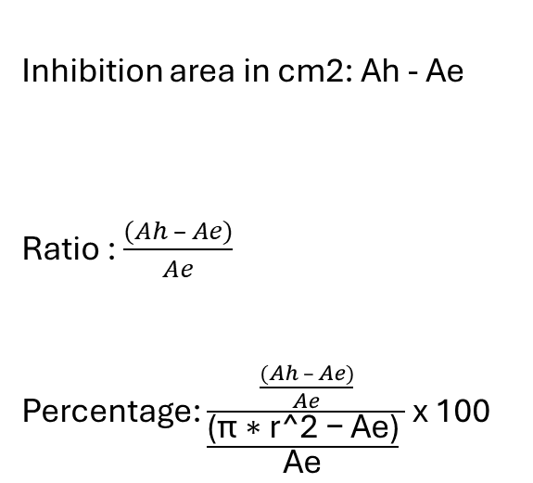
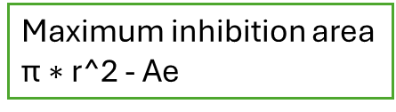
6cm diameter
Inhibition area in cm2: Ah - Ae
Ratio : $\frac{(Ah – Ae)}{Ae}$
Percentage: $\frac{\frac{(Ah – Ae)}{Ae}}{\frac{\text{(}\text{π}\text{ ∗ }\text{r}\text{^2 − }\text{Ae}\text{)}}{\text{Ae}} }$ x 100
Ah
Ae
Maximum inhibition area
$\text{π}\text{ ∗ }\text{r}\text{^2}$ - Ae
D:\Mi unidad\PilarVesga\TED\WP2_Omics\01_PopulationGenomics\01_ImageAnalyses
https://drive.google.com/drive/u/2/folders/1ICLLNMu_WUvEQ_fruv3IjaDK0PYCLP8W

Slide 3
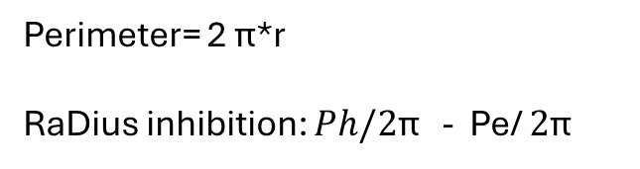
6cm diameter
Perimeter= 2 $\text{π}$*r
RaDius inhibition: $Ph/2\text{π}$ - Pe/ $2\text{π}$
Ph
Pe
Ri
ONLY VALID FOR R3E3 because is approx round
R3E5 has random shape

