Slide 1

464 Data mInIng
07-MOLES
Ege Arca Tunç 202211067
Deniz Arda Çınarer 202211019
İbrahim Ersan Özdemir 202211054

Slide 2
Outline
Missing Values and Wrong Formatted Values
Classification Results , Their ROC Curves and Confusion Matrixs
Selecting Features for Feature Selection
Accuracies Achieved Post-Feature Selection
Feature Engineering and Results with Feature Engineering

Slide 3
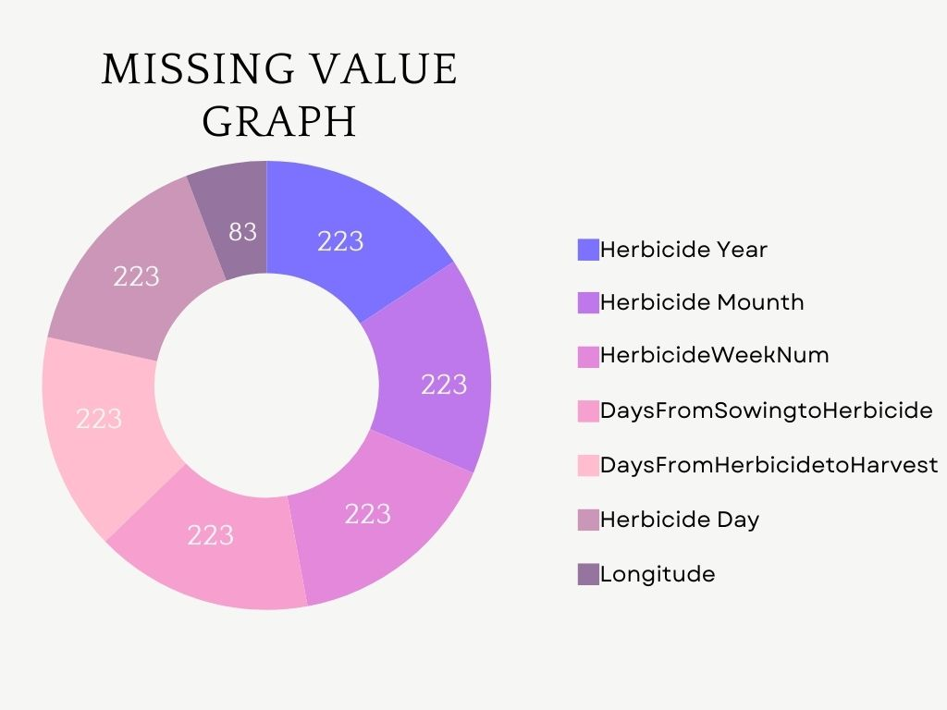

Slide 4
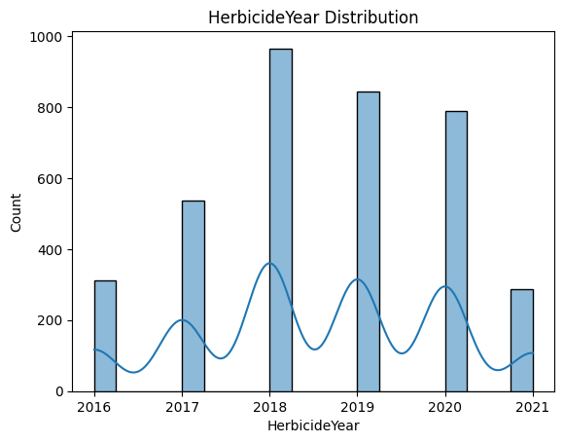
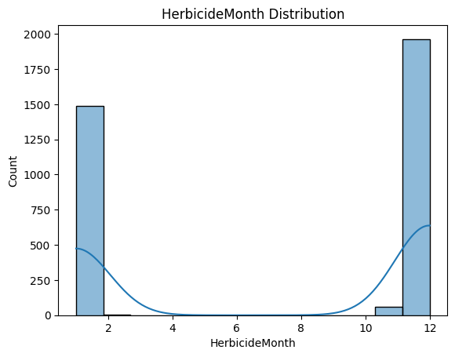
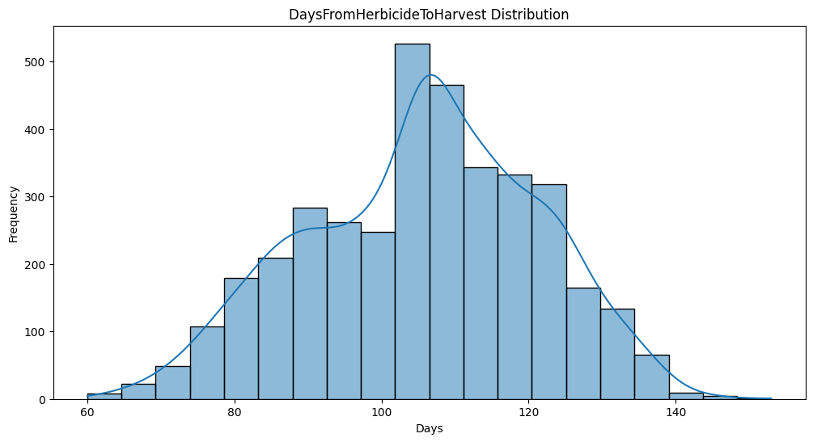
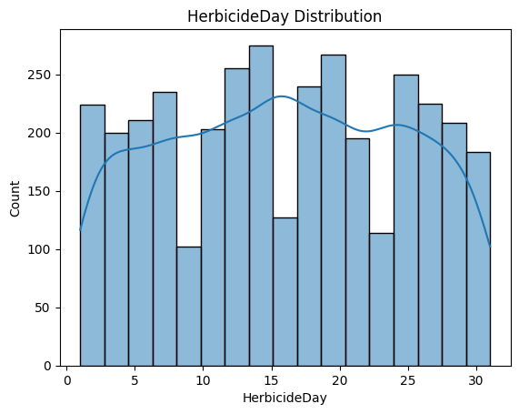
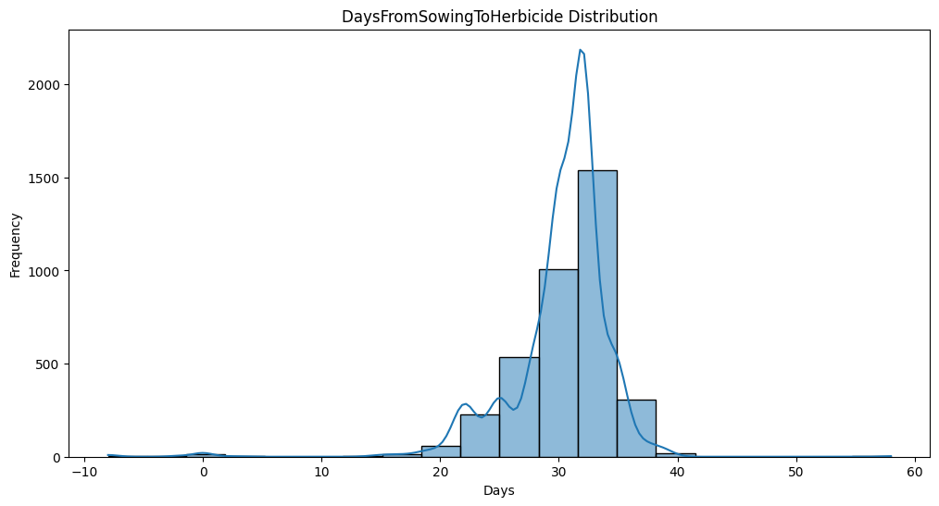
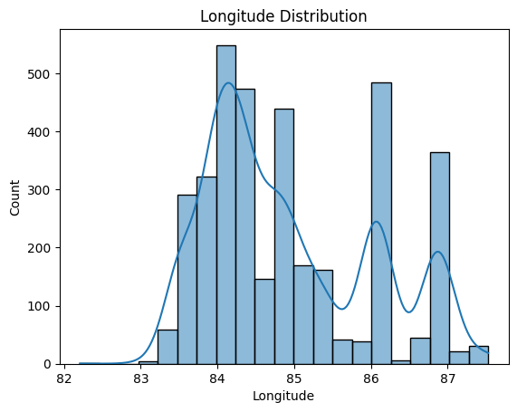

Slide 5
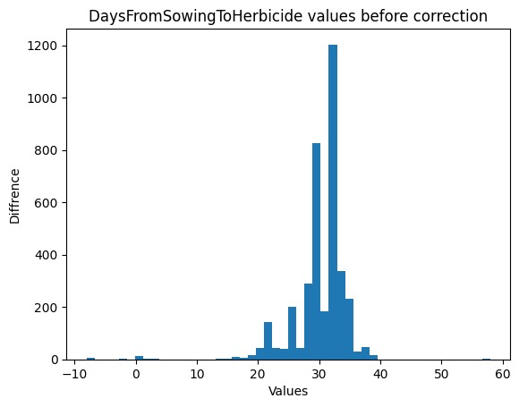
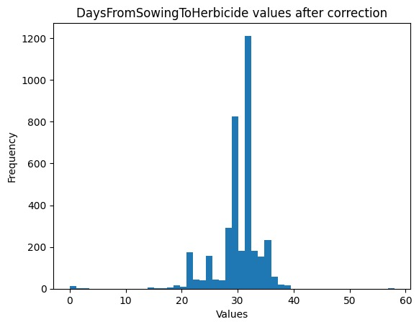
Before and After Adjustments to DaysFromSowingToHerbicide Values

Slide 6
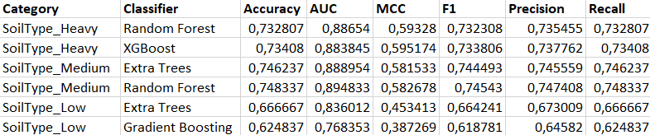
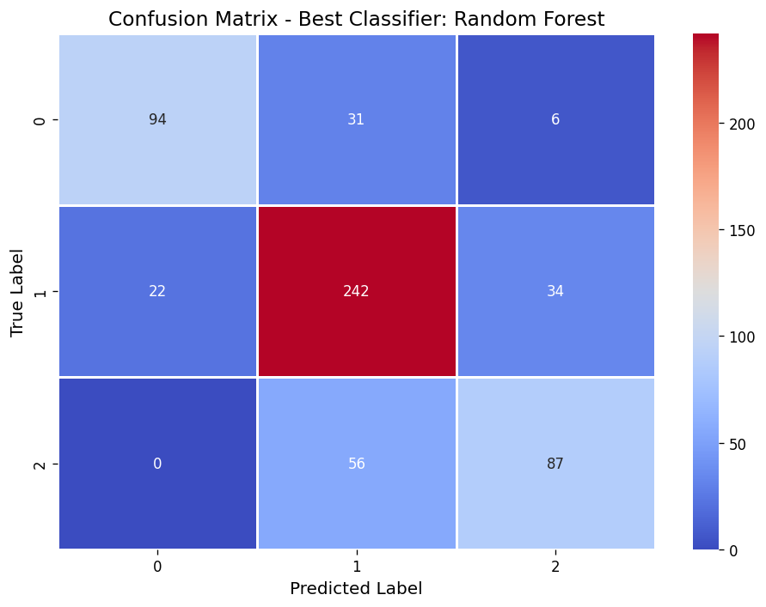
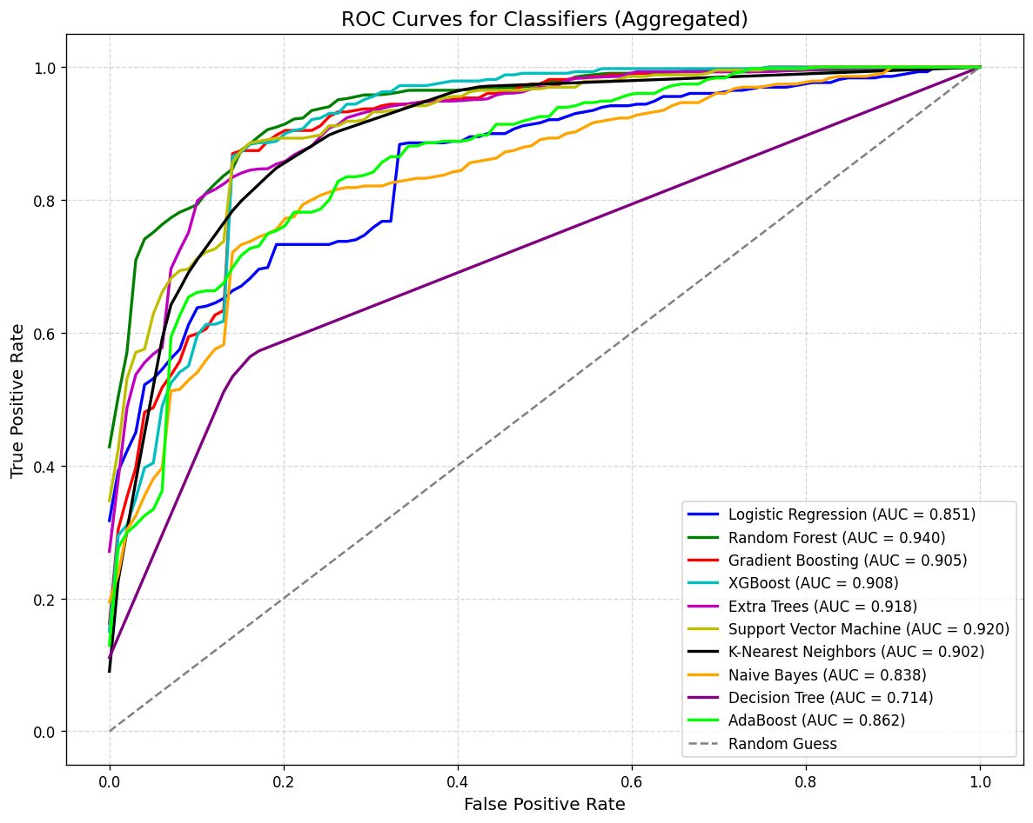
Soil Type Classification
Results

Slide 7
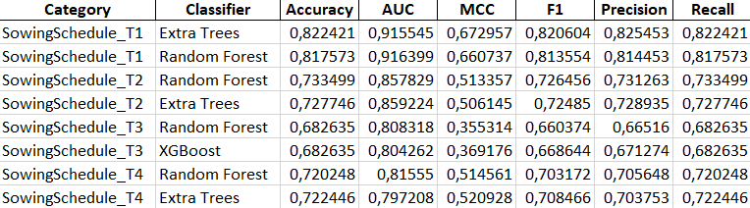
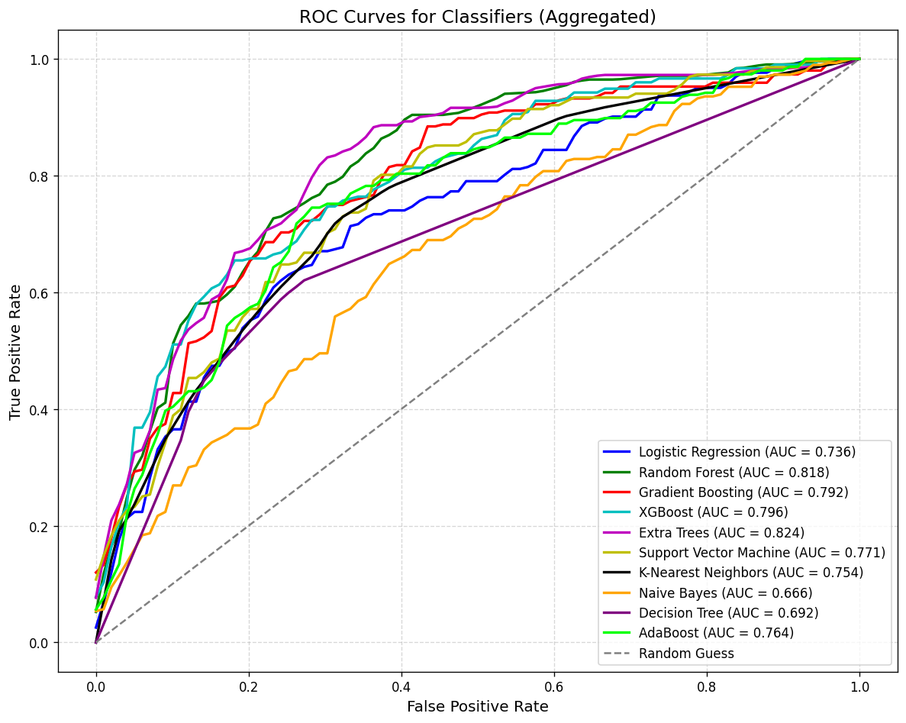
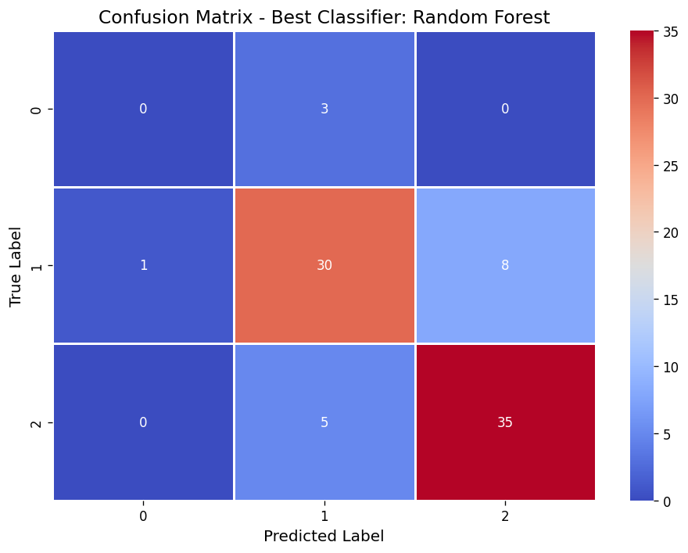
Sowing Schedule Classification
Results

Slide 8
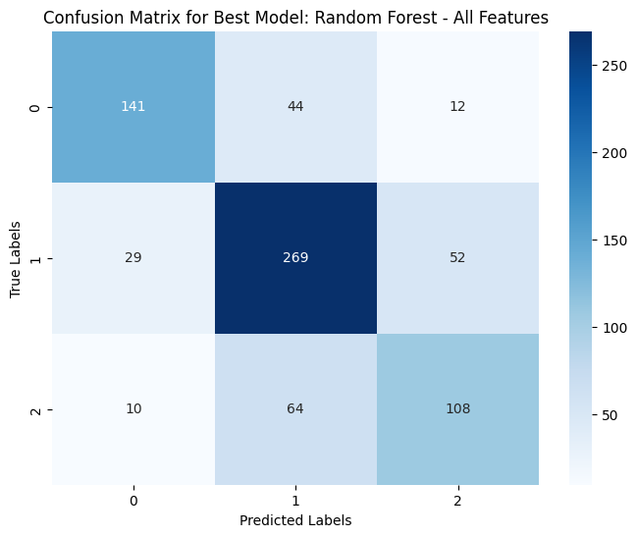
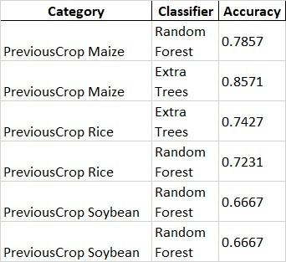
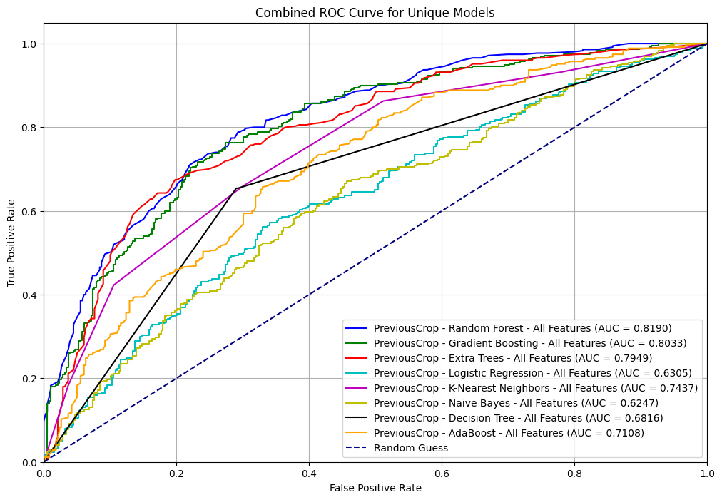
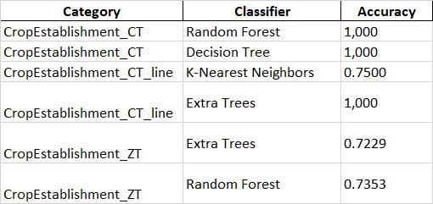
PreviousCrop and CropEstablishment Classification Results & Overfitting

Slide 9
State and LandType Classification Results
9

Slide 10
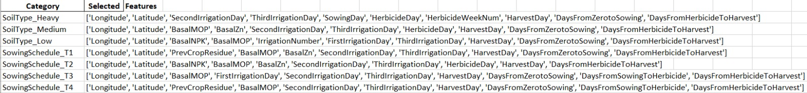
Selected Features for Feature Selection

Slide 11
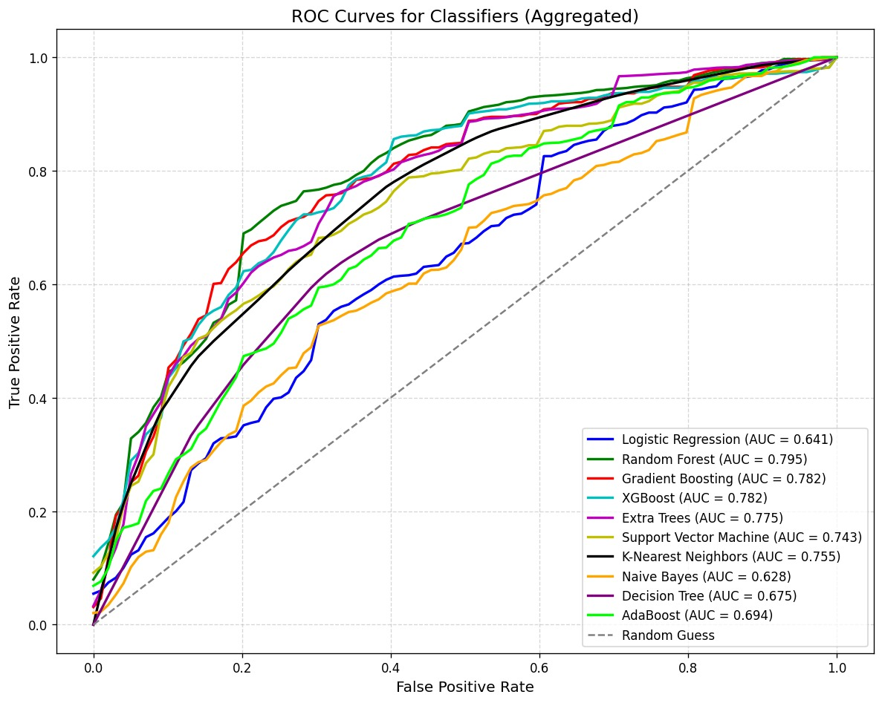
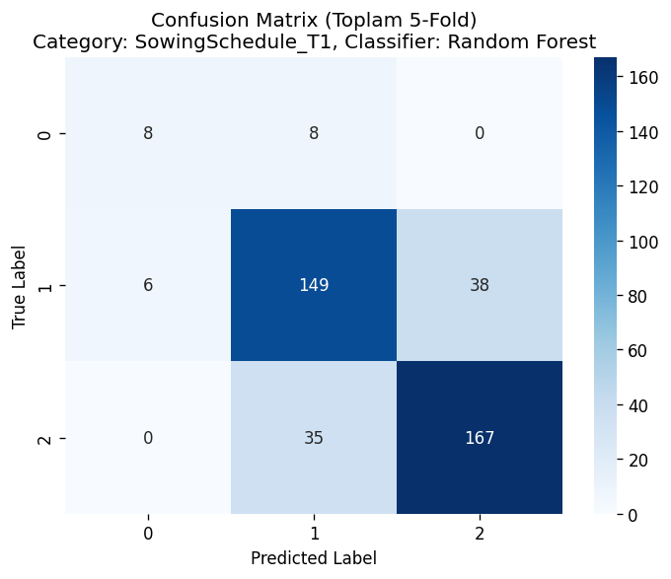
AUC, MCC, F1, Precision, Recall Reports
11

Slide 12
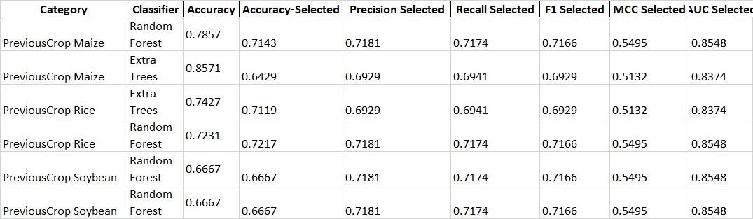
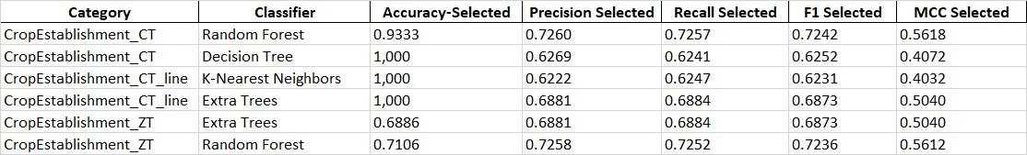
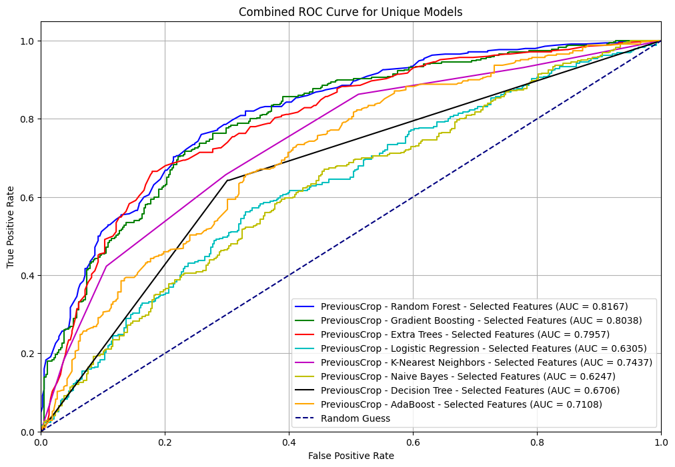

Results After Feature Selection

Slide 13
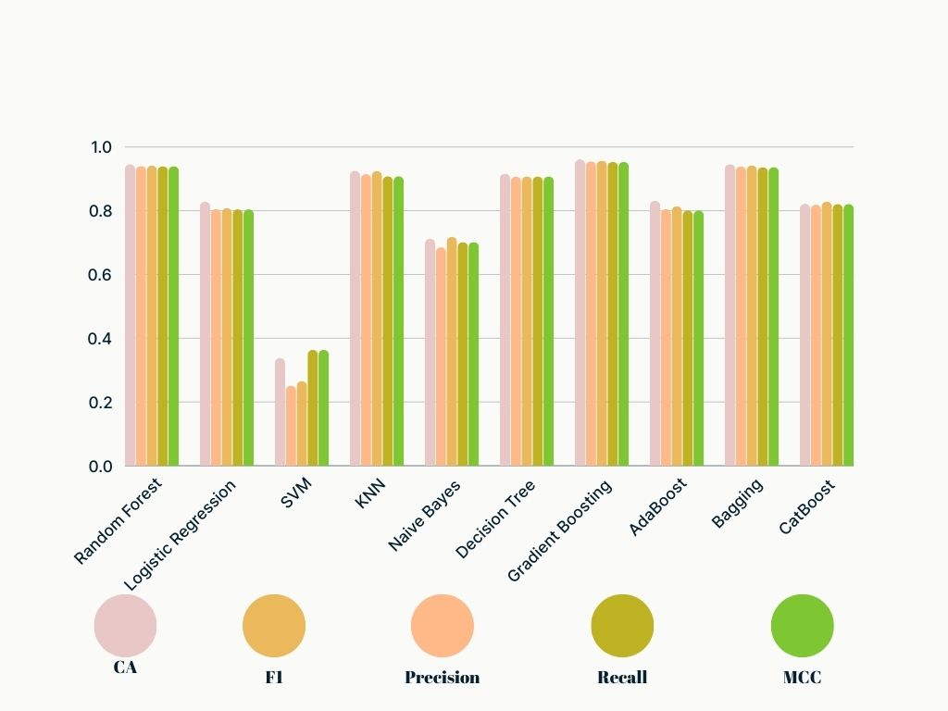
After Feature Selection and Feature Engineering Methods

Slide 14
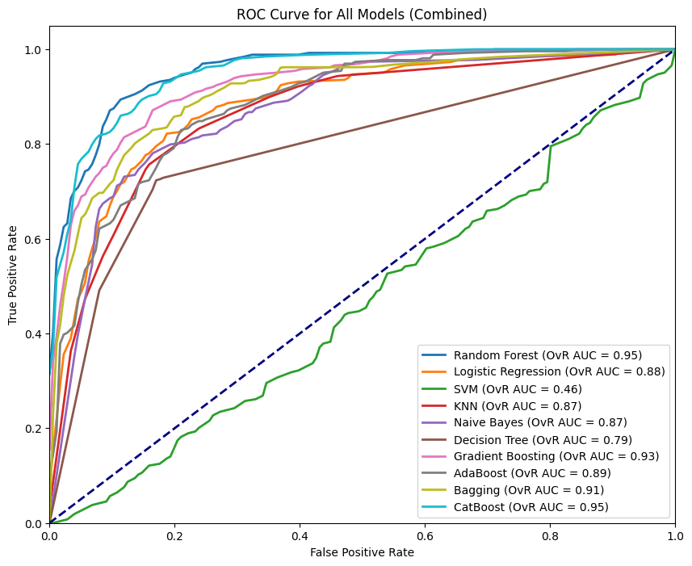
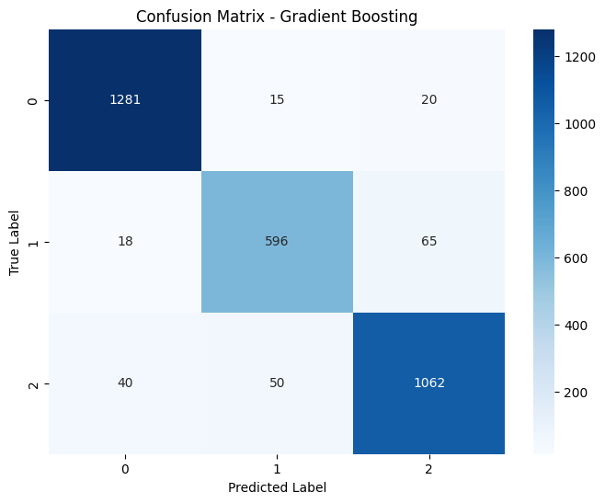
Roc Curve and Confusion Matrix Achieved Post-Feature Selection

Slide 15
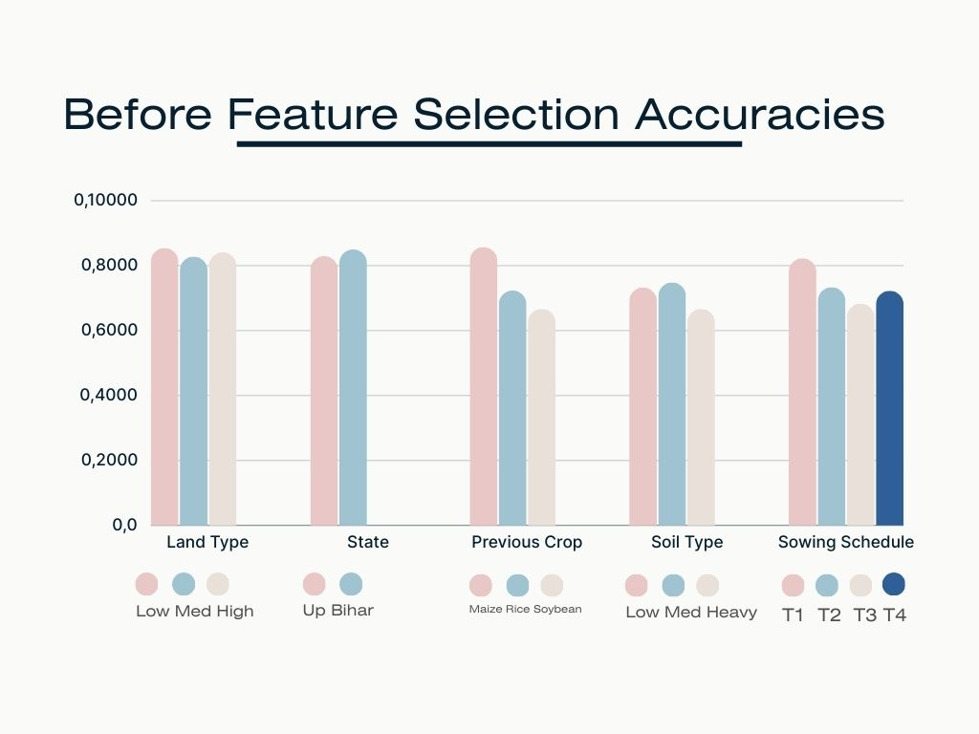

Slide 16
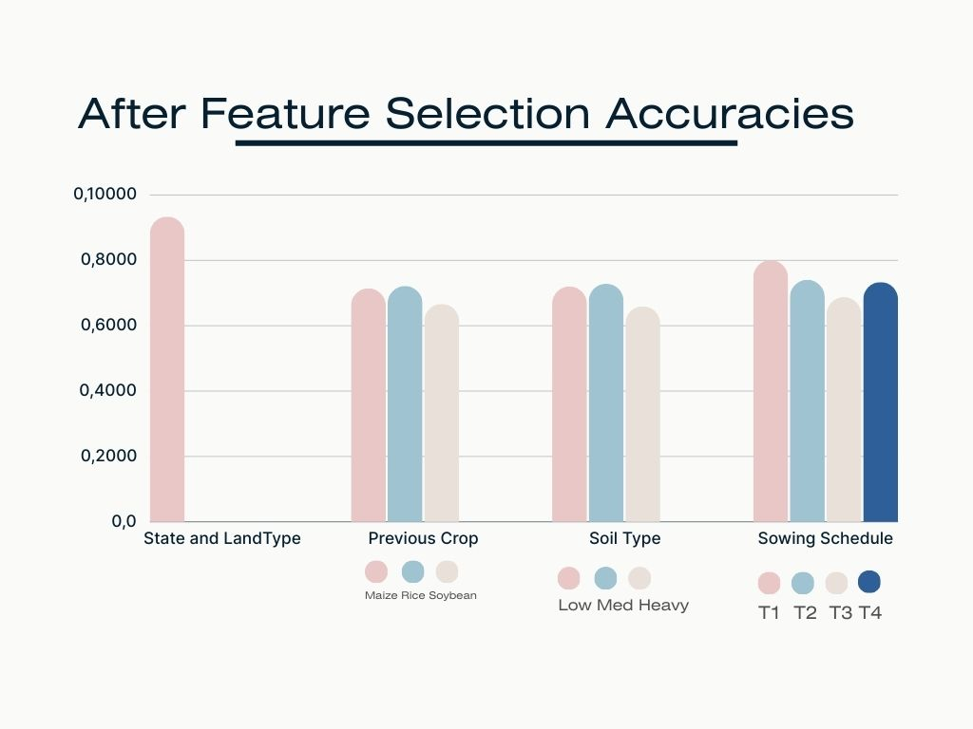

Slide 17
Thank you!!
Gül Tokdemir
Sezer Uğuz

Slide 18

QuestIons?

