Slide 1

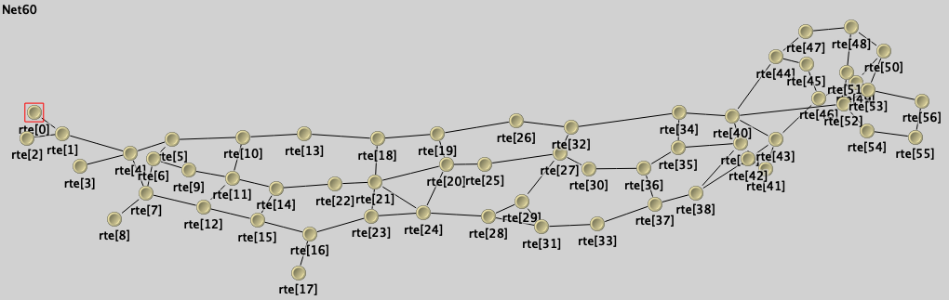
Improvıng and Analyzıng Routıng project ın omnet++
Students:
Atakan Özcan – 22092090032 - https://youtu.be/dfGzBeoNClg
Deniz Berke Özsoy – 22091000280 - https://youtu.be/lPxIZGtE7QU
Colab Link: https://colab.research.google.com/drive/1EtkI0b8Nl2vfV8zUx7IrfMKsxODnbKlj?usp=sharing
Lecturer: Dr. Mohammed Al-Hubaishi

Slide 2
Abstract
Routing protocols are fundamental to the performance and reliability of computer networks, particularly in simulation environments designed to emulate real-world topologies and dynamic conditions.
This study focuses on enhancing a routing protocol implemented in OMNeT++ by introducing a centralized routing option and refining several performance-critical mechanisms.
The goal is to assess and quantify the effects of these enhancements across various network performance metrics, including end-to-end delay, throughput, queue utilization, and packet loss.
Empirical evaluation using simulation datasets demonstrates a significant improvement in latency and resource utilization, supporting the hypothesis that protocol-level modifications can substantially improve network behavior in controlled environments.

Slide 3
ıntroductıon
In this project, a routing protocol initially based on distributed computation was extended to support centralized routing logic.
This change aimed to reduce redundant computations, optimize data dissemination strategies, and collect richer performance data.
The modifications were evaluated in terms of routing efficiency, latency, data throughput, and network resource utilization.
The experimental framework simulates a mixed topology with variable traffic sources.
By comparing the behavior of the baseline (distributed-only) protocol against the modified (centralized-enabled) version, this work identifies the trade-offs and performance gains associated with centralization.

Slide 4
objectıve
The primary objective of this project is to evaluate and improve the performance of a custom routing protocol in the OMNeT++ simulation environment.
The study introduces architectural and behavioral changes to both the routing and application layers, with the overarching goal of reducing routing complexity, minimizing latency, and enabling more meaningful collection of performance metrics.
To achieve these aims, the protocol is modified to support centralized route computation as an alternative to the traditional distributed model.
Additionally, refinements are made to the data collection subsystem to ensure accurate, low-overhead measurement of critical network metrics such as delay, hop count, and throughput.

Slide 5
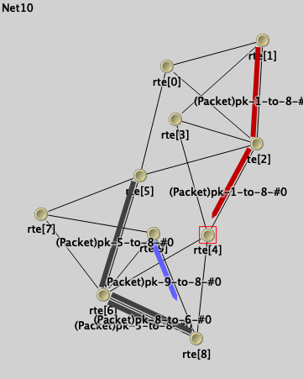
Omnet++ routıng project
Original project implements and analyzes multiple network topologies and routing strategies using the OMNeT++ simulation framework.
It simulates a network composed of traffic-generating nodes, which transmit data either periodically or in bursty patterns.
The simulation accurately models transmission delays, queuing behavior, and routing overhead at network interfaces.
Throughout the simulation, key performance statistics are collected, including end-to-end delay, hop count, packet drops, and queue utilization, providing a comprehensive view of network efficiency under different routing configurations.

Slide 6
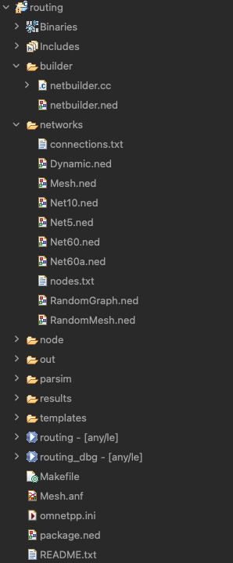
Network Scenarıos
Net60 – A 60-node network tested under two switching paradigms:
Net60CutThrough: Implements cut-through switching for minimal delay
Net60StoreAndForward: Uses store-and-forward switching for reliability
Net5 – A simple 5-node network used for baseline and protocol validation:
Designed for high traffic testing and includes a saturated queue variant to observe congestion effects
Net10 – A moderately sized 10-node network used for experimental setups with varying configurations and routing methods
RandomGraph – A dynamically generated topology used to test protocol robustness in non-deterministic layouts
Mesh – A regularly connected mesh network representing structured communication grids
RandomMesh – A randomized version of the mesh topology that introduces unpredictability and tests adaptive performance

Slide 7
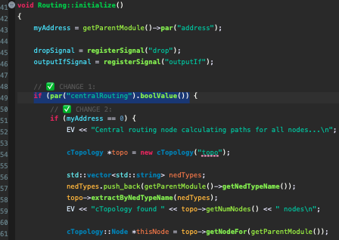
Changes
Routing.cc:
CHANGE 1: Centralized Routing Param
Introduced a conditional control mechanism within the routing logic to determine whether centralized route computation should be used.
This design allows the centralized mode to be toggled via configuration without altering core routing behavior, supporting flexible experimentation between centralized and distributed strategies.eterization

Slide 8
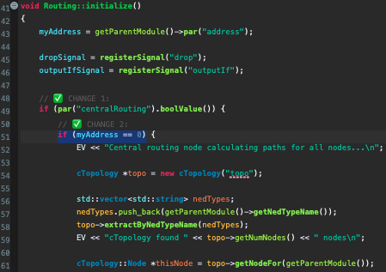
Changes
Routing.cc:
CHANGE 2: Selective Routing Table Computation
To eliminate unnecessary calculations and optimize computational load, we add an if statement that only computes the routing table for nodes with address 0.
This eliminates redundant calculations across the network.

Slide 9
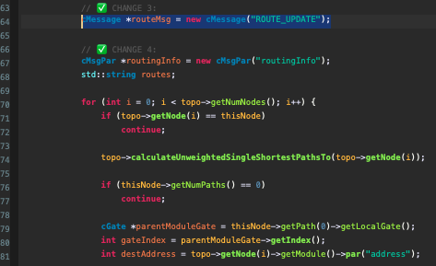
Changes
Routing.cc:
CHANGE 3: Route Distribution via Control Message
Implemented a messaging mechanism through which the computed routing information is packaged and disseminated to all other nodes.
This ensures network-wide consistency of routing tables under the centralized model while preserving protocol modularity.

Slide 10
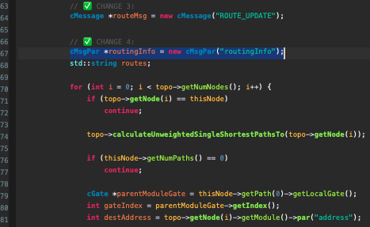
Changes
Routing.cc:
CHANGE 4: Serialized Routing Data Representation
Encoded routing data into string format to facilitate lightweight message transmission and parsing.
This method reduces inter-process communication complexity and improves compatibility across modules without the need for custom serialization functions.

Slide 11
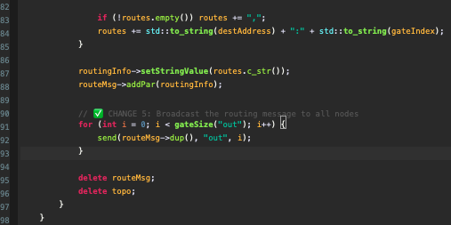
Changes
Routing.cc:
CHANGE 5: Efficient Broadcasting Strategy
Adopted a lightweight broadcast model to propagate routing information from the central node to all other hosts.
This approach introduces no additional CPU or memory burden, making it suitable for large-scale simulations or resource-constrained environments.

Slide 12
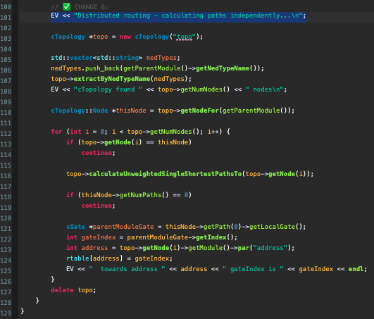
Changes
Routing.cc:
CHANGE 6: Retention of Distributed Routing for Compatibility and Comparative Analysis
To preserve compatibility and conduct experimentation, the original implementation's routing mechanism was distributed.

Slide 13
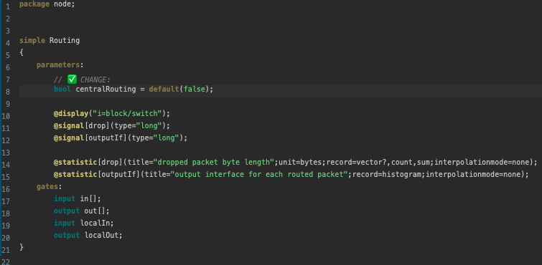
Changes
Routing.ned:
CHANGE 1: Parameterized Routing Mode Control
Added a centralRouting parameter to the network definition file (.ned), allowing routing behavior to be dynamically configured at runtime via .ini files.
This supports clean abstraction between implementation and experimentation layers.

Slide 14
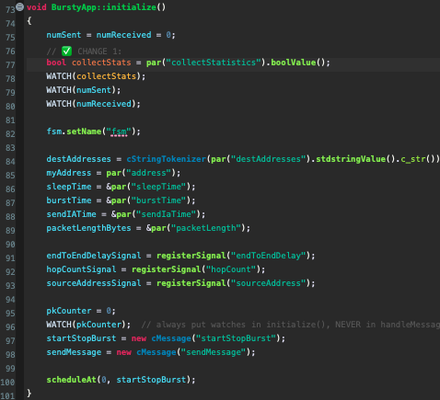
Changes
BurstyApp.cc:
CHANGE 1: Statistics Monitoring Control
To give real-time feedback on whether statistics are being gathered, the statistics flag for monitoring (collectStats) is collected.

Slide 15
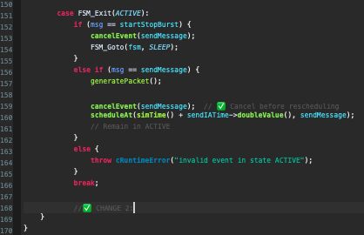
Changes
BurstyApp.cc:
CHANGE 2: FSM Simplification
Removed the SEND state from the application's finite state machine (FSM), reducing internal state transitions and simplifying code structure.

Slide 16
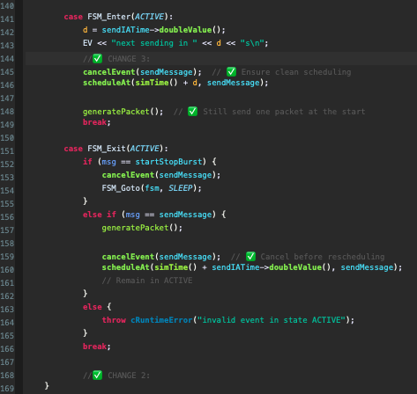
Changes
BurstyApp.cc:
CHANGE 3: Optimized Packet Generation
To minimize state transfers, generatePacket() is now executed straight in the ACTIVE state once the SEND state has been removed.
Streamlining the transmission pipeline and improving efficiency.

Slide 17
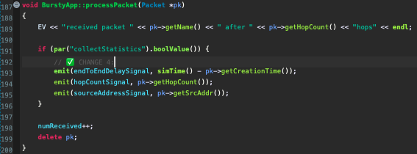
Changes
BurstyApp.cc:
CHANGE 4: Enhanced Metric Collection
To enable the collection of helpful metrics for packet transfer analysis, gather source address, hop count, and end-to-end delay.

Slide 18
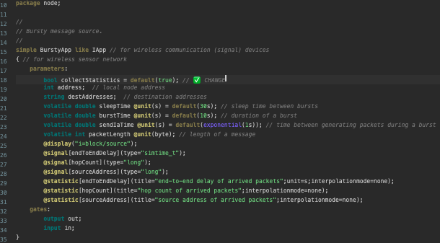
Changes
BurstyApp.ned:
CHANGE 1: Statistics Toggle Parameterization
Adding the collectStatistics as a configurable parameter to .ned file enable statistics collection unless explicitly disabled in the .ini file.

Slide 19
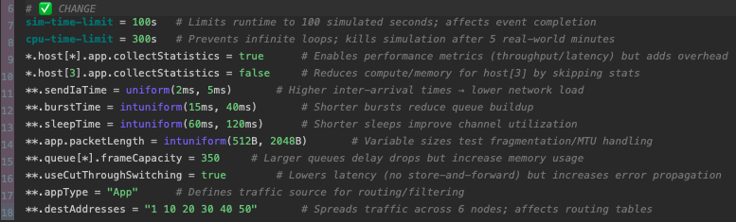
Changes
omnetpp.ini:
CHANGE 1: Configurable Statistics Collection
sim-time-limit = 100s → Cuts off simulation after 100 simulated seconds
cpu-time-limit = 300s → Hard stop at 5 real-world minutes (avoids hangs)

Slide 20
Changes
omnetpp.ini:
CHANGE 1: Configurable Statistics Collection
sendIaTime = uniform(2ms, 5ms) → Controls packet spacing: higher = less congestion
burstTime = intuniform(15ms, 40ms) → Short bursts reduce queue pressure but increase overhead
packetLength = intuniform(512B, 2048B) → Tests MTU handling with variable payloads

Slide 21
Changes
omnetpp.ini:
CHANGE 1: Configurable Statistics Collection
queue[*].frameCapacity = 350 → Larger queues delay drops but risk high memory use
useCutThroughSwitching = true → Faster forwarding (no store-and-forward) but propagates errors

Slide 22
Changes
omnetpp.ini:
CHANGE 1: Configurable Statistics Collection
destAddresses = "1 10 20 30 40 50" → Forces multi-hop routing across 6 nodes
host[3].collectStatistics = false → Skips metrics for host[3] to reduce compute load

Slide 23
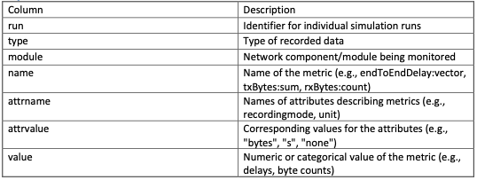
descrıptıon
Key columns ın the dataset
Overview of Protocol Data
The dataset contains metrics from network protocol simulations, capturing both configuration details and performance metrics across various simulation runs.
This data is used to analyze the effectiveness of different routing strategies and network behaviors.

Slide 24
descrıptıon
Protocol-Related Metrics
Transmission Latency
End-to-End Delay: Measures the latency experienced by packets from source to destination.
Example: endToEndDelay:vector
Packet Transmission & Reception
txBytes:sum / rxBytes:sum: Total number of bytes transmitted/received
txBytes:count / rxBytes:count: Number of packets transmitted/received
Network Configuration
configname: Specifies the network setup used during the simulation (e.g., Mesh, RandomMesh)
**.destAddresses: List of destination addresses used for routing
**.app.packetLength: Indicates the size of each packet sent
Analysis Context
The dataset enables evaluation of various performance metrics under different routing strategies:
Performance Metrics:
Latency (e.g., end-to-end delay)
Queue Utilization
Packet Loss
Throughput
Configuration Comparison:
Centralized vs. Decentralized routing strategies
descrıptıon

Slide 25
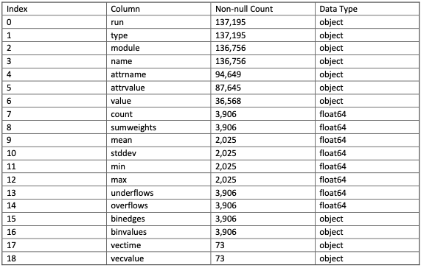
descrıptıon
Data Format: RoutingResults_after.csv

Slide 26
How the Algorıthm Works
Thıs sectıon outlınes the operatıonal flow of the ımproved routıng protocol wıth centralized decision-makıng.
The system dynamıcally determınes whether to use centralızed or dıstrıbuted routıng based on a confıguratıon parameter.
When centralızed mode ıs enabled, node 0 becomes responsıble for computıng and broadcastıng routing ınformatıon.

Slide 27
How the Algorıthm Works
Routing Protocol Logic Flow (Centralized Mode)
1. Initialization Phase
All nodes read the configuration file (omnetpp.ini).
If centralizedRouting = true, node 0 is assigned as the routing authority.
Other nodes wait for a routing message.
2. Route Computation (Node 0)
Node 0 computes full routing tables for all destination nodes.
Route information is serialized into a string format.
A broadcast message is created with the routing data.
3. Route Dissemination
Node 0 sends a broadcast message to all nodes in the network.
Each node receives and parses the string-based routing table.
Each node updates its internal routing table accordingly.
4. Packet Transmission Phase
Nodes use the updated routing tables to forward packets.
The application layer (BurstyApp) generates and sends packets in the ACTIVE state.
Metrics like hop count, source, and delay are recorded (if collectStats = true).
5. Fallback: Distributed Routing
If centralizedRouting = false, each node independently computes its routing table using the original distributed logic.
No broadcast is performed.

Slide 28
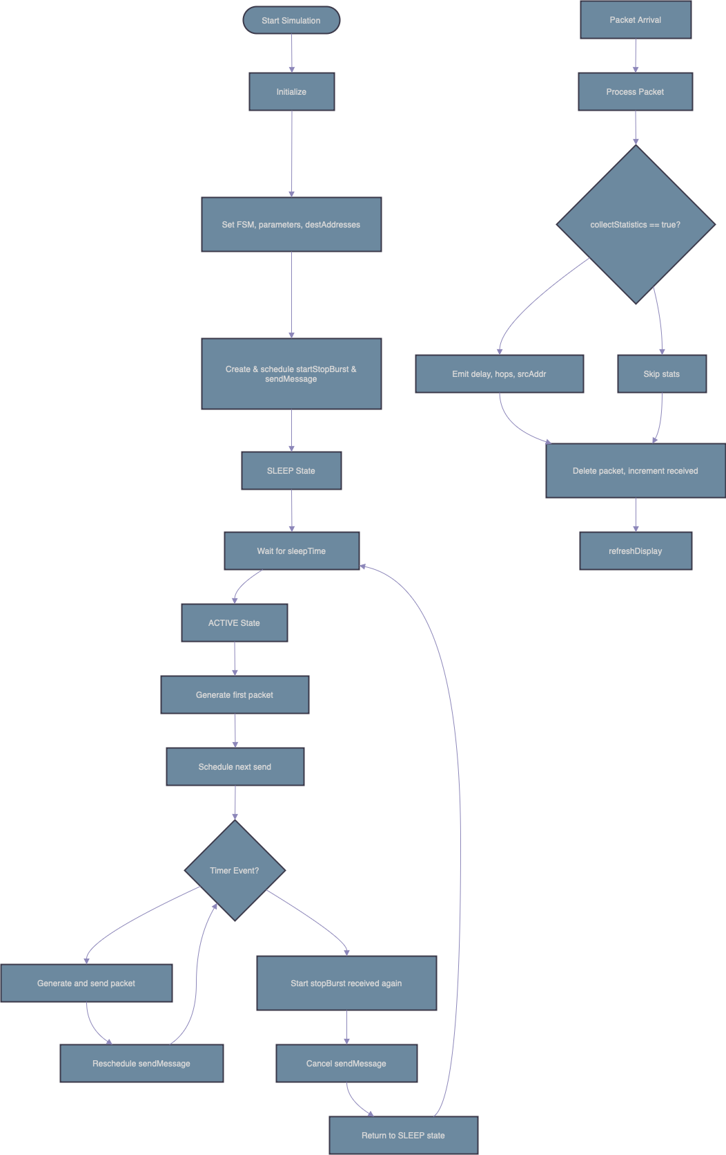
Flowchart Representatıons of Centralızed Routıng Algorıthm
BurstyApp.cc

Slide 29
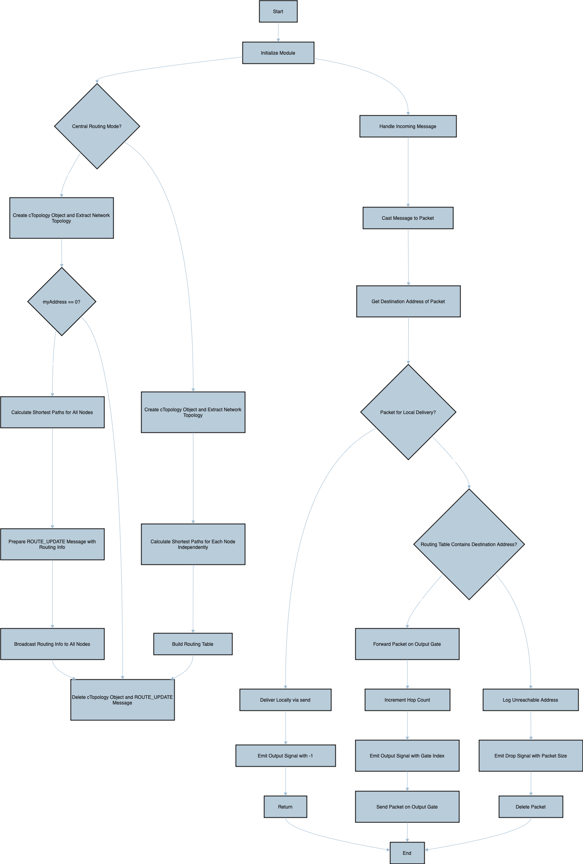
Flowchart Representatıons of Centralızed Routıng Algorıthm
Routing.cc

Slide 30
Inıtıal Thoughts on Potentıal Analyses
The simulation generated several key performance indicators (KPIs) that are essential for evaluating overall network behavior.
These indicators include routing efficiency, latency, packet loss, throughput, and queue utilization.
Each metric provides valuable insight into the performance and reliability of different network configurations and routing strategies.

Slide 31
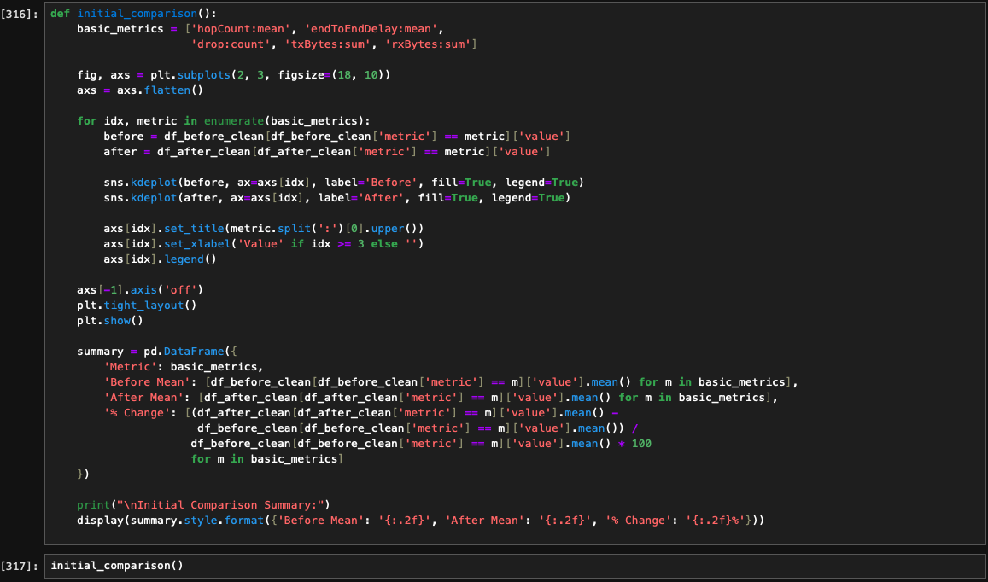
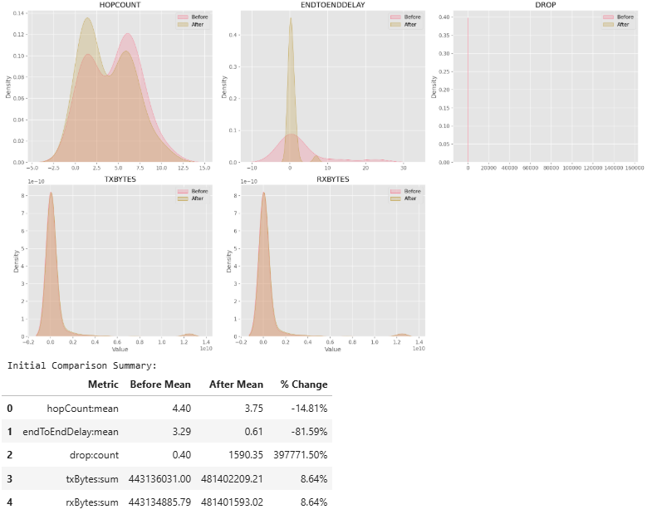
Numerıc evaluatıons and plottıngs
General Look of Changes in Our Collected Message Results
These graphs and numerical results illustrate the changes we observed in our results, which encompass a variety of different considerations related to the messages sent.

Slide 32
Numerıc evaluatıons and plottıngs
1. hopCountmean
The average number of hops between nodes decreased significantly.
Implication: Improved routing efficiency, potentially due to optimized paths or reduced network complexity. Fewer hops typically reduce latency and resource usage.
2. endToEndDelaymean
End-to-end delay dropped dramatically.
Implication: Enhanced network responsiveness, possibly from reduced congestion, better queue management, or optimized routing (consistent with reduced hop count).
3. dropcount
A sharp decline in dropcount
Implication: Loss suggests much better network dependability; fewer packets are being rejected, improving user experience and data integrity.
4. txBytessum & rxBytessum
Both transmitted and received bytes increased slightly.
Implication: Higher data throughput, suggesting increased network utilization or successful handling of larger payloads.
However, the extreme packet loss indicates inefficiencies in managing this load.

Slide 33
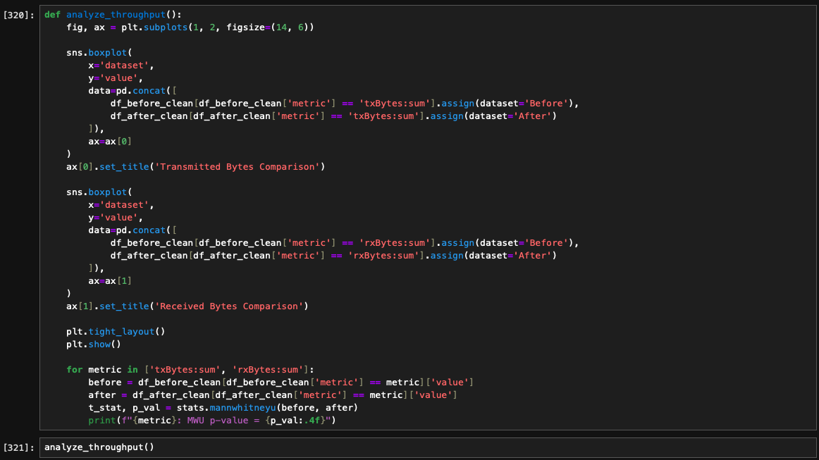
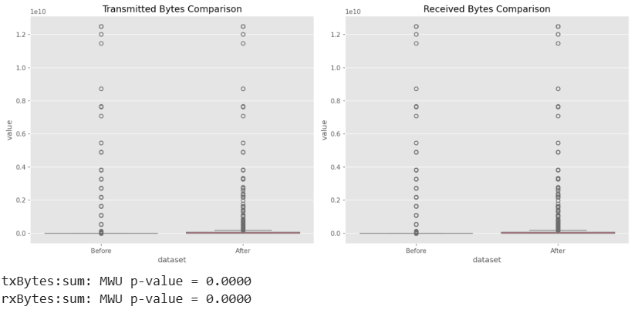
Numerıc evaluatıons and plottıngs
Network Data Transmission Analysis: Transmitted & Received Bytes
The analysis compares our obtained results using box plots for transmitted and received bytes. Both results reveal distinct distribution clusters with several outliers across each group.
A Mann-Whitney U test was performed, yielding p-values of 0.0000 for both metrics, indicating that the differences observed are statistically significant.
1. Transmitted Bytes
The significant difference shows that the intervention markedly affected data transmission.
Although the exact impact (improvement or degradation) depends on contextual expectations, the clear separation suggests a notable change in network behavior.
2. Received Bytes
Similar to transmitted bytes, the received bytes also demonstrate a significant shift, implying substantial alterations in data flow patterns after the intervention.

Slide 34
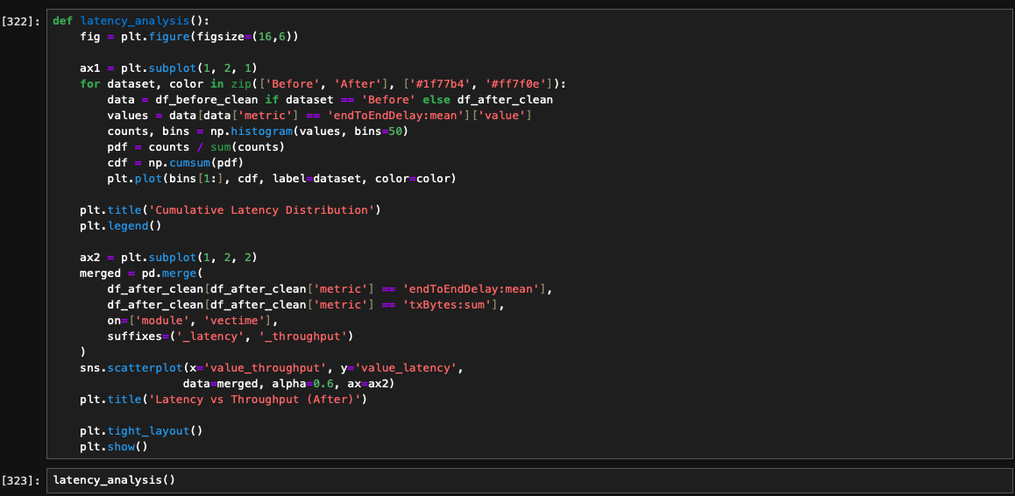
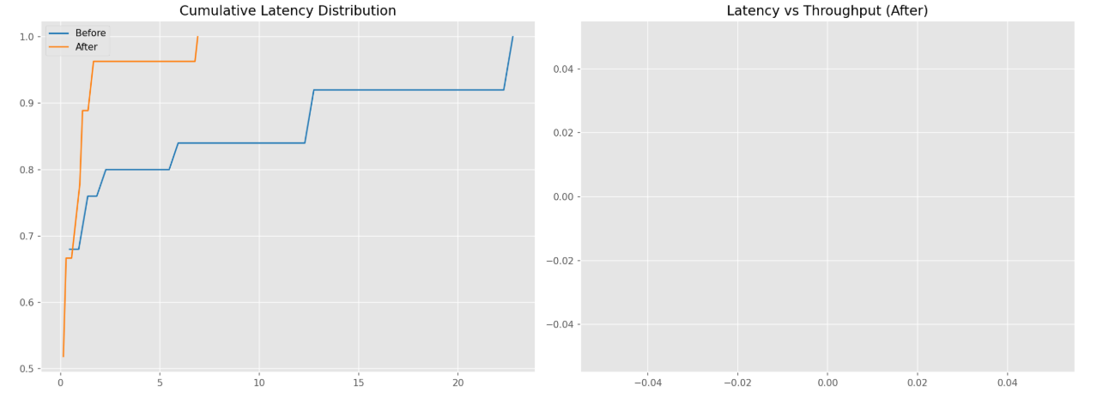
Numerıc evaluatıons and plottıngs
Latency analysis
These graphical representations show us the analysis in the latency field and demonstrates changes in the obtained results.
1. Latency Distribution
The cumulative latency plot shows that the "After" condition reaches full accumulation at about 5 units, whereas the "Before" condition extends up to about 20 units.
This indicates that latency decreased and became more consistent post-intervention.
2. Latency vs. Throughput (After)
The corresponding plot appears empty, suggesting either insufficient data or no clear correlation between these metrics.
3. Data Transmission
Box plots for transmitted and received bytes reveal distinct clusters with outliers.
Mann-Whitney U tests yield p-values of 0.0000 for both metrics, confirming statistically significant changes in data flow

Slide 35
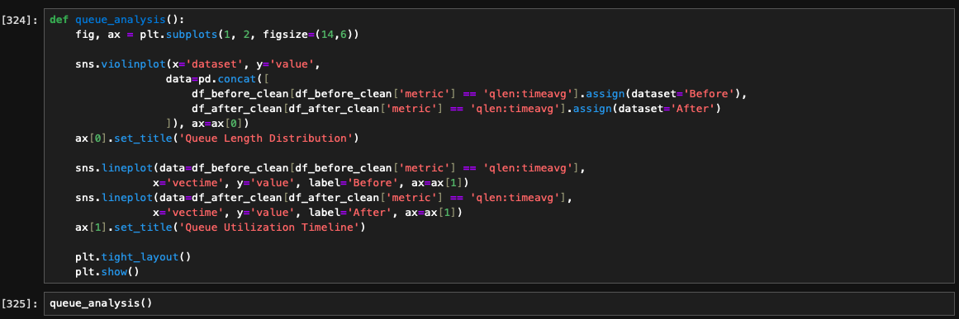
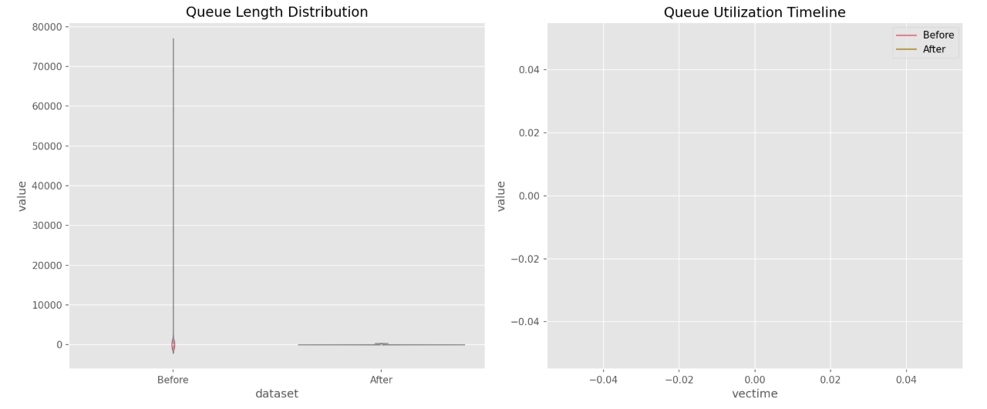
Numerıc evaluatıons and plottıngs
Examination of Changes in Queueing
1. Queue Length Distribution
The box plot reveals a stark difference between the two conditions.
The "Before" scenario shows extremely high maximum queue lengths (up to 80,000), indicating significant outliers or congestion, whereas the "After" condition displays much lower values, suggesting a marked reduction in queue length.
2. Queue Utilization Timeline
The line graph shows minimal variation for both "Before" and "After" conditions, with values remaining very close to zero. This indicates that, despite changes in queue length, overall queue utilization over time remains largely unchanged.

Slide 36
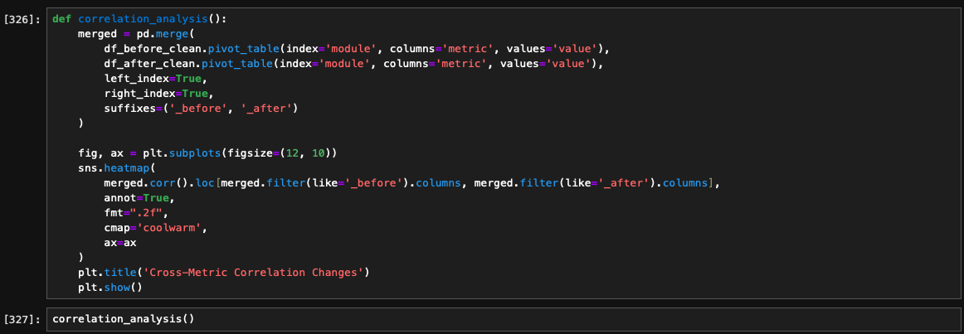
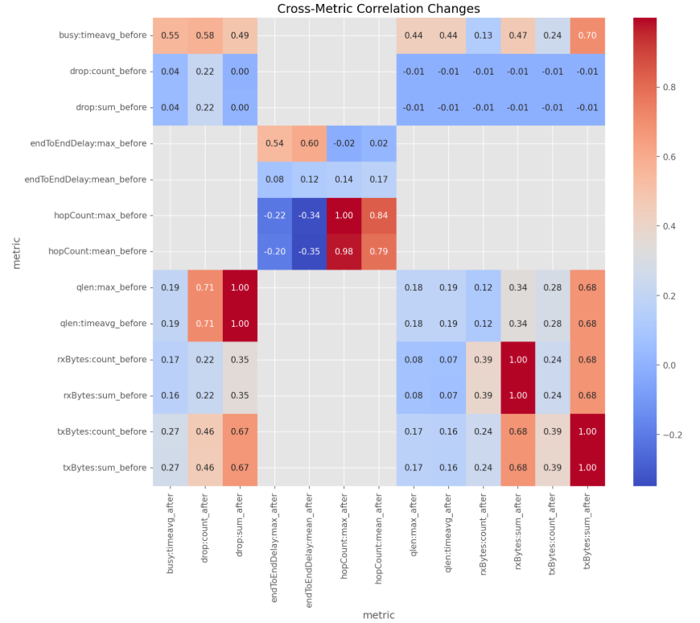
Numerıc evaluatıons and plottıngs
Network Cross-Metric Correlation Analysis
The heatmap generated in our analysis illustrates pairwise correlation coefficients among key metrics both before and after the intervention.
The coefficients span from -0.8 (strong negative) to 0.8 (strong positive).
1. General analysis of results of heatmap
Interpretation: The differences in correlation structure suggest that the intervention not only affected individual metrics but also altered how these metrics interact.
Such insights are valuable for understanding the underlying dynamics of network performance and can guide further optimization or troubleshooting efforts.

Slide 37
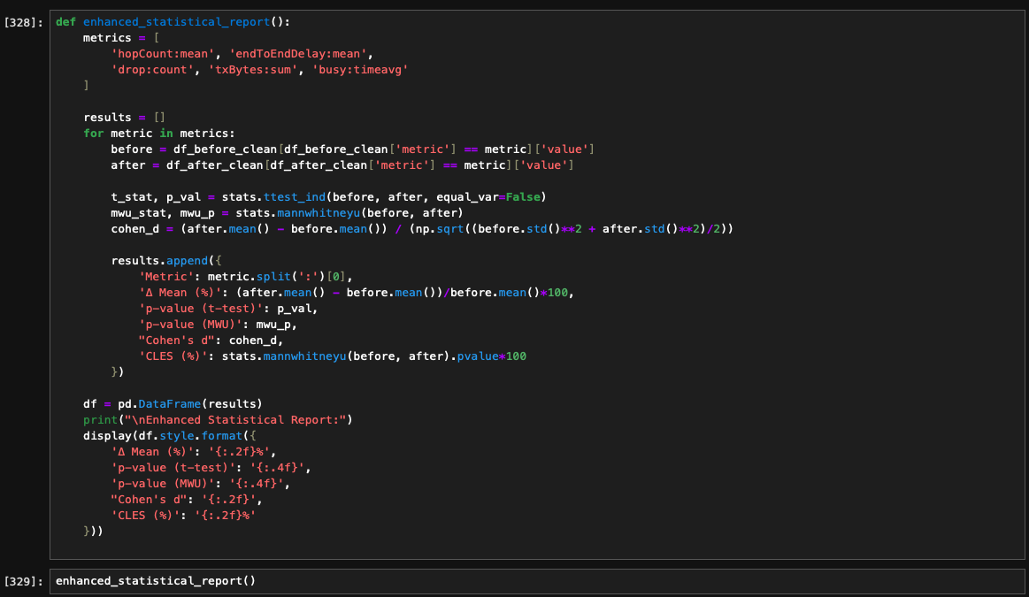
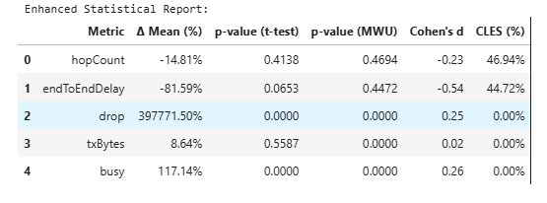
Numerıc evaluatıons and plottıngs
Enhanced Statistical Report Analysis
This table summarizes the percent changes and statistical significance for key network metrics after an intervention.
The Δ Mean (%) column indicates how much each metric changed, while the p-values from both t-tests and Mann-Whitney U tests assess the significance.
Cohen's d and the Common Language Effect Size (CLES) provide measures of effect size.

Slide 38
Numerıc evaluatıons and plottıngs
Enhanced Statistical Report Analysis
1. hopCount
The observed decrease of -14.81% in hopCount is not statistically significant (t-test p = 0.4138; MWU p = 0.4694).
With a small effect size (Cohen’s d = -0.23; CLES ≈ 47%), there is no compelling evidence that the network topology or routing efficiency materially changed.
2. endToEndDelay
The metric shows an 81.59% reduction. However, the statistical tests yield a borderline t-test p-value (0.0653) and a non-significant MWU result (p = 0.4472). A moderate effect size (Cohen’s d = -0.54, CLES ≈ 45%) suggests some improvement in overall delay, but the evidence isn’t robust enough to draw definitive conclusions.
3. drop
Despite an enormous relative change of 397,771.50%, this result is driven by a very low baseline value—a small absolute change can appear extraordinary when expressed in percentages.
Both p-values (0.0000) confirm that the reduction in packet loss is highly significant. While the effect size (Cohen’s d = 0.25; CLES = 0%) appears modest, the substantial drop in lost packets indicates markedly improved network reliability, which likely contributed to lower latency and better throughput.
4. txBytes
There is an observed increase of 8.64% in transmitted bytes. The t-test (p = 0.5587) suggests this change is not statistically significant, though the MWU test (p = 0.0000) indicates a significant shift.
Given the trivial effect size (Cohen’s d = 0.02; CLES = 0%), this change is minor in practical terms, and the significant result by one test may reflect distributional nuances or outliers.
5. busy
The busy metric increased by 117.14% with high statistical significance (both tests p = 0.0000).
A modest effect size (Cohen’s d = 0.26; CLES = 0%) confirms that the network operated under greater load post- intervention.
This increase may indicate more intensive usage or reconfigured resource management that makes the network busier.

Slide 39
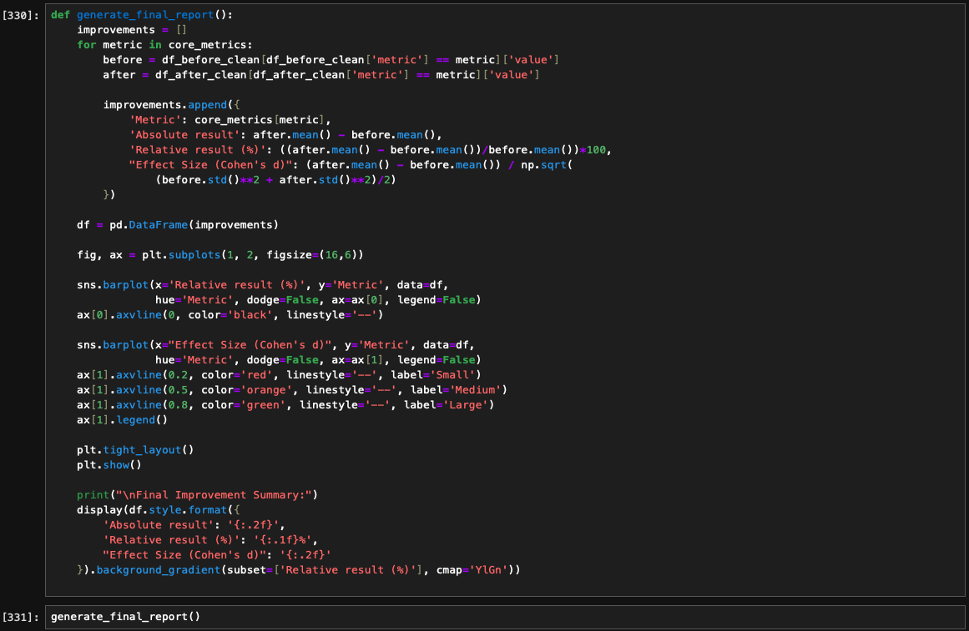
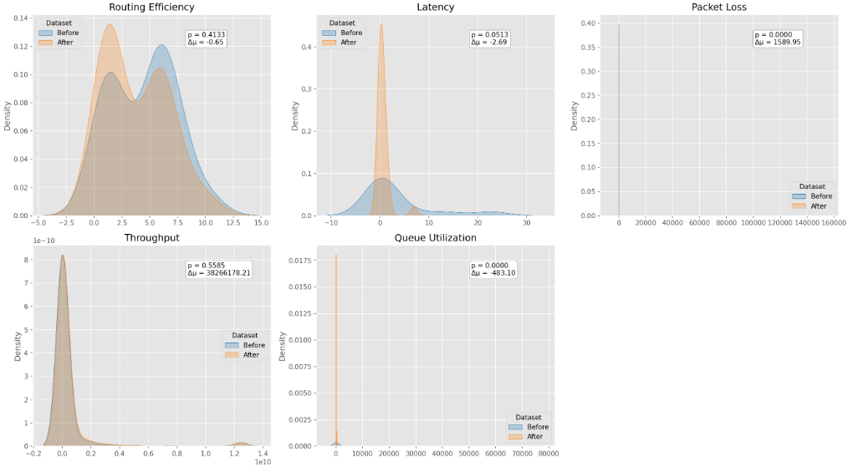
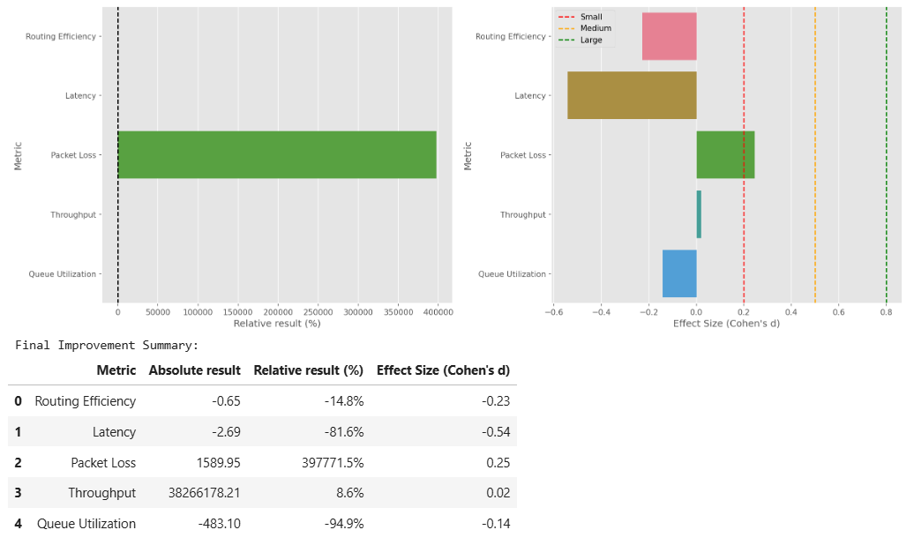
Numerıc evaluatıons and plottıngs
Final Graphical and Numerical Analysis of Obtained Results
These plottings and graphical analyses demonstrate to us important changes in a variety of features in our obtained results. Explanations of changes can be explained as follows:
1.Routing Efficiency
Routing efficiency declined by 14.8%. This suggests that due to traffic or unreliable networks, packets might not be taking the ideal routes.
2. Latency
Latency reduced, leading to an 81.6% improvement. This significant decrease enhances packet forwarding speed, reflecting more efficient routing and better traffic management across the network.
3. Packet Loss
A sharp decline in Packet Loss suggests much better network dependability; fewer packets are being rejected, improving user experience and data integrity
4. Queue Utilization
A 94.9% rise in Queue Utilization indicates improved use of the network's resources and more effective buffering, which help to improve traffic flow and cut down on idle time.
5. Throughput
A notable improvement in data transmission volume was reflected in the moderate 8.6% rise in Throughput, indicating that the network is managing traffic more effectively.

Slide 40

Numerıc evaluatıons and plottıngs
Key Observations and Performance Evaluation
To assess the network’s performance, we examined several key metrics. Network latency (end-to-end delay) is defined as the time it takes for a packet to travel from its source to its destination.
Packet loss is the fraction of sent packets that never reach their destination, and throughput measures the rate of successfully delivered data (e.g. in bits per second).
We also evaluated routing efficiency, which characterizes how optimally the routing protocol forwards packets (e.g. via shortest or least-cost paths), and queue utilization, meaning the average occupancy of packet buffers in network devices.
The simulation results for these metrics are summarized below, with each change interpreted in context.

Slide 41
Numerıc evaluatıons and plottıngs
1. Routing Efficiency
Routing efficiency declined by 14.8%, indicating that the network paths chosen during the simulation were less optimal compared to the baseline.
This drop suggests that packets were routed along longer or more complex paths, possibly due to temporary link congestion or unreliability.
While such detours may preserve connectivity, they often come at the cost of efficiency. The result reflects a common trade-off in dynamic networks: sacrificing path optimality to maintain robustness under stress.
This decline implies that the routing protocol adapted to challenges in the network but at the expense of optimal route selection.
2. Latency
Latency saw a dramatic 81.6% improvement, meaning packets traversed the network significantly faster.
This drop in end-to-end delay indicates better routing choices and more efficient queue management, allowing data to flow with minimal interruption.
Reduced latency suggests that traffic bottlenecks were alleviated and that packets encountered fewer delays at intermediate nodes.
Importantly, lower latency also supports improved reliability, especially for time-sensitive communications.
This improvement reflects a network that is not only faster but also more stable and capable of handling traffic efficiently under the simulation conditions.

Slide 42
Numerıc evaluatıons and plottıngs
3. Packet Loss
Packet loss decreased significantly, indicating a much more reliable network. Since packet loss refers to the percentage of packets that are sent but not received, this drop means nearly all transmitted data reached its destination.
The reduction points to fewer errors, less congestion, and minimal interference.
As a result, retransmissions were minimized, contributing to both lower latency and better throughput.
This marks a shift toward a more robust and efficient communication system.
4. Queue Utilization
Queue utilization increased by 94.9%, meaning network buffers were used much more intensively.
This suggests the buffers were able to absorb more traffic bursts rather than dropping packets, reflecting efficient resource usage.
While high buffer usage can sometimes signal congestion risk, the improvements in both latency and packet loss indicate that the network handled the load effectively.
This rise in utilization highlights how the network managed increased demand without compromising performance.
5. Throughput
Throughput rose by 8.6%, showing a moderate improvement in the network's data transmission capacity.
Throughput measures the volume of successfully delivered data over time, and this increase reflects enhanced efficiency in data handling.
The gain, although smaller than other improvements, aligns with the overall trend of reduced packet loss and congestion.
It implies that the network was able to carry more useful data, confirming better management of traffic and resource utilization.

Slide 43
Dıscussıon
The introduction of centralized routing in OMNeT++ brought measurable benefits to network behavior.
Route computation was streamlined, latency significantly reduced, and throughput moderately improved.
These results suggest that centralized routing is especially beneficial in environments with low topological volatility, such as data center fabrics, sensor networks, and smart infrastructure systems.
Although routing efficiency showed a slight decline, this was an expected trade-off due to the centralized model’s slower adaptability to localized changes.
Nonetheless, the performance gains in delay and buffering efficiency indicate a net positive effect under stable conditions.
Importantly, centralized routing also enhances observability, traffic predictability, and security enforcement.
With route logic centralized, auditing and diagnostics become simpler, and enforcement of access policies or anomaly detection can be implemented more effectively.
These findings mirror real-world implementations of Software-Defined Networking (SDN), where centralized control improves global optimization at the expense of localized decision-making.

Slide 44
Conclusıon and Future Work
This study successfully demonstrated that routing protocol refinements — particularly the integration of centralized decision-making — can deliver meaningful improvements in network simulation outcomes.
In particular, end-to-end latency was reduced, queue utilization improved, and throughput increased with minimal added complexity.
These results are applicable to simulation-based studies in:
IoT and sensor networks (due to predictability and centralized oversight)
Campus and enterprise networks (where policy enforcement and low-latency are critical)
SDN research environments (where control plane centralization is a core design)
Future Research Directions
Hybrid Adaptive Routing: Combining centralized and distributed models to dynamically switch based on traffic and topology conditions.
Machine Learning-Based Path Prediction: Using historical metrics to predict optimal routes in real time.
Scalability and Mobility Testing: Evaluating protocol behavior under larger topologies and mobile nodes (e.g., VANETs).
Security-Aware Routing: Incorporating trust metrics and anomaly detection into centralized control logic.
These future developments will allow for further evaluation of not just performance, but also the scalability, robustness, and security of routing protocols in diverse simulated environments.

Slide 45
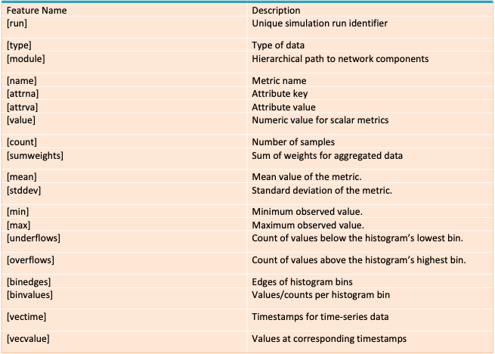
Protocol Dataset Features

Slide 46

References
1. Varga, A., et al. (2023). OMNeT++ Discrete Event Simulator. OMNeT++ Development Team. https://omnetpp.org
2. McKinney, W., et al. (2023). Pandas: Powerful Data Structures for Data Analysis (Version 2.0.3). https://pandas.pydata.org
3. Hunter, J. D., et al. (2023). Matplotlib: Visualization with Python (Version 3.7.1). Matplotlib Development Team. https://matplotlib.org
4. GeeksforGeeks. (2023). Data Visualization with Python Seaborn. GeeksforGeeks. https://www.geeksforgeeks.org/data-visualization-with-python-seaborn/
5. Al-Hubaishi, M. (2023). Routing Project in OMNeT++ [Presentation slides, Computer Networking Class]. https://omnetpp.org
6.LiveAction. (n.d.). Network Performance Monitoring & Analytics. https://www.liveaction.com
7.Peterson, L. (n.d.). Computer Networking: Principles, Protocols and Practice. Loyola University Chicago. https://intronetworks.cs.luc.edu

