Slide 1
Convolution
Berkin Deniz Kahya
No idea what else to write here ^^

Slide 2
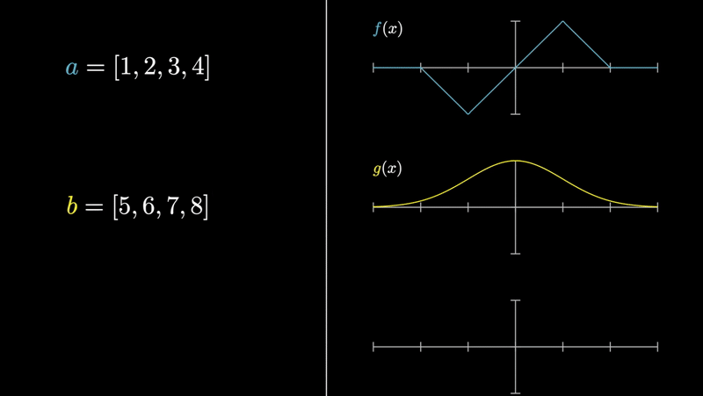
Combining two signals

Slide 3
We use them in…
Image processing
Solving differential equations
Probability theory
you can also multiply polynomials :p

Slide 4


Definition
Could be a bit overwhelming

Slide 5
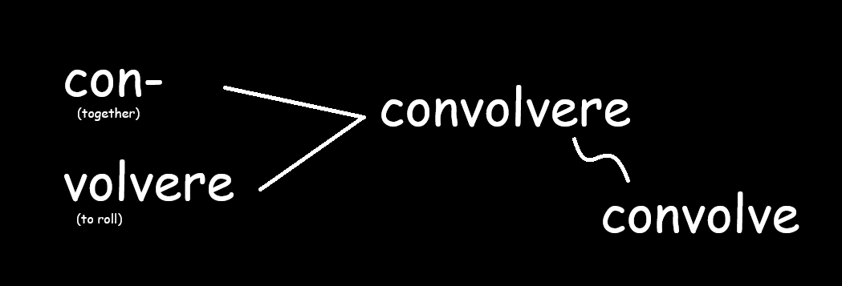
Etymology?

Slide 6
Probabilistic Approach

Slide 7
Title
text

Slide 8
Title
text

