Slide 1


C++ Foundation
Monday 14 July 2025

Slide 2
0. Introduction

Slide 3
About me
1998 – 2003: Bachelor Engineering, Electronics at Rotterdam
2003 – 2005: Coolblue, web developer.
2005 – 2010: Software eng. at Logica, Prorail, Prodrive, Dutch Railways
2010 – 2014: Software eng. TomTom
2014 – 2019: Software eng. Mapscape TomTom
2019 – 2021: Software eng. ASML
2022 – 2024: Software eng. K&S
2024 – … : Software eng. Thermofisher

Slide 4

About me
Drives motorcycles
Gaming @ home
Programming @ home

Slide 5

Please introduce yourself
Who are you?
Background
Experience
What do you want to learn

Slide 6
Expectations
Interactive, ask questions, start discussions
Notes:
Rules and Guidelines:
Interactive, room for questions and discussion
Improvised topics are possible
No single C++ expert knows everything about all parts of the standard (including me)
No long drawn out performance debates
Gradually go through slides and allow for debates, questions as we go (improvise examples on the spot)
Lots and lots of small topics, difficult to organize (tsort)

Slide 7
Plan for today:
10:30 Coffee break
12:00 Lunch
14:30 Coffee break & snack
17:00 End of the training day

Slide 8
Plan for today:
Overview
Functions
Data
Introduction to containers

Slide 9
1. Overview

Slide 10

Overview
Bjarne Stroustrup
What is C++?
C++ is a multi-paradigm compiled language that evolved from C in 1979-2014 (2017)

Slide 11
Overview
C++ is a compiled language.
It is completely translated to machine instructions before the program is executed. (not: Java, C#)
C++ code
compiler
object file
linker
executable
C++ code
compiler
object file
dynamic
library

Slide 12
Overview
C++ is statically typed.
Variables must be declared before they are used
Their type can never change
(not: Python, Ruby)

Slide 13
Overview
C++ is an intermediate-level language. It has both high-level and low-level features (not: pretty much everything else)
C++ supports object-oriented programming (not: C)
C++ supports generic programming (not: C, slightly less so: Java, C#)

Slide 14
Overview
C++ supports const-correctness (not: Java, C#)
C++ has advanced features that may lead to confusion if used incorrectly (operator overloading, multiple inheritance) (not: Java)
C++ code is notoriously difficult to parse (do not try to write a C++ compiler)

Slide 15
Overview
C++ does generally not provide features that will force your code to be less than optimal (what you don’t use, you don’t pay for)
Therefore, C++ does not provide:
Garbage collection (Java, C#, Python…)
Reflection (Java, C#, Python...)
(more examples will follow during the course)

Slide 16
Overview
C++ is not dominated by a single company, it is steered by the C++ standards committee.
Making changes to C++ is usually a slow process, where backwards compatibility is mostly maintained.
Standard releases are C++98(1998), C++03(2003), C++TR1(2007), C++11(2011), C++14(2014).
It takes a while for compilers to conform to the new standards.

Slide 17
Overview
The language is still evolving
Classic C++
C++ 11
C++ 14
Containers
C++ 17
C++ 20
Major Update
Major update
Minor Update
Minor Update
Lambdas
3-way comparison
Threading
Smart pointers
Filesystem
Historical
Classes
Inheritance
Virtual functions
Overloading
References
Exceptions
Type inference
Variadic templates
Range for
Scoped enum
nullptr
Move semantics
Variable templates
Generic lambdas
Binary literals
Digit separators
Return type deduction
make_unique
Execution policies
Fold expressions
Class template argument deduction
Coroutines
Modules
Concepts
Ranges

Slide 18
Overview
C++ is difficult to master completely.
There are many features. To write “perfect code” is to go down a long and arduous road.
It is best to leave some things to the library-makers.

Slide 19
Overview
Some well known libraries are:
Standard (Template) Library
Boost
Qt
Microsoft Foundation Class Library
( wxWidgets, OGRE, Loki, ...)

Slide 20
Overview
Standard Template Library
Is part of C++.
Provides containers and algorithms.
Is high-quality and highly efficient.
Can be mixed and extended with your own containers and algorithms.

Slide 21
Overview
Boost
Changes to the Standard Library usually first go through the “Boost C++ Libraries”
Boost libraries are peer-reviewed and free to use.
Boost is mostly a template library
Boost has smart useful C++ utilities (e.g., signaling, special containers, variant value type, etc. )
Some parts of boost are now part of C++11.

Slide 22
Overview
Boost
Boost contains some cross-platform things (file-system, time) that are not part of standard C++.
Boost contains modules with a more specific purpose (linear algebra, image processing, regular expressions, parsing, etc.).
Boost does not provide graphics display and widgets.
When you need something that is not standard C++: look in Boost first. This may result in less dependencies of your project on external libraries.

Slide 23
Overview
Qt
Application framework and widget library.
Cross-platform.
Quite elaborate.
Generally considered nice to work with.

Slide 24
2. Functions

Slide 25
Functions
Hello world!
// helloworld.cpp
#include <iostream>
int main()
{
std::cout << "Hello world!" << std::endl;
return 0;
}
Hello world!

Slide 26
Functions
Hello world!
Comment
// helloworld.cpp
#include <iostream>
int main()
{
std::cout << "Hello world!" << std::endl;
return 0;
}
Access streams functionality
Main function, returns signed integer
End line+ flush
Namespace
Standard out object (?)
Return 0 (ok)
Hello world!

Slide 27
Functions
The C++ Preprocessor
Lines that start with # will be interpreted by the preprocessor
The line #include <iostream> means: literally copy the content of the file 'iostream' here
C++ has dropped the “.h” for standard header files. C header files are still available with an extra c:
“math.h” <cmath>
“stdlib.h” <cstdlib>

Slide 28
Functions
The C++ Preprocessor
You can investigate the preprocessor by running it separately.
With gcc:
g++ -E -o helloworld.cxx helloworld.cpp

Slide 29
Functions
#include <iostream>
#include <string>
int main()
{
std::string name;
int age;
std::cout << "Name?" << std::endl;
std::cin >> name;
std::cout << "Age?" << std::endl;
std::cin >> age;
std::cout << "Hello " << name << ", you are " << age << std::endl;
return 0;
}

Slide 30
Functions
Function with one argument
void printAge( int age )
{
std::cout << "Your age is " << age << std::endl;
}
Function with return value
int getAge()
{
std::cout << "What is your age?" << std::endl;
int age;
std::cin >> age;
return age;
}

Slide 31
Functions
Function calls
int main()
{
int age = getAge();
printAge( age );
return 0;
}

Slide 32
Functions
Declaration and definition can be separate
// function declarations
void printAge( int age );
int getAge();
int main()
{
int age = getAge();
printAge( age );
return 0;
}
// function definitions
void printAge( int age )
{
std::cout << "Your age is " << age << std::endl;
}
int getAge() // function definition
{
std::cout << "What is your age?" << std::endl;
int age;
std::cin >> age;
return age;
}

Slide 33
Functions
Function overloading
#include <iostream>
// correct, but can be improved! (later)
void print( std::string name )
{
std::cout << name << std::endl;
}
void print( int age )
{
std::cout << age << std::endl;
}
int main()
{
print("John"); // calls print(std::string)
print(18); // calls print(int)
return 0;
}

Slide 34
Functions
Default arguments
void foo( int i, int j = 0 )
{
/*...*/
}
foo(3); // ok
foo(3, 4); // ok

Slide 35
Functions
Exercise
Write a program that can convert a temperature from Celsius to Fahrenheit. It must take input from the user and display the result. Use a separate function to do the conversion.
T(Fahrenheit) = 1.8 * T(Celsius) + 32

Slide 36
3. Data

Slide 37
Data
Since C++ is an imperative programming language (not a functional language), data is what provides structure to your program.
This will become even more important when we discuss object-oriented programming. Let the data lead the way!

Slide 38
Data
On built-in integer types:
Prefix with ‘unsigned’ if they are not signed
C++ does not guarantee any bit size for e.g. long and int
int is usually any ‘natural’ sized integer for the specific platform
In general: do not assume a certain size, i.e. do not use overflow as part of your program flow, do not convert pointers to long etc.

Slide 39
Data
Usually (just to get an idea):
int is 32 bit (max 2,147,483,647)
long is 32 bit or 64 bit (on Windows usually 32 bit)
long long is 64 bit (max 9,223,372,036,854,775,807 )
Use std::int32_t or std::int64_t if you need to know the size

Slide 40
Data
Be aware of integer arithmetic!
std::cout << 6 / 3 << ", ";
std::cout << 5 / 3 << ", ";
std::cout << (-5) / 3 << std::endl;
Result:
2, 1, -1

Slide 41
Data
Char type
char is one byte (usually 8 bit)
char represents a small number, as well as a character

Slide 42
Data
Boolean type
Boolean type is ‘bool’
Convertible to integer 1 for true, 0 for false
Note that = is for assignment, == is for comparison:
bool a = ( b == c );

Slide 43
Data
Example for bool:
#include <iostream>
int getAge(); // function declaration
bool isOld( int age )
{
return age > 30;
}
int main()
{
bool old = isOld( getAge() );
if ( old ) // or: if ( isOld( getAge() ) )
{
std::cout << "You are old!" << std::endl;
}
}

Slide 44
Data
Floating-point numbers
We have float, double and long double
Usually float is 32 bits, double is 64 bits and long double is more
Choose double, unless memory is very tight
Floating point arithmetic is not exact, be careful!
std::cout << ( 0.05 + 0.07 == 0.12 ) << std::endl;
-> prints “0”, meaning false

Slide 45
Data
Enum type
enum Color
{
red,
blue,
green
};
Color buttonColor = red;
Are internally represented by integer
Can be converted to integer

Slide 46
Data
Be aware of implicit conversions!
enum is implicitly convertible to int:
int value = blue;
int is not implicitly convertible to enum:
Color color = Color(0); // ok, conversion needed
Watch out with function overloading:
void getButton( int id ); // forward declaration
getButton( blue ); // not an error!
Issue is resolved with C++11, using scoped enum:
enum class Color { red, blue, green };
getButton( Color::blue ); // error

Slide 47
Data
Const data
If data is declared const, its value cannot change.
const double pi = 3.141592653589793238462643383279;
pi = 3; // compile error
Declaring things “const” more clearly shows the intent of the code.
It becomes much more useful when used together with pointers, references or objects.

Slide 48
Data
Exercise
Write a program that asks the user to enter a number of seconds.
The program should then display how many hours, minutes and seconds that is.
It should also display what percentage of the day it is.
For example:
Enter the number of seconds: 13000
13000 seconds = 3 hours, 36 minutes, 40 seconds
13000 seconds = 15.0462963% of one day

Slide 49
Data
Pointers and references
In programming in general, it is necessary to not just pass around data, but also to let different entities share data.
For this, we must pass around information to where the data is stored.
In C++ we use pointers and references for this.

Slide 50
Data
Pointers
If counter is a integer-type variable,
int counter = 3;
Then &counter is a pointer pointing to that variable. It is of type int*,
int* p = &counter;
We can access the value of the variable by dereferencing the pointer with *:
*p = 4;
int q = *p;

Slide 51
Data
This allows us to write a function that modifies a value:
void increase( int* p )
{
*p = *p + 1;
}
int counter = 3;
increase( &counter );
Note that without pointers or references, writing such a function would be impossible.

Slide 52
Data
The value of the pointer is the actual memory address of the data:
int main()
{
int counter = 3;
std::cout << &counter << std::endl;
return 0;
}
Output (for example):
0x22ff4c
In C++, we don’t ever need to know this. We rarely use pointer arithmetic.

Slide 53
Data
A note about notation: there are several ways:
int* p1; // 1
int *p2; // 2
int * p3; // 3
As Stroustrup himself puts it:
// 1 is C++ style, emphasizes type
// 2 is C style, emphasizes syntax
// 3 is mixed style, emphasizes nothing
I prefer // 1, but do not use it for declaring multiple pointers:
int* p1, p2; // wrong or confusing, should be int *p1, *p2;

Slide 54
Data
Be aware that a newly created pointer needs to be set before you use it!
int* p;
*p = 3; // probably horrible crash
Also, variables have scope. After a variable goes out of scope, you should no longer access it!
int* getDeadPointer()
{
int counter = 5;
return &counter;
// counter variable goes out of scope at exit!
}
Pointers are used with dynamic memory allocation.

Slide 55
Data
Advantages of pointers:
Pointers are flexible and powerful.
You can assign ‘0’ or ‘nullptr’ to a pointer to “reset” it. Meaning is “does not refer to anything”.
Disadvantages:
Intent is not always clear (ownership?)
You need to take into account that it can be 0.
Needs dereferencing before use

Slide 56
Data
C++ introduces references.
A reference works like a variable alias.
It can be used instead of a pointer.
A references is declared with a ‘&’.
Example:
void swap(int& a, int& b)
{
int tmp = a;
a = b;
b = tmp;
}

Slide 57
Data
Properties of references:
They cannot be null, they always point to something.
For this reason, they must be assigned when initialized:
int& r1; // error, unless it is an object member
int& r2 = a; // ok
They cannot be reseated. They will refer to the same thing for the rest of their lives.
Tip: use references when you can, pointers when you must.

Slide 58
Data
What is the size of a type in bytes?
Use the compile-time sizeof operator :
#include <iostream>
#include <string>
int main()
{
std::cout << "sizeof(bool) = " << sizeof(bool) << '\n';
std::cout << "sizeof(int) = " << sizeof(int) << '\n';
std::cout << "sizeof(long) = " << sizeof(long) << '\n';
std::cout << "sizeof(long long) = " << sizeof(long long)<< '\n';
std::cout << "sizeof(int*) = " << sizeof(int*) << '\n';
std::cout << "sizeof(std::string) = " << sizeof(std::string) << '\n';
return 0;
}

Slide 59
Data
Results (may vary):
sizeof(bool) = 1
sizeof(int) = 4
sizeof(long) = 4
sizeof(long long) = 8
sizeof(int*) = 4
sizeof(std::string) = 4
Note that the last item (string) is independent of length of the string!
The size of an object is always fixed! (hint: it may contain a pointer to the real data).

Slide 60
Data
Const pointers
Be aware of the (confusing) notation for pointers:
double var = 0;
const double* p1 = &var; // pointer-to-const
This means that the data of type double is const and cannot be modified through the pointer.
double var = 0;
double* const p2 = &var; // constant pointer
This means that the data can be modified through the pointer, but the value of the pointer is const: it will always point to var.

Slide 61
Data
Const pointers
Examples:
double var = 0;
double var2 = 0;
const double* p1 = &var; // pointer-to-const
double* const p2 = &var; // constant pointer
const double* const p3 = &var; // constant pointer-to-const
*p1 = 1; ?

Slide 62
Data
Const pointers
Examples:
double var = 0;
double var2 = 0;
const double* p1 = &var; // pointer-to-const
double* const p2 = &var; // constant pointer
const double* const p3 = &var; // constant pointer-to-const
*p1 = 1; // not ok
*p2 = 1; ?

Slide 63
Data
Const pointers
Examples:
double var = 0;
double var2 = 0;
const double* p1 = &var; // pointer-to-const
double* const p2 = &var; // constant pointer
const double* const p3 = &var; // constant pointer-to-const
*p1 = 1; // not ok
*p2 = 1; // ok
*p3 = 1; ?

Slide 64
Data
Const pointers
Examples:
double var = 0;
double var2 = 0;
const double* p1 = &var; // pointer-to-const
double* const p2 = &var; // constant pointer
const double* const p3 = &var; // constant pointer-to-const
*p1 = 1; // not ok
*p2 = 1; // ok
*p3 = 1; // not ok
p1 = &var2; ?

Slide 65
Data
Const pointers
Examples:
double var = 0;
double var2 = 0;
const double* p1 = &var; // pointer-to-const
double* const p2 = &var; // constant pointer
const double* const p3 = &var; // constant pointer-to-const
*p1 = 1; // not ok
*p2 = 1; // ok
*p3 = 1; // not ok
p1 = &var2; // ok
p2 = &var2; ?

Slide 66
Data
Const pointers
Examples:
double var = 0;
double var2 = 0;
const double* p1 = &var; // pointer-to-const
double* const p2 = &var; // constant pointer
const double* const p3 = &var; // constant pointer-to-const
*p1 = 1; // not ok
*p2 = 1; // ok
*p3 = 1; // not ok
p1 = &var2; // ok
p2 = &var2; // not ok
p3 = &var2; ?

Slide 67
Data
Const pointers
Examples:
double var = 0;
double var2 = 0;
const double* p1 = &var; // pointer-to-const
double* const p2 = &var; // constant pointer
const double* const p3 = &var; // constant pointer-to-const
*p1 = 1; // not ok
*p2 = 1; // ok
*p3 = 1; // not ok
p1 = &var2; // ok
p2 = &var2; // not ok
p3 = &var2; // not ok

Slide 68
Data
Const pointers
This is the most common, but it is sometimes advocated to put const in the middle:
const double* p1 = &var; // pointer-to-const
double const* p2 = &var; // equivalent
The advantage is that you can read from right-to-left:
double const* p3 = &var;
double* const p4 = &var;
p3 is a pointer to a constant double
p4 is a constant pointer to a double

Slide 69
Data
Const references
References can also be const
const double& p1 = var; // p1 is a const reference
The value cannot be changed through p1.
We will see it is extremely common to use const object references. They function as read-only objects.

Slide 70
Data
Casting
All of these are equivalent:
double x = 4.8;
std::cout << (int) x << std::endl;
std::cout << int(x) << std::endl;
std::cout << static_cast<int>( x ) << std::endl;
( result is always: 4 )
Often the 3rd method is preferred, because it is also the preferred method for casting pointers.

Slide 71
Data
Const Casting
It is possible to remove const with a const cast:
double var = 0;
const double& p1 = var; const_cast<double&>( p1 ) = 3;
This is generally considered bad style and should be avoided if possible.

Slide 72
Data
Arrays are a series of data of the same type
int totals[5];
declares 5 integers, which can be used:
totals[0] = 1;
totals[1] = 3;
totals[2] = 2;
totals[3] = 4;
totals[4] = 4;

Slide 73
Data
Can be initialized:
double values[3] = { 1.0, 1.5, 2.0 };
Or even:
char name[10] = "bas"; // attention !!
char name2[] = "bas"; // easier
Not default initialized to zero!
double values[3];
std::cout << values[0] << std::endl;
Output (example): 1.79106e-307

Slide 74
Data
Arrays have typical C-like disadvantages:
Not assignable
array1 = array2; // error
Array size is not easily extracted
Confusion between arrays and pointers
Is &array[0] the same as array?
You generally need a loop to use it
Often you want a dynamic sized array

Slide 75
Data
Therefore, we favor C++ classes std::string, std::vector, and std::array!
We use std::string to store strings. It can in general replace the char[] (array-of-char) type.
#include <string>
std::string s = "hello";
Note that it has a dynamic size. We don’t have to worry about buffer overflow.
s = "hello there!";

Slide 76
Data
std::vector is the champion of C++ data storage containers. It is your first choice.
It has dynamic size,
std::vector<int> numbers = { 1, 8 };
numbers.push_back(3);
numbers.push_back(2);
It provides random access,
for ( int i = 0; i < numbers.size(); ++i )
{
std::cout << numbers[i];
}

Slide 77
Data
We will study the internals of std::vector later, but we will already use it.
Note that C++11 introduced the range-based for loop:
for ( int num : numbers )
{
std::cout << num;
}
for ( int& num : numbers )
{
num = 0;
}
Attention!

Slide 78
Data
std::vector member functions
push_back() to add an element to the end
pop_back() to remove an element from the end
front() returns first element
back() returns last element
size() current number of elements
empty() returns true if it is empty
resize() to resize the vector (pushing default-constructed elements if necessary)

Slide 79
Data
You can use std::array if you need a static-sized array.
It is officially part of the new standard C++11. #include <array>
std::array<int, 3> a;
a[0] = 0;
a[1] = 1;
a[2] = 3;
We will learn more about the strange notation later (templates).

Slide 80
Data
Structures
Data that belongs together can be bound in a structure:
struct Point
{
double x, y;
};
Point p;
p.x = 1.5;
p.y = 2.5;
Point q = { -0.5, 0.5 };

Slide 81
Data
Advantages of structures:
Binding data of different types:
struct Person
{
std::string name;
int age;
};
Named access:
Person p;
p.name = "John Smiths"
Container storage:
std::array<Person,100> employees;
employees[0].name = "John Smith";

Slide 82
Data
Disadvantage of structures:
They are a stepping stone to through objects. Don’t use a structure if a true object is more appropriate.
Rule of thumb: only use struct and not class if it has no member functions

Slide 83
Data
Exercise: A survey program
We will make a small program that will ask a series of questions to the user.
The users answers the questions with yes or no. The answers are recorded.
The questions and answers are printed.

Slide 84
Data
Exercise 1: Basic survey program
Define a Question and Answer (QA) structure that contains a question string and a yes or no answer.
Define a function that takes a question string as an argument. The question is printed on the screen, the answer is recorded. The function returns the answer.
Make an array of three QA’s. Call the above function for each of the questions.
After all answers are recorded, print all questions and answers.

Slide 85
Data
Exercise 2: Advanced survey program
Modify your survey program: add a function that will ask the user for a number. Then it will allow the user to write that number of questions.
After this, let the user answer the questions of the survey like in the previous exercise.
Print all questions and answers.

Slide 86
4. Containers and Algorithms

Slide 87
Containers and Algorithms
Introduction
C++ “Extensive use of standard library and STL, exceptions and templates”
Containers and Iterators
Algorithms are universal
Concepts are important

Slide 88
Containers and Algorithms
Containers
Collection of elements
Container provides function to access elements
Easily implement common data structures like queues, lists and stacks
Sequence containers, Associative containers, and Unordered associative containers
Not interested in internals

Slide 89
Containers and Algorithms
Sequence containers
Sequence containers – Vector, Array, Deque, Forward_list
Associative containers – Set, Map, Multiset, Multimap
Unordered associative containers – Unordered_set, Unordered_map, Unordered_multiset, Unordered_multimap
Container adaptors – Stack, Queue, Priority_queue

Slide 90
Containers and Algorithms
std::vector
It is by far the most used container
std::vector is a dynamically sized array
It is a good default choice. Even if other containers may perform better in theory under special circumstances, std::vector is in practice hard to beat for small (N<100) sizes in any case.

Slide 91
Containers and Algorithms
std::vector member functions
push_back() to add an element to the end
pop_back() to remove an element from the end
front() returns first element
back() returns last element
size() current number of elements
empty() returns true if it is empty
resize() to resize the vector (pushing default-constructed elements if necessary)

Slide 92
Containers and Algorithms
std::vector member functions
Note there is no push_front() function.
Note there is no sort() function.
This is very typical of STL: as a programmer, you are pushed in a certain direction to use the STL efficiently and correctly. You may not like this.
push_front() would be very inefficient for a vector
An efficient sorting algorithm exists that works on more than just vectors.

Slide 93
Containers and Algorithms
std::vector usage
Iterating over a vector can be with simple indexing:
std::vector<int> v(10);
for ( unsigned int i = 0; i != v.size(); ++i )
{
v[i] = 0;
}
But you can also use ‘iterators’…

Slide 94
Containers and Algorithms
Iterators
Identify element in container
Traverse elements in container
Valid for limited time

Slide 95
Containers and Algorithms
std::vector with Iterators
#include <algorithm>
std::vector<int> v = {1,2,3,4,5,6};
std::vector<std::string> v = {“Cat”, ”Bird”, ”Dog”};
1
2
3
4
5
6
Cat
Bird
Dog

Slide 96
Containers and Algorithms
std::vector with iterators
Member function begin() returns an iterator pointing to the first element.
Member function end() returns an iterator pointing to one-past-last element.
Dereferencing iterators with * returns a reference to the element.
(Note: the begin() function of a const vector returns a const_iterator)

Slide 97
Containers and Algorithms
std::vector usage
Our loop can now look like this:
for ( std::vector<int>::iterator it = v.begin(); it != v.end(); ++it )
{
*it = 0;
}
What have we gained? (except a lot of extra typing)
Iterators are a common method to access a range of elements in any type of container.
In particular, it enables us to mix and match containers and algorithms (including our own).

Slide 98
Containers and Algorithms
std::vector usage
In C++11, we can also use the ranged for loop:
for( int& i : v )
{
i = 0;
}
Mind the reference-indicating ‘&’.

Slide 99
Containers and Algorithms
std::vector insertion
The insert() member function takes an iterator and an element argument.
It inserts the element before the iterator.
To insert an element at the front:
v.insert( v.begin(), 5 );
To insert an element at the end:
v.insert( v.end(), 9 );

Slide 100
Containers and Algorithms
std::vector insertion
Inserting a ‘3’ before the first occurrence of ‘4’:
std::vector<int>::iterator it;
for (it = v.begin(); it != v.end(); ++it )
{
if ( *it == 4 )
break;
}
v.insert( it, 3 );
It is better to use a standard algorithm:
auto it = std::find( v.begin(), v.end(), 4 );
v.insert( it, 3 );

Slide 101
Containers and Algorithms
std::vector insertion
Note how the standard find function is not a member of std::vector:
it = std::find( v.begin(), v.end(), 4 );
The philosophy is that the std::find function should work with any sequence container that supports iterators, including your own.

Slide 102
Containers and Algorithms
STL algorithms
Algorithms of the STL usually work on iterators.
This means they can be used on different types of containers.
If you create your own container, and you provide iterators for your containers, you can use the STL algorithms on them.

Slide 103
Containers and Algorithms
STL algorithms
Variety of purposes (searching, sorting, counting, manipulating ).
Efficient and easy to use.
Use standard containers and algorithms if you can.
As an example we will look at std::sort.

Slide 104
Containers and Algorithms
Sort
Use std::sort to sort a sequence container.
#include <algorithm>
std::vector<int> v = { 3, 2, 7, 5 }; // C++11 only
std::sort( v.begin(), v.end() );
for ( int i : v )
{
std::cout << i << ", ";
}
Output: 2, 3, 5, 7,

Slide 105
Containers and Algorithms
Sort
Numbers are sorted in incremental order
Strings are sorted in alphabetical order
To sort Persons an ordering method is needed
More on this later

Slide 106
Containers and Algorithms
Exercise 1: Use iterator
Start with a list of names, stored as std::vector<std::string>
Print the elements in reversed order
Create a std::set from the vector
Print all elements

Slide 107
Containers and Algorithms
Exercise 2: Merge two lists and sort
Start with two lists of numbers, both stored as std::vector<int>
Merge the lists, but eliminate duplicate numbers.
Print the elements of the merged list in sorted order.

Slide 108
5. Objects

Slide 109
Objects
Object-oriented programming was the first reason for C++ to exist.
What are the three principles of OOP?
Binding data and functions together
Protecting and hiding internal data and functionality
Polymorphism

Slide 110
Objects
1. Binding data and functions together
Observation: When constructs are more local, your code becomes better.
We declare variables as close as possible to where they are used.
We declare and define functions as close as possible to the data where they act on.
Result: we put the data and functions together!

Slide 111
Objects
2. Protecting and hiding internal data and functionality
Observation: when data and functions are inaccessible outside a certain scope, it becomes much easier to understand and refactor code.
Observation: programming is all about refactoring.
Result: we restrict access to some functions and (usually all) data to the class itself.

Slide 112
Objects
3. Polymorphism
Observation: coupling is bad.
We reduce coupling by talking to an interface.
The interface should be shared by objects of different types, each having different functionality and data.
Result: inheritance and polymorphism.

Slide 113
Objects
A simple class:
class Square
{
public:
Square( double size ) // constructor
{
m_size = size;
}
double area()
{
return m_size * m_size;
}
private:
double m_size;
}; // <- don’t forget ;

Slide 114
Objects
A detailed look:
The class keyword class Square
Is essentially the same as the struct keyword except that all members are by default private.
Class names often start with a capital letter, but this is up to the programmer.

Slide 115
Objects
Access control
public:
protected:
private:
Public specifies that the following members are accessible outside the class
Private specifies that the following members are not accessible outside the class
Protected: later
Reducing access is a form of information hiding

Slide 116
Objects
The constructor
Square( double size ) // constructor
{
m_size = size;
}
Is a function with the same name as the class name
Has no return value
Can take arguments, a constructor with no arguments is called the default constructor
The default constructor and copy-constructor are automatically generated (later)

Slide 117
Objects
Member function
double area()
{
return m_size * m_size;
}
Can access other private members (m_size)
Is a normal function with a return value

Slide 118
Objects
Member variable
double m_size;
Stores data for an instance of this class
Understand how a class instance is represented in memory by data only!
std::cout << sizeof(Square) << ", " << sizeof(double) << std::endl;
Result:
8, 8
This will no longer be true when we use virtual functions (later)

Slide 119
Objects
Usage:
int main()
{
Square s1(2.5);
Square s2(3.5);
std::cout << "Area = " << s1.area() << std::endl;
std::cout << "Area = " << s2.area() << std::endl;
return 0;
}
Output:
Area = 6.25
Area = 12.25

Slide 120
Objects
Let’s improve our class
Implicit conversion from double exists, which is strange:
Square s(2.5);
s = 3.5; // no error!
Therefore we make the constructor explicit:
explicit Square( double size ) // constructor
{
m_size = size;
}
Rule of thumb: always make constructors with one parameter explicit, unless you need it to be implicit

Slide 121
Objects
Use initialization list in the constructor
explicit Square( double size ) // constructor
: m_size( size )
{
}
This means we construct the members along with the object, and not use assignment.
Sometimes we must use an initialization list, so for consistency we always use an initialization list.

Slide 122
Objects
We can’t get the area from a constant Square:
const Square s(2.5);
std::cout << "Area = " << s.area() << std::endl; // error
Therefore we should make the area function const:
double area() const
{
return m_size * m_size;
}
In a const function, all class members are considered const. Many programmers consider this a major feature of C++.
Always make a function const when it can be.

Slide 123
Objects
Separate declaration from definition
We first declare all functions and data,
class Square
{
public:
explicit Square( double size ); // constructor
double area() const;
private:
double m_size;
};

Slide 124
Objects
Then we define the functions,
Square::Square( double size )
: m_size( size )
{
}
double Square::area() const
{
return m_size * m_size;
}

Slide 125
Objects
Declaration and definition are usually separated into two files: declaration in the header (.h) file, definition in a .cpp file.
It is extremely common to give each class its own .h and .cpp file.
The header file contains all the information needed by the compiler to compile code where the class is used (notably the memory layout of the class)
The header file also serves as an interface, that gives an overview of how the class can be used.

Slide 126
Objects
The full program (1/3)
// this goes in square.h
class Square
{
public:
explicit Square( double size ); // constructor
double area() const;
private:
double m_size;
};

Slide 127
Objects
The full program (2/3)
// this goes in square.cpp
#include “square.h”
Square::Square( double size )
: m_size( size )
{
}
double Square::area() const
{
return m_size * m_size;
}

Slide 128
Objects
The full program (3/3)
// this goes in main.cpp
#include <iostream>
#include “square.h”
int main()
{
Square s(2.5);
std::cout << "Area = " << s.area() << std::endl;
return 0;
}

Slide 129
Objects
Exercise: create a Student class that
Contains the name of the student.
Has a function to return the name.
Contains the grades of the student.
Has a function to add a grade.
Has a function to return the average grade.

Slide 130
Objects
We have seen constructors, we can also create a destructor:
~Square() // destructor
{
std::cout << "Square of size " << m_size <<
" is destroyed." << std::endl;
}
The destructor is automatically called when the object is destroyed.
In typical C++-fashion, this can be used to delete other objects, send notifications, release resources, etc.

Slide 131
Objects
Example program:
int main()
{
Square orig(1.5);
for ( int i = 0; i < 3; ++i )
{
Square s(i);
bool isSmaller = s.area() < orig.area();
std::string notText = isSmaller ? "" : "not ";
std::cout << "Square " << i << " is " <<
notText << "smaller" << std::endl;
}
return 0;
}

Slide 132
Objects
Output
Square 0 is smaller
Square of size 0 is destroyed.
Square 1 is smaller
Square of size 1 is destroyed.
Square 2 is not smaller
Square of size 2 is destroyed.
Square of size 1.5 is destroyed.

Slide 133
Objects
The destructor
~Square() // destructor
{
std::cout << "Square of size " << m_size <<
" is destroyed." << std::endl;
}
Is a function with the same name as the class name, prefixed by a tilde (~).
Has no return value.
Has no arguments.
A default destructor is automatically generated.

Slide 134
Objects
The this pointer
void Square::print() const
{
std::cout << "I am a square at memory location " <<
this << std::endl;
}
Output:
I am a square at memory location 0x22ff48
Sometimes you need it, in particular to test in assignment if the object is being assigned to itself.

Slide 135
Objects
static member variables
Each instance of a class (object) has instances for all its member variables.
Each function in the class needs an instance of the class (object) to run.
To define members that do not depend on having an object, use the static keyword.
This means that each class will have only one copy of the static member variable.

Slide 136
Objects
Example:
class Square
{
public:
explicit Square( double size ); // constructor
static const std::string m_type;
private:
double m_size;
};
const std::string Square::m_type = "A square";
int main()
{
Square s(3);
std::cout << s.m_type << std::endl;
return 0;
}

Slide 137
Objects
There will always be only one copy of the string m_type, no matter how many Squares we make.
We should take care to define the string:
const std::string Square::m_type = "A square";
exactly once.
It should be present in only one compilation unit, so there will be no clashes when we link our program.
Therefore it should not be in the header file, but in the .cpp file. We will practice this.

Slide 138
Objects
In this case, we should make the string const, to prevent us from making this kind of error:
std::string Square::m_type; // not const
int main()
{
Square a(3), b(4);
b.m_type = "Square b"; // no error
std::cout << "Squares types are ";
std::cout << a.m_type << ", " << b.m_type;
std::cout << std::endl;
return 0;
}
Output (oops…):
Squares types are Square b, Square b

Slide 139
Objects
Note that since this is a static member, we do not need an object to access it.
int main()
{
std::cout << Square::m_type << std::endl;
return 0;
}

Slide 140
Objects
We have previously made all member variables private.
To be consistent, we do the same for the static member variable, and use a static member function.
class Square
{
public:
explicit Square( double size ); // constructor
static std::string getType(); // static member function
private:
static const std::string m_type;
double m_size;
};

Slide 141
Objects
Usage of the static member function
int main()
{
Square s(1);
std::cout << s.getType() << std::endl;
std::cout << Square::getType() << std::endl;
return 0;
}

Slide 142
Objects
Let’s look at the definition of the function
std::string Square::getType()
{
return m_type;
}
Note how a static function cannot be const.
This is because it cannot access non-static members at all. So that makes it even better than const!

Slide 143
Objects
Exercise: extend the Student class so that it
Has a static function that takes two students and returns true if the first has a better average grade.
Has a static member variable that is always equal to the number of students.
Has a static function that returns the number of Students.
Prints a message every time a student is constructed or destructed. The message includes the name of the student.

Slide 144
Objects
Copy constructor
An object can be copy-constructed from another object.
For this, the copy constructor is called, which you can implement yourself.
If a class does not have a copy constructor, there will be a default copy constructor available, which will simply copy all member variables.
If the copy constructor is private, it will prevent your class from being copied at all.

Slide 145
Objects
Example:
class Square
{
public:
Square( const Square& source ); // copy constructor
private:
double m_size;
}
Square::Square( const Square& source ) // copy constructor
: m_size( source.m_size )
{
}

Slide 146
Objects
Note that the copy constructor
Square( const Square& source ); // copy constructor
Has this syntax:
Like all constructors, it has no return argument
It takes a const reference as the source argument

Slide 147
Objects
Solution 1: explicitly delete the copy constructor
class Square
{
public:
// explicitly delete the copy constructor
Square( const Square& source ) = delete;
};
int main()
{
Square square1;
Square square2 = square1; // compiler gives error!
return 0;
}

Slide 148
Objects
Solution 2: declare a private copy constructor!
class Square
{
private:
// private copy constructor, declared but not defined
Square( const Square& source );
};
int main()
{
Square square1;
Square square2 = square1; // compiler gives error!
return 0;
}

Slide 149
Objects
Solution 3: create a copy constructor!
class Square
{
public:
Square( const Square& source )
{
// do whatever needs to be done to copy square
}
};

Slide 150
Objects
Exercise:
Go back to your student class. Improve it by adding or deleting a copy constructor

Slide 151
Objects
Objects, pointers and references.
Until now, I have purposely not used pointers to objects.
This is because some of you may have a background in Java or C#, and must be persuaded to use objects directly.
However, in practice we often make use of pointers to objects.

Slide 152
Objects
The design principle of C++ is that objects behave ‘like the ints do’.
An integer is copied for a function call:
void doStuff( int n )
{
n = 5;
}
int i = 3;
doStuff(i);
std::cout << i; // prints 3

Slide 153
Objects
Likewise, an object is copied:
void doStuff( Student n )
{
n.addGrade(5); // modifies copy
}
Student s;
doStuff(s); // student is not modified

Slide 154
Objects
Use a reference to not copy:
void doStuff( int& n )
{
n = 5; // modifies original
}
void doStuff( Student& n )
{
n.addGrade(5); // modifies original
}
Student s;
doStuff(s); // student is modified

Slide 155
Objects
You may also use a pointer
void doStuff( int* n )
{
*n = 5; // modifies original
}
void doStuff( Student* n )
{
(*n).addGrade(5); // modifies original
n->addGrade(5); // alternative syntax
}
Student s;
doStuff(&s); // student is modified

Slide 156
Objects
Note that it is often undesirable and inefficient to make a copy.
void printAvgGrade( Student n ) // makes unnecessary copy
{
std::cout << n.avgGrade();
}
But to pass by reference would imply that you will modify the student, which is usually not the case!
void printAvgGrade( Student& n ) // function signature is deceptive
{
std::cout << n.avgGrade();
}

Slide 157
Objects
The solution is to pass by const reference:
void printAvgGrade( const Student& n )
{
std::cout << n.avgGrade();
}
For consistency: always pass objects that you do not want to modify as arguments to functions by const reference.

Slide 158
Objects
Question: Should we return objects from a function?
Answer: Yes! Simply return the object:
Student createStudent( const std::string& name )
{
Student s(name);
return s;
}
This is not inefficient, since the object has to be constructed anyway (and it is likely that the compiler will optimize the copy away).
Note: often we will return pointers to objects from functions.

Slide 159
Objects
Question: Can we also return by reference?
Answer: Yes, you can return a reference to an object which persists beyond the scope of the function:
const std::string& Student::getName() const
{
return m_name;
}
In this case, returning by value would also be possible, but less efficient.

Slide 160
Objects
However, be careful! You should never return a reference to a local object:
const std::string& repeat( const std::string& s )
{
std::string temp = s + s; // temp is a local object
return temp; // serious error!
}
Since the string temp is destroyed when the function exits, the reference is invalid!

Slide 161
Objects
In this case it is correct to return by value:
std::string repeat( const std::string& s )
{
std::string temp = s + s;
return temp; // ok
}
Again, this is not inefficient, since the object has to be constructed anyway (and it is likely that the compiler will optimize the copy away).

Slide 162
Objects
Note that the same rules apply to range-based for loops
std::vector<std::string> names = getNames();
// no copying of strings!
for ( const std::string& name : names )
{
std::cout << name;
}

Slide 163
Objects
Exercise:
Go back to your student program. Fix it by always passing objects by const reference when possible.

Slide 164
6. Dynamic Memory Allocation

Slide 165
Dynamic Memory Allocation
Dynamic memory allocation
Besides creating named variables, we can also store data by dynamically allocating it on the heap.
The heap is a place in memory, where we can allocate memory for an indefinite lifetime.
(The stack is where the memory is automatically released with the ‘last in first out’ principle.)
Memory management is manual: we are responsible to release it when we no longer need it.

Slide 166
Dynamic Memory Allocation
Dynamic memory allocation
The new operator is used to allocate memory.
We specify the type of the object that we wish to create.
The right amount of space is allocated, and the constructor for the object is called.
The delete operator is used to deallocate memory.
The right amount of space is deallocated, and the destructor for the object is called.

Slide 167
Dynamic Memory Allocation
Example:
int main()
{
Square* s = new Square(1.5);
std::cout << (*s).area() << std::endl;
std::cout << s->area() << std::endl; // alternative syntax
delete s;
return 0;
}
The constructor Square::Square(double size) is called with size = 1.5.
Don’t forget: every time you use new you also need delete!

Slide 168
Dynamic Memory Allocation
Don’t forget: every time you use new you also need delete!
Actually no: in C++ we use delete as little as possible, and we can strive to write programs that do not contain any delete at all! (we will come back to this)

Slide 169
Dynamic Memory Allocation
Further examples with plain old data:
int* p1 = new int; // value not initialized
int* p2 = new int(); // value set to 0
int* p3 = new int(3); // value set to 3
bool* p4 = new bool;
delete p1;
delete p2;
delete p3;
delete p4;

Slide 170
Dynamic Memory Allocation
In contrast to C, there is no need to check whether the pointer is 0 after allocation:
Square* s = new Square(1.5);
if ( s == 0 ) // wrong: s can never be zero
{
std::cout << "No more memory" << std::endl;
}
The operator new will never return 0, but throw an exception when out of memory.

Slide 171
Dynamic Memory Allocation
Dynamic array can be created with new[].
Memory can be freed with delete[].
Use new[] with delete[] and new with delete!
int* p = new int[10]; // get a block of 10 integers
for ( int i = 0; i < 10; ++i )
{
p[i] = i; // use integers
}
delete[] p; // free a block of 10 integers

Slide 172
Dynamic Memory Allocation
Note that the array size is truly dynamic: the size can be determined at runtime.
int main()
{
int size;
std::cout << "How many?" << std::endl;
std::cin >> size;
int* p = new int[size];
for ( int i = 0; i < size; ++i )
{
p[i] = i;
}
delete[] p;
return 0;
}

Slide 173
Dynamic Memory Allocation
In practice, we never need dynamic arrays.
Use the std::vector object instead!
int main()
{
int size;
std::cout << "How many?" << std::endl;
std::cin >> size;
std::vector<int> v(size);
for ( int i = 0; i < size; ++i )
{
v[i] = i;
}
return 0;
}

Slide 174
Dynamic Memory Allocation
Exercise: students and a school
Students go to a school, which has three courses: “C++”, “OO Design”, and “Scrum”.
Create a school class. It maintains a list of all students and also for each course a list of enrolled students.
Add a function in the school to create a new student.
Add a function to add a student to a course.
Add a function to list all students of a given course.
These instructions are not very specific on purpose!

Slide 175
Dynamic Memory Allocation
Check your code: can a school be copied?
class School
{
std::vector<Student*> students;
};
School school2 = school1; // copies all student pointers, trouble?
Better decide what you want when you create the class.

Slide 176
Dynamic Memory Allocation
Create a copy constructor to make sure your class behaves exactly like you expect it to behave.
This is usually necessary whenever you have pointer member variables.
Create a copy constructor only if you think it makes sense to directly copy the object.

Slide 177
Dynamic Memory Allocation
Two types of objects
In practice we see a distinction between “value types” and “reference types”
Value type objects are essentially data objects, that can be copied and assigned. Examples: money, string.
Reference type objects are unique and persistent entities in your program. They have no copy constructor, use inheritance and are often dynamically allocated. Examples: widget, student.

Slide 178
Dynamic Memory Allocation
Rule of Three:
If a class requires a user-defined destructor, a user-defined copy constructor, or a user-defined copy assignment operator, it almost certainly requires all three.
Rule of Five (C++11):
Because the presence of a user-defined destructor, copy-constructor, or copy-assignment operator prevents implicit definition of the move constructor and the move assignment operator, any class for which move semantics are desirable, has to declare all five special member functions:

Slide 179
Dynamic Memory Allocation
Rule of Zero:
Classes that have custom destructors, copy/move constructors or copy/move assignment operators should deal exclusively with ownership (which follows from the Single Responsibility Principle).
Other classes should not have custom destructors, copy/move constructors or copy/move assignment operators.
Notes:
In other words:
Classes should “just work” without any special member functions

Slide 180
7. Object Inheritance

Slide 181
Inheritance
Inheritance and polymorphism
Observation: two classes have functionality in common. We should not copy the code, because of the DRY (Don’t Repeat Yourself) principle.
The solution is to use inheritance: if one class extends the functionality of another, it should be derived from it.

Slide 182
Inheritance
Example:
This UML diagram gives an overview.
The classes Student is derived from Person.
Having a name is common functionality.
Having a grade is specific to students.
Person
m_name
getName()
Student
m_grade
getGrade()

Slide 183
Inheritance
Note how in the diagram, the arrow points is pointing up.
This signifies that the Student depends on Person, but not vice versa.
Person
m_name
getName()
Student
m_grade
getGrade()

Slide 184
Inheritance
The Person class should look as you expect.
class Person
{
public:
explicit Person( const std::string& name );
const std::string& getName() const;
private:
std::string m_name;
};

Slide 185
Inheritance
The Student class is derived from Person.
class Student : public Person
{
public:
Student( const std::string& name, double grade );
void setGrade( double grade );
double getGrade() const;
private:
double m_grade;
};
Why “public”? It means that all public members in the base class are also public for the derived class. This is what you want in 95% of the cases.
derives from Person

Slide 186
Inheritance
Let’s look at the definition of these functions:
Student::Student( const std::string& name, double grade )
: Person( name ),
m_grade( grade )
{
}
Note how the first item in the initialization list is a call to the constructor of the base class Person. We forward the name argument to this constructor.

Slide 187
Inheritance
Usage:
int main()
{
Person p("Peter");
Student s("Jack", 10);
std::cout << p.getName() << ", "
<< s.getName() << ", "
<< p.getGrade() << ", " // compile time error
<< s.getGrade() << std::endl;
return 0;
}
As we can see, a Student has all the properties of a Person.

Slide 188
Inheritance
As we can see, a Student has all the properties of a Person.
Let’s focus on this: another way of saying is that a Student is a Person.
This so called ‘is-a’ relation is essential when doing OO programming. All properties of the interface of the base class should be applicable to the derived class as well. (we will come back to this).

Slide 189
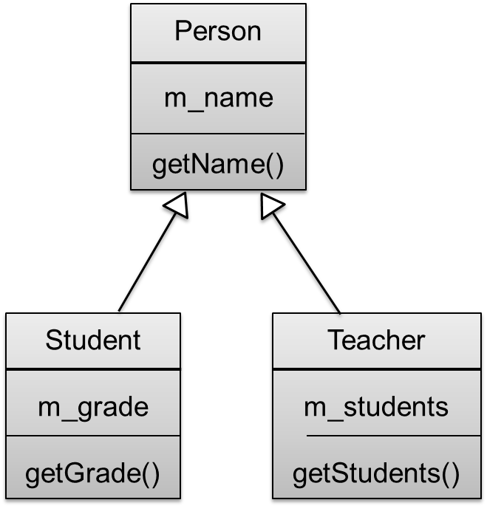

Inheritance
Code reuse example:
The classes Student and Teacher are derived from Person.
Having a name is common functionality.
Having grades is not.

Slide 190
Inheritance
The Teacher class is derived from Person.
class Teacher : public Person
{
public:
explicit Teacher( const std::string& name );
void addStudent( Student* student );
const std::vector<Student*>& getStudents() const;
private:
std::vector<Student*> m_students;
};
derives from Person

Slide 191
Inheritance
Definition of Teacher member functions:
Teacher::Teacher( const std::string& name )
: Person( name )
{
}
void Teacher::addStudent( Student* student )
{
m_students.push_back( student );
}
const std::vector<Student*>& Teacher::getStudents() const
{
return m_students;
}

Slide 192
Inheritance
Usage:
int main()
{
Student s( "Jack", 10 );
Teacher t( "Tony" );
t.addStudent( &s );
std::cout << s.getName() << ", "
<< t.getName() << ", "
<< t.getStudents()[0]->getGrade() << std::endl;
return 0;
}

Slide 193
Inheritance
Pointers, references and objects, a special relationship
A pointer of type Student* can point to a Student object.
Since Student is derived from Person, i.e. a Student is also a Person, a pointer of type Person* can also point to a Student object.
Similarly, a reference of type Person& can refer to a Person, a Student or a Teacher.

Slide 194
Inheritance
Example:
void printName( const Person& p )
{
std::cout << "Name is " << p.getName() << std::endl;
}
int main()
{
Student s( "Jack", 10 );
Teacher t( "Tony" );
printName( s );
printName( t );
return 0;
}
takes a Person reference

Slide 195
Inheritance
Quiz: which of these assignments are correct?
Person person( "Alice" );
Student student( "Jack", 10 );
Teacher teacher( "Tony" );
Person* p1 = &person; // ok
Person* p2 = &student; ?

Slide 196
Inheritance
Quiz: which of these assignments are correct?
Person person( "Alice" );
Student student( "Jack", 10 );
Teacher teacher( "Tony" );
Person* p1 = &person; // ok
Person* p2 = &student; // ok: a student is a person
Student* s1 = &student; // ok
Student* s2 = &person; ?

Slide 197
Inheritance
Quiz: which of these assignments are correct?
Person person( "Alice" );
Student student( "Jack", 10 );
Teacher teacher( "Tony" );
Person* p1 = &person; // ok
Person* p2 = &student; // ok: a student is a person
Student* s1 = &student; // ok
Student* s2 = &person; // compile-time error: a person is not a student
Student* s3 = p2; ?

Slide 198
Inheritance
Quiz: which of these assignments are correct?
Person person( "Alice" );
Student student( "Jack", 10 );
Teacher teacher( "Tony" );
Person* p1 = &person; // ok
Person* p2 = &student; // ok: a student is a person
Student* s1 = &student; // ok
Student* s2 = &person; // compile-time error: a person is not a student
Student* s3 = p2; // compile-time error: a person is not a student
Student* s4 = static_cast<Student*>( p2 ); ?

Slide 199
Inheritance
Quiz: which of these assignments are correct?
Person person( "Alice" );
Student student( "Jack", 10 );
Teacher teacher( "Tony" );
Person* p1 = &person; // ok
Person* p2 = &student; // ok: a student is a person
Student* s1 = &student; // ok
Student* s2 = &person; // compile-time error: a person is not a student
Student* s3 = p2; // compile-time error: a person is not a student
Student* s4 = static_cast<Student*>( p2 ); // ok to cast to student
Student* s5 = static_cast<Student*>( p1 ); ?

Slide 200
Inheritance
Quiz: which of these assignments are correct?
Person person( "Alice" );
Student student( "Jack", 10 );
Teacher teacher( "Tony" );
Person* p1 = &person; // ok
Person* p2 = &student; // ok: a student is a person
Student* s1 = &student; // ok
Student* s2 = &person; // compile-time error: a person is not a student
Student* s3 = p2; // compile-time error: a person is not a student
Student* s4 = static_cast<Student*>( p2 ); // ok to cast to student
Student* s5 = static_cast<Student*>( p1 ); // run-time error

Slide 201
Inheritance
Downcasting
Can we test whether a person is actually also a student?
Person* p = getSomebody();
Student* s = static_cast<Student*>( p ); // cast without checking
Yes, we can use a dynamic cast:
Student* s = dynamic_cast<Student*>( p ); // cast with checking
In case p was not a Student, s is 0.
In case p was a student, s will point to it.

Slide 202
Inheritance
Downcasting
Our program can be like this:
Person* p = getSomebody();
Student* s = dynamic_cast<Student*>( p );
if ( s )
{
std::cout << s->getGrade() << std::endl;
}

Slide 203
Inheritance
Downcasting
This can often be considered as a sign of poor design.
If you need p to be a student, it is better if your code guarantees it by type (in this case: the return type of getSomebody().
If you don’t know if p is a student, better let p itself decide what to do!
Which brings us to…

Slide 204
8. Polymorphism

Slide 205
Polymorphism
Polymorphism
As stated before, we wish to reduce the internal coupling in our software as much as possible.
We have already moved data and functions together in a class. This means that “from the outside” we are unknowing how the object does something.
Taking it one step further, we use polymorphism to further reduce coupling and lose knowledge about what an object actually is.

Slide 206
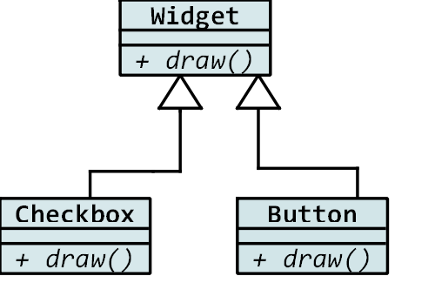
Polymorphism
Let’s explain this by example
A widget is a graphical element that can be drawn on the screen.
Button and Checkbox are both derived from Widget.
Each class has its own implementation of the draw() function.

Slide 207
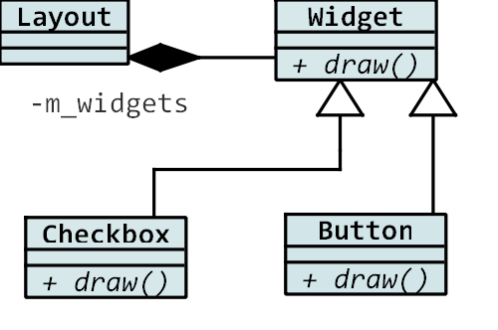
Polymorphism
A layout contains many widgets: it maintains a list of pointers of type Widget*.
Some of these widgets may be Buttons, others may be Checkboxes.
Layout calls the draw() function of each widget.
Each widget will draw itself appropriate to its type.

Slide 208
Polymorphism
What is the gain?
Layout is unknowing of the types of Widgets that exist.
Our coupling has decreased, which improves maintainability and extendibility.
We can later add more widget types without having to alter existing code.

Slide 209
Polymorphism
We can later add more widget types without having to alter existing code.
This is called the Open/Closed Principle.
Software entities (in this case a class) should be open for extension, but closed for modification.
In this example, we can make new classes derived from Widget. They are extensions of the base class, but they must always implement the base class interface.

Slide 210
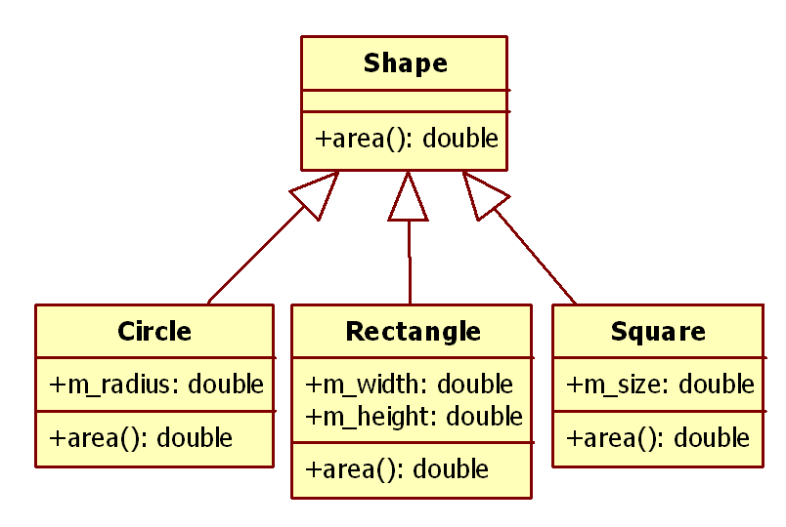
Polymorphism
Code example:
Shape is the base class
The derived classes Circle, Rectangle and Square reimplement the function area().

Slide 211
Polymorphism
Shape class definition class Shape { public: Shape(); // constructor ~Shape(); // destructor; needs fixing! (later) double area() const; // needs fixing! (later) };
(will be corrected)

Slide 212
Polymorphism
Definition of Shape member functions Shape::Shape() // constructor { } Shape::~Shape() // destructor { } double Shape::area() const { return 0; // don't know: just return 0 }

Slide 213
Polymorphism
Circle class definition class Circle : public Shape { public: explicit Circle( double radius ); // constructor ~Circle(); // destructor double area() const; private: double m_radius; };

Slide 214
Polymorphism
Definition of Circle member functions Circle::Circle( double radius ) : Shape(), m_radius( radius ) { } Circle::~Circle() { } double Circle::area() const { return M_PI * m_radius * m_radius; // #include <cmath> to get M_PI }

Slide 215
Polymorphism
Square class definition class Square : public Shape { public: explicit Square( double size ); // constructor ~Square(); // destructor double area() const; private: double m_size; };

Slide 216
Polymorphism
Definition of Square member functions Square::Square( double size ) : Shape(), m_size( size ) { } Square::~Square() { } double Square::area() const { return m_size * m_size; }

Slide 217
Polymorphism
Usage: int main() { Square s(3); Circle c(2); std::cout << "Square area is " << s.area() << std::endl; std::cout << "Circle area is " << c.area() << std::endl; }
Output: Square area is 9 Circle area is 12.5664 (so far so good!)

Slide 218
Polymorphism
Let’s introduce a function that makes use of the polymorphism of a shape: void printArea( const Shape& s ) { std::cout << "Area is " << s.area() << std::endl; }
Let’s use this in main: int main() { Square s(3); Circle c(2); printArea( s ); printArea( c ); }

Slide 219
Polymorphism
Output is not what we wanted!
Area is 0
Area is 0
Apparently, the member function of shape is used!

Slide 220
Polymorphism
The reason is that we should have used the virtual keyword in the definition of the base class:
class Shape { public: Shape(); // constructor virtual ~Shape(); // destructor; correct! virtual double area() const; // correct, but will be further improved (later)! };
Output now is correct: Area is 9 Area is 12.5664

Slide 221
Polymorphism
Every member function that should behave polymorphically must have the virtual keyword.
Why do we need to specify this?
This decision was taken at a time when people were worried about the slight increase in memory usage for objects with virtual functions (it needs a pointer to the vtable).
The philosophy of C++ was (and is): what you don’t use you don’t pay for.

Slide 222
Polymorphism
Pay extra attention to the need of a virtual destructor:
Shape* createSomeShape() { return new Circle(1); } int main() { Shape* s = createSomeShape(); delete s; // only calls the correct destructor if it is virtual! }

Slide 223
Polymorphism
What does it mean in C++?
Practically always use virtual functions if your class can be used as a base class. The memory usage is negligible.
Therefore: for classes that can be derived from:
Member functions that also appear in derived classes should always be virtual.
The destructor should always be virtual.

Slide 224
Polymorphism
A word of advice:
Do not call virtual functions in the constructor or the destructor: your class is only partially constructed/destructed.

Slide 225
Polymorphism
The slicing problem
Note that only pointers and references can be polymorphic. They can point to objects of different types.
The type of an object itself is completely fixed.
Example: let’s modify our printArea() function: void printArea( Shape s ) // pass by value { std::cout << "Area is " << s.area() << std::endl; }

Slide 226
Polymorphism
The slicing problem
Usage: int main() { Square s(3); Circle c(2); printArea( s ); printArea( c ); }
What is the output? Area is 0 Area is 0
We have lost polymorphism!

Slide 227
Polymorphism
The slicing problem
Quiz: which functions are being called? printArea( Circle(2) );
explicit Circle::Circle(double radius); // constructor
Shape::Shape(const Shape& source) // default copy constructor
void printArea(Shape s)

Slide 228
Polymorphism
Let’s again take a look at the declaration of Shape: class Shape { public: Shape(); virtual ~Shape(); virtual double area() const; };
We note that we cannot write any sensible definition for the Shape::area() function. double Shape::area() const { return 0; // basically nonsense }

Slide 229
Polymorphism
C++ provides us with the perfect solution:
class Shape { public: Shape(); virtual ~Shape(); virtual double area() const = 0; // pure virtual function };
The function is pure virtual, meaning it needs to be reimplemented in derived classes.
It also means that we cannot make instances of the class. It has become an abstract base class.

Slide 230
Polymorphism
This nicely catches errors at compile-time.
For example the slicing problem: void printArea( Shape s ) // pass by value { std::cout << "Area is " << s.area() << std::endl; }
The compiler will refuse to compile this code: error: cannot declare parameter 's' to be of abstract type 'Shape'|

Slide 231
Polymorphism
Historically difficult error using virtual keyword:
class Base {
virtual int do_work(int x) = 0;
};
class Derived: public Base {
virtual int do_work(int x)
{ std::cout << "Derived"; }
};
class MoreDerived: public Derived {
virtual int do_work(unsigned int x)
{std::cout << "MoreDerived"; }
};
MoreDerived c; c.do_work(42);

Slide 232
Polymorphism
Historically difficult error using virtual keyword:
class Base {
virtual int do_work(int x) = 0; // Introduces member function to be
}; // implemented by derived.
class Derive: public Base {
virtual int do_work(int x)
{ std::cout << "Derive"; } // Declare and implement member function.
};
class MoreDerived: public Derived {
virtual int do_work(unsigned int x)
{std::cout << "MoreDerived"; }
};

Slide 233
Polymorphism
Historically difficult error using virtual keyword:
class Base {
virtual int do_work(int x) = 0; // Introduces member function to be
}; // implemented by derived.
class Derive: public Base {
virtual int do_work(int x)
{ std::cout << "Derive"; } // Declare and implement member function.
};
class MoreDerived: public Derived {
virtual int do_work(unsigned int x)
{std::cout << "MoreDerived"; } // Different signature!
};

Slide 234
Polymorphism
Solution: Prefer to use “override” over “virtual”
virtual
The virtual specifier specifies that a non-static member function is virtual and supports dynamic dispatch
override
Specifies that a virtual function overrides another virtual function.
Using override will result in a compiler error if a member function does not exist in type we derive from.

Slide 235
Polymorphism
Exercise: Music Player (1/2)
Create a program that can play music tracks in either mp3 or flac format.
Use polymorphism to avoid duplicate code and allow adding new formats later.

Slide 236
Polymorphism
Exercise: Music Player (2/2)
Main function: int main() { MediaPlayer player; player.add(new Mp3("Editors", "Papillon")); player.add(new Flac("Macklemore", "Can't hold us")); player.play(); };
Output: Playing Track: Editors – Papillon. Decoding: Mp3 Playing Track: Macklemore - Can't hold us. Decoding: Flac

Slide 237
Polymorphism
Access Control
We have already seen the keywords public and private.
protected members are members that are accessible by derived classes, but not by others.

Slide 238
Polymorphism
Example: class Shape { public: Shape(); virtual ~Shape(); virtual double area() const = 0;
protected: static double getPi(); }; double Shape::getPi() { return 3.14; // rough approximation }

Slide 239
Polymorphism
The getPi() function may be used by derived classes: double Circle::area() const { return getPi() * m_radius * m_radius; }
It cannot be used from outside the class: Circle c(3); std::cout << c.getPi() << std::endl; // compile error
The protected function is therefore not part of the public interface of the class.

Slide 240
Polymorphism
Advantages of protected members:
We can re-use code without exposing it to the outside world.
Disadvantages:
Be careful not to expose the base class too much. If you can keep things private, your code will be more flexible and is less likely to contain bugs.
For this reason, try not to make member variables protected.

Slide 241
Polymorphism
Non-public inheritance
We have only used public inheritance so far class Derived : public Base
Using private inheritance is also possible class Derived : private Base
In this case, all public and protected members of Base are accessible by Derived, but not anywhere else.

Slide 242
Polymorphism
Non-public inheritance
Use private inheritance if there is no is-a relation between Base and Derived, but you need inheritance anyway
Prefer Composition to private inheritance.
Instead of deriving D from B, make B a member of D.
Protected inheritance makes members of B also available to derived classes of D, but is even more rarely used.

Slide 243
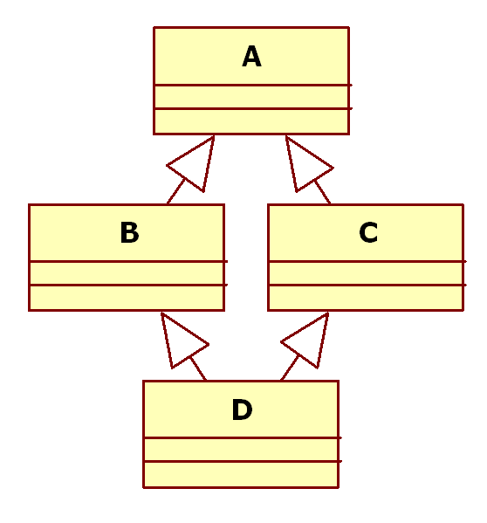
Polymorphism
Multiple Inheritance
Question: can a derived class have more than one base class?
Answer: Yes, we can use multiple inheritance
Be aware of the Diamond Problem.
Use it only in simple and clear cases.

Slide 244
9. Object Oriented Design

Slide 245
Object Oriented Design
Object Oriented Design
The quality of your code depends greatly on the design choices you make.
These are your guidelines:
A class should represent one thing, not more, not less.
Public inheritance should always represent an is-a relation.
Bind your data and functions together.

Slide 246
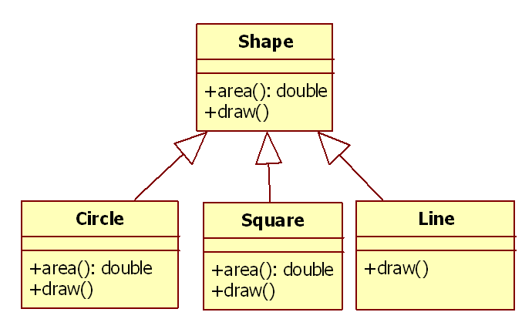
Object Oriented Design
Pitfall Example 1
We add a virtual member function draw() to the Shape so Shapes can draw themselves.
We also want to let a Line draw itself.
We make Line a derived class from shape. Reusing code is good, right?

Slide 247
Object Oriented Design
Pitfall Example 1
Wrong: a Line is-not-a Shape (rule B)
In particular, it is not possible to implement the area() function.
Rule B is also called the Liskov substitution principle: wherever you expect an object of type Base, an object of type Derived can be substituted.

Slide 248
Object Oriented Design
Pitfall Example 2
We create a class AreaCalculator.
If you pass it a reference to a Shape, it will calculate the area.
This will tidy up the Shape class. Separation is good, right?

Slide 249
Object Oriented Design
Pitfall Example 2
Wrong: we have created a class that represents nothing (rule A)
We should keep the calculation of the area together with the storage of the dimensions of the shape (rule C)
Our new class is intimately coupled to the Shape class, so we have not separated anything.

Slide 250
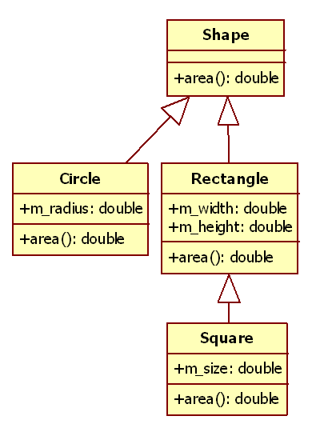
Object Oriented Design
Pitfall Example 3
A Square is-a Rectangle. Let’s derive from it! Our inheritance structure should represent the real world, right?

Slide 251
Object Oriented Design
Pitfall Example 3
Wrong: a Rectangle has properties that a Square does not fulfill.
Passing a Square to a function that expects a Rectangle is wrong. Setting the width of a square also changes the height.
The Liskov substitution principle is violated.

Slide 252
Object Oriented Design
Pitfall Example 3
Another way to catch this problem is to check the Open/Closed principle.
The base class (Rectangle) should be open for extension, but closed for modification.
Its basic properties should not be modified.

Slide 253
Object Oriented Design
Pitfall Example 4
We write a class CreateShapeDialog that is a dialog for creating a new Shape.
The user can use it to specify what the area of the new shape should be and how many corners it should have.
When the Ok button is pressed, the Dialog uses the properties to calculate what kind of shape needs to be created. Then it creates the shape.
Keeping data and functions together is good, right?

Slide 254
Object Oriented Design
Pitfall Example 4
Wrong: the CreateShapeDialog represents two things, so it violates rule A.
It represents a dialog on the screen, collecting data from the user.
It also represents a factory for creating new shapes based on complicated input.
You will most likely want to (unit) test your factory without creating a dialog.

Slide 255
Object Oriented Design
Exercise 1: Factory pattern (1/2)
The class Square models a square.
The class Circle models a circle.
We want to create the appropriate shape based on input (a string).
Problem: we want to isolate the variety of shapes in our code.
We will use a Factory to create the appropriate shape.

Slide 256
Object Oriented Design
Exercise 1: Factory pattern (2/2)
main() creates an instance of Factory.
Input is taken from the user.
The Factory decides which Shape to create.
Create the classes Shape, Square, Circle, and Factory.
Both Square and Circle have an area() function.
Implement the classes and test your program.

Slide 257
Object Oriented Design
Exercise 2: Proxy pattern, Part 1
The class Square models a square.
The class Log is a logging class.
Whenever the Square size changes, we want to log this change.
Therefore, pass a reference to the logging class to the constructor of Square.
Implement the classes and test your program.

Slide 258
Object Oriented Design
Exercise 2: Proxy pattern, Part 2 (1/2)
Problem: we may first want to buffer the messages before sending to the real log.
Square should not know whether this happens or not, it only talks to “Log”.
Therefore, make Log a base class (interface) of RealLog and BufferLog.
RealLog is the real logger (displays messages).
BufferLog buffers 5 messages, then sends it to RealLog.

Slide 259
Object Oriented Design
Exercise 2: Proxy pattern, Part 2 (2/2)
Square should be able to communicate to BufferLog or RealLog through the interface Log.
Before you start coding, draw a simple UML diagram that contains all inheritance and function calls. Have it verified before you start.
Implement the classes and test your program.

Slide 260
10. Operator Overloading

Slide 261
Operator Overloading
Assignment operator overloading
In C++, you can rewrite what happens when a class is assigned to another.
This is useful for the same reasons for writing a copy constructor.
If a class does not have an assignment operator, there will be a default assignment available, which will simply assign all member variables.

Slide 262
Operator Overloading
Example:
class Square
{
public:
Square& operator=( const Square& source ); // assignment operator
private:
double m_size;
};
Square& Square::operator=( const Square& source )
{
m_size = source.m_size;
return *this; // returns reference to itself
}

Slide 263
Operator Overloading
Usage:
int main()
{
Square s1(1.1);
Square s2(2.2);
Square s3(s2); // calls copy constructor
s1 = s2; // calls assignment operator
return 0;
}

Slide 264
Operator Overloading
Note that the assignment operator
Square& operator=( const Square& source ); // assignment operator
Has this syntax:
It returns a reference to itself. This enables us to do things like:
s1 = s2 = s3;
It takes a const reference as the source argument

Slide 265
Operator Overloading
Implementation example:
School::School( const School& source ) // copy constructor
{ // example: reuse assignment operator // this is less efficient, but prevents duplicate code *this = source; } School& School::operator=( const School& source ) { if ( this == &source ) { return *this; // do nothing for self-assignment } // [...] (copy students one by one) }

Slide 266
Operator Overloading
Note when the copy constructor is called:
int main()
{
Square s1( 3 ); // calls constructor
Square s2( s1 ); // calls copy constructor
Square s3 = s2; // calls copy constructor (!)
Square s4( 3 ); // calls constructor
s4 = s3; // calls assignment operator
return 0;
}

Slide 267
Operator Overloading
Note that the same rule applies for the assignment operator and the copy-constructor.
If you delete one, you probably also want to delete the other.
School& operator=( const School& source ) = delete;
School( const School& source ) = delete;
Alternatively, to avoid problems with dynamic memory management and copying objects, use smart pointers (later).

Slide 268
Operator Overloading
Operator overloading
It is a feature of C++ that operators likes +, *, ==, << can be overloaded for classes, i.e. given a special meaning.
We have seen operator overloading in practice with the overloading of the assignment operator.
The idea is that the code that uses these classes can be concise, clear and correct.

Slide 269
Operator Overloading
Operator overloading is sometimes criticized:
Object a = b + c;
What is the meaning? It depends on the context of ‘Object’.
Always work with the Principle of Least Surprise!
Don’t use it if you cannot guarantee there will be no surprises.

Slide 270
Operator Overloading
As usual, C++ is extremely powerful: it can be persuaded to do anything you like.
An example of the possibilities of operator overloading (or: how not to use it):
#include "analogliterals.hpp"
int vol = ( o-------------o
|L \
| L \
| L \
| o-------------o
| ! !
! ! !
o | !
L | !
L | !
L| !
o-------------o ).volume;

Slide 271
Operator Overloading
Operator overloading example: the Duration class
class Duration
{
public:
Duration( int hours, int minutes ); // constructor
void print() const;
private:
int m_hours;
int m_minutes;
};

Slide 272
Operator Overloading
Implementation:
Duration::Duration( int hours, int minutes ) // constructor
: m_hours( hours ),
m_minutes( minutes )
{
}
void Duration::print() const
{
std::cout << m_hours << " hours, ";
std::cout << m_minutes << " minutes";
std::cout << std::endl;
}

Slide 273
Operator Overloading
Usage:
int main()
{
Duration t( 2, 30 ); // constructs a duration
t.print(); // prints: 2 hours, 30 minutes
return 0;
}

Slide 274
Operator Overloading
It would make sense to add durations:
int main()
{
Duration t1( 2, 30 );
Duration t2( 1, 45 );
Duration t3 = t1 + t2;
t3.print(); // prints: 4 hours, 15 minutes
return 0;
}

Slide 275
Operator Overloading
Therefore, we overload the + operator
class Duration { /*...*/ Duration operator+( const Duration& rhs ) const; }; Duration Duration::operator+( const Duration& rhs ) const { Duration sum( m_hours + rhs.m_hours, m_minutes + rhs.m_minutes ); sum.m_hours += sum.m_minutes / 60; sum.m_minutes %= 60; return sum; }

Slide 276
Operator Overloading
Note that the overloaded operator
Duration operator+( const Duration& rhs ) const
Has this syntax:
It takes one parameter: the right-hand side.
The left-hand side is the this object itself.
It can be const, since the left-hand side is not changed.
It returns the sum duration.

Slide 277
Operator Overloading
Likewise, we can overload the * operator to multiply duration with a factor.
Duration Duration::operator*( double factor ) const
{
Duration sum( m_hours * factor, m_minutes * factor );
sum.m_hours += sum.m_minutes / 60;
sum.m_minutes %= 60;
return sum;
}

Slide 278
Operator Overloading
Usage:
int main()
{
Duration t1( 1, 45 );
Duration t2 = t1 * 2;
t2.print(); // prints: 3 hours, 30 minutes
return 0;
}

Slide 279
Operator Overloading
But there is a problem:
int main()
{
Duration t1( 1, 45 );
Duration t2 = 2 * t1; // compiler error: '2' is not an object
t2.print();
return 0;
}
We cannot freely reverse the order, which is not friendly for anyone using our class.

Slide 280
Operator Overloading
The solution is to overload the operator not as a member function, but as nonmember (ordinary) function.
Duration operator*( double factor, const Duration& t )
{
Duration sum( t.m_hours * factor, t.m_minutes * factor );
sum.m_hours += sum.m_minutes / 60;
sum.m_minutes %= 60;
return sum;
}
This poses another problem: we cannot access t.m_hours since it is a private member!

Slide 281
Operator Overloading
We can declare the function a friend of the Duration class:
class Duration
{
public:
Duration( int hours, int minutes );
Duration operator+( const Duration& rhs ) const;
Duration operator*( double factor ) const;
void print() const;
friend Duration operator*( double factor, const Duration& t );
private:
int m_hours;
int m_minutes;
};

Slide 282
Operator Overloading
In this case, it is better to write the function in terms of the reversed overloaded operator (why?):
Duration operator*( double factor, const Duration& t )
{
return t * factor;
}

Slide 283
Operator Overloading
void foo()
{
Duration a;
Duration b;
Duration c;
c = a + b; // really is ...
c.operator=( a.operator+(b) ); // ... this
}

Slide 284
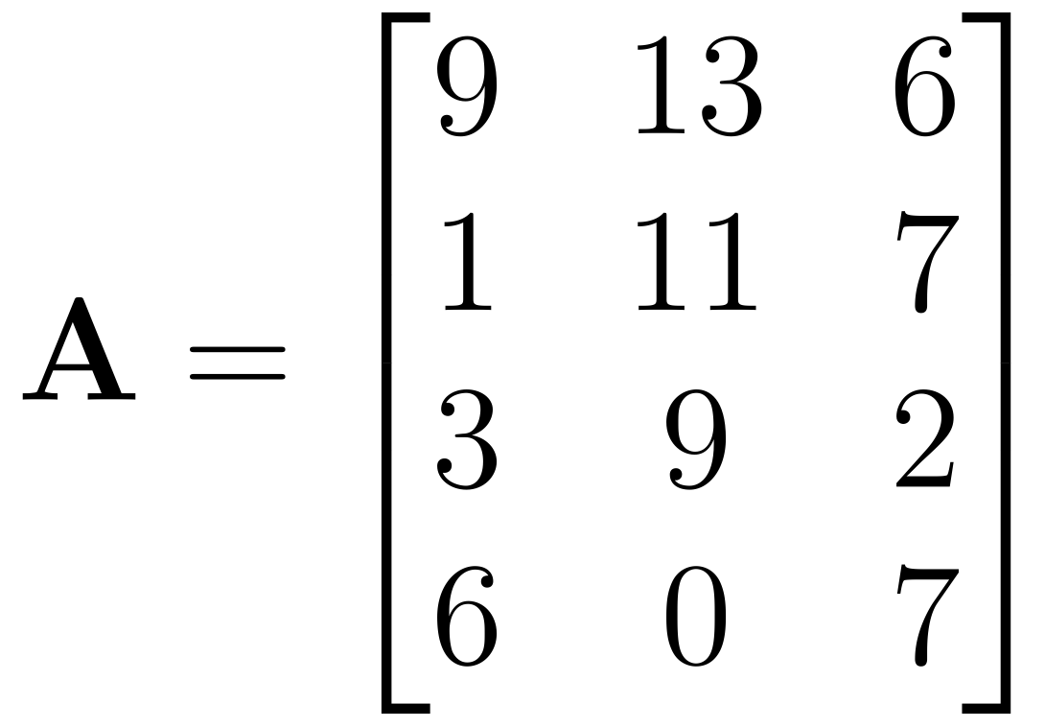
Operator Overloading
Exercise: create a Matrix class
A matrix is a rectangular arrangement of real numbers.

Slide 285
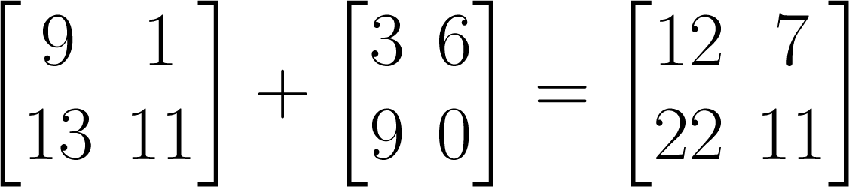
Operator Overloading
Matrices of the same size can be added.

Slide 286
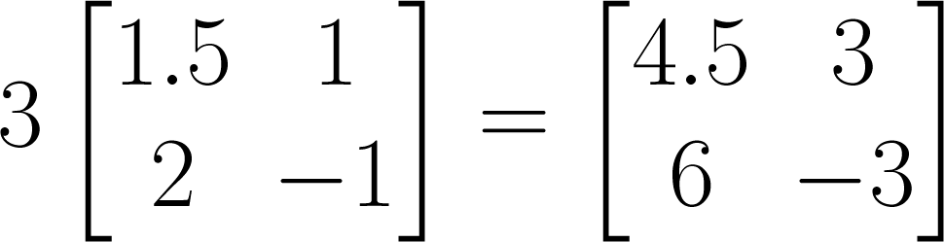
Operator Overloading
Matrices can be multiplied by a number.

Slide 287
Operator Overloading
Exercise: create a Matrix class that:
Can be constructed with two parameters, indicating number of rows and columns.
Can be copy-constructed and assigned.
Allows getting and setting elements.
Overloads operators + for adding, * for multiplication with a number
For simplicity, start indexing at 0.

Slide 288
Operator Overloading
Exercise: create a Matrix class
This exercise teaches you how to build a well-designed class. The client code (where the class is used) naturally turns out to be clear, concise and correct.

Slide 289
11. Exceptions

Slide 290
Exceptions
During runtime, we can anticipate problems with the normal flow of the program.
Some of these are common and can be locally solved, such as wrong user input.
Sometimes a problem is more rare and serious, such as a file that can suddenly not be read, or the program has run out of memory.
For these cases, we can use exceptions.

Slide 291
Exceptions
Example:
We want to read 10 integers that are in a file
#include <fstream>
#include <vector>
// reads 10 ints from stream
std::vector<int> read_10( std::ifstream& ifs )
{
std::vector<int> result(10);
for( int i = 0; i < 10; ++i)
{
ifs >> result[i];
}
return result;
}

Slide 292
Exceptions
Usage:
std::ifstream ifs ( "data.dat" );
std::vector<int> result = read_10( ifs );
So far so good. But even if we have written the file ourselves, something may be wrong. Maybe the data has been corrupted!
Let’s change our reading function, making use of the good() member function of std::ifstream.

Slide 293
Exceptions
// reads 10 ints from stream // may throw an exception std::vector<int> read_10( std::ifstream& ifs ) { std::vector<int> result(10); for( int i = 0; i < 10; ++i) { if ( !ifs.good() ) {
// std::runtime_error is derived from std::exception throw std::runtime_error("Cannot read from file!"); } ifs >> result[i]; } return result; }

Slide 294
Exceptions
The line:
throw std::runtime_error("Cannot read from file!");
throw the exception.
As you can see, we have signaled something is wrong, but we cannot deal with the error locally.
To handle the error, we also have to catch the exception.

Slide 295
Exceptions
Catching the exception:
try
{
std::ifstream ifs ( "data.dat" );
std::vector<int> result = read_10( ifs );
/* use result */
}
catch ( std::exception& message )
{
std::cout << e.what() << std::endl;
}
In this case we choose to print the message on screen.

Slide 296
Exceptions
Let’s look at the try/catch blocks
try
{
/* do things where an exception may be thrown */
}
catch ( std::exception& message ) // catch the right type of exception {
/* handle the exception */
}
When somewhere in the try block an exception is thrown, the rest of the try block is skipped. We immediately enter the catch block.

Slide 297
Exceptions
What to throw?
Technically: we can throw anything: ints, strings, pointers, Students..
Practically: only throw objects derived from std::exception
There is a standard std::exception base class. Create your own exception class by deriving from this class.
#include <exception>
class FooException : public std::exception
{
public:
FooException() {}
virtual const char* what() const throw();
};

Slide 298
Exceptions
Do not forget to provide at least useful human readable information.
Write your own implementation of the what() function.
const char* FooException::what() const throw()
{
return "Foo Exception";
}
Note: use noexcept instead of throw() since C++11

Slide 299
Exceptions
Throw by value, catch by reference.
try
{
throw FooException();
}
catch ( std::exception& e )
{
std::cout << e.what() << std::endl;
}

Slide 300
Exceptions
std::logic_error
Logic errors are a consequence of faulty logic within the program and may be preventable
std::invalid_argument
std::domain_error
std::length_error
std::out_of_range
std::future_error
std::exception
std::logic_error
std::runtime_error

Slide 301
Exceptions
std::runtime_error
Runtime errors are due to events beyond the scope of the program and can not be easily predicted.
std::range_error
std::overflow_error
std::underflow_error
std::regex_error
std::system_error
std::exception
std::logic_error
std::runtime_error

Slide 302
Exceptions
Runtime errors are due to events beyond the scope
double f(double d)
{
if ( d > 1e7 )
throw std::overflow_error("too big");
return d;
}
int main()
{
try {
std::cout << f(1e10) << std::endl;
} catch (const std::overflow_error& e) {
std::cout << e.what() << std::endl;
}
}

Slide 303
Exceptions
Mutliple catch blocks
try
{
/* do things where any exception may be thrown */
}
catch ( std::out_of_range& e ) {
/* handle specific exception */
}
catch ( std::logic_error& e ) {
/* handle all logic error exceptions */
}
catch ( std::exception& e ) {
/* handle all exception */
}

Slide 304
Exceptions
It is a benefit of exceptions that your error handling code is not mixed with your normal program code.
This is also why we should only use exceptions in exceptional cases: they should not be part of normal program flow.
And again: don’t throw an exception from your function without making sure it will be correctly caught. Use exceptions to deal with problems, not to not deal with them.

Slide 305
Exceptions
Note how the exception can be caught far from where it is thrown:
void bar()
{
/*...*/
throw 1;
}
void foo()
{
/*...*/
bar();
}
int main()
{
try
{
foo();
}
catch ( int e )
{
/*...*/
}
return 0;
}

Slide 306
Exceptions
Exceptions do not magically solve your problems.
In fact, using exceptions can introduce new problems.
In practice, know in which parts of your project exceptions are used, and how they ought to be dealt with.
Do not use exceptions without having a plan.

Slide 307
Exceptions
Exercise: Exception for your matrix class, addition of matrices with different sizes throws an exception
Let your matrix class throw an exception whenever you try to add 2 matrices that have different dimensions.
Create a special MatrixMismatchException that derives from std::exception for this throw.
Override the what() function for your exception class.
Test your code.

Slide 308
12. Smart Pointers

Slide 309
Smart Pointers
Rationale
There is an important complication with exceptions and dynamic memory management:
Student* s = 0; try { s = new Student; foo( s ); // may throw delete s; } catch ( std::exception& e ) { std::cout << e.what() << std::endl; }

Slide 310
Smart Pointers
Corrected version:
Student* s = 0; try { s = new Student; foo( s ); // may throw delete s; } catch ( std::exception& e ) { delete s; // to prevent memory leak std::cout << e.what() << std::endl; }

Slide 311
Smart Pointers
Let’s be fair: exceptions and manual resource management gives trouble.
This is an opportunity to make the switch to C++. Using proper methods, garbage collecting becomes automatic.
The idea is to solve the problem of resource management (including memory, open files, etc.) right when the resource is acquired.
This technique is also called RAII (Resource Acquisition Is Initialization).

Slide 312
Smart Pointers
Every resource is wrapped up in an object. The destructor of the object will release the resource.
An example is the use of smart pointers.
A smart pointer is a pointer with explicit ownership. The smart pointer object will take caring of destroying the object.

Slide 313
Smart Pointers
Simple smart pointer
An example is std::unique_ptr. You can use it when you want to use a pointer, but also implicate ownership.
Example:
#include <memory>
void foo()
{
std::unique_ptr<Student> p( new Student("Jack") );
/*...*/
// Student is automatically destroyed
}

Slide 314
Smart Pointers
This will solve our problem with throwing exceptions:
try
{
std::unique_ptr<Student> p( new Student("Jack") );
foo( *p ); // may throw
// delete not needed
}
catch ( std::exception& e )
{
std::cout << e.what() << std::endl;
}

Slide 315
Smart Pointers
Note that it is guaranteed that only one unique_ptr will be the owner of the student.
Note that you need std::move to transfer ownership:
std::unique_ptr<Student> p1( new Student("Jack") );
std::unique_ptr<Student> p2;
assert( p1 ); // p1 is not empty
assert( !p2 ); // p2 is empty
p1 = p2; // compile-time error!
p2 = std::move(p1); // ok
assert( !p1 );
assert( p2 ); // student has moved from p1 to p2!

Slide 316
Smart Pointers
You can also use unique_ptr in containers:
std::vector<std::unique_ptr<Student> > // ok
Using a smart pointer also clarifies your design:
a normal pointer indicates simple association
a unique_ptr indicates a life cycle dependency (composition)

Slide 317
Smart Pointers
Shared pointers
Sometimes you want to share ownership of an object.
The object should be destroyed if the last owner is removed.
For this purpose we have std::shared_ptr
It uses reference counting internally.

Slide 318
Smart Pointers
Example:
std::shared_ptr<Student> p1( new Student );
std::shared_ptr<Student> p2 = p1; //share ownership
p1.reset(); // release 1
p2.reset(); // release 2: Student is deleted
It is of course more common to have shared pointers as object members.
Shared pointers can also be used in containers:
std::vector< std::shared_ptr<Student> > v; // okay

Slide 319
Smart Pointers
Exercise: Unique ownership
Create a School class.
The School has a function to add a Student.
The School has a function to remove and return a Student.
Use a unique_ptr in the class and in both functions to indicate (transfer of) ownership
It is best practice to wrap at construction:
std::unique_ptr<Student> p1( new Student );

Slide 320
13. Templates

Slide 321
Templates
Let’s reconsider the swap function:
void swap(int& a, int& b)
{
int tmp = a;
a = b;
b = tmp;
}
It is obvious that we also want a version for doubles:
void swap(double& a, double& b)
{
double tmp = a;
a = b;
b = tmp;
}

Slide 322
Templates
And after that a version for floats, bools, Students and Squares…
This is a violation of the DRY (don’t repeat yourself) principle.
A first idea is to use inheritance and derive everything from Object (like Java):
void swap(Object& a, Object& b)
{
Object tmp = a;
a = b;
b = tmp;
}

Slide 323
Templates
There are several disadvantages:
All kinds of objects can have all kinds of properties (e.g. assignable, default-constructable, enumerable). To put all possible combinations in one inheritance tree is very impractical.
The actual type of the object is lost in the function and return argument (type erasure).
The better solution is to leave the type fixed but delay specification until we use it (duck typing).

Slide 324
Templates
This is accomplished in C++ through templates:
template <typename T>
void swap(T& a, T& b)
{
T tmp = a;
a = b;
b = tmp;
}
We can now use the function for any type:
double x, y;
int i, j;
swap(x, y);
swap(i, j);

Slide 325
Templates
Note how the first line sets up the template: it uses the template keyword:
template <typename T>
void swap(T& a, T& b)
The typename keyword specifies the types that will be used. The type in this function is denoted T. We can use T in the function:
T tmp = a; // creates a tmp of type T
We can also use the class keyword instead of typename:
template <class T>

Slide 326
Templates
Note that when the compiler reaches this code: template <typename T>
void swap(T& a, T& b)
{ T tmp = a; a = b; b = tmp; }
it cannot compile it, because T is unspecified.
Then function can only be compiled when it is used. Therefore the function definition must be available.
We must define the function in the same compilation unit that it is used in. In general we put it in a header (.h) file.

Slide 327
Templates
// utility.h template <typename T> void swap(T& a, T& b) { T tmp = a; a = b; b = tmp; }
// main.cpp #include "utility.h“ void foo() { /*...*/ swap(a, b); }

Slide 328
Templates
Template functions and classes have evolved to become the preferred mechanism to create data containers, algorithms and utilities.
This resulted in the creation of the Standard Template Library (STL) which is part of the C++ standard.

Slide 329
Templates
Advantages of templates:
Powerful and flexible (to the extreme)
Top performance
Strong type checking
Disadvantages of templates:
Need to be defined in headers, so large headers
Complex compiler errors

Slide 330
Templates
Another example:
template <typename T>
const T& max(const T& a, const T& b)
{
return b < a ? a : b;
}
Type is carefully checked: double a = 1; float b = 3; max(a, a); // ok max(a, b); // error error: no matching function for call to 'max(double&, float&)'

Slide 331
Templates
This is easily solved by specifying the template argument:
double a = 1;
float b = 3;
max<double>(a, b); // ok, conversion to double
As you can see, the template argument is normally derived from the function arguments where possible.

Slide 332
Templates
Exercise 1
Create a function with one template argument that takes two arguments: a vector and an element.
The function should return true if the vector contains the element. Test your function.
Exercise 2
A function can also take two template arguments:
template <typename T1, typename T2>
Change your answer in exercise 1, so it will also accept a std::array besides a vector.

Slide 333
Templates
Powerful and flexible (to the extreme)
You already used template classes ( std::vector<int>)
Complex compiler errors
There is more to templates that we did not discuss.

