Slide 1

IZMIR UNIVERSITY OF ECONOMICS · INDUSTRIAL ENGINEERING · FENG 498
Warehouse Layout Optimization
A Simulation Study of Storage Assignment Policies
at the Schneider Electric Manisa Plant Warehouse
Deniz ETENSEL · Deniz Ege MEMETOĞLU · Nehir KONYAR · Elif BOSTANCI · Yiğit KAÇAR · Sümeyra PULÇA
Supervisor: Dr. Oktay KARABAĞ
June 2026
Key result: Line-aware slotting → −44% lead time (6.91 vs 12.37 min/order) · paired-t p = 3.68 × 10⁻¹³ · N = 20 CRN
Notes:
Welcome the committee. Briefly: we simulated a real 400-order-per-day kitting warehouse using 4 months of actual dispatch records, compared six slotting policies, and show a 44% lead-time improvement with our proposed line-aware policy. All results come from 20 CRN replications with a distribution-driven SimPy model calibrated to the ZWM92 log.

Slide 2
Agenda
1. Problem & Motivation
6. Verification & Validation
2. The Warehouse — System Description
7. Experimental Design
3. Data Sources
8. Results & Statistical Tests
4. Simulation Model
9. Sensitivity Analysis
5. Six Slotting Policies
10. Recommendation & Conclusion
11. Limitations & Future Work
Notes:
Walk through the agenda briefly. Emphasis: we follow a standard simulation study structure — model first, then results.

Slide 3
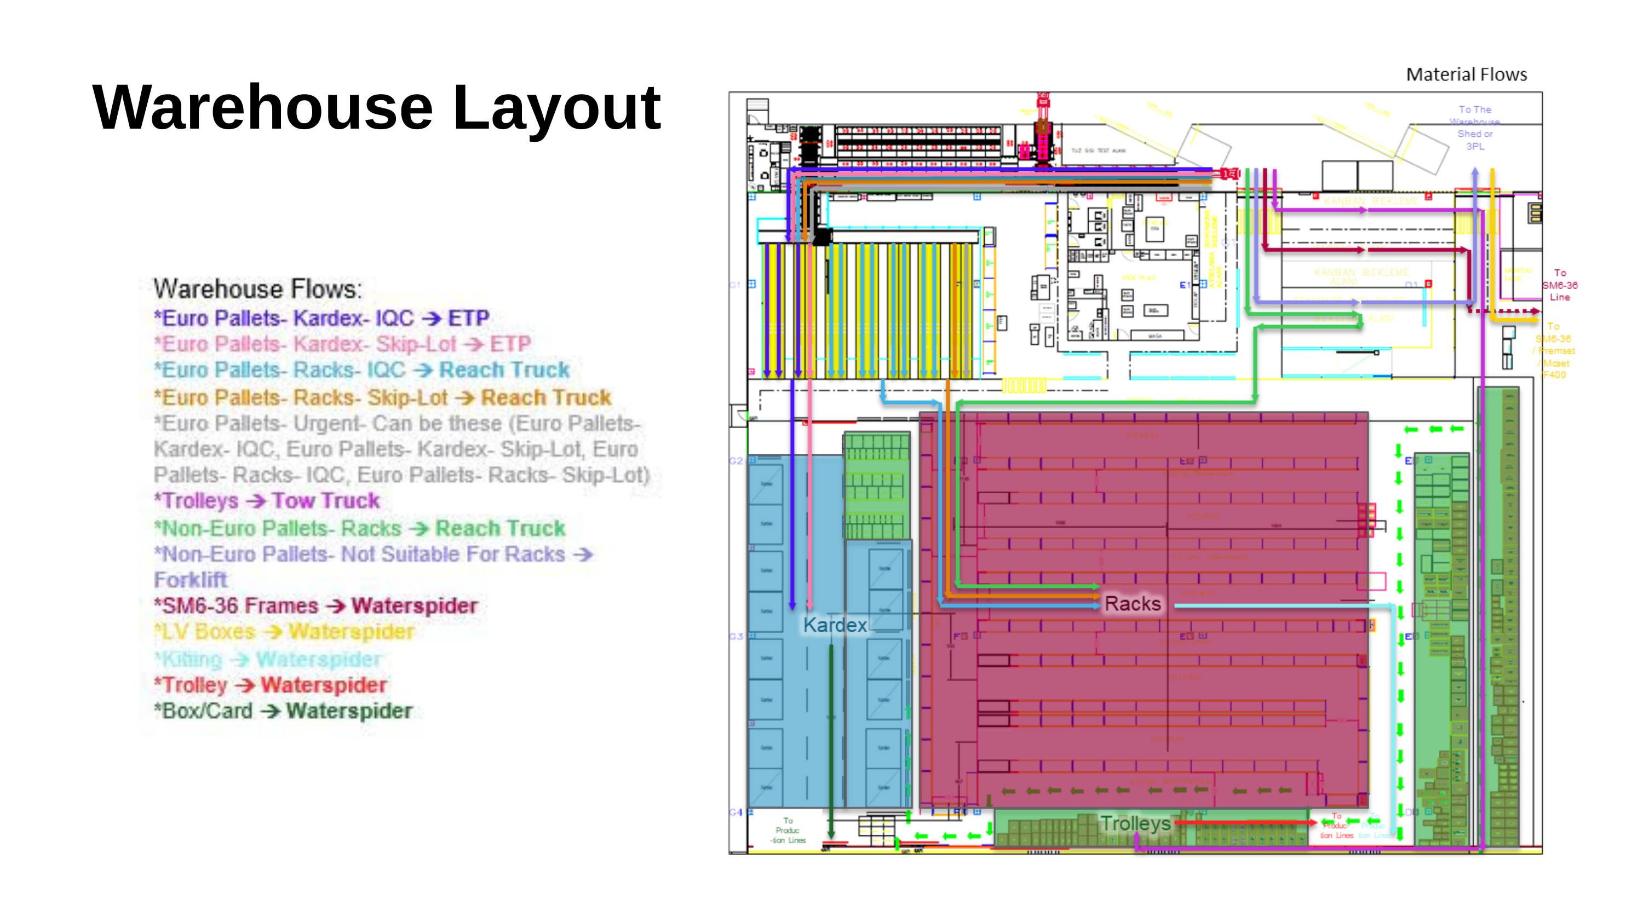
Problem & Motivation
~400 kit orders per day dispatched from a shared warehouse to 9 product-family lines
SAP bin placement is line-unaware — high-frequency parts may sit far from their kitting point
Reach truck queuing: operators wait for RT access to elevated slots, inflating lead time
Goal: identify a slotting policy that reduces order lead time without sacrificing throughput
Notes:
The Schneider Electric Manisa plant assembles medium-voltage switchgear. Kitting is the critical path: pickers must assemble a complete bill-of-materials before assembly can start. The current SAP placement was set up for replenishment convenience, not picking efficiency. We quantify the cost and test alternatives.

Slide 4
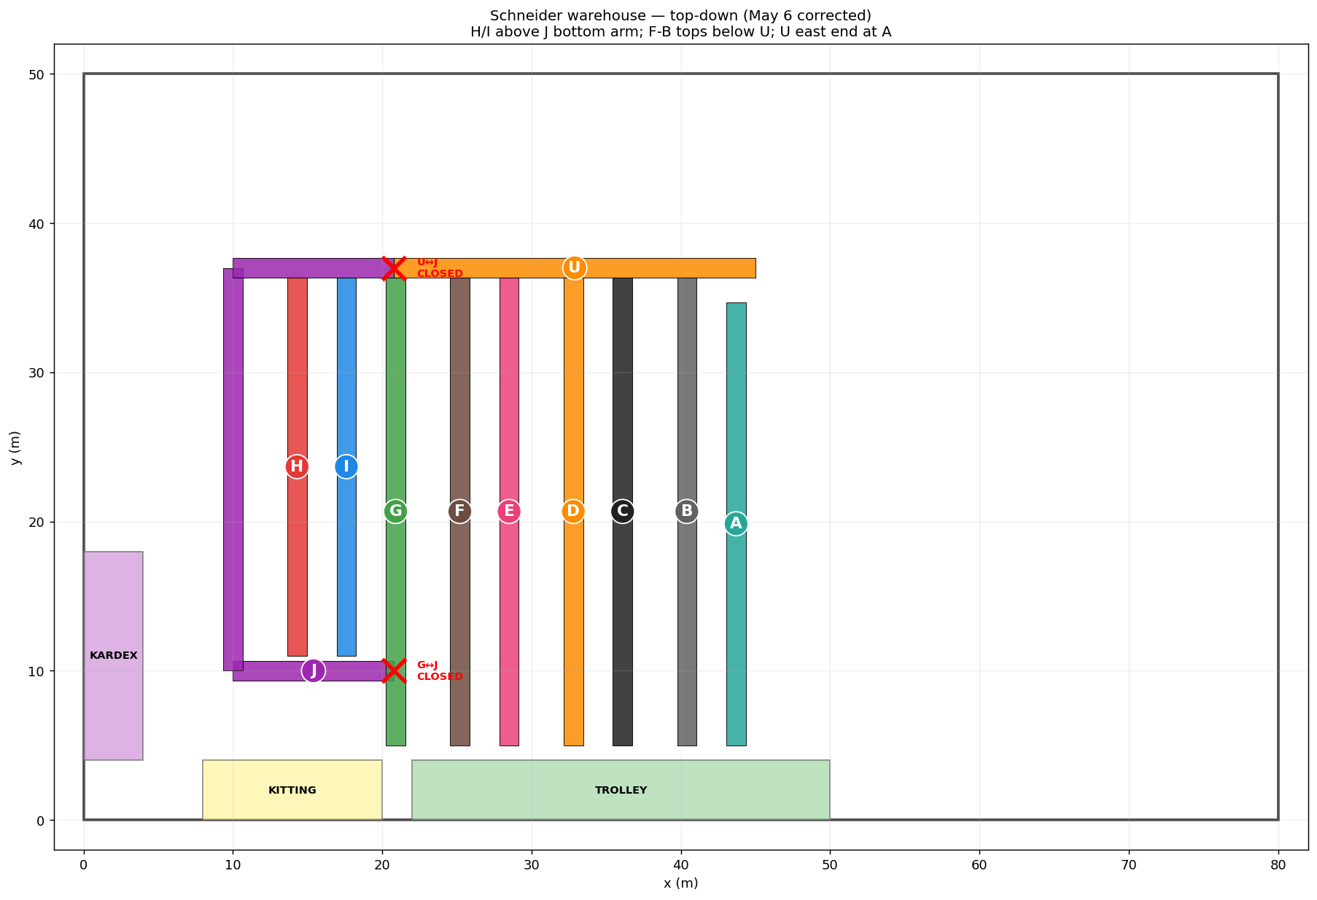
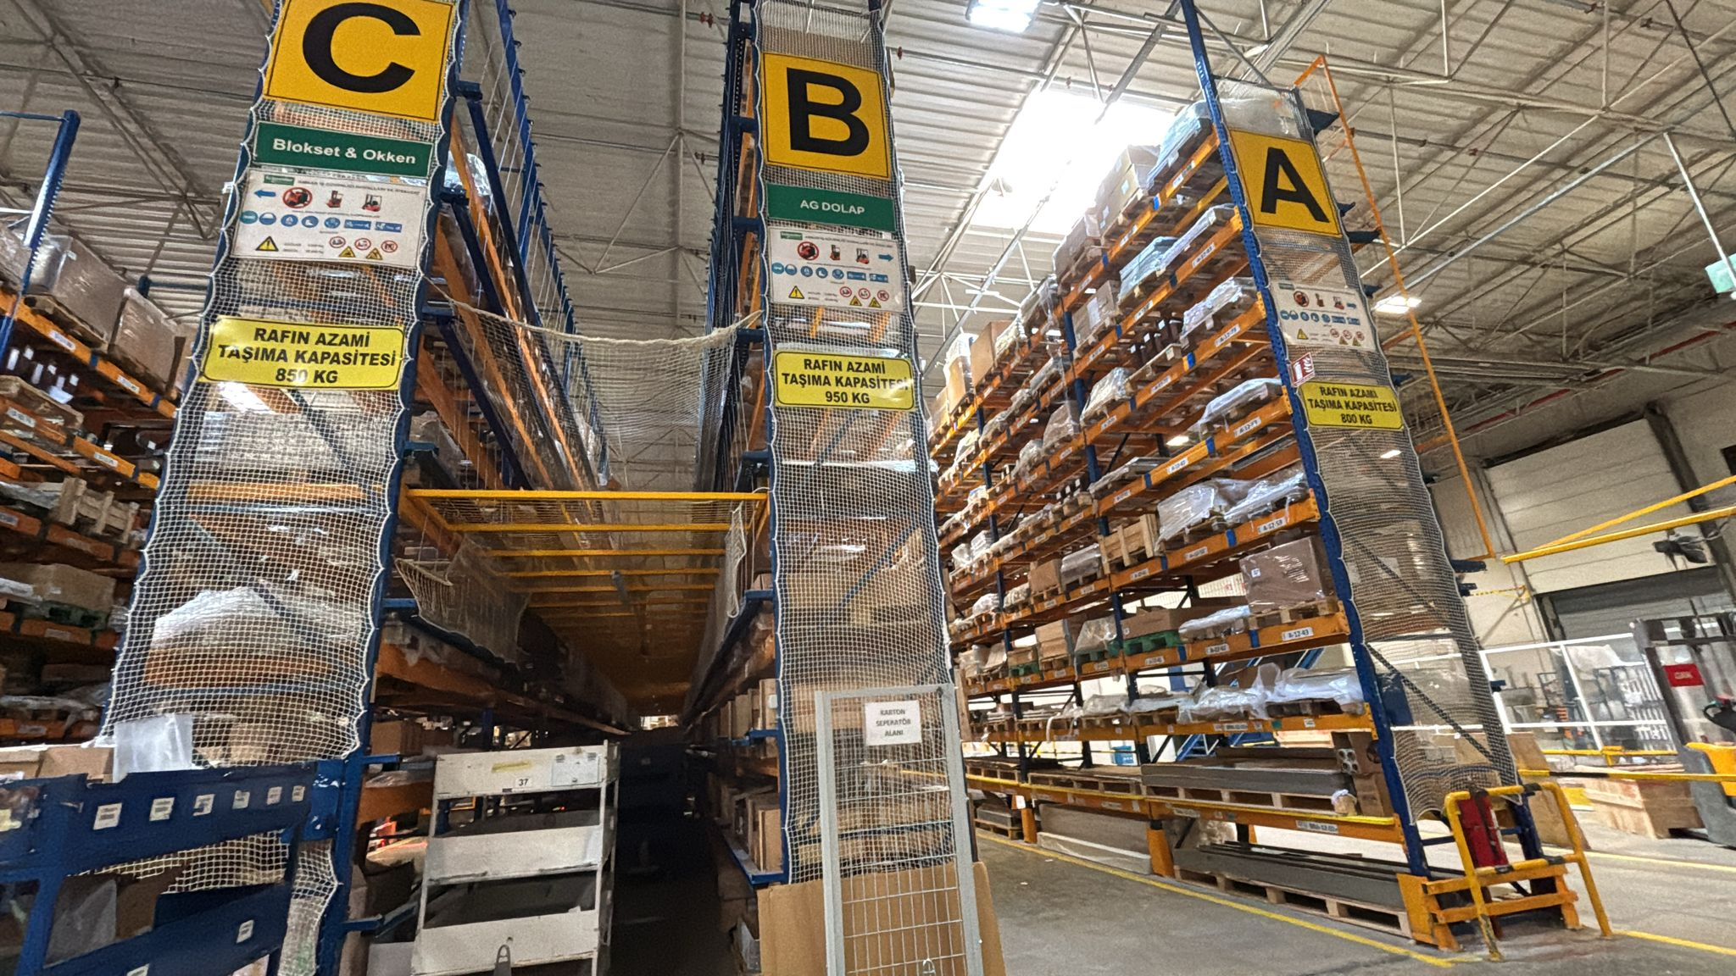
The Warehouse — System Overview
80 × 50 m; 11 rack rows (A–J + U); 3,203 pallet positions
Manual: levels 1–3; RT required: levels 4+
8 operators · 7 RTs · 4 Kardex · 7 milk-run trains
Single shift 07:00–16:00; ~400 kit orders / day
RT aisle — racks C, B, A
Floor plan — rack rows A–J, U
Notes:
The warehouse has a clear zone split: low shelves (manual) and high shelves (reach truck). Kardex automated carousels hold ~2,872 materials. The milk-run trains deliver picks to production lines. This physical split is the central lever exploited by the line-aware policy.

Slide 5
Data Sources
ZWM92 Dispatch Log
SAP Material Master (özet)
F400 Video Time Study
› 40,804 kit orders · 167,784 rows · 9 product families
› 5,941 active materials in scope
› 2,319 micro-events timed from line-F400 kitting video
› Jan 2 – May 18, 2026 (103 active days)
› 3,804 with a storage bin; 750 decoded rack/bay/level
› Lognormal σ from measured CVs (operator 1.245, RT 1.047, Kardex 1.279)
› 3,885 same-timestamp batches (mean 4.68 kits, CV = 2.04)
› 2,872 in Kardex carousels; 412 malformed/undecodable
› Pick times: operator 0.113 min, RT 0.110 min, Kardex 0.113 + 0.4 min carousel
› IAT distribution: empirical (CV = 2.04, not exponential)
› Modelled pallet positions: 3,101
› Extrapolated to all 9 product families (stated limitation)
Notes:
We have three independent data sources, which is a strength of this study. ZWM92 gives us the demand process; the material master gives bin locations for the SAP baseline; the F400 time study anchors all pick-time distributions independently. The fact that the time study was done on F400 but applied to all families is a stated limitation (see slide 15).

Slide 6
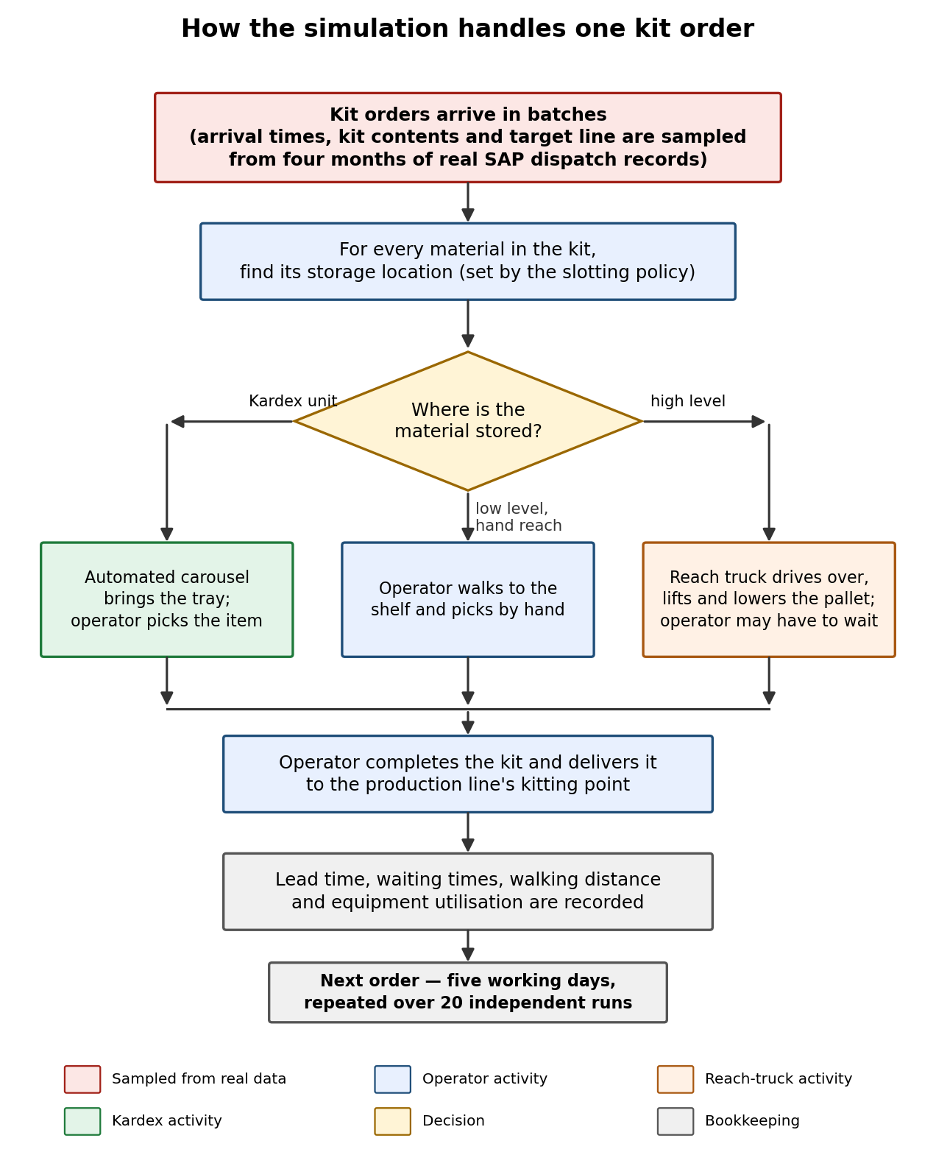
Simulation Model
SimPy DES, Python — distribution-driven (NOT trace replay)
Arrivals: empirical inter-batch gap + empirical batch size (ZWM92)
Pick times: Lognormal with σ from F400 CVs
Terminating: 07:00–16:00 single shift, 30-min warm-up
8
7
4
7
Operators
Reach Trucks
Kardex
Milk-run
Simulation lifecycle
Notes:
The 'distribution-driven' label matters: we fit empirical distributions to ZWM92 then sample from them each replication — this is what Arena would call a 'fitted distribution' model, not a trace replay. The terminating structure is appropriate because the warehouse empties every day (single shift confirmed by the ZWM92 timestamp profile).

Slide 7
Six Slotting Policies
Policy | Assignment Rule | Mean Lead Time (min/order)
Current SAP placement | As-stored in SAP material master (hybrid SAP + FMR fallback) | 12.37 ± 1.07
Capacity heuristic | Assign to first available slot by rack scan order | 14.71 ± 1.33
Usage-based ABC | Sort by pick frequency → A/B/C zone, nearest to kitting | 15.24 ± 1.44
Double ABC | Dual ABC by both frequency and volume | 14.74 ± 1.35
Travel-distance optimized | Minimize total walk distance per material, no level constraint | 24.60 ± 3.36
Line-aware slotting ★ | Co-locate by production line + prefer manual-access levels | 6.91 ± 0.47
Notes:
Six policies span the design space from purely reactive (SAP as-is) to optimized. The key insight preview: Travel-distance optimized WORSENS lead time because it ignores the reach-truck bottleneck — it clusters high-frequency items at elevated slots, causing RT queuing. The line-aware policy explicitly avoids RT-access levels for the most-picked materials.

Slide 8
Verification & Validation
Check | Statistic | Value | Interpretation
Pick share per rack row | χ² (df = 9) | 537.7, p = 4.9 × 10⁻¹¹⁰ | Significant — but n = 5,900 → high power
Effect size | Cramér's V | 0.216 | Small-to-medium practical deviation
Per-material pick counts | Paired t (n = 925) | t = 8.75, p = 9.7 × 10⁻¹⁸ | Internal consistency check (in-sample fit)
Daily order volume | Sim vs. actual | 378 vs. 396.2 orders/day (−4.6%) | Within ±5% calibration target ✓
Key message: The χ² rejection at n ≈ 5,900 reflects very high statistical power, not model failure. Cramér's V = 0.216 indicates small-to-medium practical effect. Three positive evidence channels support adequacy: (1) daily volume within ±5%, (2) independent F400 timing anchor, (3) route and face-validity checks. The per-material paired-t is an in-sample consistency check — we disclose the absence of a holdout period as a stated limitation.
Notes:
If asked: 'Your model is invalid — chi-squared rejects.' Answer: With n = 5,900 picks the test detects any real deviation. The right question is effect size: Cramér's V = 0.216 is small-to-medium. We have three independent positive channels. We also disclose that expected and observed come from the same data period — this is an internal consistency check, not out-of-sample validation, and we say so in the report.

Slide 9
Experimental Design
6 policies × 20 replications = 120 simulation runs (N = 20 CRN)
Common Random Numbers (CRN): policies share arrival and service seeds → variance reduction
Seeds: arrival seed = 42 + rep; service seed = 42 + rep + 1,000,003 (independent streams)
Primary analysis: replication-paired t-test (analogous to Minitab paired t on kpi_by_replication.csv)
Secondary: one-way ANOVA + Tukey HSD across all 6 policies; α = 0.05
6 Policies × 20 Reps
Current SAP
× 20
Capacity Heuristic
× 20
Usage-based ABC
× 20
Double ABC
× 20
Travel-dist. Opt.
× 20
Line-aware ★
× 20
= 120 runs
Notes:
CRN ensures each policy faces the same sequence of demand events, so policy differences are not confounded by stochastic noise. The paired t-test is the primary inferential tool because it exploits the CRN correlation (r ≈ 0.89 for SAP vs Line-aware lead time). Tukey is conservative under CRN but controls family-wise error rate correctly.

Slide 10
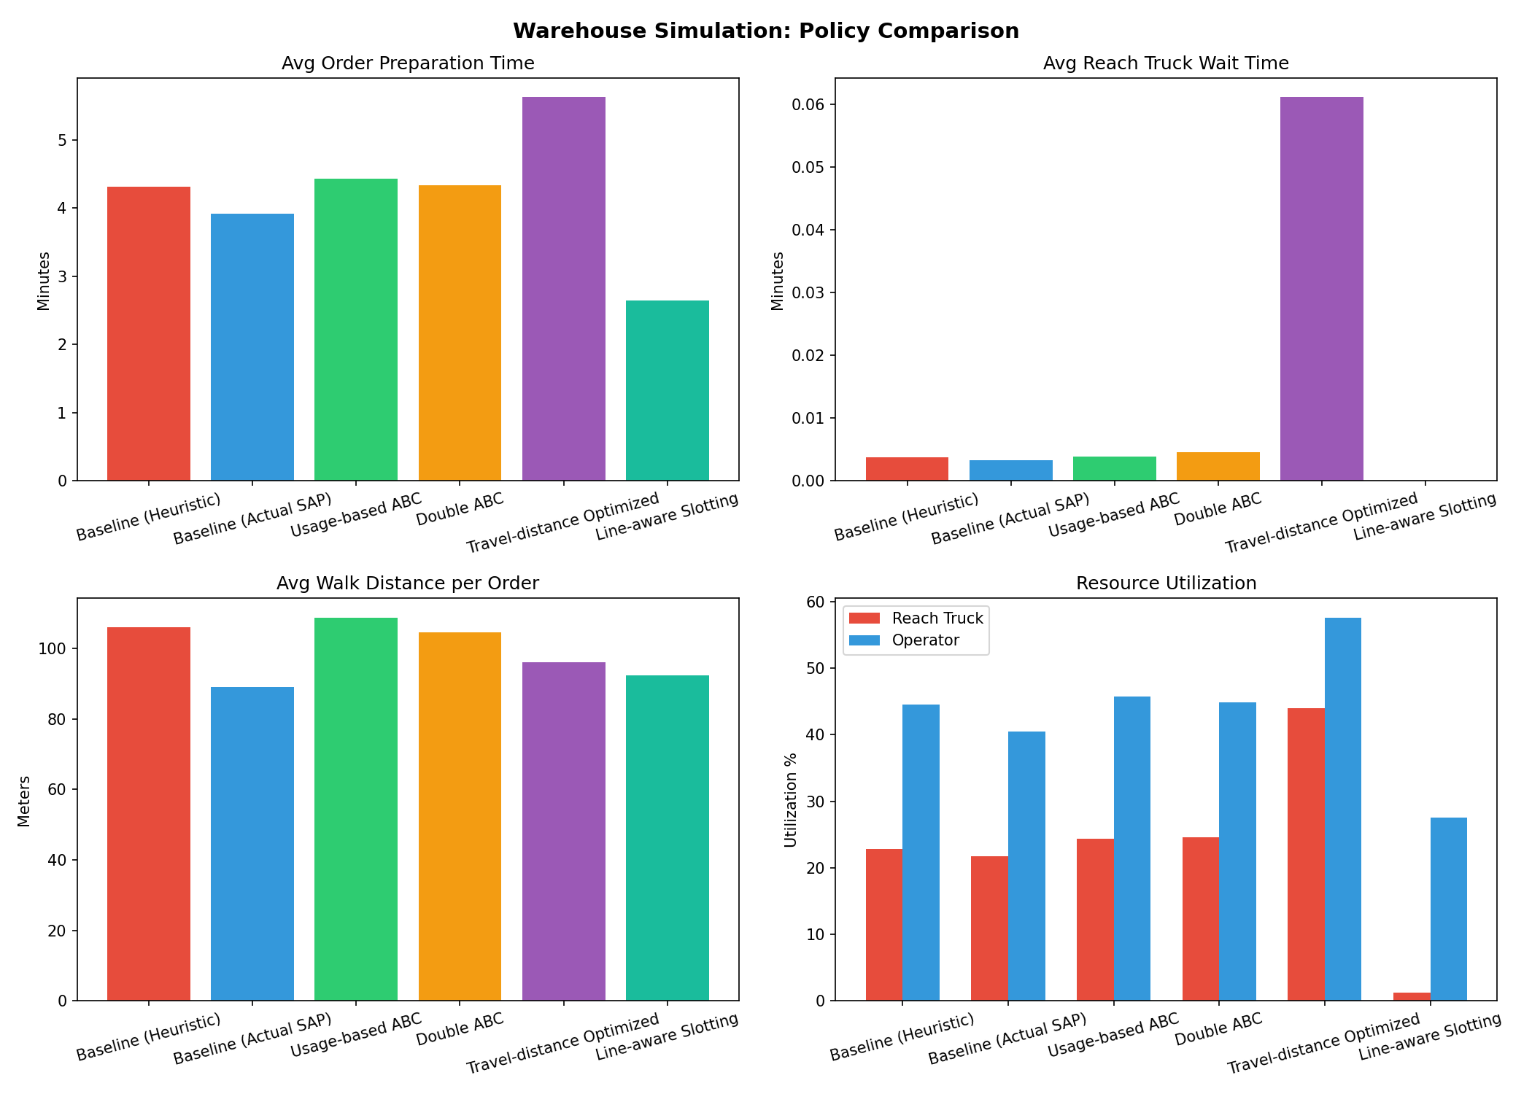
Results — KPI Overview
6.91 ± 0.47 min
12.37 ± 1.07 min
−44% (−5.46 min)
21.7% → 1.3%
Line-aware lead time
SAP baseline
Lead-time improvement
RT util SAP → Line-aware
Notes:
The big picture: Line-aware halves lead time compared to every other policy. The middle cluster (Heuristic, Usage-ABC, Double-ABC) are statistically indistinguishable from each other. Travel-distance optimized is the worst performer despite minimizing walk distance — it parks high-frequency items on RT-required shelves, triggering bottleneck queuing. Throughput is identical across all policies (ANOVA p = 1.000).

Slide 11
Results — Statistical Tests
One-Way ANOVA (6 policies, 20 reps each)
Replication-Paired t-test vs. SAP (CRN, N = 20)
KPI | F | d.f. | p-value
Kitting lead time (min) | 47.07 | (5,114) | 3.55 × 10⁻²⁶
Total waiting time (min) | 33.09 | (5,114) | 9.86 × 10⁻²¹
Reach-truck utilization | 430.06 | (5,114) | 3.19 × 10⁻⁷²
Throughput (orders/day) | 0.01 | (5,114) | 1.000 ← no diff
Walk distance (m/order) | 464.15 | (5,114) | 5.12 × 10⁻⁷⁴
Policy vs. SAP | Mean diff. | t | p-value
Capacity heuristic | +2.34 min | 11.27 | 7.47 × 10⁻¹⁰
Usage-based ABC | +2.87 min | 9.97 | 5.50 × 10⁻⁰⁹
Double ABC | +2.37 min | 10.05 | 4.85 × 10⁻⁰⁹
Travel-dist. opt. | +12.23 min | 10.06 | 4.82 × 10⁻⁰⁹
Line-aware slotting ★ | −5.46 min | −17.47 | 3.68 × 10⁻¹³
Tukey HSD: Middle cluster (Heuristic, Usage-ABC, Double-ABC) are statistically indistinguishable (all pairwise p > 0.15). Line-aware separates from ALL others (p < 10⁻⁸). Travel-distance worst (p < 10⁻⁸ worse than SAP). ANOVA throughput p = 1.000: capacity is preserved.
Notes:
Both tables together confirm: (1) policy choice matters massively for lead time and RT utilization; (2) it does NOT affect throughput; (3) Line-aware is uniquely dominant. The paired-t is the primary test — paired CRN pairs give t = −17.47 for Line-aware vs SAP, which is an extraordinarily strong signal.

Slide 12
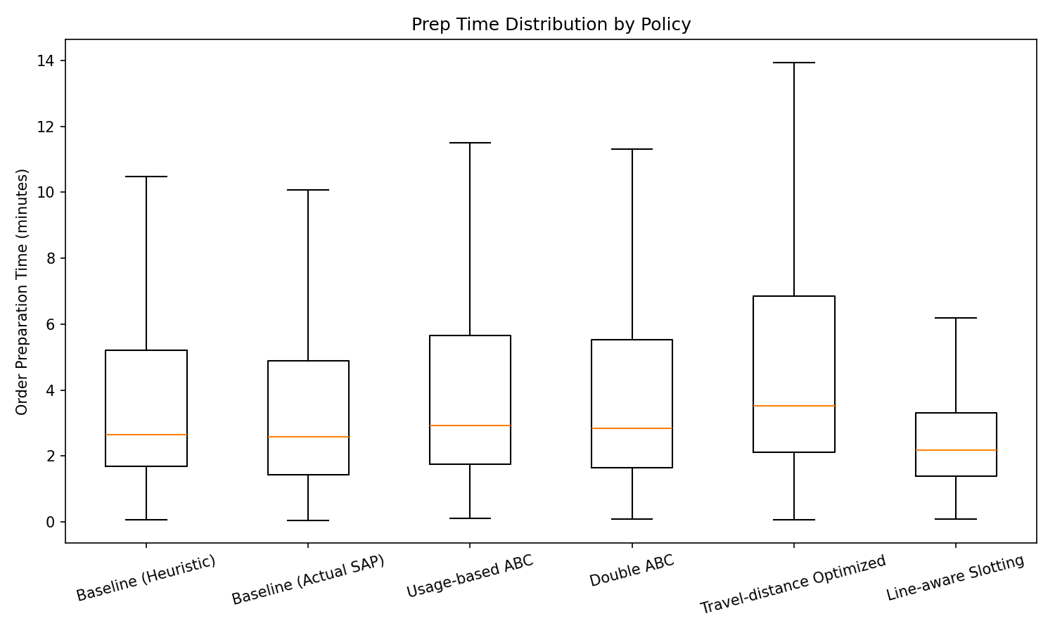
Why It Works — Queue Leverage
Walk distance range is narrow: 89–109 m across all policies (±10%)
Lead time range is vast: 6.9–24.6 min — a 3.6× spread
Root cause: RT is a shared bottleneck; queuing amplifies any additional RT demand
Line-aware → RT util 1.3% vs SAP 21.7% (Travel-dist 44%)
Preparation (wait + pick) time distribution by policy
Stress test at 2× load:
Line-aware 6.2 → 20.7 min
SAP baseline 13.5 → 34.1 min
→ Advantage grows under load
Notes:
The key insight is counterintuitive: distance is nearly the same across all policies, but lead time varies enormously. The queueing bottleneck — not walking — dominates. Little's Law in action: if RT utilization doubles, wait time more than doubles. The stress-test result (advantage grows at 2× load) confirms this is a structural property, not an artifact of calibration.

Slide 13
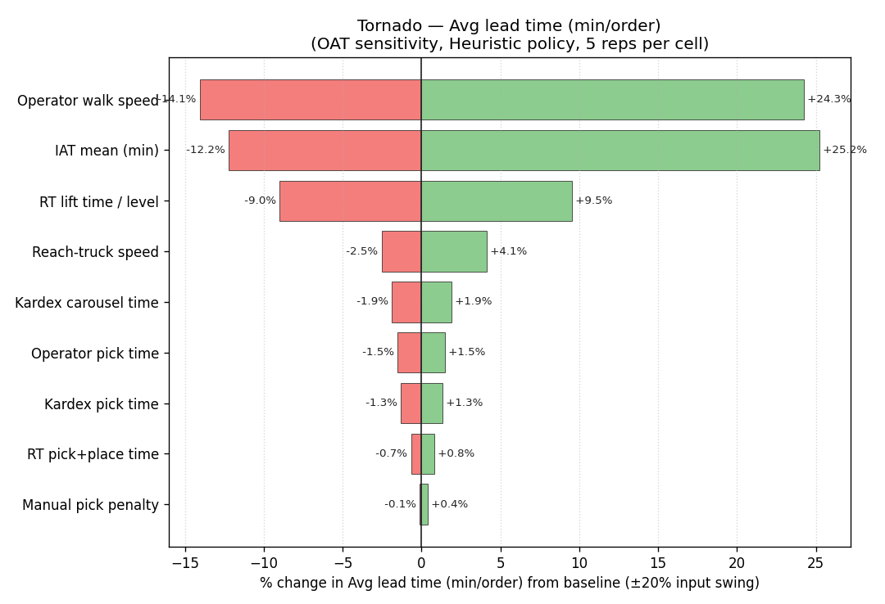
Sensitivity Analysis — Ranking Robustness
OAT tornado: pick times, arrival rate, RT count, warm-up
Line-aware ranking robust across all ±30% perturbations
RT-utilization gap (≈20 pp) preserved throughout
Tornado chart — avg. kitting lead time (OAT ±30%)
Notes:
Sensitivity analysis confirms that the ranking is not fragile. The arrival rate is the most influential parameter — at 2× load, absolute lead times grow for all policies but the relative advantage of Line-aware grows rather than shrinks. This is the structural argument against the 'upper bound' criticism: the mechanism is robust.

Slide 14
Recommendation & Conclusion
Line-aware slotting: −44% lead time (6.91 vs 12.37 min), t = −17.47, p = 3.68 × 10⁻¹³, throughput unchanged
Pilot recommendation
Phase-in strategy
Reslot 50–100 fast-movers for a single product line to manual-access levels. Measure actual lead time before/after.
Priority: top-20 high-pick materials per line (X14 panel analysis). Zero new hardware required.
Stress-test evidence
Throughput preserved
At 2× daily volume: Line-aware 20.7 min vs SAP 34.1 min — the advantage grows, confirming structural improvement.
ANOVA p = 1.000 for orders/day: the recommendation does not risk capacity. RT is freed, not overloaded.
Notes:
Practical implication: the pilot requires no capital expenditure — only a reslotting exercise on ~50–100 bins. The simulation suggests a 5-minute reduction per order at current load; at peak load the benefit is even larger. Throughput is statistically invariant across policies, so there is no capacity risk.

Slide 15
Limitations & Future Work
Known Limitations
Future Work
F400 timing extrapolated to all 9 families — per-line video needed
SAP decode rate 12.6%; remaining 87.4% use FMR fallback
In-sample fit only: Jan–May 2026 data, no holdout (Spearman ρ = 0.73 suggests stability)
Replenishment & slot depletion out of scope — affects absolute lead times, not ranking
Holdout validation: new 2–3 month ZWM92 export for out-of-sample test
Per-line time-motion studies for each product family
X14 pilot: reslot top-20 materials for one line, measure real lead time
Replenishment integration: slot-capacity depletion and scheduling
Notes:
On the '44% upper bound' question: it is upper bound because the policy was optimized on the same data period used to evaluate it. Temporal Spearman ρ = 0.73 (first vs second half of the log) suggests the ranking is stable, but the magnitude may shrink on new data. We state this clearly in the report and consider it a design choice, not a flaw — a prospective RCT would require withholding a production improvement during the study period.

Slide 16
Questions & Discussion
“In a shared-resource kitting environment,
the path to a shorter order runs through the queue,
not through the aisle.”
−44%
20.4 pp
p = 3.68×10⁻¹³
p = 1.000
Lead-time reduction
RT util. freed
Paired t (N = 20 CRN)
Throughput unchanged
Thank you
Deniz Ege Memetoğlu · denizegememetoglu@gmail.com · IUE Industrial Engineering
Notes:
Closing: repeat the one-sentence summary. Offer to discuss any of the 10 defense questions from the defense notes. Key numbers to have ready: paired-t t=−17.47 p=3.68e−13; ANOVA F=47.07 df=(5,114) p=3.55e−26; Cramér's V=0.216; daily volume error −4.6%. Stress test: Line-aware 6.2→20.7 min vs SAP 13.5→34.1 min at 2× load.

