Slide 1
ING Hubs Data Scientist Case Study

Slide 2
Exploratory Data Analysis
There are 40000 customers.

Slide 3
Exploratory Data Analysis
The major (40%) loan reason is car.

Slide 4
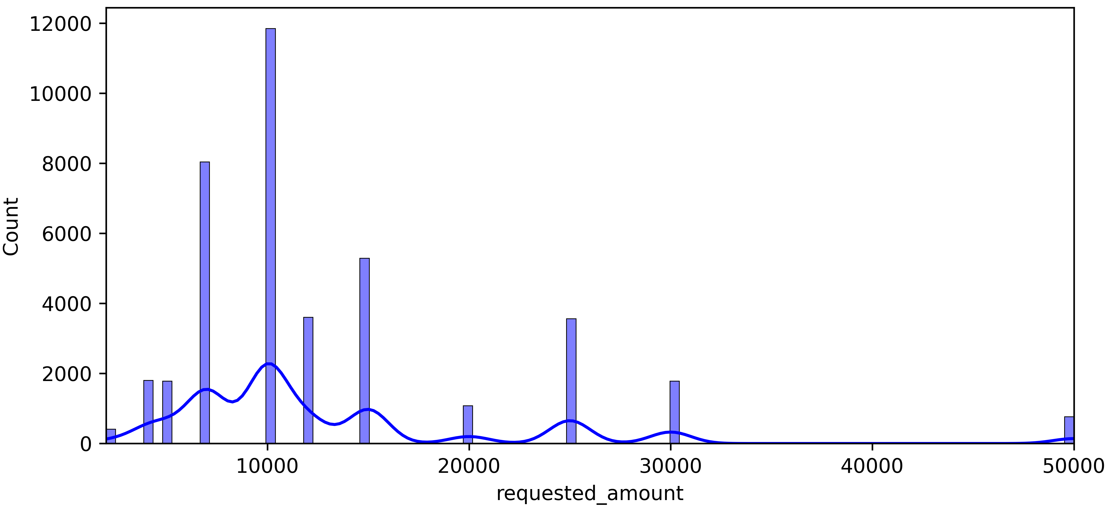
Exploratory Data Analysis
Most loan applicants have requested a loan amount of approximately $10,000.
Distribution of Requested Amount

Slide 5
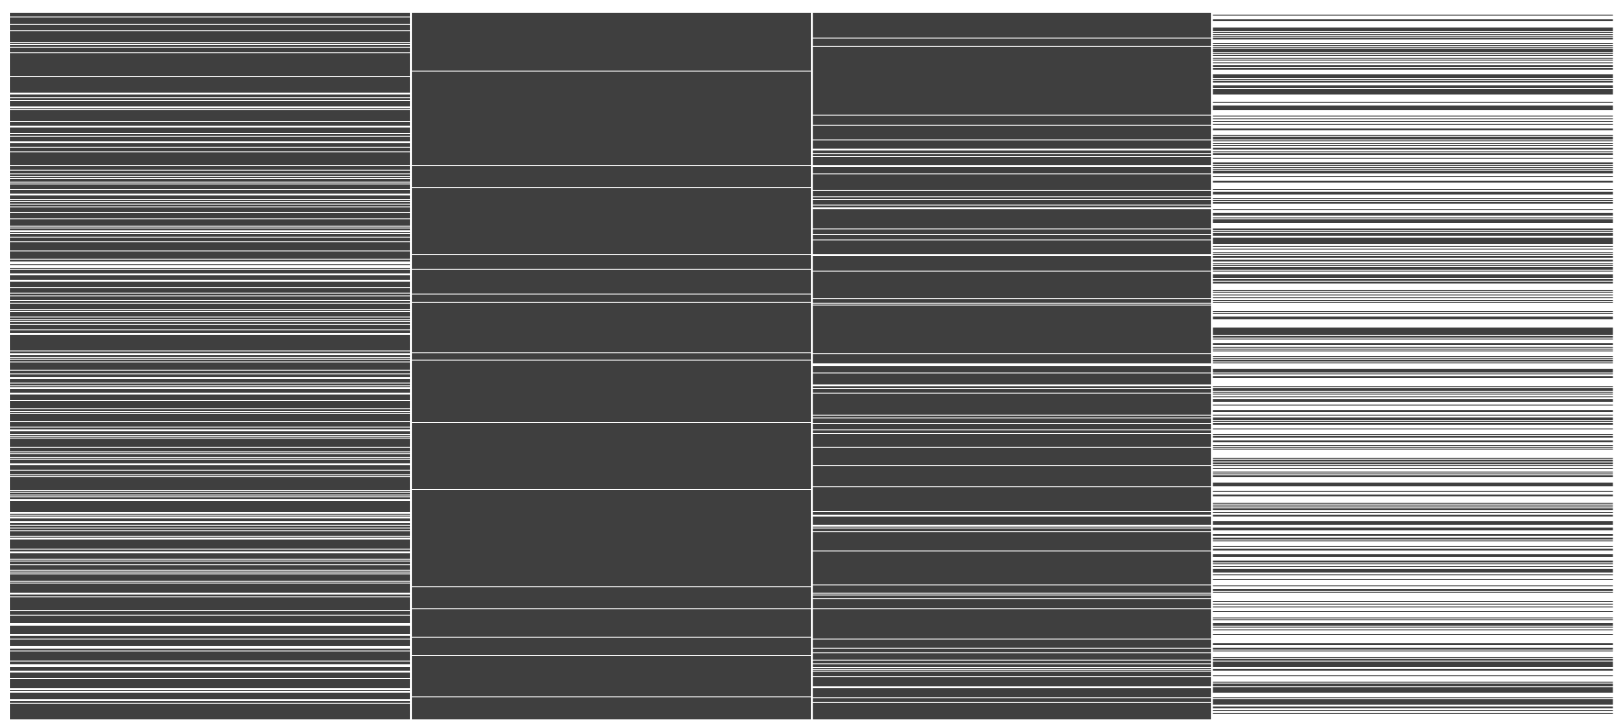
Exploratory Data Analysis
3 years customer financials data such as salary, current account balance, saving account balance, credit card balance. There are some NaN values in these columns; however, no apparent relationship is observed.
salary
current_acc_balance
saving_acc_balance
credit_card_balance

Slide 6
Exploratory Data Analysis
I have defined the target variable as a delay in payment of at least one month. In other words, the target value will be 1 for those who are late at least one month, and 0 for those who are not. The reason for this definition is that customers who are even a month late in their payments could potentially cause financial losses for the bank, which is an undesirable situation.

Slide 7
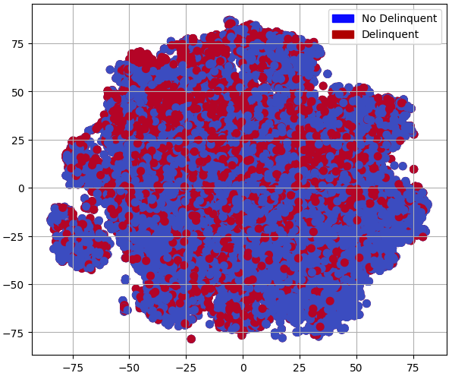
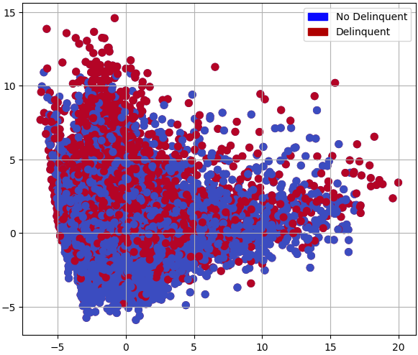
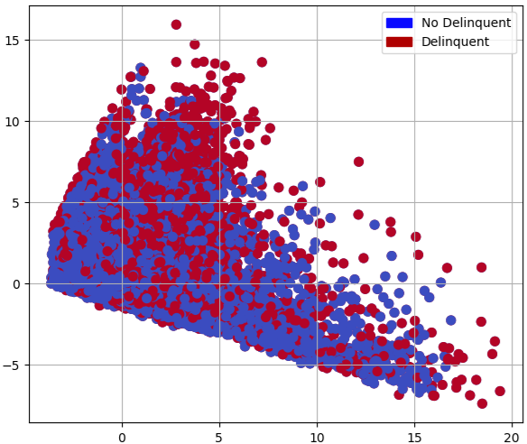
Exploratory Data Analysis
After determining the target variable, I used some dimensionality reduction techniques such as t-SNE, PCA, and SVD to see how well the data is separated according to the target variable. However, as shown in the visuals below, it seems that the separation is not very clear.
t-SNE
PCA
Truncated SVD

Slide 8
Feature Engineering
I added the following new features to the model to enhance its robustness and performance:
Financial Features
Statistical Features
Date Features
salary, current_acc_balance, saving_acc_balance, credit_card_balance
Mean, median, std, min, max of financial features
age : (date-birth_date),
tenure : (date-joined_ING_date)
Ratio Features
Additional Features
Encoding
installment / salary
installment / salary_std,
installment / current_acc_std,
installment / saving_acc_std,
installment / credit_card_std
zero_account,
request_segment
One Hot Encoding:
loan_reason,
gender,
religion,
employment,
postal_code

Slide 9
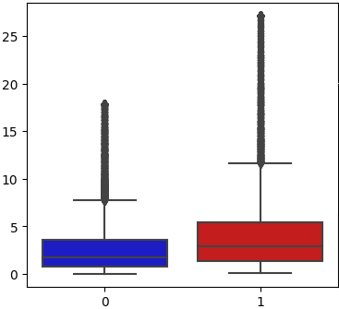
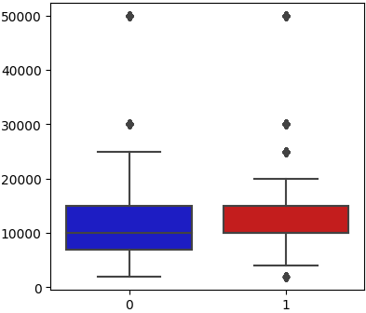
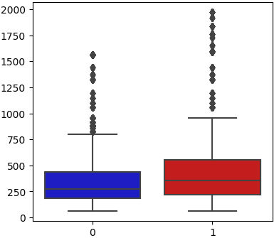
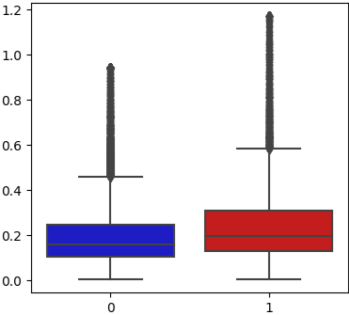
Outliers
Below, you see the box plot for some of the variables that have the highest correlation with the target variable. Also, you can see the outliers. Therefore, I split the dataset into two based on the target variable and applied the IQR method to replace the outliers using the 10th and 90th percentiles as thresholds.
install_saving_acc_std
request_amount
installment
install_salary_ratio
target
target
target
target

Slide 10
Stratified Train – Validation – Test
Train Data: 31200 rows
Validation Data: 7800 rows
Test Data: 1000 rows

Slide 11
KNN Imputing
Fit
Fitted the scaler and imputer using the training dataset.
Scaled the values using
MinMax scaler.
Scale
Filled the NaN values using the KNN imputer.
Impute
Applied inverse transform to the values.
No missing values anymore.

Slide 12
Model Selection
Model | F1 | Recall | Precision | Accuracy
CatBoost | 70.1 % | 72.4 % | 68.0 % | 76.4 %
LightGBM | 69.9 % | 73.0 % | 67.1 % | 76.0 %
XGBoost | 65.5 % | 59.6 % | 72.8 % | 76.0 %
RandomForest | 60.0 % | 50.3 % | 74.3 % | 74.3 %
I have used class weights.

Slide 13
Sampling Selection
Sampling | F1 | Recall | Precision | Accuracy
SMOTETomek | 70.7 % | 76.0 % | 66.1 % | 76.0 %
TomekLinks Un. | 70.5 % | 77.6 % | 64.5 % | 75.1 %
SMOTE | 70.1 % | 73.3 % | 67.1 % | 76.1 %
None | 70.0 % | 72.3 % | 67.9 % | 76.4 %
Random Over. | 70.0 % | 81.8 % | 61.2 % | 73.2 %
Random Under. | 69.2 % | 84.3 % | 58.8 % | 71.4 %
SMOTEEN | 65.6 % | 79.4 % | 55.9 % | 68.2 %

Slide 14
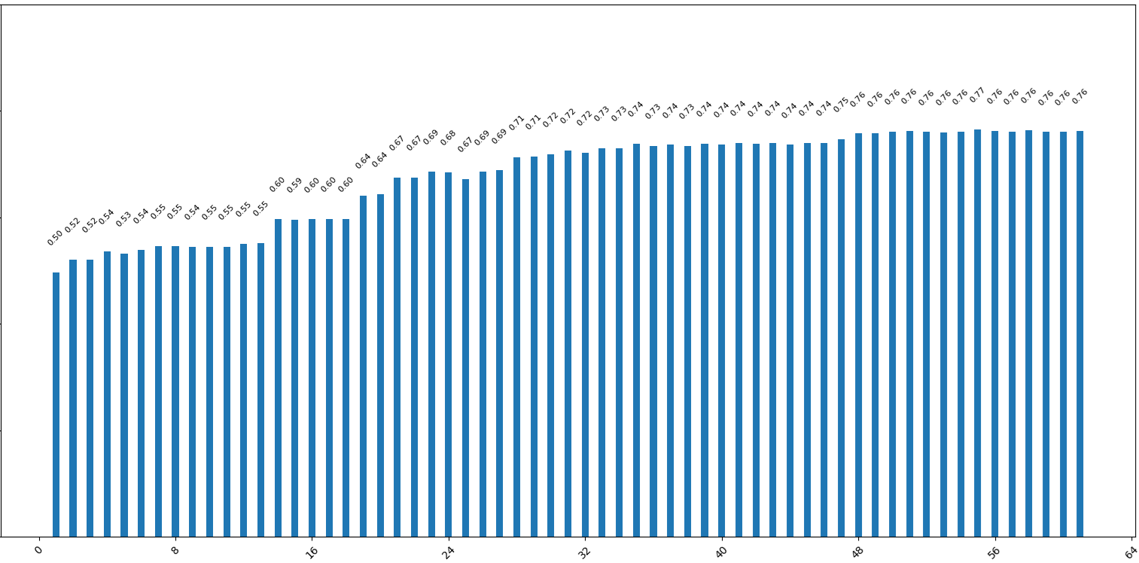
Feature Selection
Since using RFE to determine the number of features is computationally expensive, I used mutual information to decide the number of features and then applied RFE to select the top features.
F1 Scores
Number of features

Slide 15
Recursive Feature Elimination
I used the Recursive Feature Elimination technique to select the top 50 features.

Slide 16
Hyperparameter Optimization
I used Optuna, an open-source library, for hyperparameter optimization and ran it on the validation set for an hour, but it did not result in any significant performance improvement.
Therefore, I didn’t make any extensive changes to the model’s hyperparameters but only used class weights.

Slide 17
Final Model
Dataset | F1 | Recall | Precision | ROC AUC | Accuracy
Train | 83.0 % | 90.6 % | 77.5 % | 94.8 % | 86.3 %
Validation | 70.3 % | 75.4 % | 65.8 % | 84.6 % | 75.7 %
Test | 60.3 % | 89.0 % | 45.5 % | 68.5 % | 55.1 %

Slide 18
Recommendations
If I had more time, I’d have liked to do the followings:
Cross Validation: Use cross-validation to prevent overfitting by evaluating the model on multiple data splits.
Early Stopping: Play with early stopping parameter to prevent overfitting.
Regularization: Tune L1 and L2 hyperparameters to prevent overfitting.
Different Models: Try other model architectures such neural network and check out performance.
Scaler & Imputer: Re-control scaler and imputer since they might lead to data leakage.

Slide 19
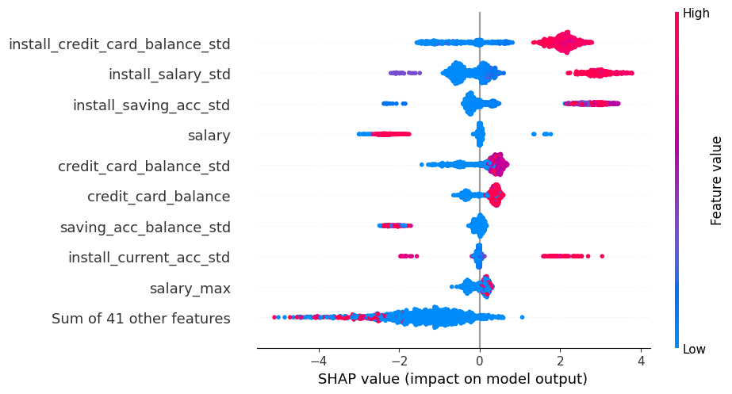
Feature Analysis
I used SHAP library to identify the most important features:

Slide 20
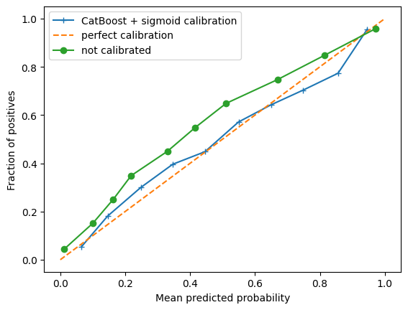
Calibrated Model
I calibrated the model using the sigmoid method because I think that probabilities are more important than labels in this case.

Slide 21
Deployment!
Please visit:
Streamlit
Docker Hub

