Slide 1
<ANALYSIS OF STAND-ALONE C PROGRAMS>
<Deniz İskender
Begüm Demirel>

Slide 2
Summary
Application domain?
stand-alone C programs
Problem?
analysis and modelling of programs and systems
Goal?
Combine Concolic testing and PRISM tool to analyze programs and make comments about them.

Slide 3
Tools, Techniques, Methods
Tools: CUTE, CREST, PRISM
Languages: C, PRISM Language
Methods considered: Concolic Testing
Deliverables:
outputs of Concolic testing and PRISM
codes and errors which are detected by PRISM
WCET analysis which is done BY PRISM
Any comments about programs

Slide 4
Current Progress
Undestanding of Concolic Testing
Understanding and usage of CREST tool
Understanding and usage of PRISM language and tool
Challenges
CUTE and DART are not available for download
combination with Concolic testing and PRISM tool

Slide 5
Concolic Testing CONCrete execution + symbOLIC execution Tools CATG (https://github.com/ksen007/janala2 - Java) Jalangi (https://github.com/SRA-SiliconValley/jalangi - Js) CUTE (http://osl.cs.illinois.edu/software/jcute/ -> C) CREST (http://www.burn.im/crest/ -> new version of CUTE) KLEE(https://klee.github.io/ )

Slide 6
CREST
Concolic test generation tool for C
Uses CIL (C Intermediate Language) to instrument C programs
To generate a symbolic input, use methods CREST_int, CREST_char, etc.

Slide 7
Running CREST
crestc .c <filename>.c
<filename>.cil.c (instrumented C file)
branches (list of paired branches)
<filename> (executable file)
run_crest ./filename <n> <Strategy>
n = number of iterations
Strategy = (dfs, cfg, random, random_input, hybrid)
coverage (list of IDs of all covered branches)

Slide 8
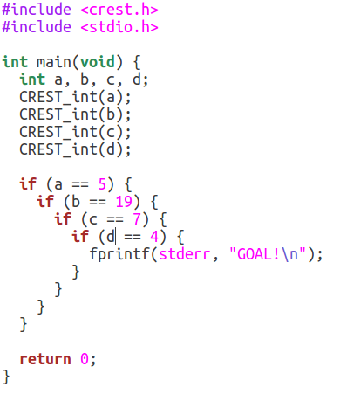
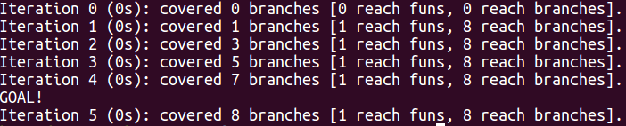


UNIFORM TEST EXAMPLE
../bin/run_crest ./uniform_test 10 -dfs
2. Console output
4. Coverage
3. Branches
1. C code

Slide 9
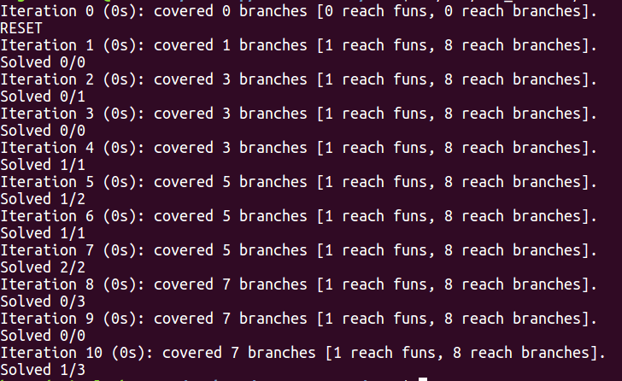
../bin/run_crest ./uniform_test 10 -random
2. Console output
1. C code

Slide 10
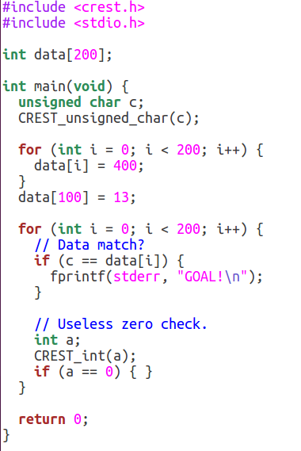
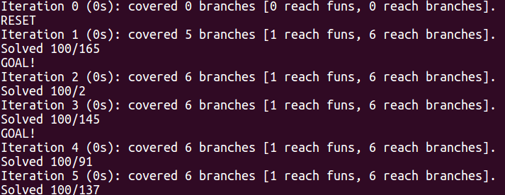
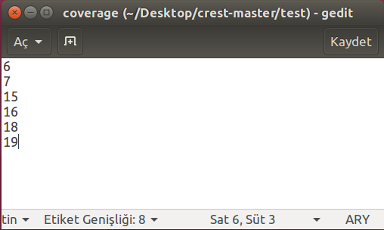
CFG SEARCH TEST EXAMPLE
../bin/run_crest ./cfg_search_test 5 -random
2. Console output
3. Coverage
1. C code

Slide 11
PRISM
is a probabilistic model checker
models and analyze systems that show random or probabilistic behaviour.
analyze systems from many different application domains, including communication and multimedia protocols.
Models are described using the PRISM language

Slide 12
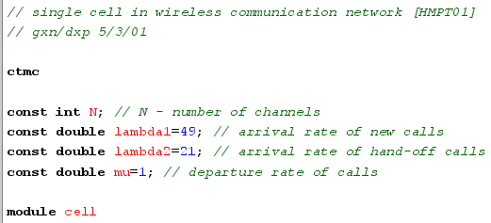

PRISM Probabilistic models:
discrete-time Markov chains (DTMCs)
continuous-time Markov chains (CTMCs)
Markov decision processes (MDPs)
probabilistic automata (PAs)
probabilistic timed automata (PTAs)

Slide 13
PRISM CAN ANSWER ...
"what is the probability of a failure ……?"
"what is the worst-case probability of ….?"
"what is the expected size of …..?"
"what is the worst-case expected time ..?"

Slide 14
PRISM LANGUAGE
- (unary minus)
*, / (multiplication, division)
+, - (addition, subtraction)
<, <=, >=, > (relational operators)
=, != (equality operators)
! (negation)
& (conjunction)
| (disjunction)
<=> (if-and-only-if)
=> (implication)
? (condition evaluation: condition ? a : b means "if condition is true then a else b")
SIMPLE AND UNDERSTANDABLE LANGUAGE!

Slide 15
Example 1
// Example 1 // M1 and M2, one representing each process mdp // supported probablistic models like DTMCs, CTMCs, MDPs and PTAs. module M1 x : [0..2] init 0; // each module has one integer variable with range [0..2] [] x=0 -> 0.8:(x'=0) + 0.2:(x'=1); // The guard x=0 indicates that this describes the behaviour of the module when the variable x has value 0
[] x=1 & y!=2 -> (x'=2); // the behaviour of one module can depend on the state of another [] x=2 -> 0.5:(x'=2) + 0.5:(x'=0); endmodule module M2 y : [0..2] init 0; [] y=0 -> 0.8:(y'=0) + 0.2:(y'=1); [] y=1 & x!=2 -> (y'=2); [] y=2 -> 0.5:(y'=2) + 0.5:(y'=0); endmodule

Slide 16
Example 2
// Example 2 // N-place queue + server ctmc // Constants can be integers, doubles or Booleans const int N = 10; const double mu = 1/10; const double lambda = 1/2; const double gamma = 1/3; module queue q : [0..N]; [] q<N -> mu:(q'=q+1); [] q=N -> mu:(q'=q); [serve] q>0 -> lambda:(q'=q-1); endmodule module server s : [0..1]; [serve] s=0 -> 1:(s'=1); [] s=1 -> gamma:(s'=0); endmodule

Slide 17
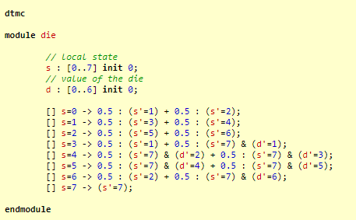
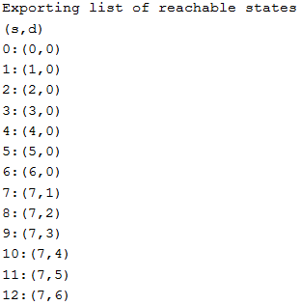
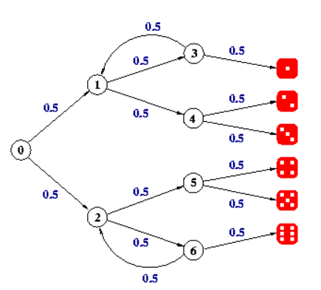
RUNNING PRISM

Slide 18
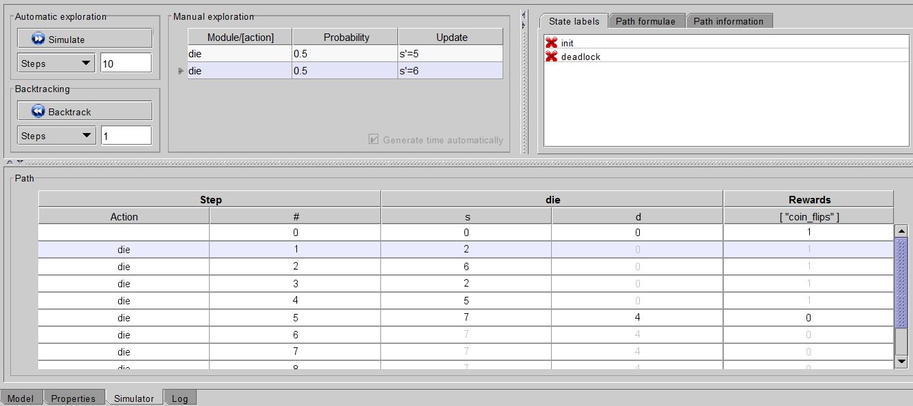
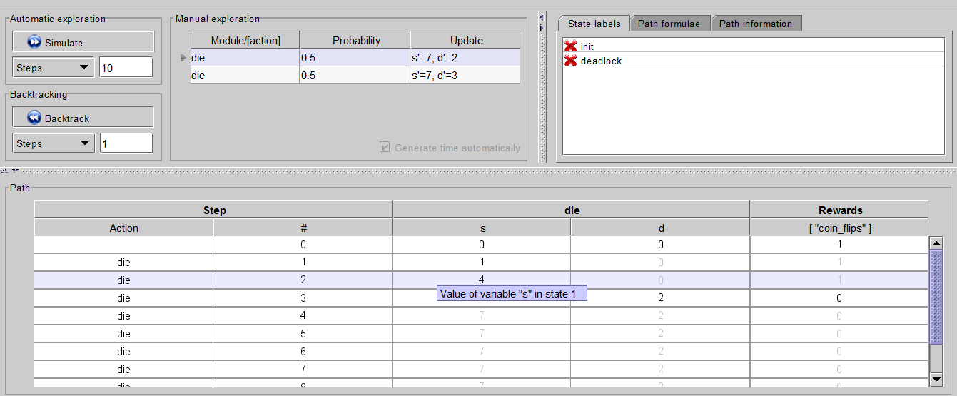
POSSIBLE SCENARIOS

Slide 19
Other Probabilistic Model Checkers
Model checkers for discrete-/continuous-time Markov chains (DTMCs/CTMCs)
PARAM
INFAMY
CASPA
Model checkers for Markov decision processes (MDPs):
PASS
RAPTURE
Model checkers for probabilistic timed automata (PTAs):
FORTUNA
UPPAAL-PRO
Approximate (statistical) probabilistic model checkers:
VESTA
PRISM-U2B
COSMOS
PLASMA

Slide 20

Future Work
Other concolic testing tools
Other model checking tools
Maybe, suitable adapter(parser) to connect Concolic testing results and model checking tools

