Slide 1
<ANALYSIS OF STAND-ALONE C PROGRAMS>
<Deniz İskender
Begüm Demirel>
Notes:
1

Slide 2
Summary
Application domain?
stand-alone C programs
Problem?
analysis and modelling of programs and systems
Goal?
To achieve execution time and WCET analysis by Concolic testing and PRISM
CS 575 Project Progress Presentation
1

Slide 3
Tools, Techniques, Methods
Tools: CUTE, CREST, PRISM
Languages: C, PRISM Language
Methods considered: Concolic Testing
Deliverables:
outputs of Concolic testing(branch coverage) and PRISM
Execution time and WCET analysis which is done by PRISM
Execution time and WCET analysis which is done by Concolic testing
Any comments about programs
CS 575 Project Progress Presentation
1

Slide 4
Results
What is achieved?
- PRISM time results
- Concolic testing time results
How effective is the applied approach/tool?
- The results taken from PRISM does not provide real time information in terms seconds vs.
- However, they are useful in terms of comparing different versions of programs
- With different parameters and different configurations.
- Concolic testing results provide real execution time and worst case execution time in terms of seconds.
What are the limitations, observed issues?
- PRISM rewards can not be expressed in terms of real time.
CS 575 Project Progress Presentation
1

Slide 5
Results(PRISM)
the ability to achieve numerical data
By assigning a cost of one unit to each step of the algorithm, PRISM can be used to compute “the expected time (number of steps)
PRISM can calculate best- and worst-case performance and reliability measures like power consumption
CS 575 Project Progress Presentation
1

Slide 6
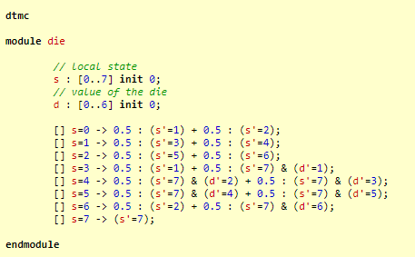
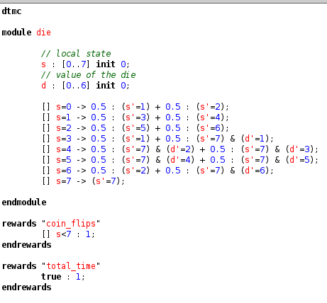
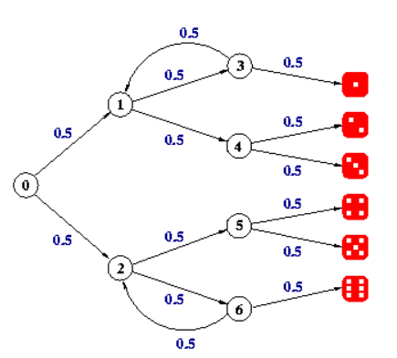
EXAMPLE 1(V1 VS V2)
CS 575 Project Progress Presentation
1

Slide 7
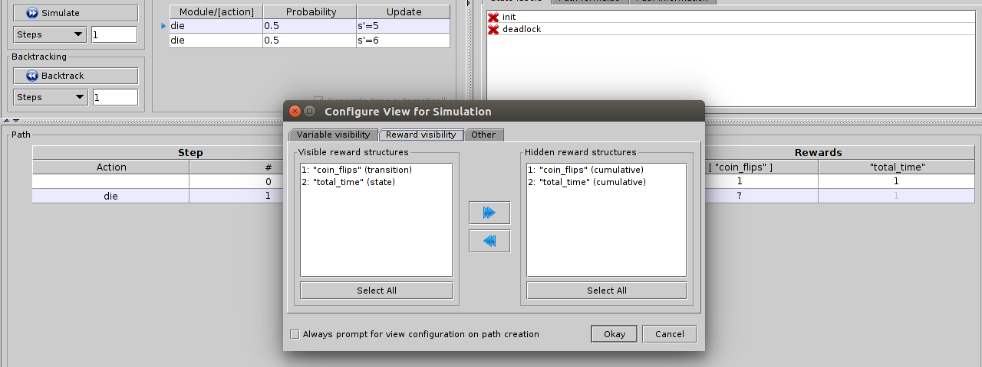
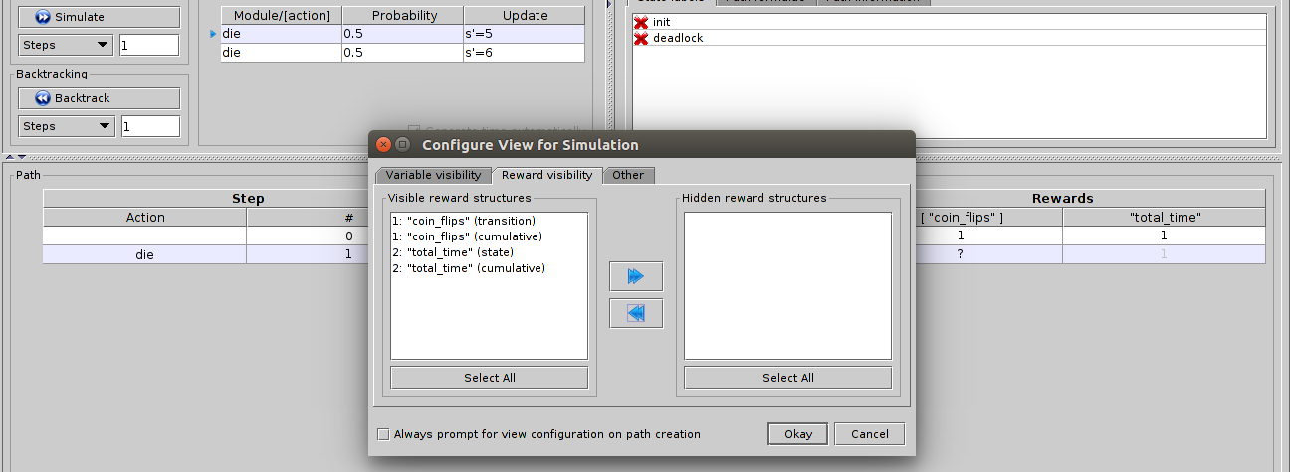

Slide 8
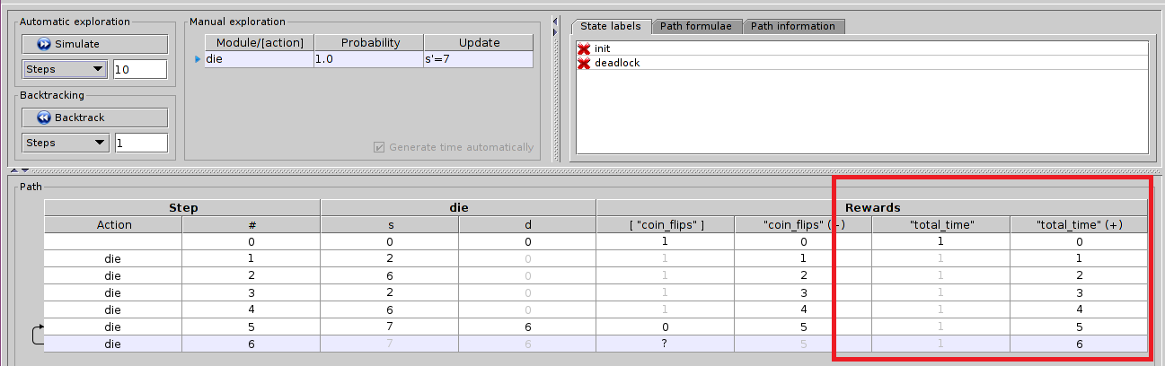

Slide 9
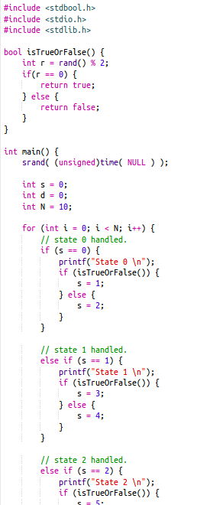
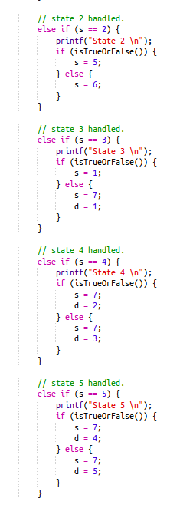
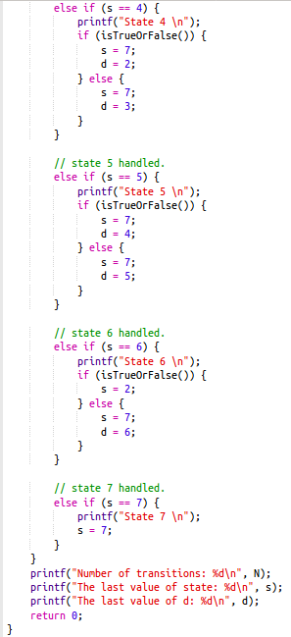

Slide 10
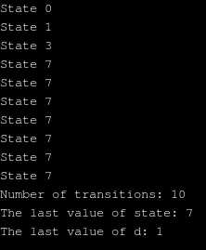
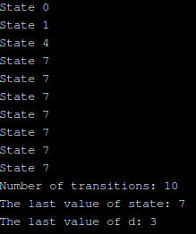
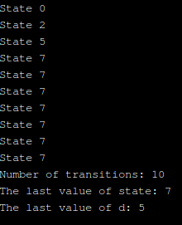
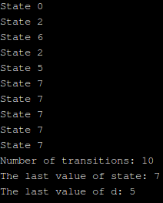
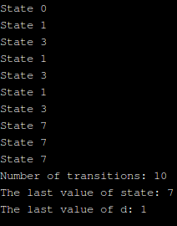
PROBABILISTIC BEHAVIOR

Slide 11
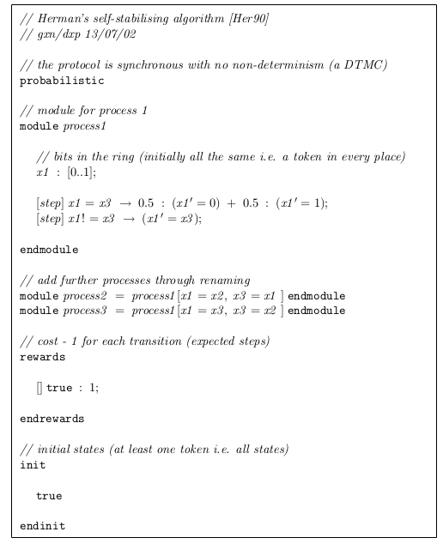
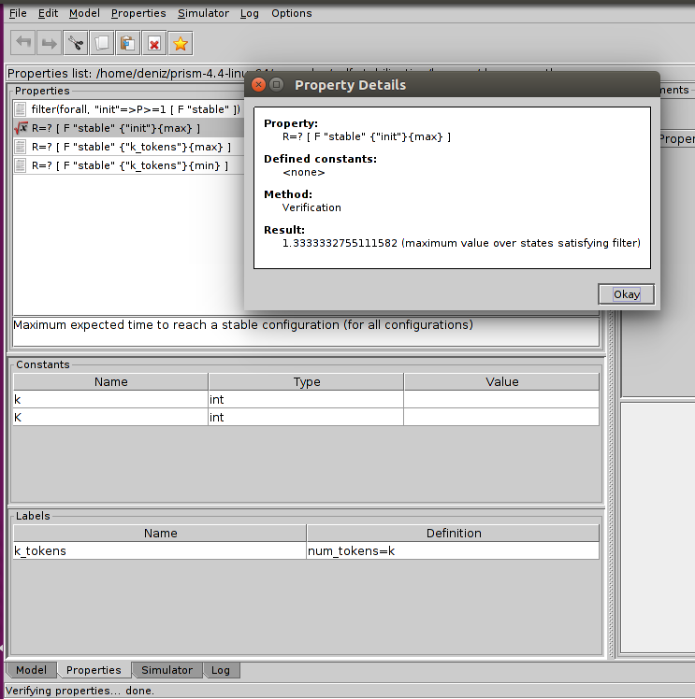
EXAMPLE 2

Slide 12
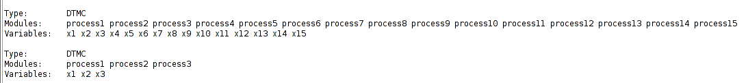
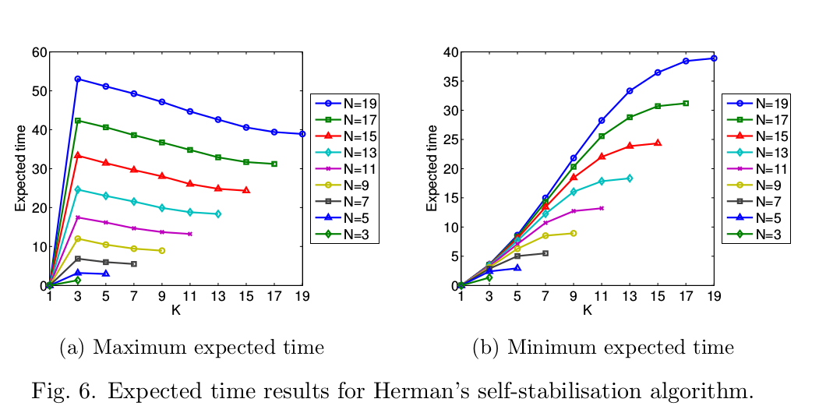

Slide 13
Results
The worst case execution time is obtained from CREST.
The difference between the starting and ending time of the program is calculated.

Slide 14
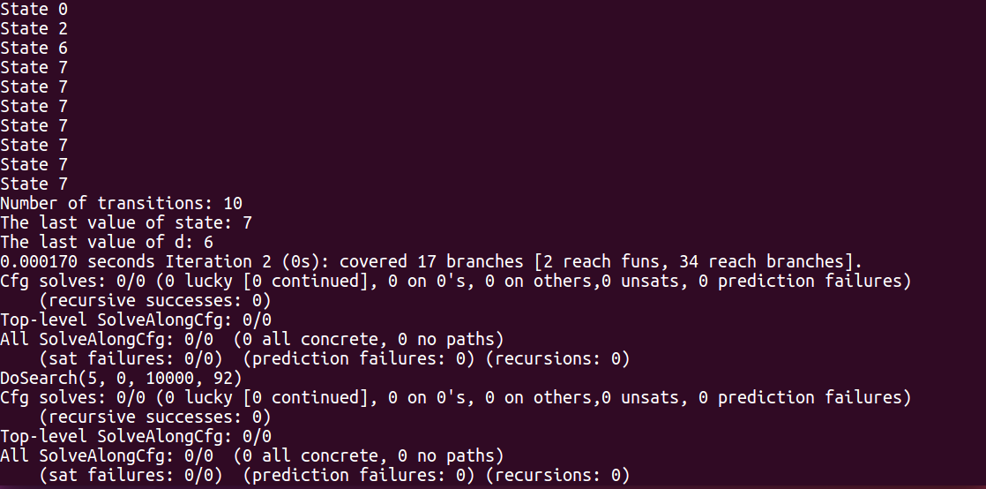
When executed with cfg (uncovered branch first) strategy;
Worst Case Execution Time: 0.000170 sec
Covered branches: 17

Slide 15
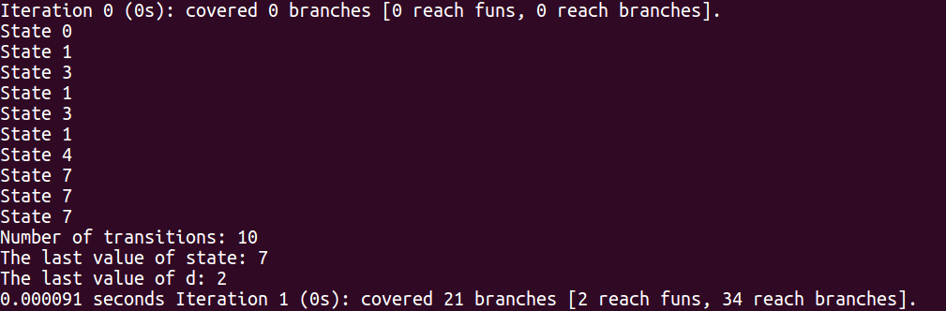
When executed with dfs (depth first search) strategy;
Worst Case Execution Time: 0.000091 sec
Covered branches: 21

