Slide 1
CHAOTIC SYSTEMS
Middle East Technical University
Institute of Applied Mathematics Department of Financial Mathematics Msc.
Deniz Kenan KILIÇ
12.03.2014
1

Slide 2
OUTLINE
INTRODUCTION to CHAOS
IMPORTANT SUBJECTS RELATED to CHAOS
IDENTIFYING and MODELING CHAOTIC SYSTEMS
CONCLUSION
2

Slide 3
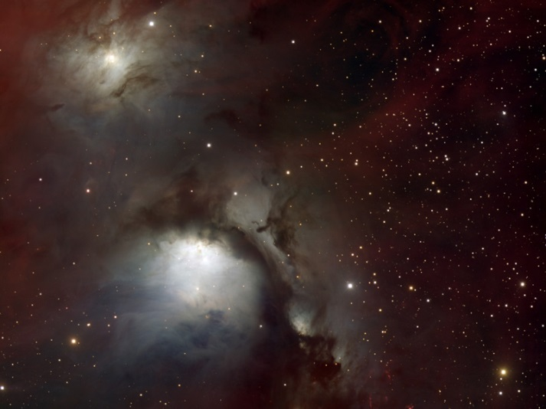
WHAT IS CHAOS?
Linear or nonlinear dynamical systems that exhibit deterministic behavior with a known initial condition (starting point).
Complex systems in geology,
mathematics, microbiology,
biology, computer science,
economics, engineering, finance,
algorithmic trading, meteorology,
philosophy, physics, politics,
population dynamics, psychology,
meteorology, robotics etc.
To make better predictions and to solve complex problems.
http://globaltransforming.files.wordpress.com/2012/06/universe.jpg
3

Slide 4

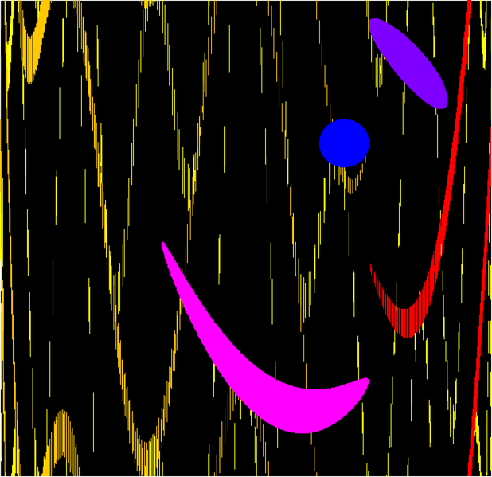
WHAT IS CHAOS?
Extreme sensitivity to initial conditions, ‘Butterfly Effect’.
Lorenz, a meteorologist and mathematician at Massachusetts Institute of Technology, used initial condition as 0.506 instead of 0.506127.
Prediction of long term nonlinear dynamic system is very difficult.
Chaos gives the transitions between order and disorder.
It is topologically mixing. Phase spaces are overlapping.
It gives feedbacks as in financial markets.
4
http://allacharade.tumblr.com/post/11955959425/warning-signs-for-tomorrow
http://en.wikipedia.org/wiki/File:Chaos_Topological_Mixing.png

Slide 5
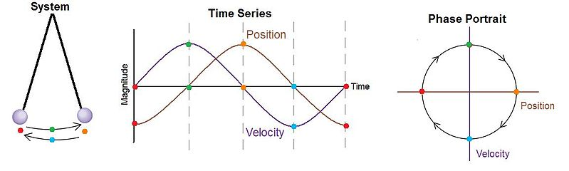
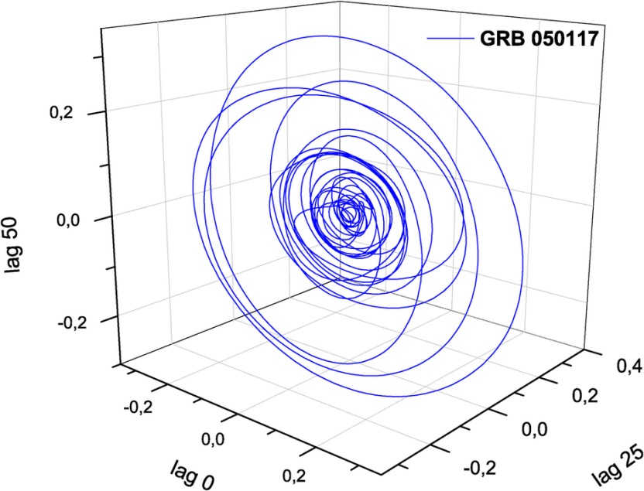
IMPORTANT SUBJECTS PHASE SPACE
All possible states of a system are represented.
Number of variables in the system is dimensionality.
Fig. Simple Pendulum
Simple example of phase space:
Checking account balance and savings account balance, (C,S) space.
Fig. Phase Space Portrait of the deterministic components discovered in the prompt emission from GRB 050117(gamma-ray bursts)
5
http://www.nature.com/srep/2011/110914/srep00091/fig_tab/srep00091_F5.html
http://en.wikipedia.org/wiki/File:Pendulum_Phase_Portrait.jpg

Slide 6
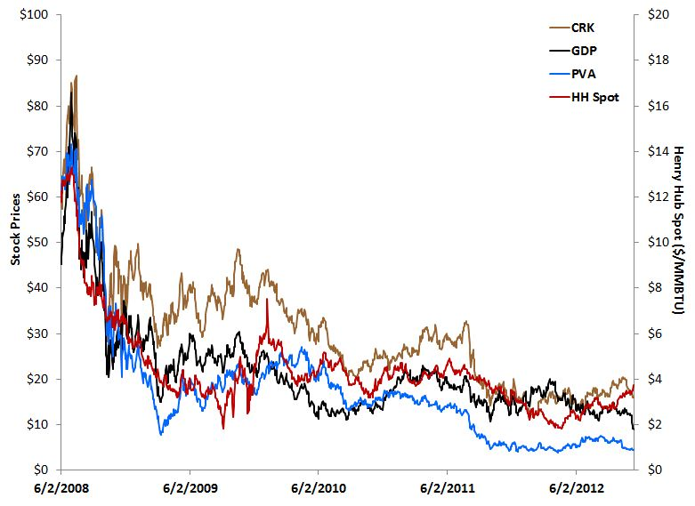
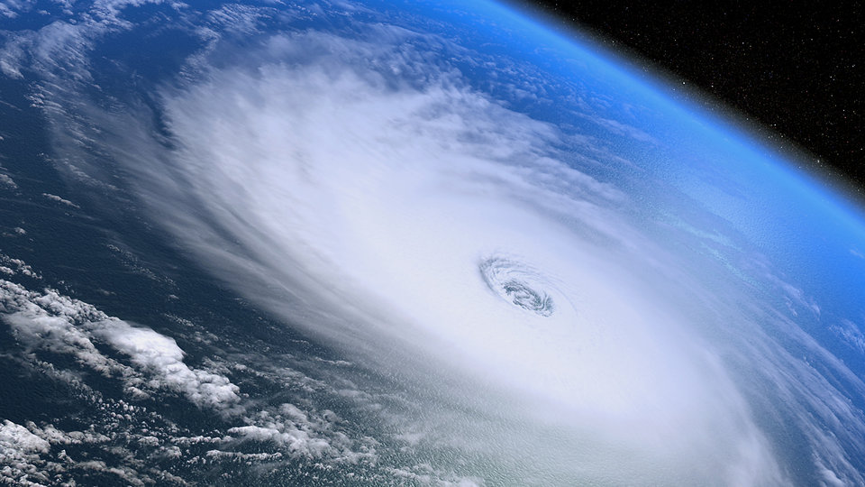
IMPORTANT SUBJECTS DYNAMICAL SYSTEM
The mathematical representation of the changing rules
Generally described by one or more differential or difference equations
Trajectory(periodic or chaotic) in phase space is orbit
Discrete(map) and continues(flow)
Linear and nonlinear systems
6
http://ruminationville.files.wordpress.com/2013/10/weather.jpg
http://theenergyharbinger.com/2012/11/14/eagle-ford-value-stock-search/

Slide 7
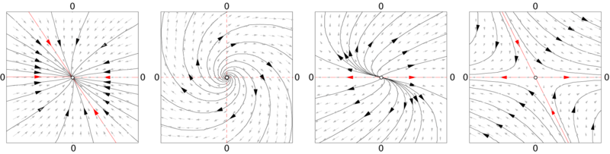
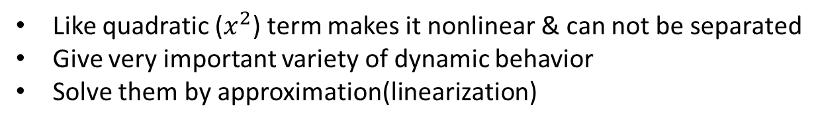
IMPORTANT SUBJECTS LINEAR vs. NONLINEAR SYSTEMS
x’=Ax where A is nxn matrix & for infinite dimensional behavior is chaotic
Combination of two solution is again solution
All linear systems are exactly solvable
Like quadratic ($x^{2}$) term makes it nonlinear & can not be separated
Give very important variety of dynamic behavior
Solve them by approximation(linearization)
7
http://en.wikipedia.org/wiki/File:LinearFields.png

Slide 8
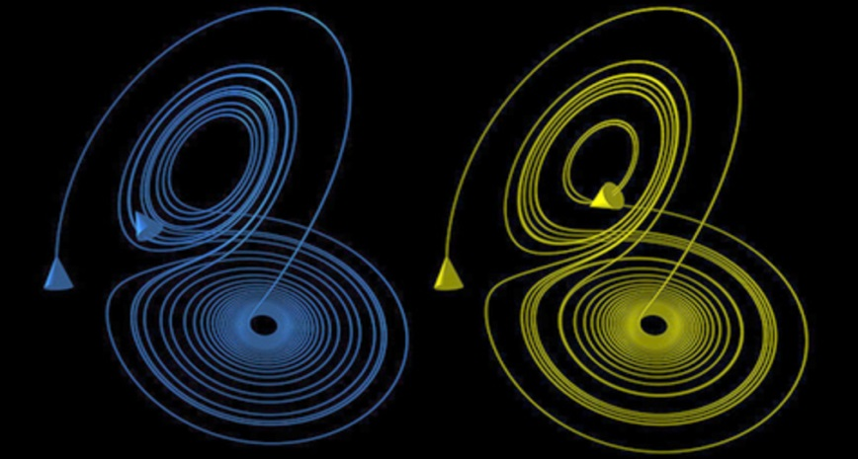
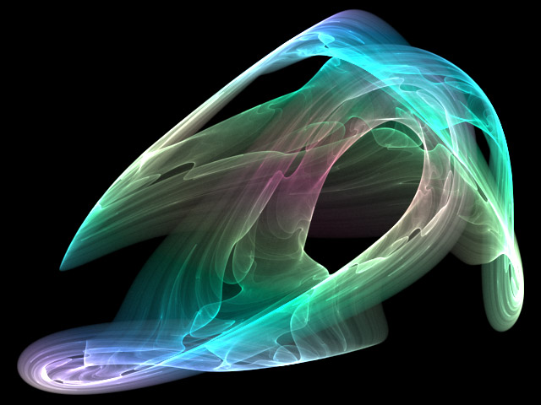
IMPORTANT SUBJECTS STRANGE ATTRACTORS
A pattern existing in a complex mathematical space (or in phase space).
It has a fractal structure(self-repeated)
It gives great detail and complexity
It is seen in both discrete and continues systems.
Fig. Two Lorenz orbits(sensitivity to initial conditions
Fig. Strange atractor Poisson Saturne
8
http://en.academic.ru/dic.nsf/enwiki/3487
http://en.wikipedia.org/wiki/File:Atractor_Poisson_Saturne.jpg

Slide 9
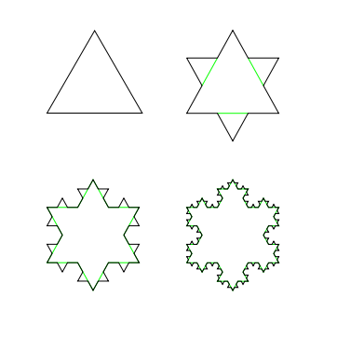
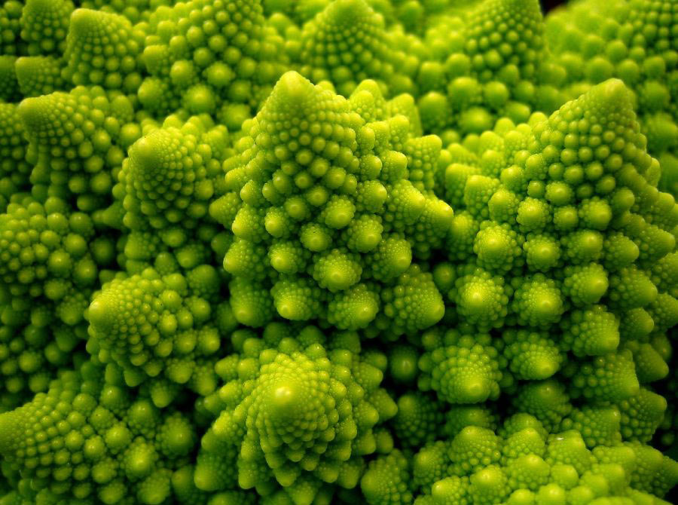
IMPORTANT SUBJECTS FRACTALS
Infinitely complex patterns that are self-similar across different scales
Images of dynamic systems – the pictures of Chaos
Nature is itself fractal: trees, rivers, coastlines, mountains, clouds, seashells, hurricanes, etc.
Fractal dimension: D = log (N) / log (1/r) where N is number of self-similar pieces and r is scaling factor.
For Koch snow flake, N=4, r=1/3, D=1.2619
Fig. Romanesco
broccoli
Fig. Koch snow flake
9
http://www.julieferwerda.com/2010/07/19/awesome-things-11-fractals/
http://en.wikipedia.org/wiki/File:KochFlake.svg

Slide 10
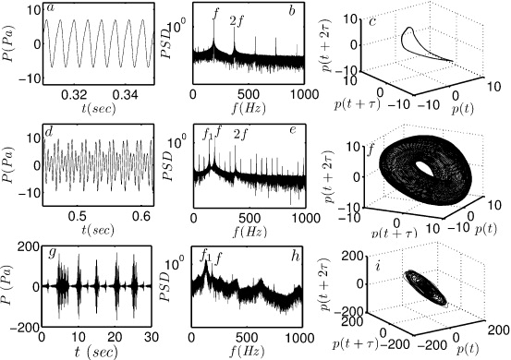
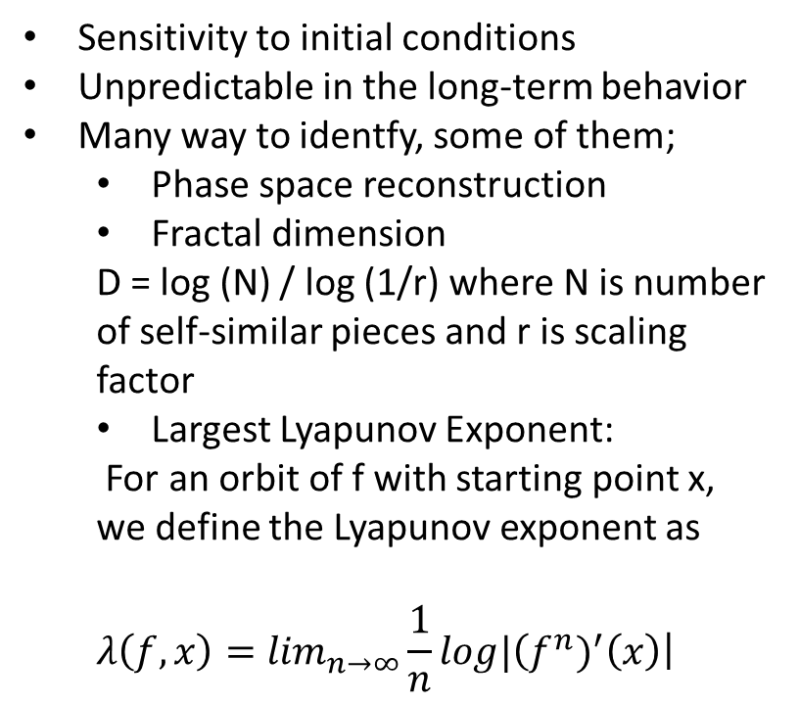
IDENTIFYING CHAOTIC SYSTEM
Sensitivity to initial conditions
Unpredictable in the long-term behavior
Many way to identfy, some of them;
Phase space reconstruction
Fractal dimension
D = log (N) / log (1/r) where N is number of self-similar pieces and r is scaling factor
Largest Lyapunov Exponent:
For an orbit of f with starting point x, we define the Lyapunov exponent as
$$λ\left(f,x\right)=\lim_{n→∞}\frac{1}{n}log|\left(f^{n})^{′}\left(x\right)\right|$$
Fig. Time series, frequency content and
phase space reconstruction from the
acquired pressure data p(t).
10
http://ej.iop.org/images/1873-7005/44/3/031408/Full/fdr422599f3_online.jpg

Slide 11
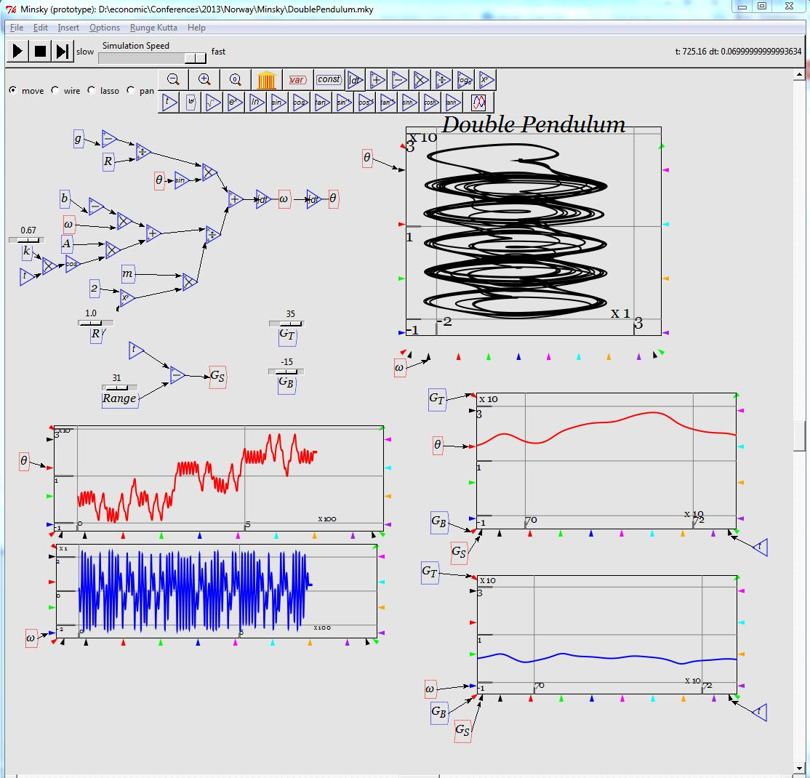
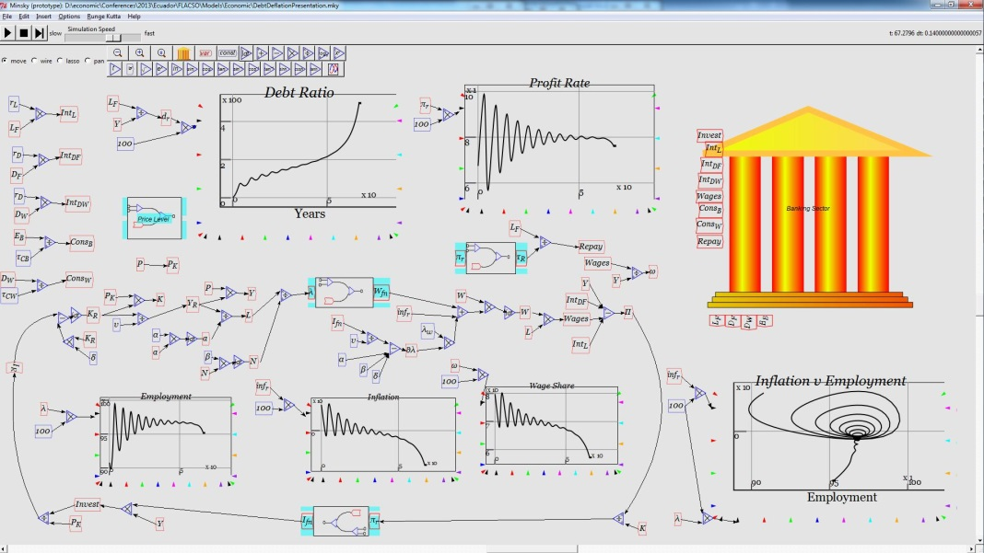
MODELLING CHAOTIC SYSTEM
After identifying, we model the chaotic system by some analytical or numerical methods (Ex: Feed-Forward Neural Networks, Wavelets, Fuzzy Logic, Genetic Algorithms etc.) to solve our system and get predictions
Fig. Debt-deflation & Double Pendulum in Minsky
11
http://a.fsdn.com/con/app/proj/minsky/screenshots/DebtDeflation.PNG
http://a.fsdn.com/con/app/proj/minsky/screenshots/DoublePendulum.PNG

Slide 12
CONCLUSION
What is chaos?
Important topics
Phase space
Dynamical system
Linear vs. nonlinear systems
Strange attractors
Fractals
Identifying chaotic system
Modeling chaotic system
12

Slide 13
THANK YOU FOR YOUR KIND ATTENTION…
13

Slide 14
REFERENCES
Barenghi Carlo, F.(2010) Introduction to chaos: theoretical and numerical methods
Bradley, L.(2010) Chaos and Fractals, Available: http://www.stsci.edu/ ~lbradley / seminar/index.html [07 March 2014]
Ciobanu, D.(n.d.) Chaos Tests for Time Series, University of Craiova [08 March 2014]
Goldberger Ary, L.(1999) Nonlinear Dynamics, Fractals, and Chaos Theory for Clinicians, Available: http://www.physionet.org/tutorials/ndc/ [07 March 2014]
Knill, O.(2005) Lyapunov Exponent, Available: http://www.math.harvard.edu/ archive /118r_spring_05/handouts/lyapunov.pdf [06 March 2014]
Pupillo, G.(2008) Introduction to Chaotic Dynamics, Universität Innsbruck [ 08 March 2014]
Rouse, M.(2009) Chaos Theory, Available: http://whatis.techtarget.com/ definition / chaos-theory [08 March 2014]
(n.d.) Available: http://fractalfoundation.org/ [07 March 2014]
14

