Slide 1
FRE 6083: Final Project Analysis of Fast Fourier Transform and Heston Model for Option Pricing
Cristobal Gonzalez / cg3516
Deniz Kural / dk3703
Liam Trodden / lct330
Under the Guidance of:
Prof. Daniel Totuoum

Slide 2
Motivation
History of Option Pricing
Stochastic Volatility Models – Heston Model
The main motivation is to compare European call option pricing with:
Closed form Heston model,
Fast Fourier Transform method (Carr-Madan)
To test the performances, models are impelemeted in Python.
Calibration is done for selecting parameters efficiently.

Slide 3
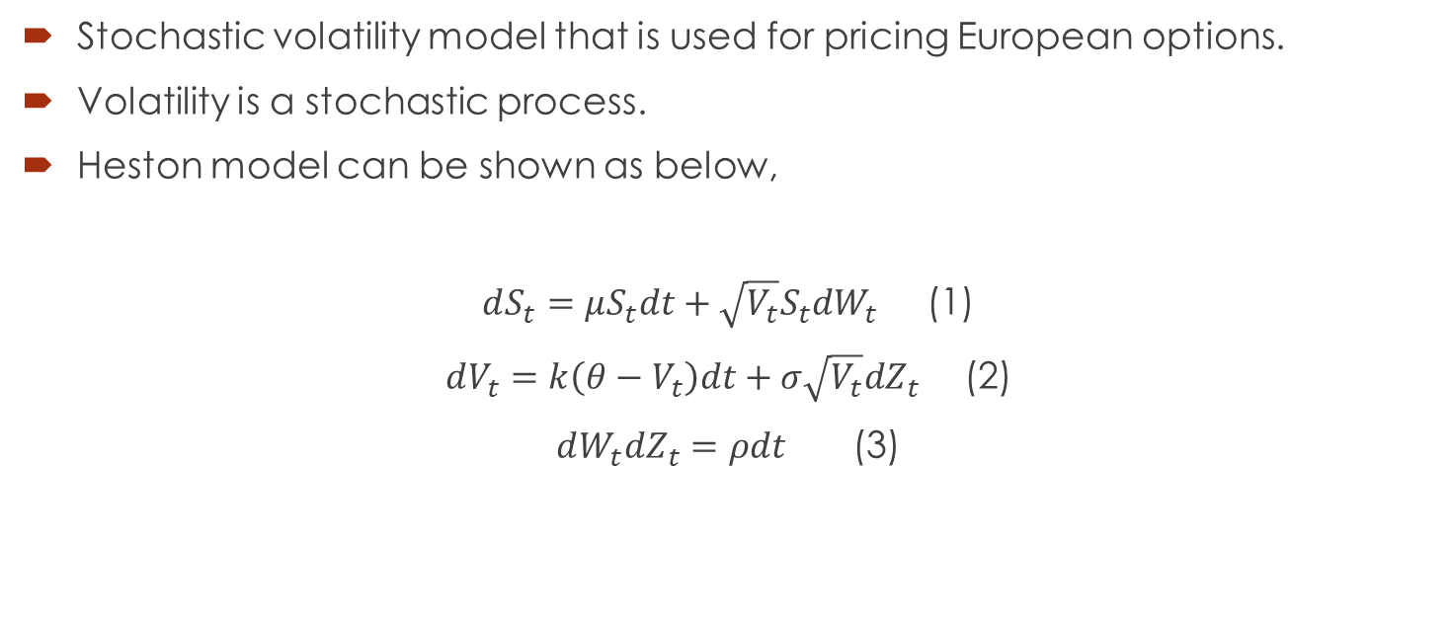
Heston Model
Stochastic volatility model that is used for pricing European options.
Volatility is a stochastic process.
Heston model can be shown as below,
$dS_{t}=μS_{t}dt+\sqrt{V_{t}}S_{t}dW_{t}$ (1)
$dV_{t}=k\left(θ−V_{t}\right)dt+σ\sqrt{V_{t}}dZ_{t}$ (2)
$dW_{t}dZ_{t}=ρdt$ (3)

Slide 4
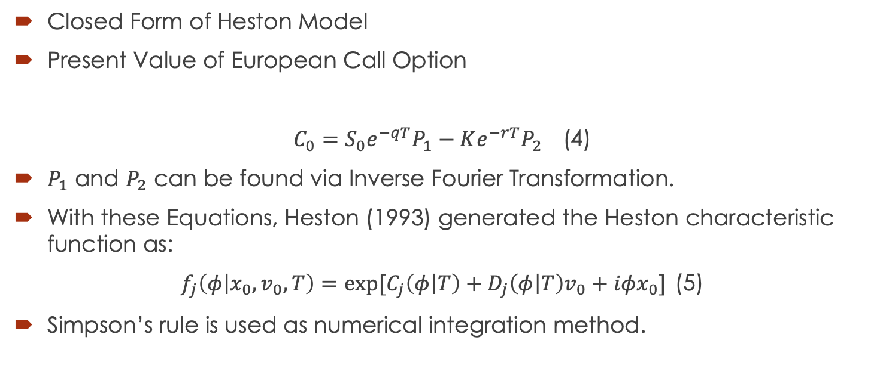
Heston Model
Closed Form of Heston Model
Present Value of European Call Option
$C_{0}=S_{0}e^{−qT}P_{1}−Ke^{−rT}P_{2}$ (4)
$P_{1}$ and $P_{2}$ can be found via Inverse Fourier Transformation.
With these Equations, Heston (1993) generated the Heston characteristic function as:
$f_{j}\left(φ | x_{0},v_{0},T\right)=exp⁡[C_{j}\left(φ | T\right)+D_{j}\left(φ | T\right)v_{0}+iφx_{0}]$ (5)
Simpson’s rule is used as numerical integration method.

Slide 5
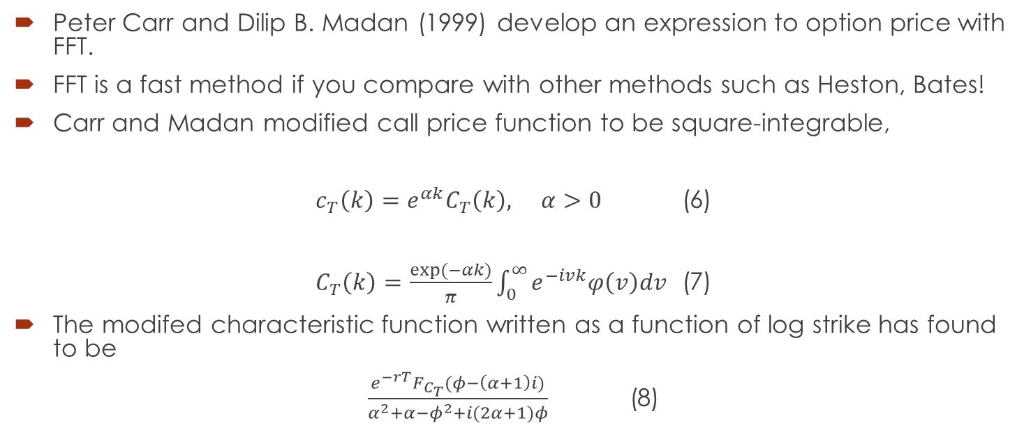
Fast Fourier Transform (FFT)
Peter Carr and Dilip B. Madan (1999) develop an expression to option price with FFT.
FFT is a fast method if you compare with other methods such as Heston, Bates!
Carr and Madan modified call price function to be square-integrable,
$c_{T}\left(k\right)=e^{αk}C_{T}\left(k\right), α>0$ (6)
$C_{T}\left(k\right)=\frac{exp⁡(−αk)}{π}\int_{0}^{∞}{e^{−ivk}φ\left(v\right)dv }$ (7)
The modifed characteristic function written as a function of log strike has found to be
$\frac{e^{−rT}F_{C_{T}}(φ−\left(α+1\right)i)}{α^{2}+α−φ^{2}+i(2α+1)φ}$ (8)

Slide 6
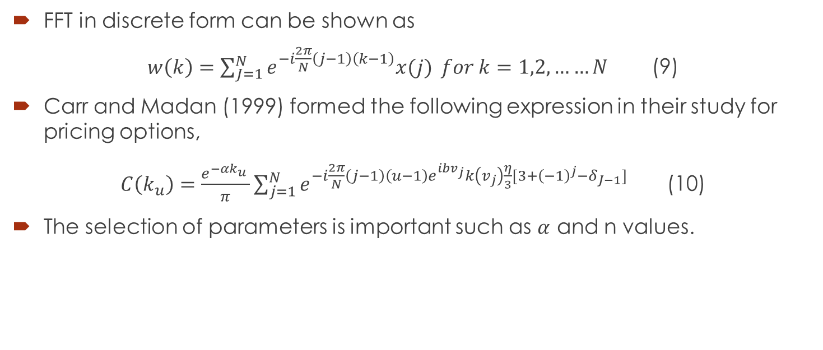
Fast Fourier Transform (FFT)
FFT in discrete form can be shown as
$w\left(k\right)=\sum_{J=1}^{N}{e^{−i\frac{2π}{N}\left(j−1\right)\left(k−1\right)}x(j)} for k=1,2,……N$ (9)
Carr and Madan (1999) formed the following expression in their study for pricing options,
$C\left(k_{u}\right)=\frac{e^{−αk_{u}^{}}}{π}\sum_{j=1}^{N}{e^{−i\frac{2π}{N}\left(j−1\right)\left(u−1\right)e^{ibv_{j}}k\left(v_{j}\right)\frac{η}{3}[3+{\left(−1\right)}^{j}−δ_{J−1}]}}$ (10)
The selection of parameters is important such as $α$ and n values.

Slide 7
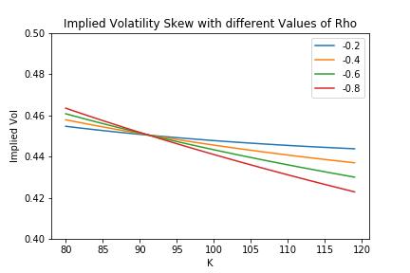
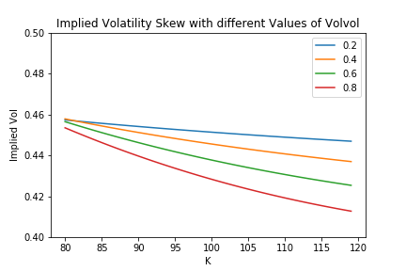

Data and Parameters
$dS_{t}=μS_{t}dt+\sqrt{V_{t}}S_{t}dW_{t}$ (1)
$dV_{t}=k\left(θ−V_{t}\right)dt+σ\sqrt{V_{t}}dZ_{t}$ (2)
$dW_{t}dZ_{t}=ρdt$ (3)

Slide 8
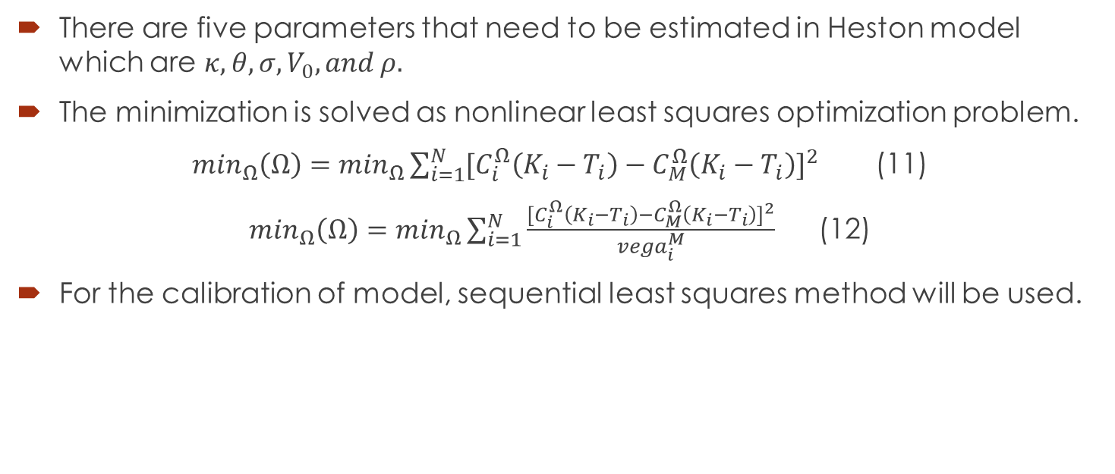
Calibration of Heston Model
There are five parameters that need to be estimated in Heston model which are $κ, θ, σ, V_{0}, and ρ.$
The minimization is solved as nonlinear least squares optimization problem.
$\min_{Ω}\left(Ω\right)=\min_{Ω}\sum_{i=1}^{N}{{[C_{i}^{Ω}\left(K_{i}−T_{i}\right)−C_{M}^{Ω}\left(K_{i}−T_{i}\right)]}^{2}}$ (11)
$\min_{Ω}\left(Ω\right)=\min_{Ω}\sum_{i=1}^{N}{\frac{{[C_{i}^{Ω}\left(K_{i}−T_{i}\right)−C_{M}^{Ω}\left(K_{i}−T_{i}\right)]}^{2}}{{vega}_{i}^{M}}}$ (12)
For the calibration of model, sequential least squares method will be used.

Slide 9
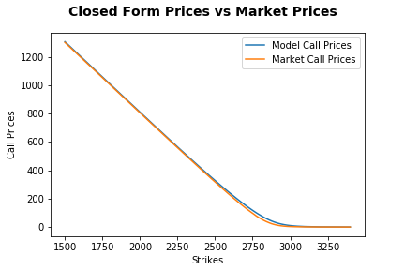
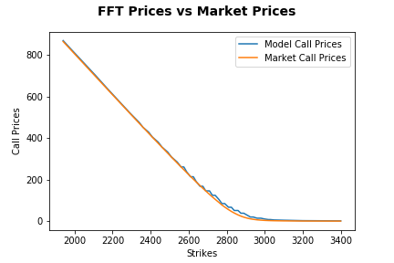
Analysis & Results

Slide 10
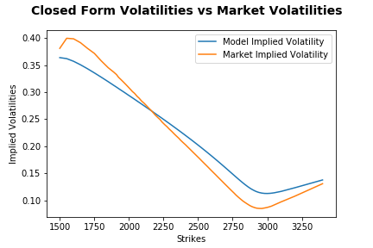
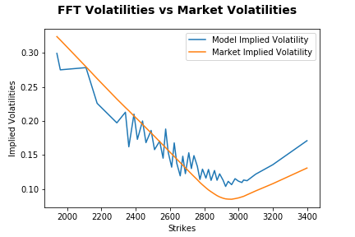
Implied Volatility Estimated by Models

Slide 11
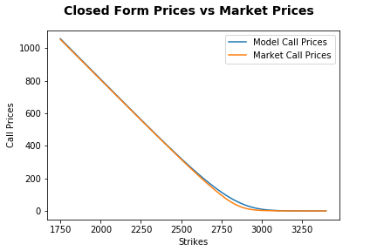
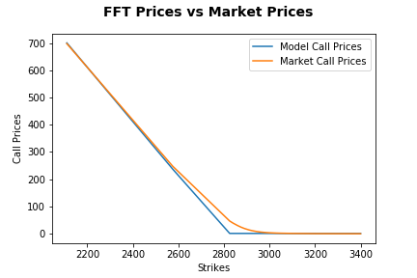
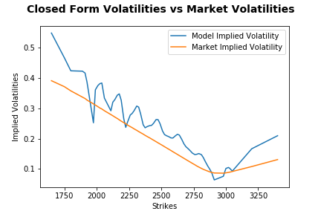
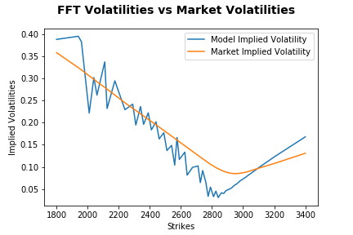
Price Estimates when including Vega in Calibration

Slide 12
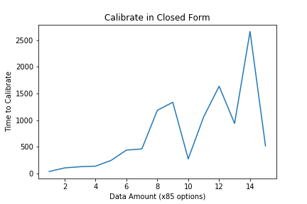
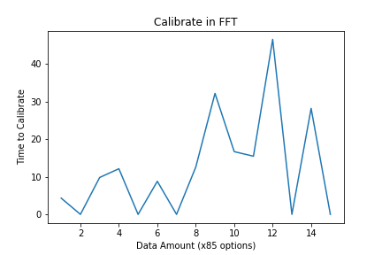
Time to Calibrate

Slide 13
Conclusions
Given the closed form Heston model and the Carr-Madan FFT, we can construct Python implementation to price options
The accuracy of both models is very high
Implied volatility estimated by the models is less accurate
Calibrate on price rather than volatility to get the best estimates
FFT Calibration ~50x faster than Heston closed form model

