Slide 1
FRE 7773 Term Project: Trading Strategy
Deniz Kural – dk3703
Qi Yan – qy606

Slide 2
Data Preparation
Data source is Apple Inc(AAPL) taken from Yahoo Finance.
Data range is specified for training and testing.
Training data range is between 01-01-2001 and 01-01-2018.
Test data range is between 01-01-2018 and 10-01-2019.
Figure 1: Apple Stock Price Chart

Slide 3
Data Preparation
New features are created for the trading strategy that is used:
Price
Open-Close
High-Low
Volume
Trade Decision
There are three Trade Decision outcomes : ‘Buy’, ‘Sell’, ‘Hold’
For finding the thresholds between outcomes, quantile is used so that number of each of outcome is presumed.

Slide 4
Assumptions
Several assumptions have been made before implementing the trading strategies:
‘Adj Close’ price is used as transaction price for trade.
Buy and sell orders are done with 100 shares which will not influence the price.
Stock market is a liquidity market so that we can buy or sell any time.
Buy and sell operations are done only with 100 shares per day. No more or less is allowed.
While using quantile method, lower bound is used as 0.05 and upper bound is used as 0.75, which are found by testing the algorithm.

Slide 5
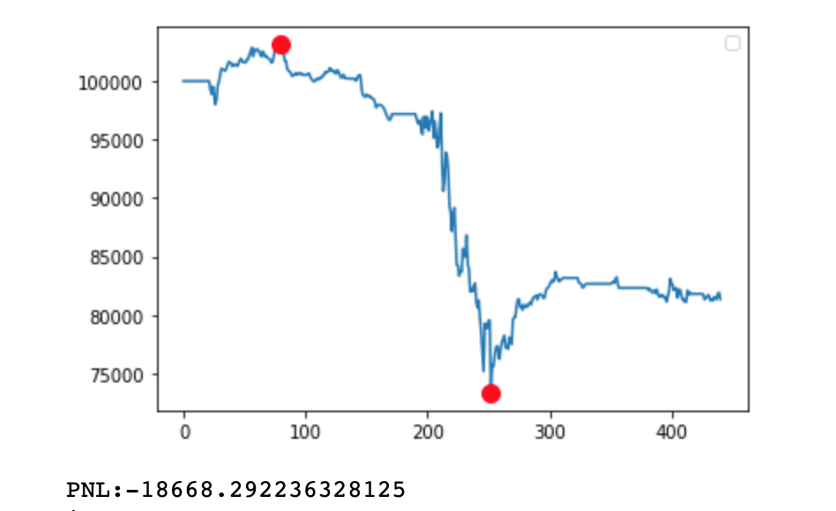
Implemented Trading Strategy
‘Random walk’ naïve strategy is implemented and used as a tester.
As it seems from PNL, loss occurred in these transactions.
Due to this result, another strategies are implemented that can be seen below:
Support Vector Machine (SVM)
Decision Tree Classifier
Random Forest Classifier
Figure 2: PNL of Random Walk Strategy

Slide 6
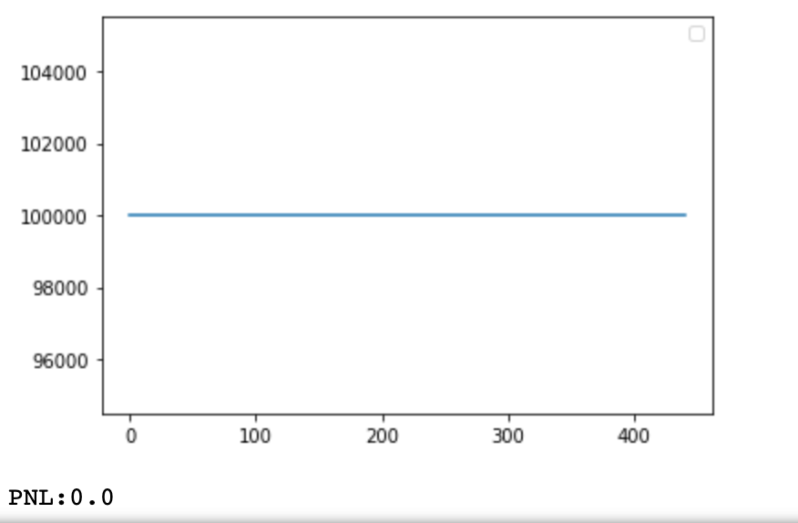
First Strategy: SVM
Score of the training data set was observed as 1.0.
Score with test data was observed as 0.699 which was exactly the ‘hold’ percentage in the assumption (1-0.05-0.25=0.70).
The SVM model is only predicted hold, so this furtherly clarifies 0.699 with test data.
This model perform poorly because of overfitting.
Figure 3: PNL of SVM Strategy

Slide 7
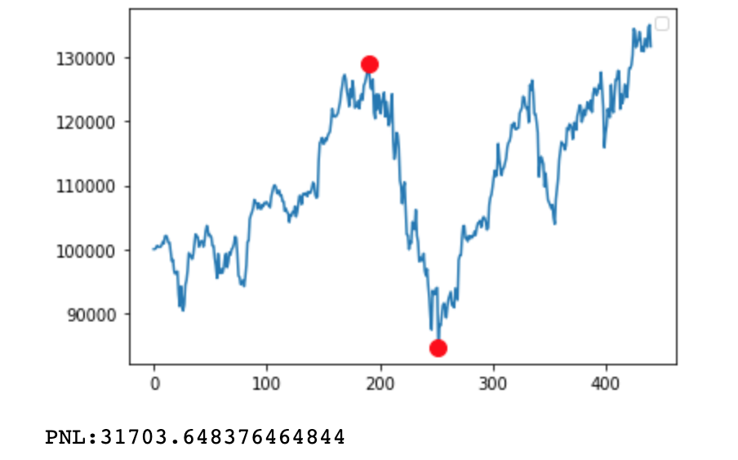
Second Strategy: Decision Tree Classifier
PNL is found to be 31703, so it is almost 32% over the year and half, which shows good performance.
Drawback happens between red dots that can be seen in Figure 4 and the drawback amount is 44467.51.
Drawback periods are in between 2018-10-03 and 2019-01-02.
Sharpe ratio for test apple data was 0.677 and sharpe ratio with our strategy increased to 0.729
Figure 4: PNL of Decision Tree Strategy

Slide 8
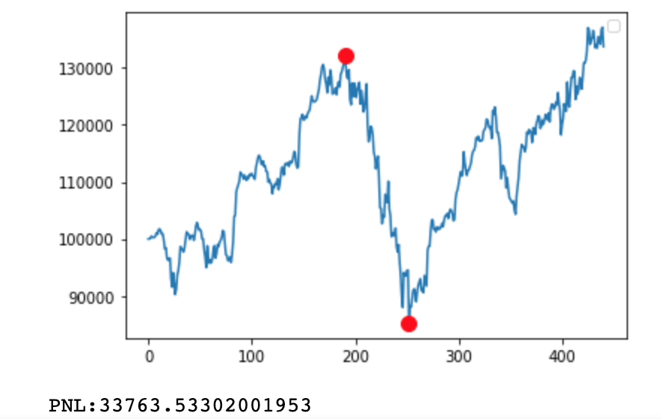
Third Strategy: Random Forest
In the algorithm, maximum number of trees is selected as 1000 and maximum features as 2.
PNL is found to be 33763, so it is almost 34% over the year and half, which shows better performance than decision tree method.
Drawback happens between red dots that can be seen in Figure 5 and the drawback amount is 47012.41.
Drawback periods are in between 2018-10-03 and 2019-01-02.
Sharpe ratio for test apple data was 0.677 and sharpe ratio with our strategy increased to 0.787 which is better than decision tree method.
Figure 5: PNL of Random Forest Strategy

Slide 9
Final Comments / Improvements
In the project description, 2 of 3 trading method should be selected.
Based on the observed performances, decision tree and random forest are selected for further use.
Among these two, random forest performed better than decision tree.
Profit value and sharpe ratio of random forest are better than stock itself and basic naïve strategy random walk significantly.
To improve the trading strategy further:
We can tune or change the parameters of machine learning methods such as maximum tree number in random forest.
Some algorithm could be implemented to try to avoid drawback and reduce it.
Number of shares per transaction could be altered for more PNL.

