Slide 1
Robust Level 3 Autonomous Drone Racing
by Gate Search and Time-Optimal Contouring Control
Ahmet Arda Hız · Deniz Öztürk
Learning Systems and Robotics — TUM | Final Presentation, SS26
Notes:
[Speaker A] Welcome. We are Arda and Deniz. Today: our final Level 3 autonomous drone racing controller — a blind gate search plus a time-optimal MPCC racer. Deniz takes over at the MPCC slide.

Slide 2
From Cascaded PID to MPCC — What Changed
Recap
Speaker: Arda
• Progress presentation: we presented a cascaded PID controller.
• Our stated end goal was a time-optimal MPCC racer.
• The blocker: the MPCC's online solver (acados) would sometimes fail to converge and the drone froze between gates — not demo-ready, so we fell back to PID.
• Fixed now: a robust solver restart (cold re-solve on failure) removes the freeze; MPCC runs reliably at 50 Hz.
• This talk presents the finished MPCC-based controller.
Progress talk
Cascaded PID (fallback)
Final talk
MPCC — blocker solved
Notes:
[Speaker A] Last time you saw a cascaded PID controller. Our goal was always MPCC. The reason we could not show it: the online optimizer occasionally failed and the drone stalled mid-track, so PID was our safe fallback. We fixed that with a robust solver restart, so MPCC now runs reliably — and that is what the rest of this talk is about.

Slide 3
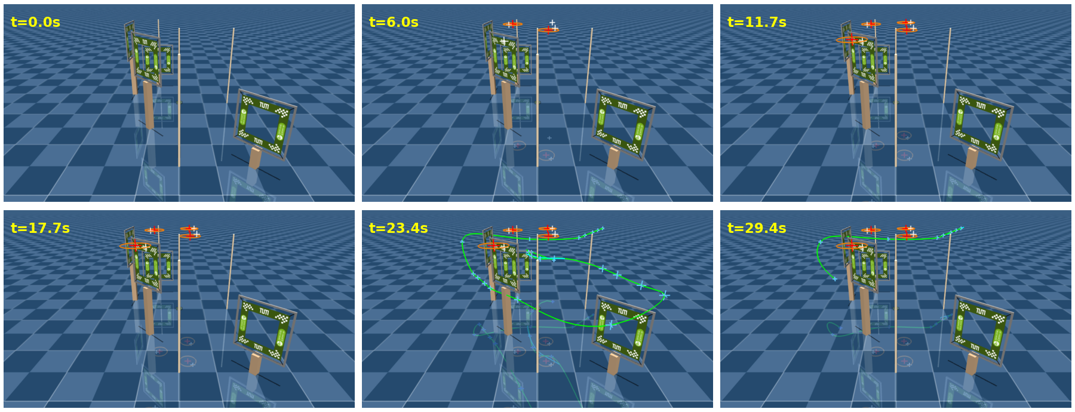
Our Angle — Find the Gates, Don't Trust the Map
Our angle
Speaker: Arda
Everyone flies the same Level 3 task. Here is what was specific to our project.
• The task, in one line: layout randomized every run, exact gate pose seen only within 0.7 m.
• The twist we hit: for most of the project the simulator gave no usable prior — every gate and obstacle sat at the origin.
• So planning from the nominal map was impossible; a known-track racer cannot fly this at all.
• Our design choice: do not trust the map. Find the gates by flying, then race them — one controller, any layout.
Level 3 in our LSY simulator — no reliable gate positions up front
Notes:
[Speaker Arda] Every group solves the same Level 3 task, so here is what was specific to us. The layout is randomized and you only see the true gate pose within 0.7 m — and for most of our project the simulator did not even give a usable prior: every object sat at the origin. That means you cannot plan from the map at all, so a standard known-track racer simply cannot fly this. Our answer, and the core of our project: do not trust the map — find the gates by flying, then race them.

Slide 4
Our Approach — Two Phases, One Loop
Methodology
Speaker: Arda
Search first, then race — the same racing core runs after the gates are found. Loop runs at 50 Hz.
discovered gates
Observation
(gates revealed within 0.7 m)
Gate Search
blind spiral sweep
Time-Optimal MPCC
race the found gates
Attitude Control
→ drone @ 500 Hz
closed loop @ 50 Hz — re-plan as new gates are revealed
Notes:
[Speaker A] The controller has two phases inside one 50 Hz loop. First it searches — a blind spiral that finds the gates. Once they are found it hands them to a time-optimal MPCC that races them, and an attitude layer sends commands to the drone. Nothing reads the nominal layout, so the same pipeline runs on any Level 3 track.

Slide 5
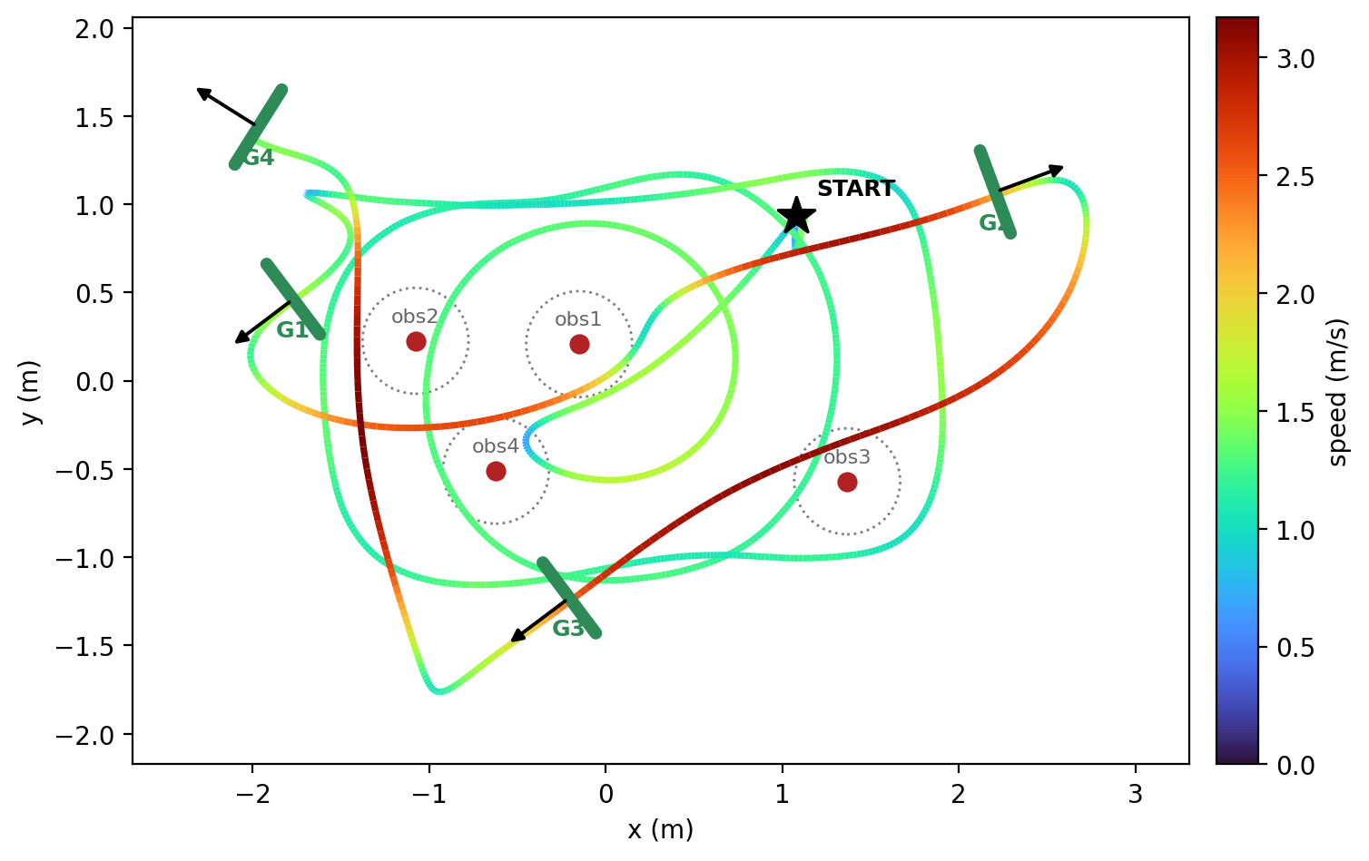
Phase 1 — Blind Gate Search
Methodology
Speaker: Arda
Fly fixed spiral (climb above the poles)
no
Gate within 0.7 m?
yes
Reveal pose, add gate to set K
no
All gates found or spiral done?
yes
Race the gates (MPCC)
Top-down: wide loops = spiral search, then the race (colored by speed)
Notes:
[Speaker A] The search is deliberately blind. The drone climbs above the obstacle poles and flies a fixed Archimedean spiral that covers the whole arena. A gate is 'found' the moment the drone passes within 0.7 m of it; we store it in the set K. When all gates are found — or the spiral ends — we start racing. On the right you can see the wide search loops, then the fast race line. Now Deniz takes over for the racing stage.

Slide 6
Phase 2 — Time-Optimal MPCC
Methodology
Speaker: Deniz
• Fit a spline through the found gates; MPCC races along it.
• Progress is a state; the solver is rewarded for progress, so speed is an output, not a fixed reference.
• Respects the real limits: thrust, tilt, and a friction-circle speed cap in the turns.
– Gate-aware weight: track stiffly only at the gates, run free on the straights.
– Progress anchor: never skip a gate at a hairpin fold.
• Solved in real time with acados (SQP-RTI) at 50 Hz.
drone p
e_c
path / tangent
e_l
p_ref
Contouring geometry: lag e_l along the path, contouring e_c across it
Notes:
[Speaker Deniz] Once the gates are known we race them with a time-optimal MPCC. The key idea: path progress is part of the state and the optimizer is rewarded for making progress, so the speed profile is an output, not something we hand-tune. We enforce the drone's real thrust and tilt limits and a friction-circle cap in the corners. Two touches make it reliable: a gate-aware weight that only tracks tightly at the gates, and a progress anchor that stops it skipping a gate at sharp turns. It all solves in real time with acados at 50 Hz.

Slide 7
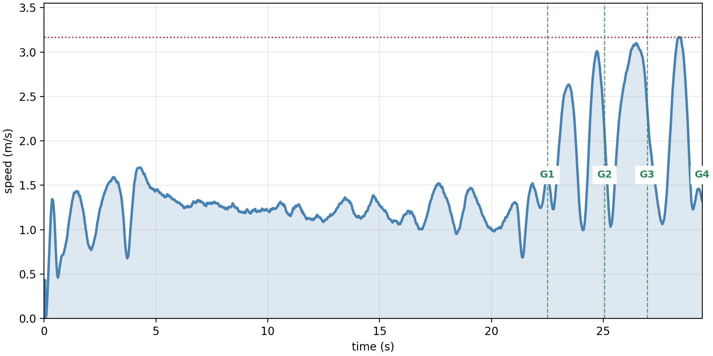
Results — Randomized Level 3
Results
Speaker: Deniz
Setting | Track | Success | Lap (s)
v24_r10 | level3.toml | 12 / 20 | 18.8
v24_r10_fast | level3.toml | 10 / 20 | 12.8
v24_r10 | final.toml (graded) | 17 / 20 | 26.9
v24_r10_fast | final.toml (graded) | 14 / 20 | 18.4
v24_r10_nosearch | final.toml (graded) | 11 / 20 | 8.7
• Graded track: fast setting clears 14/20 (70%) at 18.4 s — our headline.
• Robust setting is most reliable (17/20) but slower; no-search is fastest (8.7 s) when a prior exists.
Speed vs time: long low-speed search, then a short fast race
Notes:
[Speaker Deniz] Here are the numbers, all over 20 randomized runs. On the graded final.toml track our fast setting clears 14 of 20 — 70% — at 18.4 seconds, which is our headline. The robust setting is even more reliable, 17 of 20, but slower. And if a usable prior exists, the no-search variant skips the sweep and finishes in 8.7 seconds. The speed trace on the right shows why laps are long: most of the time is the search, the race itself is only a few seconds.

Slide 8
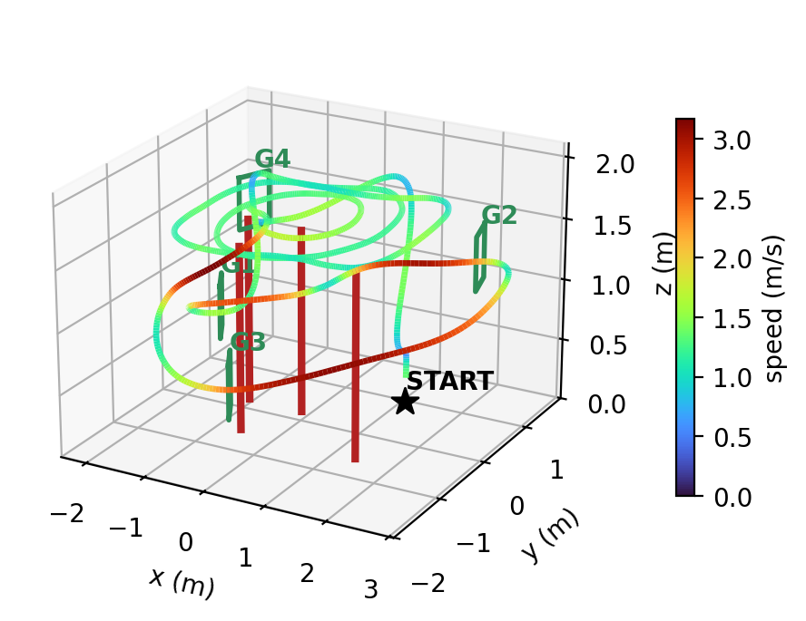
Flight Paths in Simulation
Results
Speaker: Deniz
Top-down — search loops then race, colored by speed
3D — spiral runs high above the poles, then descends to race
Notes:
[Speaker Deniz] Two views of the same run. Left, top-down: the wide loops are the search, then the fast line through the gates. Right, in 3D you can see the search deliberately runs high, above the obstacle poles, before the drone drops down to race. Same controller, straight out of the simulator.

Slide 9
Seeing It Fly — Simulation and Hardware
Demo
Speaker: Deniz
▶ Simulation flight — insert video
▶ Real Crazyflie flight — insert video
Hardware validation: the same racing core flew the real Crazyflie on a known track in 9.55 s.
(Drop the exported clips into the two frames above before presenting.)
Notes:
[Speaker Deniz] Let's watch it fly. On the left, the controller in simulation; on the right, the real Crazyflie. The same racing core that we use for search flew the real drone on a known track in 9.55 seconds — so the hardware result validates the core of the submitted controller. [Play both clips.]

Slide 10
One Controller, Any Prior
Insight
Speaker: Deniz
Same racing core throughout — the controller degrades gracefully with how good the prior is.
No usable prior
full blind search
(the regime we built for)
Coarse prior (~15 cm)
search or trust + refine
Good prior
no-search: 8.7 s
• Blind search is our submitted, general method: it works even with a wrong prior or if motion capture drops out.
• When a prior is reliable, the no-search variant reuses the exact same racing core and is far faster.
Notes:
[Speaker Deniz] One idea ties it together: it is a single controller that adapts to how good the prior is. With no prior it does the full blind search — the safe, general case we submit, which also survives a wrong prior or a motion-capture dropout. When the prior is reliable, the same racing core runs directly and is three times faster. Blind at one end, prior-guided at the other, one engine in between.

Slide 11
Conclusion
Wrap-up
Speaker: Deniz
• A general Level 3 racer: blind spiral search finds the gates, time-optimal MPCC races them.
• Gate-aware weight and progress anchor keep the racing stage reliable.
• Graded final.toml: 14/20 at 18.4 s (fast) — and 9.55 s on the real drone with the same racing core.
• The MPCC blocker from the progress talk is solved; MPCC is now our controller.
Thank you — questions?
Notes:
[Speaker Deniz] To wrap up: a general Level 3 controller — search then race — that is reliable on randomized tracks and validated on hardware at 9.55 seconds. And the MPCC problem that held us back at the progress talk is fixed, so MPCC is now our controller. Thank you — we're happy to take questions.

