Slide 1
Racing a Drone Through Gates
Autonomous Drone Racing Project Course · Progress Presentation
Ahmet Arda Hız · Deniz Öztürk
Technical University of Munich · 7 June 2026
Notes:
Good afternoon everybody. My name is Arda and this is my team mate Deniz. Today we are going to talk about the methodology and progress of our Project.

Slide 2
System Overview: Observation → Plan → Control
METHODOLOGY & APPROACH · 1 / 3
Observation
Online Spline
Planner
Cascaded-PID
Tracker
Attitude cmd
[r, p, y, thrust]
Drone
state feedback loop · every 20 ms
Its Own Flight State: Continuous 3D position, velocity, and orientation.
The Racing Environment: Exact coordinates and angles of all gates and obstacles.
Active Mission Targets: The specific gate currently being approached.
Proximity Sensors: Short-range distance tracking (0.7 m) to verify the track layout.
built by us
given
Why this design: simple + robust on real hardware -> no fragile online MPC in the loop
Given Templates: simulator, environment, observation/action interface, empty base Controller class
Notes:
Here is the whole system in one line. First, an honest scoping: the course gives every team the simulator, the environment, the observation-action interface, and an empty base controller -- the grey boxes. None of that is ours. What we built sits on top: the online spline planner and the cascaded-PID tracker -- the green boxes. The loop is simple but unforgiving: every 20 milliseconds we read the state, plan, track, and output an attitude command -- roll, pitch, yaw, thrust. The data that drives it is in the blue box: our own pose, the target-gate index, and the gate and obstacle poses, revealed within a 0.7-metre sensor range. The key constraint: the gate opening gives only a 20-centimetre half-width margin, so a few centimetres of error means a destroyed rotor. We chose planner-plus-PID for one reason: simple and robust on real hardware, no fragile online optimisation in the loop. [~60 s — Presenter A]

Slide 3
How the Drone Flies: Spline + Cascaded PID
METHODOLOGY & APPROACH · 2 / 3
Spline logic
pos · vel · accel
Outer PID
pos → vel
Inner PID
vel → force
→ Attitude
[r, p, y, thrust]
Drone
state feedback (pos, vel)
Principle
One smooth cubic spline through all remaining gates
Outer PID: where the drone physically is vs where the spline says it should be
If position error -> Calculation of target velocity for correction
Inner PID: takes the target velocity, compares it to the drone's actual velocity
Calculation of the force vector needed for motors
Notes:
Now, how does it actually fly? We build one smooth cubic spline through all the remaining gates -- that gives a position, velocity, and acceleration reference at any time. We track it with a cascaded PID: the outer loop turns position error into a velocity target; the inner loop turns velocity error into a force command, with anti-windup and a filtered derivative for stability. We add feedforward -- sixty percent of the reference acceleration plus gravity -- and convert that force vector into the attitude command. We look 0.20 seconds ahead on the spline so we do not cut corners. The command runs at 50 hertz, the inner attitude loop at 500. Cruise speeds: 1.4 metres per second near gates, 1.6 between them, capped at 1.9. Why PID and not MPC? Robustness -- our acados MPC build does not run on the deployment machine, and a controller that always runs beats one that is optimal on paper. With that, I hand over to my colleague. [~65 s — Presenter A]

Slide 4
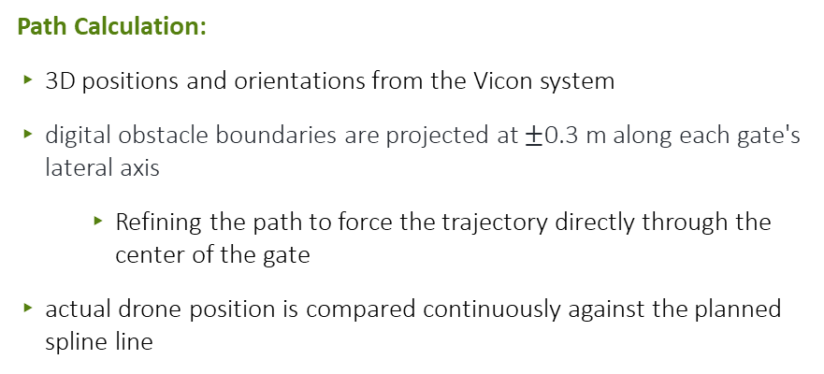
Perception & Spatial Geometry
METHODOLOGY & APPROACH · 3 / 3
GATE (top-down)
Path Calculation:
3D positions and orientations from the Vicon system
digital obstacle boundaries are projected at $±$0.3 m along each gate's lateral axis
Refining the path to force the trajectory directly through the center of the gate
actual drone position is compared continuously against the planned spline line
planned line
obstacle
virtual posts
±0.30 m
sensor 0.7 m
Key idea:
gate bars → virtual no-go zones, so the line
self-centers through every opening.
drone
Notes:
Thanks. So how does the drone see the track? Because we measure the whole course beforehand with the Vicon motion-capture system, the poses are known from the start -- the drone plans straight through all gates, no blind searching. The 0.7-metre sensor range reveals a gate's true pose up close; here it simply confirms what we already measured. The clever part is obstacle handling. A gate frame has solid bars on each side of the opening, so for every gate we inject two virtual obstacle columns, 30 centimetres to each side. The planner treats them as no-go zones, which funnels the line cleanly through the centre instead of clipping a bar. We re-plan globally only if an observed pose drifts more than 5 centimetres. One segment is consistently the hardest -- the sharp U-turn at gate 2 -- and that is exactly the story of our progress. [~55 s — Presenter B]

Slide 5
Controller Roadmap
MILESTONES & SMART GOALS
Controller Version | Key Idea / Change vs. Previous | Result
V1 ( Controllers v1-2-3 ) | Our initial idea: Search then navigate (Gate search) | Arda
V2 (Controllers v4-5-6) | Realized after lab session that we had the wrong idea | Deniz
V3 (Controllers 7-8) | Fine-tuning our parameters for speed and turning radius | Both
End Goal: | Achieving fast finishes in map blind mode | Both
Notes:
Finally, the plan. Three milestones. First, Member A generalises the gate-2 fix into automatic per-gate calibration -- probe the lag at all four gates, keep the max miss under 5 centimetres. Second, Member B replaces the static bias with iterative learning control that cancels the lag every lap and reclaims the roughly 0.8 seconds still locked up in the U-turn, while staying at 100 percent. Third, together, we harden the truly-blind random-track case, still only around 40 percent, targeting 70. Reviving the acados MPC is a stretch goal. Note: the names and dates here are placeholders for us to finalise. Thank you -- happy to take questions. [~40 s — Presenter B]

Slide 6
Our Plan
MILESTONES & SMART GOALS
Milestone | SMART goal (specific · measurable) | Owner
Optimization based planner-controller | Model predictive contouring controller to reduce lap times while maintaining reliabilitz | Arda
Potential learning / adaptation layer (feed forward based on spline-current delta | ILC to improve drone lagging behind; reducing lap times while keeping high reliability | Deniz
Revive acados MPC | Fix solver build on deploy box; A/B vs PID in sim | Both
Goal: keep 100% reliability while finishing in less than 5 seconds.
Notes:
Finally, the plan. Three milestones. First, Member A generalises the gate-2 fix into automatic per-gate calibration -- probe the lag at all four gates, keep the max miss under 5 centimetres. Second, Member B replaces the static bias with iterative learning control that cancels the lag every lap and reclaims the roughly 0.8 seconds still locked up in the U-turn, while staying at 100 percent. Third, together, we harden the truly-blind random-track case, still only around 40 percent, targeting 70. Reviving the acados MPC is a stretch goal. Note: the names and dates here are placeholders for us to finalise. Thank you -- happy to take questions. [~40 s — Presenter B]

