Slide 1
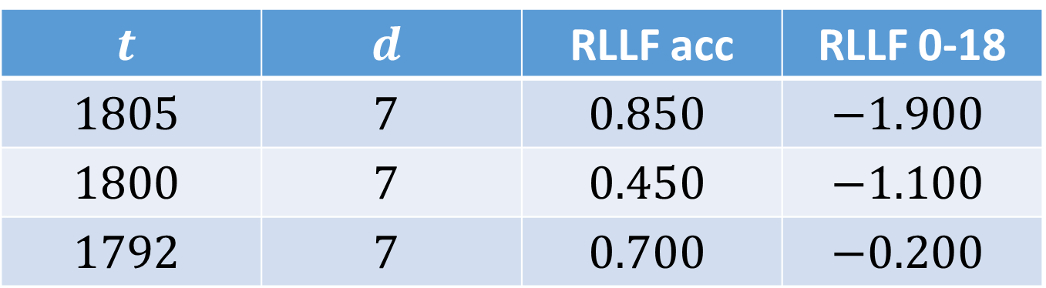
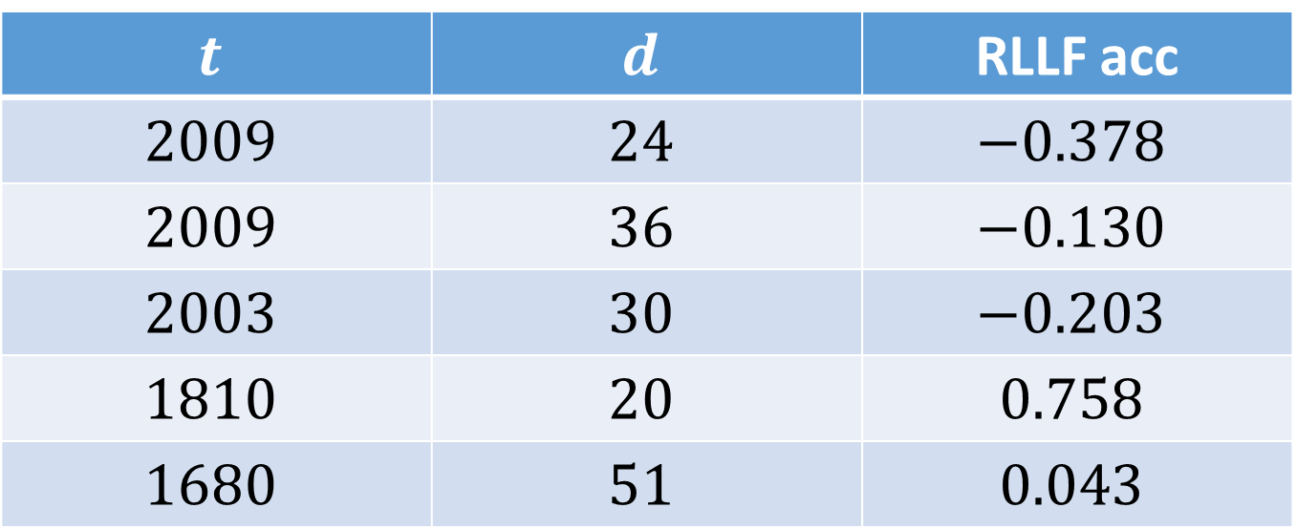
$$t$$ | $$d$$ | RLLF acc
$$2009$$ | $$24$$ | $$−0.378$$
$$2009$$ | $$36$$ | $$−0.130$$
$$2003$$ | $$30$$ | $$−0.203$$
$$1810$$ | $$20$$ | $$0.758$$
$$1680$$ | $$51$$ | $$0.043$$
$$t$$ | $$d$$ | RLLF acc | RLLF 0-18
$$1805$$ | $$7$$ | $$0.850$$ | $$−1.900$$
$$1800$$ | $$7$$ | $$0.450$$ | $$−1.100$$
$$1792$$ | $$7$$ | $$0.700$$ | $$−0.200$$

