Slide 1
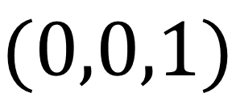

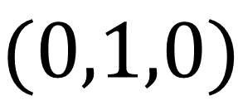

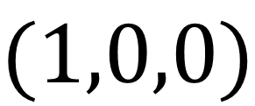



$$(1,0,0)$$
$$Γ_{0}$$
$$Γ_{1}$$
$$Q$$
$$E<μ$$
$$E≥\overline{μ}$$
$$(0,1,0)$$
$$(0,0,1)$$

Slide 2


$$(1,0,0)$$
$$Q$$
I-project
$$Q^{∗}$$
$$(0,1,0)$$
$$(0,0,1)$$

Slide 3


$$(1,0,0)$$
$$Γ_{0}$$
$$Γ_{1}$$
$$Q^{∗}$$
$$δ$$
$$(0,1,0)$$
$$(0,0,1)$$

