Slide 1
Introduction to Python Unit 1
Course 40460

Slide 2
Module 1
Introduction to Python, Unit 1

Slide 3
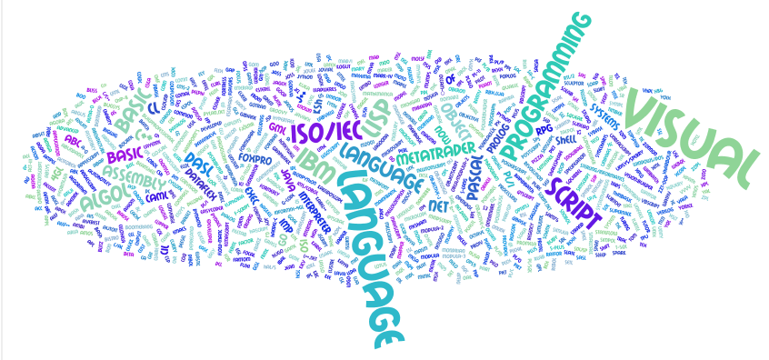
Programming languages
Notes:
This is a Wordle of a bunch of different programming languages and terms. Yes, there are a ton of them! Have students research the history of programming languages and how they have evolved over time. This can be done in groups. See activity sheet for more information.

Slide 4
What is Python?
A modern interpreted programing language, created in 1991 by Guido van Rossum.
Python 2 & 3 are actively used & improved by the Python community
Known for requiring less code to accomplish tasks than other languages
Principles:
Beautiful
Obvious
Allows programmer to be Simple
Allows programmer Complexity, without being complicated
Readable

Slide 5
Python Code in PowerPoint
programming code will be displayed with color highlighting
comment keyword string
function/reserved word
number, variable, operator

Slide 6
Functions
Remember math class? A function did what?
In programming we use functions too! A function is a mini program that runs and returns a value to your program.
print() is a function

Slide 7
Print Function
print() is used to display output to the user
Notes:
Example statement below introduces a new concept that needs discussion.

Slide 8
Print Function
In programming all data has a data type. There are several types but the most important categories number and text.
A string is a series of characters (including spaces). A string must be enclosed in quotes. The text above in the print function is a string.

Slide 9
Comments
A good program must be commented.
A comment is ignored by the interpreter or compiler. It is used by the coder to improve the readability of code.
In python we use # to denote a comment.

Slide 10
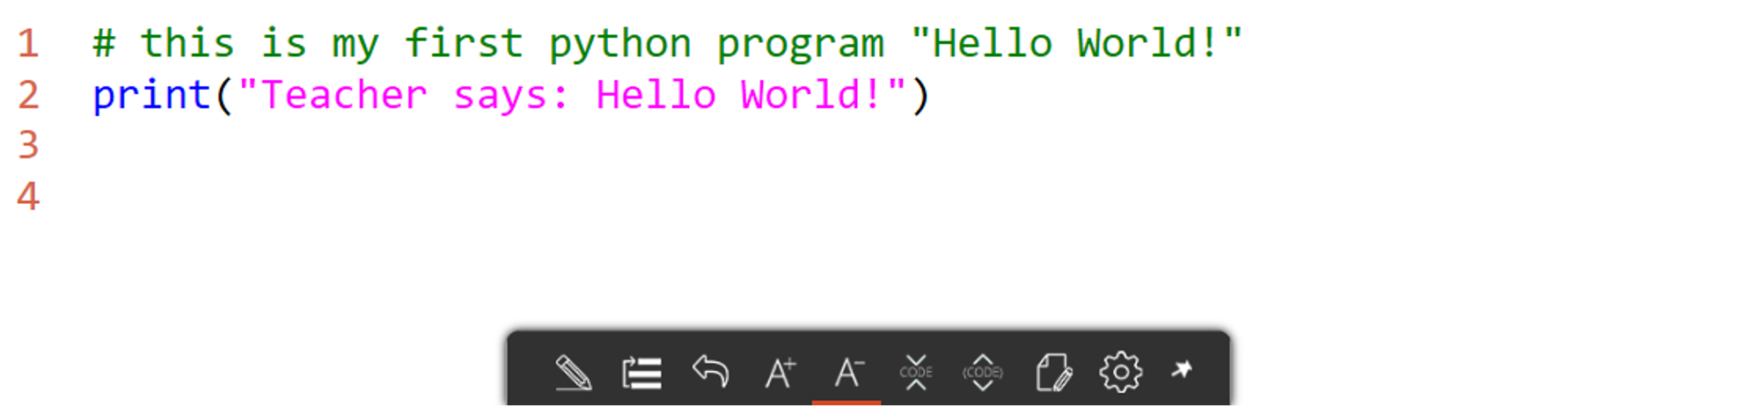
Comments
A good program must be commented.
A comment is ignored by the interpreter or compiler. It is used by the coder to improve the readability of code.
In python we use # to denote a comment.

Slide 11
Variables
What is a variable?
A placeholder for a value- remember math class?
x = 1
y = 4
z= x + y
In Python variables are used to store values.
The type of data stored is called the data type of the variable.

Slide 12
Three common data types
String (str)
A series of letters, numbers, and spaces. Always enclosed in quotes
Integer (int)
A whole number- no decimals.
Float (float)
A decimal number.
Notes:
note to students: strings use quotes, but int and float don't!

Slide 13
Variable assignment
To give a variable a value we use an assignment statement as seen below.
Do not give the variable a type. The interpreter will decide type based on the value entered.
Variables are case sensitive! Num1 and num1 are NOT the same variable!
Notes:
Some languages (C based languages for example) require a data type be given. These are called strongly typed languages. Python is Not one of these languages.

Slide 14
Why data types matter
A data type tells the interpreter what type of data to expect. It also tells the program that operations can be performed.
Example:
Why does this error occur?
Notes:
The output should be 3. But why does this error appear instead. Discuss the with students. Since quotes are used 2 is being defined as type String. A string cannot be added to an integer.

Slide 15
Why data types matter
A data type tells the interpreter what type of data to expect. It also tells the program that operations can be performed.
Example:
The quotes make all the difference! Num1 is a string. Strings cannot be added to integers.
Notes:
The output should be 0.5 (1/2). But why does this error appear instead. Discuss the with students. Since quotes are used 2 is being defined as type String. A string cannot be divided by an integer.

Slide 16
String addition
Strings can be added together. This is called concatenation.
This simply combines 2 strings into 1.
Example:
Spaces for proper structure must be added!
Notes:
Discuss that concatenation combines the strings exactly as they are. Spaces for correct structure must be added by the programmer.

Slide 17
Variable reassignment
To give a variable a new value simple write a new assignment statement
new value will overwrite the old value.

Slide 18
Using variables in print()
print() is a function
The print() function can also be used with variables and a combination of text and variables
Notes:
The plus is called the concatenation operator.

Slide 19

type() Function
Another built in Python function
Returns the data type of the given data or variable

Slide 20
Operators in variable assignment
Concatenation can also be preformed in assignment
Notes:
You have already seen an example of this (Slide 15) using addition in an assignment statement

Slide 21
Errors
When programmers code
errors are bound to happen
Three types of errors
Syntax
Run Time
Logic
Notes:
You have seen an example of an error already (slide 15)

Slide 22
Syntax error
Error in the rules of the language
using a keyword improperly
while = 3
failing to include a required item like a ":"
def hello_funtction()
print("hello world")
Illegal operation
if x=3:
Notes:
- keyword cannot be used as a variable name
function def needs a colon at end of: def hello_function():
- if needs a comparison x == 3 not assignment x = 3

Slide 23
Run time error
An error that causes a program to crash
Properly syntax but an illegal operation
Divide by zero
x = 3/0
Infinite loop
while True:
print("hello")
Notes:
divide by zero gives a ZeroDivisionError
infinite loop will lock up a browser using jupyter notebook and locks up most runtimes

Slide 24
Logic error
Hardest type of error to detect
Code is correct, but does not produce the expected results
Example:
The programmer thought x = 2 + y was the correct equation
when x = y - 2 was correct.
The program will run, but produce unintended results.
Notes:
common logic errors
switching greater than and less than (> for <)
not having a loop exit case such as x never equals 0 for a while x != 0: statement

Slide 25
Errors in python
TypeError
SyntaxError
NameError
TypeError
occurs when an illegal type operation is attempted
SyntaxError
occurs when unknown python code is used
NameError
occurs when a variable is used before it is declared or unknown command

Slide 26
TypeError
Most commonly occurs when attempt to do math operations with a string
Example:
Notes:
Strings cannot be subtracted- hence this error.

Slide 27
Character art
Using the print() function you can create character art.
Simply use the print function and multiple lines to create
the shape you want.

Slide 28
User Input
A main task programs need to perform is gathering input from the user
In Python use the input() function to gather input from the user
The program pauses and waits for user input.

Slide 29
Multiple Input Prompts
By storing inputs in variables the program can prompt the user for multiple pieces of information.
Simply use input statements in variable assignment statements.

Slide 30
Input Data Type
Input always returns a data type of string
Sometimes Python needs some help with data types and we have to convert the type, such as from String to Integer for example.
remember:
input() always returns type str (string)
Notes:
Input always returns a data type of string. No matter what the character entered.

Slide 31
Type Conversions
Python assigns the data type automatically. But what if Python is using the data in a way we don't want?
We must convert it using a type conversion where we cast the data type
To cast a data type – use the specific Type keyword ( like int or str) in front of the variable or data
Notes:
Note: int(grade1+grade2+grade3+grade4+grade5) does NOT work as a shortcut. This method will concatenate all the numbers as string, THEN convert it. So that int("1" + "1") = 11.
To Cast, is to convert from one data type to another

Slide 32
get the average
with a sum of grades stored as a number and calculated from 5 grades, the average can be calculated
average = sum / number of data points
What data type is average?
What does str(average) do?

Slide 33
Let’s get the average!
with a sum of grades stored as a number and calculated from 5 grades, the average can be calculated
average = sum / number of data points
What data type is average? Float
What does str(average) do? Convert to a string
Notes:
What data type is average? Float
What does str(average) do? Convert to a string

Slide 34
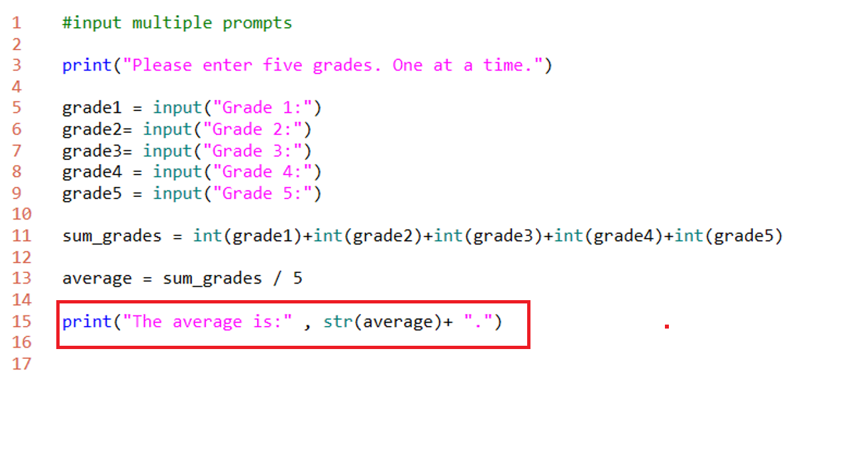
Print formatting
Besides string addition- we can concatenate in the print function with commas
comma (,) method
comma method combines
printable items with a space
Notice you can combine the
comma with string addition

Slide 35
Print formatting
Notice the space
output[]:
The average is: 94.6.
Notes:
a space is introduced between items joined by the comma formatting

Slide 36
Using a quote (“ or ‘) in a string
If you need to use the quote symbol in a string, how would you do that?
output[]:
I said to the class "sometimes you need to shutdown and restart a notebook when the cells refuse to run."
It's time to save your code
Notes:
Python will see a string end whenever a matching end quote is encountered
Python Strings can display double quotes by surrounding a string with single quotes
Python Strings can display single quotes by surrounding a string with double quotes

Slide 37
Boolean?
What is a Boolean?
What are the only possible outcomes?

Slide 38
Boolean?
What is a Boolean?
Data type with only 2 possible values
What are the only possible outcomes?
True or False
Notes:
Ture and False are Python key words – they are capitalized
Boolean is binary - only 2 outcomes

Slide 39
String Tests
Using Boolean methods we can test strings
.isalpha()
.isalnum()
.istitle()
.isdigit()
.islower()
.isupper()
.startswith()
Notes:
these methods return True or False

Slide 40

.isalpha()
Returns True if a string is an alphabetical character a-z, A-Z
"message" is an alpha, but 3 is not an alpha

Slide 41

.isalnum()
Returns True if there is at least 1 character and all are alphabetical or digits
“3rd“ is alphanumeric, but “!” is not

Slide 42

.istitle()
Tests to see if the string is title (all words capitalized)
Notes:
if any word starts lower case then .istitle( ) returns False

Slide 43

.isDigit()
Tests to see if the string is made entire of digits.
Notes:
decimal points are not digits so "3.14".isdigit( ) returns False

Slide 44
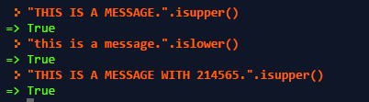
.isupper() and .islower()
These check for all uppercase or lowercase characters
Notes:
Notice digits are ignored. The last message still has all non numeric characters in uppercase.
Mixed case "I am a Message".isupper() is False

Slide 45

.startswith()
Does a string start with a certain character? We can check with .startswith()
Why is the second statement False?
Notes:
.startswith() is case sensitive
.startswith() can search a string with multiple characters as well "This is Python".startswith("This") is True

Slide 46
String Formatting
There are method to format strings in Python.
.capitalize() - capitalizes the first character of a string
.lower() - all characters of a string are made lowercase
.upper() - all characters of a string are made uppercase
.swapcase() - all characters of a string are made to switch case
upper becomes lower and vice versa
.title() - each 'word' separated by a space is capitalized
Notes:
note the similarity with the Boolean methods (.iscapital( ) is similar to .capitalize( ))

Slide 47
Combining Functions
Let’s say you have a program where you need the user’s name, but the program needs the input in all caps.
We can used nested function (a function within another function) to accomplish this.
output[]:
Please type your name Alton
ALTON
Notes:
message is a variable of type string which is being assigned the input asked of the user.
However we need all upper case. So we add .upper() at the end to make this happen

Slide 48
Another example using print
output[]:
Introduction To Python
Notes:
every word is capitalized

Slide 49
in
The in keyword allows a simple search to be preformed.
in returns a Boolean result on if the searched text is contained in a string.
output[]:
What is your name? My name is Eric
True
Notes:
the matching is case sensitive – using .lower( ) or .upper( ) can remove case sensitivity
print("eric" in message.lower( ))

