Slide 1
Introduction to Python Unit 1
Course 40460

Slide 2
Module 2
Introduction to Python, Unit 1

Slide 3
Arguments and Parameters
We have used various functions and methods so far: print(), type(), input(), .upper(), .isalpha(), etc.
After a function you might have noticed there are always ( )
Sometimes there is data passed in, sometimes not
Anything passed in the ( ) is called an argument
or it is called a parameter when defining a function
The input() function has 1 parameter: the message string to show the user
input() takes 1 argument such as "what is your name? ", a string
name_1 = input("what is your name?: ")
Notes:
parameter and argument are "sides of the came coin"
we define a parameter in a function: "this function has a integer parameter)
we pass an argument in a function call: "I am sending the function the integer argument 33"

Slide 4
User Defined Functions
A power of a programming language is being able to create functions
Functions allows code reuse. We can call a function again and again
Reuse makes programming more efficient and less prone to error
Notes:
we call print( ) instead of writing code to perform the duties of print( ). We avoid writing the several lines of code needed, over and over every time we want to display text.

Slide 5
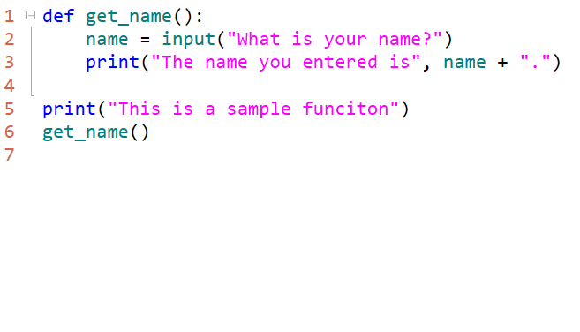
Simple Function
To create a function use the def keyword.
Each line of the function under the definition MUST be indented. This is how Python knows it is part of the function.
To call a function, type the name of the function like a built-in function.
function call: get_name()
Notes:
This function asks the user for a name and then prints it. Very simple- expect that it can be called multiple times, but only coded once.

Slide 6
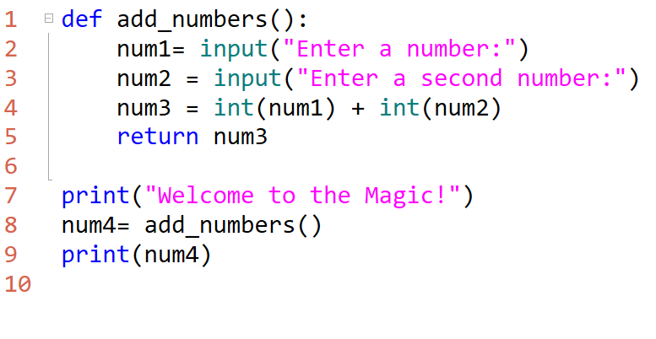
Example Function with Return
This simple function adds numbers, but returns a value to the function call
Notes:
num4 variable is assigned the value of the function call and stores the return value
<see next slide for further notes>

Slide 7
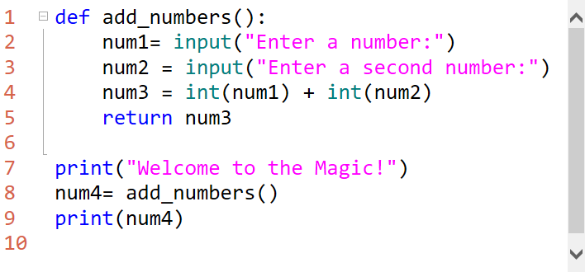
Breaking it Down
In the add_numbers() function the user is asked for 2 numbers which are added together. The return keyword is used to send the result back to the num4 variable
Why is type casting needed here?
Notes:
Num1 and num2 are variables gathering input from the user.
Num3 is the variable to hold the sum of the other 2 variables.
Since input is always of the string data type; it must be converted to an int.
Remember, if we add two strings concatenation occurs- which is not the desired result there.
All of this runs when the function is called by the assignment statement for num4 and stored in num4 variable

Slide 8
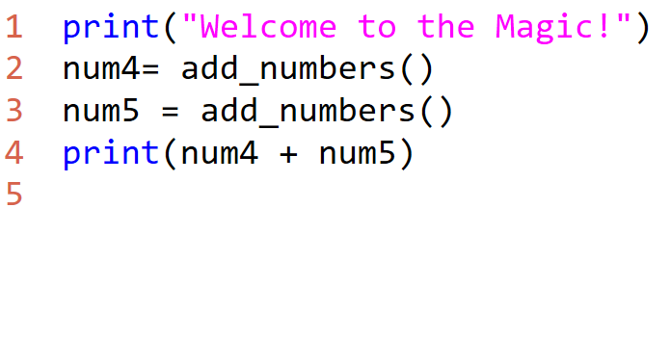
Code Reuse
We call the function more than once. This is the real power of a function
So now the function is called twice and all 4 numbers are added together.
But the addition code was only written once.

Slide 9
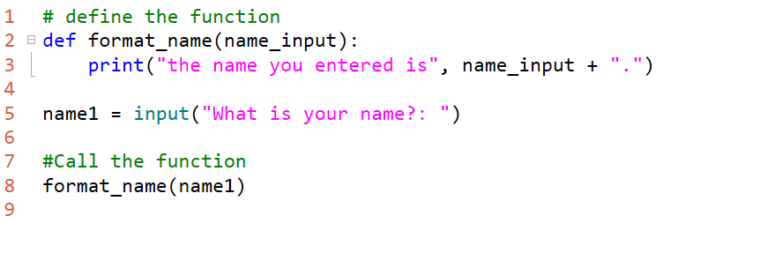
Functions with Parameters
Built-in functions like print() and type() take arguments.
User-defined functions can define parameters it will accept
Notes:
format_name( ) accepts 1 str argument – the parameter variable is called "name_input"
When calling the function the user doesn't need to know the parameter variable – just that it takes a string argument.
The parameter for this function is called "name_input" inthe function but it could be called "x" or any valid variable name.

Slide 10
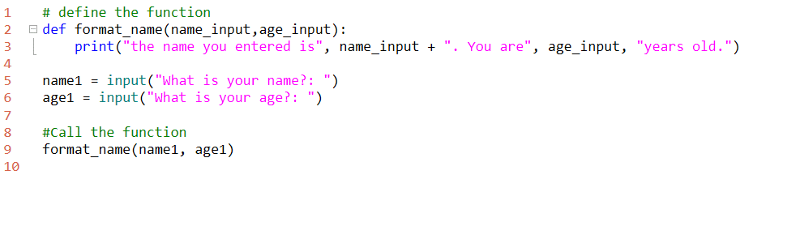
Multiple Parameters
Separate each parameter with a comma.
The number of parameters passed must exactly match the number in the def statement or Python will throw an error. Unless a default value is defined.
Notes:
discuss default in a function definition
def forrmat_name(name_input = "Alton", age_input = "15"):

