Slide 1
Introduction to Python Unit 1
Course 40460

Slide 2
Module 3
Introduction to Python, Unit 1

Slide 3
Conditionals
In Python code, decisions can be made using a Boolean condition with if statement
This allows a programmer to control the flow of code through a program
Statements are either 100% True, or it is False - no maybe
Code either runs, or does not run
Notes:
Unlike humans, computers do not understand maybe.
Example: If it is sunny we will walk, otherwise we will take the bus.
One cloud in the sky.. Is this still sunny? Or Mostly sunny? What choice would the computer make?

Slide 4
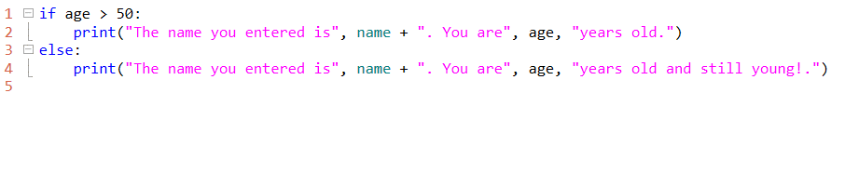
Basic Form
If condition is true do x else do y
The colon ( : ) at the end of the if statement is required. Any lines of code that go with the if statement must be indented.

Slide 5
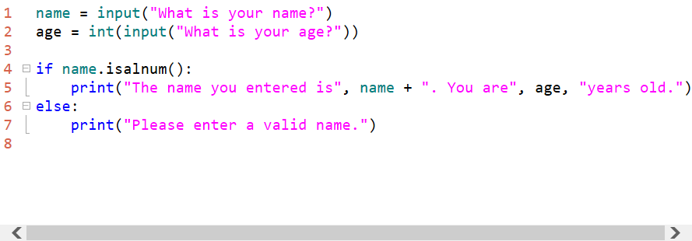
String Methods
Boolean string methods can be used in if statements
Notes:
This code ensures the user types a valid name. Well sort of.. What if we enter "335" at the name? Would the statement evaluate to true? <yes, because used isalnum( ) and not isalpha( )>

Slide 6
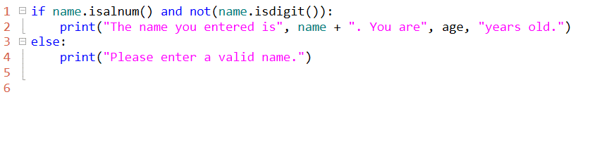
Compound if statements
It is possible to use two conditions at the same time using an and
the if statement reads:
"if name is alpha numeric and not a digit"
Notes:
Can decide to skip this slide if students still grasping simple if statements
can use and alone without not
and not are two key words that can be used independently - and not is the same as and !
example combinations:
if not name.isalnum( ):
print(….)
if name.isdigit( ):
print(….)
if name.isdigit( ) and name.isalpha( ):
print(…)

Slide 7
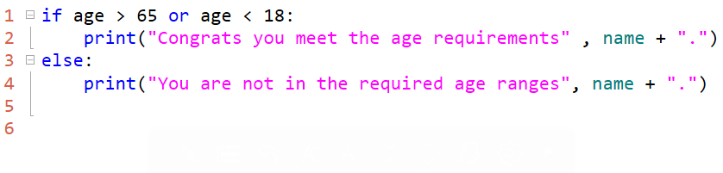
Compound if statements
It is possible to use two conditions at the same time using an or
or means either condition can be TRUE and the entire statement is TRUE
If age is smaller than18 or greater than 65 the statement is TRUE

Slide 8
Comparison Operators
Comparison operators in Python
> Greater than
< less than
>= Greater than to equal to
<= Less than to equal to
== Equals
!= Does not equal
Note: A single equals sign (=) is the assignment operator. Attempting to check for equality is a syntax error in Python

Slide 9
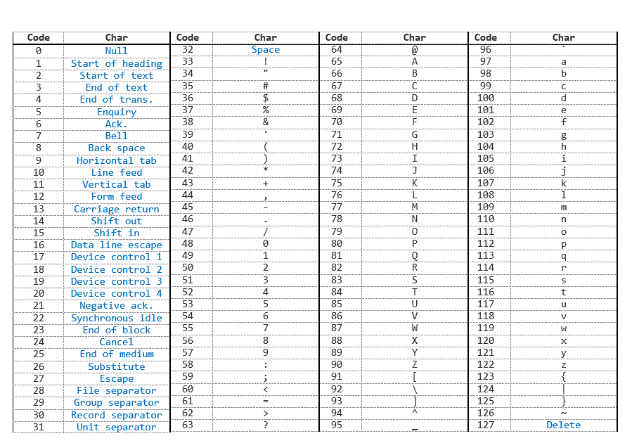
String Comparisons
Strings can be equal == or unequal != (not =)
Strings can be greater than > or less than <
alphabetically "A" is less than "B“
lower case "a" is greater than upper case "A"
Notes:
String comparisons actually look the binary number assigned to each letter using Unicode or ASCII. For example upper case “A” is 65 and lower case “a” is 97.

Slide 10
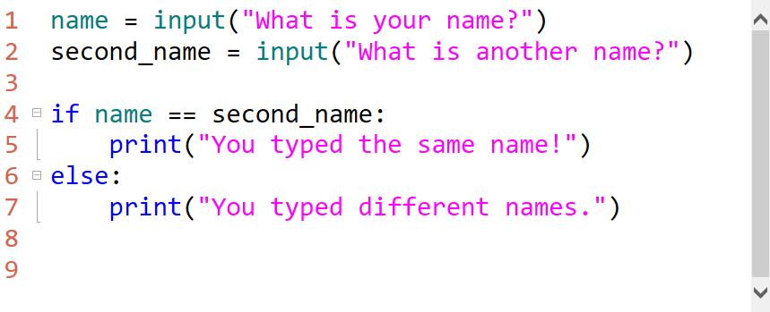
String Comparison Example
In this example two strings are compared using ==
Notes:
the comparison will include white space and is case sensitive

Slide 11
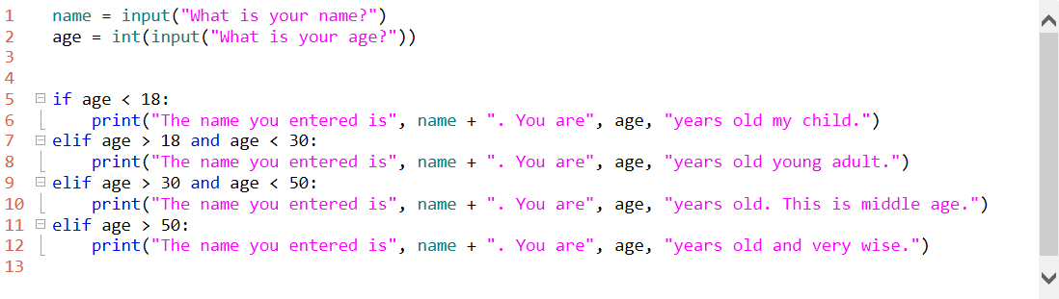
elif
What is there is more than one condition to test?
Using an else if, many conditions can be tested
In Python to accomplish this use the elif keyword.
Notes:
elif means "else if"
is the number 1? then is it 2? then is it 3? can be written
if x == 1:
print(1)
elif x == 2:
print(2)
elif x == 3:
print(3)
else:
print("I give up")

Slide 12
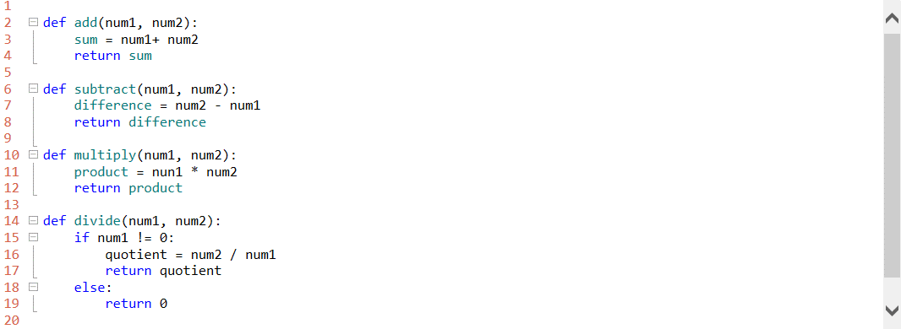
Python Calculator
Let’s write a simple Python program that will add, subtract, multiply, or divide 2 numbers! First, the functions.
Why is there an extra if statement for division?
Notes:
always avoid dividing by zero

Slide 13
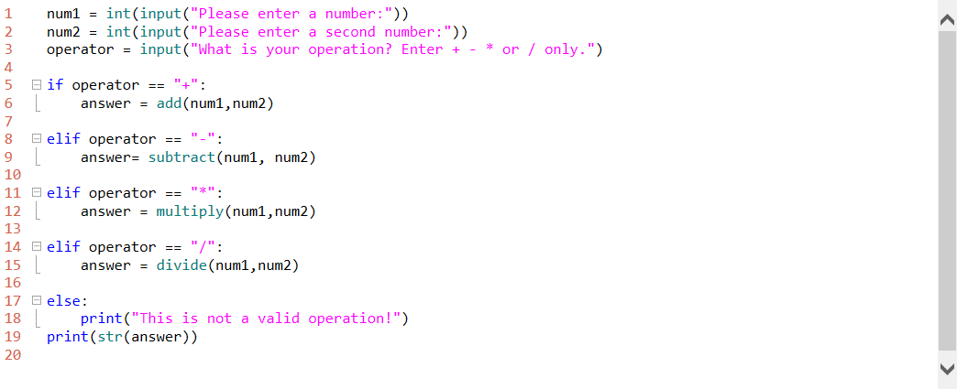
Main program
Calling the calculator function
Notes:
See the file 1.5.2_Calc_Code_Full file for all the code in one file

Slide 14
You try it!
Code the calculator program on your own!
Notes:
Have students code the calculator program at their workstations. The code on slide 70 can be used as a guide. The full code is available in the 1.5.2_Calc_Code_Full file.

