Slide 1
Introduction to Python Unit 1
Course 40460

Slide 2
Module 4
Introduction to Python, Unit 1

Slide 3
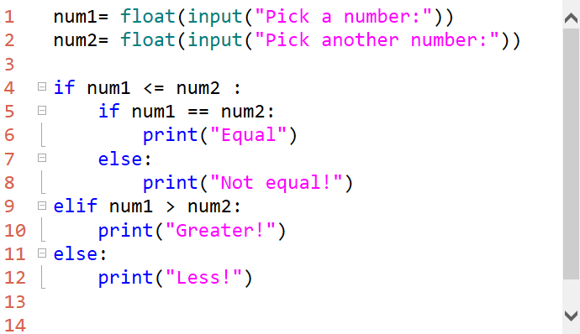
Nested Conditionals
Sometimes a program might need to test a condition and a sub condition based on the answer the first decision.
Notes:
a sub question example: "is it cold?" if yes, "do you have a hat?"
Why is type casting required here?

Slide 4
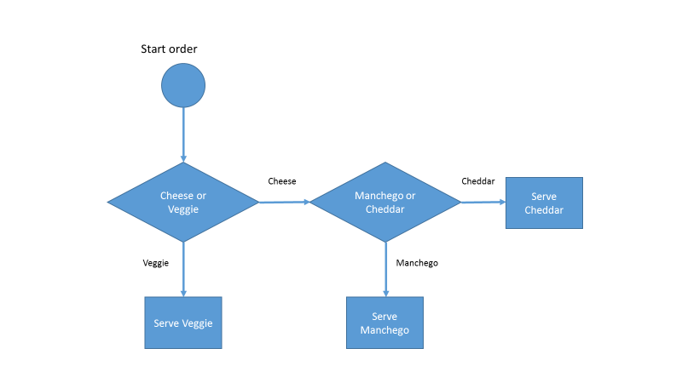
Example Flow Chart
Notes:
the meu shows Cheese or Veggie sandwiches
if you choose Cheese there are additional sub questions

Slide 5
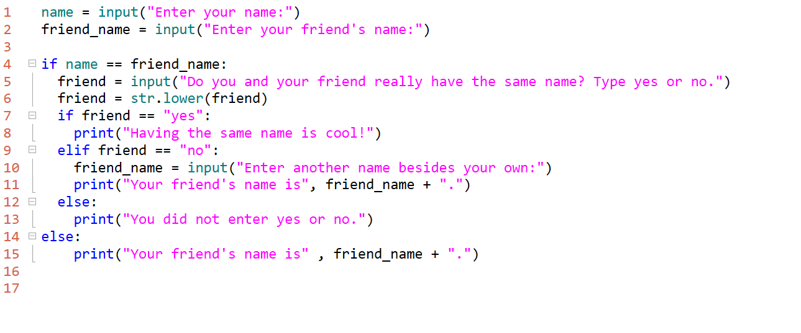
Another Example
Notes:
Why is the double equals (==) used in the if statements? [compare is ==, assign is =]

Slide 6
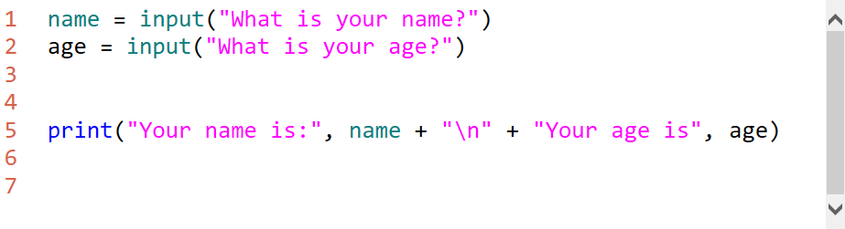
Escape Sequences
Sometimes output needs to be formatted on multiple lines.
\n is the new line or carriage return
\n causes the print statement to start a new line
Notes:
See the notebook 1-6.2 for additional escape sequences

Slide 7
Loops
Loops, like conditionals, are fundamental concept in programing.
A common loop uses the while keyword

Slide 8
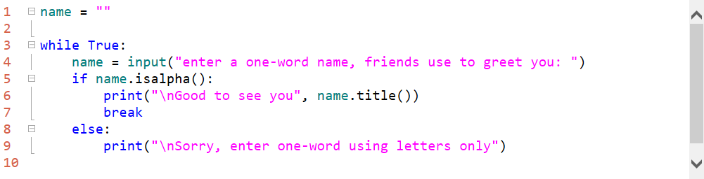
while Loop
while True: is known as the infinity loop
The break statement is critical. Otherwise this is an endless loop- a common logic error when coding with loops.
Notes:
A loop is endless when there is no way for it to become false (or terminate). The loop will run forever unless interrupted whichever comes first.
This is a pattern for forcing the user to enter valid input format

Slide 9
Incrementing Variables
A loop can also be controlled by a variable called a counter variable.
A variable can be increment or decremented as a loops run to set a condition to stop a loop.
For example using: while x < 10:
x is the counter variable we can increment by one each loop until it reaches 10 and the while condition becomes false
Notes:
while x < 10:
reads as: "while x is smaller than 10"
example

Slide 10
Increment a variable
increase the value of a variable
# initialize
x = 0
# increment
x = x + 1
There is also a shorthand way which is normally used
x += 1
Notes:
x += 1
is the same as
x = x + 1
can use x = x + 3 or x = x + y as
x += 3 or x += y

Slide 11
Decrement a variable
decrease the value of a variable
# initialize
x = 0
# decrement
x = x - 1
There is also a shorthand way which is normally used
x -= 1
Notes:
x -= 1
is the same as
x = x - 1
can use
x = x - 3 or x = x - y
as
x -= 3 or x -= y

Slide 12
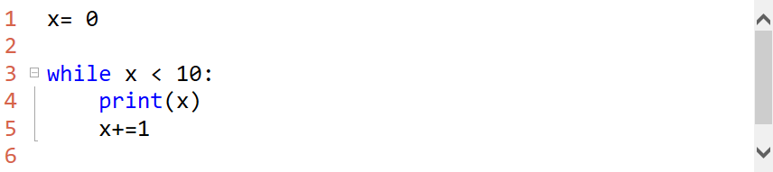
Loop with Condition
x< 10 evaluates to True or False
What would the output of this loop be?
There is no break statement, why isn’t this loop endless?
Notes:
prints 0-9 digits
exits when x is 10 and condition is False

