Slide 1
Maps
Take Me To Zalego App

Slide 2
What is MapBox
Mapbox is a developer platform used across industries to create custom applications that solve problems with maps, data, and spatial analysis. Mapbox's tools are building blocks that support every part of the web and mobile map-making process.
Mapbox provide online custom maps to websites and applications such as
Foursquare
Facebook
Finacial Times
The Weather Channel
Snapchat
Foursquare
Lonely Planet(Large travel guide book publisher)

Slide 3
Lonely Planet
How Lonely Planet use Mapbox
Lonely Planet uses Mapbox’s platform to help travelers discover where to go by plotting areas of interest in the Trips App. When they find the spot they’re looking for, travelers will know exactly how to get there using the Guides App.
https://www.mapbox.com/showcase/lonely-planet

Slide 4
Foursquare
a location technology platform dedicated to improving how people move through the real world.
is a local search-and-discovery mobile app developed by Foursquare labs inc. The app provides personalized recommendations of places to go near a user's current location based on users' previous browsing history and check-in history.
How Foursquare use Mapbox
Foursquare lets users search for restaurants, nightlife spots, shops and other places of interest in their surrounding area. It is also possible to search other areas by entering the name of a remote location. The app displays personalized recommendations based on the time of day, displaying breakfast places in the morning, dinner places in the evening etc. Recommendations are personalized based on factors that include a user's check-in history, their "Tastes" and their venue ratings.

Slide 5
Facebook
is a social networking website where users can post comments, share photographs and post links to news or other interesting content on the web, chat live, and watch short-form video.
How facebook use mapbox
Facebook is using Mapbox to bring richer maps to their user experience. They are helping millions of Facebook users improve the way they meet up with friends, find recommendations, and plan their weekends.
In the main Facebook app on Android, you can use the search feature to find a specific coffee shop, restaurant, bar, event, or see options nearby your current location. Click the Places tab to see your search results on a custom Mapbox map.
https://blog.mapbox.com/facebook-uses-mapbox-maps-11364481516e

Slide 6
Financial Times
The Financial Times is one of the world’s leading news organisations, recognised internationally for its authority, integrity and accuracy. It is part of Nikkei Inc., which provides a broad range of information, news and services for the global business community.
How Financial Times use Mapbox
Financial Times have integrated maps into their news
The Financial Times signature pink brand can now be found in its maps too.
https://blog.mapbox.com/financial-times-goes-mapbox-design-matters-36df3030667f

Slide 7
The weather Channel
is an American Pay Television owned by the Weather Group, LLC, a subsidiary of Entertainment studios. The channel's headquarters are in Atlanta, Georgia. Launched on May 2, 1982, the channel broadcasts weather forecasts and weather-related news and analysis, along with documentaries and entertainment programming related to weather.
How The Weather Channel use Mapbox
The new Storm Rader app from The Weather Channel is a full-screen interactive map that puts detailed weather and storm tracking data directly in the hands of users.
The app pulls storm data from a network of over 250,000 global personal weather stations, providing eight hours of high-resolution radar data, over 20 data layers, and hyperlocal current conditions and forecasts. Instead of looking at all of this information on the map at once — or viewing it on 20 separate maps — you can pick and choose real-time weather layers and customize the data they show

Slide 8
https://blog.mapbox.com/tracking-storms-with-the-weather-channels-newest-app-f7b31663fd21
https://blog.mapbox.com/mapbox-now-powers-the-weather-channel-app-on-ios-5f000e381d8f

Slide 9
snapchat
Snapchat is a popular messaging app that lets users exchange pictures and videos (called snaps) that are meant to disappear after they're viewed. It's advertised as a "new type of camera" because the essential function is to take a picture or video, add filters, lenses or other effects and share them with friends.
How snapchat use mapbox
snap map allows users to keep up to date with the locations of their friends, in addition to viewing Snaps and Stories
https://learn.g2.com/snapchat-map

Slide 10
prerequisite
Familiarity with android studio and java
Internet connection.

Slide 11
Getting started with MapBox
The Mapbox Navigation SDK for Android runs on API 14 and above.
The Mapbox Navigation SDK for Android gives you all the tools that you need to add turn-by-turn navigation to your app and building a more custom navigation experience with their navigation UI components.
resource we need before getting started:
A Mapbox account and access token. Sign up for an account at mapbox.com/signup. You can find your access tokens on your Account page. We will add the access token to strings.xml file After creating (Take me to zalego app).

Slide 12
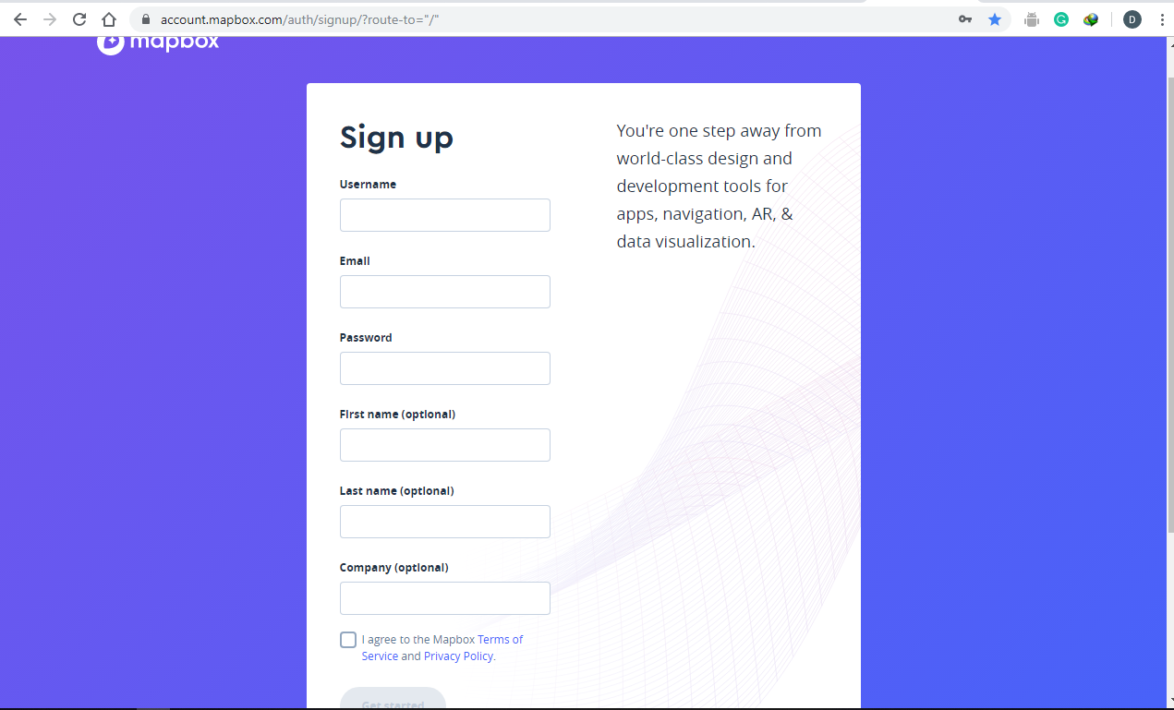
Signup page

Slide 13
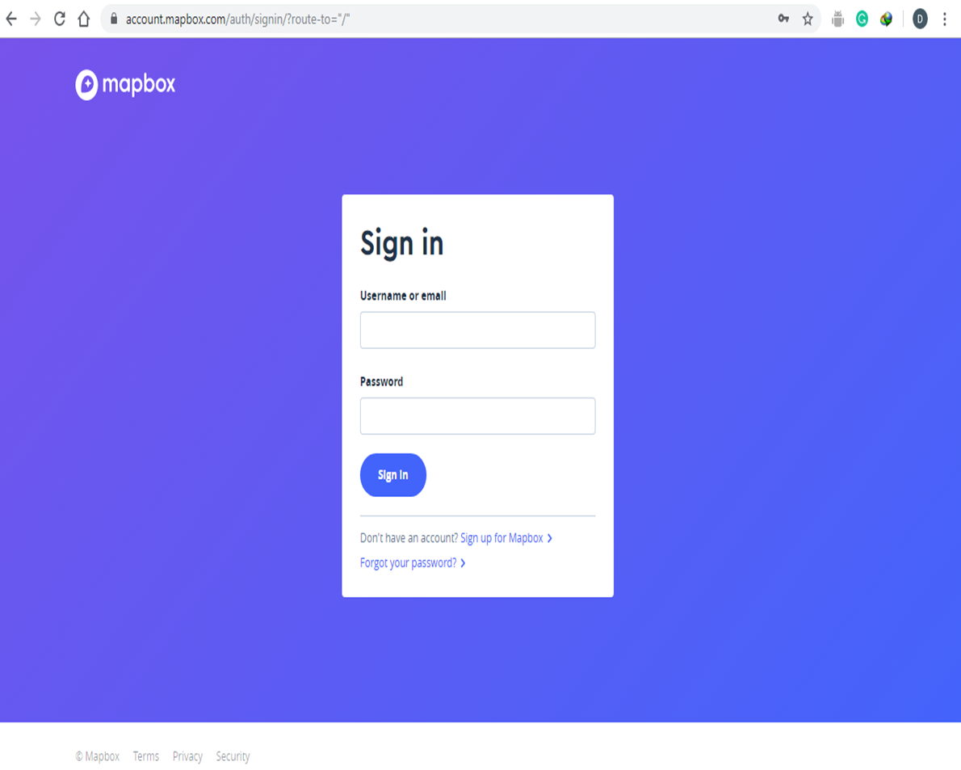
Signin page

Slide 14
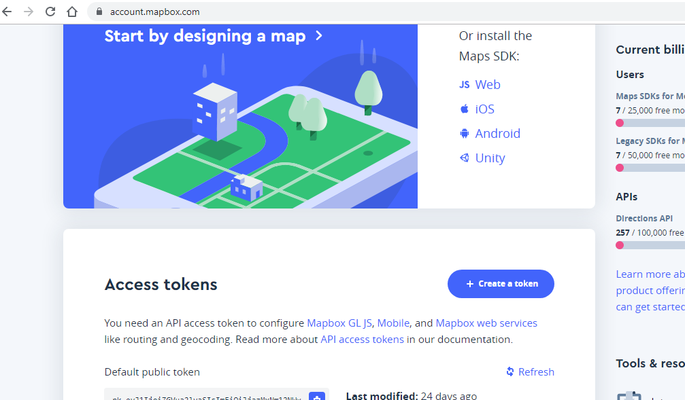
Mapbox access token
To use any of Mapbox's tools, APIs, or SDKs, you'll need a Mapbox access token. Mapbox uses access tokens to associate API requests with your account.
You can find your access tokens, create new ones, or delete existing ones on your Access Tokens page or programmatically using the Mapbox Tokens API.
In our app we will be using the default public token created after creating mapbox account.

Slide 15
Creating Take me to Zalego app
Start Android Studio.
Create a new project as follows:
If you see the Welcome to Android Studio dialog, choose Start a new Android Studio project, available under 'Quick Start' on the right of the dialog.
Otherwise, click File in the Android Studio menu bar, then New, New Project.
Enter your app name, company domain, and project location, as prompted. Then click Next.
Select the form factors you need for your app. If you're not sure what you need, just select Phone and Tablet. Then click Next.
Select Empty Activity in the 'Add an activity to Mobile' dialog. Then click Next.
Enter the activity name, layout name and title as prompted. The default values are fine. Then click Finish.

Slide 16
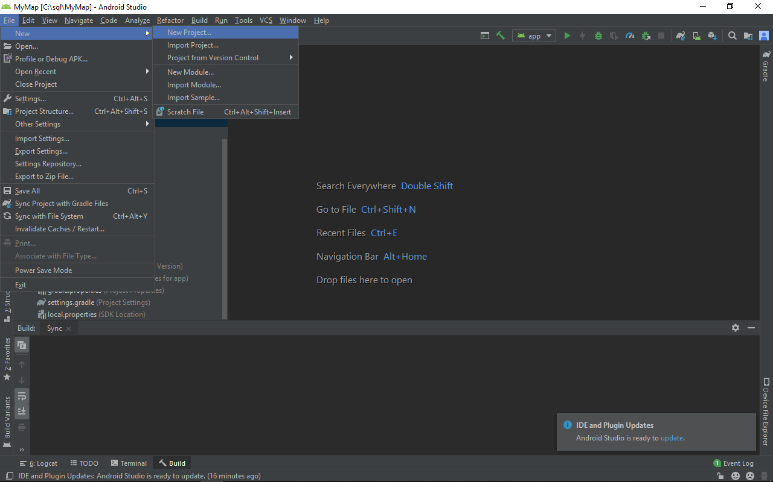

Slide 17
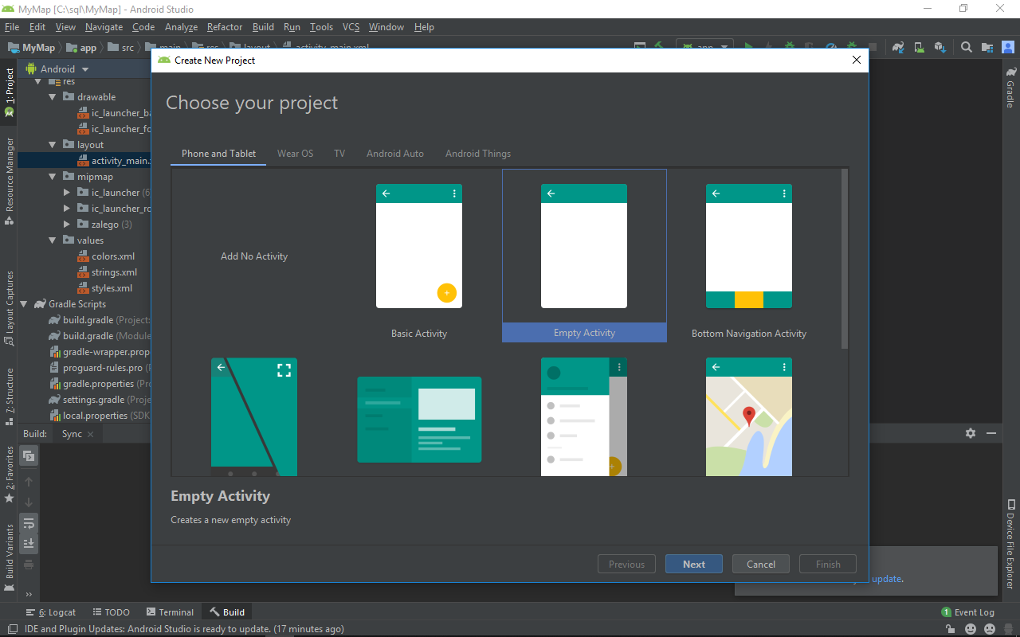

Slide 18
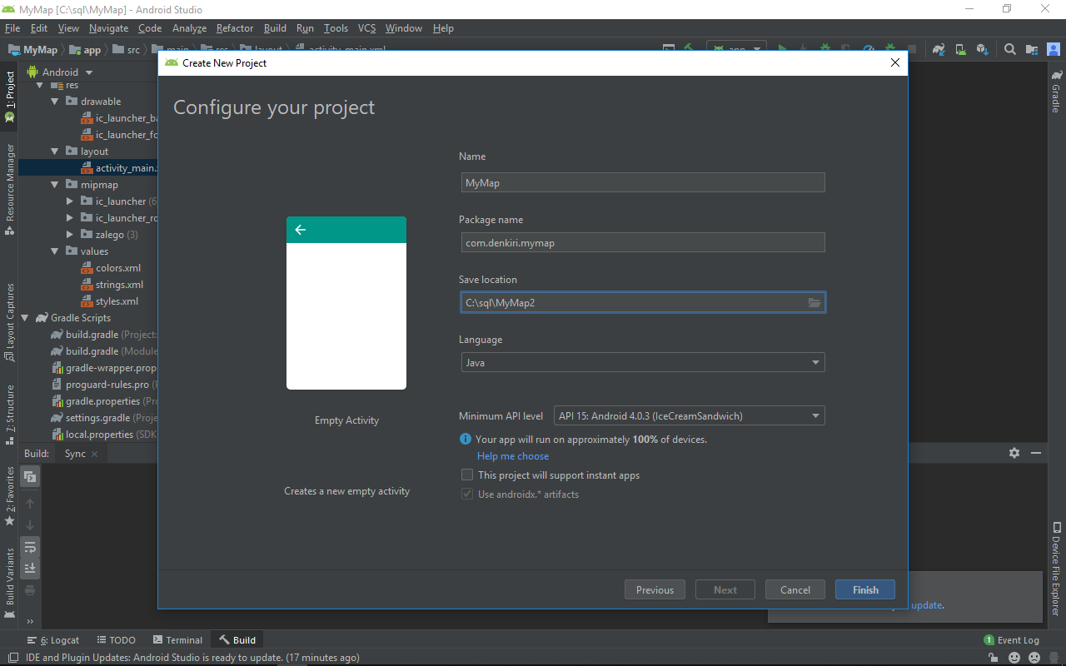

Slide 19
When the build finishes, Android Studio opens the activity_main.xml and the MainActivity.java files in the editor. (The file names depend on the configuration values you entered during setup).

Slide 20
Installing the navigation SDK
Before developing our app with the Mapbox Navigation SDK, we'll need to add several dependencies.
Android Studio uses a toolkit called Gradle to compile resources and resources code into an APK. The build.gradle file is used to configure the build and list dependencies.
You should add the Navigation UI SDK as a dependency in the repositories section.
Declaring this dependency will automatically pull in both the Mapbox Navigation SDK for Android and the Mapbox Maps SDK for Android. This is why the core Navigation SDK and Maps SDK dependency lines are not listed in the installation code snippet below

Slide 21
It is recommended not including an explicit version of the Maps SDK in your build.gradle file, because Gradle automatically takes care of adding the right dependencies. Instead, the Navigation SDK will include the Maps SDK versions that have been tested to provide the best user and developer experience for navigation apps. Manually adding a different Maps SDK version can lead to unexpected behavior

Slide 22
In the module-level build.gradle file, add the following dependencies:
// in addition to the rest of your build.gradle contents
// you should include the following repository and dependencies
repositories {
mavenCentral()
maven { url 'https://mapbox.bintray.com/mapbox' }
}
dependencies {
implementation 'com.mapbox.mapboxsdk:mapbox-android-navigation-ui:0.42.4'
}
After adding the dependancies sync gradle files(sync now)

Slide 23
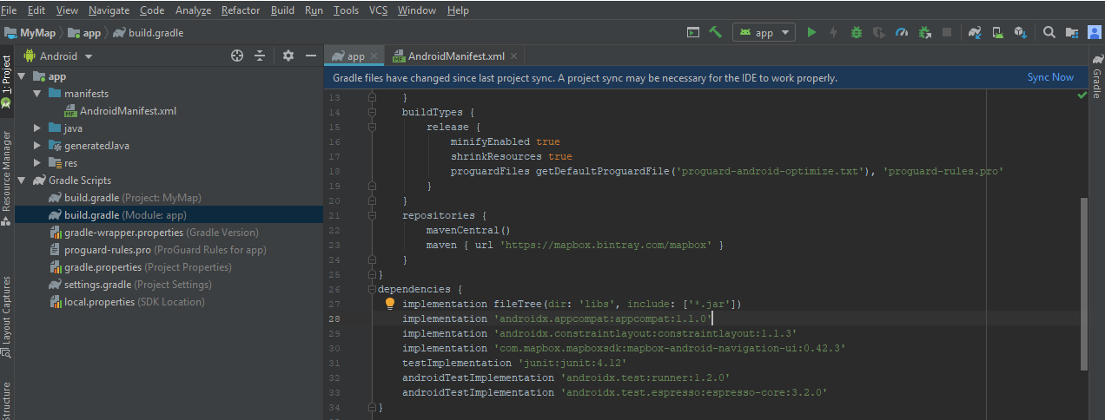

Slide 24
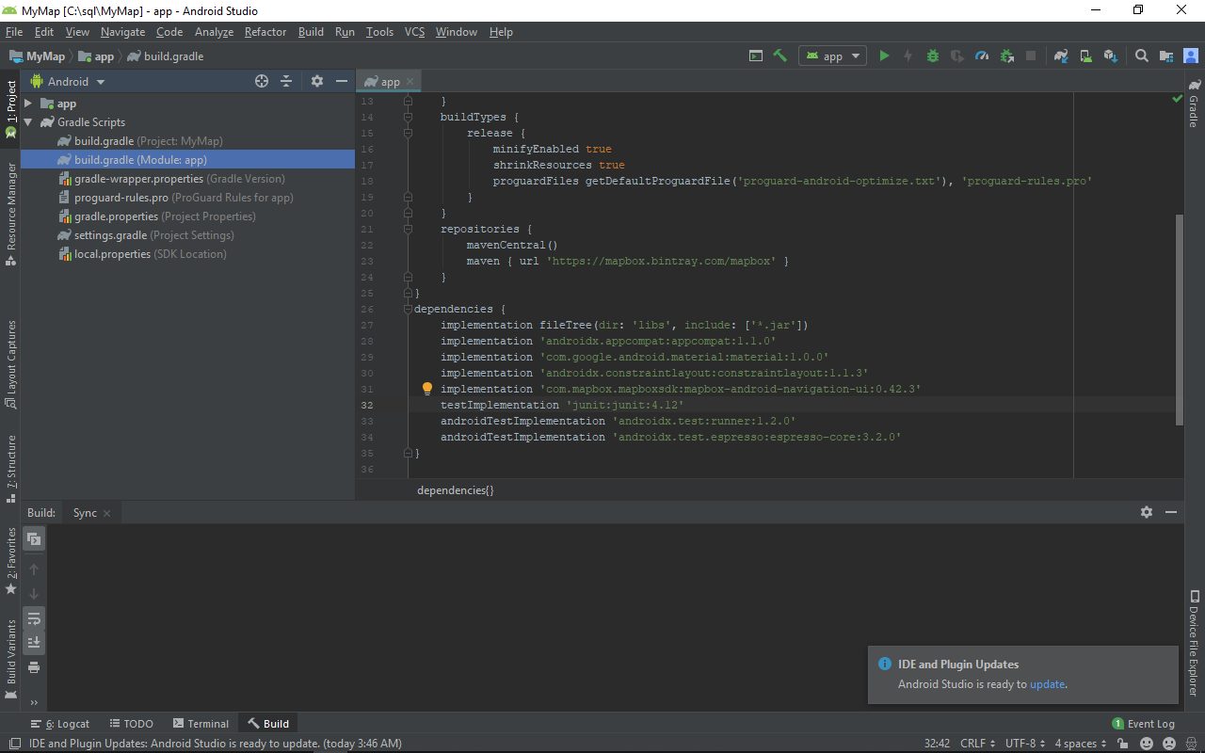

Slide 25
Besides the build.gradle file where you installed the Navigation SDK, there are four files you'll use in Android Studio to set up a Mapbox map. The four files you'll be starting with include:
AndroidManifest.xml (app/manifests/AndroidManifest.xml): This file is where you'll describe components of the application, including Mapbox-related permissions.
activity_main.xml (app/res/layout/activity_main.xml): This is where you'll set the properties for your MapView including the map center, the zoom level, and the map style that will be used when the application is initialized.
strings.xml (app/res/values/strings.xml): You'll update the name of the application and store your access token in this file.
MainActivity.java (app/java/yourcompany.yourproject/MainActivity.java): In this Java file, you'll specify Mapbox-related interactions, starting by initializing your map.

Slide 26
Location permissions
If your app needs to access the user's location, you must request permission by adding the relevant Android location permission to your app.
Android offers two location permissions: ACCESS_COARSE_LOCATION and ACCESS_FINE_LOCATION. The permission you choose determines the accuracy of the location returned by the API. You only need to request one of the Android location permissions, depending on the level of accuracy you need
android.permission.ACCESS_COARSE_LOCATION
– Allows the API to use WiFi or mobile cell data (or both) to determine the device's location. The API returns the location with an accuracy approximately equivalent to a city block.
android.permission.ACCESS_FINE_LOCATION

Slide 27
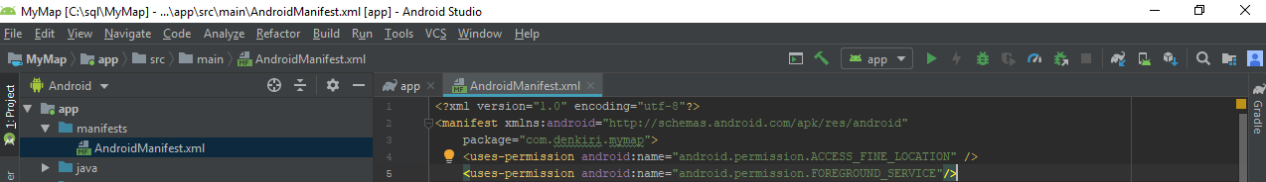
– Allows the API to determine as precise a location as possible from the available location providers, including the Global Positioning System (GPS) as well as WiFi and mobile cell data.
Add the permissions to the app manifest
<uses-permission android:name="android.permission.ACCESS_FINE_LOCATION" />

Slide 28
strings.xml (app/res/values/strings.xml)
Here you will add the access token from your mapbox account.

Slide 29
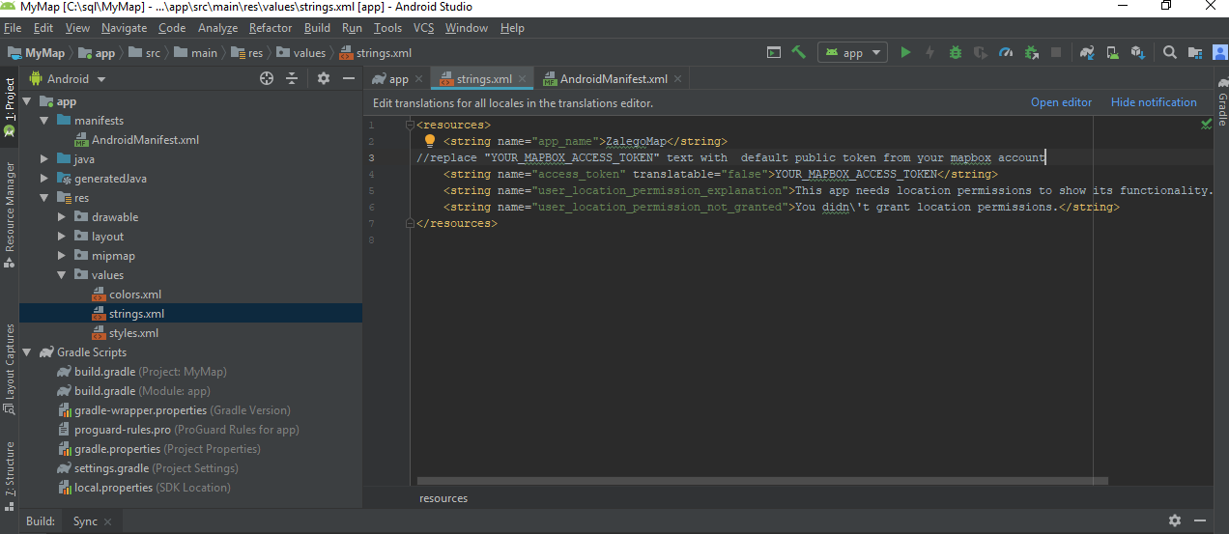

Slide 30
INITIALIZING THE MAP

Slide 31
activity_main.xml
<?xml version="1.0" encoding="utf-8"?>
<android.support.constraint.ConstraintLayout
xmlns:android="http://schemas.android.com/apk/res/android"
xmlns:mapbox="http://schemas.android.com/apk/res-auto"
android:layout_width="match_parent"
android:layout_height="match_parent">
<com.mapbox.mapboxsdk.maps.MapView
android:id="@+id/mapView"
android:layout_width="match_parent"
android:layout_height="match_parent"
mapbox:mapbox_cameraTargetLat="38.9098"
mapbox:mapbox_cameraTargetLng="-77.0295"
mapbox:mapbox_cameraZoom="12" />

Slide 32
<Button
android:id="@+id/startButton"
android:layout_width="fill_parent"
android:layout_height="wrap_content"
android:layout_marginStart="16dp"
android:layout_marginLeft="16dp"
android:layout_marginTop="16dp"
android:layout_marginEnd="16dp"
android:background="@color/mapboxGrayLight"
android:enabled="false"
android:text= "Take me to Zalego"
android:textColor="@color/mapboxWhite"
mapbox:layout_constraintStart_toStartOf="parent"
mapbox:layout_constraintTop_toTopOf="parent" />
</android.support.constraint.ConstraintLayout>

Slide 33
MainActivity.java
import android.graphics.BitmapFactory;
import android.os.Bundle;
import java.util.List;
import android.support.annotation.NonNull;
import android.support.v7.app.AppCompatActivity;
import android.widget.Toast;
// classes needed to initialize map
import com.mapbox.mapboxsdk.Mapbox;
import com.mapbox.mapboxsdk.maps.MapView;
import com.mapbox.mapboxsdk.maps.MapboxMap;
import com.mapbox.mapboxsdk.maps.Style;
import com.mapbox.mapboxsdk.maps.OnMapReadyCallback;

Slide 34
public class MainActivity extends AppCompatActivity implements OnMapReadyCallback, MapboxMap.OnMapClickListener, PermissionsListener {
// variables for adding location layer
private MapView mapView;
private MapboxMap mapboxMap;

Slide 35
@Override
protected void onCreate(Bundle savedInstanceState) {
super.onCreate(savedInstanceState);
Mapbox.getInstance(this, getString(R.string.access_token));
setContentView(R.layout.activity_main);
mapView = findViewById(R.id.mapView);
mapView.onCreate(savedInstanceState);
mapView.getMapAsync(this);
}
@Override
public void onMapReady(@NonNull final MapboxMap mapboxMap) {
this.mapboxMap = mapboxMap;
mapboxMap.setStyle(getString(R.string.navigation_guidance_day), new Style.OnStyleLoaded() {
});
}

Slide 36
@Override
protected void onStart() {
super.onStart();
mapView.onStart();
}
@Override
protected void onResume() {
super.onResume();
mapView.onResume();
}
@Override
protected void onPause() {
super.onPause();
mapView.onPause();
}
@Override
protected void onStop() {
super.onStop();
mapView.onStop();
}

Slide 37
@Override
protected void onSaveInstanceState(Bundle outState) {
super.onSaveInstanceState(outState);
mapView.onSaveInstanceState(outState);
}
@Override
protected void onDestroy() {
super.onDestroy();
mapView.onDestroy();
}
@Override
public void onLowMemory() {
super.onLowMemory();
mapView.onLowMemory();
}

Slide 38
Display user location
Showing a user's location requires importing several classes related both specifically to Mapbox and generally to location. Import the following classes below the classes you've already imported to your MainActivity file
You'll also be using several variables throughout the process of adding a user's location to the map. Declare the following variables inside the MainActivity class below the existing variable, private MapView mapView;
Now you are ready to enable the location component and display the user's location.
You will also need to add two implementations to the MainActivity class: LocationEngineListener and PermissionsListener.
Notice the updates to the onStart, onStop, and onDestroy methods.

Slide 39
Step1:Adding classes needed to add location components
Add the following classes below classes needed to initialize the map
// classes needed to add the location component
import com.mapbox.android.core.permissions.PermissionsListener;
import com.mapbox.android.core.permissions.PermissionsManager;
import com.mapbox.mapboxsdk.location.LocationComponent;
import com.mapbox.mapboxsdk.location.modes.CameraMode;

Slide 40
Step2:Adding location layer variables
Add the following variables below existing variables
private MapView mapView;
// variables for adding location layer
private PermissionsManager permissionsManager;
private LocationComponent locationComponent;

Slide 41
Step3: adding enableLocationComponent() method
when the map is finished loading. Add the following code after the code used to initialize the map.
add the code below inside Style.OnStyleLoaded() method
@Override
public void onStyleLoaded(@NonNull Style style) {
enableLocationComponent(style);
}

Slide 42
Step4:LocationEngineListener and PermissionsListener
@SuppressWarnings( {"MissingPermission"})
private void enableLocationComponent(@NonNull Style loadedMapStyle) {
// Check if permissions are enabled and if not request
if (PermissionsManager.areLocationPermissionsGranted(this)) {
// Activate the MapboxMap LocationComponent to show user location
// Adding in LocationComponentOptions is also an optional parameter
locationComponent = mapboxMap.getLocationComponent();
locationComponent.activateLocationComponent(this, loadedMapStyle);
locationComponent.setLocationComponentEnabled(true);
// Set the component's camera mode
locationComponent.setCameraMode(CameraMode.TRACKING);
} else
{
permissionsManager = new PermissionsManager(this);
permissionsManager.requestLocationPermissions(this);}}

Slide 43
@Override
public void onRequestPermissionsResult(int requestCode, @NonNull String[] permissions, @NonNull int[] grantResults) {
permissionsManager.onRequestPermissionsResult(requestCode, permissions, grantResults);
}
@Override
public void onExplanationNeeded(List<String> permissionsToExplain) {
Toast.makeText(this, R.string.user_location_permission_explanation, Toast.LENGTH_LONG).show();
}

Slide 44
@Override
public void onPermissionResult(boolean granted) {
if (granted) {
enableLocationComponent(mapboxMap.getStyle());
} else {
Toast.makeText(this, R.string.user_location_permission_not_granted, Toast.LENGTH_LONG).show();
finish();
}
}

Slide 45
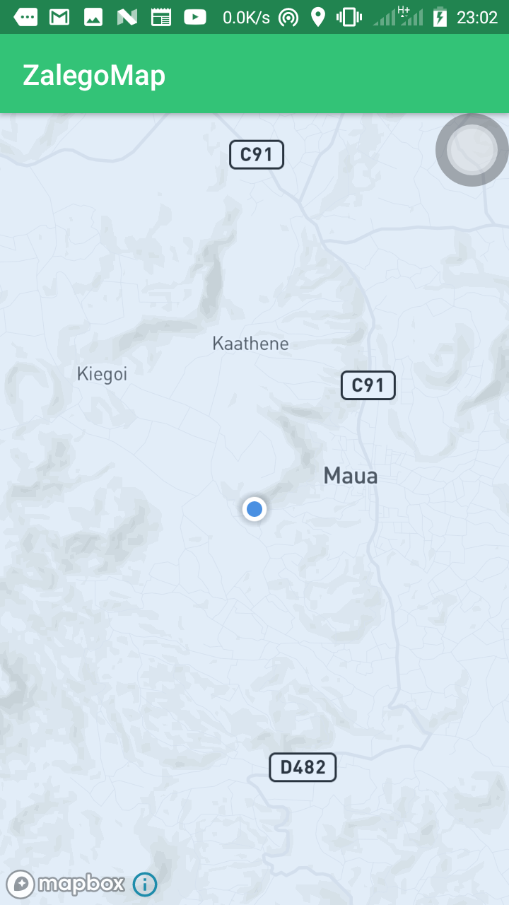
Step5:
Run your application and you will see a circular "puck", which is the user's location on the map

