Slide 1
Adding a marker on click
In this application, the user will be able to retrieve a route between your current location and Zalego Institute. Next, we will create the ability to add a marker to the map when the user taps on the map.
Start by importing the necessary classes for adding a marker to the map.
Then, add a few new variables that you will use to define the origin and destination based on the user's location and zalego Institute, respectively.
Now you are ready to add the code that will listen for when a user clicks on the map and then add a marker to the map.

Slide 2
Classes needed to add a marker
// classes needed to add a marker
import com.mapbox.geojson.Feature;
import com.mapbox.geojson.Point;
import com.mapbox.mapboxsdk.geometry.LatLng;
import com.mapbox.mapboxsdk.style.layers.SymbolLayer;
import com.mapbox.mapboxsdk.style.sources.GeoJsonSource;
import static com.mapbox.mapboxsdk.style.layers.PropertyFactory.iconAllowOverlap;
import static com.mapbox.mapboxsdk.style.layers.PropertyFactory.iconIgnorePlacement;
import static com.mapbox.mapboxsdk.style.layers.PropertyFactory.iconImage;

Slide 3
we call addDestinationIconSymbolLayer(style) after taping on the map to draw destination icon at zalego institute
//add below code inside OnStyleLoaded() method
addDestinationIconSymbolLayer(style);

Slide 4
We add onMapClickListener when user clicks on the map to add marker at zalego institute
//add below code inside OnStyleLoaded() method
mapboxMap.addOnMapClickListener(MainActivity.this);

Slide 5
addDestinationIconSymbolLayer(style) method code
private void addDestinationIconSymbolLayer(@NonNull Style loadedMapStyle) {
loadedMapStyle.addImage("destination-icon-id",
BitmapFactory.decodeResource(this.getResources(), R.drawable.mapbox_marker_icon_default));
GeoJsonSource geoJsonSource = new GeoJsonSource("destination-source-id");
loadedMapStyle.addSource(geoJsonSource);
SymbolLayer destinationSymbolLayer = new SymbolLayer("destination-symbol-layer-id", "destination-source-id");
destinationSymbolLayer.withProperties(
iconImage("destination-icon-id"),
iconAllowOverlap(true),
iconIgnorePlacement(true)
);
loadedMapStyle.addLayer(destinationSymbolLayer);
}

Slide 6
@SuppressWarnings( {"MissingPermission"})
@Override
public boolean onMapClick(@NonNull LatLng point) {
//Zalego institute coordinates
Point destinationPoint = Point.fromLngLat(36.804470,-1.266375);
Point originPoint = Point.fromLngLat(locationComponent.getLastKnownLocation().getLongitude(),
locationComponent.getLastKnownLocation().getLatitude());
GeoJsonSource source = mapboxMap.getStyle().getSourceAs("destination-source-id");
if (source != null) {
source.setGeoJson(Feature.fromGeometry(destinationPoint));
}
return true;
}
Run the application again. Click on the map, and you will see a marker added to the map.

Slide 7
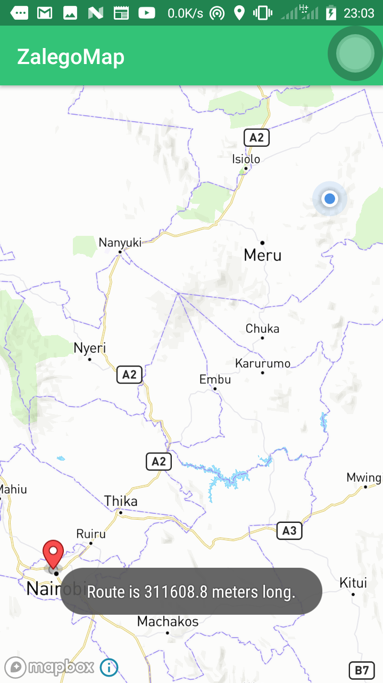

Slide 8
Calculating and drawing route
Next, we calculate and draw a route between the user's location and Zalego Institute marker. First, import a set of classes required to calculate and draw a route on the map using the Mapbox Navigation SDK and the Mapbox Android Services Directions API wrapper.
Next, add a few more variables that you'll use while calculating and drawing the route.
Now you're ready to write a new getRoute method. This method will require a origin and destination to build a NavigationRoute. After passing an origin and destination to the method, you will make a request to the Mapbox Directions API. Once you've received a response, that response will be stored as the currentRoute. Then, you'll add currentRoute to your map. Start by checking if a route already exists on the map. If it does, remove it. Then, add the currentRoute to the map as a NavigationMapRoute.

Slide 9
Now you've written the getRoute method, but it still need to be called when the user adds a marker to the map. Call the getRoute method inside the onMapClick() { ... }); method.

Slide 10
Classes to calculate route
// classes to calculate a route
import com.mapbox.services.android.navigation.ui.v5.NavigationLauncherOptions;
import com.mapbox.services.android.navigation.ui.v5.route.NavigationMapRoute;
import com.mapbox.services.android.navigation.v5.navigation.NavigationRoute;
import com.mapbox.api.directions.v5.models.DirectionsResponse;
import com.mapbox.api.directions.v5.models.DirectionsRoute;
import retrofit2.Call;
import retrofit2.Callback;
import retrofit2.Response;
import android.util.Log;

Slide 11
variables for calculating and drawing a route
// variables for calculating and drawing a route
private DirectionsRoute currentRoute;
private static final String TAG = "DirectionsActivity";
private NavigationMapRoute navigationMapRoute;

Slide 12
variables for calculating and drawing a route
// variables for calculating and drawing a route
private DirectionsRoute currentRoute;
private static final String TAG = "DirectionsActivity";
private NavigationMapRoute navigationMapRoute;

Slide 13
getRoute method code
private void getRoute(Point origin, Point destination) {
NavigationRoute.builder(this)
.accessToken(Mapbox.getAccessToken())
.origin(origin)
.destination(destination)
.build()
.getRoute(new Callback<DirectionsResponse>() {
@Override
public void onResponse(Call<DirectionsResponse> call, Response<DirectionsResponse> response) {
// You can get the generic HTTP info about the response
Log.d(TAG, "Response code: " + response.code());

Slide 14
if (response.body() == null) {
Log.e(TAG, "No routes found, make sure you set the right user and access token.");
return;
} else if (response.body().routes().size() < 1) {
Log.e(TAG, "No routes found");
return;
}
currentRoute = response.body().routes().get(0);

Slide 15
// Draw the route on the map
if (navigationMapRoute != null) {
navigationMapRoute.removeRoute();
} else {
navigationMapRoute = new NavigationMapRoute(null, mapView, mapboxMap, R.style.NavigationMapRoute);
}
navigationMapRoute.addRoute(currentRoute);
}
@Override
public void onFailure(Call<DirectionsResponse> call, Throwable throwable) {
Log.e(TAG, "Error: " + throwable.getMessage());
}
});
}

Slide 16
Call the getRoute method inside the onMapClick() { ... }); method.
getRoute(originPoint, destinationPoint);
Run the application, click the map, and you will see a marker added to the map and a line displaying a route between the user's location and Zalego Institute.

Slide 17
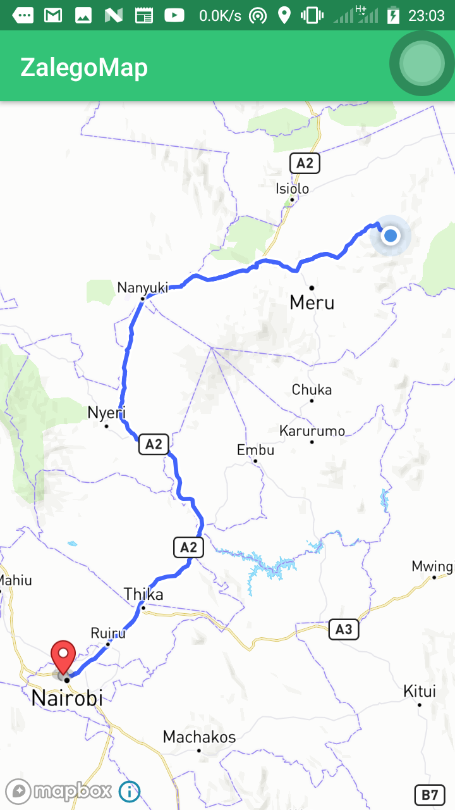

Slide 18
Add a button to start navigation
Finally, we will add a button and specify that when that button is clicked, a navigation interface should be displayed.
Start by defining a few styles for the button.
In the colors.xml file, add three new colors.

Slide 19
colors.xml
<color name="colorPrimary">#33C377</color>
<color name="colorPrimaryDark">#FF218450</color>
<color name="colorAccent">#FF4081</color>
<color name="mapboxWhite">#ffffff</color>
<color name="mapboxBlue">#4264fb</color>
<color name="mapboxGrayLight">#c6d2e1</color>
<color name="mapboxPink">#ee4e8b</color>
<color name="mapboxYellow">#d9d838</color>
<color name="mapboxRed">#b43b71</color>

Slide 20
Then, create a button in the activity_main.xml file. Use the colors you specified to set the background and textColor.
Notice that when the application is first opened, the button will not be enabled (android:enabled="false") and the button will be the mapboxGrayLight color.

Slide 21
activity_main.xml
<?xml version="1.0" encoding="utf-8"?>
<android.support.constraint.ConstraintLayout xmlns:android="http://schemas.android.com/apk/res/android"
xmlns:mapbox="http://schemas.android.com/apk/res-auto"
android:layout_width="match_parent"
android:layout_height="match_parent">
<com.mapbox.mapboxsdk.maps.MapView
android:id="@+id/mapView"
android:layout_width="match_parent"
android:layout_height="match_parent"
mapbox:mapbox_cameraTargetLat="38.9098"
mapbox:mapbox_cameraTargetLng="-77.0295"
mapbox:mapbox_cameraZoom="12" />

Slide 22
<Button
android:id="@+id/startButton"
android:layout_width="fill_parent"
android:layout_height="wrap_content"
android:layout_marginStart="16dp"
android:layout_marginLeft="16dp"
android:layout_marginTop="16dp"
android:layout_marginEnd="16dp"
android:background="@color/mapboxGrayLight"
android:enabled="false"
android:text=« Take me to zalego"
android:textColor="@color/mapboxWhite"
mapbox:layout_constraintStart_toStartOf="parent"
mapbox:layout_constraintTop_toTopOf="parent" />
</android.support.constraint.ConstraintLayout>

Slide 23
Back in the NavigationActivity file, import the necessary classes for adding a button and opening a new navigation view.
Add a new variable for the button.
Then, add a button with a click listener. When the button is clicked, start the NavigationLauncher.
Finally, you'll need to specify that the button should change to be enabled after a marker is added to the map (when the destination is defined). You can accomplish this by setting the button to enabled and setting the background to the mapboxBlue color defined in the colors.xml file.

Slide 24
MainActivity.java
// classes needed to launch navigation UI
import android.view.View;
import android.widget.Button;
import com.mapbox.services.android.navigation.ui.v5.NavigationLauncher;
// variables needed to initialize navigation
private Button button;

Slide 25
add a button with a click listener. When the button is clicked, start the NavigationLauncher.
//Add the following code below inside onStyleLoaded() method
button = findViewById(R.id.startButton);
button.setOnClickListener(new View.OnClickListener() {
@Override
public void onClick(View v) {
boolean simulateRoute = true;
NavigationLauncherOptions options = NavigationLauncherOptions.builder()
.directionsRoute(currentRoute)
.shouldSimulateRoute(simulateRoute)
.build();
// Call this method with Context from within an Activity
NavigationLauncher.startNavigation(MainActivity.this, options);
}
});

Slide 26
Finally, you'll need to specify that the button should change to be enabled after a marker is added to the map (when the destination is defined). You can accomplish this by setting the button to enabled and setting the background to the mapboxBlue color defined in the colors.xml file.
//add the code below inside onMapClick() method
button.setEnabled(true);
button.setBackgroundResource(R.color.mapboxBlue);
Run the application again. You should see a full width button at the top of the screen. Click a point on the map to add a marker at Zalego Institute and see an overview of the route. Then, click Take me to Zalego button to pull up the navigation view.

Slide 27
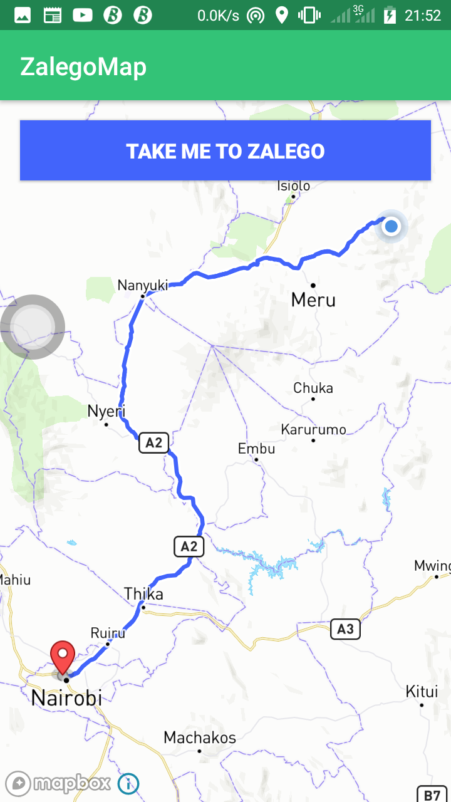

Slide 28
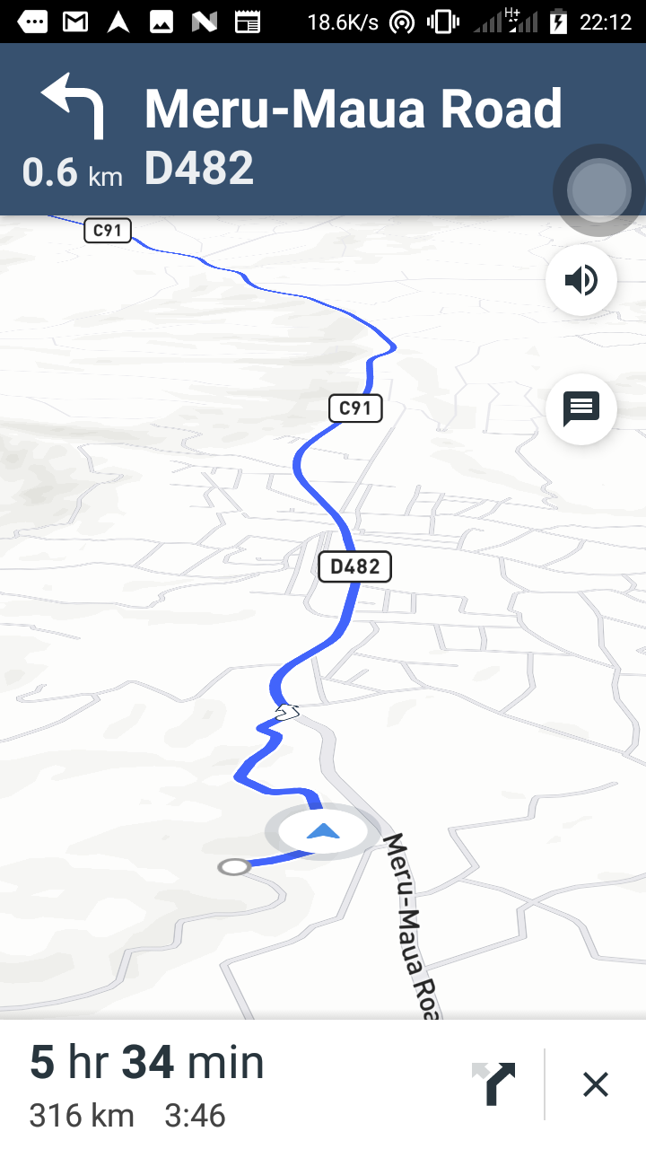
After clicking Take me to zalego button

Slide 29
Camera
The Maps SDK's camera is the user's viewpoint above the map. The camera can be tilted, rotated, zoomed, and/or moved by on-screen gestures such as pinching or with pre-written code. It's important to know that the camera object will not make any changes to markers, layers, sources, or other annotations that you've added without you directly influencing this behavior.

Slide 30
Camera position
The Maps SDK includes a CameraPosition class which is comprised of the camera's target, angle, zoom, tilt, and padding. These camera options shape the user's perspective of the map tile(s).

Slide 31
Target
The target is a single latitude and longitude coordinate that the camera centers itself on. Changing the camera's target will move the camera to the inputted coordinates. The target is a LatLng object. The target coordinate is always at the center of the viewport.
Dragging the map with a finger will pan the map and thus, the camera target.

Slide 32
Tilt
Tilt is the camera's angle from the nadir (directly facing the Earth) and uses unit degrees. The camera's minimum (default) tilt is 0 degrees, and the maximum tilt is 60. Tilt levels use six decimal point of precision, which enables you to restrict/set/lock a map's bearing with extreme precision.
The map camera tilt can also adjust by placing two fingertips on the map and moving both fingers up and down in parallel at the same time

Slide 33
Bearing
Bearing is the direction that the camera is pointing in and measured in degrees clockwise from north.
The camera's default bearing is 0 degrees (i.e. "true north") causing the map compass to hide until the camera bearing becomes a non-zero value. The mapbox_uiCompass boolean XML attribute allows adjustment of the compass' visibility. Bearing levels use six decimal point precision, which enables you to restrict/set/lock a map's bearing with extreme precision. Besides programmatically adjusting the camera bearing, the user can place two fingertips on the map and rotate their fingers.

Slide 34
Zoom
Zoom controls the scale of the map and consumes any value between 0 and 22. At zoom level 0, the viewport shows continents and other world features. A middle value of 11 will show city level details, and at a higher zoom level, the map will begin to show buildings and points of interest. The camera can zoom in the following ways:
Pinch motion two fingers to zoom in and out.
Quickly tap twice on the map with a single finger to zoom in.
Quickly tap twice on the map with a single finger and hold your finger down on the screen after the second tap. Then slide the finger up to zoom out and down to zoom out.

Slide 35
Adding Camera and Zoom Out Feature
CameraPosition is a useful Mapbox class used to set position, angle, zoom and tilt of the user’s viewpoint
//add the code below inside onMapClick() method

Slide 36
CameraPosition position = new CameraPosition.Builder()
.target(new LatLng(-1.266375,36.804470)) // Sets the new camera position
.zoom(10)
.bearing(180)
.tilt(30)
// Sets the zoom// Set the camera tilt
.build();
// Creates a CameraPosition from the builder
mapboxMap.animateCamera(CameraUpdateFactory
.newCameraPosition(position), 7000);

Slide 37
animateCamera() method
Animate the camera to a new location defined within a CameraUpdate object. The pre-defined camera animation evokes powered flight.

