Slide 1
Introduction into Programming in Scala
Denes Borbas

Slide 2
Agenda
What is Scala
Resources for beginners
Scla IDEs and build tools
Programming examples

Slide 3
What is Scala
Designed by Martin Odersky (first version in 2003?)
Functional (postfunctional ☺)
Paralel progamming is much easier
Object oriented
Runs on JVM
Java calsses can be easily used
Scala calsses can be easily used in Java
Scalable level of usage

Slide 4
Scala IDE for Eclipse 3.01
http://scala-ide.org/
for Scala 2.10, based on Eclipse 3.7 (Indigo)
Java 6 (JDK 7)
Advantage
Code completion, refactoring, etc.
Worksheet support (fast)
Disadvantage
Bugs in code completion and refactoring

Slide 5
Scala plugin for IntellJ IDEA
http://plugins.jetbrains.com/plugin/?id=1347
Adventage
Very good codecompletion and refactoring
Worksheet support
Disadvantage
Worksheet evaluatiaon is slow

Slide 6
Scala plugin for Netbeans
Project home: https://github.com/dcaoyuan/nbscala
Latest plugin artifact: 7.x_2.10.x, 2013-03-11
Very small community, small number of users

Slide 7
SBT (Simple Build Tool)
Home: http://www.scala-sbt.org/
Maven like file structure or just a simple directory
Dependency management : Ivy
Project configuraion in .sbt or .scala files
Scala console (REPL) can be started from sbt prompt, project classes are loaded in

Slide 8
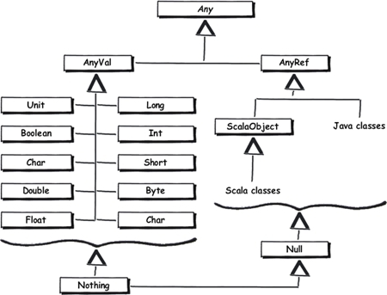
Scala type hierarchy

