Slide 1
Introduction into Programming in Scala
Main Template

Slide 2
Scala IDE for Eclipse 3.01
http://scala-ide.org/
for Scala 2.10, based on Eclipse 3.7 (Indigo)
Java 6 (JDK 7)

Slide 3
Scala plugin for Netbeans
Project home: https://github.com/dcaoyuan/nbscala
Latest plugin artifact: 7.x_2.10.x, 2013-03-11
Very small community, small number of users

Slide 4
Scala plugin for IntellJ IDEA
http://plugins.jetbrains.com/plugin/?id=1347
Pros: very good codecompletion and refactoring
Cons: worksheet evaluatiaon is slow

Slide 5
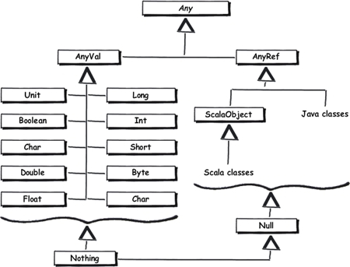
Scala type hierarchy

