Slide 1
NS-2 TCP-Linux
David Wei and Pei Cao

Slide 2
Outline
Motivation
Code structure of NS-2 TCP-Linux agent
Design of Scoreboard1, a new module for SACK processing
Validation Results

Slide 3
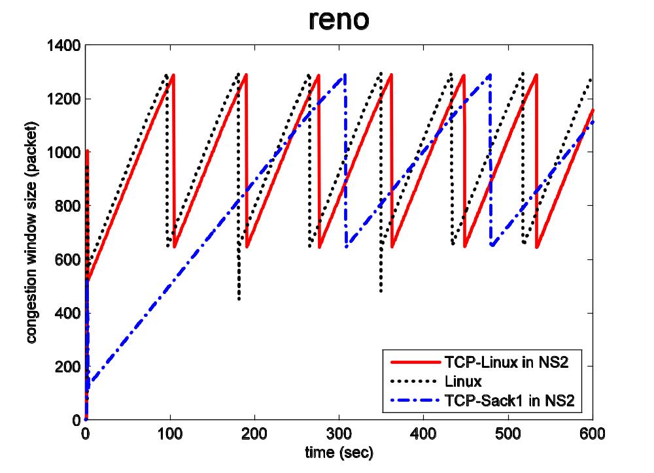
Why one more TCP agent in NS-2?

Slide 4
TCP Implementations in NS-2
Low simulation accuracy
Low simulation performance
  up to 20 hours to run a simulation of 200-second traffic on gigabit links
Poor extensibility
  Much fewer number of congestion control algorithms than Linux 2.6
Notes:
Poor code extensibility: to add a new TCP congestion control algorithm in NS2, we need to do either of the following two things:
A simpler one for developer which most of the analysis community takes: Add the new congestion control as a windowOption in TCPAgent. The advantage of this approach is that the same congestion control algorithm can work with other algorithms (loss recovery, ECN and etc). The disadvantages are: All the state variables from all different congestion control algorithms are variables in the same TCPAgent class even there is only one set of variables used at any time. So, this solution does not scale with the # of congestion control algorithms.
A more complicated one is to write a new subclass derived from TCPAgent and overwrite the relevant functions (“slowdown” and “opencwnd”). This will make the number of class variables controllable. On the other hand, the disadvantages are: 1. if each congestion control algorithm has to use a new derived class, other algorithms (loss recovery, ECN and etc) have to be repeatedly implemented in all these new derived model. 2. The congestion control algorithm of a TCP cannot be changed in the middle of a simulation (this point is less important).
The implementation complexity of method 2 is much higher than method 1. Hence, most of the researchers choose to do 1.
Poor accuracy and slow speed: evidences are as in the paper.

Slide 5
TCP Implementations in Linux 2.6
Standard interface for congestion control algorithms:
  void start(struct tcp_sock *tp): init the algorithm
  u32 ssthresh(struct tcp_sock *tp): called after packet loss
  u32 min_cwnd(struct tcp_sock *tp): called after loss
  void cong_avoid(struct tcp_sock *tp, u32 ack, u32 rtt, u32 in_flight, int good): called after ack received
  void rtt_sample(struct tcp_sock *tp, u32 rtt): called after rtt calculation
  set_state(…), cwnd_event(…), undo_cwnd(…), get_info(…)
Better SACK processing than NS-2 implementation
Notes:
The algorithms are: Reno (actually with FACK), Vegas, HS-TCP, Scalable-TCP, BIC, Cubic, Westwood, H-TCP, Hybla, Veno, TCP-LP, Compound,
Better SACK: will explain details later
D-SACK and Adaptive Delayed ACK: currently not implemented in NS2 TCP-Linux and not covered in this talk

Slide 6
Narrow the gap between NS-2 and Linux 2.6 → NS-2 TCP-Linux
Design goals of NS-2 TCP-Linux:
Accuracy:
  Use congestion control algorithm code *as-is* from Linux 2.6 source trees
  Improve SACK processing
Extensibility:
  Import the concept of interfaces for loss detection algorithms
Speed:
  Improve event queue scheduler
Notes:
Accuracy: only include the design concepts of Linux loss detection, but not the real algorithms as Linux implementation has higher complexity. We will talk about this later.

Slide 7
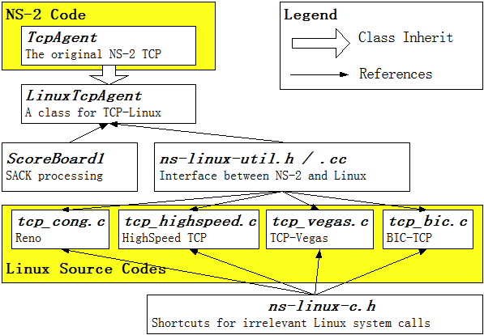
Code structure
Notes:
The yellow boxes are from existing codes (one from NS2, the other from Linux kernels).
LinuxTcpAgent is a subclass of TcpAgent in NS-2.
ScoreBoard1 is an independent class for loss detection (or more generally, “per-packet state management”).
Ns-linux-util.h / .cc are interfaces between NS-2 and Linux.
Ns-linux-c.h is a highly simplified environment for Linux codes (the environment is made from sets of macro definitions to shortcut all system calls that are not related to TCP)

Slide 8
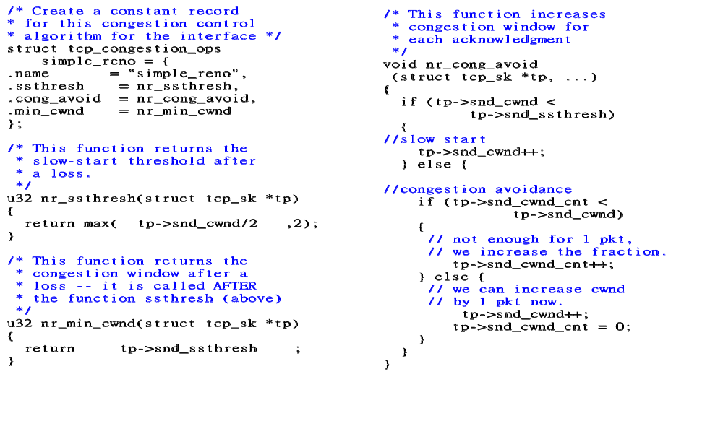
An example of congestion control algorithm in NS-2 TCP-Linux
Notes:
To implement a new congestion window algorithm with Linux interface, the researchers need to implement three functions minimally.
This figure illustrates a minimal implementation of TCP (Reno)
Note that this illustration is for NS-2 TCP-Linux. If it is to be used in Linux system, the module register functions also need to be implemented (can be done by copy-and-paste).
Also, it takes less than 10 detailed steps to include a new algorithm in Linux into NS-2 TCP-Linux. (It usually takes me <1 hour to do that.) Though we highly recommend the researchers to thoroughly test the newly included module before running performance simulation.

Slide 9
Status of NS-2 TCP-Linux
Imported all 9 congestion control algorithms from Linux 2.6.16-3
  Reno (FACK), Vegas, HS-TCP, Scalable-TCP, BIC, Cubic, Westwood, H-TCP, Hybla
Imported 3 experimental congestion control algorithms in testing for future Linux versions
  Veno, TCP-LP, TCP Compound (MS Windows Vista)
3 bugs were found with Linux 2.6 HighSpeed TCP, 1 performance problem is found with Linux 2.6 Vegas
Notes:
The 9 algorithms are: Reno (actually with FACK), Vegas, HS-TCP, Scalable-TCP, BIC, Cubic, Westwood, H-TCP, Hybla
The 3 experimental ones are: Veno, TCP-LP, Compound,
Among them, Compound is the new algorithm by MSR which will be included in Windows Vista.

Slide 10
Using LinuxTCPAgent in NS-2 Simulations
Easy usage for all users to migrate TCL scripts:
    …
    #set tcp [new Agent/TCP/Sack1]
    set tcp [new Agent/TCP/Linux]
    …
    #everything else is the same
    …
    ns at 0 “tcp select_ca reno”
    …
    #everything else is the same
    …
Notes:
The yellow parts (3 lines) are the simulation codes (tcl script) to be changed.
“tcp select_ca <congestion control algorithm>” is a new command introduced by NS-2 TCP-Linux for selecting different congestion modules.

Slide 11
Better SACK Processing
Scoreboard1:
  Combines NS-2 Sack1 design and Linux scoreboard design
  Enable correct implementation of FACK
  Simulation speed similar to NS-2 Sack1

Slide 12


SACK Processing in NS-2 Sack1
Reassembly queue
  Pro: scans the SACK list very fast
  Con: difficult to implement FACK correct, can’t identify retransmitted packets, etc.
Notes:
1~11: eleven packets that are sent but not acknowledged.
Yellow blocks: packets that are SACKed
White blocks: packets that are not Sacked nor Acked. (maybe lost, maybe inflight)
Sack1 design use a data structure called “reassembly queue” – to mimic the packet reassembling in the receiver side. The queue combines the all sacked packets in a block into one node.
pro: scanning a SACK queue much faster (in the order of # of SACK block instead of # of packets in flight).
con: How to implement FACK? How to identify retransmitted packets? How to identify lost retransmitted packets? And retransmitted-loss-retransmitted packets? …

Slide 13
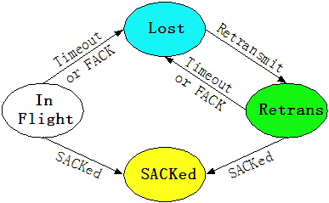
SACK processing in Linux 2.6
Per-packet state machine
  Con: slower processing of SACK lists
Notes:
Each packet (sent yet unacked) has a state diagram as above
This packet state machine can solve the FACK problem.

Slide 14

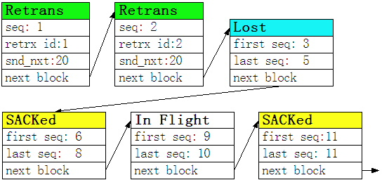
ScoreBoard1
Combine the Linux design (state diagram for each packet) and Sack1 design (Reassembly Queue)
Notes:
ScoreBoard1 in NS2-TCP-Linux combines the concept of packet state machine into the reassembly queue data structure.
One Exemption: For each retransmitted packet, we have an element in the queue – as retx_id itself is not necessarily increasing.
RtxID is an ID for each inflight retransmitted packets (can be retransmitted multiple times). It’s like a sequence number for retransmitted packets. This is to help the FACK: if a retransmitted packet is acked/sacked (with a retrx id of N), all retransmitted packets with retxid smaller than N-3 are considered lost.
Snd_nxt is the snd_nxt seq # when the packet is retransmitted. It’s another way to help FACK: if a nonretransmitted packet is acked/sacked with a sequence number of N, all retransmitted packets with snd_nxt seq # smaller than N-3 are considered lost.
Con: If the number of retransmitted packets are large, the current implementation is not efficient. (extension: split the retrans element only when the retx_id is not increasing)

Slide 15
Validation Results
Accuracy: Comparable to Linux results in the level of congestion window trajectories
Simulation speed:
  Best case: 50 times faster than NS-2 SACK1
  Worst case: as fast as NS-2 SACK1
Memory consumption: very similar memory usage as NS-2 SACK1
Notes:
Note that NS-2 Sack1 is the best existing NS-2 TCP we’ve tried.

Slide 16

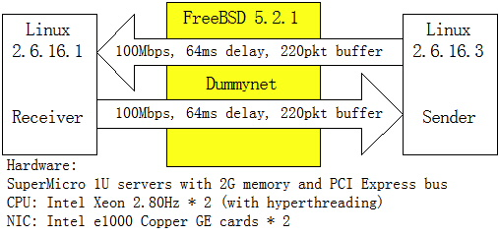
Evaluation Setup
Comparing NS-2 TCP-Linux Results with Dummynet Results.
Notes:
The upper figure is the NS-2 simulation setup.
The lower figure is the dummynet testbed setup. They are equivalent in parameter settings.

Slide 17
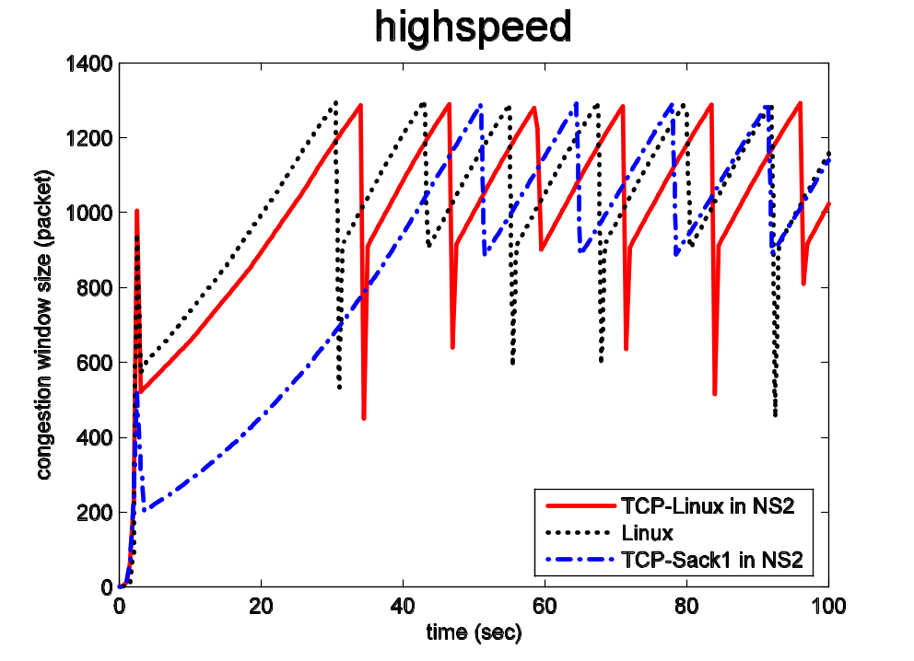
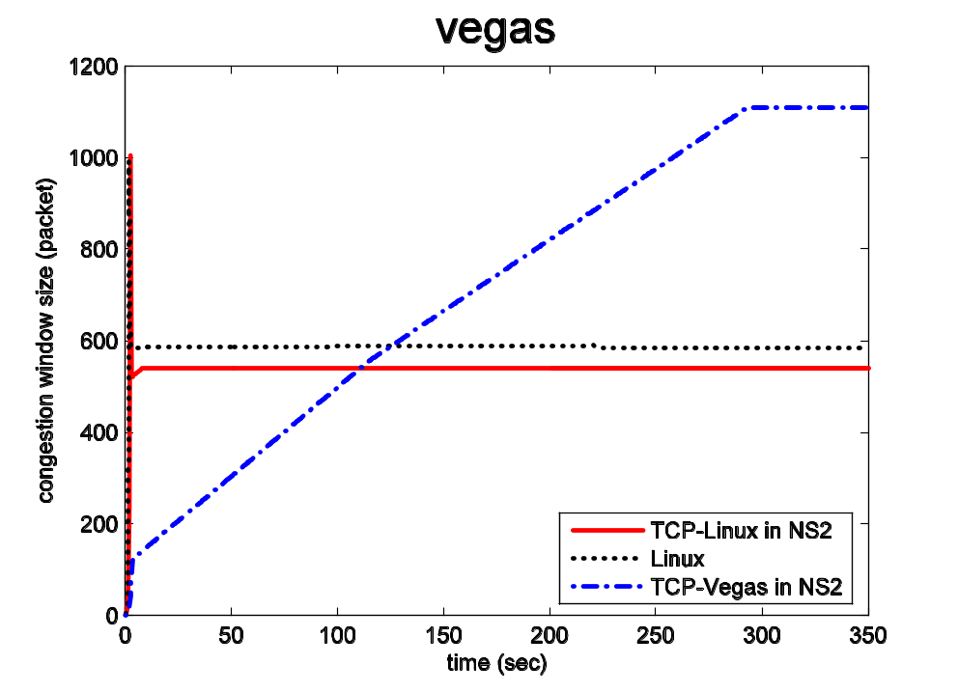
Accuracy: window trajectory
Notes:
Reno: Linux TCP has ABC (a mechanism that compensate delayed-ack effect on slowing down congestion window growth) implemented, which grows congestion window faster than NS-2 Sack1.
Vegas: Delayed ack + ack-clocking leads to the fact that every RTT sample includes the propagation delay+almost one packet worth queueing delay (the packet whose ack is delayed.) As alpha parameter in Vegas is set to 1, Vegas tries to keep 1 packet in the queue. Due to the “almost one packet worth of queueing delay”, Vegas does not increase its congestion window size. In NS-2 simulation, the old Vegas was implemented with float variable (comparing to integer variable in the Linux code), it can still find the “almost one packet worth of queueing delay” to be less than one packet.

Slide 18
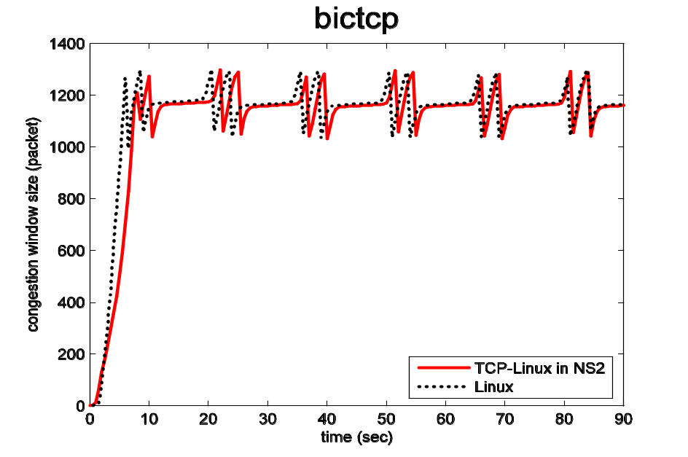
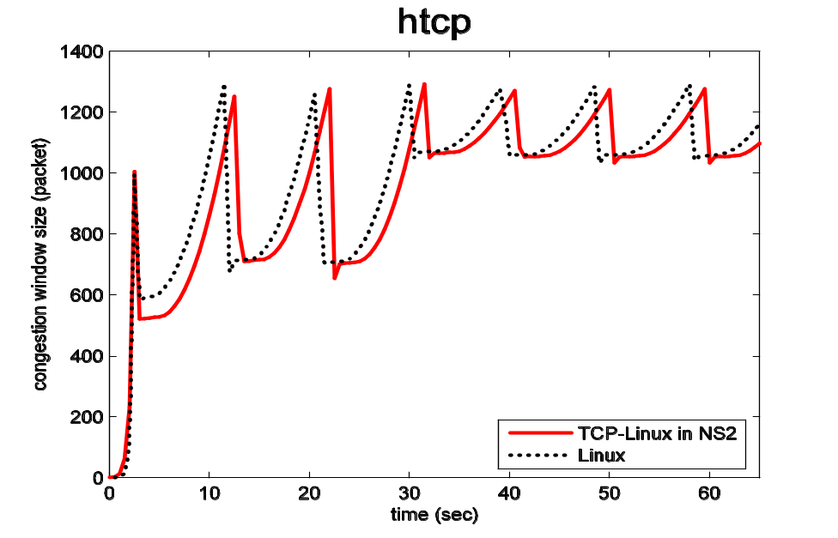
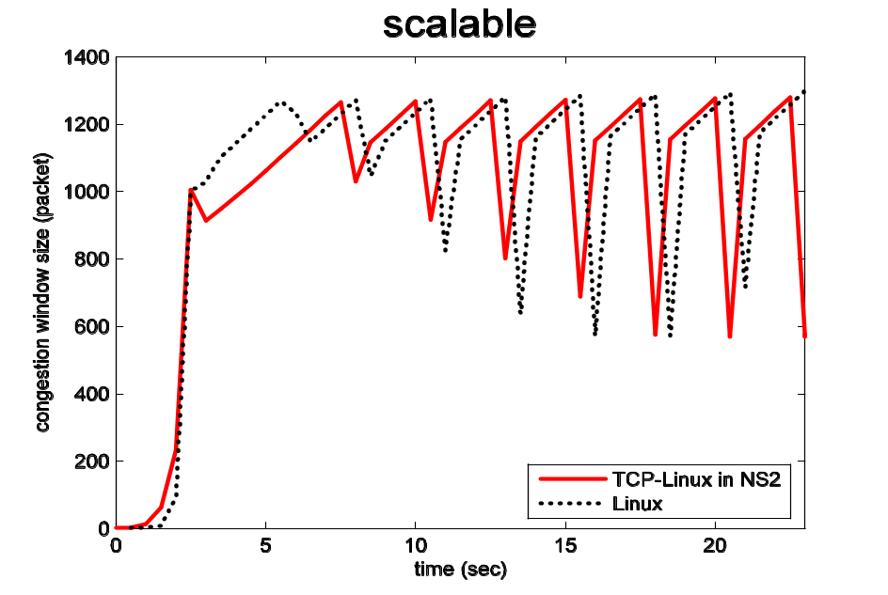
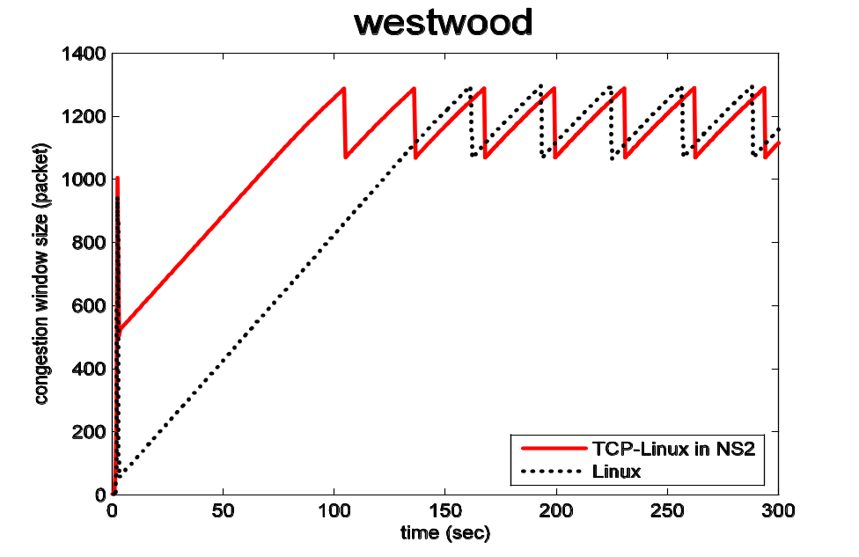
Extensibility
Notes:
X axle: time
Y axle: congestion window
Congestion window is measured every 0.5 second in dummynet testbed.
We didn’t show Hybla and Cubic due to:
Space limit
There are some small difference between dummynet experiments and simulation results. We need to further understand them.

Slide 19
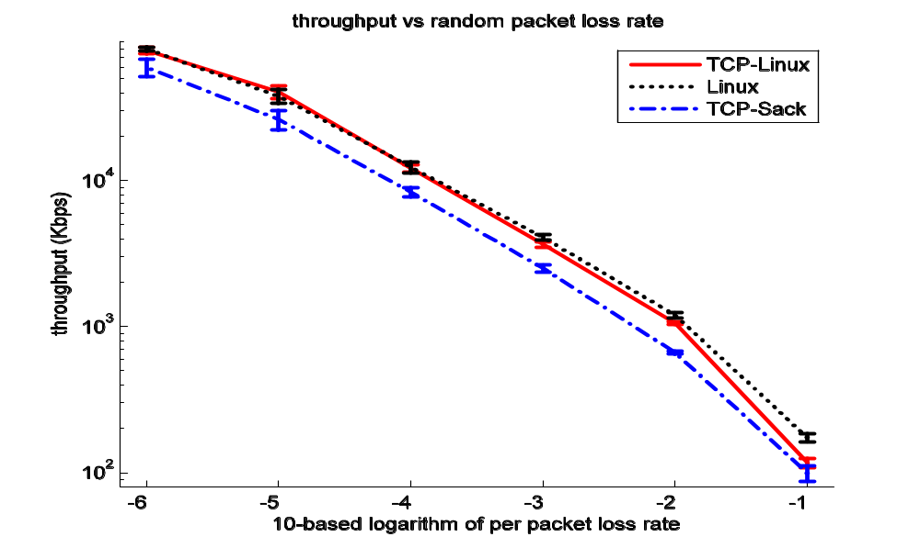
Accuracy: throughput in lossy link
Notes:
Note: the X-axle (loss rate) and Y-axle (throughput) are both in log scale. Such a constant gap is a constant ratio in throughput.
Why the NS-2 TCP-Linux also predicts a lower throughput when loss rate is 10%? This is due to the adaptive delayed ack in Linux receiver, which is not implemented in NS-2 TCPLinux. (Adaptive delayed ack seems to disable delayed ack when the window size is small. Need to understand more).

Slide 20
Why use NS-2 TCP-Linux
NS-2 Analysis community:
Able to analyze new algorithms without waiting for the availability of the NS-2 versions
Higher accuracy and faster simulation
Linux Implementation community:
Able to run repeatable simulation to test new algorithms
A larger user pool to find bugs
Notes:
We will present an example on how some bugs can be found by NS-2 TCP-Linux.

Slide 21
TCP-Linux: a better TCP for NS-2
Future works:
D-SACK processing and window reduction undo
Support for non-SACK receivers
A tutorial for the public: “Tuning TCP in NS-2”
A TCP benchmark suite in NS-2
Notes:
In summary…
White items: improvement for the NS-2 TCP Linux
Yellow items: broader improvements to provide better simulation results for TCP research based on NS-2
Especially: “Tuning TCP in NS-2” wants to help the researchers who were educated by “NS-2 by Examples”. “NS-2 by examples” is a highly successful tutorial for new NS-2 users. However, it’s TCP setup is not for high performance environment. And unfortunately, after we released NS2 TCP-Linux, we found many questions from users are in fact problems of incorrect parameter settings for high speed TCP. So, we want to write a new tutorial as a follow-up tutorial of “NS-2 by example”, to help new NS-2 TCP users to know how to set up different parameters in TCP.

Slide 22
Thank you☺
Questions ?

Slide 23
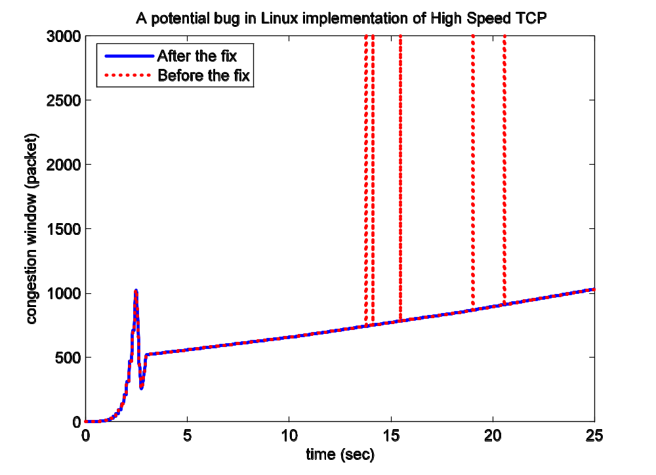
Example 1: variable overflow in Linux HS-TCP
Notes:
The transient infinitely large congestion window is due to a variable overflow in cwnd_cnt (recording the portion of cwnd). Sometimes it can be -1 due to a bug.
Fortunately, in the source code, this variable will not be referred when it is -1. (But who knows what happens later?)
This bug is fixed. The blue line is the fixed version.

Slide 24
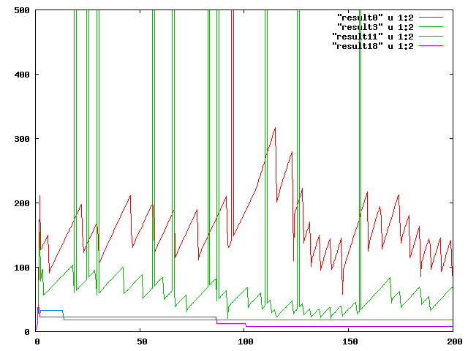
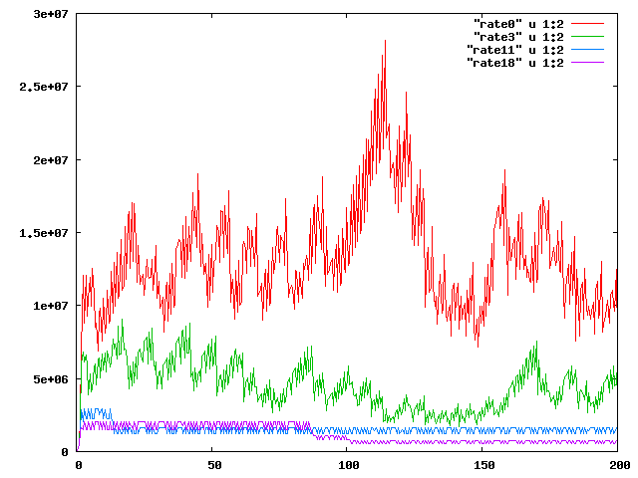
Example 2: AI bugs in Linux HS-TCP
cwnd
RTT: 64ms
Flow #: 32
(4 flows are presented)
Capacity: 100Mbps
Buffer size: 220pkt
Acker: Sack1/DelAck
rate
Notes:
There are two bugs in HS-TCP in Linux 2.6.13 shown here.
First bug: that the congestion window won’t be increased if it is smaller than 38. This is the blue and purple lines.
Second bug: once the AI value is set to be high (due to a transient high value of congestion window), it is not decreased. This is the case of the red and green lines.
These two bugs may lead to misunderstanding that HS-TCP is highly unfair.
So: We have to be careful of our results – no matter it is simulation or experiment.
If the researchers are careful, they can help Linux to find bugs with NS-2 Linux TCP

Slide 25
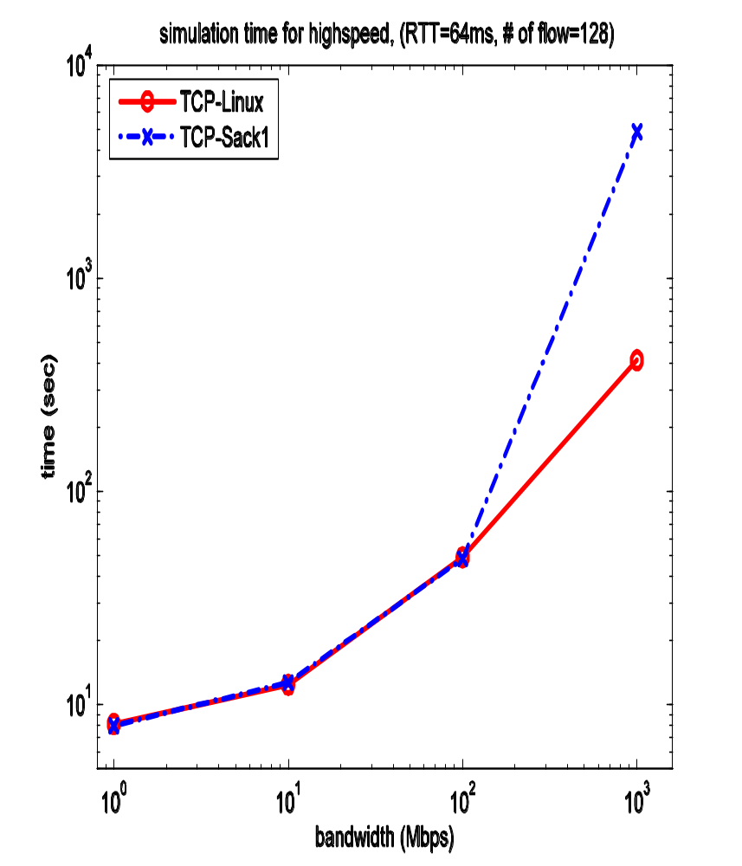
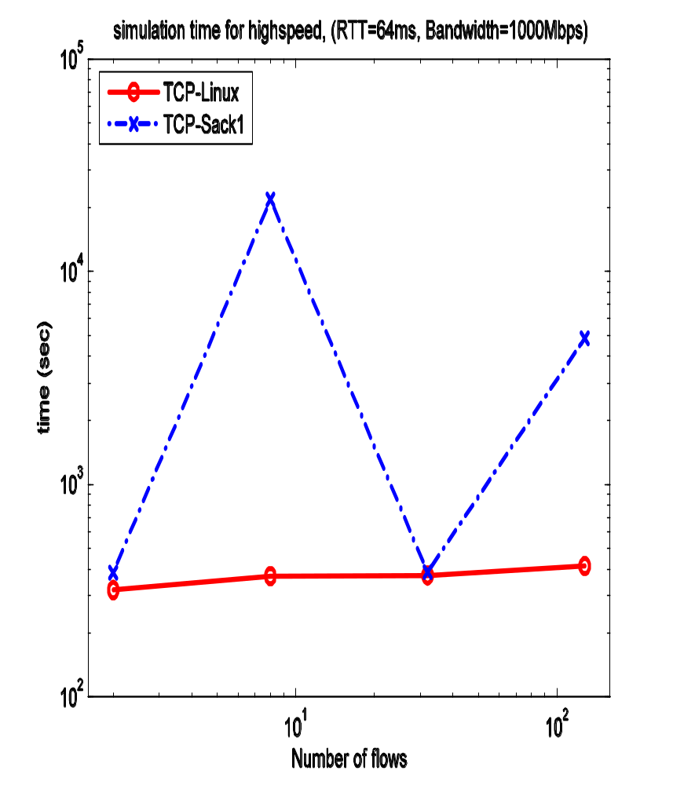
Performance: Speed
Notes:
The inconsistent and dramatic difference in speed is due to the poor performance of calendar queue in NS-2. This happens randomly

Slide 26
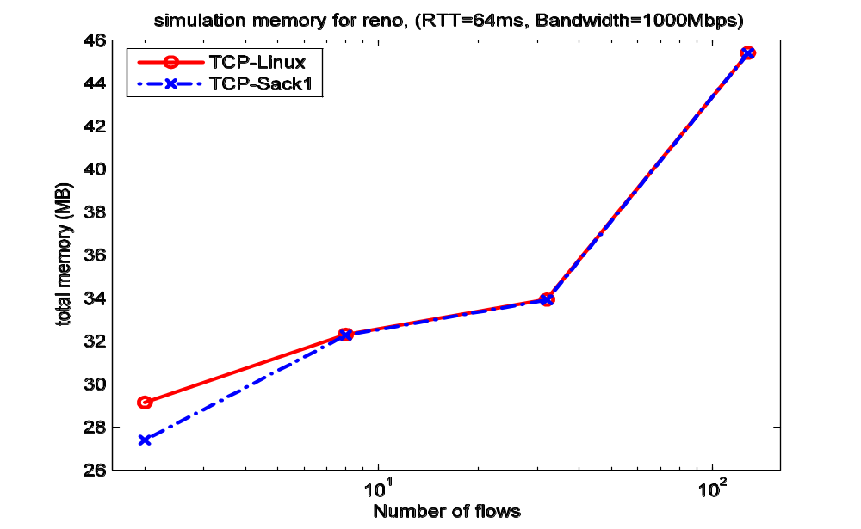
Performance: Memory
Notes:
We measure the memory used by NS-2 in the middle of each simulation.

