Slide 1
NS Tutorial

Slide 2
Basics
Setting up the environment
Create the simulator object
Create the nodes and Link the nodes together
Setup the application or traffic generator
Tracing a Queue
Schedule and Run
Post-Process the results

Slide 3
Setting up the environment
Add
/afs/cs.unc.edu/proj/courses/comp234-f05/NS/ns-allinone-2.28/otcl-1.9,
/afs/cs.unc.edu/proj/courses/comp234-f05/NS/ns-allinone-2.28/lib,
into your LD_LIBRARY_PATH environment variable.
  If it complains about X libraries, add path to your X libraries
  into LD_LIBRARY_PATH.
Add
/afs/cs.unc.edu/proj/courses/comp234-f05/NS/ns-allinone-2.28/tcl8.4.5/library
into TCL_LIBRARY environment variable
Add
/afs/cs.unc.edu/proj/courses/comp234-f05/NS/ns-allinone-2.28/bin
/afs/cs.unc.edu/proj/courses/comp234-f05/NS/ns-allinone-2.28/tcl8.4.5/unix
/afs/cs.unc.edu/proj/courses/comp234-f05/NS/ns-allinone-2.28/tk8.4.5/unix
into PATH environment variable

Slide 4
Setting up the environment
  If you are using csh, you can set it like:
    setenv LD_LIBRARY_PATH <paths>
  If you are using sh, you can set it like:
  export LD_LIBRARY_PATH=<paths>
  Alternatively you could set it up in your .bashrc, .cshrc files

Slide 5
Create the simulator object
set ns [new Simulator]
set nf [open out.tr w]
$ns trace-all $nf
proc finish {}
{ global ns nf
$ns flush-trace
close $nf
exec nam out.nam &
exit 0 }
$ns at 5.0 "finish"
$ns run

Slide 6
Create and Link the nodes
set n0 [$ns node]
set n1 [$ns node]
Link Types
duplex-link
simplex-link
To Create a Link: Format is
duplex-link n1 n2 bw delay type
Example:
$ns duplex-link $n0 $n1 1Mb 10ms DropTail

Slide 7
Create and Link the nodes
Setting up the queue size
$ns queue-limit $n2 $n3 10
Some Types:
DropTail
RED (thresh_ ,maxthresh_)
SFQ
dsRED
XCP
Each of these has their own set of parameters that can be set.
http://www.isi.edu/nsnam/ns/ns-man.html

Slide 8
Setup the application or traffic generator
Two Major protocols that will be used
UDP
  Parameters that can be set
  Set packetSize_ <K> # K is in bytes
TCP
Parameters that can be set
  Set window_ 20
  Set numdupacks_ 3
  Set maxcwnd_ 0
  Set seqno_ 0
Null : This is a traffic sink agent

Slide 9
Setting up the Application or Traffic Generator
For TCP
set tcp [new Agent/TCP]
$tcp set class_ 2
$ns attach-agent $n0 $tcp
$tcp set fid_ 1
For UDP
set udp [new Agent/UDP]
$ns attach-agent $n1 $udp
$udp set fid_ 2

Slide 10
Setup the application or traffic generator
Application/Traffic/CBR
set rate_ 448Kb
set packetSize_ 210
set interval_
Application/Traffic/FTP
  set type_ FTP

Slide 11
Setup the application or traffic generator
#Create a UDP agent and attach it to node
n0 set udp0 [new Agent/UDP]
$ns attach-agent $n0 $udp0
# Create a CBR traffic source and attach it to udp0
set cbr0 [new Application/Traffic/CBR]
$cbr0 set packetSize_ 500
$cbr0 set interval_ 0.005
$cbr0 attach-agent $udp0
set null0 [new Agent/Null]
$ns attach-agent $n3 $null0

Slide 12
Monitor a queue
set lf [open link.tr w]
$ns trace-queue $n2 $n3 $lf
set qfile [$ns monitor-queue $n2 $n3 [open queue.tr w] 0.05]
[$ns link $n2 $n3] queue-sample-timeout;
Format
time src dst size(b) size(pkts) parrivals pdepartures pdrops barrivals bdepartures bdrops

Slide 13
Schedule the start of the simulation and Run
$ns at .1 start “Agent1”
$ns at .5 start “Agent2”
$ns at 5 stop “Agent1”
$ns at 10 stop “Agent2”
$ns at 11 finish # end of simulation
$ns run # run the simulation

Slide 14
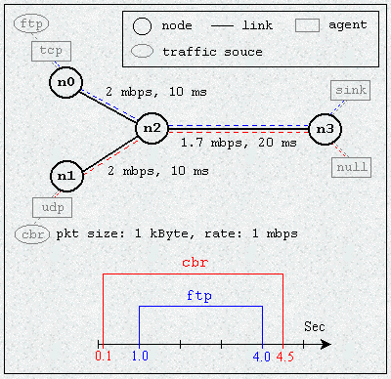
Example Script: Demo this script

Slide 15
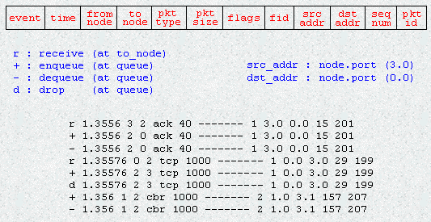
Post-Processing

Slide 16
Primer to perl
Sample Perl script

Slide 17
Primer to Gnuplot
Sample Gnuplot Script

Slide 18
Primer to ‘awk’
awk '/gold/ {print $5,$6,$7,$8}' coins.txt
awk '{if ($3 < 1980) print $3, " ",$5,$6,$7,$8}' coins.txt
/(^Germany)|(^Netherlands)/
/[Tt]he/
Strings are expressed in double-quotes. For example:
  "All work and no play makes Jack a homicidal maniac!"

Slide 19
Random Thoughts
for {set i 1} {$i < $num} {incr i}
{
set node($i) [$ns node]
}

Slide 20
Other Sources of Information
http://www.isi.edu/nsnam/ns/
http://www.cs.clemson.edu/~mweigle/research/ns/intro/
http://nile.wpi.edu/NS/
http://www.isi.edu/nsnam/ns/tutorial/
PERL TUTORIAL
http://www.comp.leeds.ac.uk/Perl/start.html
AWK TUTORIAL
http://www.vectorsite.net/tsawk.html

