Slide 1
Network Simulation and Analysis---Using NS2
Chih-Heng Ke (柯志亨)
Webpage: http://hpds.ee.ncku.edu.tw/~smallko
Email: smallko@ee.ncku.edu.tw
MSN: smallko@hotmail.com

Slide 2
Methods for network research
Analytical
  Model
  General expression or close form
Emulation
  Network testbed
  Lab environment
  Real code
Simulation
  Virtual network testbed

Slide 3
Why Simulation
Study of implemented protocols and algorithms
  Behavior
  Performance
Test of unimplemented new protocols and algorithms
Comparison of results across research efforts

Slide 4
Simulation -- Advantage
Inexpensive, Flexible and Reconfigurable
Network phenomena interested can be reproduced
Opportunity to study large-scale network
Easier comparison of results across research efforts

Slide 5
Simulation -- Disadvantage
Important network details may be missed
Protocols or algorithms must be “added” before simulation can be done
High start-up cost
Have to be carefully verified before the test results can be used

Slide 6
Outline1
NS2 Introduction and Installation
  cygwin installation
  ns2.26, ns2.27, ns2.28, ns2.29, myNS2, others
  How to apply the patch
  New module insertion
  Recompilation
Tools
  nsbench
  NS2 Scenarios Generator (NSG)

Slide 7
Outline2
How to measure the loss rate, delay, jitter, throughput?
  parse the trace file
  use “LossMonitor” agent
  modify the C++ code
How to present the simulation result?
  gnuplot (xgraph, or Excel)
  random number generator
  confidence interval
    How to run the simulation in a batch mode?

Slide 8
Outline3
How CBR works?
How UDP works?
How DCF works ?
  Trace the C++ code in NS2
    Multicast
    Unicast
Propagation Model
  Transmission range

Slide 9
Outline4
wireless error model
  random uniform model
  GE model (burst pattern)
  Others
DCF vs. EDCF
  Adaptive Approach for QoS Support in IEEE
  802.11e Wireless LAN

Slide 10
Outline5
How to dynamically set the link bandwidth during simulation?
How to set the different operation modes (DCF or EDCF) for different mobile nodes?
How to set the different transmission speeds to different mobile nodes?
How to measure the queue length in the base station or mobile node?
How to set the communication radius in wireless nodes?
Hidden Terminal Problem
How to get the information in different layers?

Slide 11
Outline6
Multimedia simulation
  myEvalvid (encoding from raw YUV video)
  myEvalvid-NT (for publicly available video traffic traces)
  Multiple Description Coding (MDC)
  voip simulation

Slide 12
What is NS-2
NEST (Network Simulation Testbed) → REAL (Realistic and Large) → NS-1 → NS-2
NS-2 is a common network simulator
NS-2 is developed by the VINT project in order to reduce duplication of effort within the network research and develop community
http://www.isi.edu/nsnam

Slide 13
Ns functionalities
Wired
  Transportation: TCP,UDP,RTP,SRM
  Traffic sources:web, ftp, telnet, cbr, stochastic
  Queuing disciplines:drop-tail, RED, FQ, SFQ, DRR
  QoS: IntServ and Diffserv
  Emulation
Wireless
  Ad hoc routing and mobile IP
  Directed diffusion, sensor-MAC
Tracing, visualization, various utilities

Slide 14
“Ns” Components
Ns, the simulator itself
Nam, the network animator
  Visualize ns (or other) output
  Nam editor: GUI interface to generate ns scripts
Pre-processing:
  Traffic and topology generators
Post-processing:
  Simple trace analysis, often in awk, perl, or Tcl

Slide 15
NS Architecture
Split-Programming Model
  C++
    implement the simulation model
    Implement data path
    per packet processing, core of ns
    fast to run, detailed, complete control
  OTcl (Tcl script language with Object-oriented extensions developed at MIT )
    Simulation scenario configurations
    Periodic or triggered action
    Manipulating existing C++ objects
    fast to write and change

Slide 16
The simulation procedure
Problems
Modify the simulation
Simulate the environment
Run with ns-2
Analysis the result
No
Yes
Finish simulation

Slide 17
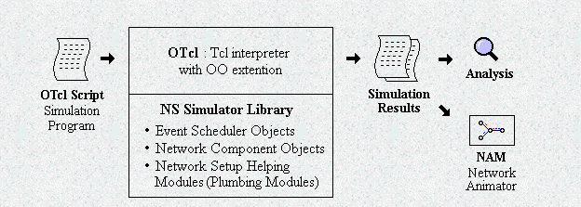
User’s view of NS2

Slide 18
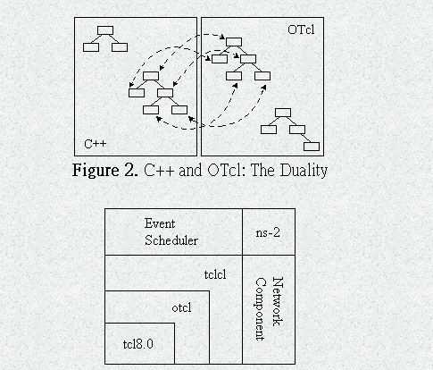
Architecture view of NS2

Slide 19
NS2 Installation
Cygwin installation
  install from Internet or local directory
    don’t install from install Internet now
      gcc version is new new
    install from local directory
      http://140.116.72.80/~smallko/ns2/setup_en.htm
  installation problems
    http://www.isi.edu/nsnam/ns/ns-problems.html#general

Slide 20
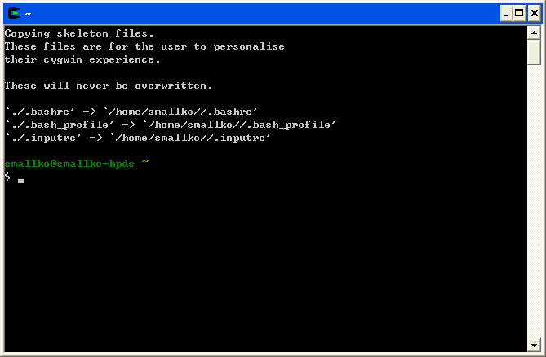
完成安裝後， 並重新啟動cygwin視窗，就會如上圖所示，產生一個home 目錄
並且把一些設定檔案放到home目錄下
若是沒辦法產生如上圖所示，而是出現如bash$這樣的問題,可以
1)重新安裝windows system
2)安裝完後馬上安裝cygwin + ns2
3)裝完ns2後,再裝其他的軟體,如service pack, office等等

Slide 21
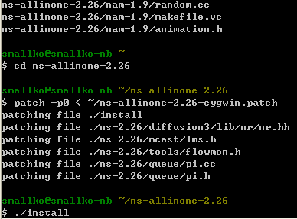
NS2 installation
ns2 version ( for my provided cygwin)
  ns-2.26 (need patch)
    http://www.isi.edu/nsnam/ns/ns-cygwin-old.html
      cd ns-allinone-2.26
      patch -p0 < ~/ns-allinone-2.26-cygwin.patch
      $./install
  ns-2.27, ns-2.28, ns-2.29
  myNS2—enhanced ns-2.28 (It includes TKN 802.11e EDCF module, NOAH routing, MFlood, CSFQ, Poisson traffic, wireless random uniform and GE error model, and tcldebug.)
  ns-2 802.11 support
    http://yans.inria.fr/ns-2-80211/
      ET/SNRT/BER-based PHY models
      802.11a multirate
      802.11e HCCA and EDCA
一個cygwin上面，可以同時安裝好幾個版本的ns，不是只能安裝一個

Slide 22
export NS_HOME=`pwd`/ns-allinone-2.27
export PATH=$NS_HOME/tcl8.4.5/unix:$NS_HOME/tk8.4.5/unix:$NS_HOME/bin:$PATH
export LD_LIBRARY_PATH=$NS_HOME/tcl8.4.5/unix:$NS_HOME/tk8.4.5/unix:\
$NS_HOME/otcl-1.8:$NS_HOME/lib:$LD_LIBRARY_PATH
export TCL_LIBRARY=$NS_HOME/tcl8.4.5/library
但不一定所有的電腦，設定路徑後一定會有效，所以當路徑設定無效時，可以把ns.exe
拷貝到要模擬的tcl script同一目錄下
$cd ns-allineone-2.28/ns-2.28
$cp ns.exe ~/abc
$cd ~/abc
$./ns.exe test.tcl

Slide 23
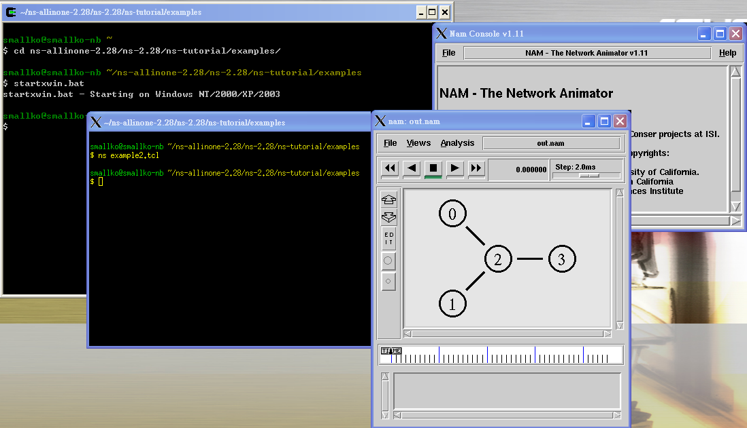
測試你安裝的ns2
1.如上圖所示
2. $cd ns-allinone-2.28/ns-2.28
$./validate

Slide 24
How to insert a new module into your NS2?
Take NOAH as an example
  http://icapeople.epfl.ch/widmer/uwb/ns-2/noah/
Step-by-step installation instructions for ns-2.26
Makefile.in | add noah/noah.o \ to OBJ_CC and tcl/mobility/noah.tcl \ to NS_TCL_LIB
noah/noah.{h,cc} | add noah.h and noah.cc to a new subdirectory noah/
tcl/mobility/noah.tcl | add noah.tcl to tcl/mobility/
tcl/lib/ns-lib.tcl.h | line 191: add source ../mobility/noah.tcl line 603ff: add NOAH { set ragent [$self create-noah-agent $node] } line 768ff: add Simulator instproc create-noah-agent { node } { # Create a noah routing agent for this node set ragent [new Agent/NOAH] ## setup address (supports hier-addr) for noah agent ## and mobilenode set addr [$node node-addr] $ragent addr $addr $ragent node $node if [Simulator set mobile_ip_] { $ragent port-dmux [$node demux] } $node addr $addr $node set ragent_ $ragent return $ragent }
$cd ns-alline-2.26/ns-2.26
$make

Slide 25

set ns_ [new Simulator]
$ns_ node-config -addressType hierarchical
AddrParams set domain_num_ 2
lappend cluster_num 1 1
AddrParams set cluster_num_ $cluster_num
lappend eilastlevel 1 2
AddrParams set nodes_num_ $eilastlevel
set tracefd [open noah.tr w]
$ns_ trace-all $tracefd
set topo [new Topography]
$topo load_flatgrid 100 100
set god_ [create-god 2]
set W(0) [$ns_ node 0.0.0]
set chan_ [new Channel/WirelessChannel]
$ns_ node-config -adhocRouting NOAH \
-llType LL \
-macType Mac/802_11 \
-ifqType Queue/DropTail/PriQueue \
-ifqLen 50 \
-antType Antenna/OmniAntenna \
-propType Propagation/TwoRayGround \
-phyType Phy/WirelessPhy \
-channel $chan_ \
-topoInstance $topo \
-wiredRouting ON\
-agentTrace OFF \
-routerTrace OFF \
-macTrace OFF
set BA [$ns_ node 1.0.0]
$ns_ node-config -wiredRouting OFF
set MH(0) [$ns_ node 1.0.1]
$MH(0) random-motion 0
$MH(0) set base-station [AddrParams addr2id [$BA node-addr]]
$BA set X_ 50.0
$BA set Y_ 50.0
$BA set Z_ 0.0
$MH(0) set X_ 80.0
$MH(0) set Y_ 80.0
$MH(0) set Z_ 0.0
$ns_ duplex-link $W(0) $BA 10Mb 10ms DropTail
set udp [new Agent/UDP]
$ns_ attach-agent $W(0) $udp
set null [new Agent/Null]
$ns_ attach-agent $MH(0) $null
$ns_ connect $udp $null
set cbr [new Application/Traffic/CBR]
$cbr attach-agent $udp
$cbr set type_ CBR
$cbr set packet_size_ 1000
$cbr set rate_ 1Mb
$cbr set random_ false
$ns_ at 0.0 "$cbr start"
$ns_ at 50.0 "$cbr stop"
$ns_ at 50.1 "$MH(0) reset";
$ns_ at 50.0001 "$W(0) reset"
$ns_ at 50.0002 "stop "
$ns_ at 50.0003 "$ns_ halt"
proc stop {} {
global ns_ tracefd
close $tracefd
}
$ns_ run
W(0)
BA
MH(0)

Slide 26
IEEE 802.11e for the ns-2 simulator
An IEEE 802.11e EDCA and CFB Simulation Model for ns-2
  http://sourceforge.net/project/showfiles.php?group_id=136544
  $tar xvfz v1.0.tar.gz
  $cp –r 802_11e ~/ns-allinone-2.26/ns-2.26/mac
  open README and follow the steps to install 802.11e
  $make clean; make depend; make

Slide 27
modify the original C++ code
queue/drop-tail.cc
void DropTail::enque(Packet* p)
{
hdr_ip* iph=hdr_ip::access(p);
hdr_cmn* cmh=hdr_cmn::access(p);
int size= cmh->size();
printf("DropTail(enque) size:%d iph->prio:%d\n", cmh->size(), iph->prio());
if (summarystats) {
Queue::updateStats(qib_?q_->byteLength():q_->length());
}
int qlimBytes = qlim_ * mean_pktsize_;
if ((!qib_ && (q_->length() + 1) >= qlim_) ||
(qib_ && (q_->byteLength() + hdr_cmn::access(p)->size()) >= qlimBytes)){
// if the queue would overflow if we added this packet...
if (drop_front_) { /* remove from head of queue */
q_->enque(p);
Packet *pp = q_->deque();
drop(pp);
} else {
drop(p);
}
} else {
q_->enque(p);
}
}
若是沒有新增加.cc和.h
只是修改原本檔案中的程式碼
直接compile就可以了
$make clean ; make depend; make

Slide 28
nsBench
http://www.mnlab.cs.depaul.edu/projects/nsbench/
This project is to develop supporting tools that enable creating, analyzing and visualizing NS-2 simulation scripts and traces automatically.
It is a drag-and-drop GUI and easy to use in undergraduate and graduate networking courses. nsBench makes NS-2 simulation development and analysis faster and easier for students and researchers without losing the flexibility or expressiveness gained by writing a script.
It needs to install Java 1.4 or later.

Slide 29
nsBench Features
Nodes, simplex/duplex links and LANs
Agents: TCP, UDP, TCPSink, TCP/Fack, TCP/FullTcp, TCP/Newreno, TCP/Reno, TCP/Sack1, TCPSink, TCPSink/Sack1, TCPSink/DelAck, TCPSink/Sack1/DelAck, TCP/Vegas, Null Agent
Applications/Traffic: FTP, Telent, Http/Server, Http/Client, Http/Cache, webtraf, Traffic/CBR, Traffic/Pareto, Traffic/Exponential
Services: Multicast, Packet Scheduling, RED, DiffServ
Creating "Groups" concept to compensate for "loops"
Scenario generator
Link Monitors
Loss Models
Routing Protocols
Demonstration:
Dumbbell topology
LAN
Multicast

Slide 30
NS2 Scenarios Generator
http://edith.cse.nsysu.edu.tw/wordpress/?p=66
國立中山大學 資訊工程系 創新智慧資訊系統實驗室
吳鵬榮 (wupl + 小老鼠 + cse.nsysu.edu.tw)
指導教授 : 李宗南教授
NS2 Scenarios Generator(NSG)是一個用JAVA所寫的NS2劇本產生器，由於JAVA本身跨平台的特性，使得NSG可以在各種支援JAVA的平台上運作，目前NSG所能夠產生的劇本檔僅限於wireless ad-hoc的部份，功能有:
建立wireless node(手動, 自動)
手動的部分由使用者自行透過滑鼠點選
自動的部份支援(chain-topology, grid-topology, random-topology)
建立連線(手動, 自動)
手動的部分由使用者自行透過滑鼠點選(選取source以及destination)
自動的部份支援 :
  fully(兩兩之間建立連線)
  intelligent(可連線範圍內建立連線)
  random(任意選取二點建立連線)

Slide 31
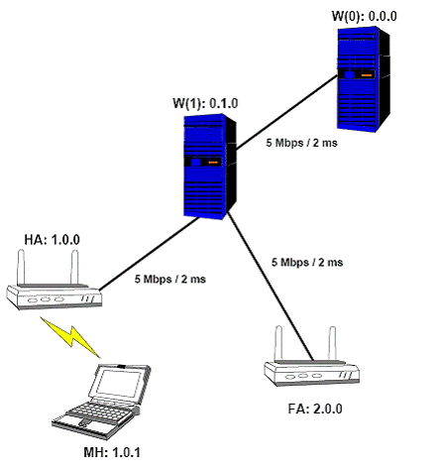
An example: mobile ip

Slide 32
set opt(nn) 1 ;# number of mobilenodes
set num_wired_nodes 2
set opt(x) 670 ;# x coordinate of topology
set opt(y) 670 ;# y coordinate of topology
set opt(ftp1-start) 100.0
set opt(stop) 250 ;# time to stop simulation
set opt(tr-ns) infra-out.tr
set opt(tr-nam) infra-out.nam
Mac/802_11 set dataRate_ 2.0e6
Mac/802_11 set RTSThreshold_ 3000
set ns_ [new Simulator]
$ns_ node-config -addressType hierarchical
AddrParams set domain_num_ 3 ;# number of domains
lappend cluster_num 2 1 1 ;# number of clusters in each domain
AddrParams set cluster_num_ $cluster_num
lappend eilastlevel 1 1 2 1 ;# number of nodes in each cluster
AddrParams set nodes_num_ $eilastlevel ;# of each domain
set tracefd [open $opt(tr-ns) w]
set namtrace [open $opt(tr-nam) w]
$ns_ trace-all $tracefd
$ns_ namtrace-all-wireless $namtrace $opt(x) $opt(y)
set topo [new Topography]
$topo load_flatgrid $opt(x) $opt(y)
create-god [expr $opt(nn) + 2]
# 2 for HA and FA

Slide 33
set temp {0.0.0 0.1.0} ;# hierarchical addresses
for {set i 0} {$i < $num_wired_nodes} {incr i} {
set W($i) [$ns_ node [lindex $temp $i]]
}
$ns_ node-config -mobileIP ON \
-adhocRouting DSDV \
-llType LL \
-macType Mac/802_11 \
-ifqType Queue/DropTail/PriQueue \
-ifqLen 50 \
-antType Antenna/OmniAntenna \
-propType Propagation/TwoRayGround \
-phyType Phy/WirelessPhy \
-channelType Channel/WirelessChannel \
-topoInstance $topo \
-wiredRouting ON \
-agentTrace ON \
-routerTrace OFF \
-macTrace OFF
# Create Home Agent and Foreign Agent
set HA [$ns_ node 1.0.0]
set FA [$ns_ node 2.0.0]
$HA set X_ 1.00
$HA set Y_ 2.00
$HA set Z_ 0.00
$FA set X_ 650.00
$FA set Y_ 600.00
$FA set Z_ 0.00
# create links between wired and BaseStation nodes
$ns_ duplex-link $W(0) $W(1) 5Mb 2ms DropTail
$ns_ duplex-link $W(1) $HA 5Mb 2ms DropTail
$ns_ duplex-link $W(1) $FA 5Mb 2ms DropTail
$ns_ duplex-link-op $W(0) $W(1) orient down
$ns_ duplex-link-op $W(1) $HA orient left-down
$ns_ duplex-link-op $W(1) $FA orient right-down
# create a mobilenode (in the domain of the HA)
# that is moving between HA and FA.
$ns_ node-config -wiredRouting OFF
set MH [$ns_ node 1.0.1]
set HAaddress [AddrParams addr2id [$HA node-addr]]
[$MH set regagent_] set home_agent_ $HAaddress
$MH set Z_ 0.00
$MH set Y_ 2.00
$MH set X_ 2.00

Slide 34
# MH starts to move towards FA
$ns_ at 100.00 "$MH setdest 640.00 610.00 20.00"
# goes back to HA
$ns_ at 200.00 "$MH setdest 2.00 2.00 20.00"
# Define initial node position in nam
$ns_ initial_node_pos $MH 20
set tcp1 [new Agent/TCP]
$tcp1 set class_ 2
set sink1 [new Agent/TCPSink]
$ns_ attach-agent $W(0) $tcp1
$ns_ attach-agent $MH $sink1
$ns_ connect $tcp1 $sink1
set ftp1 [new Application/FTP]
$ftp1 attach-agent $tcp1
$ns_ at $opt(ftp1-start) "$ftp1 start"
$ns_ at $opt(stop).0 "$MH reset";
$ns_ at $opt(stop).0 "$HA reset";
$ns_ at $opt(stop).0 "$FA reset";
$ns_ at $opt(stop).0002 "puts \"NS EXITING...\" ; $ns_ halt"
$ns_ at $opt(stop).0001 "finish"
proc finish {} {
global ns_ tracefd namtrace
close $tracefd
close $namtrace
exec rm -f out-tcp.xgr
exec awk -f fil-tcp.awk infra-out.tr > out-tcp.xgr
exec xgraph out-tcp.xgr &
exec nam infra-out.nam &
}
puts "Starting Simulation..."
$ns_ run

Slide 35
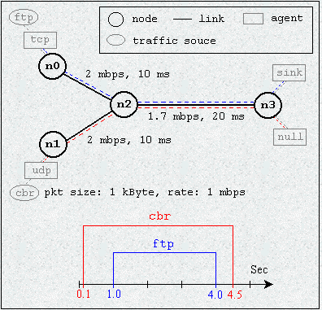
How to measure the loss rate, delay, jitter, throughput?
nsBench
Write the tcl script yourself

Slide 36
set ns [new Simulator]
#針對不同的資料流定義不同的顏色，這是要給NAM用的
$ns color 1 Blue
$ns color 2 Red
#開啟一個NAM 記錄檔
set nf [open out.nam w]
$ns namtrace-all $nf
#開啟一個模擬過程記錄檔，用來記錄封包傳送的過程
set nd [open out.tr w]
$ns trace-all $nd
#定義一個結束的程序
proc finish {} {
global ns nf nd
$ns flush-trace
close $nf
close $nd
#以背景執行的方式去執行NAM
exec nam out.nam &
exit 0
}
#產生傳輸節點
set s1 [$ns node]
set s2 [$ns node]
#產生路由器節點
set r [$ns node]
#產生資料接收節點
set d [$ns node]
$ns duplex-link $s1 $r 2Mb 10ms DropTail
$ns duplex-link $s2 $r 2Mb 10ms DropTail
$ns duplex-link $r $d 1.7Mb 20ms DropTail
#設定r到d之間的Queue Limit為10個封包大小
$ns queue-limit $r $d 10
#設定節點的位置，這是要給NAM用的
$ns duplex-link-op $s1 $r orient right-down
$ns duplex-link-op $s2 $r orient right-up
$ns duplex-link-op $r $d orient right
#觀測r到d之間queue的變化，這是要給NAM用的
$ns duplex-link-op $r $d queuePos 0.5
#建立一條TCP的連線
set tcp [new Agent/TCP]
$ns attach-agent $s1 $tcp
set sink [new Agent/TCPSink]
$ns attach-agent $d $sink
$ns connect $tcp $sink
#在NAM中，TCP的連線會以藍色表示
$tcp set fid_ 1
#在TCP連線之上建立FTP應用程式
set ftp [new Application/FTP]
$ftp attach-agent $tcp
$ftp set type_ FTP

Slide 37
#建立一條UDP的連線
set udp [new Agent/UDP]
$ns attach-agent $s2 $udp
set null [new Agent/Null]
$ns attach-agent $d $null
$ns connect $udp $null
#在NAM中，UDP的連線會以紅色表示
$udp set fid_ 2
#在UDP連線之上建立CBR應用程式
set cbr [new Application/Traffic/CBR]
$cbr attach-agent $udp
$cbr set type_ CBR
#設定傳送封包的大小為1000 byte
$cbr set packet_size_ 1000
#設定傳送的速率為1Mbps
$cbr set rate_ 1mb
$cbr set random_ false
#設定FTP和CBR資料傳送開始和結束時間
$ns at 0.1 "$cbr start"
$ns at 1.0 "$ftp start"
$ns at 4.0 "$ftp stop"
$ns at 4.5 "$cbr stop"
#結束TCP的連線(不一定需要寫下面的程式碼來實際結束連線)
$ns at 4.5 "$ns detach-agent $s1 $tcp ; $ns detach-agent $d $sink"
#在模擬環境中，5秒後去呼叫finish來結束模擬(這樣要注意模擬環境中
#的5秒並不一定等於實際模擬的時間
$ns at 5.0 "finish"
#執行模擬
$ns run

Slide 38
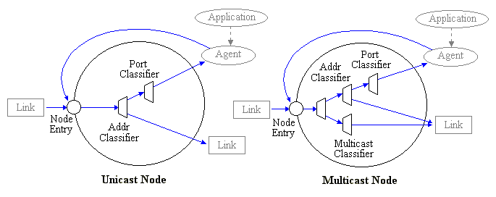
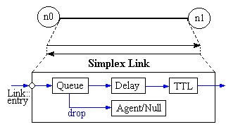
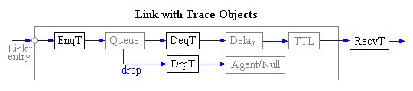

Slide 39
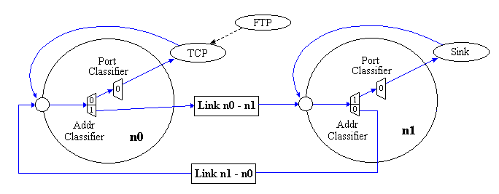

Slide 40
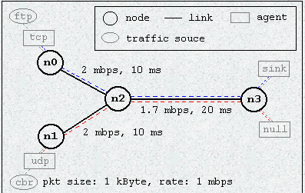
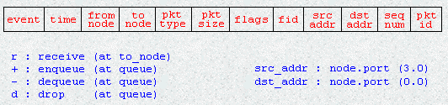
+ 0.1 1 2 cbr 1000 ------- 2 1.0 3.1 0 0
- 0.1 1 2 cbr 1000 ------- 2 1.0 3.1 0 0
+ 0.108 1 2 cbr 1000 ------- 2 1.0 3.1 1 1
- 0.108 1 2 cbr 1000 ------- 2 1.0 3.1 1 1
r 0.114 1 2 cbr 1000 ------- 2 1.0 3.1 0 0
+ 0.114 2 3 cbr 1000 ------- 2 1.0 3.1 0 0
- 0.114 2 3 cbr 1000 ------- 2 1.0 3.1 0 0
+ 0.116 1 2 cbr 1000 ------- 2 1.0 3.1 2 2
- 0.116 1 2 cbr 1000 ------- 2 1.0 3.1 2 2
r 0.122 1 2 cbr 1000 ------- 2 1.0 3.1 1 1
+ 0.122 2 3 cbr 1000 ------- 2 1.0 3.1 1 1
- 0.122 2 3 cbr 1000 ------- 2 1.0 3.1 1 1
+ 0.124 1 2 cbr 1000 ------- 2 1.0 3.1 3 3
- 0.124 1 2 cbr 1000 ------- 2 1.0 3.1 3 3
r 0.13 1 2 cbr 1000 ------- 2 1.0 3.1 2 2
+ 0.13 2 3 cbr 1000 ------- 2 1.0 3.1 2 2
- 0.13 2 3 cbr 1000 ------- 2 1.0 3.1 2 2
+ 0.132 1 2 cbr 1000 ------- 2 1.0 3.1 4 4
- 0.132 1 2 cbr 1000 ------- 2 1.0 3.1 4 4
r 0.138 1 2 cbr 1000 ------- 2 1.0 3.1 3 3
+ 0.138 2 3 cbr 1000 ------- 2 1.0 3.1 3 3
- 0.138 2 3 cbr 1000 ------- 2 1.0 3.1 3 3
r 0.138706 2 3 cbr 1000 ------- 2 1.0 3.1 0 0
………………………………………………
0.0
3.0
3.1
1.0
sequence_number: 對於同一條flow而言,
這個flow所產生的第一個packet,它的sequence number
就是0,第二個flow所產生的packet,就是1,以此類推
packet_id: 這是對於整個系統而言,
整個系統中所產生的第一個packet,
它的packet id 就是0,第二個packet,就是1,
以此類推

Slide 41
#這是測量CBR封包端點到端點間延遲時間的awk程式
BEGIN {
#程式初始化，設定一變數以記錄目前最高處理封包的ID。
highest_packet_id = 0;
}
{
action = $1;
time = $2;
from = $3;
to = $4;
type = $5;
pktsize = $6;
flow_id = $8;
src = $9;
dst = $10;
seq_no = $11;
packet_id = $12;
#記錄目前最高的packet ID
if ( packet_id > highest_packet_id )
highest_packet_id = packet_id;
#記錄封包的傳送時間
if ( start_time[packet_id] == 0 )
start_time[packet_id] = time;
#記錄CBR (flow_id=2) 的接收時間
if ( flow_id == 2 && action != "d" ) {
if ( action == "r" ) {
end_time[packet_id] = time;
}
} else {
#把不是flow_id=2的封包或者是flow_id=2但此封包被drop的時間設為-1
end_time[packet_id] = -1;
}
}
END {
#當資料列全部讀取完後，開始計算有效封包的端點到端點延遲時間
for ( packet_id = 0; packet_id <= highest_packet_id; packet_id++ ) {
start = start_time[packet_id];
end = end_time[packet_id];
packet_duration = end - start;
#只把接收時間大於傳送時間的記錄列出來
if ( start < end ) printf("%f %f\n", start, packet_duration);
}
}

Slide 42
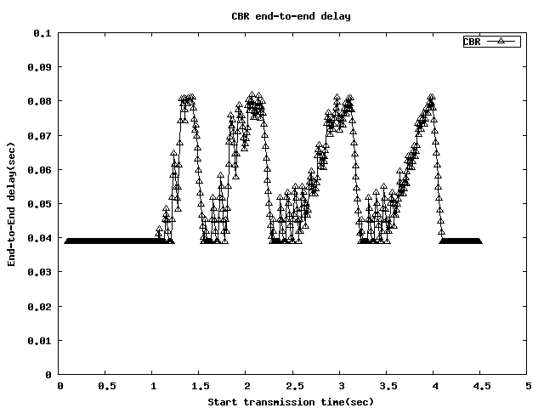
$awk –f measure-delay.awk out.tr > cbr-delay
set term png medium #000000
set output "cbr-delay.png"
set ylabel "End-to-End delay(sec)"
set xlabel "Start transmission time(sec)"
set xrang [0:5]
set xtics 0, 0.5, 5
set yrang [0:0.1]
set ytics 0, 0.01, 0.1
set title "CBR end-to-end delay"
plot "cbr-delay" title "CBR" with linespoints lt -1 pt 8
$gnuplot
gnuplot> load ‘plotdelay.plot’

Slide 43
set ns [new Simulator]
$ns color 1 Blue
$ns color 2 Red
set nf [open out.nam w]
$ns namtrace-all $nf
set nd [open out.tr w]
$ns trace-all $nd
set f0 [open cbr-throughput.tr w]
set f1 [open cbr-loss.tr w]
set f2 [open ftp-throughput.tr w]
set last_ack 0
proc record {} {
global ns null tcp f0 f1 f2 last_ack
set time 0.5 ;#Set Sampling Time to 0.5 Sec
set a [$null set bytes_]
set b [$null set nlost_]
set c [$tcp set ack_]
set d [$tcp set packetSize_]
set now [$ns now]
puts $f0 "$now [expr $a*8/$time]"
puts $f1 "$now [expr $b/$time]"
if { $c > 0} {
set e [expr $c - $last_ack]
puts $f2 "$now [expr $e*$d*8/$time]"
set last_ack $c
} else {
puts $f2 "$now 0"
}
$null set bytes_ 0
$null set nlost_ 0
$ns at [expr $now+$time] "record" ;# Schedule Record after $time interval sec
}

Slide 44
proc finish {} {
global ns nf nd f0 f1 f2
$ns flush-trace
close $nf
close $nd
close $f0
close $f1
close $f2
# Plot Recorded Statistics
exec xgraph cbr-throughput.tr ftp-throughput.tr -geometry 800x400 &
exec xgraph cbr-loss.tr -geometry 800x400 &
#以背景執行的方式去執行NAM
exec nam out.nam &
exit 0
}
set s1 [$ns node]
set s2 [$ns node]
set r [$ns node]
set d [$ns node]
$ns duplex-link $s1 $r 2Mb 10ms DropTail
$ns duplex-link $s2 $r 2Mb 10ms DropTail
$ns duplex-link $r $d 1.7Mb 20ms DropTail
#設定r到d之間的Queue Limit為10個封包大小
$ns queue-limit $r $d 10
set tcp [new Agent/TCP]
$ns attach-agent $s1 $tcp
set sink [new Agent/TCPSink]
$ns attach-agent $d $sink
$ns connect $tcp $sink
$tcp set fid_ 1

Slide 45
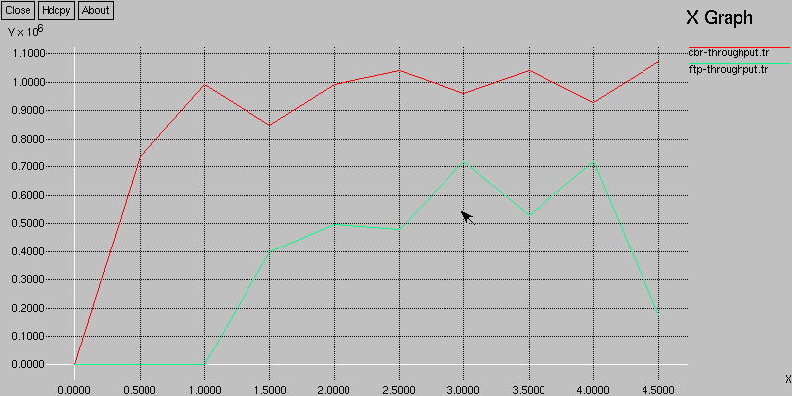
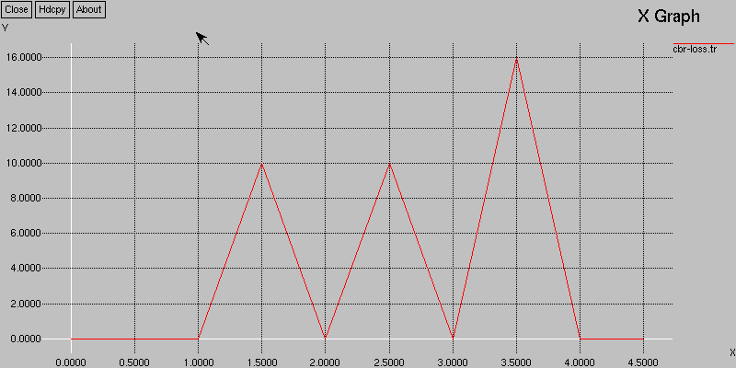
set ftp [new Application/FTP]
$ftp attach-agent $tcp
$ftp set type_ FTP
set udp [new Agent/UDP]
$ns attach-agent $s2 $udp
set null [new Agent/LossMonitor]
$ns attach-agent $d $null
$ns connect $udp $null
$udp set fid_ 2
set cbr [new Application/Traffic/CBR]
$cbr attach-agent $udp
$cbr set type_ CBR
$cbr set packet_size_ 1000
$cbr set rate_ 1mb
$cbr set random_ false
$ns at 0.0 "record"
$ns at 0.1 "$cbr start"
$ns at 1.0 "$ftp start"
$ns at 4.0 "$ftp stop"
$ns at 4.5 "$cbr stop"
$ns at 4.5 "$ns detach-agent $s1 $tcp ; $ns detach-agent $d $sink"
$ns at 5.0 "finish"
$ns run

Slide 46
How CBR works?
The source code is under tools (cbr_traffic.cc)
#include <stdlib.h>
#include "random.h"
#include "trafgen.h"
#include "ranvar.h“
/*
* Constant bit rate traffic source. Parameterized by interval, (optional)
* random noise in the interval, and packet size.
*/
class CBR_Traffic : public TrafficGenerator {
public:
CBR_Traffic();
virtual double next_interval(int&);
//HACK so that udp agent knows interpacket arrival time within a burst
inline double interval() { return (interval_); }
protected:
virtual void start();
void init();
double rate_; /* send rate during on time (bps) */
double interval_; /* packet inter-arrival time during burst (sec) */
double random_;
int seqno_;
int maxpkts_;
};

Slide 47
static class CBRTrafficClass : public TclClass {
public:
CBRTrafficClass() : TclClass("Application/Traffic/CBR") {}
TclObject* create(int, const char*const*) {
return (new CBR_Traffic());
}
} class_cbr_traffic;
CBR_Traffic::CBR_Traffic() : seqno_(0)
{
bind_bw("rate_", &rate_);
bind("random_", &random_);
bind("packetSize_", &size_);
bind("maxpkts_", &maxpkts_);
}
void CBR_Traffic::init()
{
// compute inter-packet interval
interval_ = (double)(size_ << 3)/(double)rate_ ;
if (agent_)
if (agent_->get_pkttype() != PT_TCP &&
agent_->get_pkttype() != PT_TFRC)
agent_->set_pkttype(PT_CBR);
}
void CBR_Traffic::start()
{
init();
running_ = 1;
timeout();
}

Slide 48
double CBR_Traffic::next_interval(int& size)
{
// Recompute interval in case rate_ or size_ has changes
interval_ = (double)(size_ << 3)/(double)rate_;
double t = interval_;
if (random_)
t += interval_ * Random::uniform(-0.5, 0.5);
size = size_;
if (++seqno_ < maxpkts_)
return(t);
else
return(-1);
}
void TrafficGenerator::timeout()
{
if (! running_)
return;
/* send a packet */
send(size_);
/* figure out when to send the next one */
nextPkttime_ = next_interval(size_);
/* schedule it */
if (nextPkttime_ > 0)
timer_.resched(nextPkttime_);
else
running_ = 0;
}
void TrafficTimer::expire(Event *)
{
tgen_->timeout();
}
trafgen.cc

Slide 49
How UDP works
The source codes are under apps (udp.cc, udp.h)
#ifndef ns_udp_h
#define ns_udp_h
#include "agent.h"
#include "trafgen.h"
#include "packet.h"
//"rtp timestamp" needs the samplerate
#define SAMPLERATE 8000
#define RTP_M 0x0080 // marker for significant events
class UdpAgent : public Agent {
public:
UdpAgent();
UdpAgent(packet_t);
virtual void sendmsg(int nbytes, const char *flags = 0)
{
sendmsg(nbytes, NULL, flags);
}
virtual void sendmsg(int nbytes, AppData* data, const char *flags = 0);
virtual void recv(Packet* pkt, Handler*);
virtual int command(int argc, const char*const* argv);
protected:
int seqno_;
};
#endif
udp.h

Slide 50
#include "udp.h"
#include "rtp.h"
#include "random.h"
#include "address.h"
#include "ip.h"
static class UdpAgentClass : public TclClass {
public:
UdpAgentClass() : TclClass("Agent/UDP") {}
TclObject* create(int, const char*const*) {
return (new UdpAgent());
}
} class_udp_agent;
UdpAgent::UdpAgent() : Agent(PT_UDP), seqno_(-1)
{
bind("packetSize_", &size_);
}
UdpAgent::UdpAgent(packet_t type) : Agent(type)
{
bind("packetSize_", &size_);
}
udp.cc

Slide 51
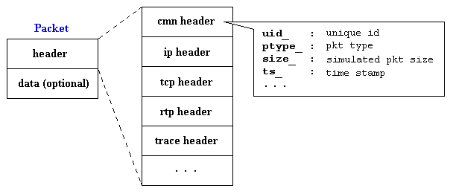
// put in timestamp and sequence number, even though UDP doesn't usually have one.
void UdpAgent::sendmsg(int nbytes, AppData* data, const char* flags)
{
Packet *p;
int n;
assert (size_ > 0);
n = nbytes / size_;
if (nbytes == -1) {
printf("Error: sendmsg() for UDP should not be -1\n");
return;
}
// If they are sending data, then it must fit within a single packet.
if (data && nbytes > size_) {
printf("Error: data greater than maximum UDP packet size\n");
return;
}
double local_time = Scheduler::instance().clock();
while (n-- > 0) {
p = allocpkt();
hdr_cmn::access(p)->size() = size_;
hdr_rtp* rh = hdr_rtp::access(p);
rh->flags() = 0;
rh->seqno() = ++seqno_;
hdr_cmn::access(p)->timestamp() =
(u_int32_t)(SAMPLERATE*local_time);
// add "beginning of talkspurt" labels (tcl/ex/test-rcvr.tcl)
if (flags && (0 ==strcmp(flags, "NEW_BURST")))
rh->flags() |= RTP_M;
p->setdata(data);
target_->recv(p);
}

Slide 52
n = nbytes % size_;
if (n > 0) {
p = allocpkt();
hdr_cmn::access(p)->size() = n;
hdr_rtp* rh = hdr_rtp::access(p);
rh->flags() = 0;
rh->seqno() = ++seqno_;
hdr_cmn::access(p)->timestamp() =
(u_int32_t)(SAMPLERATE*local_time);
// add "beginning of talkspurt" labels (tcl/ex/test-rcvr.tcl)
if (flags && (0 == strcmp(flags, "NEW_BURST")))
rh->flags() |= RTP_M;
p->setdata(data);
target_->recv(p);
}
idle();
}

Slide 53
void UdpAgent::recv(Packet* pkt, Handler*)
{
if (app_ ) {
// If an application is attached, pass the data to the app
hdr_cmn* h = hdr_cmn::access(pkt);
app_->process_data(h->size(), pkt->userdata());
} else if (pkt->userdata() && pkt->userdata()->type() == PACKET_DATA) {
// otherwise if it's just PacketData, pass it to Tcl
//
// Note that a Tcl procedure Agent/Udp recv {from data}
// needs to be defined. For example,
//
// Agent/Udp instproc recv {from data} {puts data}
PacketData* data = (PacketData*)pkt->userdata();
hdr_ip* iph = hdr_ip::access(pkt);
Tcl& tcl = Tcl::instance();
tcl.evalf("%s process_data %d {%s}", name(),
iph->src_.addr_ >> Address::instance().NodeShift_[1],
data->data());
}
Packet::free(pkt);
}

Slide 54
int UdpAgent::command(int argc, const char*const* argv)
{
if (argc == 4) {
if (strcmp(argv[1], "send") == 0) {
PacketData* data = new PacketData(1 + strlen(argv[3]));
strcpy((char*)data->data(), argv[3]);
sendmsg(atoi(argv[2]), data);
return (TCL_OK);
}
} else if (argc == 5) {
if (strcmp(argv[1], "sendmsg") == 0) {
PacketData* data = new PacketData(1 + strlen(argv[3]));
strcpy((char*)data->data(), argv[3]);
sendmsg(atoi(argv[2]), data, argv[4]);
return (TCL_OK);
}
}
return (Agent::command(argc, argv));
}

Slide 55
#ifndef ns_mudp_h
#define ns_mudp_h
#include "udp.h"
class mUdpAgent : public UdpAgent {
public:
mUdpAgent();
virtual void sendmsg(int nbytes, AppData* data, const char *flags = 0);
virtual int command(int argc, const char*const* argv);
protected:
int id_;
char BWfile[100];
FILE *BWFile;
int openfile;
};
#endif
mudp.h

Slide 56
#include "mudp.h"
#include "rtp.h"
#include "random.h"
#include "address.h"
#include "ip.h"
static class mUdpAgentClass : public TclClass {
public:
mUdpAgentClass() : TclClass("Agent/mUDP") {}
TclObject* create(int, const char*const*) {
return (new mUdpAgent());
}
} class_mudp_agent;
mUdpAgent::mUdpAgent() : id_(0), openfile(0)
{
bind("packetSize_", &size_);
UdpAgent::UdpAgent();
}
void mUdpAgent::sendmsg(int nbytes, AppData* data, const char* flags)
{
Packet *p;
int n;
char buf[100]; //added by smallko
if (size_)
n = nbytes / size_;
else
printf("Error: myUDP size = 0\n");
if (nbytes == -1) {
printf("Error: sendmsg() for UDP should not be -1\n");
return;
}
mudp.cc

Slide 57
double local_time = Scheduler::instance().clock();
while (n-- > 0) {
………………………………………………………………………………..
hdr_cmn::access(p)->sendtime_ = local_time; // (smallko)
if(openfile!=0){
hdr_cmn::access(p)->frame_pkt_id_ = id_++;
sprintf(buf, "%-16f id %-16d udp %-16d\n", local_time, hdr_cmn::access(p)->frame_pkt_id_, hdr_cmn::access(p)->size()-28);
fwrite(buf, strlen(buf), 1, BWFile);
}
………………………………………………………………….
p->setdata(data);
target_->recv(p);
}
n = nbytes % size_;
if (n > 0) {
……………………………………………………………………………..
hdr_cmn::access(p)->sendtime_ = local_time; // (smallko)
if(openfile!=0){
hdr_cmn::access(p)->frame_pkt_id_ = id_++;
sprintf(buf, "%-16f id %-16d udp %-16d\n", local_time, hdr_cmn::access(p)->frame_pkt_id_, hdr_cmn::access(p)->size()-28);
fwrite(buf, strlen(buf), 1, BWFile);
}
……………………………………………………..…………………..
p->setdata(data);
target_->recv(p);
}
idle();
}

Slide 58
int mUdpAgent::command(int argc, const char*const* argv)
{
if(argc ==2) { //added by smallko
if (strcmp(argv[1], "closefile") == 0) {
if(openfile==1)
fclose(BWFile);
return (TCL_OK);
}
}
if (argc ==3) { //added by smallko
if (strcmp(argv[1], "set_filename") == 0) {
strcpy(BWfile, argv[2]);
BWFile = fopen(BWfile, "w");
openfile=1;
return (TCL_OK);
}
}
return (UdpAgent::command(argc, argv));
}

Slide 59
#ifndef mudpsink_h
#define mudpsink_h
#include <stdio.h>
#include "agent.h"
class mUdpSink : public Agent
{
public:
mUdpSink() : Agent(PT_UDP), pkt_received(0) {}
void recv(Packet*, Handler*);
int command(int argc, const char*const* argv);
void print_status();
protected:
char tbuf[100];
FILE *tFile;
unsigned long int pkt_received;
};
#endif
mudpsink.h

Slide 60
#include <stdio.h>
#include <stdlib.h>
#include "mudpsink.h"
#include "ip.h"
#include "udp.h"
#include "rtp.h"
static class mUdpSinkClass : public TclClass {
public:
mUdpSinkClass() : TclClass("Agent/mUdpSink") {}
TclObject* create(int, const char*const*) {
return (new mUdpSink);
}
} class_mudpsink;
void mUdpSink::recv(Packet* pkt, Handler*)
{
hdr_cmn* hdr=hdr_cmn::access(pkt);
pkt_received+=1;
fprintf(tFile,"%-16d %-16f %-16f %-16f %-16d\n", hdr->pkt_id_, hdr->sendtime_, Scheduler::instance().clock(), Scheduler::instance().clock()-hdr->sendtime_, hdr->size());
if (app_)
app_->recv(hdr_cmn::access(pkt)->size());
Packet::free(pkt);
}
mudpsink.cc

Slide 61
int mUdpSink::command(int argc, const char*const* argv)
{
Tcl& tcl = Tcl::instance();
if (strcmp(argv[1], "set_filename") == 0) {
strcpy(tbuf, argv[2]);
tFile = fopen(tbuf, "w");
return (TCL_OK);
}
if (strcmp(argv[1], "closefile") == 0) {
fclose(tFile);
return (TCL_OK);
}
if(strcmp(argv[1],"printstatus")==0) {
print_status();
return (TCL_OK);
}
return (Agent::command(argc, argv));
}
void mUdpSink::print_status()
{
printf("mUdpSink2)Total packets received:%ld\n", pkt_received);
}

Slide 62
add sendtime_, pkt_id_ into packet common header. (modify common/packet.h)
struct hdr_cmn {
enum dir_t { DOWN= -1, NONE= 0, UP= 1 };
packet_t ptype_; // packet type (see above)
int size_; // simulated packet size
int uid_; // unique id
int error_; // error flag
int errbitcnt_; // # of corrupted bits jahn
int fecsize_;
double ts_; // timestamp: for q-delay measurement
int iface_; // receiving interface (label)
dir_t direction_; // direction: 0=none, 1=up, -1=down
double sendtime_; ...
unsigned long int pkt_id_;
...
inline int& addr_type() { return (addr_type_); }
inline int& num_forwards() { return (num_forwards_); }
inline int& opt_num_forwards() { return (opt_num_forwards_); }
//monarch_end
inline double& sendtime() { return (sendtime_); } // added by smallko
}
Add the “measure/mudp.o measure/mudpsink.o “ in the OBJ_CC of Makefile.
Add “Agent/mUDP set packetSize_ 1000” in the ns-default.tcl.
./configure ; make clean ; make depend ; make

Slide 63
……………………………………………..
set tcp [new Agent/TCP]
$ns attach-agent $s1 $tcp
set sink [new Agent/TCPSink/mTcpSink]
$sink set_filename tcp_sink
$ns attach-agent $d $sink
$ns connect $tcp $sink
$tcp set fid_ 1
set ftp [new Application/FTP]
$ftp attach-agent $tcp
$ftp set type_ FTP
set udp [new Agent/mUDP]
$udp set_filename sd
$ns attach-agent $s2 $udp
set null [new Agent/mUdpSink]
$null set_filename rd
$ns attach-agent $d $null
$ns connect $udp $null
$udp set fid_ 2
set cbr [new Application/Traffic/CBR]
$cbr attach-agent $udp
$cbr set type_ CBR
$cbr set packet_size_ 1000
$cbr set rate_ 1mb
$cbr set random_ false
……………………………………………….

Slide 64
The perl script for calculating the throughput of UDP-based application
#使用方法: perl throughput.pl <trace file> <granlarity>
#記錄檔檔名
$infile=$ARGV[0];
#多少時間計算一次(單位為秒)
$granularity=$ARGV[1];
$sum=0;
$sum_total=0;
$clock=0;
$maxrate=0;
$init=0;
#打開記錄檔
open (DATA,"<$infile")
|| die "Can't open $infile $!";
#讀取記錄檔中的每行資料,資料是以空白分成眾多欄位
while (<DATA>) {
@x = split(' ');
if($init==0){
$start=$x[2];
$init=1;
}
#讀取的第一個欄位是時間
#判斷所讀到的時間,是否已經達到要統計吞吐量的時候
if ($x[2]-$clock <= $granularity)
{
#計算單位時間內累積的封包大小
$sum=$sum+$x[4];
#計算累積的總封包大小
$sum_total=$sum_total+$x[4];
}
else
{
#計算吞吐量
$throughput=$sum*8.0/$granularity;
if ($throughput > $maxrate){
$maxrate=$throughput;
}
#輸出結果: 時間 吞吐量(bps)
print STDOUT "$x[2] $throughput\n";
#設定下次要計算吞吐量的時間
$clock=$clock+$granularity;
#計算單位時間內累積的封包大小
$sum=$sum+$x[4];
$sum=$x[4];
}
}
$endtime=$x[2];
#計算最後一次的吞吐量大小
$throughput=$sum*8.0/$granularity;
print STDOUT "$x[2] $throughput\n";
$clock=$clock+$granularity;
$sum=0;
#print STDOUT "$sum_total $start $endtime\n";
$avgrate=$sum_total*8.0/($endtime-$start);
#print STDOUT "Average rate: $avgrate bps\n";
#print STDOUT "Peak rate: $maxrate bps\n";
#關閉檔案
close DATA;
exit(0);

Slide 65
End-to-end delay
Sending time
Packet id
Receiving time
Packet size
0 0.100000 0.138706 0.038706 1000
1 0.108000 0.146706 0.038706 1000
2 0.116000 0.154706 0.038706 1000
3 0.124000 0.162706 0.038706 1000
4 0.132000 0.170706 0.038706 1000
5 0.140000 0.178706 0.038706 1000
6 0.148000 0.186706 0.038706 1000
7 0.156000 0.194706 0.038706 1000
8 0.164000 0.202706 0.038706 1000
9 0.172000 0.210706 0.038706 1000
10 0.180000 0.218706 0.038706 1000
………………………………………………………………………………………..

Slide 66
The perl script for calculating the throughput of TCP-based application
#使用方法: perl throughput.pl <trace file> <granlarity>
#記錄檔檔名
$infile=$ARGV[0];
#多少時間計算一次(單位為秒)
$granularity=$ARGV[1];
$sum=0;
$sum_total=0;
$clock=0;
$init=0;
#打開記錄檔
open (DATA,"<$infile")
|| die "Can't open $infile $!";
#讀取記錄檔中的每行資料,資料是以空白分成眾多欄位
while (<DATA>) {
@x = split(' ');
if($init==0){
$start=$x[1];
$init=1;
}
#讀取的第一個欄位是時間
#判斷所讀到的時間,是否已經達到要統計吞吐量的時候
if ($x[1]-$clock <= $granularity)
{
#計算單位時間內累積的封包大小
#要不要減去40 ? (IP header: 20, TCP header:20)
$sum=$sum+$x[2];
#計算累積的總封包大小
$sum_total=$sum_total+$x[2];
}
else
{
#計算吞吐量
$throughput=$sum*8.0/$granularity;
#輸出結果: 時間 吞吐量(bps)
print STDOUT "$x[1] $throughput\n";
#設定下次要計算吞吐量的時間
$clock=$clock+$granularity;
#計算單位時間內累積的封包大小
$sum=$sum+$x[1];
$sum=$x[1];
}
}
$endtime=$x[1];
#計算最後一次的吞吐量大小
$throughput=$sum*8.0/$granularity;
print STDOUT "$x[1] $throughput\n";
$clock=$clock+$granularity;
$sum=0;
#print STDOUT "$sum_total $start $endtime\n";
$avgrate=$sum_total*8.0/($endtime-$start);
#print STDOUT "Average rate: $avgrate bps\n";
#關閉檔案
close DATA;
exit(0);

Slide 67
Receiving time
Packet id
Packet size
1 1.034894 40
2 1.104296 1040
3 1.113896 1040
4 1.175600 1040
5 1.180494 1040
6 1.190094 1040
7 1.199694 1040
8 1.247600 1040
9 1.252494 1040
10 1.262094 1040
………………………………………

Slide 68
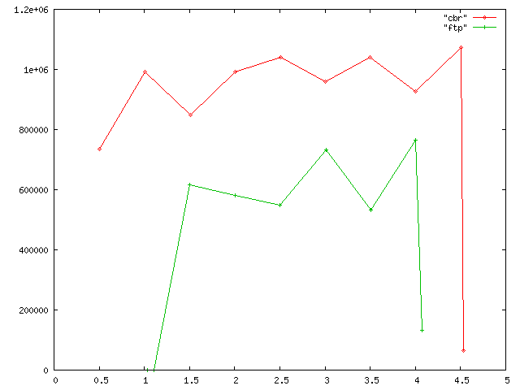
$perl throughput.pl rd 0.5 > cbr
$perl tcp_throughput.pl tcp_sink 0.5 > ftp
$gnuplot
gnuplot> plot “cbr” with linespoints 1, “ftp” with linespoints 2
gnuplot > set xrange [0:5]
gnuplot > set xtics 0, 0.5, 5
gnuplot > replot
comparison

Slide 69
Implementing mobile node by Extending “standard” NS node
Node
Classifier:Forwarding
Agent: Protocol Entity
Routing
Node Entry
LL
ARP
LL:Link layer object
LL
LL
IFQ:Interface queue
MAC
Radio Propagation Model
MAC
MAC:Mac object
PHY
MobileNode
PHY
PHY:Net interface
CHANNEL

Slide 70
Wireless Channel
Duplicate packets to all mobile nodes attached to the channel except the source itself.
It is the receiver’s responsibility to decide if it can receive the packet

Slide 71
void WirelessChannel::sendUp(Packet* p, Phy *tifp)
{
………………………………………………………………….
{
MobileNode *mtnode = (MobileNode *) tnode;
MobileNode **affectedNodes;// **aN;
int numAffectedNodes = -1, i;
if(!sorted_){
sortLists();
}
affectedNodes = getAffectedNodes(mtnode, distCST_ + /* safety */ 5, &numAffectedNodes);
for (i=0; i < numAffectedNodes; i++) {
rnode = affectedNodes[i];
if(rnode == tnode)
continue;
newp = p->copy();
propdelay = get_pdelay(tnode, rnode);
rifp = (rnode->ifhead()).lh_first;
for(; rifp; rifp = rifp->nextnode()){
s.schedule(rifp, newp, propdelay);
}
}
delete [] affectedNodes;
}
Packet::free(p);
}
mac/channel.[cc,h]

Slide 72
wireless-phy
The function of class WirelessPhy is to send packets to Channel and receive packet from Channel.
Packet Sending (void WirelessPhy::sendDown(Packet *p))
channel_->recv(p, this);
Packet Reception (int WirelessPhy::sendUp(Packet *p))
//calculate Rx power by path loss models
Pr = propagation_->Pr(&p->txinfo_, &s, this)
if (Pr <CSThresh_){
pkt_recvd=0; // cannot hear it
…
}
if (Pr >=CSThresh_ && Pr < RXThresh_){
pkt_recv=1;
hdr->error = 1; // error reception, for carrier sense
….
}
if (Pr >= RXThresh_) {
pkt_recvd=1;
hdr->error=0l //maybe coorect reception
….
}

Slide 73
Radio Propagation Model --- TwoRayGround
Mobile/tworayground.[cc, h]
double TwoRayGround::TwoRay(double Pt, double Gt, double Gr, double ht, double hr, double L, double d)
{
/*
* Two-ray ground reflection model.
*
* Pt * Gt * Gr * (ht^2 * hr^2)
* Pr = ----------------------------
* d^4 * L
*
* The original equation in Rappaport's book assumes L = 1.
* To be consistant with the free space equation, L is added here.
*/
return Pt * Gt * Gr * (hr * hr * ht * ht) / (d * d * d * d * L);
}

Slide 74
Medium Access Control
Distributed Coordination Function (DCF)
How to send a multicast packet over 802_11 network.ppt
How to receive a multicast packet.ppt
How to send a unicast packet.ppt
How to receive a unicast packet.ppt

Slide 75
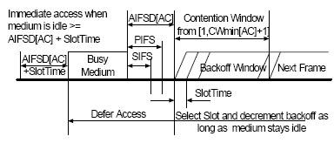
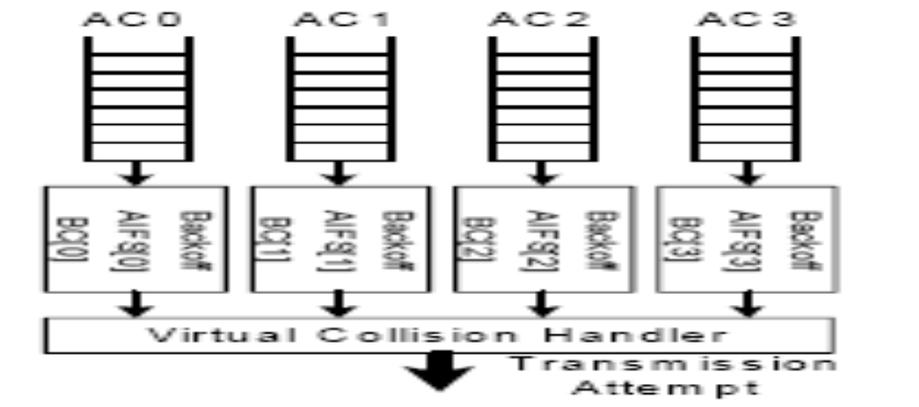
802.11e (EDCF)
http://www.tkn.tu-berlin.de/research/802.11e_ns2/

Slide 76
# globals and flags
set ns [new Simulator]
#number of nodes
set num_wired_nodes 1
set num_mobile_nodes 1
set num_bs_nodes 1 ;# number of base stations
set num_nodes [expr $num_wired_nodes + $num_mobile_nodes + $num_bs_nodes]
set bs_id $num_wired_nodes
# Parameter for wireless nodes
set opt(chan) Channel/WirelessChannel ;# channel type
set opt(prop) Propagation/TwoRayGround ;# radio-propagation model
set opt(netif) Phy/WirelessPhy ;# network interface type
set opt(mac) Mac/802_11e ;# MAC type
set opt(ifq) Queue/DTail/PriQ ;# interface queue type
set opt(ifqlen) 50
set opt(ll) LL ;# link layer type
set opt(ant) Antenna/OmniAntenna ;# antenna model
set opt(ifqlen) 50 ;# max packet in ifq
set opt(adhocRouting) NOAH ;# routing protocol
set opt(x) 670 ;# X dimension of the topography
set opt(y) 670 ;# Y dimension of the topography
#smallko add the following two lines
Mac/802_11e set dataRate_ 1Mb
Mac/802_11e set basicRate_ 1Mb
BS
MH
multi_udpflows_802_11e.tc

Slide 77
#set up for hierarchical routing
#(needed for routing over a basestation)
$ns node-config -addressType hierarchical
AddrParams set domain_num_ 2 ;# domain number
lappend cluster_num 1 1 ;# cluster number for each domain
AddrParams set cluster_num_ $cluster_num
lappend eilastlevel $num_wired_nodes [expr $num_mobile_nodes + $num_bs_nodes] ;# number of nodes for each cluster
AddrParams set nodes_num_ $eilastlevel
#Open the nam trace file
set nf [open out.nam w]
$ns namtrace-all-wireless $nf $opt(x) $opt(y)
set ntr [open out.tr w]
$ns trace-all $ntr
set chan [new $opt(chan)]
set topo [new Topography]
$topo load_flatgrid $opt(x) $opt(y)
# Create God
create-god [expr $num_mobile_nodes + $num_bs_nodes]
# creating wired nodes
for {set i 0} {$i < $num_wired_nodes} {incr i} {
set W($i) [$ns node 0.0.$i]
puts "wired node $i created"
}

Slide 78
# creating base station
$ns node-config -adhocRouting $opt(adhocRouting) \
-llType $opt(ll) \
-macType $opt(mac) \
-ifqType $opt(ifq) \
-ifqLen $opt(ifqlen) \
-antType $opt(ant) \
-propType $opt(prop) \
-phyType $opt(netif) \
-channel $chan \
-topoInstance $topo \
-wiredRouting ON \
-agentTrace OFF \
-routerTrace OFF \
-macTrace OFF \
-movementTrace OFF
set BS(0) [$ns node 1.0.0]
$BS(0) random-motion 0
puts "Base-Station node $bs_id created"
#provide some co-ord (fixed) to base station node
$BS(0) set X_ 1.0
$BS(0) set Y_ 2.0
$BS(0) set Z_ 0.0
# creating mobile nodes
$ns node-config -wiredRouting OFF
for {set i 0} {$i < $num_mobile_nodes} {incr i} {
set wl_node_($i) [$ns node 1.0.[expr $i + 1]]
$wl_node_($i) random-motion 0 ;# disable random motion
puts "wireless node $i created ..."
$wl_node_($i) base-station [AddrParams addr2id [$BS(0) node-addr]]
$wl_node_($i) set X_ [expr $i * 10]
$wl_node_($i) set Y_ [expr $i * 10]
$wl_node_($i) set Z_ 0.0
}

Slide 79
# linking of root to base-station node
$ns duplex-link $W(0) $BS(0) 10Mb 2ms DropTail
# linking of wired nodes to root node
#for {set i 1} {$i < $num_wired_nodes} {incr i} {
# $ns duplex-link $W($i) $W(0) 10Mb 2ms DropTail
#}
set src_udp0 [new Agent/UDP]
$src_udp0 set class_ 0
$src_udp0 set prio_ 0
set dst_udp0 [new Agent/Null]
$ns attach-agent $wl_node_(0) $src_udp0
$ns attach-agent $W(0) $dst_udp0
set app0 [new Application/Traffic/CBR]
$app0 attach-agent $src_udp0
$ns connect $src_udp0 $dst_udp0
$ns at 0.0 "$app0 start"
set src_udp1 [new Agent/UDP]
$src_udp1 set class_ 1
$src_udp1 set prio_ 1
set dst_udp1 [new Agent/Null]
$ns attach-agent $wl_node_(0) $src_udp1
$ns attach-agent $W(0) $dst_udp1
set app1 [new Application/Traffic/CBR]
$app1 attach-agent $src_udp1
$ns connect $src_udp1 $dst_udp1
$ns at 0.3 "$app1 start"

Slide 80
set src_udp2 [new Agent/UDP]
$src_udp2 set class_ 2
$src_udp2 set prio_ 2
set dst_udp2 [new Agent/Null]
$ns attach-agent $wl_node_(0) $src_udp2
$ns attach-agent $W(0) $dst_udp2
set app2 [new Application/Traffic/CBR]
$app2 attach-agent $src_udp2
$ns connect $src_udp2 $dst_udp2
$ns at 0.1 "$app2 start"
set src_udp3 [new Agent/UDP]
$src_udp3 set class_ 3
$src_udp3 set prio_ 3
set dst_udp3 [new Agent/Null]
$ns attach-agent $wl_node_(0) $src_udp3
$ns attach-agent $W(0) $dst_udp3
set app3 [new Application/Traffic/CBR]
$app3 attach-agent $src_udp3
$ns connect $src_udp3 $dst_udp3
$ns at 0.2 "$app3 start"
# Define node initial position in nam
for {set i 0} {$i < $num_mobile_nodes} {incr i} {
$ns initial_node_pos $wl_node_($i) 20
}
# Tell nodes when the simulation ends
for {set i 0} {$i < $num_mobile_nodes } {incr i} {
$ns at 10.0 "$wl_node_($i) reset";
}
$ns at 100.0 "$BS(0) reset";
$ns at 100.0 "$app0 stop"
$ns at 100.0 "$app1 stop"
$ns at 100.0 "$app2 stop"
$ns at 100.0 "$app3 stop"
$ns at 110.0 "puts \"NS EXITING...\" ; $ns halt"
proc stop {} {
global ns ntr nf
close $ntr
close $nf
}
# run the simulation
$ns run

Slide 81
#這是測量CBR封包平均吞吐量(average throughput)的awk程式
BEGIN {
i0=0;
i1=0;
i2=0;
i3=0;
}
{
action = $1;
time = $2;
from = $3;
to = $4;
type = $5;
pktsize = $6;
flow_id = $8;
src = $9;
dst = $10;
seq_no = $11;
packet_id = $12;
if(action=="r" && from==1 && to==0 && flow_id==0) {
pkt_byte_sum0[i0+1]=pkt_byte_sum0[i0]+ pktsize;
end_time0[i0] = time;
i0 = i0+1;
}
if(action=="r" && from==1 && to==0 && flow_id==1) {
pkt_byte_sum1[i1+1]=pkt_byte_sum1[i1]+ pktsize;
end_time1[i1] = time;
i1 = i1+1;
}
measure-throughput.awk

Slide 82
if(action=="r" && from==1 && to==0 && flow_id==2) {
pkt_byte_sum2[i2+1]=pkt_byte_sum2[i2]+ pktsize;
end_time2[i2] = time;
i2 = i2+1;
}
if(action=="r" && from==1 && to==0 && flow_id==3) {
pkt_byte_sum3[i3+1]=pkt_byte_sum3[i3]+ pktsize;
end_time3[i3] = time;
i3 = i3+1;
}
}
END {
if(pkt_byte_sum0[i0]!=0)
printf("average throughput of Flow 0:%f Bytes Per Second\n", pkt_byte_sum0[i0]/(end_time0[i0-1]-end_time0[0]));
if(pkt_byte_sum1[i1]!=0)
printf("average throughput of Flow 1:%f Bytes Per Second\n", pkt_byte_sum1[i1]/(end_time1[i1-1]-end_time1[0]));
if(pkt_byte_sum2[i2]!=0)
printf("average throughput of Flow 2:%f Bytes Per Second\n", pkt_byte_sum2[i2]/(end_time2[i2-1]-end_time2[0]));
if(pkt_byte_sum3[i3]!=0)
printf("average throughput of Flow 3:%f Bytes Per Second\n", pkt_byte_sum3[i3]/(end_time3[i3-1]-end_time3[0]));
}
ns multi_udpflows_802_11e.tcl
awk –f measure-throughput.awk out.tr
average throughput of Flow 0:60341.412277 Bytes Per Second
average throughput of Flow 1:19359.667045 Bytes Per Second
average throughput of Flow 2:6124.881852 Bytes Per Second
average throughput of Flow 3:580.070331 Bytes Per Second

Slide 83
Adaptive Approach for QoS Support in IEEE
802.11e Wireless LAN
Accepted by IEEE International Conference on Wireless and Mobile Computing , Networking and Communications (WiMob 2005), Montreal, Canada, August 2005
The proposed approach is based on adapting the values of CW depending on the channel congestion level.
The value of CW is incremented whenever a station fails to transmit due to a collision.
  when the channel is highly congested CW would acquire values distant from CWmin and close to CWmax
  when the channel is free, CW values would be close to CWmin and distant from CWma

Slide 84
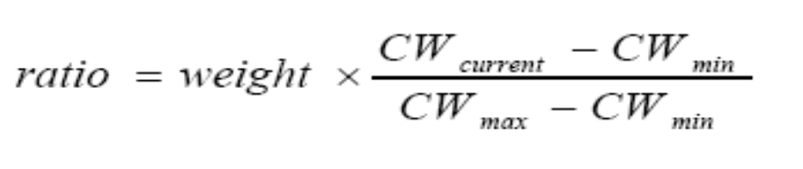
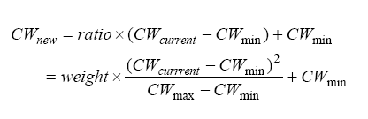
Link congestion ratio in the proposed Adaptive scheme can be written as:
It is bounded by [CWmin, CWmax].
To obtain some preliminary simulation results, the weight was fixed in
this paper to a value of 0.9.

Slide 85
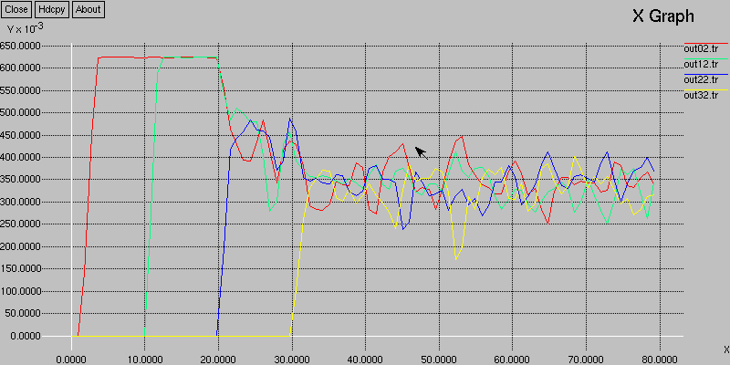
inline void rst_cw(int level) {
if(rst_cw_mode_==0)
cw_[level] = cwmin_[level]; // original EDCF
else
cw_[level] = int(0.9 * (cw_[level] - cwmin_[level]) * (cw_[level] - cwmin_[level])/ (cwmax_[level] - cwmin_[level])) + cwmin_[level];
// modified EDCF
}
DCF

Slide 86
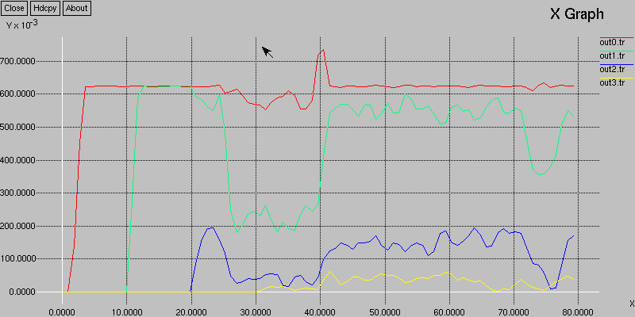
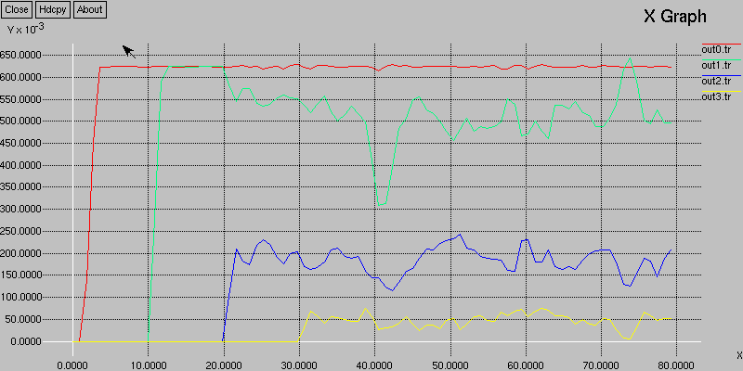
EDCF
Modified
EDCF

Slide 87
Interface Queue
Queue/DropTail/PriQueue
void PriQueue::recv(Packet *p, Handler *h)
{
if(Prefer_Routing_Protocols) {
switch(ch->ptype()) {
case PT_DSR:
case PT_MESSAGE:
case PT_TORA:
case PT_AODV:
case PT_PROTONAME:
recvHighPriority(p, h);
break;
default:
Queue::recv(p, h);
}
}
else {
Queue::recv(p, h);
}
}
queue/priqueue.[cc,h]

Slide 88
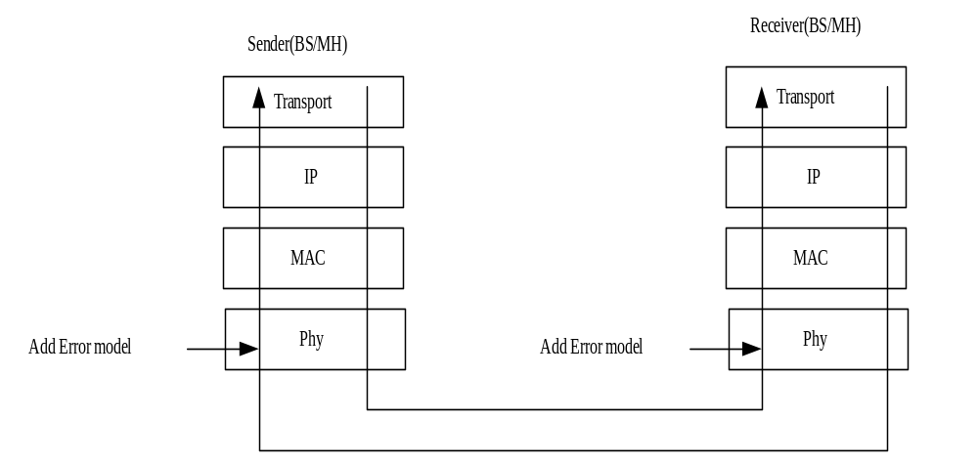
Wireless error model
Random uniform model
Gilbert-Elliot (GE) model

Slide 89
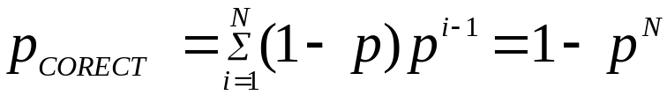

Uniform Distribution Model
Multicast (without any retransmission when packet is lost):
Packet Loss Rate = P_{G}
Unicast:
The perceived correct rate at transport protocol is
where N is the maximum number of retransmission at MAC (DCF mode)
and p is packet loss rate at physical layer. Consequently, the perceived
lost rate at transport protocol is

Slide 90
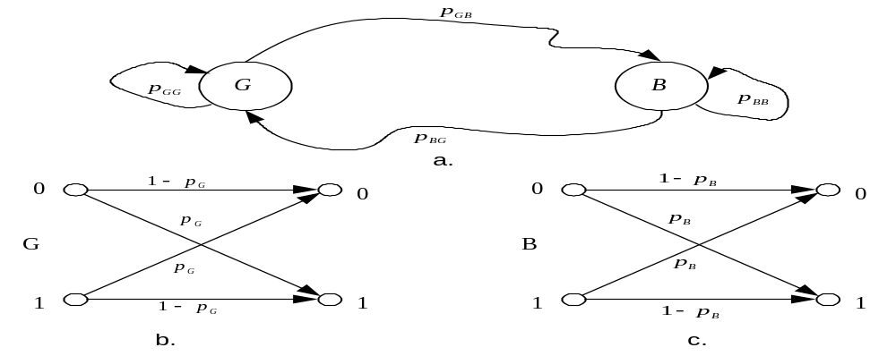

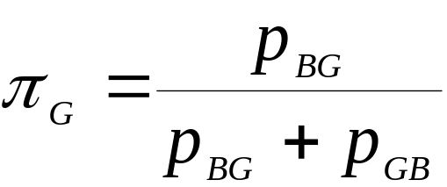
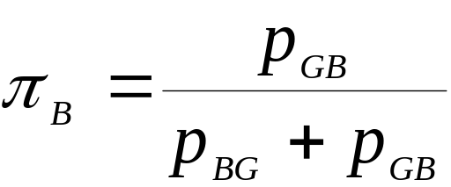
Gilbert-Elliott (GE) model
In the “good” state (G) losses occur with low probability P_{G} while in the “bad” state (B)
they happen with high probability P_{B}. The steady state probabilities of being in states G
and B are and , respectively. The average packet loss rate produced by the Gilbert
channel is

Slide 91
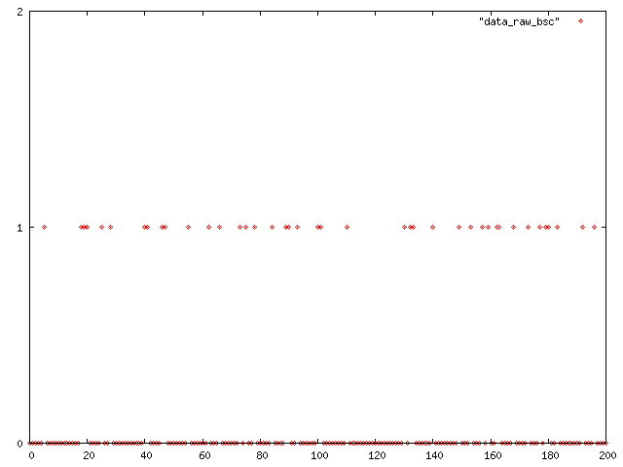
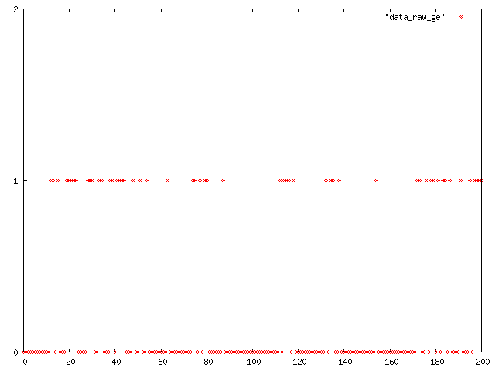
Uniform
P~0.2
GE model
P~0.22

Slide 92
Simulation Topology
802.11
W(0)
10Mbps, 10ms
HA
(base station)
MH

Slide 93
#設定模擬結束時間
set opt(stop) 250
#設定base station的數目
set opt(num_FA) 1
#讀取使用者設定的參數
proc getopt {argc argv} {
global opt
lappend optlist nn
for {set i 0} {$i < $argc} {incr i} {
set opt($i) [lindex $argv $i]
}
}
getopt $argc $argv
set pGG $opt(0)
set pBB $opt(1)
set pG $opt(2)
set pB $opt(3)
set fname $opt(4)
set comm_type $opt(5)
set loss_model $opt(6)

Slide 94
#產生一個模擬的物件
set ns_ [new Simulator]
#使用hierarchial addressing的方式定址
$ns_ node-config -addressType hierarchical
puts [ns-random 0]
#設定有兩個domain,每個domain各有一個cluster
#第一個cluster(wired)有一個node,第二個cluster(wireles)有兩個node (base state + mobile node)
AddrParams set domain_num_ 2
lappend cluster_num 1 1
AddrParams set cluster_num_ $cluster_num
lappend eilastlevel 1 2
AddrParams set nodes_num_ $eilastlevel
#設定記錄檔,把模擬過程都記錄下來
set tracefd [open test$fname w]
$ns_ trace-all $tracefd
#設定mobile node的個數
set opt(nnn) 1
# 拓樸的範圍為 100m x 100m
set topo [new Topography]
$topo load_flatgrid 100 100
Tcl 程式碼

Slide 95
#create god
set god_ [create-god [expr $opt(nnn)+$opt(num_FA)]]
# wired nodes
set W(0) [$ns_ node 0.0.0]
# create channel
set chan_ [new Channel/WirelessChannel]
#設定節點參數
$ns_ node-config -mobileIP ON \
-adhocRouting NOAH \
-llType LL \
-macType Mac/802_11 \
-ifqType Queue/DropTail/PriQueue \
-ifqLen 2000 \
-antType Antenna/OmniAntenna \
-propType Propagation/TwoRayGround \
-phyType Phy/WirelessPhy \
-channel $chan_ \
-topoInstance $topo \
-wiredRouting ON\
-agentTrace ON \
-routerTrace ON \
-macTrace ON

Slide 96
#設定base station節點
set HA [$ns_ node 1.0.0]
set HAnetif_ [$HA set netif_(0)]
$HAnetif_ set-error-level $pGG $pBB $pG $pB $loss_model
#設定mobile node的參數
#不需要wired routing,所以把此功能off
$ns_ node-config -wiredRouting OFF
set MH(0) [$ns_ node 1.0.1]
set MHnetif_(0) [$MH(0) set netif_(0)]
$MHnetif_(0) set-error-level $pGG $pBB $pG $pB $loss_model
#把此mobile node跟前面的base station節點做連結
[$MH(0) set regagent_] set home_agent_ [AddrParams addr2id [$HA node-addr]]
#設定base station的位置在(100.0, 100.0)
$HA set X_ 100.0
$HA set Y_ 100.0
$HA set Z_ 0.0
#設定mobile node的位置在(80.0, 80.0)
$MH(0) set X_ 80.0
$MH(0) set Y_ 80.0
$MH(0) set Z_ 0.0

Slide 97
#在wired node和base station之間建立一條連線
$ns_ duplex-link $W(0) $HA 10Mb 10ms DropTail
$ns_ at $opt(stop).1 "$MH(0) reset";
$ns_ at $opt(stop).0001 "$W(0) reset"
#建立一個CBR的應用程式 (wired node ---> base station)
set udp0 [new Agent/UDP]
$ns_ attach-agent $W(0) $udp0
$udp0 set packetSize_ 1000
set cbr0 [new Application/Traffic/CBR]
$cbr0 attach-agent $udp0
$cbr0 set rate_ 50000
$cbr0 set packetSize_ 1000
set null0 [new Agent/Null]
$MH(0) attach $null0 3
#當base station收到cbr packet時,可以根據使用者設定以unicast或multicast轉送封包到mobile node)
set forwarder_ [$HA set forwarder_]
puts [$forwarder_ port]
$ns_ connect $udp0 $forwarder_
$forwarder_ dst-addr [AddrParams addr2id [$MH(0) node-addr]]
$forwarder_ comm-type $comm_type

Slide 98
#在2.4秒時,開始送出cbr封包
$ns_ at 2.4 "$cbr0 start"
#在200.0秒時,停止傳送
$ns_ at 200.0 "$cbr0 stop"
$ns_ at $opt(stop).0002 "stop "
$ns_ at $opt(stop).0003 "$ns_ halt"
#設定一個stop的程序
proc stop {} {
global ns_ tracefd
#關閉記錄檔
close $tracefd
}
#執行模擬
$ns_ run

Slide 99
comm_type=1
loss_model=0
for x in 0.3 0.4 0.5 0.6
do
pG=$x
pB=0
pGG=0
pBB=0
ith=20
for xx in $( seq 1 $ith )
do
echo $xx
echo $x
./ns.exe wireless_error.tcl $pGG $pBB $pG $pB $xx $comm_type $loss_model
done
./plot_err.pl test $ith $x
done
# ith is the number of iteration
# if BSC channel packet loos rate =pG
# loss_model: 0 for BSC, 1 for GE model
# comm_type: 0 for broacdcast, 1 for unicast
run_bsc_error:測試uniform distribution的script

Slide 100
comm_type=0
loss_model=1 run_ge_error:測試GE model的script
for x in 0.4 0.5 0.6 0.7
do
pG=0.01
pB=$x
pGG=0.96
pBB=0.94
ith=20
for xx in $( seq 1 $ith )
do
echo $xx
echo $x
./ns.exe wireless_error.tcl $pGG $pBB $pG $pB $xx $comm_type $loss_model
done
./plot_err.pl test $ith $x
done
# ith is the number of iteration
# if BSC channel packet loos rate =pG
# loss_model: 0 for BSC, 1 for GE model
# comm_type: 0 for broacdcast, 1 for unicast

Slide 101
執行的方法: (以run_bsc_error為例)
$./run_bsc_error
執行後會產生許多的記錄檔,底下為某次實驗的範例
+ 2.4 0 1 cbr 1000 ------- 0 0.0.0.0 1.0.0.4 0 7 (wired trace file format)
- 2.4 0 1 cbr 1000 ------- 0 0.0.0.0 1.0.0.4 0 7
r 2.4108 0 1 cbr 1000 ------- 0 0.0.0.0 1.0.0.4 0 7
r 2.410800000 _1_ AGT --- 7 cbr 1000 [0 0 0 0] ------- [0:0 4194304:4 31 0] [0] 0 0
f 2.410800000 _1_ RTR --- 7 cbr 1020 [0 0 0 0] ------- [4194304:4 -1:3 32 0] [0] 0 0
s 2.411475000 _1_ MAC --- 7 cbr 1072 [0 ffffffff 0 800] ------- [4194304:4 -1:3 32 0] [0] 0 0
r 2.420051094 _2_ MAC --- 7 cbr 1020 [0 ffffffff 0 800] ------- [4194304:4 -1:3 32 0] [0] 1 0 (wireless)
r 2.420076094 _2_ RTR --- 7 cbr 1020 [0 ffffffff 0 800] ------- [4194304:4 -1:3 32 0] [0] 1 0
r 2.420076094 _2_ AGT --- 7 cbr 1020 [0 ffffffff 0 800] ------- [4194304:4 -1:3 31 0] [0] 1 0
+ 2.56 0 1 cbr 1000 ------- 0 0.0.0.0 1.0.0.4 1 8
- 2.56 0 1 cbr 1000 ------- 0 0.0.0.0 1.0.0.4 1 8
r 2.5708 0 1 cbr 1000 ------- 0 0.0.0.0 1.0.0.4 1 8
r 2.570800000 _1_ AGT --- 8 cbr 1000 [0 0 0 0] ------- [0:0 4194304:4 31 0] [1] 0 0
f 2.570800000 _1_ RTR --- 8 cbr 1020 [0 0 0 0] ------- [4194304:4 -1:3 32 0] [1] 0 0
s 2.571455000 _1_ MAC --- 8 cbr 1072 [0 ffffffff 0 800] ------- [4194304:4 -1:3 32 0] [1] 0 0
r 2.580031094 _2_ MAC --- 8 cbr 1020 [0 ffffffff 0 800] ------- [4194304:4 -1:3 32 0] [1] 1 0
r 2.580056094 _2_ RTR --- 8 cbr 1020 [0 ffffffff 0 800] ------- [4194304:4 -1:3 32 0] [1] 1 0
r 2.580056094 _2_ AGT --- 8 cbr 1020 [0 ffffffff 0 800] ------- [4194304:4 -1:3 31 0] [1] 1 0

Slide 102
#!/usr/bin/perl
$event_filter = “[rs]”; 分析trace file format的程式
@ptype_filter = ("tcp", "cbr", "exp");
$ttype_filter = "MAC";
if (@ARGV < 1) {
printf "usage plot_tp.pl [-s size] <trace file> [node1, ...]\n";
exit;
}
$tracenametmp = shift;
$numith =shift;
$errorlevel=shift;
@trace_type = ();
print "tracenametmp=$tracenametmp numith=$numith errorlevel=$errorlevel\n";
$tt=1;
@iteration=();
while($tt<=$numith){
push @iteration,$tt;
$tt=$tt+1;
}

Slide 103
$totalarverror=0.0;
$indith=0;
$maxseqno=0;
foreach $ith (@iteration){
$indith=$indith+1;
$tracename="$tracenametmp$ith";
$totalpktsize=0;
@src =();
@mh1 =();
open(infile, $tracename) or die "couldn't open $tracename";
while ($line = <infile>) {
++$line_no;
@entry = split(/[\s\(\)\[\]]+/, $line);
$event = $entry[0];
$time = $entry[1];

Slide 104
# check for trace format and parse entry (wireless traffic trace format.)
# The format of all records is not the same.
if ($entry[2] =~ /_+(\d+)_+/) { # mobile
$to = $1;
next if ($entry[3] ne $ttype_filter);
$pktid = $entry[5];
#die "packet error $pktid (line $line_no)" if ($packet_source{$pktid} == undef);
$from = $packet_source{$pktid};
$type = $entry[6];
$size = $entry[7];
$packet_source{$pktid} = $to;
$seqno=$entry[17];
} else { # standard (wired traffic trace format)
$to = $entry[3];
$pktid = $entry[11];
$from = $entry[2];
$type = $entry[4];
$size = $entry[5];
$seqno=$entry[10];
$packet_source{$pktid} = $to;
}

Slide 105
#判斷event是接收(r)且封包型態是cbr的記錄
if(($event eq "r")&&($type eq "cbr")) {
$tmpname="mh1";
#記錄從HA到MH的packet seqno到$tmpname
if ($to == 2)
{
push @$tmpname,{ SEQNO => $seqno,TIME => $time};
}
#記錄從W(0)到HA的packet seqno到$src
if($to == 1){
push @src ,{ SEQNO => $seqno,TIME => $time};
}
}
}
#關閉檔案
close($infile);
#開啟檔案(Open the file for writing)
open(datafile, ">data_raw") or die "couldn't open data";

Slide 106
$error=0;
$maxseqno=0;
$tmpmaxseqno=0;
foreach $srcdata (@src) {
$tmpname="mh1";
$chk=0;
foreach $mhdata (@$tmpname) {
#判斷$src中的記錄中是否可在$tmpname中找到相同的記錄
if($srcdata->{SEQNO}==$mhdata->{SEQNO}){
if ($chk==0) {
#把沒遺失的封包記錄為0
print datafile "$srcdata->{SEQNO} 0\n";
$chk=1;
}else {
$dup=$dup+1;
}
}
}

Slide 107
#找不到相同記錄時,代表有封包遺失
if ($chk==0)
{
#把遺失的封包記錄為1
print datafile "$srcdata->{SEQNO} 1\n";
$error=$error+1;
}
#記錄目前處理封包的最大seqno(最後的值就是共傳送多少封包)
if($srcdata->{SEQNO}>$maxseqno){
$maxseqno=$srcdata->{SEQNO};
}
}
print "errr $error\t $maxseqno\n";
#單次平均的error rate = error發生的次數 / 總共的封包數 * 100%
$arverror=$error/$maxseqno*100;
$totalarverror=$totalarverror+$arverror;
}
#總平均的error rate = 全部error rate總和 / 模擬的字數
$arverror=$totalarverror/$numith;
print "Average error =\t$arverror \tpercent\n";
#開啟檔案(Open the file for appending)
open(cmd, ">>data.out");
#記錄errorlevel和模擬所得到的總平均error rate
printf cmd "$errorlevel\t$arverror\n";
#關閉檔案
close(cmd);

Slide 108
實驗結果 (1)
 | p | Simulated p (%)
1 | 0.1 | 10.0971659919028
2 | 0.2 | 20.2914979757085
3 | 0.3 | 30.2348178137652
4 | 0.4 | 39.7651821862348
5 | 0.5 | 50.085020242915
Uniform Distribution:
I ran 20 iterations. Broadcasting is used.

Slide 109
實驗結果 (2)
 | p | P_{r} | Simulated p (%)
1 | 0.3 | 0.0081 | 0.817813765182186
2 | 0.4 | 0.0256 | 2.47773279352227
3 | 0.5 | 0.0625 | 6.18218623481781
4 | 0.6 | 0.1296 | 12.7894736842105
Uniform Distribution:
I ran 20 iterations. Unicast is used.
Maximum Retransmission Times: 4

Slide 110

實驗結果 (3)
 | P_{B} |  | Simulated p (%)
1 | 0.4 | 0.1660 | 16.17004048583
2 | 0.5 | 0.2060 | 22.1336032388664
3 | 0.6 | 0.2460 | 24.6923076923077
4 | 0.7 | 0.2860 | 28.0283400809717
GE model:
Multicast is used. I ran 20 iterations
P_{G}=0.01
P_{GG}=0.96
P_{BB}=0.94

Slide 111
How to dynamically set the link bandwidth during simulation?
set ns [new Simulator]
set n0 [$ns node]
set n1 [$ns node]
$ns simplex-link $n0 $n1 1Mb 10ms DropTail
$ns simplex-link $n1 $n0 10Mb 10ms DropTail
set tcp [new Agent/TCP]
$ns attach-agent $n0 $tcp
set tcpsink1 [new Agent/TCPSink/mTcpSink]
$tcpsink1 set_filename tcp_sink
$ns attach-agent $n1 $tcpsink1
$ns connect $tcp $tcpsink1
set ftp [new Application/FTP]
$ftp attach-agent $tcp
$ftp set type_ FTP
$ns at 0.0 "$ftp start"
$ns at 10.0 "$ns bandwidth $n0 $n1 5Mb"
$ns at 15.0 "$ftp stop"
$ns at 20.0 "$tcpsink1 closefile"
$ns at 20.1 "puts \"NS EXITING...\" ; $ns halt"
$ns run

Slide 112
perl tcp_throughput.pl tcp_sink 1.0
1.007184 957120
2.005584 998400
3.003984 998400
4.002384 998400
5.000784 998400
6.007504 1006720
7.005904 998400
8.004304 998400
9.002704 998400
10.001104 998400
11.001168 4933760
12.001232 5000320
13.001296 5000320
14.001360 5000320
15.001424 5000320
15.023056 116480

Slide 113
How to set the different operation modes (DCF or EDCF) for different mobile nodes?
set val(chan) Channel/WirelessChannel ;# channel type
set val(prop) Propagation/TwoRayGround ;# radio-propagation model
set val(netif) Phy/WirelessPhy ;# network interface type
set val(mac) Mac/802_11 ;# MAC type
set val(ifq) Queue/DropTail/PriQueue ;# interface queue type
set val(ll) LL ;# link layer type
set val(ant) Antenna/OmniAntenna ;# antenna model
set val(ifqlen) 50 ;# max packet in ifq
set val(rp) DumbAgent
set ns [new Simulator]
Mac/802_11 set dataRate_ 2Mb
Mac/802_11 set basicRate_ 1Mb
Mac/802_11 set RTSThreshold_ 3000
set f [open test.tr w]
$ns trace-all $f
$ns eventtrace-all
set nf [open test.nam w]
$ns namtrace-all-wireless $nf 500 500
set topo [new Topography]
$topo load_flatgrid 500 500
create-god 3
set chan [new $val(chan)]
EDCF/DCF
DCF
0
1
2
DCF
test_dcf_edcf.tcl

Slide 114
$ns node-config -adhocRouting $val(rp) \
-llType $val(ll) \
-macType $val(mac) \
-ifqType $val(ifq) \
-ifqLen $val(ifqlen) \
-antType $val(ant) \
-propType $val(prop) \
-phyType $val(netif) \
-channel $chan \
-topoInstance $topo \
-agentTrace ON \
-routerTrace OFF \
-macTrace ON \
-movementTrace OFF
for {set i 0} {$i < 2} {incr i} {
set node_($i) [$ns node]
$node_($i) random-motion 0
}
set val(mac1) Mac/802_11e ;# MAC type
set val(ifq1) Queue/DTail/PriQ ;# interface queue type
Mac/802_11e set dataRate_ 2Mb
Mac/802_11e set basicRate_ 1Mb
$ns node-config -macType $val(mac1)
$ns node-config -ifqType $val(ifq1)
set node_(2) [$ns node]
$node_(2) random-motion 0

Slide 115
$node_(0) set X_ 30.0
$node_(0) set Y_ 30.0
$node_(0) set Z_ 0.0
$node_(1) set X_ 50.0
$node_(1) set Y_ 30.0
$node_(1) set Z_ 0.0
$node_(2) set X_ 100.0
$node_(2) set Y_ 30.0
$node_(2) set Z_ 0.0
set udp [new Agent/mUDP]
#set the sender trace file name to sd1
$udp set_filename sd1
$ns attach-agent $node_(0) $udp
set null [new Agent/mUdpSink]
#set the receiver filename to rd1
$null set_filename rd1
$ns attach-agent $node_(1) $null
$ns connect $udp $null
set cbr [new Application/Traffic/CBR]
$cbr attach-agent $udp
$cbr set type_ CBR
$cbr set packet_size_ 1000
$cbr set rate_ 1Mb
$cbr set random_ false
$ns at 1.0 "$cbr start"
$ns at 15.0 "$cbr stop"
set udp2 [new Agent/mUDP]
$udp2 set_filename sd2
$udp2 set prio_ 0
$ns attach-agent $node_(2) $udp2
set null2 [new Agent/mUdpSink]
$null2 set_filename rd2
$ns attach-agent $node_(1) $null2
$ns connect $udp2 $null2
set cbr2 [new Application/Traffic/CBR]
$cbr2 attach-agent $udp2
$cbr2 set type_ CBR
$cbr2 set packet_size_ 1000
$cbr2 set rate_ 1Mb
$cbr2 set random_ false
$ns at 1.0 "$cbr2 start"
$ns at 15.0 "$cbr2 stop"
for {set i 0} {$i < 3} {incr i} {
$ns initial_node_pos $node_($i) 30
$ns at 20.0 "$node_($i) reset";
}
$ns at 20.0 "finish"
$ns at 20.1 "puts \"NS EXITING...\"; $ns halt"
proc finish {} {
global ns f nf val
$ns flush-trace
close $f
close $nf
}
puts "Starting Simulation..."
$ns run

Slide 116
All nodes are in DCF
perl throughput.tcl rd1 1.0
……………………………….
Average rate: 812715.938099886 bps
Peak rate: 896000 bps
perl throughput.tcl rd2 1.0
……………………………….
Average rate: 774294.098658433 bps
Peak rate: 856000 bps
Node 2 is in EDCF
perl throughput.tcl rd1 1.0
……………………………….
Average rate: 636328.809983617 bps
Peak rate: 656000 bps
perl throughput.tcl rd2 1.0
……………………………….
Average rate: 991902.368466875 bps
Peak rate: 1008000 bps

Slide 117
How to set the different transmission speeds to different mobile nodes?
set val(chan) Channel/WirelessChannel ;# channel type
set val(prop) Propagation/TwoRayGround ;# radio-propagation model
set val(netif) Phy/WirelessPhy ;# network interface type
set val(mac) Mac/802_11 ;# MAC type
set val(ifq) Queue/DropTail/PriQueue ;# interface queue type
set val(ll) LL ;# link layer type
set val(ant) Antenna/OmniAntenna ;# antenna model
set val(ifqlen) 50 ;# max packet in ifq
set val(rp) DumbAgent
set ns [new Simulator]
#Mac/802_11 set dataRate_ 2Mb
#Mac/802_11 set basicRate_ 1Mb
Mac/802_11 set RTSThreshold_ 3000
set f [open test.tr w]
$ns trace-all $f
$ns eventtrace-all
set nf [open test.nam w]
$ns namtrace-all-wireless $nf 500 500
set topo [new Topography]
$topo load_flatgrid 500 500
create-god 3
set chan [new $val(chan)]
11Mbps
11 / 1 Mbps
0
1
2
11Mbps
test_different_speed.tcl

Slide 118
set udp [new Agent/mUDP]
#set the sender trace file name to sd1
$udp set_filename sd1
$ns attach-agent $node_(0) $udp
set null [new Agent/mUdpSink]
#set the receiver filename to rd1
$null set_filename rd1
$ns attach-agent $node_(1) $null
$ns connect $udp $null
set cbr [new Application/Traffic/CBR]
$cbr attach-agent $udp
$cbr set type_ CBR
$cbr set packet_size_ 1000
$cbr set rate_ 1Mb
$cbr set random_ false
$ns at 1.0 "$cbr start"
$ns at 15.0 "$cbr stop"
set udp2 [new Agent/mUDP]
$udp2 set_filename sd2
$udp2 set prio_ 0
$ns attach-agent $node_(2) $udp2
set null2 [new Agent/mUdpSink]
$null2 set_filename rd2
$ns attach-agent $node_(1) $null2
$ns connect $udp2 $null2
set cbr2 [new Application/Traffic/CBR]
$cbr2 attach-agent $udp2
$cbr2 set type_ CBR
$cbr2 set packet_size_ 1000
$cbr2 set rate_ 1Mb
$cbr2 set random_ false
$ns at 1.0 "$cbr2 start"
$ns at 15.0 "$cbr2 stop"
set n0_mac [$node_(0) set mac_(0)]
set n1_mac [$node_(1) set mac_(0)]
set n2_mac [$node_(2) set mac_(0)]
$n0_mac set dataRate_ 11Mb
$n0_mac set basicRate_ 1Mb
$n1_mac set dataRate_ 11Mb
$n1_mac set basicRate_ 1Mb
$n2_mac set dataRate_ 1Mb
$n2_mac set basicRate_ 1Mb
$node_(0) set X_ 30.0
$node_(0) set Y_ 30.0
$node_(0) set Z_ 0.0
$node_(1) set X_ 50.0
$node_(1) set Y_ 30.0
$node_(1) set Z_ 0.0
$node_(2) set X_ 100.0
$node_(2) set Y_ 30.0
$node_(2) set Z_ 0.0

Slide 119
for {set i 0} {$i < 3} {incr i} {
$ns initial_node_pos $node_($i) 30
$ns at 20.0 "$node_($i) reset";
}
$ns at 20.0 "finish"
$ns at 20.1 "puts \"NS EXITING...\"; $ns halt"
#INSERT ANNOTATIONS HERE
proc finish {} {
global ns f nf val
$ns flush-trace
close $f
close $nf
}
puts "Starting Simulation..."
$ns run
All nodes transmit at 11Mbps
perl throughput rd1 1.0
……………………………….
Average rate: 992327.680776302 bps
Peak rate: 1000000 bps
Perl throughput rd2 1.0
…………………………………
Average rate: 992076.389882021 bps
Peak rate: 1000000 bps
node 2 transmit at 1Mbps
perl throughput rd1 1.0
…………………………….
Average rate: 732728.597037112 bps
Peak rate: 872000 bps
…………………………….
Perl throughput rd2 1.0
…………………………….
Average rate: 716865.252233207 bps
Peak rate: 744000 bps

Slide 120
How to measure the queue length in the base station or mobile node?
Modify queue/priqueue.h
#include "trace.h"
class PriQueue : public DropTail {
public:
PriQueue();
int command(int argc, const char*const* argv);
void recv(Packet *p, Handler *h);
void recvHighPriority(Packet *, Handler *);
// insert packet at front of queue
void filter(PacketFilter filter, void * data);
// apply filter to each packet in queue,
// - if filter returns 0 leave packet in queue
// - if filter returns 1 remove packet from queue
Packet* filter(nsaddr_t id);
void Terminate(void);
//added by smallko
Tcl_Channel tchan_; /* place to write trace records */
TracedInt curq_; /* current qlen seen by arrivals */
void trace(TracedVar*); /* routine to write trace records */
……………………………………………………………………………………………

Slide 121
修改queue/ priqueue.cc
PriQueue::PriQueue() : DropTail()
{
bind("curq_",&curq_);
tchan_=0;
………………………...
}
void PriQueue::recv(Packet *p, Handler *h)
{
curq_ = q_->length();
if (Prefer_Routing_Protocols) {
……………………………
}
void PriQueue::trace(TracedVar* v)
{
char wrk[500], *p;
if (((p = strstr(v->name(), "curq")) == NULL) ) {
fprintf(stderr, "PriQueue:unknown trace var %s\n", v->name());
return;
}
if (tchan_) {
int n;
double t = Scheduler::instance().clock();
if (strstr(v->name(), "curq") != NULL) {
sprintf(wrk, "Q %g %d", t, int(*((TracedInt*) v)));
}
n = strlen(wrk);
wrk[n] = '\n';
wrk[n+1] = 0;
(void)Tcl_Write(tchan_, wrk, n+1);
}
return;
}

Slide 122
修改tcl/lib/ns-default.tcl
加入 Queue/DropTail/PriQueue set curq_ 0
make clean ; make depend ; make
test_different_speed_ifqlen.tcl
set val(chan) Channel/WirelessChannel ;# channel type
set val(prop) Propagation/TwoRayGround ;# radio-propagation model
set val(netif) Phy/WirelessPhy ;# network interface type
set val(mac) Mac/802_11 ;# MAC type
set val(ifq) Queue/DropTail/PriQueue ;# interface queue type
set val(ll) LL ;# link layer type
set val(ant) Antenna/OmniAntenna ;# antenna model
set val(ifqlen) 100 ;# max packet in ifq
set val(rp) DumbAgent
set ns [new Simulator]
#Mac/802_11 set dataRate_ 2Mb
#Mac/802_11 set basicRate_ 1Mb
Mac/802_11 set RTSThreshold_ 3000
set f [open test.tr w]
$ns trace-all $f
$ns eventtrace-all
set nf [open test.nam w]
$ns namtrace-all-wireless $nf 500 500
# set up topography object
set topo [new Topography]
$topo load_flatgrid 500 500

Slide 123
set topo [new Topography]
$topo load_flatgrid 500 500
create-god 2
set chan [new $val(chan)]
$ns node-config -adhocRouting $val(rp) \
-llType $val(ll) \
-macType $val(mac) \
-ifqType $val(ifq) \
-ifqLen $val(ifqlen) \
-antType $val(ant) \
-propType $val(prop) \
-phyType $val(netif) \
-channel $chan \
-topoInstance $topo \
-agentTrace ON \
-routerTrace OFF \
-macTrace ON \
-movementTrace OFF
for {set i 0} {$i < 2} {incr i} {
set node_($i) [$ns node]
$node_($i) random-motion 0
}
set n0_mac [$node_(0) set mac_(0)]
set n1_mac [$node_(1) set mac_(0)]
$n0_mac set dataRate_ 11Mb
$n0_mac set basicRate_ 1Mb
$n1_mac set dataRate_ 11Mb
$n1_mac set basicRate_ 1Mb
$ns at 4.0 "$n0_mac set dataRate_ 5.5Mb"
$ns at 7.0 "$n0_mac set dataRate_ 2Mb"
$ns at 10.0 "$n0_mac set dataRate_ 1Mb"
$ns at 15.0 "$n0_mac set dataRate_ 2Mb“
set n0_ifq [$node_(0) set ifq_(0)]
set queuechan [open qlen.tr w]
$n0_ifq trace curq_
$n0_ifq attach $queuechan
$node_(0) set X_ 30.0
$node_(0) set Y_ 30.0
$node_(0) set Z_ 0.0
$node_(1) set X_ 50.0
$node_(1) set Y_ 30.0
$node_(1) set Z_ 0.0
set udp [new Agent/mUDP]
#set the sender trace file name to sd1
$udp set_filename sd1
$ns attach-agent $node_(0) $udp
set null [new Agent/mUdpSink]
#set the receiver filename to rd1
$null set_filename rd1
$ns attach-agent $node_(1) $null
$ns connect $udp $null

Slide 124
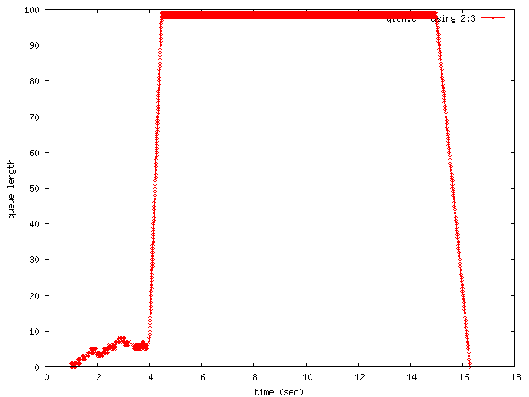
set cbr [new Application/Traffic/CBR]
$cbr attach-agent $udp
$cbr set type_ CBR
$cbr set packet_size_ 1000
$cbr set rate_ 5Mb
$cbr set random_ false
$ns at 1.0 "$cbr start"
$ns at 20.0 "$cbr stop"
$ns at 15.0 "$cbr set rate_ 1Mb"
for {set i 0} {$i < 2} {incr i} {
$ns initial_node_pos $node_($i) 30
$ns at 20.0 "$node_($i) reset";
}
$ns at 20.0 "finish"
$ns at 20.1 "puts \"NS EXITING...\"; $ns halt"
#INSERT ANNOTATIONS HERE
proc finish {} {
global ns f nf val
$ns flush-trace
close $f
close $nf
}
puts "Starting Simulation..."
$ns run
$startxwin.bat
$gnuplot
gnuplot> plot “qlen.tr” using 2:3 with linespoints 1
gnuplot> set xlabel “time (sec)”
gnuplot> set ylabel “queue length”

Slide 125
How to set the communication radius in wireless nodes?
To set communication radius, you have to set the receiving threshold value, RXThresh_.
This can be obtained by running the program ~ns/indep-utils/propagation/threshold.cc
compile threshold.cc
$ cd ns/indep-utils/propagation/
$ g++ -lm threshold.cc -o threshold

Slide 126
USAGE: find receiving threshold for certain communication range (distance)
SYNOPSIS: threshold -m <propagation-model> [other-options] distance
<propagation-model>: FreeSpace, TwoRayGround or Shadowing
[other-options]: set parameters other than default values:
Common parameters:
-Pt <transmit-power>
-fr <frequency>
-Gt <transmit-antenna-gain>
-Gr <receive-antenna-gain>
-L <system-loss>
For two-ray ground model:
-ht <transmit-antenna-height>
-hr <receive-antenna-height>
For shadowing model:
-pl <path-loss-exponent>
-std <shadowing-deviation>
-d0 <reference-distance>
-r <receiving-rate>
distance = 100
propagation model: TwoRayGround
Selected parameters:
transmit power: 0.281838
frequency: 2.472e+09
transmit antenna gain: 1
receive antenna gain: 1
system loss: 1
transmit antenna height: 1.5
receive antenna height: 1.5
Receiving threshold RXThresh_ is: 2.62861e-09
distance = 150
propagation model: TwoRayGround
Selected parameters:
transmit power: 0.281838
frequency: 2.472e+09
transmit antenna gain: 1
receive antenna gain: 1
system loss: 1
transmit antenna height: 1.5
receive antenna height: 1.5
Receiving threshold RXThresh_ is: 1.16827e-09

Slide 127
set val(chan) Channel/WirelessChannel
set val(prop) Propagation/TwoRayGround
set val(netif) Phy/WirelessPhy
set val(mac) Mac/802_11
set val(ifq) Queue/DropTail/PriQueue
set val(ll) LL
set val(ant) Antenna/OmniAntenna
set val(ifqlen) 50
set val(rp) DumbAgent
set ns [new Simulator]
Antenna/OmniAntenna set X_ 0
Antenna/OmniAntenna set Y_ 0
Antenna/OmniAntenna set Z_ 1.5
Antenna/OmniAntenna set Gt_ 1.0
Antenna/OmniAntenna set Gr_ 1.0
Phy/WirelessPhy set CPThresh_ 10.0
Phy/WirelessPhy set CSThresh_ 1.559e-11
Phy/WirelessPhy set RXThresh_ 2.62861e-9
Phy/WirelessPhy set bandwidth_ 2e6
Phy/WirelessPhy set Pt_ 0.281838
Phy/WirelessPhy set freq_ 2.472e+9
Phy/WirelessPhy set L_ 1.0
set f [open test.tr w]
$ns trace-all $f
$ns eventtrace-all
set nf [open test.nam w]
$ns namtrace-all-wireless $nf 500 500
set topo [new Topography]
$topo load_flatgrid 500 500
create-god 2
set chan [new $val(chan)]
$ns node-config -adhocRouting $val(rp) \
-llType $val(ll) \
-macType $val(mac) \
-ifqType $val(ifq) \
-ifqLen $val(ifqlen) \
-antType $val(ant) \
-propType $val(prop) \
-phyType $val(netif) \
-channel $chan \
-topoInstance $topo \
-agentTrace ON \
-routerTrace OFF \
-macTrace ON \
-movementTrace OFF
for {set i 0} {$i < 2} {incr i} {
set node_($i) [$ns node]
$node_($i) random-motion 0
}
$node_(0) set X_ 30.0
$node_(0) set Y_ 30.0
$node_(0) set Z_ 0.0
$node_(1) set X_ 129.5
$node_(1) set Y_ 30.0
$node_(1) set Z_ 0.0
test_transmission_range.tcl

Slide 128
set udp [new Agent/mUDP]
$udp set_filename sd
$ns attach-agent $node_(0) $udp
set null [new Agent/mUdpSink]
$null set_filename rd
$ns attach-agent $node_(1) $null
$ns connect $udp $null
set cbr [new Application/Traffic/CBR]
$cbr attach-agent $udp
$cbr set type_ CBR
$cbr set packet_size_ 1000
$cbr set rate_ 1Mb
$cbr set random_ false
$ns at 0.0 "$cbr start"
$ns at 15.0 "$cbr stop"
for {set i 0} {$i < 2} {incr i} {
$ns initial_node_pos $node_($i) 30
$ns at 20.0 "$node_($i) reset";
}
$ns at 20.0 "finish"
$ns at 20.1 "puts \"NS EXITING...\"; $ns halt"
proc finish {} {
global ns f nf val
$ns flush-trace
close $f
close $nf
}
puts "Starting Simulation..."
$ns run
Simulation results: (check the receiver trace file)
If the range < 100m, the receiver can receive packets. Otherwise, no packets are received

Slide 129
Hidden Terminal Problem
test_hidden_terminal.tcl
set val(chan) Channel/WirelessChannel
set val(prop) Propagation/TwoRayGround
set val(netif) Phy/WirelessPhy
set val(mac) Mac/802_11
set val(ifq) Queue/DropTail/PriQueue
set val(ll) LL
set val(ant) Antenna/OmniAntenna
set val(ifqlen) 50
set val(rp) DumbAgent
set ns [new Simulator]
Mac/802_11 set RTSThreshold_ 3000
Antenna/OmniAntenna set X_ 0
Antenna/OmniAntenna set Y_ 0
Antenna/OmniAntenna set Z_ 1.5
Antenna/OmniAntenna set Gt_ 1.0
Antenna/OmniAntenna set Gr_ 1.0
Phy/WirelessPhy set CPThresh_ 10.0
Phy/WirelessPhy set CSThresh_ 1.16827e-9
Phy/WirelessPhy set RXThresh_ 2.62861e-9
Phy/WirelessPhy set bandwidth_ 2e6
Phy/WirelessPhy set Pt_ 0.281838
Phy/WirelessPhy set freq_ 2.472e+9
Phy/WirelessPhy set L_ 1.0
set f [open test.tr w]
$ns trace-all $f
$ns eventtrace-all
set nf [open test.nam w]
$ns namtrace-all-wireless $nf 500 500
set topo [new Topography]
$topo load_flatgrid 500 500
create-god 3
set chan [new $val(chan)]
$ns node-config -adhocRouting $val(rp) \
-llType $val(ll) \
-macType $val(mac) \
-ifqType $val(ifq) \
-ifqLen $val(ifqlen) \
-antType $val(ant) \
-propType $val(prop) \
-phyType $val(netif) \
-channel $chan \
-topoInstance $topo \
-agentTrace ON \
-routerTrace OFF \
-macTrace ON \
-movementTrace OFF

Slide 130
for {set i 0} {$i < 3} {incr i} {
set node_($i) [$ns node]
$node_($i) random-motion 0
}
$node_(0) set X_ 30.0
$node_(0) set Y_ 30.0
$node_(0) set Z_ 0.0
$node_(1) set X_ 120.0
$node_(1) set Y_ 30.0
$node_(1) set Z_ 0.0
$node_(2) set X_ 210.0
$node_(2) set Y_ 30.0
$node_(2) set Z_ 0.0
set udp [new Agent/mUDP]
$udp set_filename sd1
$ns attach-agent $node_(0) $udp
set null [new Agent/mUdpSink]
$null set_filename rd1
$ns attach-agent $node_(1) $null
$ns connect $udp $null
set cbr [new Application/Traffic/CBR]
$cbr attach-agent $udp
$cbr set type_ CBR
$cbr set packet_size_ 1000
$cbr set rate_ 1Mb
$cbr set random_ false
$ns at 0.0 "$cbr start"
$ns at 15.0 "$cbr stop"
set udp2 [new Agent/mUDP]
$udp2 set_filename sd2
$ns attach-agent $node_(2) $udp2
set null2 [new Agent/mUdpSink]
$null2 set_filename rd2
$ns attach-agent $node_(1) $null2
$ns connect $udp2 $null2
set cbr2 [new Application/Traffic/CBR]
$cbr2 attach-agent $udp2
$cbr2 set type_ CBR
$cbr2 set packet_size_ 1000
$cbr2 set rate_ 1Mb
$cbr2 set random_ false
$ns at 1.0 "$cbr2 start"
$ns at 15.0 "$cbr2 stop"
for {set i 0} {$i < 3} {incr i} {
$ns initial_node_pos $node_($i) 30
$ns at 20.0 "$node_($i) reset";
}
$ns at 20.0 "finish"
$ns at 20.1 "puts \"NS EXITING...\"; $ns halt"
proc finish {} {
global ns f nf val
$ns flush-trace
close $f
close $nf
}
$ns run

Slide 131
rts/cts disabled: Mac/802_11 set RTSThreshold_ 3000
There are only 191 packets received in rd1.
There are only 94 packets received in rd2.
rts/cts enable: Mac/802_11 set RTSThreshold_ 0
There are only 801 packets received in rd1.
There are only 802 packets received in rd2.

Slide 132
How to get the information in different layers?
An example: The UDP layer of a mobile node checks the interface queue length before sends down the packet to the lower layer.
modify the mudp.cc
int mUdpAgent::command(int argc, const char*const* argv)
{
Tcl& tcl=Tcl::instance();
………………………………………………………….
if (strcmp(argv[1], "ifqlen?") ==0) {
tcl.evalf("%s set mynode_handle", name_);
const char *mynode_handle = tcl.result();
tcl.evalf("[%s set ifq_(0)] set curq_", mynode_handle);
int curq = atoi(tcl.result());
printf("current interface queue length:%d\n", curq);
return (TCL_OK);
}
……………………………………………………………
}

Slide 133
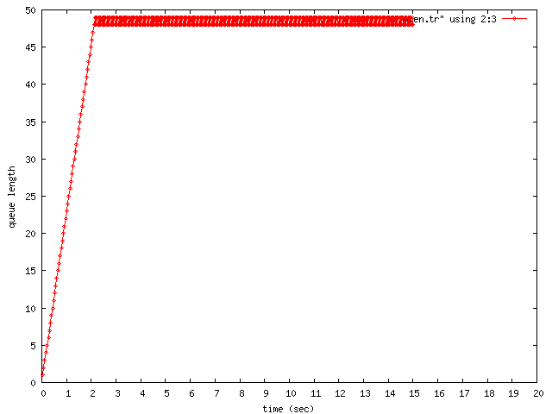
modified the test_transmission_range.tcl
set udp [new Agent/mUDP]
$udp set_filename sd
$udp set mynode_handle $node_(0)
$udp set mynode_id [$node_(0) id]
$ns attach-agent $node_(0) $udp
set null [new Agent/mUdpSink]
$null set_filename rd
$ns attach-agent $node_(1) $null
$ns connect $udp $null
set cbr [new Application/Traffic/CBR]
$cbr attach-agent $udp
$cbr set type_ CBR
$cbr set packet_size_ 1000
$cbr set rate_ 1Mb
$cbr set random_ false
$ns at 0.0 "$cbr start"
$ns at 15.0 "$cbr stop"
$ns at 1.0 "$udp ifqlen?"
$ns at 1.5 "$udp ifqlen?"
$ns at 2.0 "$udp ifqlen?"
$ns at 14.0 "$udp ifqlen?"
node-config
create-wireless-node
create-wireless-node
Starting Simulation...
NS EXITING...
num_nodes is set 2
channel.cc:sendUp - Calc highestAntennaZ_ and distCST_
highestAntennaZ_ = 1.5, distCST_ = 550.0
current interface queue length:22
current interface queue length:34
current interface queue length:45
current interface queue length:48

