Slide 1
ns-2 Tutorial
Kumar Viswanath & Ignacio Solis
UC Santa Cruz

Slide 2

What is NS
Discrete event simulator
Packet-level
Link layer and up
Wired and wireless

Slide 3
History and Status
Columbia NEST
UCB REAL
ns-1
ns-2
  100K lines of C++
  70K lines of OTcl
  30K lines of test suite
  20K lines of documentation

Slide 4
Platforms
Most UNIX and UNIX-like systems
  FreeBSD or *BSD
  Linux
  Sun Solaris
  HP, SGI
Window 95/98/NT
  Some work, some does not
(Emulation only for FreeBSD for now)

Slide 5

Related Research
Routing
  Unicast (DV, link state), multicast
intserv/diffserv
Transport
  TCP
  Congestion control
  Reliable multicast
Application
  Web caching
  Multimedia

Slide 6
Installation
Getting the piecesTcl/TK 8.x (8.0.5 preferred): http://dev.scriptics.com
  OTcl, TclCL, ns-2, nam-1: http://www.isi.edu/nsnam/dist
Other utilities
  http://www.isi.edu/nsnam/ns/ns-build.html
  Tcl-debug, GT-ITM, xgraph, 

Slide 7
Getting Help
ns-2 build questionshttp://www.isi.edu/nsnam/ns/ns-build.html
  ns-users@isi.edu (previously ns-users@mash.cs.berkeley.edu
)
  ns-users-request@isi.edu
  subscribe ns-users in body
  Archive: http://www.isi.edu/nsnam/ns

Slide 8
Resources
Tcl (Tool Command Language)
  http://dev.scriptics.com/scripting
OTcl (MIT Object Tcl)
  ~otcl/doc/tutorial.html (in distribution)
ns manual
  Included in distribution: ~ns/doc
  http://www.isi.edu/~salehi/ns_doc.ps.gz

Slide 9
ns Architecture
Object-oriented (C++, OTcl)
Scalability + Extensibility
  Control/data separation
  Split C++/OTcl object
Modular approach
  Fine-grained object composition

Slide 10

Object-Oriented
Reusability
Maintenance
Performance (speed and memory)
Careful planning of modularity

Slide 11
C++ and OTcl Separation
C++ for data
  Per packet action
OTcl for control
  Periodic or triggered action
Compromise between composibility and speed
Learning and debugging

Slide 12
OTcl and C++: The Duality
Pure C++
objects
Pure OTcl
objects
C++/OTcl split objects
C++
OTcl
ns

Slide 13
Elements of ns-2
Create the event scheduler
[Turn on tracing]
Create network
Setup routing
Insert errors
Create transport connection
Create traffic
Transmit application-level data

Slide 14
Creating Event Scheduler
Create event scheduler
  set ns [new Simulator]
Schedule events
  $ns at <time> <event>
  <event>: any legitimate ns/tcl commands
Start scheduler
  $ns run

Slide 15
Creating Network
Nodes
  set n0 [$ns node]
  set n1 [$ns node]
Links and queuing
  $ns duplex-link $n0 $n1 <bandwidth> <delay> <queue_type>
  <queue_type>: DropTail, RED, CBQ, FQ, SFQ, DRR

Slide 16
Creating Network: LAN
LAN
  $ns make-lan <node_list> <bandwidth> <delay> <ll_type> <ifq_type> <mac_type> <channel_type>
  <ll_type>: LL
  <ifq_type>: Queue/DropTail,
  <mac_type>: MAC/802_3
  <channel_type>: Channel

Slide 17
Inserting Errors
Creating Error Module
  set loss_module [new ErrorModel]
  $loss_module set rate_ 0.01
  $loss_module unit pkt
  $loss_module ranvar [new RandomVariable/Uniform]
  $loss_module drop-target [new Agent/Null]
Inserting Error Module
  $ns lossmodel $loss_module $n0 $n1

Slide 18
Setup Routing
Unicast
  $ns rtproto <type>
  <type>: Static, Session, DV, cost, multi-path
Multicast
  $ns multicast (right after [new Simulator])
  $ns mrtproto <type>
  <type>: CtrMcast, DM, ST, BST

Slide 19
Creating Connection: UDP
UDP
  set udp [new Agent/UDP]
  set null [new Agent/Null]
  $ns attach-agent $n0 $udp
  $ns attach-agent $n1 $null
  $ns connect $udp $null

Slide 20
Creating Traffic: On Top of UDP
CBR
  set src [new Application/Traffic/CBR]
Exponential or Pareto on-off
  set src [new Application/Traffic/Exponential]
  set src [new Application/Traffic/Pareto]

Slide 21
Creating Connection: TCP
TCP
  set tcp [new Agent/TCP]
  set tcpsink [new Agent/TCPSink]
  $ns attach-agent $n0 $tcp
  $ns attach-agent $n1 $tcpsink
  $ns connect $tcp $tcpsink

Slide 22
Creating Traffic: On Top of TCP
FTP
  set ftp [new Application/FTP]
  $ftp attach-agent $tcp
Telnet
  set telnet [new Application/Telnet]
  $telnet attach-agent $tcp

Slide 23
Application/TcpApp
Step 1: FullTcp connection
  set tcp1 [new Agent/TCP/FullTcp]
  set tcp2 [new Agent/TCP/FullTcp]
  $ns attach-agent $n1 $tcp1
  $ns attach-agent $n2 $tcp2
  $ns connect $tcp1 $tcp2
  $tcp2 listen

Slide 24
Summary: Generic Script Structure
set ns [new Simulator]
# [Turn on tracing]
# Create topology
# Setup packet loss, link dynamics
# Create routing agents
# Create:
# - multicast groups
# - protocol agents
# - application and/or setup traffic sources
# Post-processing procs
# Start simulation

Slide 25
ns  Wired World
Basic ns
A complete example
  Multicast routing
Visualization

Slide 26
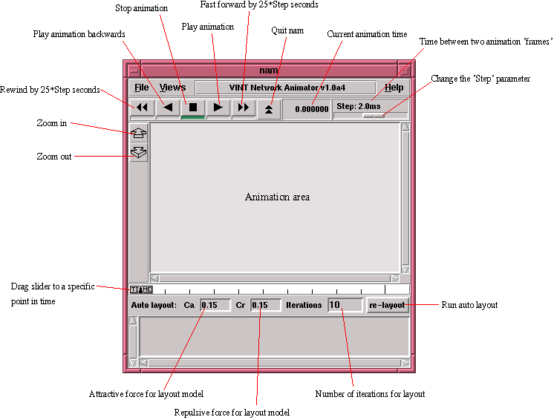
Sample Nam

Slide 27
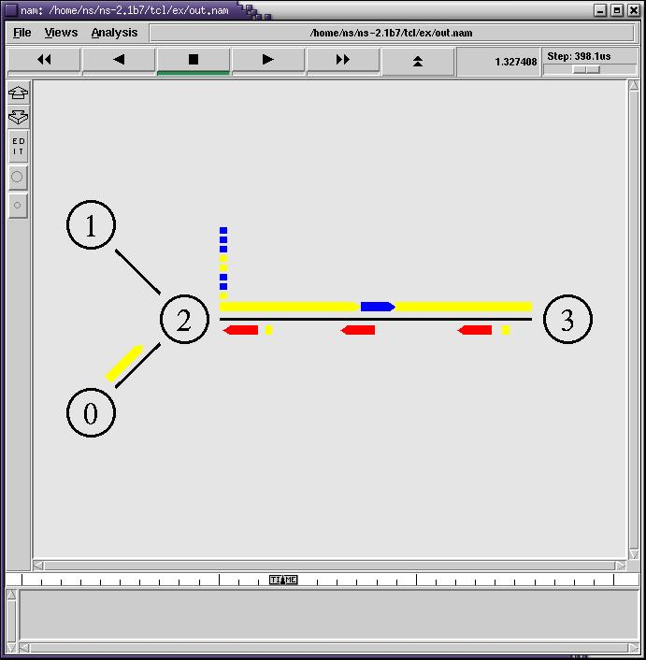
Nam Running (1)

Slide 28
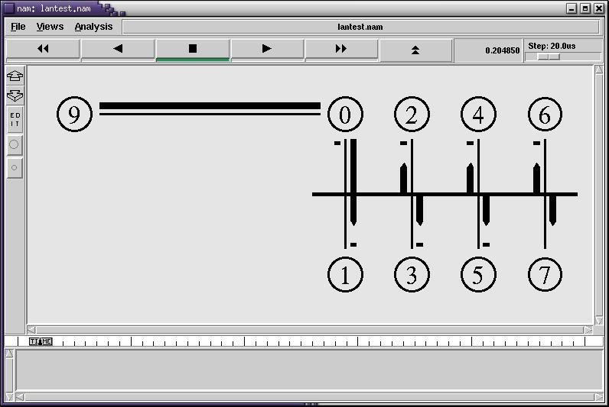
Nam Running (2)

Slide 29
Basic OTcl
Class Mom
Mom instproc greet {} {
$self instvar age_
puts “age_ years old mom: How are you doing?”
}
Class Kid -superclass Mom
Kid instproc greet {} {
$self instvar age_
puts “age_ years old kid: What’ up, dude?”
}
set mom [new Mom]
$mom set age_ 45
set kid [new Kid]
$kid set age_ 15
$mom greet
$kid greet

Slide 30
Example: Multicast Routing
Dynamic group membership under Dense Mode
time
1.2s
time
1.3s
time
1.35s
G1
G2
G2
G2
n2
1.5Mb, 10ms
time
1.25s
1.5Mb, 10ms
n0
n1
G1
1.5Mb, 10ms
G2
n3

Slide 31
Multicast: Step 1
Scheduler, tracing, and topology
# Create scheduler
set ns [new Simulator]
# Turn on multicast
$ns multicast
# Turn on Tracing
set fd [new “cast.nam” w]
$ns namtrace-all $fd

Slide 32
Multicast: Step 2
Topology
# Create nodes
set n0 [$ns node]
set n1 [$ns node]
set n2 [$ns node]
set n3 [$ns node]
# Create links
$ns duplex-link $n0 $n1 1.5Mb 10ms DropTail
$ns duplex-link $n0 $n2 1.5Mb 10ms DropTail
$ns duplex-link $n0 $n3 1.5Mb 10ms DropTail

Slide 33
Multicast: Step 3
Routing and group setup
# Routing protocol: let’ run distance vector
$ns mrtproto DM
# Allocate group addresses
set group1 [Node allocaddr]
set group2 [Node allocaddr]

Slide 34
Multicast: Step 4
Sender 0
# Transport agent for the traffic source
set udp0 [new Agent/UDP]
$ns attach-agent $n1 $udp0
$udp0 set dst_addr_ $group1
$udp0 set dst_port_ 0
# Constant Bit Rate source #0
set cbr0 [new Application/Traffic/CBR]
$cbr0 attach-agent $udp0
# Start at time 1.0 second
$ns at 1.0 "$cbr0 start"

Slide 35
Multicast: Step 5
Sender 1
# Transport agent for the traffic source
set udp1 [new Agent/UDP]
$ns attach-agent $n3 $udp1
$udp1 set dst_addr_ $group2
$udp1 set dst_port_ 0
# Constant Bit Rate source #0
set cbr1 [new Application/Traffic/CBR]
$cbr1 attach-agent $udp1
# Start at time 1.1 second
$ns at 1.1 "$cbr1 start"

Slide 36
Multicast: Step 6
Receiver with dynamic membership
# Can also be Agent/Null
set rcvr [new Agent/LossMonitor]
# Assign it to node $n2
$ns at 1.2 "$n2 join-group $rcvr $group2"
$ns at 1.25 "$n2 leave-group $rcvr $group2"
$ns at 1.3 "$n2 join-group $rcvr $group2"
$ns at 1.35 "$n2 join-group $rcvr $group1"

Slide 37
Multicast: Step 7
End-of-simulation wrapper (as usual)
$ns at 2.0 "finish"
proc finish {} {
global ns fd
close $fd
$ns flush-trace
puts "running nam..."
exec nam out.nam &
exit 0
}
$ns run

Slide 38
Other Examples
Available in the Lab this afternoon
Web traffic model
Multicast routing
RED
Queueing

Slide 39
ns  Wired World
Basic ns
Two examples
  TCP, multicast routing
Visualization

Slide 40
Visualization Tools
nam-1 (Network AniMator Version 1)
  Packet-level animation
  Well supported by ns
xgraph
  Conversion from ns trace to xgraph format

Slide 41
nam
Basic visualization
  Topology layout
  Animation control
  Synchronous replay
Fine-tune layout
TCP/SRM visualization
Editor: generate ns simulation scripts

Slide 42
nsnam Interface
Color
Node manipulation
Link manipulation
Topology layout
Protocol state
Misc

Slide 43
nam Interface: Color
Color mapping
  $ns color 40 red
  $ns color 41 blue
  $ns color 42 chocolate
Color ↔ flow id association
  $tcp0 set fid_ 40 ;# red packets
  $tcp1 set fid_ 41 ;# blue packets

Slide 44
nam Interface: Nodes
Color
  $node color red
Shape (cant be changed after sim starts)
  $node shape box ;# circle, box, hexagon
Marks (concentric shapes)
  $ns at 1.0 $n0 add-mark m0 blue box
  $ns at 2.0 $n0 delete-mark m0
Label (single string)
  $ns at 1.1 $n0 label \web cache 0\

Slide 45
nam Interfaces: Links
Color
  $ns duplex-link-op $n0 $n1 color "green"
Label
  $ns duplex-link-op $n0 $n1 label "abced"
Dynamics (automatically handled)
  $ns rtmodel Deterministic {2.0 0.9 0.1} $n0 $n1
Asymmetric links not allowed

Slide 46
nam Interface: Topo Layout
Manual layout: specify everything
  $ns duplex-link-op $n(0) $n(1) orient right
  $ns duplex-link-op $n(1) $n(2) orient right
  $ns duplex-link-op $n(2) $n(3) orient right
  $ns duplex-link-op $n(3) $n(4) orient 60deg
If anything missing  automatic layout

Slide 47
nam Interface: Protocol State
Monitor values of agent variables
  $ns add-agent-trace $srm0 srm_agent0
  $ns monitor-agent-trace $srm0
  $srm0 tracevar C1_
  $srm0 tracevar C2_
  #  
  $ns delete-agent-trace $tcp1

Slide 48
nam Interface: Misc
Annotation
  Add textual explaination to your sim
  $ns at 3.5 "$ns trace-annotate \packet drop\"
Set animation rate
  $ns at 0.0 "$ns set-animation-rate 0.1ms"

Slide 49
Multicast Example: nam-Enhanced
Packet coloring
Node color
Node label
Link label
Annotation
Manual layout
Queueing

Slide 50
Multicast: Step 1.1
Define nam color
# Colors for packets from two mcast groups
$ns color 10 blue
$ns color 11 red
# Prune packets (predefined)
$ns color 30 purple
# Graft packets
$ns color 31 green

Slide 51
Multicast: Step 2.1
Layout topology
# Manual layout: order of the link is significant!
$ns duplex-link-op $n0 $n1 orient right
$ns duplex-link-op $n0 $n2 orient right-up
$ns duplex-link-op $n0 $n3 orient right-down
# Show queue on simplex link n0->n1
$ns duplex-link-op $n0 $n1 queuePos 0.5

Slide 52
Multicast: Step 4.1, 5.1
Source coloring
# Group 0
$udp0 set fid_ 10
$n1 color blue
$n1 label Source for group 0
# Group 1
$udp1 set fid_ 11
$n3 color red
$n3 label Source for group 1

Slide 53
Multicast: Step 6.1
Receiver coloring
$n2 label Receiver
$ns at 1.2 "$n2 join-group $rcvr $group2; \
$n2 add-mark m0 red"
$ns at 1.25 "$n2 leave-group $rcvr $group2; \
$n2 delete-mark m0"
$ns at 1.3 "$n2 join-group $rcvr \ $group2; \
$n2 add-mark m1 red"
$ns at 1.35 "$n2 join-group $rcvr $group1; \
$n2 add-mark m2 blue"

Slide 54
Multicast: Step 7.1
One final tweak
# Animation was too fast...
$ns set-animation-rate 0.8ms

Slide 55
Outline
Overview
Worlds of ns Simulation
  Wired
  Wireless
  Emulation
Supporting Tools
Extending ns in OTcl

Slide 56
ns  Wireless World
Ad hoc routing
Mobile IP
Satellite networking

Slide 57
Ad Hoc Routing  An Example
Scenario
  3 mobile nodes
  moving within 670mX670m flat topology
  using DSDV ad hoc routing protocol
  Random Waypoint mobility model
  TCP and CBR traffic
ns-2/tcl/ex/wireless-demo-csci694.tcl

Slide 58
An Example  Step 1
# Define Global Variables
# create simulator
set ns [new Simulator]
# create a topology in a 670m x 670m area
set topo [new Topography]
$topo load_flatgrid 670 670

Slide 59
An Example  Step 2
# Define standard ns/nam trace
# ns trace
set tracefd [open demo.tr w]
$ns trace-all $tracefd
# nam trace
set namtrace [open demo.nam w]
$ns namtrace-all-wireless $namtrace 670 670

Slide 60
An Example  Step 3
# Create God
set god [create-god 3]
$ns at 900.00 $god setdist 2 3 1
God: store an array of the smallest number of hops required to reach one node to an other
Optimal case against which to compare routing protocol performance
Automatically generated by scenario file

Slide 61
An Example  Step 4
# Define how a mobile node should be created
$ns node-config \
-adhocRouting DSDV \
-llType LL \
-macType Mac/802_11 \
-ifqLen 50 \
-ifqType Queue/DropTail/PriQueue \
-antType Antenna/OmniAntenna \
-propInstance [new Propagation/TwoRayGround] \
-phyType Phy/WirelessPhy \
-channel [new Channel/WirelessChannel] \
-topoInstance $topo
-agentTrace ON \
-routerTrace OFF \
-macTrace OFF

Slide 62
An Example  Step 5
# Create a mobile node, attach it to the channel
set node(0) [$ns node]
# disable random motion
$node(0) random-motion 0
Use for loop to create 3 nodes:
for {set i < 0} {$i < 3} {incr i} {
set node($i) [$ns node]
}

Slide 63
An Example  Step 6
# Define node movement model
source movement-scenario-files
# Define traffic model
source traffic-scenario-files

Slide 64
Scenario Generator: Movement
Mobile Movement Generator
  setdest -n <num_of_nodes> -p pausetime -s <maxspeed> -t <simtime> -x <maxx> -y <maxy>
Random movement
  $node start
  Source: ns-2/indep-utils/cmu-scen-gen/setdest/

Slide 65
A Movement File
$node_(2) set Z_ 0.000000000000
$node_(2) set Y_ 199.373306816804
$node_(2) set X_ 591.256560093833
$node_(1) set Z_ 0.000000000000
$node_(1) set Y_ 345.357731779204
$node_(1) set X_ 257.046298323157
$node_(0) set Z_ 0.000000000000
$node_(0) set Y_ 239.438009831261
$node_(0) set X_ 83.364418416244
$ns_ at 50.000000000000 "$node_(2) setdest 369.463244915743 170.519203111152 3.371785899154"
$ns_ at 51.000000000000 "$node_(1) setdest 221.826585497093 80.855495003839 14.909259208114"
$ns_ at 33.000000000000 "$node_(0) setdest 89.663708107313 283.494644426442 19.153832288917"

Slide 66
Scenario Generator: Traffic
Generating traffic pattern files
  CBR traffic
  ns cbrgen.tcl [-type cbf|tcp] [-nn nodes] [-seed seed] [-mc connections] [-rate rate]
  TCP traffic
  ns tcpgen.tcl [-nn nodes] [-seed seed]
  Source: ns-2/indep-utils/cmu-scen-gen/

Slide 67
A Traffic Scenario
set udp_(0) [new Agent/UDP]
$ns_ attach-agent $node_(0) $udp_(0)
set null_(0) [new Agent/Null]
$ns_ attach-agent $node_(2) $null_(0)
set cbr_(0) [new Application/Traffic/CBR]
$cbr_(0) set packetSize_ 512
$cbr_(0) set interval_ 4.0
$cbr_(0) set random_ 1
$cbr_(0) set maxpkts_ 10000
$cbr_(0) attach-agent $udp_(0)
$ns_ connect $udp_(0) $null_(0)
$ns_ at 127.93667922166023 "$cbr_(0) start"
.

Slide 68
An Example  Step 7
# Define node initial position in nam
for {set i 0} {$i < 3 } { incr i} {
$ns initial_node_position $node($i) 20
}
# Tell ns/nam the simulation stop time
$ns at 200.0 $ns nam-end-wireless 200.0
$ns at 200.0 $ns halt
# Start your simulation
$ns run

Slide 69
Energy Extension
Node is energy-aware
Define node by adding new options:
$ns_ node-config \
–eergyModel EnergyModel
    -initialEnergy 100.0
    -txPower 0.6
    -rxPower 0.2

Slide 70
nam Visualization
Use nam to visualize:
  Mobile node position
  Mobile node moving direction and speed
  Energy consumption at nodes (color keyed)

Slide 71
nam Visualization
Replace
$ns namtrace-all $fd
with
$ns namtrace-all-wireless $fd
At the end of simulation, do
$ns nam-end-wireless [$ns now]
See an example:

Slide 72
Summary
Mac Layer: IEEE 802.11
Address Resolution Protocol (ARP)
Ad hoc routing protocols: DSDV, DSR,TORA, AODV
Radio Propagation Model
  Friss-space attenuation at near distances
  Two ray ground at far distances
Antenna: an omni-directional antenna having unity gain

Slide 73
Summary
Energy consumption model for sensor networks
Visualization of node movement, reachability, and energy
Validation test suites

Slide 74
A Brief on Satellite Networking
Developed by Tom Henderson (UCB)
Supported models
  Geostationary satellites: bent-pipe and processing-payload
  Low-Earth-Orbit satellites
Example: tcl/ex/sat-*.tcl
Much in-development

Slide 75
A Brief on MobileIP Support
Developed by Sun
  Require a different Node structure than the MobileNode
  Co-exists with wired world in ns
Standard MobileIP
  Home Agent, Foreign Agent, MobileHosts
Example
  ~ns/tcl/ex/wired-cum-wireless.tcl

Slide 76
Outline
Overview
Worlds of ns Simulation
  Wired
  Wireless
  Emulation
Supporting Tools
Extending ns in OTcl

Slide 77
ns  Emulation
Simulator  real network
  Inject received packets into simulation
  Emit packets on to live network
Usage
  Subject real implementations to controlled conditions in the simulator
  Subject simulations to real-world traffic
Currently only works on FreeBSD

Slide 78
Sample Environment
Proxy ARP for
Test Machine
DHCP for address/routing
Internet
Emulation
Machine
Test
Machine
web
server
browser

Slide 79
Emulation Machine
Scheduler/RealTime
Simulator
Agent/Tap
BPF
BPF
BPF
Network
objects
RAW IP
ns
Network/IP
Network/Pcap/Live
world
real network

Slide 80
Realtime Scheduler
Extended from Scheduler/List
Synchronizes simulation time to real time
Fails when simulation time falls behind
$ns use-scheduler RealTime

Slide 81
Network Objects
Abstraction of real traffic source/sink
Base class for various network types
  Opened read-only, write-only, or read-write
Raw IP and UDP/IP network object
  Send/receive raw IP packets or UDP/IP
  IP multicast support
Pcap network object
  Send/receive link-layer frames
  Use BPF/libpcap filtering language

Slide 82
Tap Agents
ns packets: to/from other nodes
Tap
agent
src
IP/UDP
packets
dst
IP
packet
payload

network
object
userdata
ns
real network
Notes:
Reason to use tap agents: incompatible ns/IP addressing
from real network: encapsulation
to real network: decapsulation

Slide 83
Emulation Modes
Protocol mode
  Simulator interpret/generate live traffic
  Existing agents: ICMP ECHO, ICMP Redirect, ARP, TCP NAT
Opaque mode
  Simulator does not interpret network data
  Operations: packet drop/reordering/delay

Slide 84
Protocol Mode: Ping Responder
Input tap
agent
n0
100Mb, 1000ms
real Ping
application
real
traffic
ICMP ECHO
responder
n2
100Mb, 1000ms
n1
Output tap
agent
ns

Slide 85
Ping: Step 1
Stage setup
# Create simulator
set ns [new Simulator]
$ns use-scheduler RealTime
# Emulator address
set me [exec hostname]
# Or an arbitrary one (may require ARP support)
# set me “0.11.12.13”

Slide 86
Ping: Step 2
Create I/O network objects
# Packet input
set bpf0 [new Network/Pcap/Live]
$bpf0 set promisc_ true
set nd0 [$bpf0 open readonly fxp0]
set filt “not ip host $me)”
$bpf0 filter $filt
# Packet output
set ipnet [new Network/IP]
$ipnet open writeonly

Slide 87
Ping: Step 3
Agents
# Input agent
set pfa [new Agent/Tap]
$pfa network $bpf0
# Output agent
set ipa [new Agent/Tap]
$ipa network $ipnet
# ICMP ECHO agent
set echoagent [new Agent/PingResponder]
Notes:
with simplification: we do not show how ARP cache is done, etc.

Slide 88
Ping: Step 4
Create network topology
set n0 [$ns node]
set n1 [$ns node]
set n2 [$ns node]
$ns simplex-link $n0 $n2 100Mb 1000ms DropTail
$ns simplex-link $n2 $n1 100Mb 1000ms DropTail
$ns attach-agent $n0 $pfa
$ns attach-agent $n1 $ipa
$ns attach-agent $n2 $echoagent
$ns simplex-connect $pfa $echoagent
$ns simplex-connect $ipa $echoagent

Slide 89
Ping: Step 5
Start
# Wait for ping to come in...
$ns run
Result
  2000.052ms ± 1.021ms

Slide 90
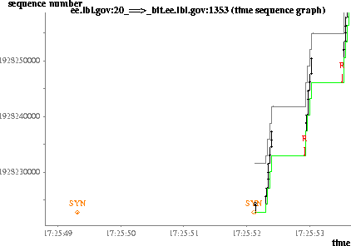
Opaque Mode (TCP: 10 packet periodic drop)
Lost
ACK of SYN+ACK
Dropped SYN
Retransmitted
SYN
Notes:
8Mb, 10ms links
win95 TCP
gray line: advertised window
green line: highest ack

Slide 91
More Examples
~ns/emulate
Example scripts
  Protocol mode: ~ns/emulate/empaper.tcl
  Opaque mode: ~ns/emulate/em3.tcl

Slide 92
Outline
Overview
Worlds of ns Simulation
  Wired
  Wireless
  Emulation
Supporting Tools
Extending ns in OTcl

Slide 93
ns  Supporting Tools
Tcl debugger
Topology generation
Scenario generation
Web cache trace converter

Slide 94
Debugging Your ns Script
tcl-debug 1.9
  http://expect.nist.gov/tcl-debug/
  Works with Tcl 8.0.4 and below
Installation
  [make distclean] in ns
  ./configure --with-tcldebug=<dir>
  make

Slide 95
Debugging Your ns Script
Using tcl-debug
  Insert debug 1 into your scripts, e.g.:
  set tcp [new Agent/TCP]
  debug 1
  $tcp set window_ 200
  When debug 1 is executed, ns drops to:
  vint/ns-2(121): ./ns t.tcl
  2: lappend auto_path $dbg_library
  dbg2.0>

Slide 96
Debugging Your ns Script
dbg2.0> h
s [#] step into procedure
n [#] step over procedure
N [#] step over procedures, commands, and arguments
c continue
r continue until return to caller
u [#] move scope up level
d [#] move scope down level
go to absolute frame if # is prefaced by "#"
w show stack ("where")
w -w [#] show/set width
w -c [0|1] show/set compress
b show breakpoints
b [-r regexp-pattern] [if expr] [then command]
b [-g glob-pattern] [if expr] [then command]
b [[file:]#] [if expr] [then command]
if pattern given, break if command resembles pattern
if # given, break on line #
if expr given, break if expr true
if command given, execute command at breakpoint
b -# delete breakpoint
b - delete all breakpoints

Slide 97
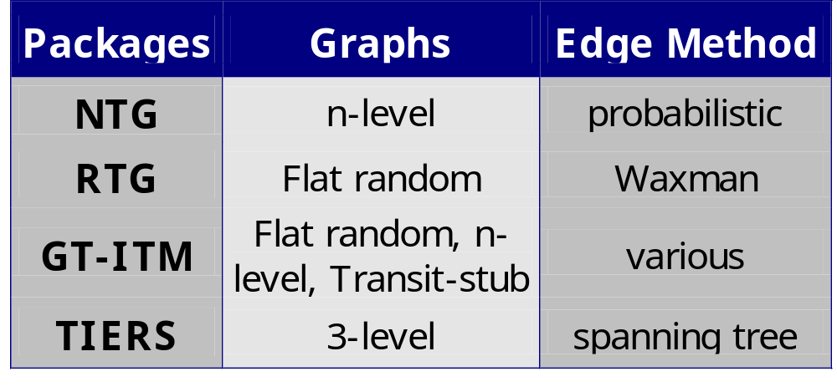
Topology Generation
http://www.isi.edu/nsnam/ns/ns-topogen.html

Slide 98
GT-ITM
Installation
  Comes with ns-allinone
  Require Knuths cweb and SGB
Usage
  itm <config_file>
Three graph models
  Flat random: Waxman
  n-level hierarchy
  Transit-stub

Slide 99
GT-ITM: Transit-Stub Model
transit
domains
transit-transit link
stub-stub link
stub
domains

Slide 100
GT-ITM: Example
Transit-stub network
Config file (e.g., ts1)
# <method keyword> <number of graphs> [<initial seed>]
# <# stubs/trans node> <#rand. t-s edges> <#rand. s-s edges>
# {<n> <scale> <edgemethod> <alpha> [<beta>] [<gamma>]}
# (average!) number of nodes = 1x2x(1+3x4) = 26
ts 10 47 # 10 graphs, init seed 47
3 0 0 # 2 stubs per transit nodes
1 20 3 1.0 # n. of transit domains (pure random)
2 20 3 0.5 # n. of nodes per transit domain
4 10 3 0.5 # n. nodes in each stub domain

Slide 101
GT-ITM: Example
Run
  itm ts1
  Result: ts1-{0-9}.gb
Result files in SGB format

Slide 102
Converters for GT-ITM
sgb2ns
  Convert SGB format to ns config file
  sgb2ns <SGB_file> <OTcl_file>
  ts2ns: output lists of transit and stub nodes
sgb2hier
  Convert transit-stub information into hierarchical addresses
  sgb2hierns <SGBFile> <TclFile>

Slide 103
Converters for GT-ITM
Format of generated ns config files
proc create-topology {nsns node linkBW} {
upvar $node n
upvar $nsns ns
# Create nodes, links,
......
}
Usage
  source <OTcl_file>
  create-topology ns nodes 1.5Mb

Slide 104
See Your Topology
Create an ns wrapper
# Assume you’e done “gb2ns ts1-0.gb ts1.tcl”
source ts1.tcl
set ns [new Simulator]
$ns namtrace-config [open ts1.nam w]
create-topology ns node 1.5Mb
$ns at 1.0 “xit 0”
$ns run

Slide 105
Outline
Overview
Worlds of ns Simulation
  Wired
  Wireless
  Emulation
Supporting Tools
Extending ns in OTcl

Slide 106
ns Directory Structure
ns-allinone
Tcl8.0
TK8.0
OTcl
tclcl
ns-2
nam-1
tcl
...
C++ code
ex
test
lib
mcast
...
examples
validation tests
OTcl code

Slide 107
Extending ns in OTcl
If you dont want to compile
  source your changes in your sim scripts
Otherwise
  Modifying code; recompile
  Adding new files
    Change Makefile (NS_TCL_LIB), tcl/lib/ns-lib.tcl
    Recompile

Slide 108
Example: Agent/Message
C
n2
n4
C
cross
traffic
128Kb, 50ms
n0
n1
10Mb, 1ms
10Mb, 1ms
S
n3
n5
R
msg agent

Slide 109
Agent/Message
pkt: 64 bytes
of arbitrary string
Receiver-side
processing
S
R
A UDP agent (without UDP header)
Up to 64 bytes user message
Good for fast prototyping a simple idea
Usage requires extending ns functionality

Slide 110
Agent/Message: Step 1
Define sender
class Sender –uperclass Agent/Message
# Message format: “ddr Op SeqNo”
Sender instproc send-next {} {
$self instvar seq_ agent_addr_
$self send “$gent_addr_ send $seq_”
incr seq_
global ns
$ns at [expr [$ns now]+0.1] "$self send-next"
}

Slide 111
Agent/Message: Step 2
Define sender packet processing
Sender instproc recv msg {
$self instvar agent_addr_
set sdr [lindex $msg 0]
set seq [lindex $msg 2]
puts "Sender gets ack $seq from $sdr"
}

Slide 112
Agent/Message: Step 3
Define receiver packet processing
Class Receiver –uperclass Agent/Message
Receiver instproc recv msg {
$self instvar agent_addr_
set sdr [lindex $msg 0]
set seq [lindex $msg 2]
puts “Rceiver gets seq $seq from $sdr”
$self send “$ddr_ ack $seq”
}

Slide 113
Agent/Message: Step 4
Scheduler and tracing
# Create scheduler
set ns [new Simulator]
# Turn on Tracing
set fd [new “essage.nam” w]
$ns namtrace-all $fd

Slide 114
Agent/Message: Step 5
Topology
for {set i 0} {$i < 6} {incr i} {
set n($i) [$ns node]
}
$ns duplex-link $n(0) $n(1) 128kb 50ms DropTail
$ns duplex-link $n(1) $n(4) 10Mb 1ms DropTail
$ns duplex-link $n(1) $n(5) 10Mb 1ms DropTail
$ns duplex-link $n(0) $n(2) 10Mb 1ms DropTail
$ns duplex-link $n(0) $n(3) 10Mb 1ms DropTail
$ns queue-limit $n(0) $n(1) 5
$ns queue-limit $n(1) $n(0) 5

Slide 115
Agent/Message: Step 6
Routing
# Packet loss produced by queueing
# Routing protocol: let’ run distance vector
$ns rtproto DV

Slide 116
Agent/Message: Step 7
Cross traffic
set udp0 [new Agent/UDP]
$ns attach-agent $n(2) $udp0
set null0 [new Agent/NULL]
$ns attach-agent $n(4) $null0
$ns connect $udp0 $null0
set exp0 [new Application/Traffic/Exponential]
$exp0 set rate_ 128k
$exp0 attach-agent $udp0
$ns at 1.0 “exp0 start”

Slide 117
Agent/Message: Step 8
Message agents
set sdr [new Sender]
$sdr set packetSize_ 1000
set rcvr [new Receiver]
$rcvr set packetSize_ 40
$ns attach $n(3) $sdr
$ns attach $n(5) $rcvr
$ns connect $sdr $rcvr
$ns connect $rcvr $sdr
$ns at 1.1 “sdr send-next”

Slide 118
Agent/Message: Step 9
End-of-simulation wrapper (as usual)
$ns at 2.0 finish
proc finish {} {
global ns fd
$ns flush-trace
close $fd
exit 0
}

Slide 119
Agent/Message: Result
Example output
> ./ns msg.tcl
Receiver gets seq 0 from 0
Sender gets ack 0 from 1
Receiver gets seq 1 from 0
Sender gets ack 1 from 1
Receiver gets seq 2 from 0
Sender gets ack 2 from 1
Receiver gets seq 3 from 0
Sender gets ack 3 from 1
Receiver gets seq 4 from 0
Sender gets ack 4 from 1
Receiver gets seq 5 from 0

Slide 120
Add Your Changes into ns
ns-allinone
Tcl8.0
TK8.0
OTcl
tclcl
ns-2
nam-1
tcl
...
C++ code
ex
test
mysrc
lib
mcast
...
examples
validation tests
msg.tcl
OTcl code

Slide 121
Add Your Change into ns
tcl/lib/ns-lib.tcl
Class Simulator
…
source ../mysrc/msg.tcl
Makefile
  NS_TCL_LIB = \
  tcl/mysrc/msg.tcl \
  …
  Or: change Makefile.in, make distclean, then ./configure --enable-debug
Notes:
- or change Makefile.in, make distclean, then

Slide 122
Recap
Overview
Worlds of ns Simulation
  Wired
  Wireless
  Emulation
Supporting Tools
Extending ns in OTcl

Slide 123
Further Information
ns-2 build questions
  http://www.isi.edu/nsnam/ns/ns-build.html
ns-users@isi.edu
  ns-users-request@isi.edu
  subscribe ns-users in body
  Search the mailing list archive at http://www.isi.edu/nsnam/ns

