Slide 1
A Style-Aware Architectural Middleware for Resource Constrained, Distributed Systems¹
IT821
Michael Thimblin
February 4, 2009
¹S. Malek, M. Mikic-Rakic, and N. Medvidovic. "A Style-Aware Architectural Middleware for Resource Constrained, Distributed Systems." IEEE Transactions on Software Engineering, vol. 31, no. 3, March 2005

Slide 2

Agenda
Motivation for the work
Discussion of the solution, Prism-MW
  Core
  Extensibility
  Using
  Highlights
Critique
Future areas of work

Slide 3
Motivation
New platforms for software systems
  Increase in portable, mobile, embedded, and pervasive environments
Transition from Programming-in-the-Large (PitL) to Programming-in-the-small-and-many (Prism)
Deal with problems associated with these new environments
  Mobility of hardware, data, and code
  Heterogeneous and distributed environments
  Constrained resources
    Power, memory, CPU, network bandwidth, etc.
  Dynamic reconfiguration of software
  Disconnected Operation

Slide 4
Motivation
Software architecture has been used to deal with the complexity of PitL systems and it is expected to help in Prism systems
  Models and guide-lines are used to describe a system
    Structure
    Behavior
    Key properties
Architectural models must be supported by implementation tools to be useful
  Not enough to just provide a model or guide-lines

Slide 5
Prism-MW
Middleware solution to support software architecture-based development in the Prism setting
  Implemented in Java JVM
  Subsets of the functionality have been implemented in Java KVM, C++, EVC++, Python, and Brew
  Core code is small <900 SLOC
Modular in design that employs extensive separation of concerns
Provides support for various architectural styles
  C2, Pipe-and-Filter, Client/Server, Publish/Subscribe

Slide 6
Prism-MW
Programming platform that supports the implementation of architectural-level concepts
  Components, connectors, configuration, and events
Imposes minimal overhead during application execution
  Limited resources are typical in the Prism environment
Provides scalability
  Handle large number of system components
Provides extensibility
  Handle multiple architectural styles
  Handle other development concerns
    Awareness, mobility, dynamic reconfigurability, security, real-time support, and delivery guarantees

Slide 7
Support for Architectural Styles
Ability to distinguish between different architectural elements
Ability to specify stylistic behavior of the architectural elements
Ability to specify rules and constraints for the behavior of the architectural elements
Ability to use multiple architectural styles in an application

Slide 8
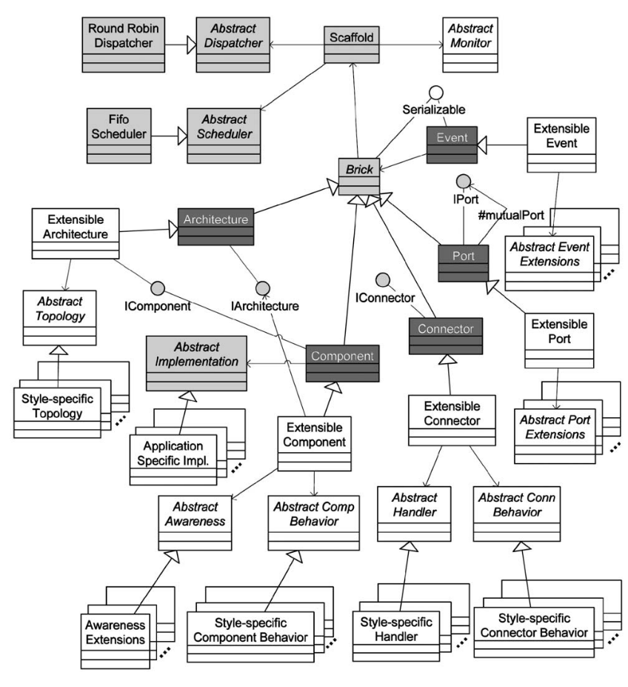
Prism-MW Core
Event
  Used to capture communication between components
Port
  Interaction points between system objects
  Request/reply
Connector
  Interaction mechanism (via ports)
  Used to control routing of Events
Component
  Perform computations
  Implements business logic
Architecture
  Records configuration of system objects
Scaffold
  Schedules and queues events for delivery

Slide 9
Prism-MW Extensibility
Provides support through subclasses of core
  ExtensitbleComponent
  ExtensibleConnector
  ExtensibleArchitecture
  ExtensiblePort
  ExtensibleEvent
Each subclass has associated abstract classes, for example:
  AbstractCompBehavior
  AbstractTopology

Slide 10
Key Functionality of Prism-MW
Distribution
  Support for communication of components across the network
Communication Properties
  Support for specialized interaction between components
  Security, delivery guarantees, data conversion
Awareness (i.e., reflection)
  Support for metalevel components
  Observe and/or facilitate execution of application-level components
Deployment and Mobility
  Provides support for component migration
  Stateless and stateful
Disconnected Operation
  Support for component operation when the network is unavailable

Slide 11


Using Prism-MW
C2 Architecture Example
Comp A
Comp B
class DemoArch {
static public void main(String argv[]) {
ExtensibleArchitecture arch = StyleFactory.generateArchitecture (“Ex“, “C2”);
// create components
Component a = new CompA ("A");
Component b = new CompB ("B");
Component c = new CompC (“C");
// create connectors
Connector d = new Connector(“D");
// add components and connectors
arch.addComponent(a);
arch.addComponent(b);
arch.addComponent(c);
arch.addConnector(d);
// establish the interconnections
arch.weld(a, d);
arch.weld(b, d);
arch.weld(d, c);
}
}
Connector D
Comp C
Comp A
Comp B
Comp C
Connector D

Slide 12
Using Prism-MW
C2 Architecture Example
//Component C sends an event
Event e = new Event ("Event_C“, REQUEST);
e.addParameter("param_1", p1);
send (e);
Comp A
Comp B
Connector D
//Component B handles the event and sends a //response
public void handle(Event e)
{
if (e.equals("Event_C")) {
...
Event e1= new Event("RSP_to_C“, REPLY);
e1.addParameter("response", resp);
send(e1);
}...
}
Comp C

Slide 13
Highlights of Prism-MW
Through the use of extensions to the core implementation Prism-MW provides support for some of the challenges developers face in Prism systems
  Distribution, communication properties, awareness, deployment and mobility
  Disconnected Operation
Provides separation of computation from interaction
  Components handle computation
  Ports and connectors handle interaction
Style support allows developers to focus on application specific logic
Implementation specific requirements can be easily accommodated through the use of the abstract classes and interfaces

Slide 14
Critique
Paper describes the design of a solution that involved about 10 years of work
Paper provides a good description of the problem and how their solution addresses each concern
Provides implementation examples of how Prism-MW has been used
Provides performance data
Includes a good summary of related work and how their work fills the current gaps in research
Lists areas of future work
  Configuration management
  Automatic generation of an optimized version of the middleware

Slide 15
Future Areas of Work
The paper does not discuss some potential problems in regards to component migration
  The state of the component (e.g., active, idle)
  Does not consider the dependency of the system’s software components
    The “ripple effects” of changing a software component (e.g., the impact on another component that is communicating with, or relying on, the changed component)
  Does not provide a dependable way to move migrate the components to a new piece of hardware
  Transaction integrity
    Does not identify a mechanism for determining what components are involved in a transaction

Slide 16
Future Areas of Work
Dynamically adapt software systems at runtime
Provide adaptation with minimal interruption to system
Application developer responsible for maintaining system integrity
Not all requirements and conditions can be accounted for during design and development
  Security concerns, upgrade feature set, provide better QoS
The changes in the system need to occur in a coordinated manner
Use the system’s architectural style to determine a sequence of changes that need to occur for safe and sound adaptation
  Prism-MW can provide a platform for this work

Slide 17


