Slide 1
Prism-MW Tutorial

Slide 2
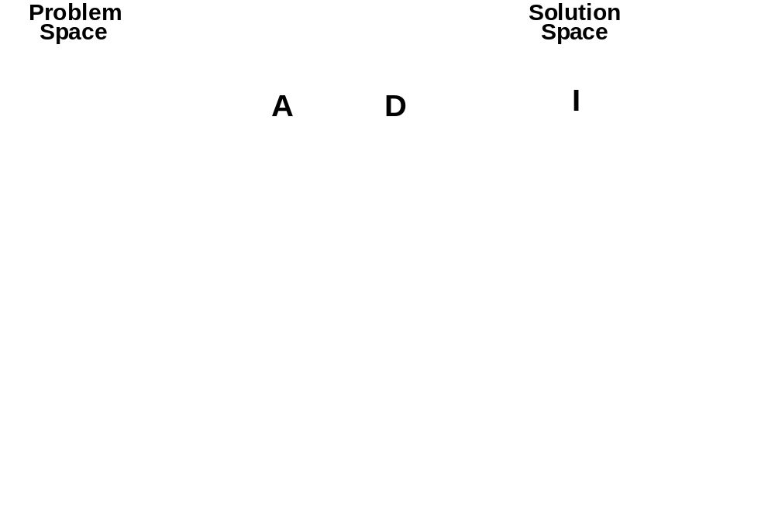
From Architecture to Design

Slide 3

From Architecture to Implementation

Slide 4
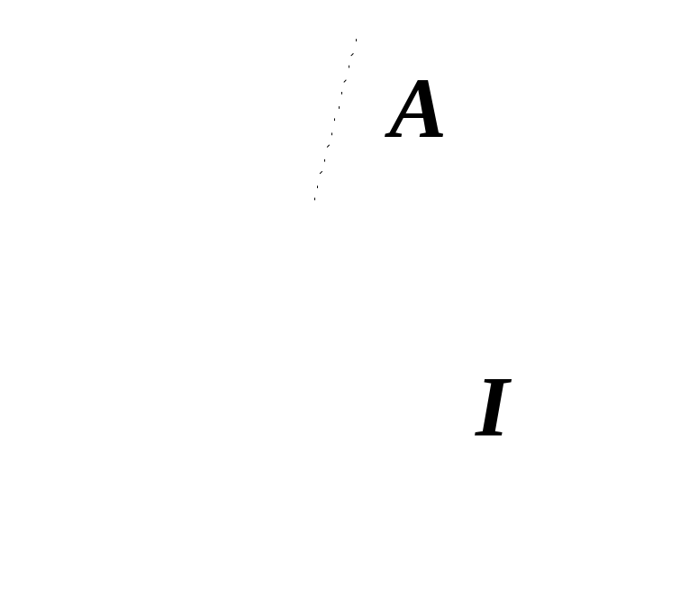
Mapping Architecture to Implementation
Infeasible in general
  Reduces to transformational programming
Possible by limiting target space
  Middleware platforms
  Software bus technologies

Slide 5
Relating Architecture and Implementation
Architectures provide high-level concepts
  Components, connectors, ports, events, configurations
Programming languages provide low-level constructs
  Variables, arrays, pointers, procedures, objects
Bridging the two often is an art-form
  Middleware can help “split the difference”
Existing middleware technologies
  Support some architectural concepts (e.g., components, events)
  but not others (e.g., configurations)
  Impose particular architectural styles
End result ➔ architectural erosion
  Architecture does not match the implementation
What is needed is “architectural middleware”

Slide 6
The Mapping Problem
Components → ?
  classes, packages, modules, …
Connectors → ?
  software buses, middleware; what else?
Interfaces → ?
  API signatures; what about protocols?
Configurations → ?
  interfaces, function pointers, reflection
Design rationale → ?
  comments, documentation
Behavior → ?
  how do we translate FSP, StateCharts, Z, etc. to code?
NFPs → ?
  indirectly via rationale, inspections, testing, user studies, …

Slide 7
Architectural Middleware
Natively support architectural concepts as middleware constructs
Include system design support
  Typically via an accompanying ADL and analysis tools
Support round-trip development
  From architecture to implementation and back
Support automated transformation of architectural models to implementations
  i.e., dependable implementation
Examples
  ArchJava
  Aura
  c2.framework
  Prism-MW

Slide 8
What Matters in an Architectural Framework
Matching assumptions
Fidelity
Platform support
Efficiency
… anything else?

Slide 9
Prism-MW
Architectural middleware for distributed, resource constrained, mobile, and embedded systems
Supports architecture-based software development
  Architecture-based software development is the implementation of a software system in terms of its architectural elements
Efficient
Scalable
Flexible and Extensible
  Allows us to cope with heterogeneity
Supports arbitrarily complex architectures
Supports multiple architectural styles

Slide 10
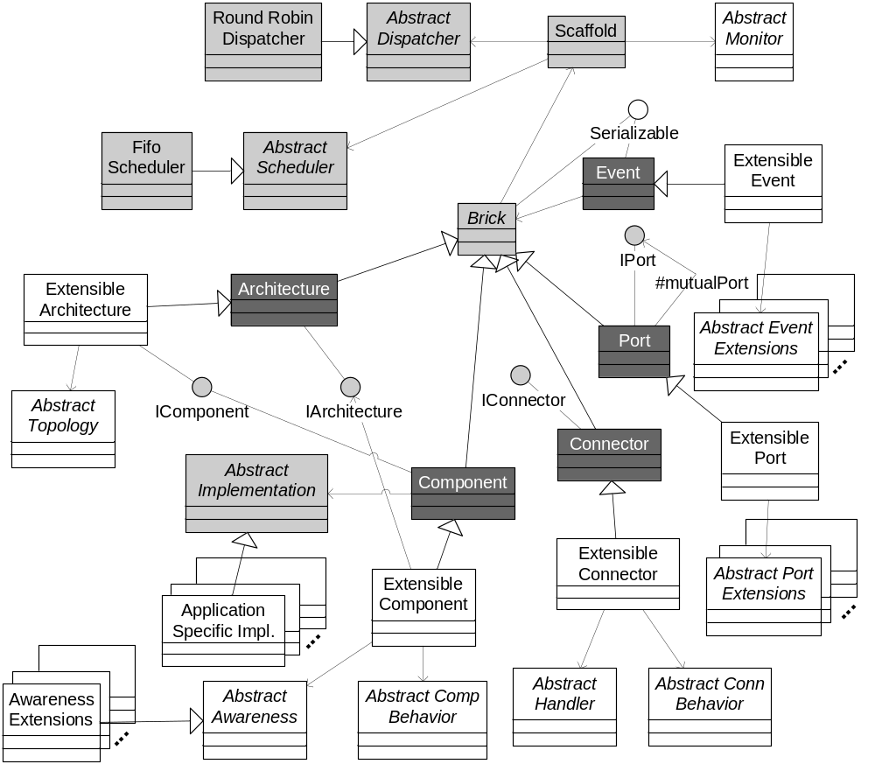
Prism-MW

Slide 11
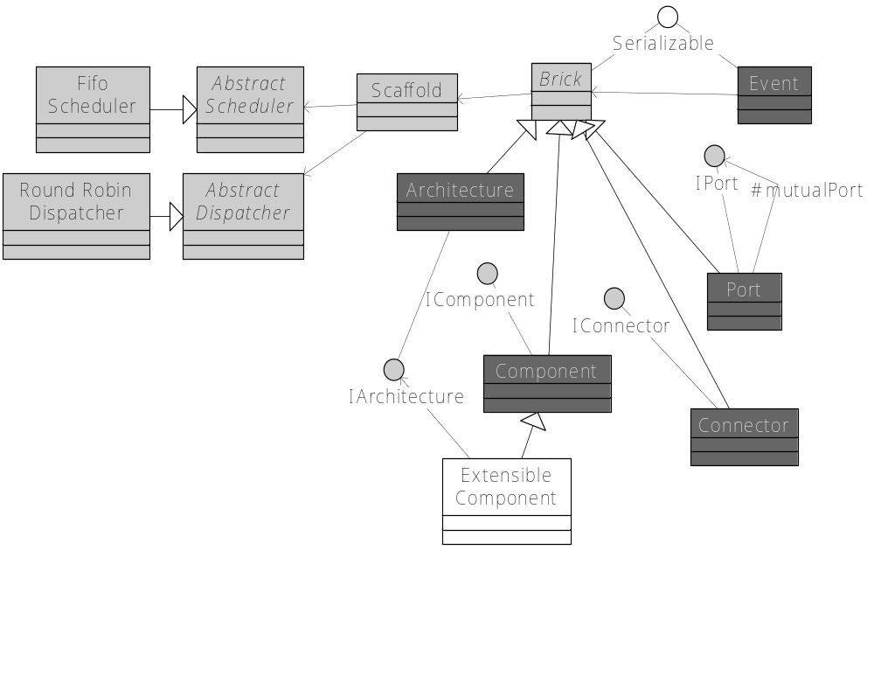
Prism-MW

Slide 12
Using Prism-MW
class DemoArch {
static public void main(String argv[]) {
Architecture arch = new Architecture ("DEMO");
Architecture - DEMO
Component A
Component B
// create components
ComponentA a = new ComponentA ("A");
ComponentB b = new ComponentB ("B");
ComponentD d = new ComponentD ("D");
Connector C
// create connectors
Connector conn = new Connector("C");
C
// add components and connectors
arch.addComponent(a);
arch.addComponent(b);
arch.addComponent(d);
arch.addConnector(conn);
Component D
// establish the interconnections
arch.weld(a, conn);
arch.weld(b, conn);
arch.weld(conn, d)
}
}
Connector C
Component A
Component B
Component D
C

Slide 13
Using Prism-MW
Component D sends an event
Event e = new Event ("Event_D");
e.addParameter("param_1", p1);
send (e);
Architecture - DEMO
Send (e1)
Component A
Component B
Component B handles the event and sends a response
public void handle(Event e)
{
if (e.equals("Event_D")) {
...
Event e1= new Event("Response_to_D");
e1.addParameter("response", resp);
send(e1);
}...
}
Connector C
C
Send (e)
Component D

Slide 14
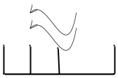
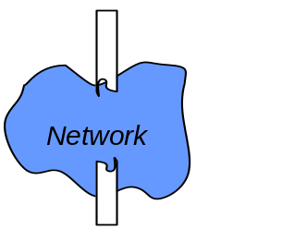
Event Dispatching
Scaffold
Thread Pool
Adaptation of an existing worker thread pool technique
  Topology based routing
  Single event queue for both locally and remotely generated events
  Easy redeployment and redistribution of applications onto different hardware configurations
E₂
Component
A
Component B
Component
B
handle Event
E
2
Connector
C
X
X
E
E
E
E
E
E
1
2
3
4
5
send Event
Component
D
E
Notes:
Role of connectors in mobility

Slide 15
Prism-MW Performance
Efficiency
  1750 SLOC
  4600 B for the core
  160 B per component
  240 B per connector
  70 B per weld
  160 B per event
  240 B per event parameter
…
100 001 components
100 000 connectors
Total event roundtrip time 2.7 sec
Scalability
Numbers of devices, threads and events
not limited by Prism-MW
Numbers of components and connectors
available_memory – middleware_size
average_element_size

Slide 16
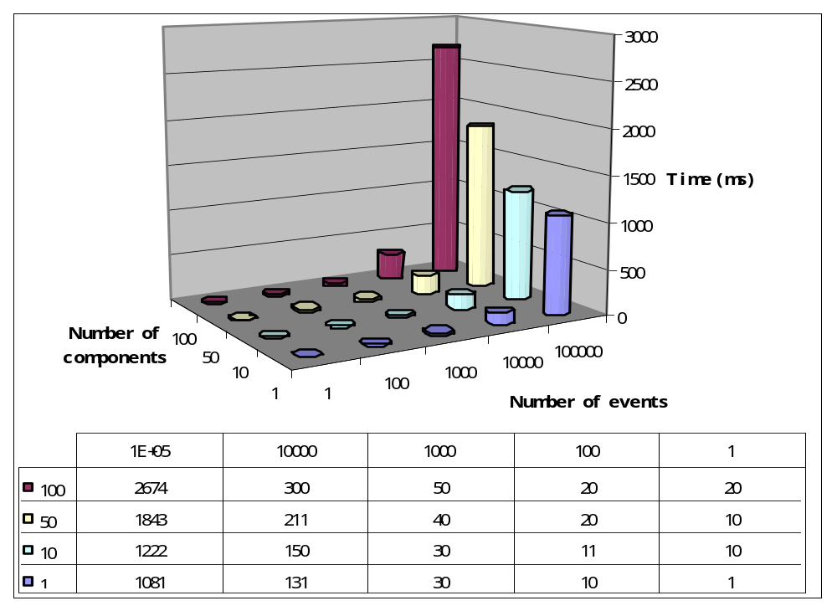
Prism-MW Benchmarks on a PC

Slide 17
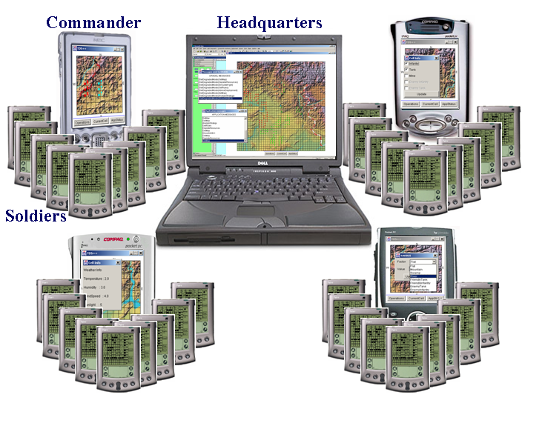
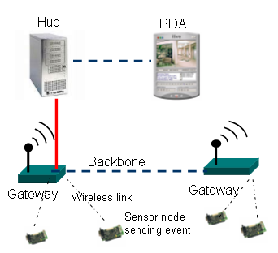
Prism-MW has been adopted by several industry partners
Troops Deployment Simulation
US Army
MIDAS
Bosch Research and Technology Center

Slide 18
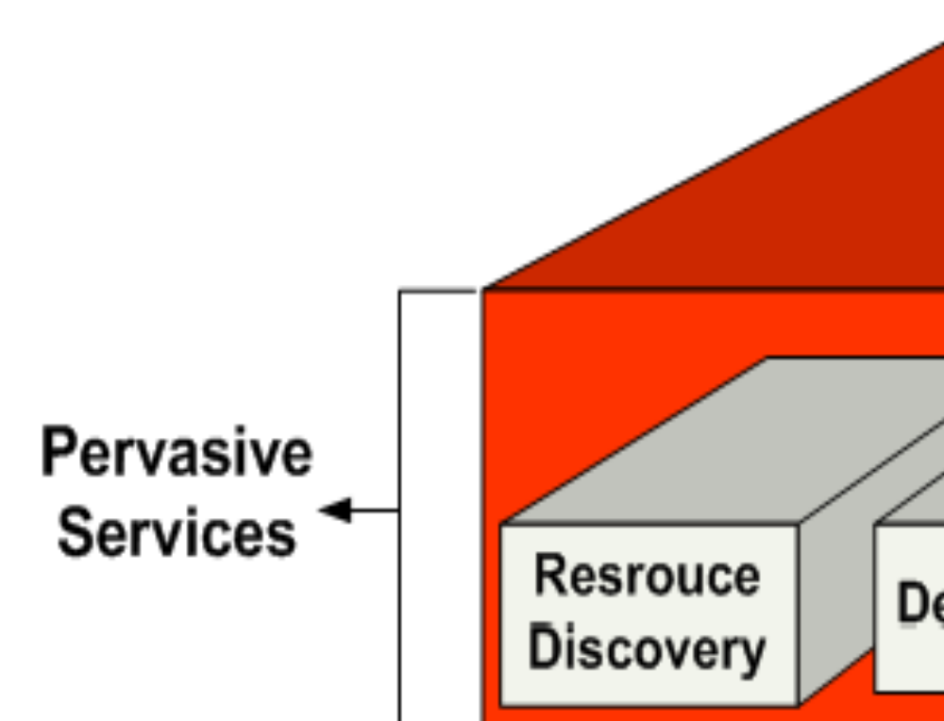
Recent Progress

Slide 19
Obtaining Prism-MW Lite
Download Prism-MW Lite from
http://sunset.usc.edu/~softarch/Prism/code/PrismMW-Lite.zip
Compile and develop your code on top of it
Alternatively, you could download Prism-MW Jar file and set the appropriate class paths
The easiest way to compile the source code is to use Eclipse
  You can download the eclipse from: http://www.eclipse.org/
  Create a Java project and import the source code
  Eclipse will automatically compile the code for you

Slide 20
Package Structure
Prism
  Benchmark
  Core
  Exception
  Extensions
    Architecture
    Component
    Connector
    Evt
    Port
  Style
  Test
    Core
    Extensible_port
    real_time
    Style
Packages you would need to be familiar with

Slide 21
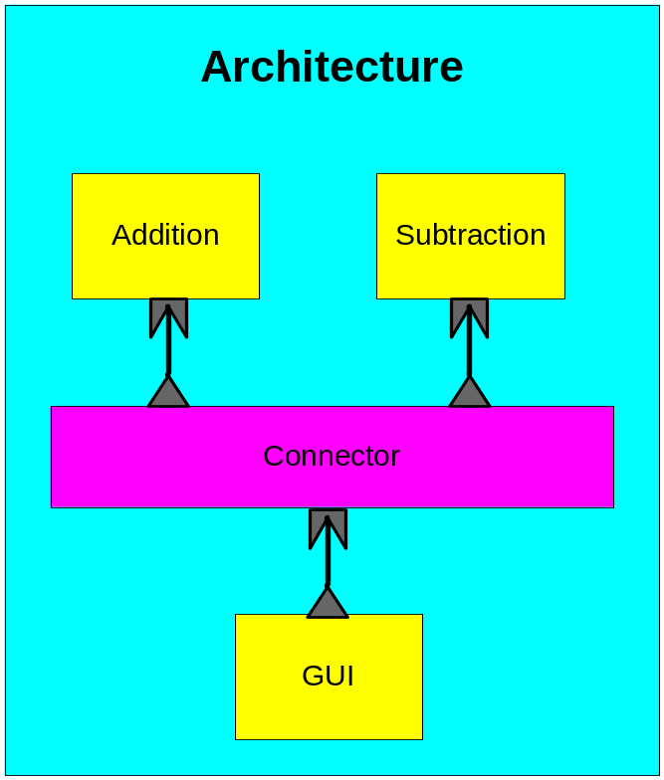
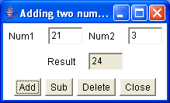
Simple Calculator

Slide 22
Simple Calculator – Single Address Space 1/2
package Prism.test.core;
/* import statements removed for brevity */
class testArchLocally {
static public void main(String argv[]) {
// Create an architecture for the calculator.
Architecture calculatorArchitecture = new Architecture();
// Create the GUI component.
Component guiComponent = new Component();
guiComponent.setImplementation(new GUI());
// Add a port to the GUI for sending requests.
Port guiRequestPort = new Port(PrismConstants.REQUEST);
guiComponent.addPort(guiRequestPort);
// Add the GUI to the calculator architecture.
calculatorArchitecture.add(guiComponent);
// Create the subtraction component.
Component subtractComponent = new Component();
subtractComponent.setImplementation(new Subtract());
// Add a port to the subtraction component for receiving requests.
Port subReplyPort = new Port(PrismConstants.REPLY);
subtractComponent.addPort(subReplyPort);
// Add the subtraction component to the calculator architecture.
calculatorArchitecture.add(subtractComponent);

Slide 23
Simple Calculator – Single Address Space 2/2
// Create the addition component.
Component additionComponent = new Component();
additionComponent.setImplementation(new Addition());
// Add a port to the addition component for receiving requests.
Port addReplyPort = new Port(PrismConstants.REPLY);
additionComponent.addPort(addReplyPort);
// Add the addition component to the calculator architecture.
calculatorArchitecture.add(additionComponent);
// Create a connector for the calculator.
Connector connector = new Connector();
// Add a port to the connector for receiving requests.
Port connectorReplyPort1 = new Port(PrismConstants.REPLY);
connector.addPort(connectorReplyPort1);
calculatorArchitecture.weld(guiRequestPort, connectorReplyPort1);
// Add a port to the connector for forwarding requests to the
// subtraction component.
Port connectorRequestPort1 = new Port(PrismConstants.REQUEST);
connector.addPort(connectorRequestPort1);
calculatorArchitecture.weld(subReplyPort, connectorRequestPort1);
// Add a port to the connector for forwarding requests to the addition
// component.
Port connectorRequestPort2 = new Port(PrismConstants.REQUEST);
connector.addPort(connectorRequestPort2);
calculatorArchitecture.weld(addReplyPort, connectorRequestPort2);
calculatorArchitecture.start();
}
}

Slide 24
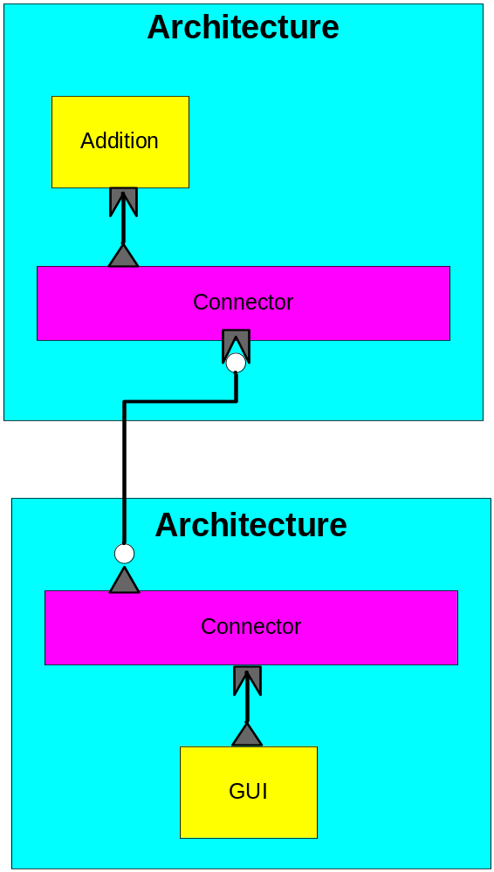
Simple Calculator – Distributed

Slide 25
Client Side – GUI Component 1/2
package Prism.test.extensible_port;
/* import statements removed for brevity */
public class testClientWithExtensiblePort
{
public static void main(String argv[])
{
String hostName = "localhost";
int portNum = 2601;
// Create an architecture for the calculator client.
Architecture clientArchitecture = new Architecture();
// Create the GUI component.
Component guiComponent = new Component();
guiComponent.setImplementation(new GUI());
// Add a port to the GUI for sending requests.
Port guiRequestPort = new Port(PrismConstants.REQUEST);
guiComponent.addPort(guiRequestPort);
// Add the GUI to the calculator architecture.
clientArchitecture.add(guiComponent);
// Create a connector for the calculator client.
Connector clientConnector = new Connector();
// Add a port to the connector for receiving requests.
Port connReplyPort = new Port(PrismConstants.REPLY);
clientConnector.addPort(connReplyPort);
// Add a port to the connector for forwarding requests to the calculator server.
ExtensiblePort connRequestPort = new ExtensiblePort (PrismConstants.REQUEST);
connRequestPort.addDistribution(new SocketDistribution());
clientConnector.addPort(connRequestPort);

Slide 26
Client Side – GUI Component 2/2
// Add the client connector to the calculator architecture.
clientArchitecture.add(clientConnector);
// Weld the GUI request port to the connector reply port.
clientArchitecture.weld(guiRequestPort, connReplyPort);
// Start the architecture.
clientArchitecture.start();
// Connect the connector request port to the calculator server.
connRequestPort.connect(hostName, portNum);
}
}

Slide 27
Server Side – Addition Component 1/2
package Prism.test.extensible_port;
/* import statements removed for brevity */
public class testServerWithExtensiblePort {
public static void main(String argv[]) {
int portNum = 2601;
// Create an architecture for the calculator server.
Architecture serverArchitecture = new Architecture();
// Create the Addition component.
Component additionComponent = new Component();
additionComponent.setImplementation(new Addition());
// Add a port to the Addition for receiving requests.
Port additionReplyPort = new Port(PrismConstants.REPLY);
additionComponent.addPort(additionReplyPort);
// Add the Addition to the calculator architecture.
serverArchitecture.add(additionComponent);
// Create a connector for the calculator server.
Connector serverConnector = new Connector();
// Add a port to the connector for forwarding requests.
Port connRequestPort = new Port(PrismConstants.REQUEST);
serverConnector.addPort(connRequestPort);

Slide 28
Server Side – Addition Component 2/2
// Add a port to the connector for receiving requests from the
// calculator client.
ExtensiblePort connReplyPort = new ExtensiblePort(PrismConstants.REPLY);
connReplyPort.addDistribution(new SocketDistribution(portNum));
serverConnector.addPort(connReplyPort);
// Add the server connector to the calculator architecture.
serverArchitecture.add(serverConnector);
// Weld the Addition reply port to the connector request port.
serverArchitecture.weld(additionReplyPort, connRequestPort);
// Start the architecture.
serverArchitecture.start();
}
}

