Slide 1
A Gentle Introduction to Machine Learning with F#

Slide 2

Hello :)
Mathias Brandewinder
@brandewinder

Slide 3
You?
Who is…
.NET developer
F# developer
Functional, from other tribes
Data science / machine learning
Let’s say hi to each other!
Find one person around you who you don’t know, and introduce yourself

Slide 4
This workshop
Functional Programming is a huge topic
Machine Learning is a huge topic
Half a day isn’t much time…

Slide 5
Expectations
Mostly beginners in both F# & Machine Learning

Slide 6
Hands-on learning
Hacking on real-world problem
Get a feel for what it is to “do machine learning”
Learn some simple, core ideas that can be extended
Avoid jumping into libraries & frameworks
Get familiar with F# and functional ideas

Slide 7
What is machine learning?
Writing a program to perform a task
With more information, the program performs the task better
Without having to change the code

Slide 8
A couple of comments
Relevant to developers
Similar and different from “regular coding”
Less complicated than it seems

Slide 9
Areas of machine learning
Classification vs. Regression
Predict what class it belong to (ex: Spam, not Spam)
Predict a number (ex: price)
Supervised vs. Unsupervised
Unsupervised: tell me something about my data
Online learning
Learning all the time, as data comes in

Slide 10
The plan
Digit Recognizer (Classification)
Demo / solution
Demo / additional tools
Scaling with mbrace.io
Working with data using Type Providers

Slide 11
Logistics
09:00 – 10:30 Workshop (1st part)
10:30 – 11:00 Break
11:00 – 13:00 Workshop (2nd part)

Slide 12
Questions?

Slide 13
Digit Recognizer

Slide 14
Highlights
Machine learning
Classification
Validation
Functional / F#
Working with scripts
Map, don’t iterate
Pipelines

Slide 15
Kaggle Digit Recognizer contest
http://www.kaggle.com/c/digit-recognizer
Dataset of hand-written digits
Goal = automatically recognize digits
Training sample = 50,000 examples
Contest = predict 20,000 “unknown” digits

Slide 16
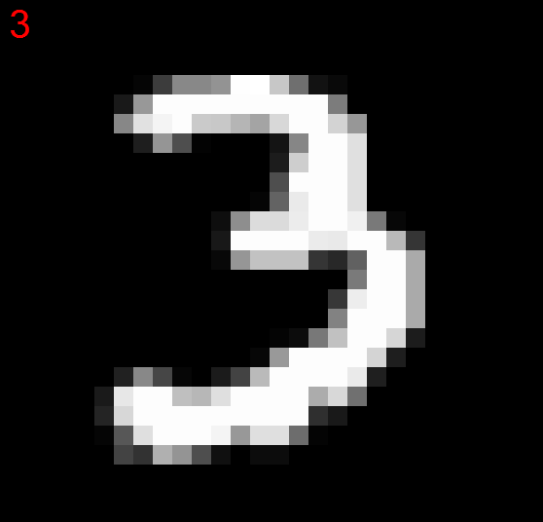
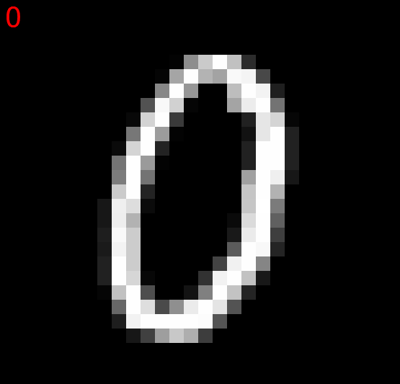
The data “looks like that”

Slide 17
Real sample
28 x 28 pixels
Grayscale (0 = black, to 255 = white)
Flattened: each record = Number + 784 pixels
CSV file
Reduced dataset: 5,000 training, 500 validation

Slide 18
Illustration (simplified 4x4 data)
1,0,0,255,0,0,255,255,0,0,0,255,0,0,0,255,0
Actual number
Each pixel, encoded from 0 to 255

Slide 19
What’s a classifier?
“Give me an unknown data point and I will predict what class it belongs to”
In this case, classes = 0, 1, 2, … 9
Unknown data point = scanned digit, without the class it belongs to

Slide 20
The KNN Classifier
KNN = K Nearest Neighbors
Given an unknown subject to classify,
Lookup all the known examples,
Find the K closest examples,
Take a majority vote,
Predict what the majority says

Slide 21
Illustration: 1-nearest neighbor
Sample
Unknown
0
?
1
Which element in the Sample
is the most similar / closest to
the Unknown item we want to
classify?

Slide 22
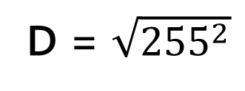
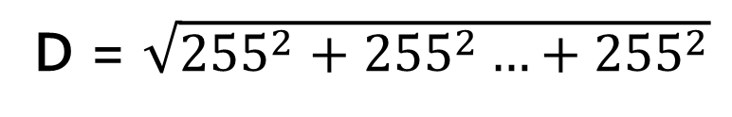
Illustration: 1-nearest neighbor (2)
D = $\sqrt{{255}^{2}+{255}^{2}…+{255}^{2}}$
D = $\sqrt{{255}^{2}}$
We compute the distance between
each element of the Sample, and
the Item we try to classify
Compare images,
pixel by pixel

Slide 23
Illustration: 1-nearest neighbor (3)
The second example is closest,
therefore we predict that the
unknown Item has the same label,
and is a 1
0
1

Slide 24
Questions so far?

Slide 25
Let’s get coding!

Slide 26
Conclusion

Slide 27
What did we see?
Scripts
Map, map, map
Function composition, pipe-forward |>
Records

Slide 28
Methodology
Establish a baseline with test/train, iterate
Create a simple, working model first
Next: good enough, faster, more accurate?
Distance is crucial

Slide 29
But… this is pretty dumb!
There is no “learning”
Still fits the definition of Machine Learning

Slide 30
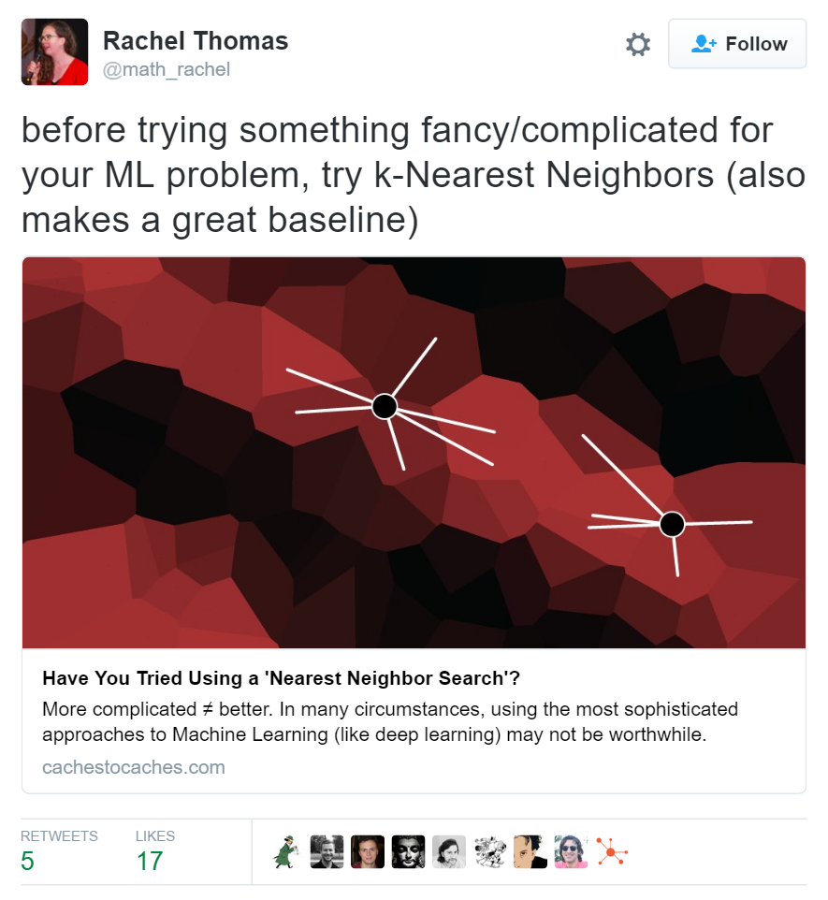

Slide 31
But… this won’t scale!
KNN doesn’t scale well
Data processing doesn’t scale well
Can we use scripts at scale?

Slide 32
List.map
Transform a list into another list
Ex: squares of [1;2;3;4;5]
Procedural style: iterate
for (i = 1; i <= 5; i++) { transform[i] = data[i]*data[i] }
Functional style: apply a function
[1;2;3;4;5] |> List.map (x * x)

Slide 33
Illustration
1
2
3
4
5
f(x) = x²
1
4
9
16
25

Slide 34
Why is this interesting?
1
2
3
4
5
f(x) = x²
1
4
9
16
25

Slide 35

Demo: mbrace.io

Slide 36
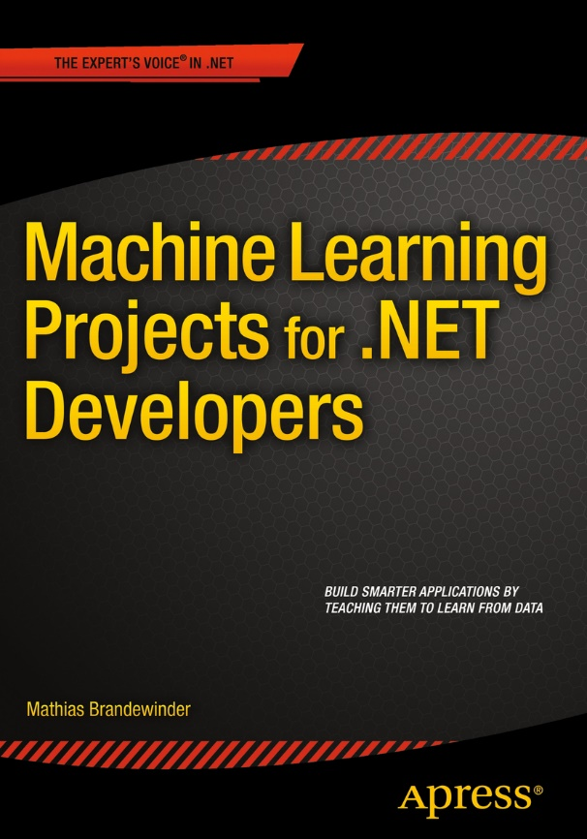
Thank you!
Hope this gave you a taste for ML and F#
Ping me:
@brandewinder
www.brandewinder.com
mathias.brandewinder@gmail.com

