Slide 1
IMB capstone project
Opening a new Russian restaurant in Chicago
By: Denis Mamedov
Oct, 2019

Slide 2
Business case
Make a decision where to open new restaurant in Chicago
Analyze and pick best areas in Chicago for new restaurant

Slide 3
Data
REQUIREMENTS
1) List of Chicago areas and communities
2) Coordinates for each area in Chicago
3) Restaurant data
SOURSE
1) https://en.wikipedia.org/wiki/List_of_neighborhoods_in_Chicago
2) Geocoder
3) Foursquare

Slide 4
methodology
Use bf4 to extract data from web
Get latitude and longitude using Geocoder
Merge data of neighborhood names and coods
Used Foursquare API to get restaurants in each area in Chicago
Prepare data
Used K-Means clustering to categorize areas with Russian restaurants

Slide 5
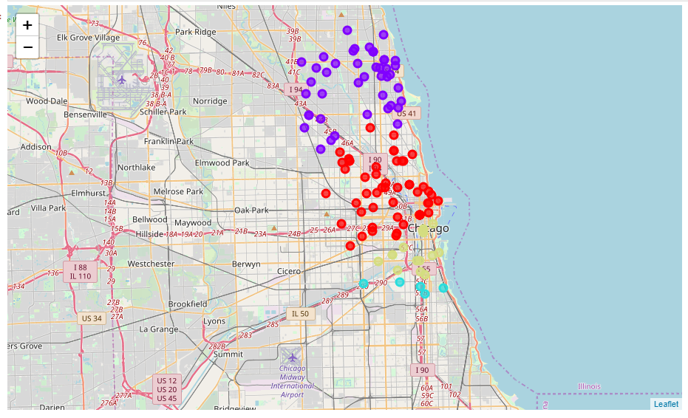
RESULTS
K-means clustering categorized Chicago neighborhood into 4 groups based on the density of Russian restaurant.

Slide 6
DISCUSSION
Observing results and clusters we can notice that Russian restaurant are mostly located and distributed on the north side of the Chicago. Blue cluster group is the biggest one, it could be explained by the fact that one of the biggest Russian/ Ukrainian/ Polish communities’ that live on the north side neighborhoods of the Chicago. Second biggest group is red cluster in the center of the town. Third and fourth clusters are located way smaller and located on the south side of the town. Its also where China town located, and it explains why we don’t see a lot of Russian restaurants there.

Slide 7
CONCLUSION
In this project we identified and stated a business case and requirements for data and what data is required. We extracted all necessary data and prepared for further analysis. We used machine learning clustering technique to group the data into 4 groups based on their similarities. Based on the result of that we propose options where new Russian restaurant could be potentially opened

