Slide 1

Northwind
Group1
Adarsh I V
Barath M
Daman Bindal
Denna Mariya Binu
Diya P
Gunturu Venkata Ramesh Reddy

Slide 2
Contents
Introduction
Datawarehouse Concepts
Data Flow
Python Integration
Testing
Query Analysis

Slide 3
Northwind Database
The Northwind database is a fictional B2B ( Business to Business) trading company that imports and exports specialty food items.
It includes varied data such as product details, orders, customer and employee information and more, providing a practical base for wide-ranging analytical applications.
Using this source we have created a data warehouse called Northwind.DW.

Slide 4
Project Introduction
The primary objective of this project is to move data from OLTP (online transaction processing ) to OLAP (online analytical processing) using Dimensional Modelling in order to build a concept data warehouse.
Initially, we used the OLTP data to generate the landing layer without performing any transformations.
Second, we constructed the staging layer using merge function and performed the transformation, removing columns and tables which are not required in the data warehouse using landing layer.
Third, we used merge function to generate the dimension tables with SCD Type II.
Finally, we used the dimension tables to generate the fact tables.

Slide 5
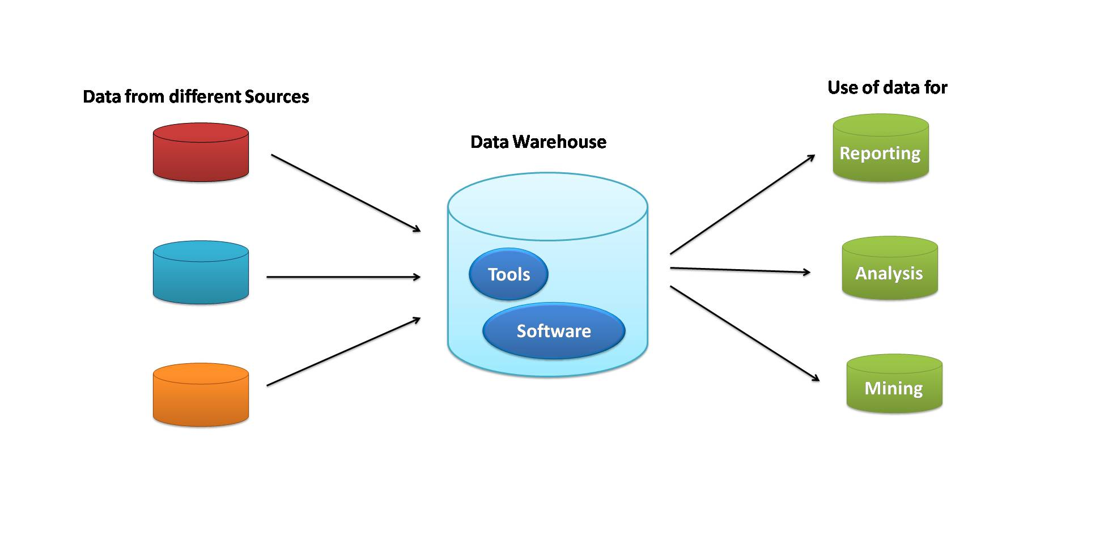
Data Warehouse
A data warehouse is a centralized repository that stores data from various sources within an organization. It is a core component of business intelligence that helps in reporting, data analysis, and decision making.
Features of Data Warehouse:
Subject oriented
Integrated
Time-Variant
Non-Volatile

Slide 6
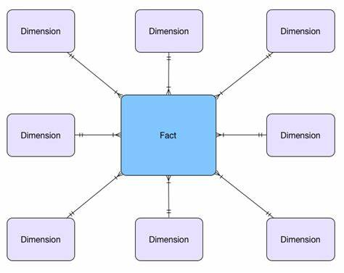
A data warehouse utilizes two types of tables:
Fact Table: This is the core table in a data warehouse schema. It includes quantitative information for analysis and references to data in dimension tables.
Dimension Table: These tables provide the context for the measurements in the fact table. They contain descriptive, categorical information that offers multiple ways to analyse the facts.

Slide 7
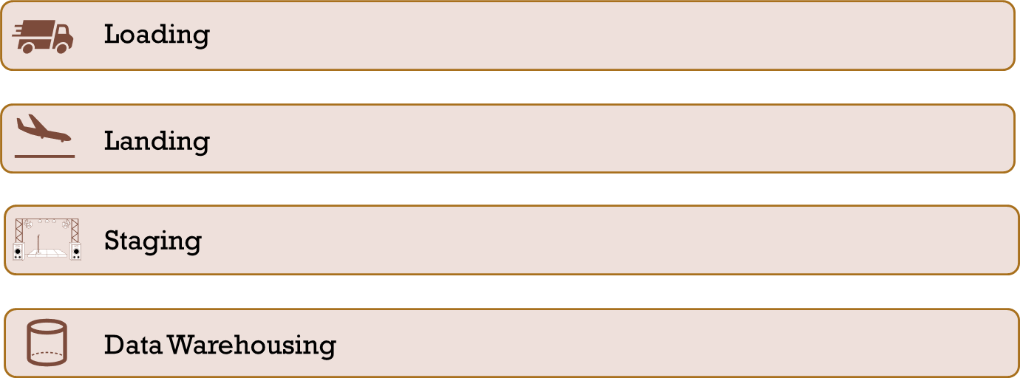
Data Flow

Slide 8
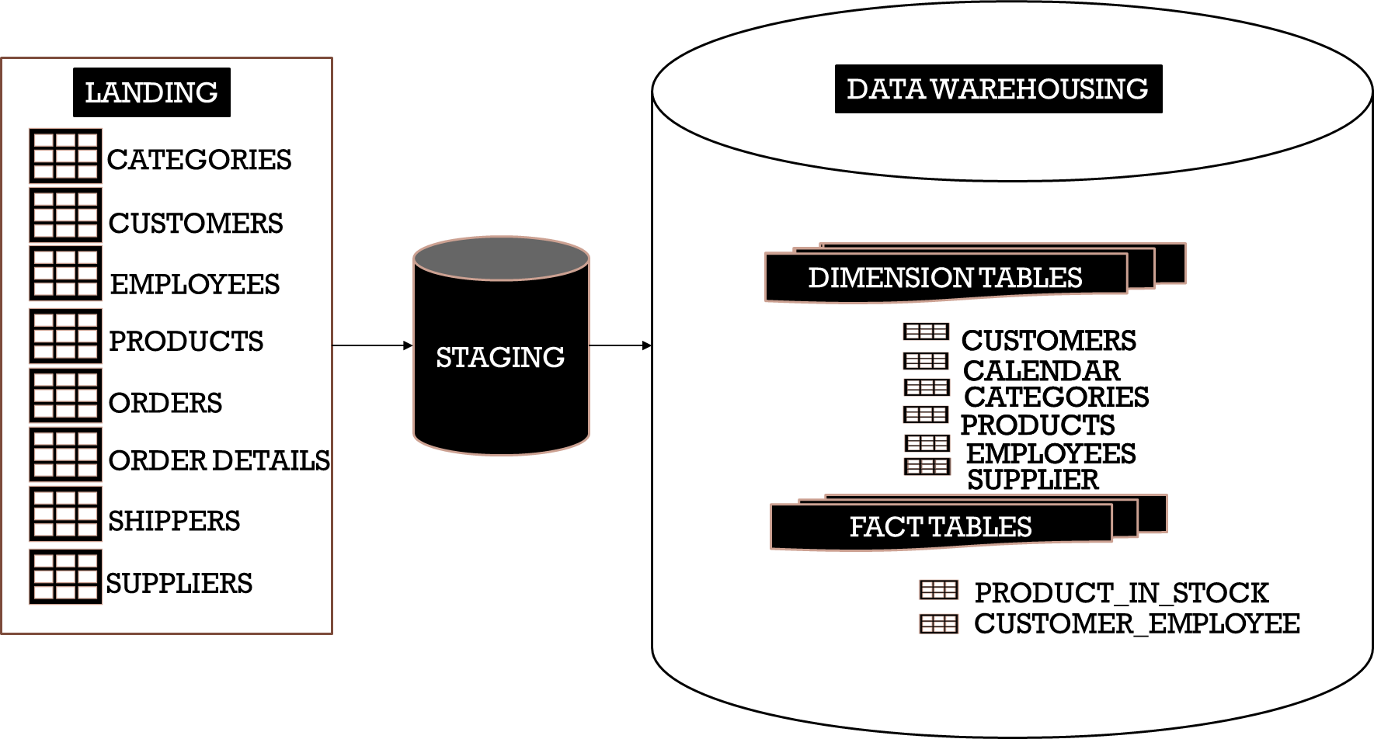
Data Flow

Slide 9
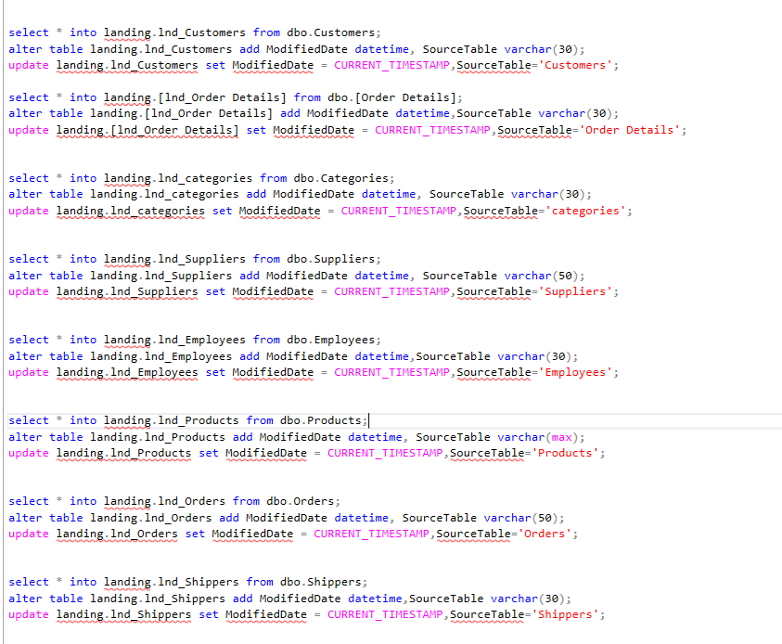
Landing
This is the first stage of data warehousing process where data is extracted and loaded from various sources into an intermediate location known as the landing zone.

Slide 10
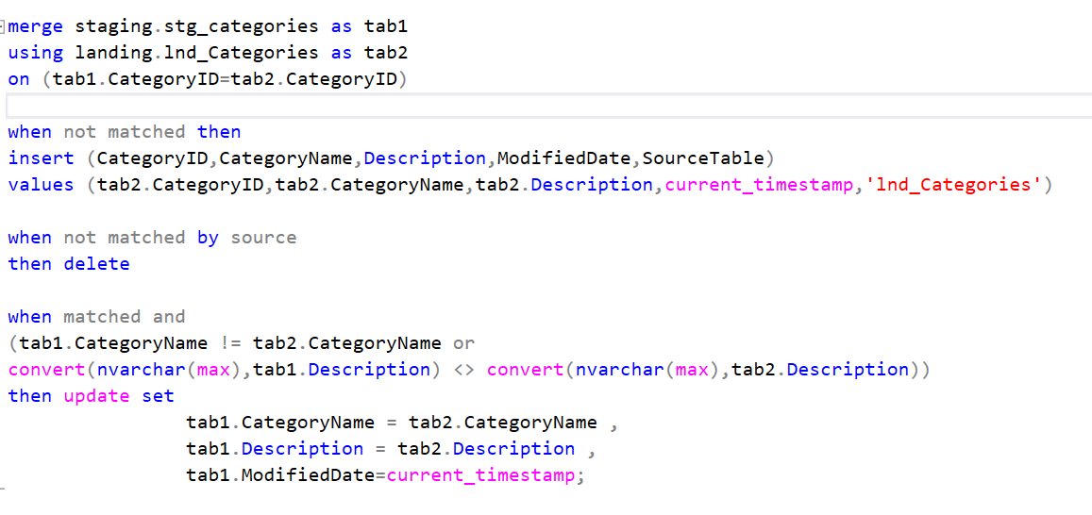
Staging
In the staging stage, data is examined, cleaned, and made ready for further use. Verification and validation techniques are applied to ensure the data's integrity, completeness, and quality.

Slide 11
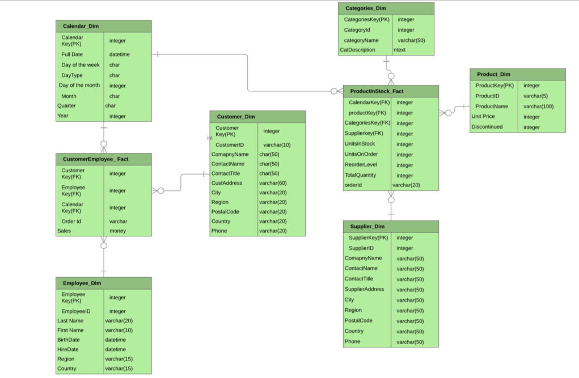
Data Warehousing
In the data warehousing stage, cleaned data from the staging area is loaded into the warehouse. It's organized into fact and dimension tables. These tables are structured to facilitate efficient querying and analysis.

Slide 12
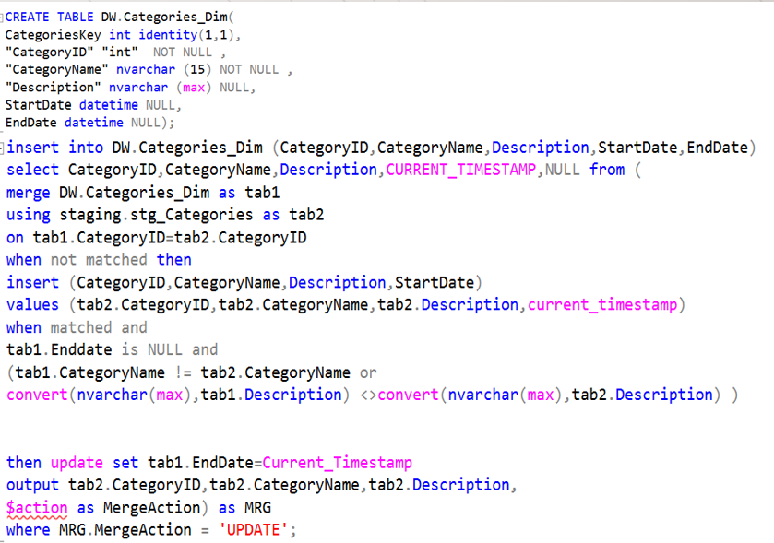
Creation of Dimension Tables
There are mainly 3 types of slowly changing dimensions:
Type-I SCD
Type-II SCD
Type-III SCD
Northwind datawarehouse has 5 dimensional tables:
Customer_dim-Type-II SCD
Categories_dim-Type-II SCD
Products_dim-Type-II SCD
Employees_dim-Type-II SCD
Supplier_dim-Type-II SCD
Calendar_dim-Fixed Dimension
Categories_dim table

Slide 13
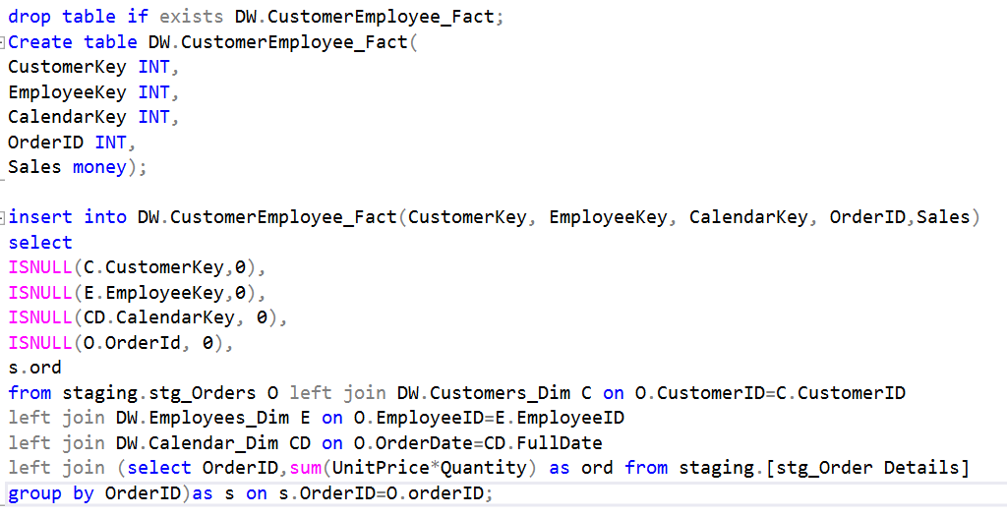
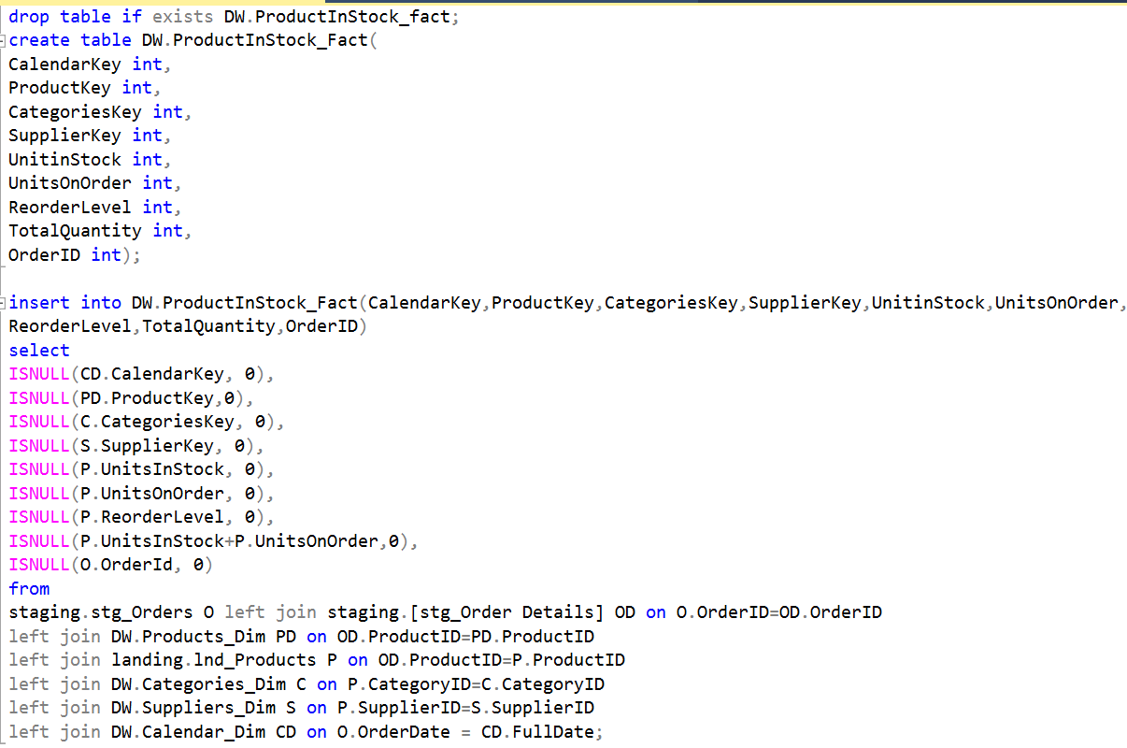
Creation of Fact Tables
CustomerEmployee_fact table
Northwind data warehouse has 2 fact tables.
ProductinStock_fact
CustomerEmployee_fact
ProductinStock_fact table

Slide 14
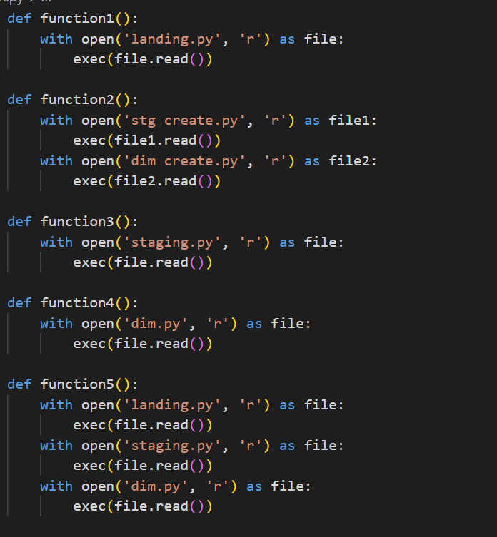
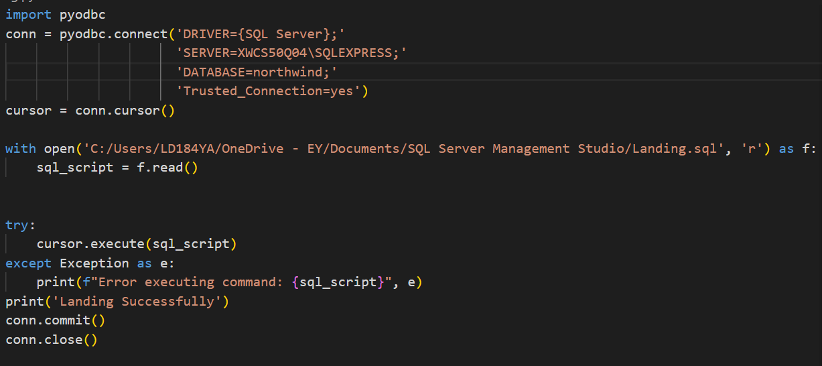
Python Integration
Landing file
Main file

Slide 15
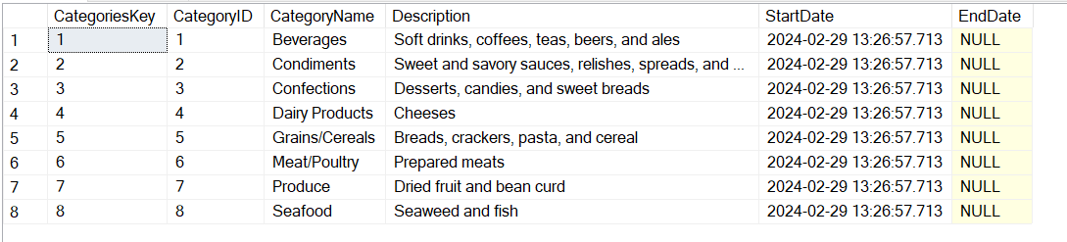
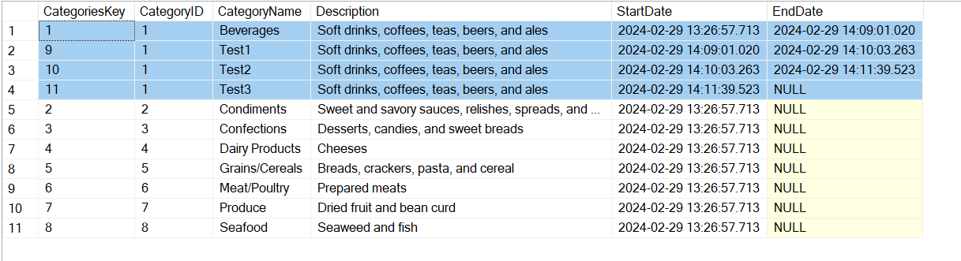
Testing
Original Categories_dim table
Updated Categories_dim table (Type-II SCD)

Slide 16
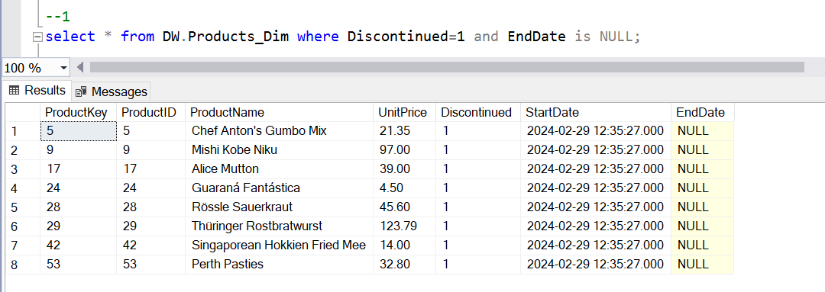
Query Analysis
1. Discontinued_product_report

Slide 17
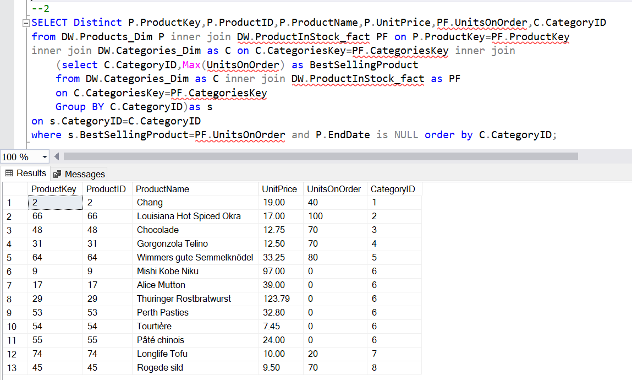
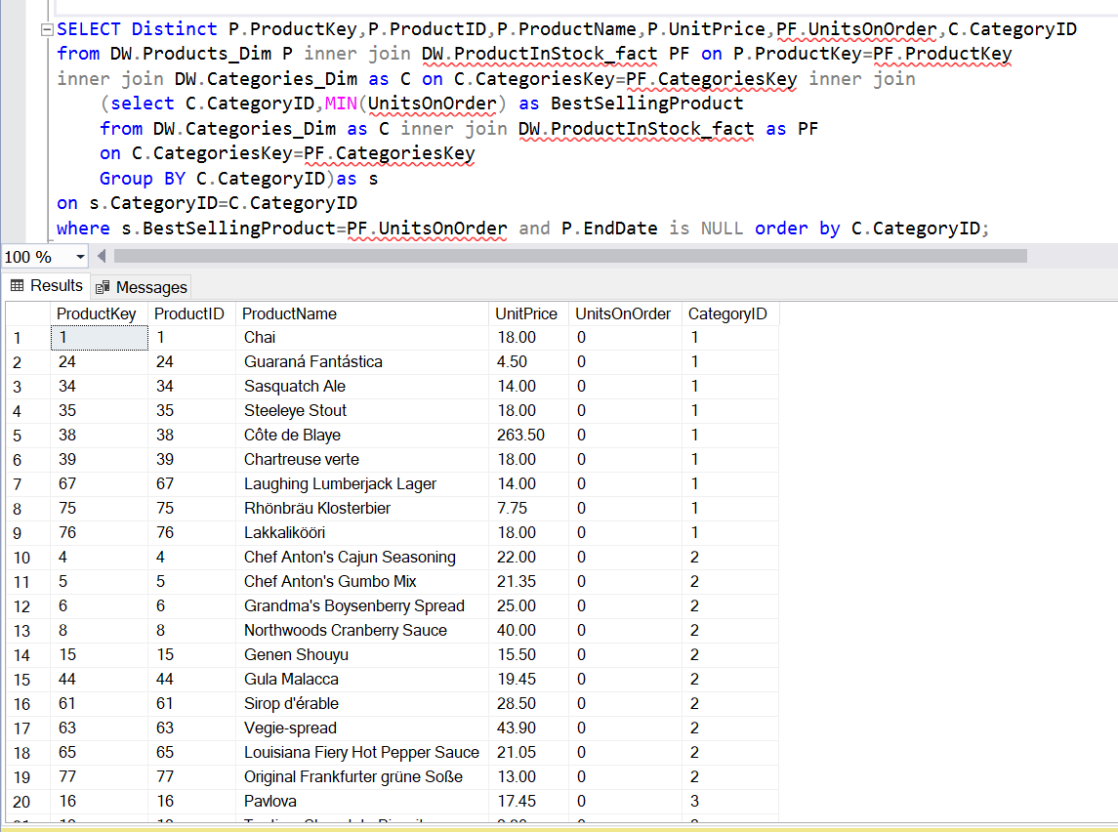
2. Best and least selling product in each category
Query Analysis

Slide 18
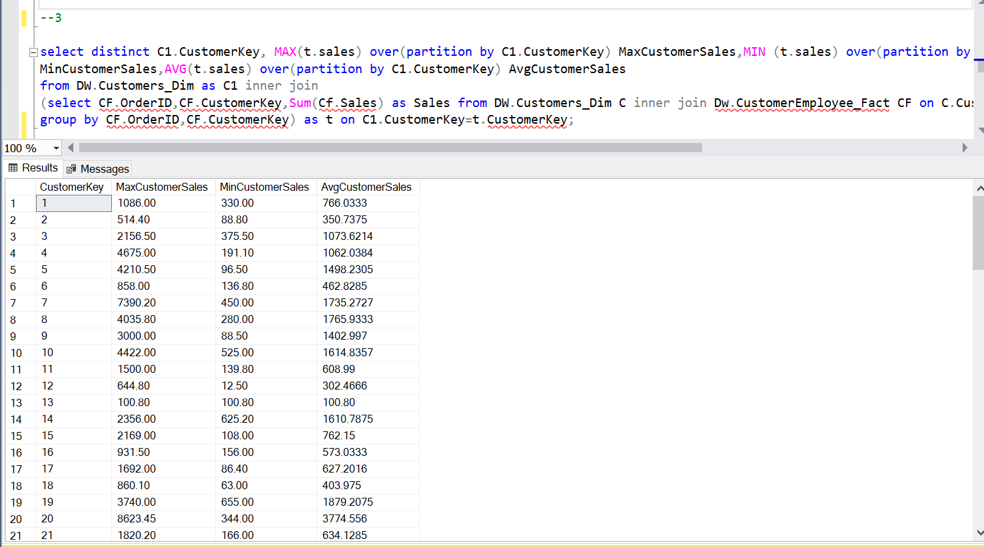
Query Analysis
3. Min max avg customer billing

Slide 19
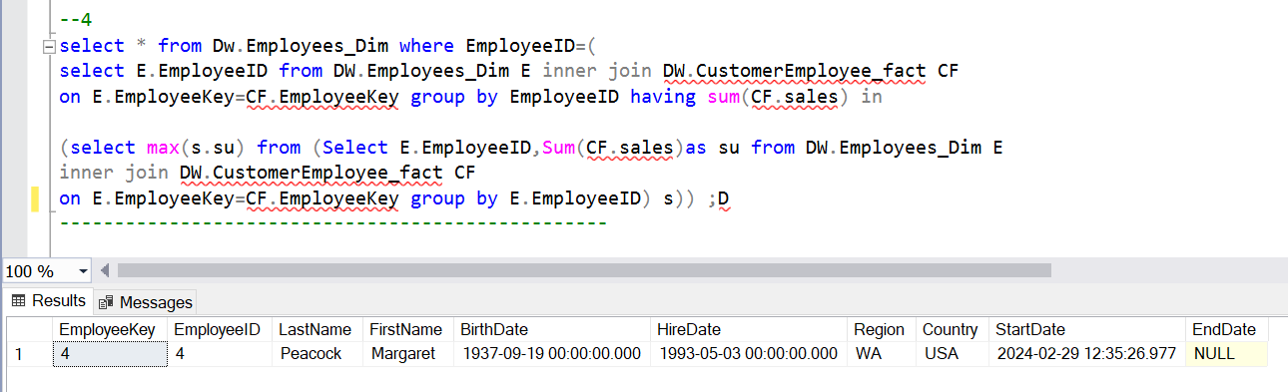
Query Analysis
4. Best Salesperson

Slide 20
Thank You

