Slide 1

Self Introduction
Shilpa Matta

Slide 2
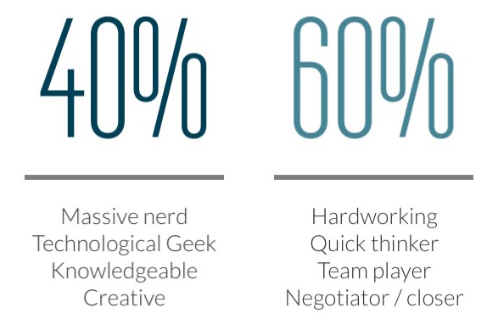
WHO AM I? I AM

Slide 3





My Strengths
ACHIEVER
IDEATION
RESPOSIBILITY
LEARNER
POSITIVITY

Slide 4

MY JOURNEY
PayPal
eBay
Cognizant

Slide 5
Bluefin Automation Framework Training
Facilitated the smooth transition from functional to automation testing.
Role – Lead for project Bluefin Automation Training.
Conducted several knowledge sharing sessions and evaluation tests for multiple teams for automation technologies – Java, Selenium, WebDriver, TestNG
Awards – Increased productivity of fellow team members, decrease in backlog automation, Received ‘Star Employee of the quarter’ award of fellow

Slide 6
Password Recovery
Automated the entire project from scratch
Role – Automation framework architect and developer
Reduced the manual effort spent on testing the application
Reduced the time taken for testing from – to – hours
Captured the difficult use cases like automating the captcha
Continuous Integration from build to automatic deployment
on stage environment and running the tests
Early Defect detection and leakage prevention
Received multiple appreciation awards for my contribution
to driving the automation in short time span.

Slide 7
MAM
Successful in onboarding 8.8 million accounts
Successful launch the project to production
in a mere 2 sprints time.
Coordinated the QE activities from 6 cross functional teams.
Responsible for overall project quality
Lead the team to design/build environment agnostic automation
framework to run on PayPal QA Stage, Sandbox and
Live environments

Slide 8


