Slide 1
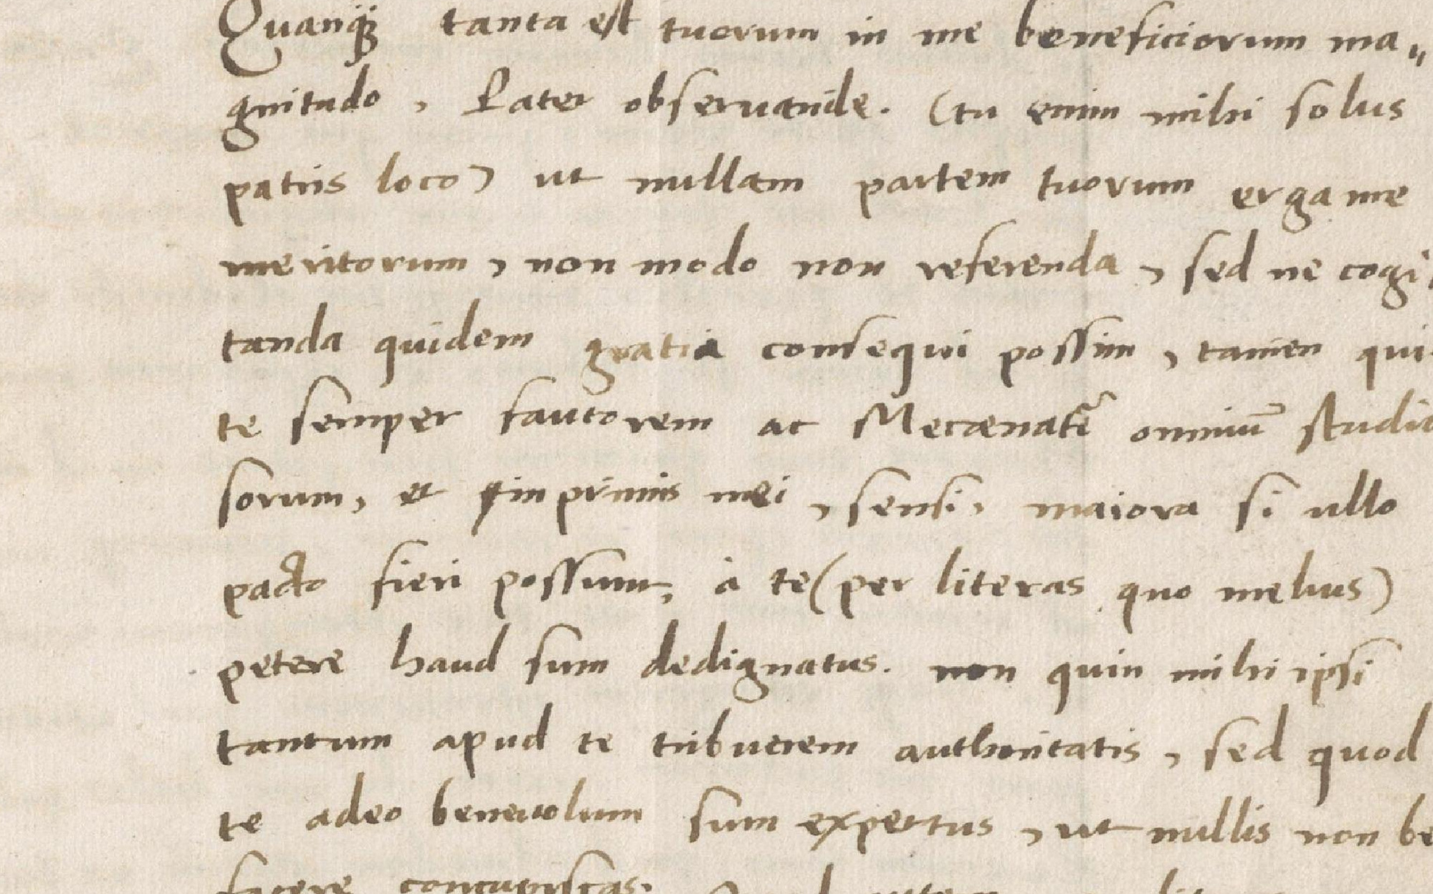
Newline-Only Transcription Alignment For Historical And Modern Documents With Vision-Language Models
Master's Thesis Defense.
Dennis Berger
University of Fribourg
Department of Informatics
AIBEX Group
Professor: Prof. Dr. Andreas Fischer
Supervisor: Dr. Anna Scius Bertrand
June 16, 2026
Dennis Berger | University of Fribourg
01 / 14
Notes:
Target Time: 0:35 Move On At: 0:35
Good afternoon. I am Dennis Berger, and this defense presents my master thesis on newline-only transcription alignment for historical and modern documents with vision-language models.
The central task is seemingly trivial. The transcription is already available, and the system should recover the line breaks without changing any non-newline character. So this is an alignment task, not OCR or HTR.
I first motivate why line-level alignment matters. Then I explain the research questions, datasets, methods, and metrics. After that I show the main results, explain how fixed-transcription validity is enforced, compare the best evaluated VLM setup with NNTP, and close with the main limitations and future work.
Transition: I start with the problem that motivates the task.
Optional: A useful way to keep the whole talk in mind is: the text is trusted, but the line structure has to be recovered.

Slide 2
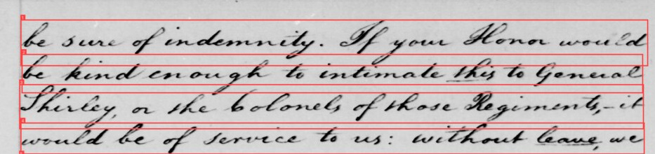
Motivation
Linking Transcription To Page Evidence
page image crop
page-level transcription
be sure of idemnity. If your Honor would be kind enough to intimate this to General Shirley, or the Colonels of those Regiments,- it would be of service to us: without leave we
1
2
3
4
↓
↓
aligned line transcription
1
be sure of idemnity. If your Honor would
be kind enough to intimate this to General
Shirley, or the Colonels of those Regiments,- it
would be of service to us: without leave we
2
3
4
Line Evidence Enables Inspection
Line boundaries connect transcription back to the visual page; in the document pipeline, newline-only alignment links available structure to the fixed transcription.
Dennis Berger | University of Fribourg
02 / 14
Notes:
Target Time: 1:25 Move On At: 2:00
This slide shows the basic problem & motivation.
On the left, we have a manuscript crop with four visible text lines. On the right, the same text appears in two forms.
The page-level transcription keeps the words and their order, but it removes the local connection to the page. It does not tell us which span of text belongs to line 1, line 2, line 3, or line 4.
The aligned line transcription adds back exactly that structure. The text is the same fixed transcription, but newline characters are inserted so that the transcription can be read line by line against the image.
This matters because line boundaries connect text back to evidence. For humanities work, this helps someone inspect a phrase on the manuscript page, check a reading, or understand where a line wraps. For computer-science workflows, it helps create line-image and line-text pairs for training, validation, and error analysis.
The important constraint is that the task is not to recognize the text again. The characters are already supplied. The system only decides where newline boundaries should be inserted.
Transition: once the task is defined as alignment rather than recognition, the next question is why VLMs are useful, and why they need control.
Optional: This is why line alignment is not just formatting. If the same character stream is attached to the wrong visual line, local inspection and line-level evaluation become unreliable.

Slide 3
Rationale
Why VLMs
Why VLMs
Challenges
- Avoid training a task-specific aligner for every evidence setting
- Combine page image, line crops, OCR/HTR hints, and fixed transcription
- Use visual layout and textual context together
- Generative output may omit, normalize, or add text
- Copied text is not trusted as final content
- Transcription alignment needs post-processing
Evaluate input combinations + control setups, not just models.
Dennis Berger | University of Fribourg
03 / 14
Notes:
Target Time: 1:15 Move On At: 3:15
This slide explains the rationale for using VLMs.
The opportunity is that with VLMs. Instead of training a separate aligner for every dataset and evidence combination, a general VLM can be tested across different input setups without training.
A second reason is practical. VLMs can combine different evidence types in one setup. They can receive the page image, line crops, OCR or HTR hints, and the fixed transcription. That is useful because line placement can depend on both layout and text.
For example, the page image may show where line breaks occur visually, while OCR or HTR hints may provide a rough line order, and the fixed transcription provides the trusted character sequence.
But the challenge is validity. A generative model may omit text, normalize spelling, add words, or copy an OCR error. In an open transcription task, those would be recognition errors. In this task, they are constraint violations, because the fixed transcription must not be rewritten.
That is why the structured methods do not trust copied model text as final content. The model can provide boundary hints, but the final output has to be validated and projected back onto the supplied transcription.
So the thesis evaluates input combinations together with output-control setups, not only model names.
Transition: these design tensions lead to the research questions.
Optional: The key distinction is between using the model as a source of text and using the model as a source of boundary evidence. The structured methods aim for the second interpretation.

Slide 4
Contribution
Research Questions & Contribution
Which Input And Method Variants Improve Newline-Boundary Accuracy For Fixed Transcriptions?
Compare input and method variants under fixed transcription
RQ1
How Can Generated Outputs Be Constrained So The Fixed Transcription Is Preserved?
Constrain outputs through repair, recovery, fallback, projection
RQ2
How Does The Highest-Scoring Evaluated VLM Setup Compare With The Deterministic NNTP Reference?
Compare highest-scoring evaluated VLM setup with deterministic NNTP reference
RQ3
Contribution: Newline-only protocol/benchmark | input/method variants | repair/recovery/fallback/projection | projection preserves fixed transcription | deterministic NNTP comparison
Dennis Berger | University of Fribourg
04 / 14
Notes:
Target Time: 1:10 Move On At: 4:25
This slide structures the defense around three research questions.
RQ1 asks which input and method variants improve newline-boundary accuracy for fixed transcriptions. In other words, given the same trusted text, what evidence helps us place line breaks correctly?
RQ2 asks how generated outputs can be constrained so the fixed transcription is preserved. This is necessary because raw model output can look plausible while still changing the text. The thesis therefore evaluates repair, recovery, fallback, and projection as part of the structured output path.
RQ3 asks how the highest-scoring evaluated VLM setup compares with NNTP, the deterministic forced-alignment reference. I present output validity before the NNTP comparison because we first need to understand what the VLM output actually is. In M5, the final scored output is not raw copied model text. It is a projected boundary plan over the fixed transcription.
The contribution row summarizes the thesis: a newline-only protocol and benchmark, a comparison of input and method variants, a structured output-control path, projection that preserves the fixed transcription when successful, and a comparison with NNTP.
Transition: before explaining the methods, I define the datasets used for evaluation.

Slide 5
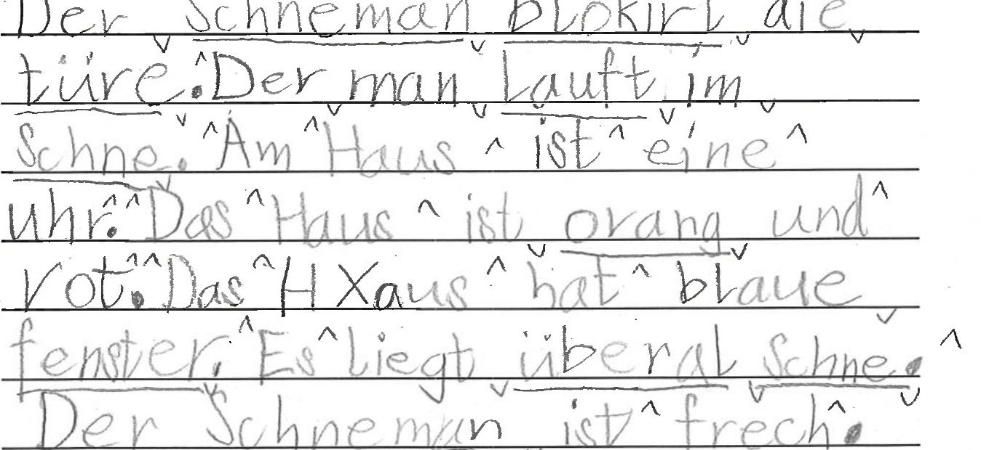
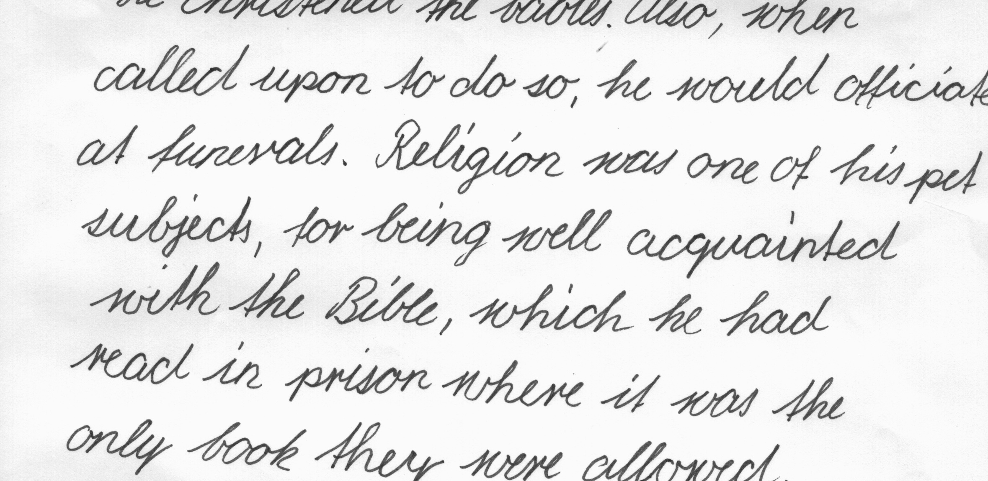
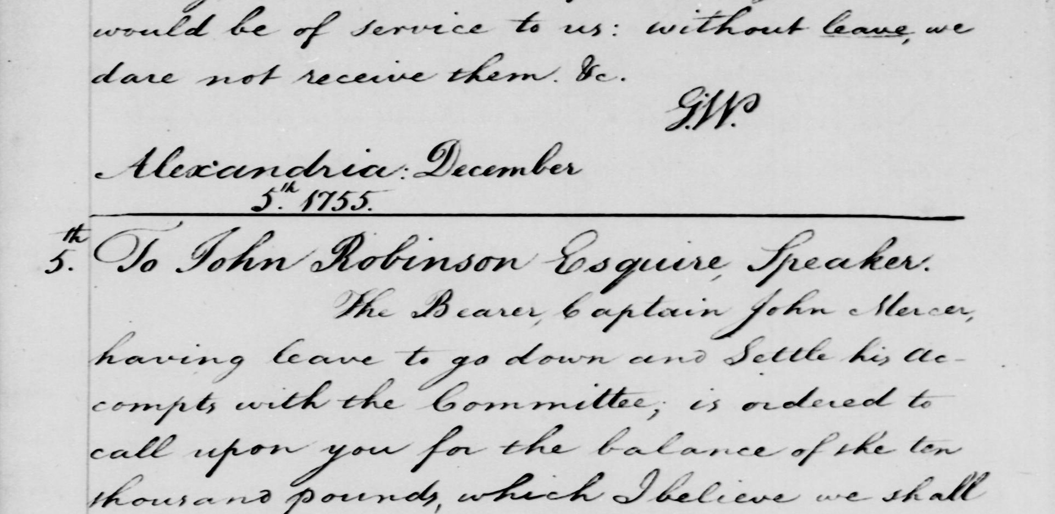
Data
Datasets
Bullinger
Latin / Premodern German / Multilingual
Children
German Child Handwriting
IAM
English Modern Handwriting
Washington
Historical English Manuscript
handwritten
handwritten
handwritten
handwritten
59 samples
100 pages
2,535 lines
133,883 chars
63 pages
394 lines
10,261 chars
20 pages
180 lines
7,604 chars
20 pages
656 lines
26,458 chars
Printed
Bullinger Print: 10 samples/pages, 271 lines, 15,004 chars
IAM Print: 30 pages/forms, 161 lines, 12,194 chars
Dennis Berger | University of Fribourg
05 / 14
Notes:
Target Time: 1:10 Move On At: 5:35
This slide shows the evaluation portfolio.
The main evaluation is handwritten-first and covers four datasets.
Bullinger is historical correspondence. It is linguistically diverse, including Latin, premodern German, and multilingual material. It has 59 samples, 100 pages, 2,535 lines, and about 134,000 characters. It is the largest and most difficult handwritten dataset in the main result story.
Children is German child handwriting. It contributes a different handwriting style, a different writer population, and modern German material. The slide reports 63 pages, 394 lines, and about 10,000 characters.
IAM is modern English handwriting. It acts as a public benchmark anchor and is more regular than the historical datasets. Here the thesis uses 20 pages or forms, with 180 lines and about 7,600 characters.
Washington is historical English manuscript material. It has 20 pages, 656 lines, and about 26,000 characters. It adds another historical setting, but with a different language and page style from Bullinger.
At the bottom are the supporting printed-context datasets: Bullinger Print and IAM Print. These are part of the thesis, but they are secondary context. They were evaluated for M1 to M3 only, not for the full M1 to M5 plus NNTP comparison.
The reason for this portfolio is diversity: language, period, handwriting style, document type, and difficulty. Newline placement is not the same problem across all these document types.
Transition: with the data scope defined, I now explain the evaluated methods.
Optional: The known-count caveat later is connected to this data staging: the structured methods use stored line metadata in the handwritten setup, so they test boundary assignment under available line evidence, not blind page segmentation.

Slide 6
Methods
Methods
LLM/VLM Setups
M1
page image(s) + fixed transcription
->
raw returned text
NNTP Reference
M2
page image(s) + OCR/HTR hint + fixed transcription
->
raw returned text
Line images + recognizer evidence + fixed transcription
M3
OCR/HTR hint + fixed transcription
->
raw returned text
→ Deterministic forced alignment
M4
ordered OCR-line scaffold + expected N + fixed transcription
->
strict JSON + repair/fallback + projection
Separate Non-Prompt Reference
M5
ordered line crops + OCR/HTR line text + page image + expected N + fixed transcription
->
strict JSON + repair/recovery/fallback + projection
Models: GPT-5.4-0305, GPT-5.2, Gemini-2.5-Pro, Gemini-3-Pro, Gemini-3.1
Qwen3-VL-8B, Qwen3-VL-32B, Mistral-2512
Dennis Berger | University of Fribourg
06 / 14
Notes:
Target Time: 1:55 Move On At: 7:30
This slide is the method map, and the result claims later should be read as claims about these complete setups.
The first group is M1 to M3. These are raw-output LLM or VLM setups. The model is asked to return the line-broken transcription directly, and that raw returned text is scored.
M1 receives page images plus the fixed transcription. The reason for M1 is to test whether the model can infer line breaks from visual layout while preserving the supplied text.
M2 adds OCR or HTR hints. The reason for M2 is that OCR or HTR may expose rough line order or line breaks. But it is only a structural hint, not a replacement transcription.
M3 removes the image and uses OCR or HTR text plus the fixed transcription. This tests how much line structure is already recoverable from the recognized text hint alone, without visual correction.
The second group is M4 and M5. These change the output path. Instead of scoring raw copied text, they ask for strict JSON with a list of lines, validate the line count, and project the selected boundary plan back onto the fixed transcription.
M4 uses an ordered OCR-line scaffold, the expected line count, and the fixed transcription. It adds strict JSON, repair or fallback, and projection.
M5 is the richest evaluated VLM setup. It uses ordered line crops, OCR or HTR line text, page context, the expected line count, and the fixed transcription. It also uses strict JSON, repair, recovery, fallback, and projection.
The model list shows that this was not only one provider. The evaluated landscape includes OpenAI, Gemini, Qwen3-VL, and Mistral configurations. But the thesis does not claim an intrinsic model leaderboard. The comparison is about complete configurations.
NNTP is separate. It is the deterministic non-prompt reference. It uses line images, recognizer evidence, and the fixed transcription to perform forced alignment. It does not freely generate new text.
The key interpretation is that M5 combines several ingredients. So when I say M5 performs best among the evaluated VLM setups, that is a configuration-level statement, not proof that one isolated component caused the whole gain.
Transition: to evaluate these methods, the metric has to measure line structure, not only character correctness.
Optional: The reason for choosing M1 to M5 is that they separate two design axes. M1 to M3 vary the evidence under weak control. M4 and M5 add structured output and projection. NNTP then anchors the comparison against a deterministic forced-alignment family.

Slide 7
Metrics
Experimental Setup
What exactly is calculated?
Same character stream; one missing newline merges Alpha and Beta.
Metric formulas and plug-in values
Metric Example
Metric
Formula / calculation
Result
Ground truth
LA->
top-down exact line matches / n
0 / 4 = 0.000
1 Alpha
2 Beta
3 Gamma
4 Delta
LA<-
bottom-anchored exact line matches / n
2 / 4 = 0.500
LAnorm+/-
(LA->norm + LA<-norm) / 2
(0 + 0.500) / 2 = 0.250
Prediction
1 Alpha Beta
2 Gamma
3 Delta
F1,line
P=2/3, R=2/4; F1 = 2PR / (P + R)
0.571
CERnorm
lev(chars(Nx), chars(Ny)) / |chars(Nx)|
0 / 22 = 0.000
After whitespace normalization, both full texts are:
Alpha Beta Gamma Delta
WERnorm
lev(words(Nx), words(Ny)) / |words(Nx)|
0 / 4 = 0.000
n = max(4, 3) = 4; exact matched lines: Gamma, Delta.
CER/WER see identical normalized text, while line metrics expose the lost boundary between Alpha and Beta.
Dennis Berger | University of Fribourg
07 / 14
Notes:
Target Time: 2:00 Move On At: 9:30
This slide explains the metric calculation with a example.
The ground truth has four lines: Alpha, Beta, Gamma, Delta. The prediction has three lines because Alpha and Beta are merged into one line. Gamma and Delta remain correct.
After whitespace normalization, both full texts are identical: Alpha Beta Gamma Delta. That is why the character and word metrics are zero-error here. CERnorm is zero, and WERnorm is zero.
But the structure is wrong, because one newline boundary is missing.
The table shows how the line metrics capture this.
For forward LA, we compare the sequences from the top. The first ground-truth line is Alpha, but the first predicted line is Alpha Beta. That does not match. After that, the sequence is shifted, so there are no top-down exact matches. LA forward is 0 divided by 4, so 0.000.
For reverse LA, we compare from the bottom. Delta matches Delta, and Gamma matches Gamma. So two of the four ground-truth positions are recovered from the end. LA reverse is 2 divided by 4, so 0.500.
LAnorm± averages these two views. So it is 0 plus 0.500, divided by 2, which gives 0.250.
F1_line is a supporting exact-line metric. It ignores order more than LA does and asks which complete normalized line strings occur. Here Gamma and Delta are exact matched lines. Precision is 2 out of 3 predicted lines, recall is 2 out of 4 ground-truth lines, and the resulting F1 is 0.571.
Forward and reverse LA are both useful because line-boundary errors often shift the sequence. A boundary error near the top can make the forward score harsh even if the tail realigns; the reverse score captures that tail recovery. The combined score gives a more balanced view of structural alignment.
Transition: with the metric defined, I can now show the main method results.

Slide 8
RQ1
Method Results
Bullinger
Children
1
0.843
1
0.872
0.859
0.948
0.777
0.822
0.300
0.297
0.406
0.120
0
0
M1
M2
M3
M4
M5
M1
M2
M3
M4
M5
IAM
Washington
1
0.948
1.000
1
0.980
0.855
0.817
0.883
0.752
0.653
0.711
0.589
0
0
M1
M2
M3
M4
M5
M1
M2
M3
M4
M5
Metric: LAnorm±
M5 Is Highest-Scoring Among Evaluated LLM/VLM Methods.
Intermediate methods are dataset-dependent; no monotonic component ablation is claimed.
Dennis Berger | University of Fribourg
08 / 14
Notes:
This slide answers RQ1, which input variants improve Line Accuracy the most. Each small chart is one handwritten dataset, and the metric is LAnorm±. Higher is better.
One important clarification before reading the numbers: this is a combined method-level visual. For each dataset and method, the bar shows the best observed score across the evaluated model configurations. So this slide summarizes the best result achieved by each method design, not a single fixed-model run.
The main pattern is that M5 is highest-scoring among the evaluated LLM/VLM methods on all four handwritten datasets.
On Bullinger, the raw methods are low: M1 is 0.300, M2 is 0.120, and M3 is 0.297. M4 improves to 0.406, but M5 jumps to 0.843. This is the largest separation on the slide. A safe interpretation is that Bullinger is a difficult historical correspondence setting where richer line-level evidence and stronger output control are especially valuable.
On Children, the scores are higher from the start. M1 is 0.872, M2 is 0.777, M3 is 0.859, and M4 is 0.822. M5 improves to 0.948. So M5 still wins, but the gain is smaller because several earlier configurations already recover much of the line structure.
On IAM, M3 is already very strong at 0.948, and M5 reaches 1.000. This is consistent with IAM being a more regular modern handwriting setting where OCR or HTR lineation can already provide a strong structural cue.
On Washington, the progression is M1 at 0.653, M2 at 0.711, M3 at 0.817, M4 at 0.883, and M5 at 0.980. Here the structured and context-rich setup also performs very well.
The bottom sentence is important: this is not a monotonic component ablation. M1 through M4 do not always improve step by step. The defensible claim is that M5, as a complete evaluated setup, is highest-scoring across these handwritten datasets, while intermediate methods are dataset-dependent.
Transition: the next slide expands this from method averages to model-and-method configurations.
Optional: The failure-mode appendix helps explain this non-monotonicity. For example, OCR hints can help but can also mislead; structured output can improve validity but still follow a flawed scaffold; and M5 is strong overall but not an every-sample winner.

Slide 9
RQ1
Results Per Model And Dataset
Whitespace-normalized LAnorm+/- macro scores. Means are unweighted over represented cells; partial rows are context, and dashes stay missing/ineligible.
Complete four-dataset
Partial coverage
Configuration
Cov
Mean
B
C
IAM
W
Configuration
Cov
Mean
B
C
IAM
W
GPT-5.4-0305 / M5
4/4
0.940
0.843
0.948
1.000
0.970
NNTP / NNTP
3/4
0.976
-
0.939
1.000
0.990
Gemini-2.5-Pro / M5
4/4
0.786
0.423
0.846
0.992
0.883
Qwen3-VL-32B / M5
3/4
0.962
-
0.923
0.982
0.980
4/4
0.730
0.297
0.859
0.948
0.817
Mistral-2512 / M5
3/4
0.911
-
0.846
0.930
0.957
GPT-5.4-0305 / M3
4/4
0.705
0.406
0.822
0.855
0.737
Qwen3-VL-8B / M4
3/4
0.672
0.398
-
0.736
0.883
GPT-5.4-0305 / M4
4/4
0.610
0.380
0.351
0.830
0.876
Gemini-2.5-Pro / M2
2/4
0.873
-
0.868
-
0.879
Mistral-2512 / M4
Gemini-2.5-Pro / M1
2/4
0.867
-
0.858
-
0.876
GPT-5.4-0305 / M2
4/4
0.590
0.120
0.777
0.752
0.711
GPT-5.2 / M1
2/4
0.803
-
0.846
-
0.761
GPT-5.4-0305 / M1
4/4
0.554
0.300
0.804
0.458
0.653
GPT-5.2 / M2
2/4
0.795
-
0.837
-
0.752
Mistral-2512 / M3
4/4
0.405
0.067
0.556
0.789
0.208
Gemini-2.5-Pro / M3
2/4
0.286
-
0.095
-
0.477
Gemini-3.1 / M1
4/4
0.397
0.062
0.872
0.589
0.065
GPT-5.2 / M3
2/4
0.226
-
0.066
-
0.386
Qwen3-VL-8B / M2
4/4
0.234
0.040
0.352
0.000
0.545
Gemini-3-Pro / M2
2/4
0.201
-
0.377
-
0.024
Mistral-2512 / M2
4/4
0.234
0.027
0.401
0.246
0.263
Gemini-3-Pro / M1
2/4
0.190
-
0.360
-
0.019
Qwen3-VL-8B / M1
4/4
0.225
0.108
0.485
0.003
0.305
Gemini-3-Pro / M3
2/4
0.044
-
0.066
-
0.022
Mistral-2512 / M1
4/4
0.216
0.046
0.525
0.111
0.181
Gemini-3.1 / M2
1/4
0.092
-
-
-
0.092
Qwen3-VL-8B / M3
4/4
0.173
0.002
0.190
0.424
0.076
Gemini-3.1 / M3
1/4
0.073
-
-
-
0.073
Dennis Berger | University of Fribourg
09 / 14
Notes:
Target Time: 1:40 Move On At: 12:45
This slide is intentionally dense, so I will not read it row by row. I use it as an audit slide: it shows whether the M5 result is only a single summary artifact, or whether it remains visible across model and method configurations.
First, how to read the table. Each row is a model-and-method configuration. “Cov” means how many of the four headline handwritten datasets are represented. “Mean” is an unweighted average over the represented cells. The dataset columns are Bullinger, Children, IAM, and Washington. Dashes mean missing or ineligible values; they are not filled in or treated as zero.
The first important point is the complete four-dataset block. These rows are the fairest rows for a full handwritten comparison. In that block, GPT-5.4-0305 with M5 has the highest mean, 0.940. This is important because it means the M5 result is not only a cross-model maximum; even when the model is fixed to GPT-5.4 for M1 to M5, M5 remains highest. The same fixed-model comparison also shows that the path is not monotonic: GPT M3 has a mean of 0.730, GPT M4 has 0.705, and then GPT M5 jumps to 0.940. So structured output alone is not automatically enough; the full M5 configuration matters.
The second interesting point is provider dependence. Gemini-2.5-Pro with M5 is the second complete M5 row, with a mean of 0.786. It is almost perfect on IAM, 0.992, and strong on Washington, 0.883, but much lower on Bullinger, 0.423. That suggests that M5 as a method design is useful, but the model and dataset still interact strongly. It is not only the method label that determines the result.
The third point is dataset dependence. IAM is comparatively easy for several configurations: GPT M3 already reaches 0.948, and GPT M5 reaches 1.000. That supports the interpretation that, on this subset, the OCR or HTR lineation already carries a lot of the line structure. Bullinger is the opposite. Most raw and intermediate rows are much lower there, and GPT M5 is the only complete row that is very high on Bullinger, at 0.843. So Bullinger is the dataset that most clearly separates the context-rich structured setup from the weaker configurations.
The fourth point is that local or open-weight rows are not simply weak. Qwen3-VL-32B with M5 is a partial-coverage row, but it is very strong where it is represented: its mean over Children, IAM, and Washington is 0.962. On Washington specifically, it reaches 0.980, which is the highest VLM value shown for Washington on this table, above GPT M5 at 0.970 and Mistral M5 at 0.957. But because the Bullinger row is incomplete, it must stay in the partial-coverage block, not in the complete ranking.
The fifth point is that NNTP is very strong, but it is a different kind of row. It has a three-dataset mean of 0.976 over Children, IAM, and Washington, with 1.000 on IAM and 0.990 on Washington. That prepares the next comparison slide. But it is not a complete four-dataset LLM/VLM row, and Bullinger has to be handled separately through the published-reference comparison.
So the main message of this slide is not a universal model leaderboard. The table shows three things: M5 is the strongest complete evaluated LLM/VLM configuration, the same conclusion holds under the fixed GPT-5.4 comparison, and partial rows reveal interesting context — especially Qwen on Washington and NNTP on the three matched datasets — but they should not be ranked as if all four datasets were present.
Transition: after this accuracy audit, I now move to validity: how the structured methods preserve the fixed transcription.Transition: after the accuracy results, I now explain output validity: how the structured methods preserve the fixed transcription.

Slide 10
RQ2
Fixed-Transcription Preservation
Strict JSON
Repair If Parse/Count Fails
Recover Or Fallback If No Plan
Project Boundaries
Score Re-Sliced Fixed Text
Projection Mechanism
Validity Evidence
Model / JSON Line Hint
"The Bearer, Caplain"
"John Mercer"
0 / 162 M5 preservation failures.
↓
Fixed Transcription
"The Bearer, Captain John Mercer"
M1-M3 Average line-count drift: 8.195
↓
Raw generations often returned too many or too few lines.
Projected Output
"The Bearer, Captain
John Mercer"
M4-M5 Average line-count drift: 0.059
Structured validation/projection almost eliminates line-count drift.
Boundary From Hint; Characters From Fixed Text.
Known-count staging: M4/M5 validate against stored line counts.
Dennis Berger | University of Fribourg
10 / 14
Notes:
Target Time: 2:00 Move On At: 14:45
This slide answers RQ2: how generated outputs can be constrained so the fixed transcription is preserved.
I start with the workflow at the top. First, the model is asked for strict JSON. For M4 and M5, the response should contain a list of lines, and that list has to have exactly the expected number of lines. The expected count comes from stored ordered line metadata.
If parsing fails, or if the line count is wrong, the system tries repair. Repair is one additional structured prompt using the previous response and the error information. The goal is to obtain a valid exact-count line list.
If there is still no usable plan, M5 can use recovery or fallback. Recovery means extracting useful loose line strings from a response that did not satisfy strict JSON, and reconciling them with the expected structure where possible. Fallback means using a deterministic backup plan, for example from ordered OCR-line hints or another exact-count scaffold, when no usable model plan remains.
Then comes projection, which is the preservation step. The selected line hints are treated as boundary evidence, not as final content.
The example on the left shows why this matters. The model hint contains “Caplain”, but the fixed transcription contains “Captain”. If the system copied the model text, it would change the transcription and violate the task. Instead, the system uses the hint to infer where the boundary should go, and then slices the original fixed transcription at the projected boundary.
So the boundary comes from the hint, but the characters come from the fixed text. The final output keeps “Captain” and inserts the line break before “John Mercer”.
Mechanically, projection uses the candidate hint lines to define cumulative boundary offsets. Those offsets are mapped monotonically back to the untouched transcription using matching text anchors and interpolation. Then the original transcription is re-sliced at those projected offsets.
The numbers on the right are validity diagnostics. The M5 trace audit reports 0 out of 162 final failures. Raw M1 to M3 rows have a mean absolute line-count drift of 8.195 over 1,660 rows, while structured M4 to M5 rows have 0.059 over 973 rows.
The requirement at the bottom is essential: M4 and M5 validate against stored line counts. So this supports known-count boundary assignment and fixed-transcription preservation. It does not claim blind page-side line-count prediction.
Transition: now that the M5 output is defined as a projected boundary plan, I can compare it with NNTP.

Slide 11
RQ3
Comparison
M5
NNTP
Children
M5 0.948
NNTP 0.939
Δ +0.009
paired counts 4 / 2 / 57
IAM
M5 1.000
NNTP 1.000
Δ 0.000
paired counts 0 / 0 / 20
Washington
M5 0.980
NNTP 0.990
Δ -0.009
paired counts 2 / 4 / 14
Bullinger Subset 1 (Published, Direct)
M5 0.821
NNTP 0.861
Δ -0.040
raw LA→, direct
Bullinger Subset 2 (Published, Contextual)
M5 0.865
NNTP 0.773
Δ +0.092
raw LA→, contextual
Children/IAM/Washington use LAnorm±. Bullinger subset rows use raw LA→ against the published NNTP reference.
M5 is close to an established deterministic reference.
Dennis Berger | University of Fribourg
11 / 14
Notes:
Target Time: 1:45 Move On At: 16:30
This slide answers RQ3: how the highest-scoring evaluated VLM setup compares with a determinist reference.
The table compares M5 with NNTP or the published NNTP reference. For Children, IAM, and Washington, the metric is LAnorm±. For the Bullinger subset rows, the metric is raw LA forward, because those rows use the published Bullinger NNTP reference.
On Children, M5 is 0.948 and NNTP is 0.939, so the difference is plus 0.009 in favor of M5. The paired counts are 4 M5 wins, 2 NNTP wins, and 57 ties. So the dataset-level difference is small, and most samples are tied.
On IAM, both methods reach 1.000. The paired counts are 0, 0, and 20, meaning all 20 cases are ties.
On Washington, M5 is 0.980 and NNTP is 0.990, so the difference is minus 0.009, slightly favoring NNTP. The paired counts are 2 M5 wins, 4 NNTP wins, and 14 ties. Again, the comparison is dominated by ties.
Bullinger is separate. Subset 1 is the direct published comparison. M5 is 0.821, and published NNTP is 0.861, so NNTP is higher there. Subset 2 is contextual because the inventories differ. M5 is 0.865 and published NNTP is 0.773, but this should not be treated as a full-dataset winner claim.
The careful interpretation is the sentence at the bottom: M5 is close to an established deterministic reference.
For the “why”, the safest explanation is that M5 and NNTP use different evidence and have different failure modes. M5 uses line crops, OCR or HTR line text, page context, model reasoning, and projection. That can help when visual context and textual context together disambiguate a local boundary. NNTP uses recognizer-derived CTC evidence and deterministic forced alignment, so it can be very strong when recognizer evidence fits the fixed transcription well.
So one method can be better on one dataset and slightly worse on another without contradiction. The supported conclusion is close, tie-dominated, and dataset-dependent, not universal dominance by either paradigm.
Transition: the next slide shows why line structure matters even when the character stream looks perfect.

Slide 12
Example
Qualitative Example
Washington 304
Ground truth
1 | 304. Letters Orders and Instructions. December 1755.
2 | be sure of idemnity. If your Honor would
3 | be kind enough to intimate this to General
4 | Shirley, or the Colonels of those Regiments,- it
5 | would be of service to us: without leave we
M3: 'be' joins
header line
M3 prediction
1 | 304. Letters Orders and Instructions. December 1755. be
2 | sure of idemnity. If your Honor would be kind enough
3 | to intimate this to General Shirley, or the Colonels
4 | of those Regiments,- it would be of service to us:
5 | without leave we dare not receive them. c. GW
Boundary after the header is shifted.
CERnorm 0.000
LAnorm+/- 0.338
M5 prediction
1 | 304. Letters Orders and Instructions. December 1755.
2 | be sure of idemnity. If your Honor would
3 | be kind enough to intimate this to General
4 | Shirley, or the Colonels of those Regiments,- it
5 | would be of service to us: without leave we
M5: break after
December 1755.
CERnorm 0.000
LAnorm+/- 1.000
Dennis Berger | University of Fribourg
12 / 14
Notes:
Target Time: 1:05 Move On At: 17:35
This example makes the metric story concrete.
The ground truth is from Washington 304. The first line is the header: “304. Letters Orders and Instructions. December 1755.” The second line starts with “be sure of idemnity.”
In the M3 prediction, the normalized CER is 0.000. So after normalization, the character stream is correct. But structurally, the first boundary is wrong. The word “be” is attached to the header line. That shifts the following line sequence, and LAnorm± drops to 0.338.
In the M5 prediction, the same character stream is preserved, but the line break after “December 1755.” is restored. The second line starts where it should. That gives LAnorm± of 1.000 in this example.
This slide illustrates why CER alone is not enough. A prediction can preserve all characters and still be poor for line-level alignment. The real target is not text recognition; it is the boundary structure over known text.
Transition: I now summarize what the thesis establishes and where the limits are.

Slide 13
Interpretation
Conclusion
Established Within Scope
Limits
Future Work
- Boundary prediction over fixed text
- M5 is highest-scoring among evaluated LLM/VLM setups
- Output control is central
- Close and dataset-dependent vs. NNTP
- Known-count structured setting
- Configuration-Level Evidence
- Blind line-count / segmentation setting
- Component-level isolation
- Direct boundary prediction / constrained decoding
Dennis Berger | University of Fribourg
13 / 14
Notes:
Target Time: 1:20 Move On At: 18:55
The conclusion is organized into three columns.
The first column is what the thesis establishes within scope. It establishes newline-only alignment as boundary prediction over fixed text. It shows that M5 is the highest-scoring evaluated LLM/VLM setup on the main handwritten results. And it shows that output control is central, because prompt-only output is not enough to guarantee fixed-transcription validity.
The second column gives the limits. First, the NNTP comparison is close and dataset-dependent. The thesis does not claim that M5 universally beats NNTP. It claims that M5 is competitive with a strong deterministic reference.
Second, the structured setting is known-count. M4 and M5 validate against stored expected line counts, so the structured results are about boundary assignment under reliable line metadata, not blind line-count prediction.
Third, the evidence is configuration-level. M5 combines line crops, OCR or HTR line text, page context, expected count, strict JSON, repair, recovery, fallback, and projection. The thesis does not isolate the causal effect of each component.
The final column lists natural future work: blind line-count or segmentation settings, component-level isolation, and direct boundary prediction or constrained decoding over the fixed transcription.
Transition: I close with the main takeaway.

Slide 14
From Prompting To Controlled Alignment
Newline-only alignment moves from weakly constrained prompting to structured boundary assignment.
1
VLMs can use line-level visual evidence for transcription alignment.
2
Output control is what makes the result valid under fixed transcription.
3
The highest-scoring evaluated VLM setup is competitive with NNTP.
Thank you!
Dennis Berger | University of Fribourg
14 / 14
Notes:
Target Time: 1:05 Move On At: 20:00
The final takeaway is that newline-only alignment should not be treated as only a prompt asking a model to copy text and add line breaks.
The first point is that VLMs can use line-level visual evidence for newline-only alignment. In the evaluated handwritten setting, the context-rich M5 setup shows that visual line crops, OCR or HTR line text, page context, and the fixed transcription can be combined effectively.
The second point is that output control is what makes the result valid under fixed transcription. The model can propose boundary hints, but the final scored output must preserve the supplied character stream. That is why repair, recovery, fallback, and especially projection are central to the thesis.
The third point is that the highest-scoring evaluated VLM setup is competitive with NNTP. The comparison is close and dataset-dependent, so the thesis does not claim universal VLM superiority. But it does show that a controlled VLM-based pipeline can be a strong alternative to a deterministic forced-alignment reference in this newline-only setting.
So the main takeaway is this: when the transcription is already trusted, the real task is not to generate the text again, but to recover its line structure in a controlled way. This thesis shows that vision-language models can contribute to that task — not as unconstrained transcribers, but as sources of boundary evidence that can be validated and projected. Thank you, and I am happy to take your questions.

Slide 15
Appendix A1
Formal Task Definition
Given fixed transcription x, predict y such that remove_newlines(y) = x.
Y(x) = all strings formed by inserting zero or more newline characters between existing characters of x
Boundary-vector view: choose admissible insertion positions; do not change the underlying character sequence.
Dennis Berger | University of Fribourg
15 / 14
Notes:
Timing: Optional appendix
Use this slide if the committee asks for the formal task definition.
The supplied transcription is fixed. A valid prediction is any string that becomes the original transcription again after newline characters are removed.
In boundary-vector terms, the method chooses admissible insertion positions between existing characters. It does not edit, normalize, or re-recognize the character sequence.
This is also the boundary between the thesis task and OCR/HTR. OCR and HTR evidence may help decide where line breaks should go, but the evaluated target for M1-M5 is newline-only alignment over the supplied transcription.
Transition: If the question is about denominators, move to the dataset inventory.

Slide 16
Appendix A2
Dataset Inventory
Dataset
Modality
n
Pages
Lines
Chars
Bullinger Handwritten
handwritten
59
100
2,535
133,883
Children Handwritten
handwritten
63
63
394
10,261
IAM Handwritten
handwritten
20
20
180
7,604
Washington Handwritten
handwritten
20
20
656
26,458
Bullinger Print
printed
10
10
271
15,004
IAM Print
printed
30
30
161
12,194
Dennis Berger | University of Fribourg
16 / 14
Notes:
Timing: Optional appendix
Use this slide if asked about denominators, snapshots, or dataset naming.
The headline handwritten datasets are Bullinger Handwritten, Children Handwritten, IAM Handwritten, and Washington Handwritten. The submitted-thesis counts are 59 Bullinger handwritten samples, 63 Children samples, 20 IAM handwritten forms or pages, and 20 Washington pages.
The printed Bullinger and IAM rows are supporting printed context, not a second full evaluation track.
Older easy_historical artifacts should not be silently treated as the current Washington Handwritten result. The snapshot or aliasing decision has to be named explicitly.
Transition: If the question is about method inputs, move to the full method cards.

Slide 17
Appendix A3
Methods
Method
Input evidence
Output control
Scored output
M1
page image(s) + fixed transcription
prompt only
raw returned text
M2
page image(s) + OCR/HTR hint + fixed transcription
prompt only
raw returned text
M3
OCR/HTR hint + fixed transcription
prompt only
raw returned text
M4
ordered OCR-line scaffold + expected N + fixed transcription
strict JSON, repair/fallback, projection
projected boundary plan
M5
ordered line crops + OCR/HTR line text + page context + expected N + fixed transcription
strict JSON, repair/recovery/fallback, projection
projected boundary plan
NNTP
line images + recognizer output + fixed transcription
deterministic forced alignment; PyLaia filtering
filtered reconstruction
Dennis Berger | University of Fribourg
17 / 14
Notes:
Timing: Optional appendix
Use this slide if asked exactly what each method sees and what gets scored.
M1-M3 score raw returned text, so copied-text drift remains part of the prediction. M4 and M5 score projected boundary plans selected from accepted, repaired, recovered, or fallback hints.
M5 is a combined configuration. It uses ordered line crops, OCR/HTR line text, page context, expected line count, strict JSON, repair or recovery, fallback, and projection. The thesis does not isolate one ingredient as the cause of the gain.
NNTP is a separate deterministic forced-alignment reference. It filters labels to the active PyLaia symbol inventory before alignment, so line-level comparisons are the cleanest shared surface and character-level comparability keeps that preprocessing caveat.
Transition: If the question is about scoring, move to the metric definition slide.

Slide 18
Appendix A4
Typical Failure Modes By Method
Method
Typical failure mode
Why it happens
Example / evidence
Interpretation
M1
Raw Copy + Segment Drift
Copying and boundary inference happen in one raw generation; no projection.
452/648 non-space drift; 295 under, 78 over. Bullinger 11084: missing opener; LAnorm+/- 0.484, F1norm 0.984.
Image evidence can help, but fixed-text validity is not guaranteed.
M2
Noisy OCR Hint Followed
Image, fixed text, OCR/HTR hint, and chunks must be reconciled.
M2-M1 worse in 233/506. Children 2A_11_18-19: M1 exact; M2 one line (Qwen3-VL-8B).
OCR/HTR is a noisy structural hint, not monotonic extra information.
M3
No Visual Correction
OCR/HTR hint plus fixed text only; raw returned text is scored.
271/506 under-segmented. Washington 304: CERnorm 0.000, LAnorm+/- 0.338.
Near-ceiling when lineation is good; limited when the scaffold is wrong.
M4
Flawed OCR Scaffold
Exact count and JSON/projection can still follow bad OCR splits.
Washington 307: M3 exact; M4 LAnorm+/- 0.000 despite F1norm 0.839.
Validity control improves form, not guaranteed boundary accuracy.
M5
Hard Local Boundary / Fallback Context
Line crops, OCR text, page context, repair/fallback, and projection remain entangled.
17 hyphen mismatches; fallback LAnorm+/- 0.573 vs projection 0.920. Washington 270: M5 0.871 < M3 0.935.
Highest-scoring evaluated setup, not an every-sample winner.
Illustrative mechanisms from stored prediction/trace analysis; not causal component ablations.
Dennis Berger | University of Fribourg
18 / 14
Notes:
Appendix Q&A slide, not part of the main timing.
Failure mechanisms differ by method because the scored object differs. M1-M3 score raw returned text, so copy drift and line-count drift remain part of the prediction. M4 and M5 score projected boundary plans, so their failures are more often scaffold, projection, repair/fallback, or local-boundary issues rather than free text rewriting. M5 remains the strongest evaluated setup, but these examples show why it is not perfect and why component-level isolation remains future work.

Slide 19
Appendix A5
M1 Failure Example: Missing Opening Line
M1
Raw Copy + Segment Drift
Example 1/5
Stored prediction excerpt
Bullinger 11084 · GPT-5.4-0305
Ground truth opening
Actual M1 prediction opening
L01: 20154
L02: Op D. Lieber gunstiger Heu vnd bruder, das ich nun schriben an Ich
L03: So hang verzogen hab ist kein andere Vrsach dan das ich alwege verhoffett hat
L04: Hans schmid wurde hinuber komen, das ich inne brief durch ein gewisser
L01: Op D. Lieber gunstiger Heu vnd bruder, das ich nun schriben an Ich
L02: So hang verzogen hab ist kein andere Vrsach dan das ich alwege verhoffett hat
L03: Hans schmid wurde hinuber komen, das ich inne brief durch ein gewisser
L04: botte vch vberantwurten mocht das aber mit bestheilen etc. vff Sommlichen
Prediction starts at the second ground-truth line; the opening line “20154” is absent.
LAnorm+/- 0; reverse LAnorm 0.969; F1norm 0.984; CERnorm 0.003.
Short verbatim windows from retained predictions; examples illustrate mechanisms, not causal component ablations.
Dennis Berger | University of Fribourg
19 / 14
Notes:
Appendix Q&A note for M1. This is a raw-generation failure: the character stream is almost intact after the opening omission, but the line sequence shifts from the start. The displayed text windows are read from retained ground-truth and prediction files in the canonical handwritten results release.

Slide 20
Appendix A6
M2 Failure Example: OCR Hint Followed Too Coarsely
M2
Noisy OCR Hint Followed
Example 2/5
Stored prediction excerpt
Children 2A_11_18-19 · Qwen3-VL-8B
Ground truth has seven lines
Actual M2 prediction collapses to one line
L01: Ein grosses blaues waser
L02: sit man. Der leuchttarm Jeuchtet.
L03: Man siet auch eine insel.
L04: Ein Kreps & pakt den man
L05: an den Oren und der man
L06: sagt aaa aua und weint
L07: fast un das so weetut.
L01: Ein grosses blaues waser sit man. Der leuchttarm Jeuchtet. Man siet auch eine insel. Ein Kreps & pakt den man an den Oren und der man sagt aaa aua und weint fast un das so weetut.
The same model is exact in M1, but M2 returns the whole text as one metric line.
M1 LAnorm+/- 1 vs M2 LAnorm+/- 0; M2 lines pred/gt 1/7.
Short verbatim windows from retained predictions; examples illustrate mechanisms, not causal component ablations.
Dennis Berger | University of Fribourg
20 / 14
Notes:
Appendix Q&A note for M2. This is why OCR/HTR is described as a noisy structural hint rather than monotonic additional information. The displayed text windows are read from retained ground-truth and prediction files in the canonical handwritten results release.

Slide 21
Appendix A7
M3 Failure Example: No Visual Correction
M3
OCR/HTR-Only Under-Segmentation
Example 3/5
Stored prediction excerpt
Washington 304 · GPT-5.4-0305
Ground truth opening
Actual M3 prediction opening
L01: 304. Letters Orders and Instructions. December 1755.
L02: be sure of idemnity. If your Honor would
L03: be kind enough to intimate this to General
L04: Shirley, or the Colonels of those Regiments,- it
L05: would be of service to us: without leave we
L06: dare not receive them. c.
L01: 304. Letters Orders and Instructions. December 1755. be
L02: sure of idemnity. If your Honor would be kind enough
L03: to intimate this to General Shirley, or the Colonels
L04: of those Regiments,- it would be of service to us:
L05: without leave we dare not receive them. c. GW
L06: Alexandria: December 5th. 1755.
The text stream normalizes correctly, but opening boundaries are merged and shifted.
CERnorm 0; LAnorm+/- 0; F1norm 0.708; 31/34 predicted lines.
Short verbatim windows from retained predictions; examples illustrate mechanisms, not causal component ablations.
Dennis Berger | University of Fribourg
21 / 14
Notes:
Appendix Q&A note for M3. M3 can preserve the fixed transcription while still inheriting structural lineation errors because no image-side evidence remains to adjudicate the boundary. The displayed text windows are read from retained ground-truth and prediction files in the canonical handwritten results release.

Slide 22
Appendix A8
M4 Failure Example: Correct Count, Wrong Boundary
M4
Flawed OCR Scaffold
Example 4/5
Stored prediction excerpt
Washington 307 · GPT-5.4-0305
Ground truth header/date
Actual M4 projected prediction
L01: Letters Orders and Instructions. December 1755.
L02: 10th. Alexandria December 10th. 1755.
L03: A Sergeant and twelve men, to be
L04: in readiness to escort a waggon up to Winchester to-
L05: morrow.
L01: Letters Orders and Instructions.
L02: December 1755.
L03: 10th. Alexandria December 10th. 1755.
L04: A Sergeant and twelve men, to be
L05: in readiness to escort a waggon up to Winchester to-
L06: morrow.
M4 keeps the expected line count, but splits the opening header/date and shifts the sequence.
M3 exact; M4 LAnorm+/- 0 despite F1norm 0.839; M4 lines pred/gt 31/31.
Short verbatim windows from retained predictions; examples illustrate mechanisms, not causal component ablations.
Dennis Berger | University of Fribourg
22 / 14
Notes:
Appendix Q&A note for M4. This illustrates that JSON validity and count control improve form, but a locally flawed OCR-line scaffold can still place boundaries incorrectly. The displayed text windows are read from retained ground-truth and prediction files in the canonical handwritten results release.

Slide 23
Appendix A9
M5 Failure Example: Local Hyphen Boundary Shift
M5
Hard Local Boundary / Repair Context
Example 5/5
Stored prediction excerpt
Washington 270 · Qwen3-VL-32B
Ground truth hyphenated continuations
Actual M5 projected prediction
L14: The Officers who came down
L15: from Fort Cumberland with Colonel
L16: Washington, are immediately to go Recrui-
L17: ting; and they are allowed until the 1st. of De-
L22: They are to wait upon the Aid de camp
L23: at one of the Clock, to receive their Recrui-
L24: ting Instructions. Each Officer present, to give
L14: The Officers who came down
L15: from Fort Cumberland with Colonel
L16: Washington, are immediately to go Recrui
L17: - ting; and they are allowed until the 1st. of De-
L22: They are to wait upon the Aid de camp
L23: at one of the Clock, to receive their Recrui
L24: - ting Instructions. Each Officer present, to give
The local split moves the hyphen from the end of “Recrui-” to the start of the next line.
M5 LAnorm+/- 0.871 vs M3 0.935; trace attempts: initial+repair; repair trigger “expected 31 lines but got 29”.
Short verbatim windows from retained predictions; examples illustrate mechanisms, not causal component ablations.
Dennis Berger | University of Fribourg
23 / 14
Notes:
Appendix Q&A note for M5. This keeps M5 framed as the highest-scoring evaluated configuration, not as an every-sample winner or a causal component proof. The displayed text windows are read from retained ground-truth and prediction files in the canonical handwritten results release.

Slide 24
Appendix A10
Metrics
LAnorm+/-
F1_line norm
CERnorm / WERnorm
primary
supporting
supporting
Average of forward and reverse order-sensitive line accuracy after whitespace normalization.
Order-insensitive multiset exact-line matching; useful when many line strings are present but shifted.
Sanity checks for residual character or word drift after full-text whitespace normalization.
Dennis Berger | University of Fribourg
24 / 14
Notes:
Timing: Optional appendix
Use this slide if asked about the metric stack or formulas.
Forward line accuracy compares the predicted and ground-truth line sequences from the beginning after padding to the same number of lines. Reverse line accuracy makes the same comparison from the end. LAnorm+/- is the average of the normalized forward and reverse scores.
Exact-line precision, recall, and F1 use multiset matching over complete normalized line strings. This is useful for checking whether line strings occur somewhere, but it is order-insensitive.
CER and WER use Levenshtein distance over characters or word tokens. In the thesis they are supporting diagnostics for content drift, especially in raw M1-M3 outputs.
Keep raw and whitespace-normalized metrics separate. Normalized metrics are useful for line-structure evaluation under minor spacing variation, while raw metrics expose strict formatting and copying behavior.
Transition: If the question is about printed material, move to the printed-context slide.

Slide 25
Printed Results
Appendix A11
Printed vs Handwritten Support
Diagnostic matched-support comparison: whitespace-normalized LAnorm+/-
Dataset
n
Dataset
M1 HW
M1 Print
Samples
M2 HW
M1
M2 Print
M2
M3 HW
M3
M3 Print
support slice
Bullinger Print
10
0.594
0.566
0.115
LAnorm+/-
LAnorm+/-
LAnorm+/-
LAnorm+/-
LAnorm+/-
LAnorm+/-
Bullinger
10
0.148
0.594
0.083
0.566
0.066
0.115
IAM Print
30
0.917
0.896
0.934
IAM
30
0.959
0.917
0.912
0.896
0.802
0.934
Printed results are M1–M3 only.
Printed scope remains M1-M3 only; no printed M4, M5, or NNTP rows were run.
Dennis Berger | University of Fribourg
25 / 14
Notes:
Use this appendix slide if asked how the printed rows compare to handwriting.
The handwritten values here are not the main handwritten benchmark rows. They are restricted support slices that correspond to the printed context rows: Bullinger uses the same 10 shared IDs, and IAM uses the paired 30 a01-* forms.
The metric is whitespace-normalized combined line accuracy, LAnorm+/-. It averages the forward and reverse normalized line accuracy macro rows and is rounded to three decimals.
The pattern is diagnostic. Bullinger print is higher than the matched handwritten support slice for M1, M2, and M3, but Bullinger print M3 is still weak compared with M1 and M2. IAM is strong in both modalities: the handwritten support slice is higher for M1 and M2, while print is higher for M3.
Important caveat: printed context was evaluated only for M1-M3. There are no printed M4, M5, or NNTP rows, so this slide should not be used as a full-method comparison or as a replacement for the headline handwritten results.

Slide 26
Appendix A12
One-Shot Results
Model
M1
M2
M3
GPT-5.2
-0.042
-0.122
+0.039
Qwen3-VL-8B
+0.037
+0.027
+0.078
Exploratory early check: one example can help, do nothing, or hurt depending on model and method.
Dennis Berger | University of Fribourg
26 / 14
Notes:
Timing: Optional appendix
Use this slide if asked about prompting examples.
The one-shot check was exploratory, early, and limited to M1-M3. It used one same-dataset example, with the deterministic example selection documented with seed 42.
The result was mixed. GPT-5.2 changed by -0.042 on M1, -0.122 on M2, and +0.039 on M3. Qwen3-VL-8B changed by +0.037 on M1, +0.027 on M2, and +0.078 on M3.
That is why the main experiments do not claim that one-shot prompting generally helps. The main claim stays with the evaluated M5 configuration and its output-control path.
Transition: If the question is about Bullinger versus NNTP, move to the Bullinger subset slide.

Slide 27
Appendix A13
Bullinger Subset Comparison
Subset
Thesis M5 raw LA->
Published NNTP raw LA->
Interpretation
Subset 1
0.821
0.861
direct; published NNTP higher
Subset 2
0.865
0.773
contextual; inventories differ
Not a full-dataset M5-vs-NNTP winner claim.
Dennis Berger | University of Fribourg
27 / 14
Notes:
Timing: Optional appendix
Use this slide if the Bullinger part of RQ2 needs unpacking.
There is no matched thesis-side NNTP summary over the full 59-sample Bullinger denominator. The thesis therefore compares Bullinger against the published NNTP reference at subset level.
Subset 1 is direct because the thesis-side and published inventories match at the letter and line level; published NNTP is higher there, with 0.861 versus M5 at 0.821 using raw forward line accuracy.
Subset 2 is contextual because the inventories differ; thesis M5 is higher there, with 0.865 versus the published NNTP value of 0.773, but that should not be converted into a full-dataset winner claim.
The careful wording is that Bullinger remains subset-level context for the overall NNTP comparison, and NNTP remains an important deterministic reference point.
Transition: If the question is about output validity, move to the M5 trace slide.

Slide 28
Appendix A14
Exact OpenAI Control
Bullinger
Children
1
0.843
1
0.859
0.948
0.804
0.777
0.822
0.300
0.297
0.406
0.120
0
0
M1
M2
M3
M4
M5
M1
M2
M3
M4
M5
IAM
Washington
1
0.948
1.000
1
0.970
0.752
0.855
0.817
0.653
0.711
0.737
0.458
0
0
M1
M2
M3
M4
M5
M1
M2
M3
M4
M5
Metric: LAnorm±
Backup Evidence: Single OpenAI Configuration; M5 Is Highest-Scoring In Each Dataset.
Dennis Berger | University of Fribourg
28 / 14
Notes:
Timing: Optional appendix
Use this backup slide if the committee asks whether the M5 pattern still appears when the GPT-5.4 configuration is held fixed across M1-M5. This slide was removed from the main flow but retained as exact OpenAI-control context.

Slide 29
Appendix A15
M5 Trace
Dataset
Samples
1st JSON
Repair
Recovery
Fallback
Final proj.
Fail
Missing
Bullinger
59
54
2
3
3
39
0
0
Children
63
63
0
0
0
58
0
0
IAM
20
20
0
0
0
20
0
0
Washington
20
20
0
0
0
19
0
0
157/162
first JSON exact-count
Dennis Berger | University of Fribourg
29 / 14
Notes:
Timing: Optional appendix
Use this slide if asked where the M5 trace counts come from.
The trace audit covers all 162 handwritten samples. In 157 cases, the first strict JSON response already satisfied the expected line count. The remaining events are where repair, loose recovery, fallback, or projection paths were needed. Final failures and missing traces are zero in this audit layer.
The event columns are flags, not mutually exclusive partitions. A sample can have more than one flag, so the columns should not be summed as if they were a disjoint breakdown.
This evidence supports output validity for the archived M5 setup under known-count staging. It does not by itself isolate the causal effect of repair, recovery, fallback, projection, crop quality, or provider choice.
Transition: if the question is about limits, move to the validity-boundaries slide.

Slide 30
Appendix A16
Validity Boundaries
known-count staging for M4/M5
mixed line-crop provenance
model-configuration dependence
projection vs raw returned text
M1/M2 multi-page chunking
NNTP PyLaia symbol filtering
small or mismatched sample sets
missing deterministic scaffold ablations
Dennis Berger | University of Fribourg
30 / 14
Notes:
Timing: Optional appendix
Use this slide if asked for limitations or threat boundaries.
The central boundary is known-count staging for M4 and M5. The structured methods validate against stored line counts, so the result does not claim blind page-side line counting or segmentation.
Other boundaries are model-configuration dependence, M1/M2 multi-page chunking, small or mismatched sample sets, mixed line-crop provenance, projection versus raw returned text, NNTP PyLaia symbol filtering, and missing deterministic scaffold ablations.
Also keep the partial-run caveat visible: Bullinger Qwen3-VL-32B M5 context100 covers only 20 of 59 samples and is excluded from maxima and best-model claims.
These limits define what the evidence supports: controlled newline-only benchmarking and a strong evaluated VLM configuration, not a universal best-system result or a component-isolated causal claim.
Transition: If the question is about next steps, move to the future-work slide.

Slide 31
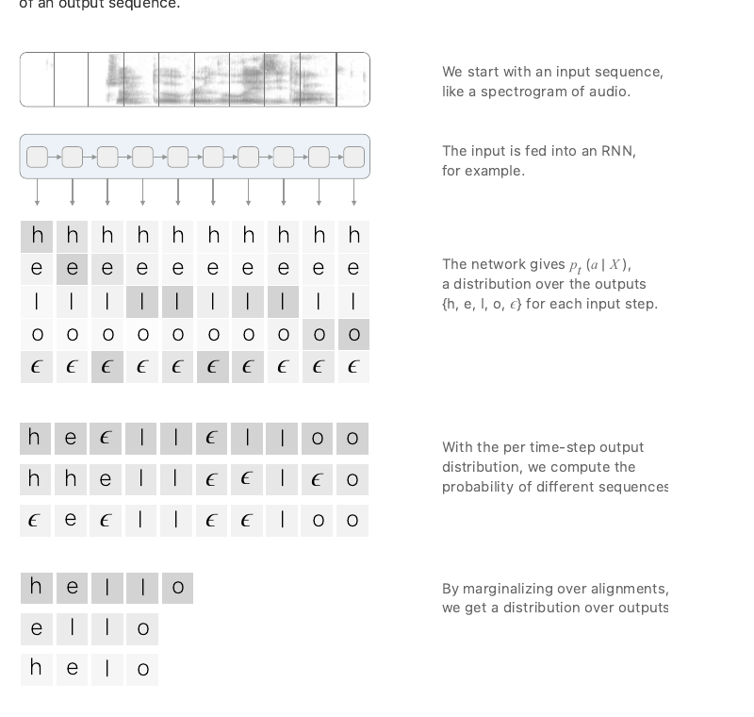
Appendix A17
NNTP And CTC Loss
CTC loss
CTC Recognizer
image time steps
+ char/blank probabilities
many paths collapse
to the same target text
loss = -log sum
of valid paths
Image Time
Steps
Character / Blank
Probabilities
->
>
>
CTC Loss = −log Total Probability
Of All Valid Paths That Collapse
To The Target Text
->
No manual character positions are needed.
Blanks and repeats let many paths explain the same line text.
Path Sum /
Collapse
Blank + Repeats Collapse To Text.
NNTP
Hannun, Distill 2017, CC-BY 4.0
Line Images + CTC Observations
+ Fixed Transcription
Forced
Alignment
Newline
Boundaries
NNTP: how line breaks are recovered
->
->
ordered line crops
+ CTC observations
fixed transcription
characters unchanged
token passing /
forced alignment
newlines at
line-image breaks
>
>
>
NNTP Uses CTC Observations At Inference; It Does Not Freely Generate Text.
NNTP uses CTC observations at inference
PyLaia syms.txt caveat: unsupported characters can be stripped before NNTP alignment.
Dennis Berger | University of Fribourg
31 / 14
Notes:
This slide connects the CTC (Connectionist Temporal Classification) recognizer visual to NNTP.
Start with the figure on the right. In the article the input is speech, but in this thesis we can read it as a handwritten line image scanned from left to right. The recognizer does not immediately output one final string. For each image time step, it gives probabilities over characters plus a blank symbol.
The CTC idea is that many different monotonic time-step paths can represent the same target text. Repeated labels are merged and blanks are removed. The CTC loss therefore sums the probability of all valid paths that collapse to the target text, and then takes the negative log of that total. This is why the recognizer can be trained without manually annotated character positions for every image column.
For NNTP, this CTC part is not the final answer. It is evidence. PyLaia produces character posterior probabilities for the ordered line images. The token-passing alignment then combines those probabilities with the machine-readable transcription.
The Bullinger paper describes the process in three steps. First, existing newlines are removed from the transcription, and the transcription is expanded into a CTC-style finite-state automaton with blank states. At the same time, the character probabilities from all line images and pages are concatenated in visual reading order.
Second, dynamic programming, implemented as token passing, finds the highest-probability path through that fixed transcription automaton. The text itself is not changed: NNTP cannot skip words, add characters, change characters, or swap text. It is choosing where the fixed characters best fit in the recognizer evidence.
Third, newline characters are inserted according to the line-image break positions in the optimal character sequence. That is the direct answer to how the line breaks are found: once the optimal path maps the fixed transcription onto the concatenated line-image probability sequence, the stored line-image boundaries tell us where to put the newlines.
So the short version is: CTC gives probabilistic character evidence over image time steps; NNTP uses that evidence for forced alignment of the fixed transcription and recovers newline boundaries from the line-image break positions.
One caveat for character-level comparisons is that NNTP uses the active PyLaia symbol table, so unsupported characters can be stripped before alignment.
Figure source: Hannun, Sequence Modeling with CTC, Distill, 2017, DOI 10.23915/distill.00008, CC-BY 4.0.

Slide 32
Appendix A18
How Fixed Transcription Is Preserved
Candidate Line
Hints
Validate
Exact Count
Repair /
Recovery If Needed
Fallback If No
Usable Plan
Project Boundaries Onto
Fixed Transcription
Final
Output
Caplain -> Captain Projection Example
Q&A Takeaways
Model Hint:
"The Bearer, Caplain "
"John Mercer"
Model Text Is Boundary Evidence, Not Final Content.
"The Bearer, Captain John Mercer"
Projection Re-Slices The Untouched Transcription.
Fixed Transcription:
Successful Projection Preserves The Non-Newline Character Stream.
1 | The Bearer, Captain
2 | John Mercer
Projected Output:
Known-Count Staging: M4/M5 Use Stored Expected Line Count.
Projection Uses Cumulative Hint Offsets Mapped To The Fixed Transcription.
Thesis Anchors: Section 5.7, Appendix A.3, Table 6.7, Table 6.8
Dennis Berger | University of Fribourg
32 / 14
Notes:
Timing: Optional appendix
Use this slide if the committee asks how repair, recovery, fallback, and projection differ.
Repair is one extra structured prompt when strict JSON parsing or exact-count validation fails. Recovery means using a loose but still useful model line plan from a malformed or wrong-count response when it can be reconciled with the expected structure. Fallback means using deterministic line hints when no usable model plan remains.
Projection is the final safety step. The model text is treated as boundary evidence, not final content. The pipeline records where the candidate line hints place boundaries, maps those offsets monotonically to the untouched fixed transcription, and then re-slices the supplied transcription.
The example shows the consequence. The model hint writes "Caplain", but the fixed transcription has "Captain". Projection keeps the line break pattern and the final output uses the fixed text, including the real line break before "John Mercer".
The caveat is unchanged: this works under known-count staging for M4 and M5, because the pipeline validates against a stored expected line count.

Slide 33
Appendix A19
Future Work
- blind line-count / segmentation setting
- deterministic scaffold references
- ablations of M5 components
- dedicated boundary prediction
- constrained decoding instead of post-hoc projection
- broader datasets and stronger crop pipelines
Core direction
predict boundaries directly over the fixed transcription
Dennis Berger | University of Fribourg
33 / 14
Notes:
Timing: Optional appendix
Use this slide if asked what should come next.
The decisive next step is to move from configuration evidence to component evidence. That means testing blind line-count or segmentation settings, deterministic scaffold references, ablations of M5 components, dedicated boundary prediction, and constrained decoding instead of post-hoc projection.
The core direction is to predict boundaries directly over the fixed transcription while reducing the amount of known-count and post-processing structure required around the model.
Transition: If the discussion turns to likely defense questions, use the final appendix prompt slide.

Slide 34
Appendix A20
M5 vs NNTP: concrete non-tie cases
Tie-dominated: Children 57/63, IAM 20/20, Washington 14/20
Dataset
Sample ID
Higher LAnorm
Delta LAnorm+/-
Observed mechanism
Local excerpt evidence
Evidence file
Children
2A_12_8-9
M5
+1.000
NNTP merged first two lines and split a short final fragment.
GT/M5: "...Ka&Ze | und ain Hund | Der Ma"
NNTP: "...Ka&Ze und ain Hund | Der | Ma"
M5 trace JSON
NNTP pred TXT
Children
2A_12_10-11
NNTP
-0.500
M5 shifted "Saine" to the previous line; NNTP keeps the local boundary.
GT/NNTP: "Der Man TuT | Saine Claider..."
M5: "Der Man TuT Saine | Claider..."
M5 trace JSON
NNTP pred TXT
Washington
278
M5
+0.063
NNTP split short "andria." and merged the remainder into the next numbered line.
GT/M5: "Alex- | andria. | 1st. To..."
NNTP: "Alex- | andri | a. 1st. To..."
M5 trace JSON
NNTP pred TXT
Washington
272
NNTP
-0.059
M5 merged a header/date boundary; NNTP matches the date split.
GT/NNTP: "...Instructions. October | 28th. To..."
M5: "...Instructions. October 28th. | To..."
M5 trace JSON
NNTP pred TXT
Observed mechanism
Possible explanation supported by artifacts
- Non-ties are local boundary placements.
- Repeated sites: short fragments, header/date lines, hyphenated continuations, and mid-word splits.
- Mixed cases are not shown here.
- M5 records line crops, page context, OCR/HTR hints, expected line count, and projection/fallback paths.
- NNTP records recognizer-derived forced-alignment output.
- No ablation proves a stronger causal story.
Dennis Berger | University of Fribourg
34 / 14
Notes:
Q&A prep note for Appendix A14.
Main conclusion:
The artifacts support a close, tie-dominated, dataset-dependent interpretation. Children has 57 ties out of 63 matched cases, IAM has 20/20 ties, and Washington has 14 ties out of 20. The selected rows are clean examples, not representative causal ablations.
Observed mechanisms:
- Children 2A_12_8-9: M5 score 1.000, NNTP score 0.000. GT/M5 keep "Es warainml ain Ka&Ze" / "und ain Hund" / "Der Ma"; NNTP merges the first two lines and splits "Der Ma" into "Der" / "Ma".
- Children 2A_12_10-11: M5 score 0.500, NNTP score 1.000. GT/NNTP place the boundary after "Der Man TuT"; M5 shifts "Saine" onto the previous line. M5 trace shows the line-image OCR text begins line 2 with "Saine...", so do not claim the OCR hint caused the error.
- Washington 278: M5 score 1.000, NNTP score 0.9375. GT/M5 preserve "Alex-" / "andria." / "1st. To Mr. Boyd..."; NNTP splits "andria." into "andri" / "a. 1st...".
- Washington 272: M5 score 0.941176, NNTP score 1.000. GT/NNTP split after "October"; M5 writes "October 28th." on one line. Trace line-image OCR around the date/header is noisy ("Oetober 17.", "2th. To..."), so treat that only as a possible local ambiguity, not proof of causality.
Possible explanation:
M5 and NNTP use different evidence. M5's output is the model line plan projected back onto the fixed transcription; traces record line crops, page context, OCR/HTR hints, expected line count, and projection/fallback behavior. NNTP is a deterministic forced-alignment reference based on recognizer-derived evidence, with the PyLaia syms.txt alphabet filtering caveat for character-level comparability. The examples support the weaker explanation that M5 can benefit from visual/page-context and projection when they place local boundaries well, while NNTP can be stronger when recognizer-derived alignment places a boundary more reliably. They do not support a stronger component-level causal claim.
Evidence paths:
- Children M5 trace: /Users/dennisberger/Library/Mobile Documents/com~apple~CloudDocs/Dokumente/Uni/Master_Thesis/predictions/thesis_results_final_2026-04-20/handwritten_results/children_handwritten/m5_context100/gpt-5.4/traces/2A_12_8-9.json
- Children NNTP prediction: /Users/dennisberger/Library/Mobile Documents/com~apple~CloudDocs/Dokumente/Uni/Master_Thesis/predictions/thesis_results_final_2026-04-20/handwritten_results/children_handwritten/nntp/NNTP/predictions/children_handwritten_predictions_nntp_fold_c/2A_12_8-9.txt
- Children M5 trace: /Users/dennisberger/Library/Mobile Documents/com~apple~CloudDocs/Dokumente/Uni/Master_Thesis/predictions/thesis_results_final_2026-04-20/handwritten_results/children_handwritten/m5_context100/gpt-5.4/traces/2A_12_10-11.json
- Children NNTP prediction: /Users/dennisberger/Library/Mobile Documents/com~apple~CloudDocs/Dokumente/Uni/Master_Thesis/predictions/thesis_results_final_2026-04-20/handwritten_results/children_handwritten/nntp/NNTP/predictions/children_handwritten_predictions_nntp_fold_c/2A_12_10-11.txt
- Washington M5 trace: /Users/dennisberger/Library/Mobile Documents/com~apple~CloudDocs/Dokumente/Uni/Master_Thesis/predictions/thesis_results_final_2026-04-20/handwritten_results/washington_handwritten/m5_context100/qwen3-vl-32b-instruct/traces/278.json
- Washington NNTP prediction: /Users/dennisberger/Library/Mobile Documents/com~apple~CloudDocs/Dokumente/Uni/Master_Thesis/predictions/thesis_results_final_2026-04-20/handwritten_results/washington_handwritten/nntp/NNTP/predictions/washington_handwritten_predictions_nntp_train_a_test_b/278.txt
- Washington M5 trace: /Users/dennisberger/Library/Mobile Documents/com~apple~CloudDocs/Dokumente/Uni/Master_Thesis/predictions/thesis_results_final_2026-04-20/handwritten_results/washington_handwritten/m5_context100/qwen3-vl-32b-instruct/traces/272.json
- Washington NNTP prediction: /Users/dennisberger/Library/Mobile Documents/com~apple~CloudDocs/Dokumente/Uni/Master_Thesis/predictions/thesis_results_final_2026-04-20/handwritten_results/washington_handwritten/nntp/NNTP/predictions/washington_handwritten_predictions_nntp_train_a_test_b/272.txt

Slide 35
How Fallback And Recovery Work
Appendix A21
Safety path when strict M5 JSON or expected line count validation fails.
Boundary hints only: final characters come from fixed transcription.
Initial
JSON invalid
or wrong count
Repair
Ask model once
to fix response
Recovery
Salvage loose
model line plan
Fallback
Use OCR/HTR
line hints
Projection
Map hint offsets;
slice fixed text
Final
Newline-only
output
>
>
>
>
>
Recovery is tried before fallback: the system prefers a usable model boundary plan, but falls back to deterministic line hints if no plan can be reconciled.
Tiny recovery example
Definitions
Fixed transcription:
Expected lines:
Loose model plan:
OCR/HTR hint:
Recovered hints:
Projected final:
abcdefgh
4
ab | cdef | gh (wrong count)
ab | cd | ef | gh
ab | cd | ef | gh
ab | cd | ef | gh
- Repair: ask once for valid JSON and count.
- Recovery: reconcile loose model lines with expected count and OCR/HTR hints.
- Fallback: use OCR/HTR line texts as boundary hints when model hints fail.
- Projection: map hint offsets, then slice fixed text.
The recovered text is not copied as final content. It supplies boundary positions.
Not OCR/HTR replacement; boundary projection only.
Source: M5 inference code and regression tests; mechanism shown as implemented behavior, not a metric claim.
Dennis Berger | University of Fribourg
35 / 35
Notes:
Timing: Optional appendix / Q&A.
Use this slide if asked how fallback and recovery work in M5.
First, separate the terms. Repair is a second structured prompt: if the initial model response is not valid JSON or has the wrong number of lines, the system asks the model once to fix that response.
Recovery happens after strict initial and repair parsing fail. The code still looks for loose line candidates in the model responses. If one of those candidates can be reconciled with the expected line count and OCR/HTR line hints, it is used as a boundary plan.
Fallback is the deterministic exit path when no usable model boundary plan remains. It uses OCR/HTR line texts from the stored line payload as boundary hints. In the code, these hints can be used post hoc even though the final answer still must be the fixed transcription sliced with newlines.
The key point is projection. The recovered or fallback text is not trusted as final transcription. The system computes cumulative boundary positions from the hint lines, maps those positions monotonically to the original fixed transcription, and then slices that fixed transcription.
So the safe defense answer is: fallback and recovery can affect where newlines go, but they should not introduce new non-newline characters. They are validity and robustness mechanisms, not a guarantee that every line break is correct. If the hints are wrong, the projected boundary can still be wrong.

