Slide 1
Introduction to Machine Learning

Slide 2
What you will learn
ML vs. traditional programming
Building blocks
Types of ML
When to use it ?

Slide 3
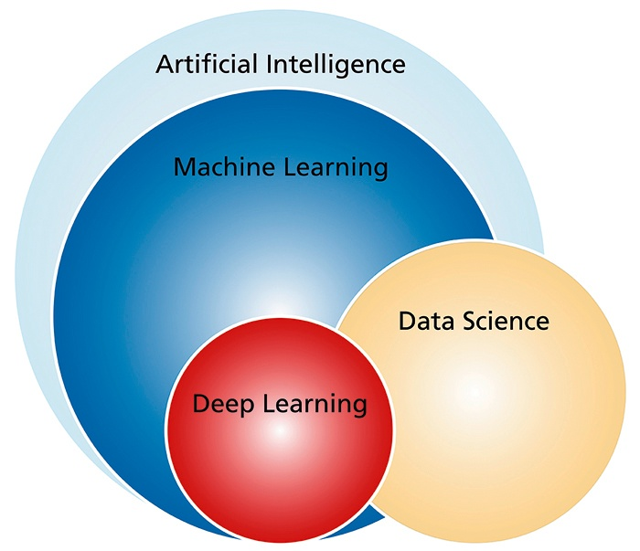

Slide 4
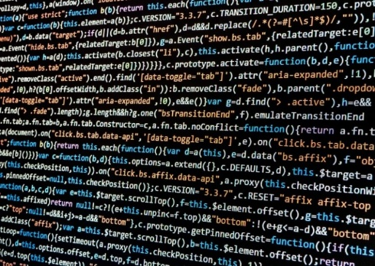
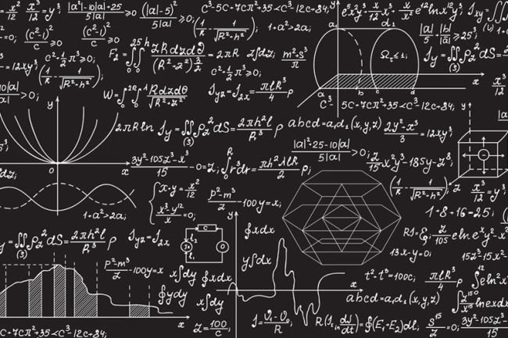
Traditional programming
Data of interest
Computer
Output
Program

Slide 5
Machine learning
Historic data
Computer
Program
Output

Slide 6
Machine learning
Historic data
Computer
Program
Output
Data of interest
Computer
Output
Program

Slide 7
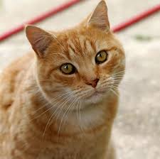
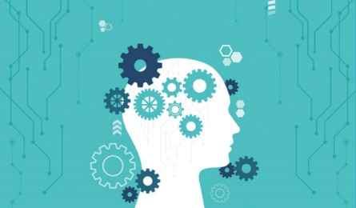
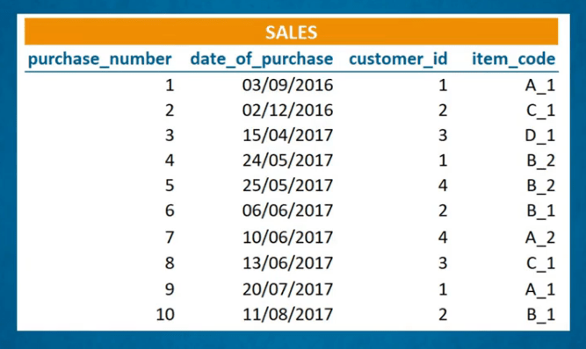
Historic data
Computer
Program
“CAT”
Output

Slide 8
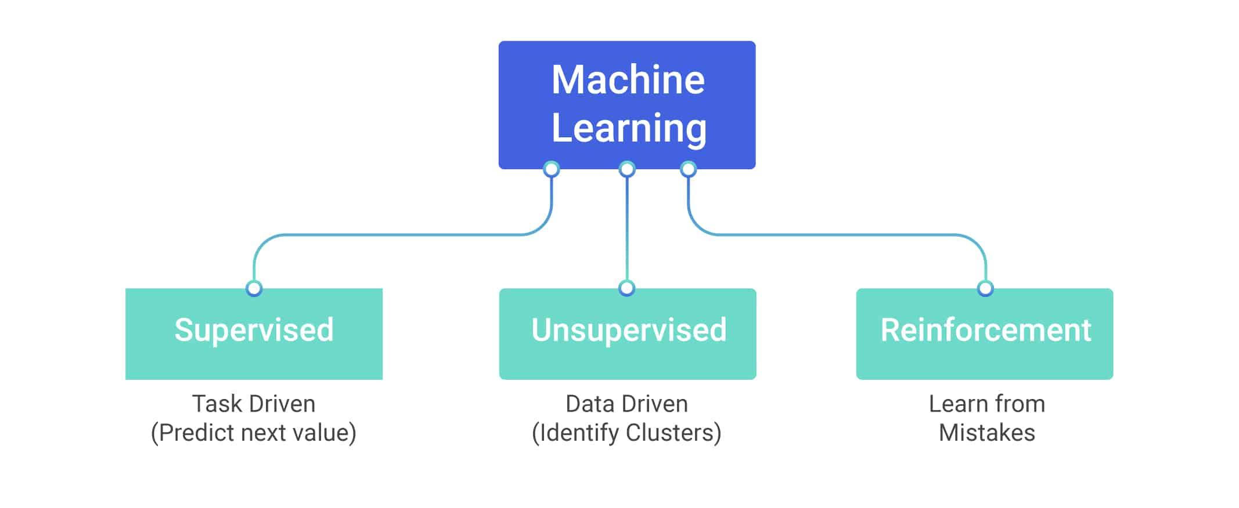

Slide 9
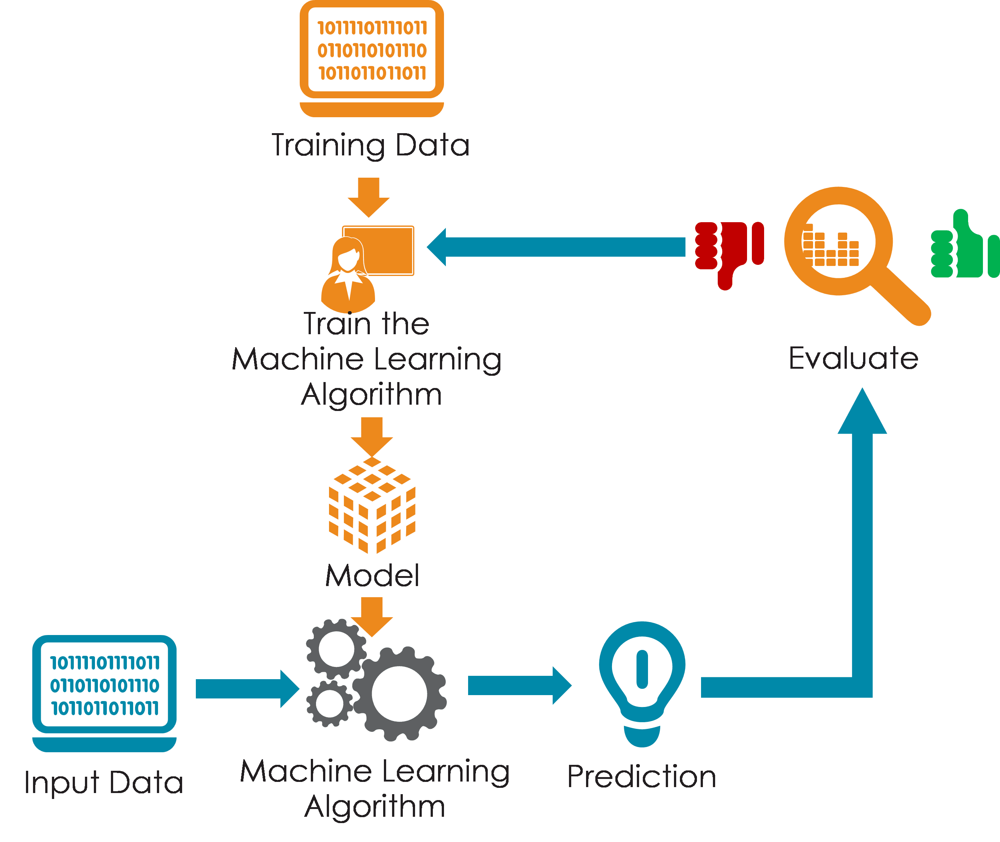
Training

Slide 10
Training

Slide 11
Application

Slide 12
Application

Slide 13
Main interest...

