Slide 1
Rent influencing factors – in Stuttgart
Applied Data Science Capstone Project on Cousera

Slide 2
Rents are getting more and more expensive
Rents are influenced by many factors
What factors make the rent rise?
Can we build a model that can predict the average rent ?

Slide 3
Data acquisition and preperation
Average rents in the boroughs from https://www.wohnungsboerse.net/mietspiegel-Stuttgart/972
Coordinates of the boroughs from https://www.suche-postleitzahl.org/stuttgart-plz-70173-70629.608e
General statistics about the boroughs from https://statistik.stuttgart.de/statistiken/statistikatlas/atlas/atlas.html?indikator=i0&select=00
Data about the venues in the boroughs from foursquare
-> 12 features were extracted and prepared

Slide 4
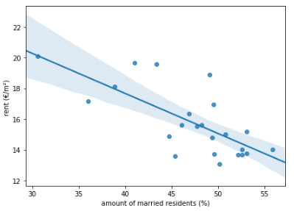
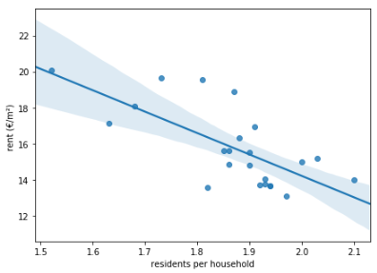
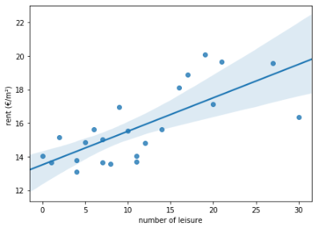
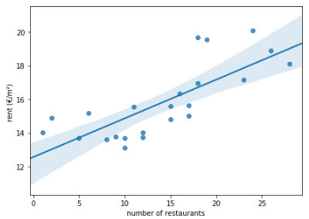
Correlation between feature and rent
Regression plots were used to determine relevant features:

Slide 5
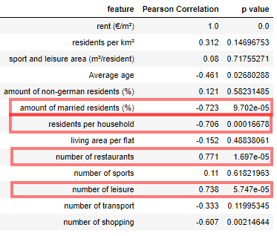
Correlation between feature and rent
The Pearson Correlation and the p-value validates our finding

Slide 6
Building a model
A multiple linear regression model was used because we have several features with a linear correlation to the rent
The cross validation of 0.24 shows however, that the used features are not very informative

Slide 7
Conclusion
We have found some features that show a correlation to the rent
Other cities should be looked at to see if the same features occur
More data and a wider set of features should be included in future researches

