Slide 1

Note: The data and information in this document is reflective of a hypothetical situation and client. This document is to be used for KPMG Virtual Internship purposes only.
Sprocket Central Pty Ltd
Data analytics approach
[Division Name] - [Engagement Manager], [Senior Consultant], [Junior Consultant]

Slide 2
Note: The data and information in this document is reflective of a hypothetical situation and client. This document is to be used for KPMG Virtual Internship purposes only.
Agenda
Introduction
Data Exploration
Model Development
Interpretation

Slide 3
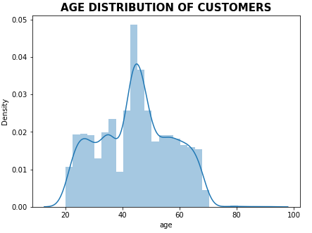
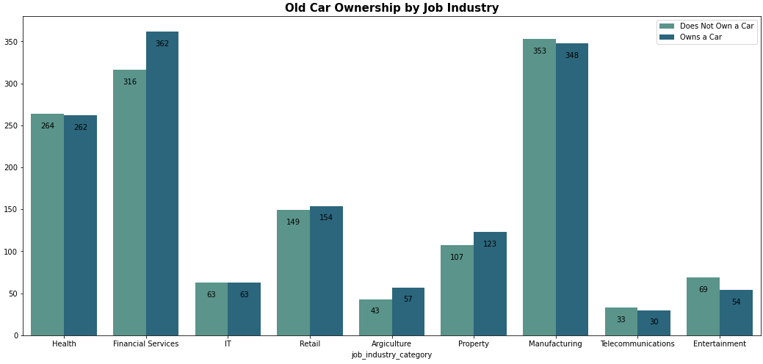
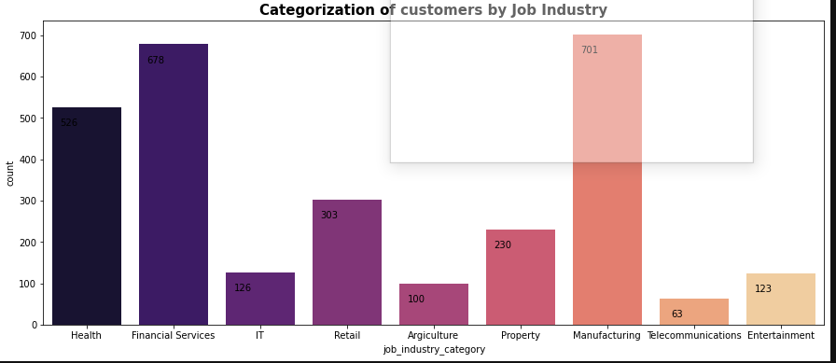
Note: The data and information in this document is reflective of a hypothetical situation and client. This document is to be used for KPMG Virtual Internship purposes only.
Introduction
Age Distribution of Customer’s
Majority of the patients were between 40 and 50 years.
Job industry Category
Most of our new customers are from the manufacturing industry followed by finance industry.

Slide 4
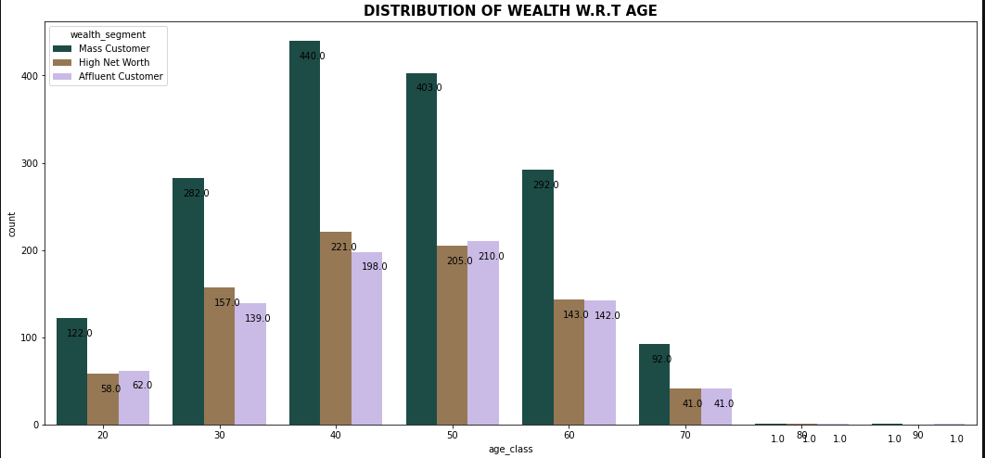
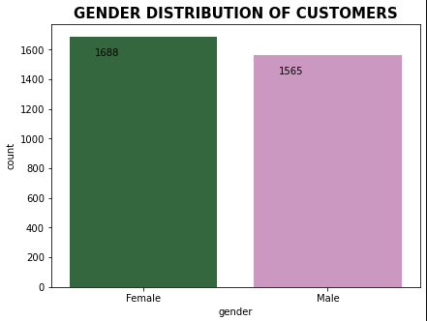
Note: The data and information in this document is reflective of a hypothetical situation and client. This document is to be used for KPMG Virtual Internship purposes only.
Data Exploration
Distribution of wealth w.r.t age
Majority of the customers were mass between the age group of 30 and 60 years. This should be highly targeted.
High net customers should be the next target and finally the affluent customers.
Distribution of customers according to Gender
Female customers made the most purchases.
Both genders can be targeted since there is a small sales difference between them.

Slide 5
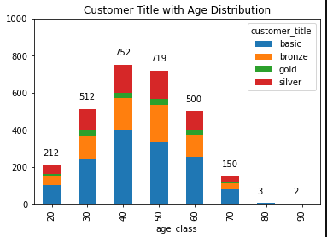
Note: The data and information in this document is reflective of a hypothetical situation and client. This document is to be used for KPMG Virtual Internship purposes only.
Model Development
Customer Title with age distribution
Majority of the customers were were basic customers with the age group of 40 leading in consumption.

Slide 6
Note: The data and information in this document is reflective of a hypothetical situation and client. This document is to be used for KPMG Virtual Internship purposes only.
Appendix

Slide 7
Note: The data and information in this document is reflective of a hypothetical situation and client. This document is to be used for KPMG Virtual Internship purposes only.
Appendix
This is an optional slide where you may place any supporting items.

